Slide 1
Virtual Ambulance – Building a remote consultation model in the 999 setting
Gillian MacLeod, National Lead for Advanced Practice and Non Medical Prescribing
Notes:
Thank you for joining us today and allowing us to provide an overview of how the Scottish ambulance service introduced remote consultation within the 999 setting.
I am ,…………………
And my colleague Callum Johnston is the clinical lead for Advanced Practice.
We are part of the team leading the development of Advanced practice within SAS including the introduction of remote consultation.

Slide 2
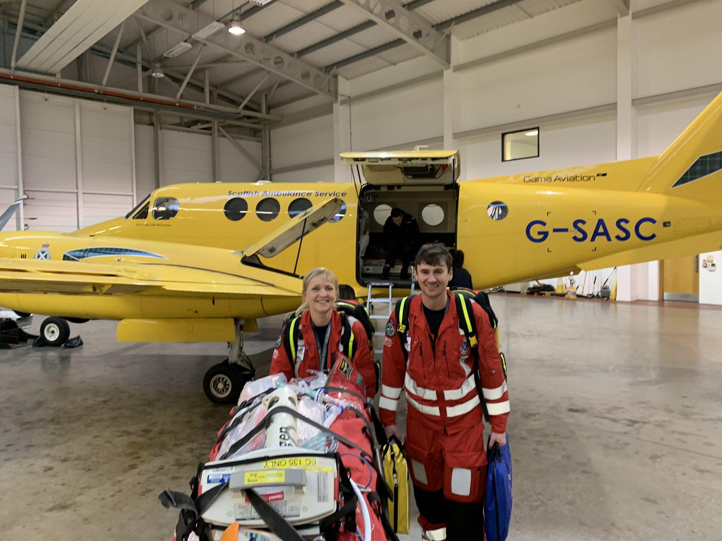
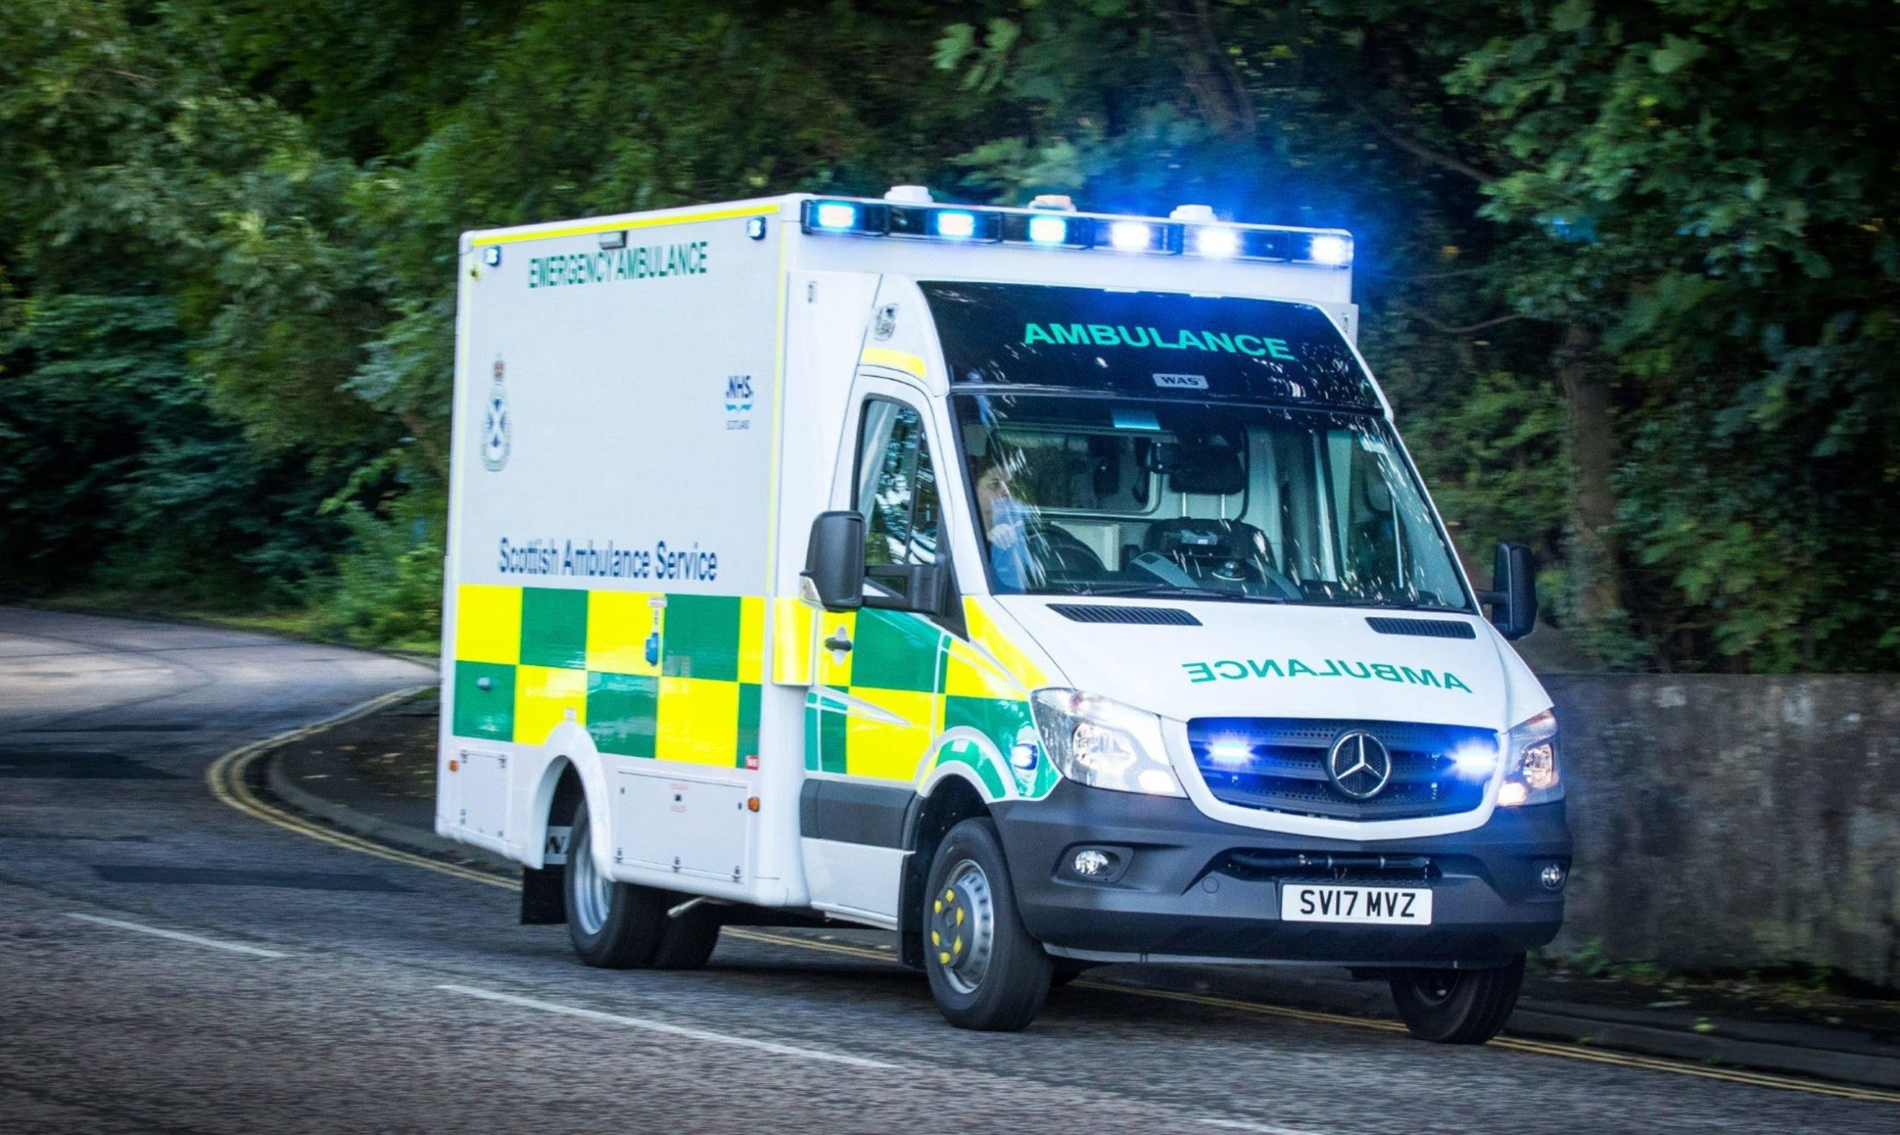
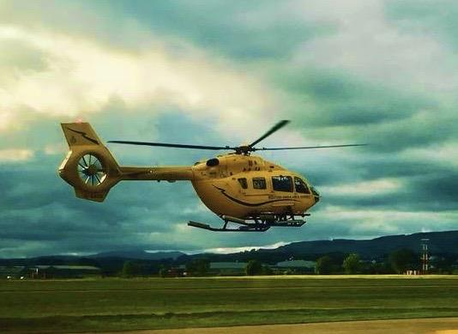
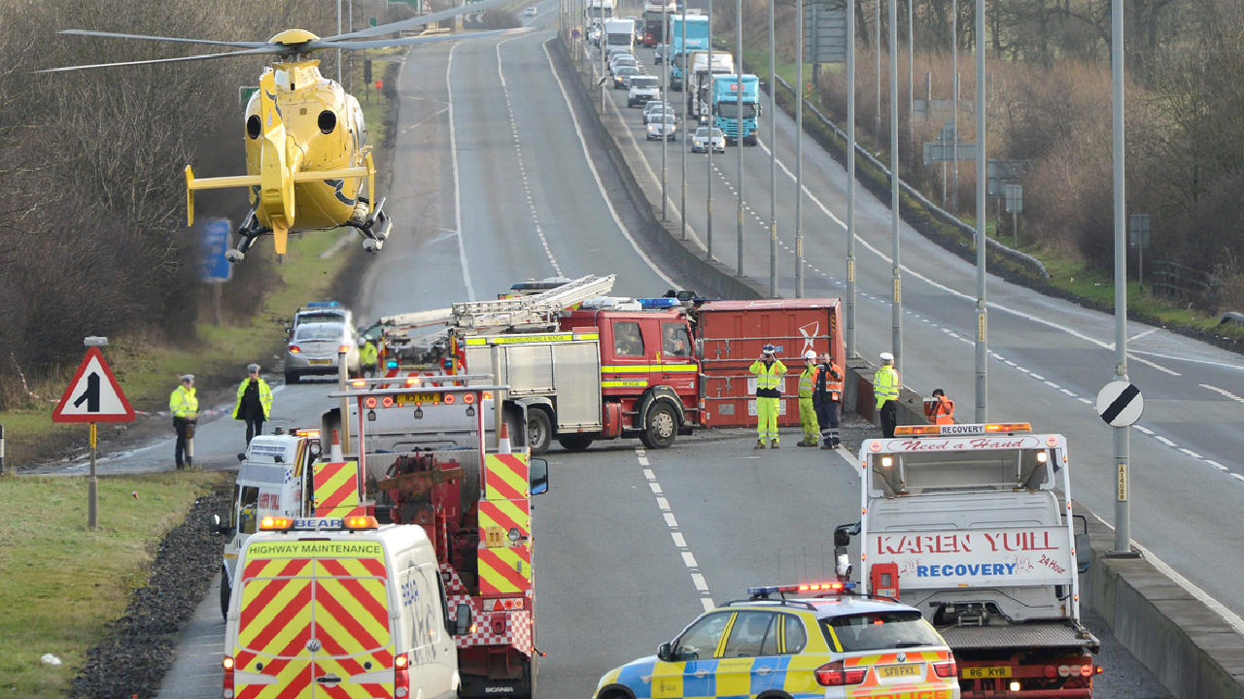
Ambulance Service / Paramedics
Notes:
It would be fair to say that most peoples perception of the Scottish Ambulance service aligns with our highly visible response attending to life threatening incidents. And SAS still on a daily basis provides high quality emergency care to members of the public who require this response. Within this slide is the first Advanced Practitioners in Critical care.
However, the majority of people calling 999 present with non-life threatening conditions, SAS provides the first point of contact for patients with a wide range of clinical presentations including falls, respiratory conditions, mental health and end of life care …...
In April of last year in response to COVID-19, SAS similarly to many areas of the NHS introduced Remote Consultation with Patients presenting with these non life threatening conditions. This helped ensure our continued respond to patients calling 999 promptly and efficiently during the pandemic whilst reducing the potential transmission of COVID-19 and the risk of patient and staffs exposure to the virus. Once established this model of working clearly demonstrated an efficient and effective way of responding to members of the public calling 999 with lower acuity conditions, illness and injury which ensured patients received the most appropriate care in the right place at the right time. It also helped to reduce unnecessary ambulances attendance and admissions to the ED.

Slide 3
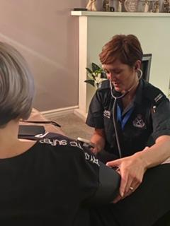
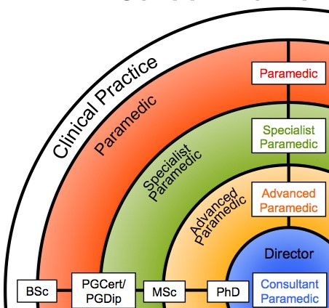
Overview AP U&PC
Scottish Ambulance Service Advanced Practitioners(AP) are experienced and highly educated Registered Paramedics and Nurses who align with the Transforming Roles Framework and the level of Advanced Practice across the NHS in Scotland.
SAS APs are educated at Masters Level in Advanced Practice and are assessed as competent through extensive clinical supervision and appraisal.
Notes:
The remote consultation model is delivered through the utilisation of our Advanced Practitioners in Urgent care. These Advanced Paramedics and Nurses align with NMANP transforming roles and are highly educated and experienced Healthcare Professionals.
They aim to manage the complete clinical episode of care for their patient and provide high level autonomous decision making, including assessment, diagnosis and treatment including prescribing where necessary, for patients with complex multi-dimensional presentations. They have the authority to refer, admit and discharge patients to the most appropriate care setting, and SAS continues to work and collaborate with health and social care partners to develop local referral pathways for patients.

Slide 4
How do we ensure APs’ competency ?
TRIANGLE OF CAPABILITY
YEAR 1 - PGCert - Advanced Clinical Assessment & clinical Decision Making
12 weeks theory / 12 weeks Supervised Practice (MIU/ED/OOH/Primary Care)
YEAR 2 – PGDip - Advanced Research or WBL Module + Independent Prescribing
Competency Framework & Sign-Off
Mandatory Elements:
Academic Base
Practice-based Assessment
Clinical Supervision
Sign-off
In principle 2 – 3 years to complete
Ongoing CPD & Annual Clinical Appraisal
Academic Preparation
ADVANCED PRACTICE
Clinical competence
Effective Supervision
Notes:
As mentioned APs within SAS trained in line with the Transforming Roles criteria for advanced practice and to the same level as all other Advanced Practitioners across the NHS in Scotland. As part of all three Scottish regional Advanced Practice Academies we continue to ensure alignment of SAS AP’s with current Advanced Practice guidance and recommendations.
As indicated in this slide it is important to us that our APs receive the appropriate academic development, but also ensure attainment of clinical competencies required though effective clinical placements and supervision to achieve eventual sign off.

Slide 5
Rotational model
Objectives
Manage more patients at home or in a community setting through:
Remote triage & consultation
Mobile within AP cars conducting Face to Face Assessment
Part of a multi-disciplinary team in primary care / OOH
Free up crew time through internal referral to manage more complex patients
Clinical leadership for other ambulance clinicians – Clinical Decision Support.
Primary Care /OOH Rotation
SAS Mobile Response Rotation
Ambulance Control centre/Remote Consultation Rotation
Notes:
SAS APs in urgent and primary care work a rotational model, ensuring they continue to develop their clinical skills and experience and also supports effective and competent decision making. It also helps the retention of the AP cohort by providing them with continued variety within their role and provides SAS with the most effective model for delivery of service by increasing our capacity…AP’s triaging and consulting remotely and AP’s rotating through cars on the road ensure the most appropriate treatment for patients but also releases ambulance conveyance resources to attend to the higher acuity calls. Right resource tasked to the most appropriate patients.
Greater integration with Primary care and OOH supports the clinical development of our staff and as mentioned earlier ensures better collaborative working within local areas and the effective involvement of SAS within the redesign of Urgent Care.
I’ll hand over to my colleague Callum now who can tell you a bit more about our Remote Consultation and its impact in SAS and for patients.

Slide 6
Virtual Ambulance – Building a remote consultation model in the 999 setting Callum Johnston, Clinical Lead for Advanced Practice
Notes:
Thank you for joining us today and allowing us to provide an overview of how the Scottish ambulance service introduced remote consultation within the 999 setting.
I am ,…………………
And my colleague Callum Johnston is the clinical lead for Advanced Practice.
We are part of the team leading the development of Advanced practice within SAS including the introduction of remote consultation.

Slide 7
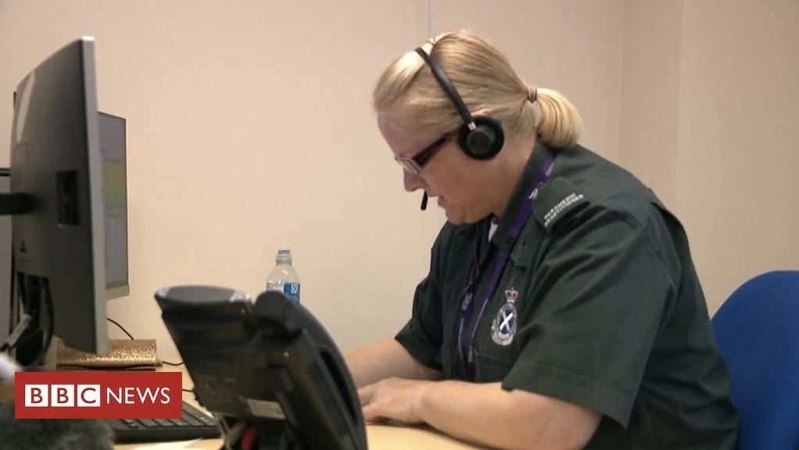
Remote Triage & Consultation
999 call meets pre-determined criteria for Teal coding (suitable for AP review)
AP enters call and phones patient (may also use video if required)
Checks available notes/ECS/KIS/clinical portal info, agrees best outcome with patient & documents consultation
AP closes, downgrades or upgrades call as clinically appropriate
AP is now ready for the next virtual consultation
Notes:
Gillian has outlined how remote consultation was introduced as part of the AP rotational model in response to the COVID-19 Pandemic last Year.
I’m going to give some more information on the process for remote consultation and its impact for our patients and our Advanced Practitioners in Urgent & Primary Care.
We use a code-based system for our 999 calls, with an evidence based subset of these determined as appropriate for consultation by an Urgent Care AP. The APs have access to a selection of patient information and clinical notes to aid their decision making and arrive at a joint decision with the patient or caller as to the best outcome.
This outcome may be upgrading the response if there is a deterioration or clinical need, downgrade to a more time scheduled ambulance response, self care management advice or referral to a partner agency or pathway (for example respiratory, falls or mental health, their own GP or NHS24).

Slide 8
What has been achieved?
Notes:
Since the outset of this model our ability to deal with these selected codes has increased and has now, as seen in this graph, reached a consistent level.
The lines to focus on are the blue line representing the volume of patients consulted by phone or video by an AP, the red line showing the number that subsequently receive a face to face to face assessment by an ambulance clinician, and the yellow line indicating the patients that were conveyed to definitive care such as an ED.
The gaps between the blue and the red show the amount of people offered self care advice or signposted and referred to more appropriate health and social care providers. The gap between red and yellow illustrates the amount of people who were seen in person and treated at the scene or signposted to other services than the acute front door.
It is important to note that all of these calls are 999s and would previously have been allocated an emergency ambulance.
There is the potential to improve these figures with the recruitment of further Advanced Practitioners working through a rotational model and the ability to target APs working in cars to patients who have undergone a remote consultation by a colleague but cannot be safely discharged without face to face assessment. This management may be able to be delivered at delivered at home by an AP colleague, for example medication issue or wound closure or dressing care.

Slide 9
What has been achieved?
The APs in Urgent and Primary Care have been reviewing approximately 12.5% of our overall 999 demand.
Approx. 40% of these patients are managed by the APs and provided with self-care advice or referred to alternative pathway without the need for face to face review.
Sustaining a <1% 24hr recall rate.
Since April of 2020 SAS have managed circa 87,000 patients remotely.
Circa 70,000 + following a remote consultation with an AP.
Over 26,500 patients through AP consultation (approx.38%)
Circa 17,000 have been discharged by ambulance crews or a mobile AP following face to face assessment and treatment (24%)
Approximately a 40% hear and treat outcome against a historic background of approximately 18%
Notes:
Daily and weekly data is collated and reviewed to measure and evaluate performance and to ensure continued progress.
The key figures are highlighted here in red and show that the Urgent Care APs have consulted in excess of 70000 patients since last April and found alternatives to an ambulance response for approximately 27000 (or 40%) of them, with around a further 17000 (or 20%) being discharged or referred to alternative options from the scene by an attending ambulance clinician.
The remaining 40% have been treated and managed by our ambulance clinicians and required hospital attendance for further assessment and definitive care.
This has resulted in more appropriate care for patients, better and more expedient patient journeys and reduced presentations at Emergency Departments across Scotland.

Slide 10
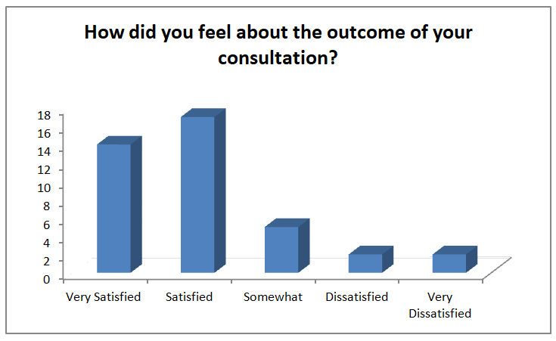
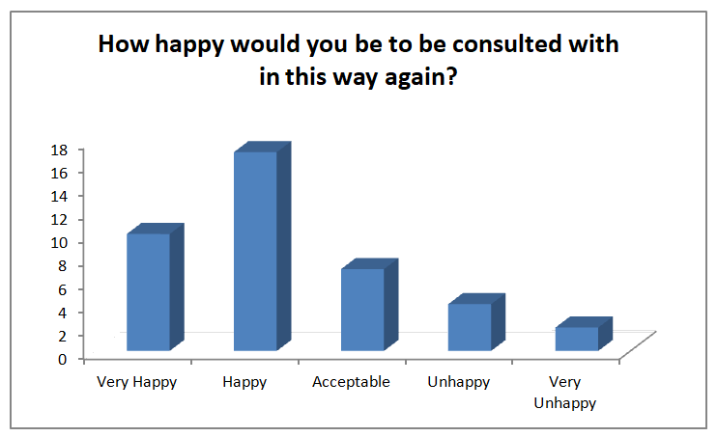
Patient Feedback
85% of patients rated their overall experience as being either good or very good with 10% saying their experience was acceptable. 5% of patients felt they had a poor consultation experience.
77.5% of patients felt very satisfied or satisfied with the outcome of the call. 12.5% of patients felt somewhat satisfied. 10% of patients feeling very dissatisfied or dissatisfied.
Notes:
Patient feedback to date has been very positive, as seen in this survey from June 2020, and we are in the process of establishing a feedback mechanism to ensure ongoing patient engagement.
Internal review of call back rates from patients within 24hrs of their initial call has been less than 1% and this has provided some assurance that the AP consultation model is generating appropriate clinical outcomes for patients.
CHI seeding with Public Health Scotland is currently in progress to allow follow up of any patient journeys post discharge by APs conducting remote consultation, this will further provide assurance that the system is robust.
In the interest of transparency, out of the 87,000+ Patient contacts managed in this way we have to date identified and undertaken four Significant Adverse Event Reviews.

Slide 11
AP Feedback
When asked whether practitioners felt this new process had been beneficial to their own practice 85% felt that it had been. 90% of practitioners felt this new way of working was beneficial for patients and the overwhelming majority felt this way of working should be retained as part of the rotational model.
Notes:
And what do our APs think?
This staff survey was conducted last summer and feed back from the APs themselves was that they felt this way of working was beneficial for patients as well as for their own practice.
There was also a strong feeling that this model should remain in place.

Slide 12
Collaborative Working
Collaborative working with IJBs, H&SC & Third Sector to support the development of appropriate referral pathways.
Extended access to clinical portals
Integration of Advanced Practitioners within Primary and OOH Care to facilitate clinical development of APs and promote a whole system approach to patient care.
Access to electronic prescribing and access to medicines
Notes:
This map shows the sites across Scotland where we have APs located and several of them already rotate through in or out hours primary care, with more areas scheduled to launch over the coming weeks and months.
We’re also working collaboratively as part of the Redesign of Urgent Care, Scottish Government’s Workstream 7 regarding Alternatives to Admission and Flow Navigation Centres, to further integrate into the wider health and social care landscape.
Tests of change with Flow Centres in Grampian, Lothian and Ayrshire & Arran are underway and access to further referral and direct admission pathways will further increase the streamlining of patient journeys and ensure the right care, in the right place, the first time.

Slide 13
Notes:
Many thanks for listening and I’d now like to invite Gillian back to join me in answering any questions you may have.
Thank you.

