Slide 1
Re-organisation of Unscheduled Surgical Services In NHS Tayside
Mr Christopher Payne
Clinical Service Director for Unscheduled Surgery NHS Tayside

Slide 2

Overview
Background to unscheduled surgery in Tayside
Re-organisation in Response to COVID
Engagement Project
Data Review
Outcomes

Slide 3

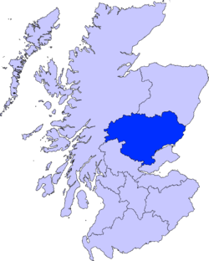
3 Local Government Areas
  Dundee City / Angus / P&K
Population 416,090
SLE NE Fife (75,666)
43,500 Unscheduled Admissions 2019
30% Surgical

Slide 4
Unscheduled Surgical Services NHST
General Surgery (colorectal, oesophago-gastric, hepato-biliary, endocrine and breast)
Trauma and Orthopaedics
Urology
Vascular Surgery
Plastic Surgery
Ear, Nose and Throat Surgery (ENT)
Oral and Maxillofacial Surgery (OMFS)
Ophthalmic Surgery
Neurosurgery
Gynaecological Surgery

Slide 5
Unscheduled Surgery First wave
Multiple ‘front-doors’ / admission areas / theatres not possible
Single point of entry through ASRU
  No additional increase in footprint or resource
  Multiple challenges
Separation of Red / Amber / Green pathways
Common Emergency theatre

Slide 6
Assessment Areas
Pre-COVID
Post-COVID
ASRU /
Ward 9
ASRU
GS / Vasc/ Uro
T&O
Many areas
ASRU / TAU
Plastics
Ward 27 Treatment Room
ASRU
ENT / OMFS
Ward 26 Treatment Room
ASRU
Neurosurgery
Ward 23b
ASRU
Gynaecology
GAU
GAU

Slide 7
Assessment Areas
Pre-COVID
Post-COVID
ASRU /
Ward 9
ASRU
GS / Vasc/ Uro
T&O
Many areas
ASRU / TAU
Plastics
Ward 27 Treatment Room
ASRU
ENT / OMFS
Ward 26 Treatment Room
ASRU
Neurosurgery
Ward 23b
ASRU
Gynaecology
GAU
GAU
11 Areas
3 Areas

Slide 8
Admission Areas
Pre-COVID
Post-COVID
Ward 7 / 8/ 9
Ward 7
GS / Vasc/ Uro
T&O
Ward 17, 18, 19
Ward 9
Plastics
Ward 27
Ward 7
ENT / OMFS
Ward 26
Ward 7
Neurosurgery
Ward 23b
Ward 7
Gynaecology
Ward 36
Ward 36
10 Wards
3 Wards

Slide 9
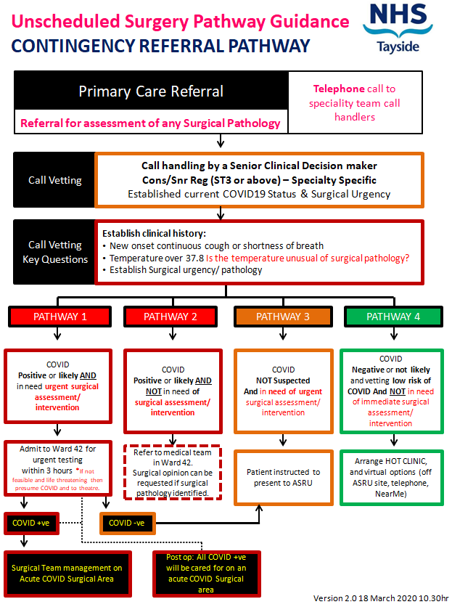

Slide 10
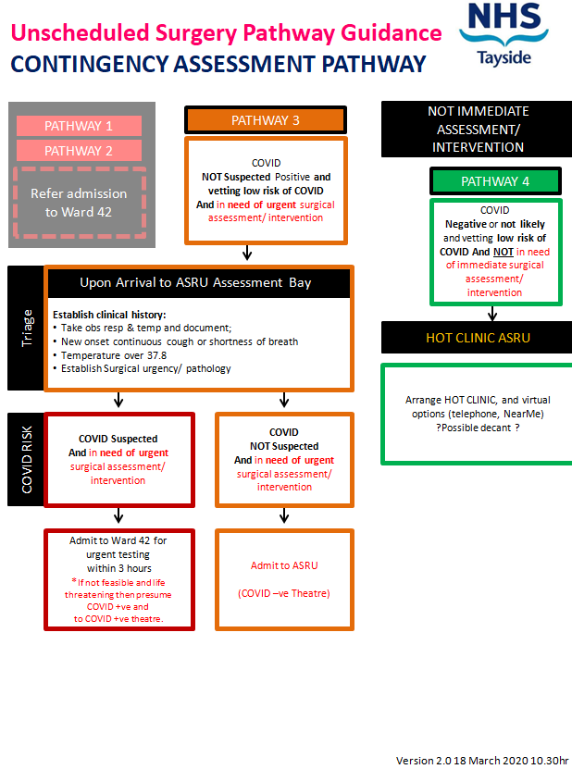

Slide 11
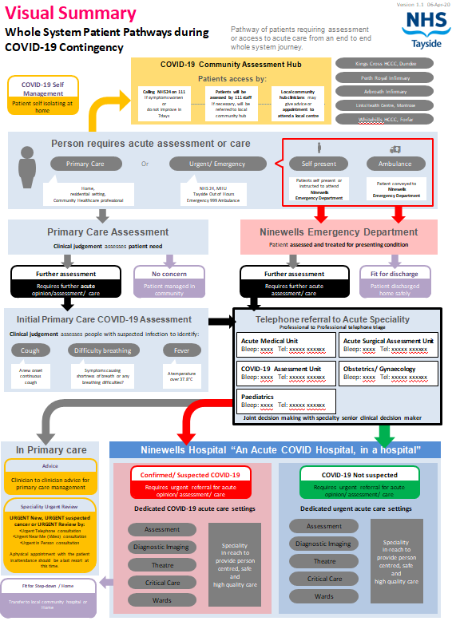

Slide 12
Benefits
Refine assessment / admission processes
Consolidate workforce
Resource
  ANPs / HCSW / AHPs / A&C
Develop ambulatory pathways
Surgical Frailty
Teams familiar with COVID processes
COVID triage and testing / preparation for theatre

Slide 13
Challenges
Displaced teams / pathways / processes
Staff Skill mix
Patient safety
Flow and capacity

Slide 14
Challenges for Capacity and Flow in COVID era
Delayed presentations
Patient Factors
Increased clinical complexity
Deconditioned patient group
Delay to theatre
Theatres
Reduced theatre capacity
Reduced theatre efficiency
Loss of Theatre Admission Area
Ward / bay closures
Wards
Displaced clinical teams
Boarding
Delay to diagnostics
COVID infection
Delay to Discharge/ POC

Slide 15
System-wide Review
Engagement
Process Mapping
Data Analysis
Identify Priorities
Coherent re-emergence plan for Unscheduled Surgery

Slide 16
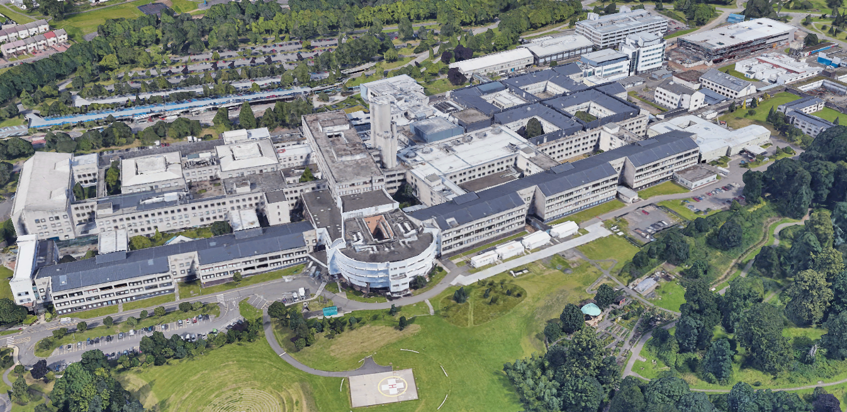



Tayside Unscheduled Surgery Improvement Programme
Stage 1&2 Initial Report
Engagement and System Mapping
March 2021
Mr Christopher Payne Stuart McAllan
Consultant General and Colorectal Surgeon Improvement Advisor
Clinical Director Unscheduled Surgery Improvement Team

Slide 17
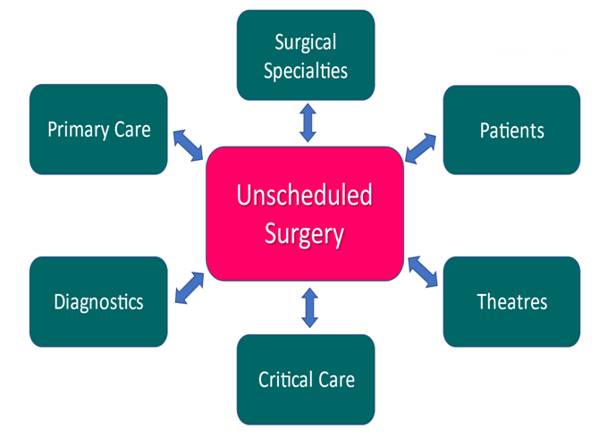

Slide 18
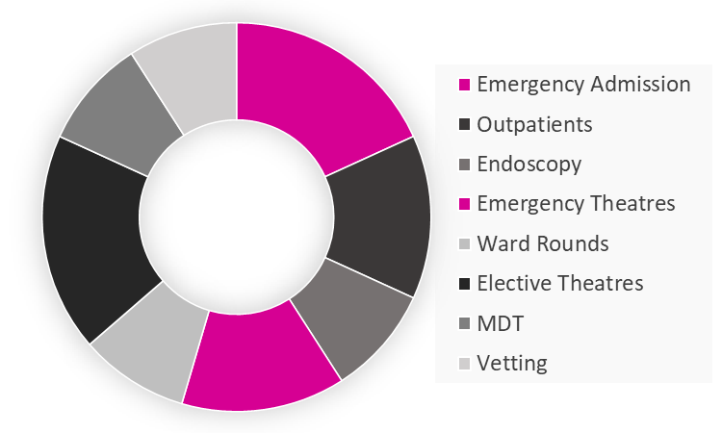

Slide 19
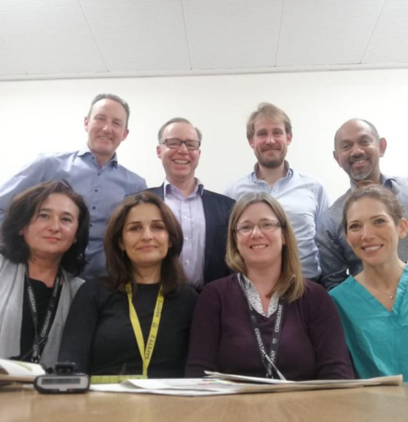

Slide 22
The improvement approach: Understanding the system
1. Document Pre-COVID pathways and practices Mapping and Health & Business Intelligence support
2. Engage, what worked well, what didn’t?
3. Document current pathways and practices
4. Data driven
5. Identify priorities for re-emergence / living with COVID

Slide 23
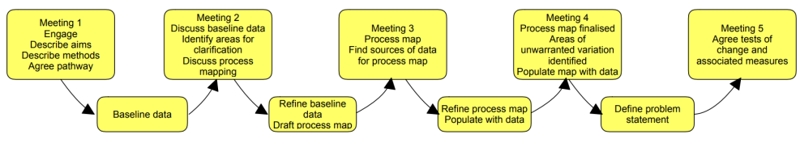
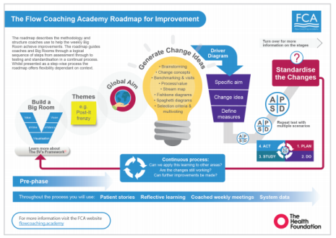

Methodology: Engagement
The selected approach for cross speciality engagement was based on core principals of:
Ownership, not buy-in
Leadership engagement
Respect of speciality in a complex system
Commitment to quality and improvement
To use data for improvement
To involve and listen
To be time and action focussed
Selecting improvement methods: A hybrid
Effective Care Pathway (ECaP)
Flow Coaching Academy Big Room

Slide 24
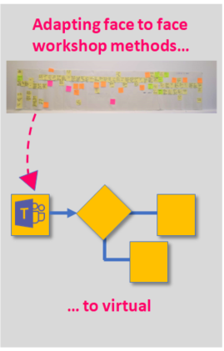
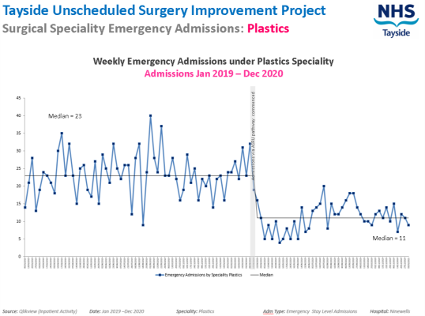
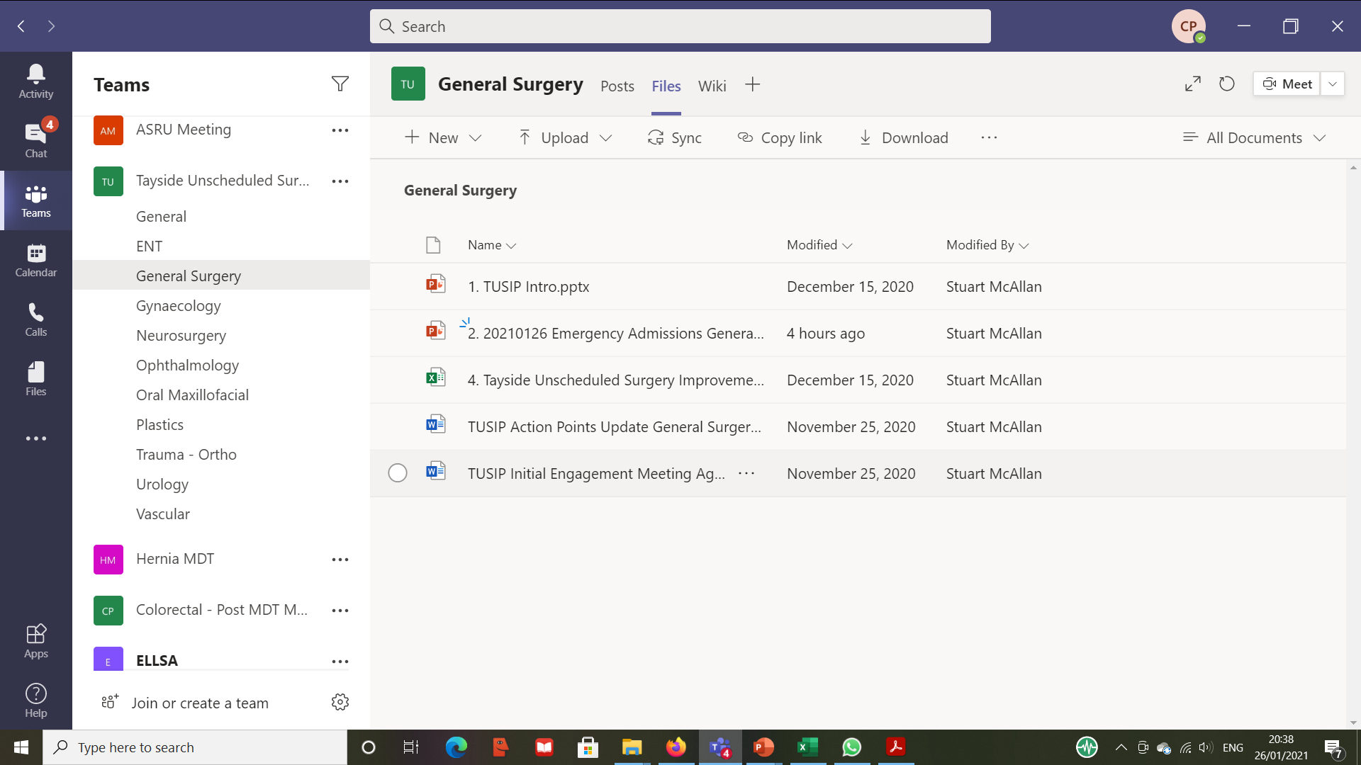
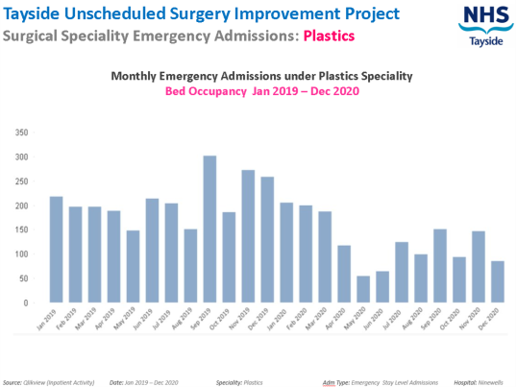
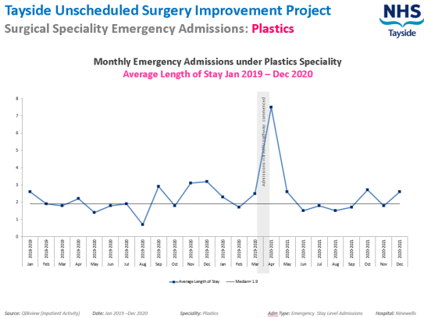
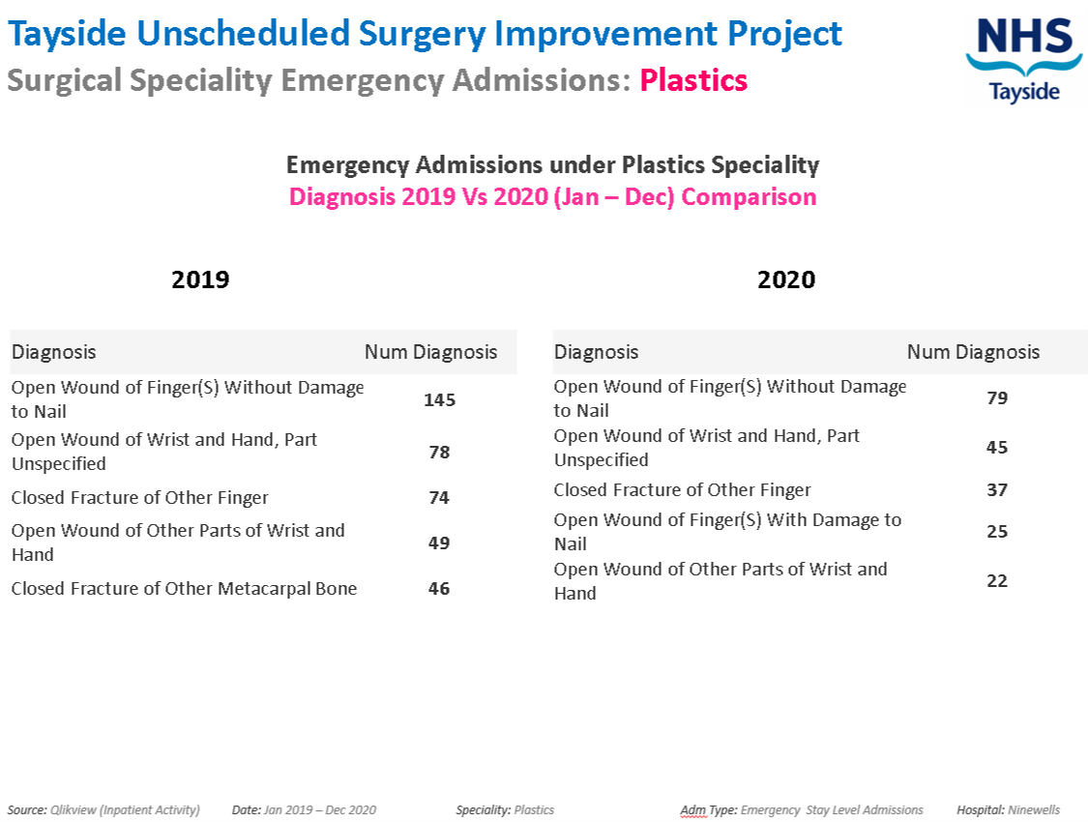
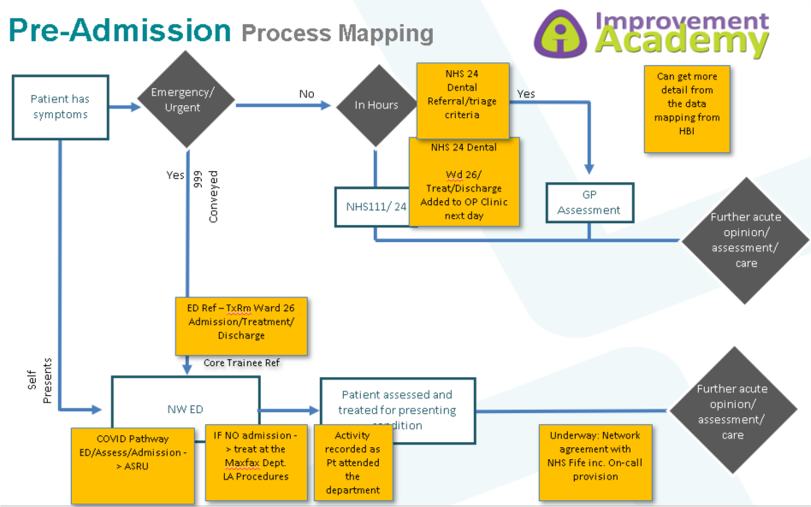
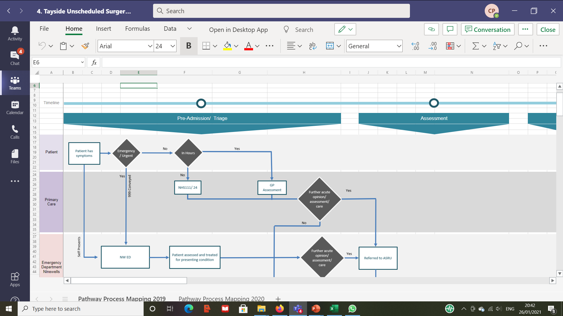
Methodology: Virtual Ways in Working
All speciality Teams virtual platform
Data driven speciality mapping
Participative, virtual process mapping
Speciality owned mapping – access to peers

Slide 25
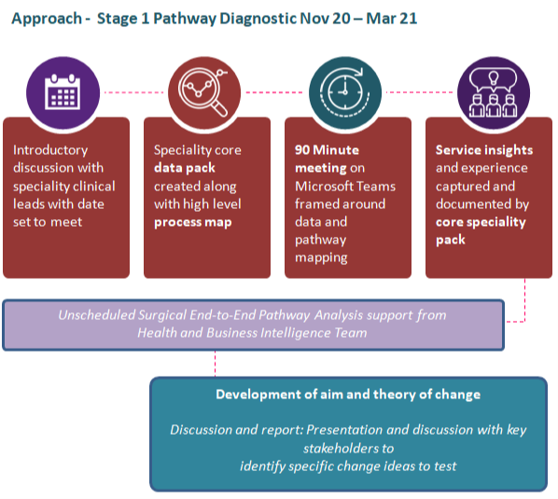
Methodology: Pathway Mapping and Data
ENT
Other stakeholder groups:
Jan – Feb 2021
.
General Practitioners
03 Feb 21
Redesigning Urgent Care Flow Navigation Hub
04 Feb 21
Critical Care
Theatres
Diagnostics
01 Dec 20
General Surgery
04 Dec 20
Urology
08 Dec 20
Plastics
15 Dec 20
Neurosurgery
20 Jan 21
Trauma & Orthopaedics
07 Jan 21
Vascular
14 Jan 21
Oral Maxillofacial
29 Jan 21
Gynaecology
29 Jan 21
Ophthalmology
04 Feb 21

Slide 26

What doesn’t work well What works well Ideas for improvement
Primary Care Unscheduled Surgery Interface Engagement Meeting: MS Teams 03 Feb 2021
Dr S. Jamieson, Dr A. Thomson, Dr C. Payne, S. McAllan
ASRU Referral from Primary Care
Plastics Referral from Primary Care
Neurosurgery Referral from Primary Care
“Dramatic Improvement” in experience of referring to ASRU.
ANP single call referral. Knowledgeable and well served.
Consultant Connect/ Prof to Prof could be a useful tool in order to avoid a bleep method.
Removing system built delay.
OOH experience overnight can be challenging
Contacting Plastics Reg overnight – Switch board will transfer to H@N Nurse. Significant time delays for referrer and patient
Cauda equina senior referral - experience of referral criteria
Would like to speak to the Reg if clinically required.
Cauda equina referral pathway with Neuro and Medical pathways
ANPs has been a good experience of partnership working with PC in management of referrals.
Timely: Need to be able to the senior clinical decision maker for advice
Telephone or SCI referral
Gynae Referral from Primary Care
OOH experience overnight can be challenging as wait on clinical decision maker
Gynae referral experience is more often than not a nurse through the day.
ENT Referral from Primary Care
Acute Vascular referrals not regular. ANP via ASRU? Or Vascular Reg?
ENT through the day is found good.
OOH experience overnight can be challenging
Page based systems are no longer fit for purpose
Referrals based on learning form Paeds model of tiered system of contact from advice to senior clinician.
Scheduling urgent care to meet the needs of referrals:
Advice
Assessment (Scheduled)
Admission (Need of IP care)
Accessing Scheduled Urgent Care
Primary Care Direct Referral by way of appointing in a scheduled way into the speciality by agreed pathways and criteria

Slide 27
Engagement Session: Sharing Feedback
The process
Acute Surgical Receiving Unit
A very positive conversation and facilitative style which, I am sure, will enable improvements in patient pathways, care and enhance relationships throughout the system.
First time to be part of a process like this
Felt part of the process, listened to and data for improvement
The team should be proud.
Commend the improvements that have been put in place for ASRU.
The hugely positive experience with the ANP team receiving calls.
Supporting the corporate culture of change and excellence
Process supporting flow and capacity as a whole system
Further enhancing the deliverables of Unscheduled care to the whole system as well as specialities
These changes would be refinements of an already high-quality interaction.
The route map for the future, including minimising system delays, will all enhance and capitalise on the willingness to enhance communication and embrace a culture of unity across historically perceived boundaries.
The organisation
The system

Slide 28
TUSIP NOV20 – FEB21 IN NUMBERS:
10
Surgical Specialities
9
Weeks
(Inc Festive break)
>30
Clinicians and managers
90
Minute Sessions
2
A team of 2
All
Reported positive experience of process
98
Insights from engagement captured
10
High level speciality pathways mapped and data analysis

Slide 29

Surgical Speciality Mapping

Slide 30
Unscheduled Surgery Template Pathway
Pre-admission
Assessment
Admission
Diagnostics
Theatre
Discharge
Self-Presentation
(ED)
ASRU
Ward7/8
Radiology
Home
Endoscopy
Primary Care
Ambulatory
Other hospital
CEPOD
Expedited Theatre
Care Home
Out of Region
Measures
Volume in each pathway
LOS

Slide 31
Reception Phase
Primary Care
Ambulatory Pathway
ED
Assessment
IP Pathway
Out of Region

Slide 33
Admitting Specialty | Dundee City | Perth and Kinross | Angus | Fife | All others
General Surgery | 35% | 28% | 26% | 8% | 3%
Trauma and Orthopaedic Surgery | 31% | 30% | 25% | 9% | 5%
Ear, Nose and Throat ENT | 37% | 28% | 23% | 8% | 4%
Gynaecology | 37% | 29% | 23% | 6% | 4%
Neurosurgery | 35% | 22% | 21% | 18% | 4%
Oral and Maxillofacial Surgery | 43% | 23% | 21% | 9% | 5%
Plastic Surgery | 32% | 27% | 26% | 12% | 4%
Urology | 34% | 30% | 25% | 8% | 3%
Vascular Surgery | 21% | 17% | 14% | 47% | 1%

Slide 34
Ambulatory Phase
Ambulatory
Discharge
Ambulatory Diagnostics
OP Follow-up
IP Pathway
WL

Slide 35
In Patient Phase
Admission
Discharge
Diagnostics
Discharge
Diagnostics
Theatre
Discharge
Theatre
Discharge

Slide 36
In Patient Phase
Admission
Discharge
26%
Diagnostics
Discharge
51%
Diagnostics
Theatre
Discharge
14%
Theatre
Discharge
9%
General Surgery data October – December 2020

Slide 37
In Patient Phase
Admission
Discharge
21%
Diagnostics
Discharge
15%
Diagnostics
Theatre
Discharge
18%
Theatre
Discharge
46%
T&O data October – December 2020

Slide 38
Admitting Specialty | No Radiology or Theatre | Radiology Only | Radiology & Theatre | Theatre Only
General Surgery (excl Vascular) | 25.3% | 51.2% | 14.3% | 9.2%
Trauma and Orthopaedic | 21.2% | 15.2% | 18.0% | 45.6%
Urology | 38.3% | 36.4% | 11.1% | 14.2%
Gynaecology | 63.7% | 15.1% | 3.4% | 17.9%
Vascular Surgery | 31.5% | 28.4% | 20.4% | 19.8%
Plastic Surgery | 34.4% | 2.6% | 2.0% | 60.9%
Ear, Nose and Throat ENT | 90.9% | 6.1% | 0.0% | 3.0%
Neurosurgery | 13.8% | 67.2% | 17.2% | 1.7%
Oral and Maxillofacial Surgery | 40.0% | 12.0% | 16.0% | 32.0%
Total | 30.5% | 33.0% | 13.6% | 23.0%

Slide 39
Admitting Specialty | No Radiology or Theatre | Radiology Only | Radiology & Theatre | Theatre Only
General Surgery (excl Vascular) | 25.3% | 51.2% | 14.3% | 9.2%
Trauma and Orthopaedic | 21.2% | 15.2% | 18.0% | 45.6%
Urology | 38.3% | 36.4% | 11.1% | 14.2%
Gynaecology | 63.7% | 15.1% | 3.4% | 17.9%
Vascular Surgery | 31.5% | 28.4% | 20.4% | 19.8%
Plastic Surgery | 34.4% | 2.6% | 2.0% | 60.9%
Ear, Nose and Throat ENT | 90.9% | 6.1% | 0.0% | 3.0%
Neurosurgery | 13.8% | 67.2% | 17.2% | 1.7%
Oral and Maxillofacial Surgery | 40.0% | 12.0% | 16.0% | 32.0%
Total | 30.5% | 33.0% | 13.6% | 23.0%

Slide 40
Admitting Specialty | No Radiology or Theatre | Radiology Only | Radiology & Theatre | Theatre Only
General Surgery (excl Vascular) | 25.3% | 51.2% | 14.3% | 9.2%
Trauma and Orthopaedic | 21.2% | 15.2% | 18.0% | 45.6%
Urology | 38.3% | 36.4% | 11.1% | 14.2%
Gynaecology | 63.7% | 15.1% | 3.4% | 17.9%
Vascular Surgery | 31.5% | 28.4% | 20.4% | 19.8%
Plastic Surgery | 34.4% | 2.6% | 2.0% | 60.9%
Ear, Nose and Throat ENT | 90.9% | 6.1% | 0.0% | 3.0%
Neurosurgery | 13.8% | 67.2% | 17.2% | 1.7%
Oral and Maxillofacial Surgery | 40.0% | 12.0% | 16.0% | 32.0%
Total | 30.5% | 33.0% | 13.6% | 23.0%

Slide 41
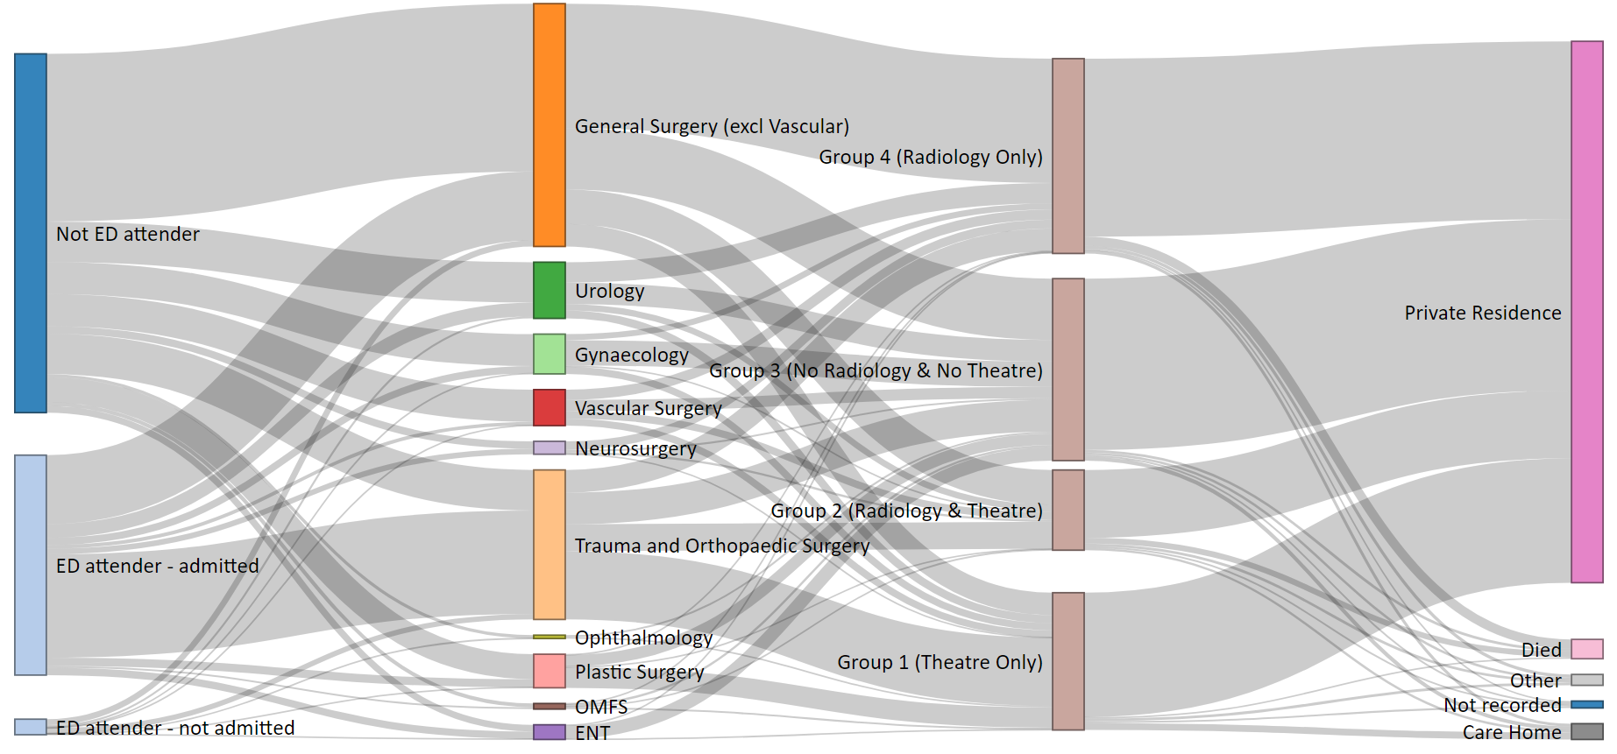

Slide 42
Care Group 4 Unscheduled Admissions per week

Slide 43
ENT Unscheduled Admissions per week

Slide 44
Plastic Surgery Unscheduled Admissions per week

Slide 45
ASRU admissions showing impact of specialist surgery demand

Slide 46
Challenges for Capacity and Flow in COVID era
Delayed presentations
Patient Factors
Increased clinical complexity
Deconditioned patient group
Delay to theatre
Theatres
Reduced theatre capacity
Reduced theatre efficiency
Loss of Theatre Admission Area
Ward / bay closures
Wards
Displaced clinical teams
Boarding
Delay to diagnostics
COVID infection
Delay to Discharge/ POC

Slide 47
Average LOS 2019-2020
 | n | 2019 LOS (days) | n | 2020 LOS (days)
General Surgery | 4799 | 5.5 | 4402 | 5.1
T&O | 3185 | 11.6 | 2786 | 10.1
Plastic Surgery | 1239 | 1.8 | 738 | 1.9
Urology | 908 | 3.9 | 895 | 3.2
Gynaecology | 743 | 2.1 | 659 | 1.7
Vascular | 661 | 14.3 | 592 | 12.7
ENT | 733 | 2.5 | 359 | 2.3
Neurosurgery | 298 | 7.7 | 197 | 7.4
OMFS | 143 | 2.6 | 123 | 2.3

Slide 48
Average LOS 2019-2020
 | n | 2019 LOS (days) | n | 2020 LOS (days)
General Surgery | 4799 | 5.5 | 4402 | 5.1
T&O | 3185 | 11.6 | 2786 | 10.1
Plastic Surgery | 1239 | 1.8 | 738 | 1.9
Urology | 908 | 3.9 | 895 | 3.2
Gynaecology | 743 | 2.1 | 659 | 1.7
Vascular | 661 | 14.3 | 592 | 12.7
ENT | 733 | 2.5 | 359 | 2.3
Neurosurgery | 298 | 7.7 | 197 | 7.4
OMFS | 143 | 2.6 | 123 | 2.3
Total | 12709 | 6.7 | 10751 | 6.1

Slide 49
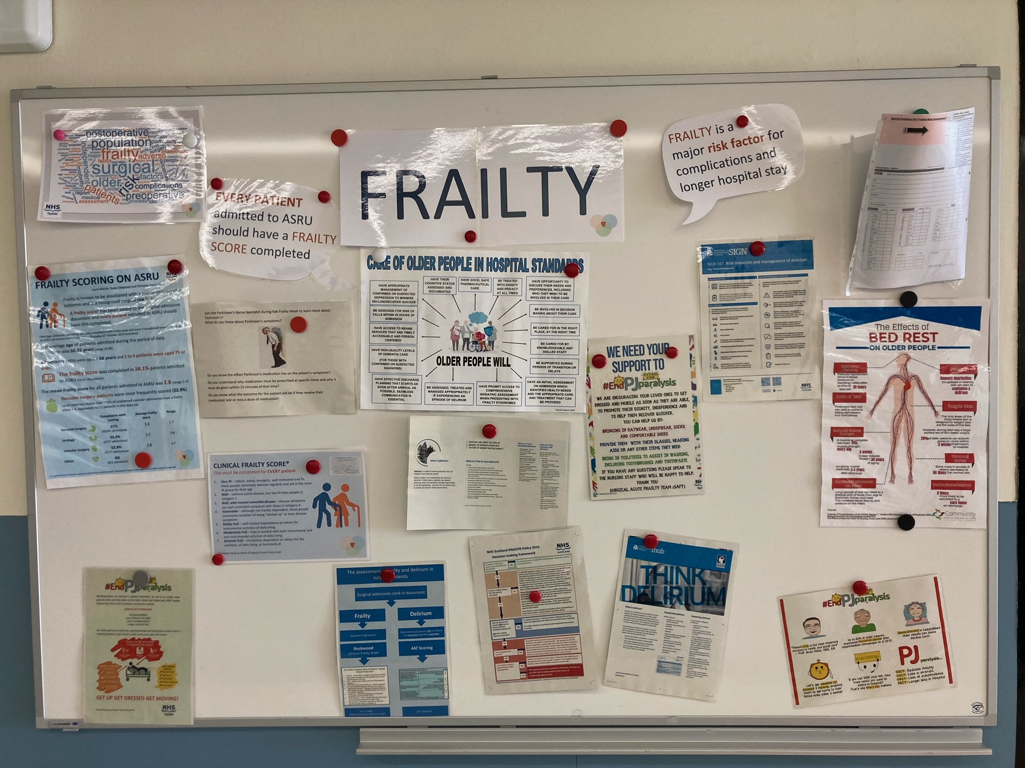

Slide 50

















Apr ’20
SAFT Shared ward round with Vascular and General Surgery
Shared polypharmacy reviews
Aug ’20
Recruited SAFT
Link nurses
Teching commenced
4th yr MBChB formal
5th yr MBChB SCC frailty
Feb ’21
New MFE consultant in post
> 800 patients seen by SAFT
Oct ’20
International Older Persons Day
Dec ’20 – Jan ‘21
Snr. Medical Support provided to surgical Covid ward
Feb ’20
Medical staff added to ANP/OT/DCC SAFT formed
Apr ’21
Screening All >65 yr old and updated referral criteria
Mar ’20
Referral criteria established
Sep ’20
Establishment of SAFT database for QI & research
‘Fab frailty’ awareness campaign
Jan ’21
Educational Program Expanded
Reduced length of stay by over 1 day
Mar ’21
Shared Morbidity and Mortality governance established
Jun ’20
Educational Program
Commenced
Nov’’20
SAFT poster presentation ACAP conference
-

Slide 54
Age >80 years LOS 2019-2020
 | n | 2019 LOS | n | 2020 LOS
General Surgery | 643 | 9.1 | 592 | 7.8
Urology | 192 | 6.6 | 179 | 4.1
Vascular | 156 | 14.8 | 155 | 12.6

Slide 58
Post-COVID Achievements Surgery
Service changes within existing improvement / governance framework
Rapid re-organisation of all surgical pathways for all surgical specialties
Consolidate and enhance processes and pathways in ASRU and TAU
Recruitment and retention
Ambulatory pathways – scheduling unscheduled patients
  GS /US / CT / Specialty pathways
Surgical Acute Frailty Team
System wide review of services

Slide 59
Top Ten Themes!
Move to common entry via ASRU / TAU very positive
Referral pathways / call handling
Ambulatory pathways need prioritised and resourced
Theatre access / theatre co-ordination
Ambulatory Admission area
Trauma Lists / Cold cases / urgent bookable
Non-medical workforce
7 day service
Frailty
Critical Care Footprint

Slide 60
Opportunities
Prioritise coherent re-emergence plan for Unscheduled Surgery
Raise and progress common issues amongst the surgical specialties
Share good practice between specialties and sites
Map and resource footprint
  Inpatient / Ambulatory / Theatre + Critical care
Learn from others
Celebrate good practice!

Slide 64
Summary
Re-organisation of unscheduled surgery
Methodology of system-wide service review
Value of engagement
Mapping process
Data review
Recommendations for further service improvements

Slide 65
Acknowledgements
The Health and Business Intelligence Team
The specialty leadership teams that participated in the engagement sessions
Primary Care contributors
Colleagues in the Improvement Academy
Flow and Navigation Centre Team
The Emergency Theatre Lead and Theatre Co-ordinators
Unscheduled Care Board
Operational Leadership Team

Slide 66
Enquries / Questions
Christopher.Payne@nhs.scot

