Slide 1
Navigating the Pandemic Winter – Our Map and Compass
Dr David Connell, Consultant Physician, NHS Tayside

Slide 2
Why is Winter hard?
Increased system demand
Respiratory Illness/Influenza
Frail elderly
Orthopaedic
Weather
Staff illness

Slide 3
Summer 2020: A Reasonable Worst Case Scenario for NHS Tayside
Significant Influenza Season
Concomitant COVID-19 surges
Nosocomial transmission
Increased demand of unscheduled and planned non-COVID care
Staff shortages
Winter weather
EU Exit
At least 7-14 weeks of this: ‘slow burn major incident’

Slide 4
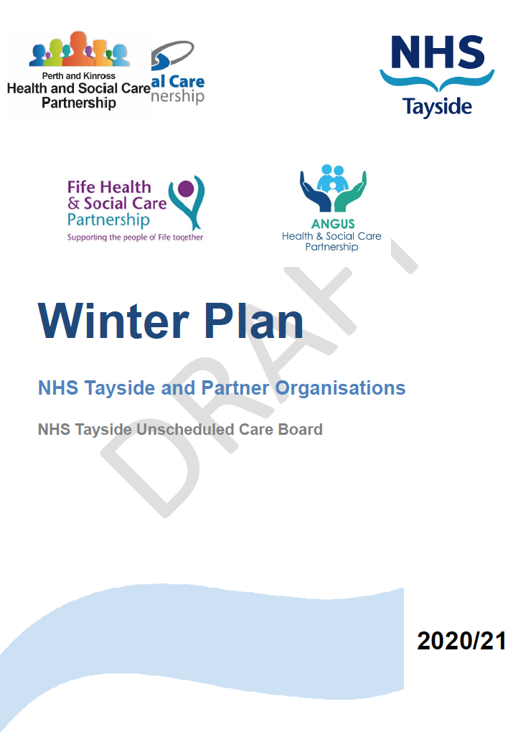
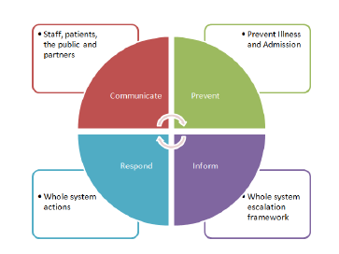
£1.5m agreed by NHS Tayside for Winter and Unscheduled Funding

Slide 5
Prevent
Illness and Admissions within our population and staff
Inform
Whole System Escalation Framework
Respond
Local and Organisational Business Continuity Planning
Communicate
Informing our staff, patients, and the public in Tayside

Slide 6
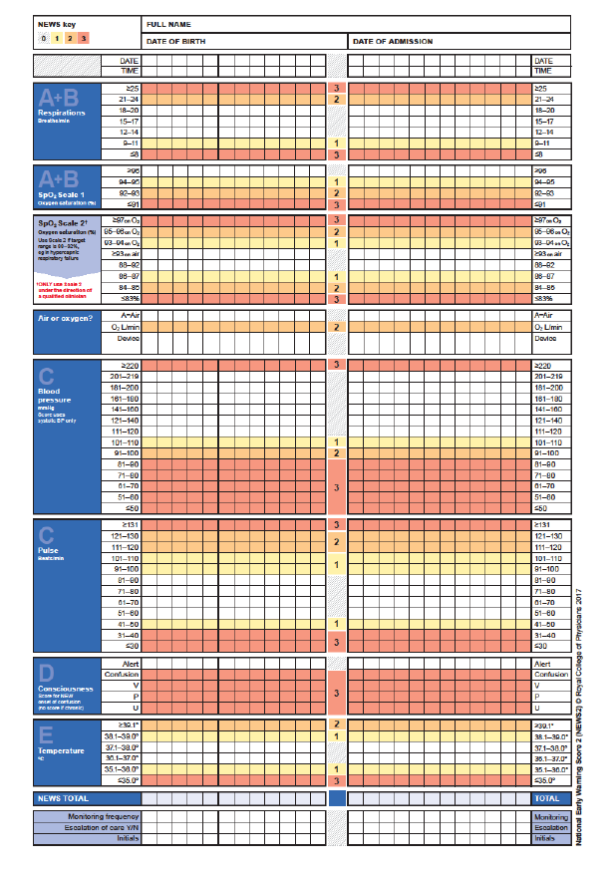
The Organisation as Organism

Slide 7
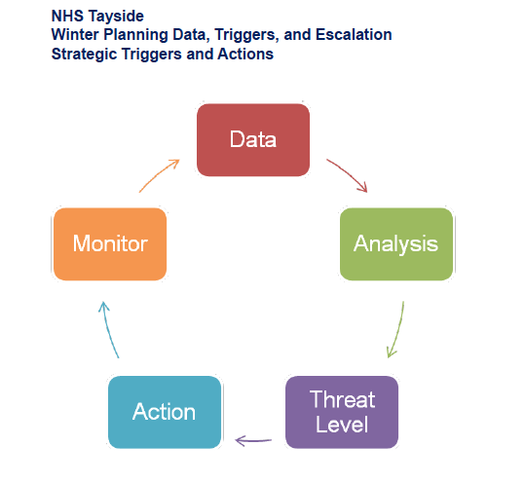

Slide 8
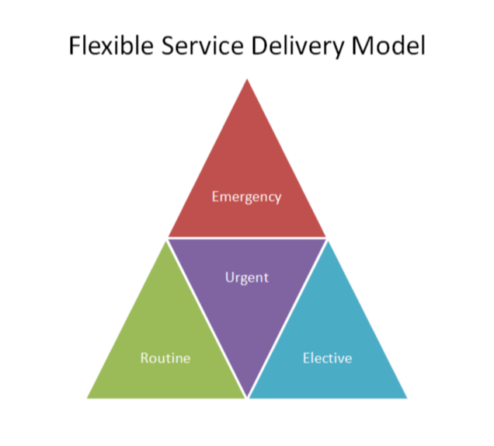

Slide 9
Navigating the Pandemic Winter – Our Map and Compass
Jennifer Woods, Health & Business Intelligence Lead, NHS Tayside

Slide 10
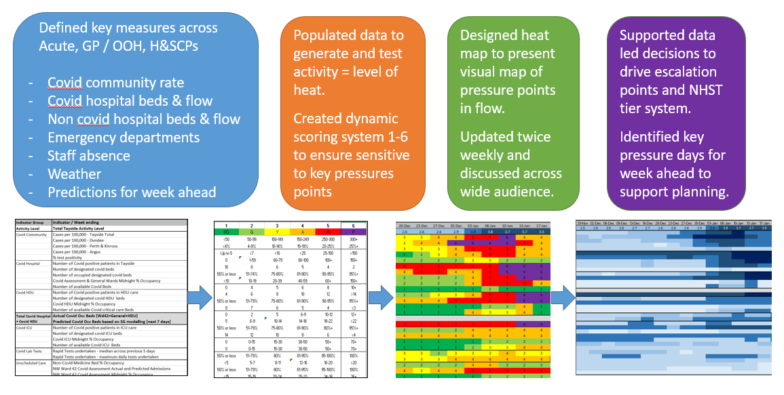
NHS Tayside Heat Map Activity Level Tracker

Slide 11
Navigating the Pandemic Winter – Our Map and Compass
Dr Ron Cook, Clinical Director, NHS Tayside

Slide 12
NHS Tayside Heat Map Activity Level Tracker

Slide 13
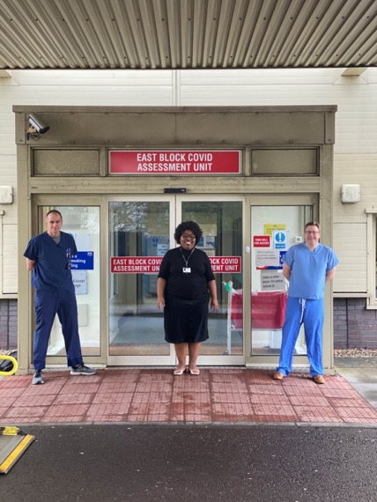
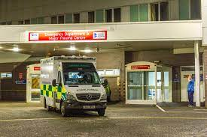
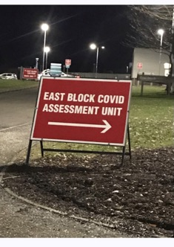
WINTER MULTI-FRONT DOOR STRATEGY
Pre-Covid – ED P2P with SAS – 30% treatment out of hospital
Rapid expansion in Prof-to-Prof enabling a multi-front door response
Emergency Medicine
Acute Medicine
CoVid Assessment
Stroke
Paediatrics

Slide 14
Winter Multi-Front Door and R.U.C.
Dedicated Emergency Medicine SDM for Flow Nav and Prof-to-Prof
SAS Test of Change – Perth and Kinross
Significant increase in SAS use of Prof-to-Prof (+300% Increase)
Sep 2019 – Mar 2020 – Calls connected ED - 1237, AMU – 942
Sep 2020 – Mar 2021 – Calls Connected
ED – 4006
AMU – 1063
Covid - 1769
Stroke 232
Outcomes maintained in audit results

Slide 15
Prof-to-Prof Winter 2020 - 2021
Multi factorial benefits.
Prof-to-Prof enabled multi-front door model (ED, CoVid, AMU, Stroke)
Increasing Specialities offering
MfE
Diabetes
Acute Surgery
No P2P = potential 25% increase in unscheduled ‘traditional’ ED presentations
RUC Remote SDM consultation and scheduling
WINTER WOULD HAVE BEEN VERY DIFFERENT….

Slide 16
Navigating the Pandemic Winter – Our Map and Compass
Jonathon Will, Clinical Effectiveness Lead, Scottish Ambulance Service

Slide 17
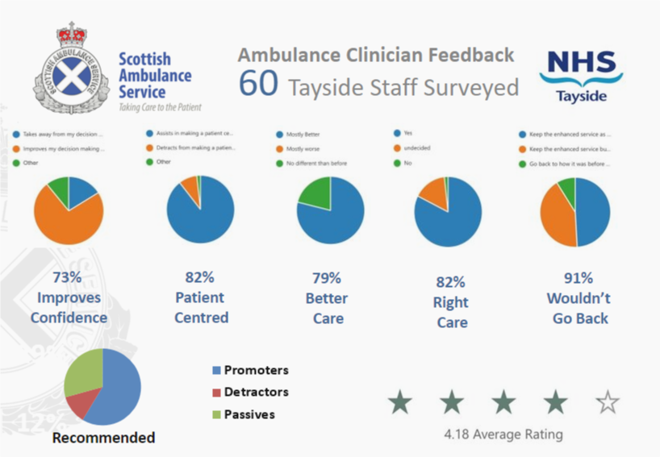

Slide 18
Navigating the Pandemic Winter – Our Map and Compass
Dr David Connell, Consultant Physician, NHS Tayside

Slide 19
NHS Tayside Heat Map Activity Level Tracker
Community Case Rate
Tracker
Primary Care/GP
Tracker
Acute Activity
Tracker

Slide 20
Winter Planning and Operations from 06/2020
NHS Tayside Heat Map Activity Level Tracker
Tracker Score
Winter Review from 03/2021
Regular Winter Huddles start
ELT approve Winter plan
Op Jan Level 4 escalation
Regular Winter Huddles end
Op Jan approved
Start of
Winter
Start Winter Peak:
GP 🡺Case Rate🡺Acute
All trackers <3.5:
end of Winter Peak
Start Autumn Surge:
GP 🡺Case Rate🡺Acute
Tabletop Planning Exercises
COMPASS deployed
Community Case Rate
Tracker
Primary Care/GP
Tracker
Acute Activity
Tracker
Tracker Score of 3.5

Slide 21
Frailty – From Front Door to Front Room
Dr Helen Elder, Specialty Doctor – Medicine for the Elderly, NHS Tayside

Slide 22
Contents
Acute Frailty in Tayside – a continuously evolving process
Acute Frailty Team and Unit – background and development
Results of improvement interventions
Whole system impact

Slide 23
Before Acute Frailty
All patients admitted via Acute Medical Unit
Lengthy and complex process
Patients to wrong places
Boarding, high length of stay and delayed discharges

Slide 24
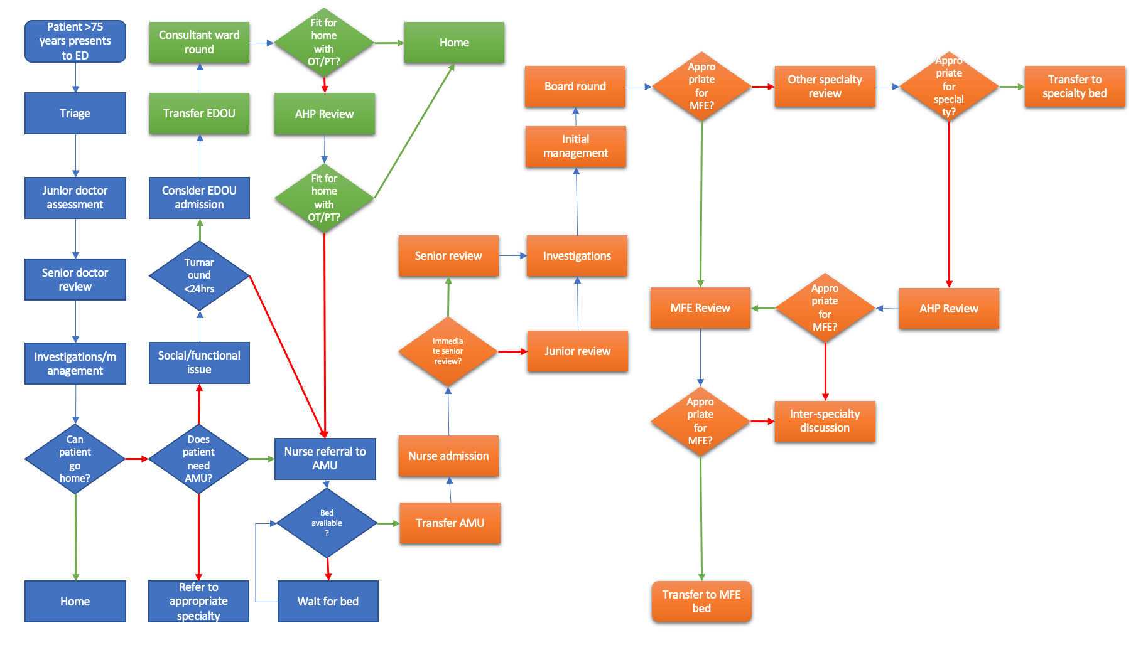

Slide 25
What This Means in Practice – Mr B
Background medical history and function
Admitted with shortness of breath – process of assessment
Journey through MFE
Discharge condition/requirements
25 days more than predicted!

Slide 26
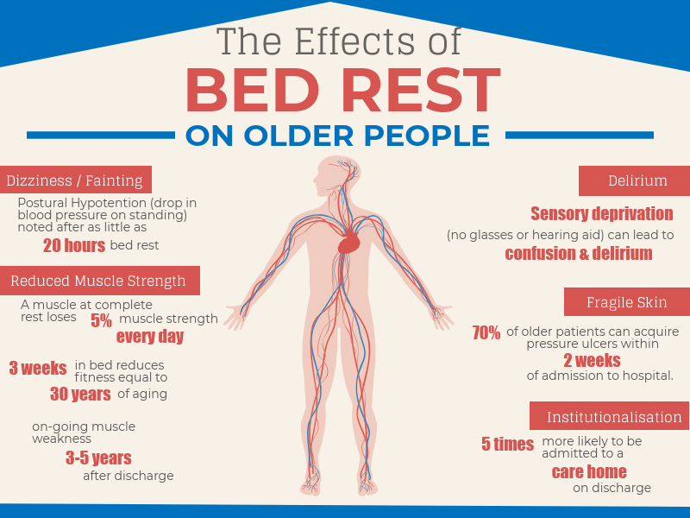
Impact of this Journey
Hospital acquired delirium/infection
Deconditioning/hospital acquired dependency
Increased social care requirements
Pressure on other areas of the system

Slide 27
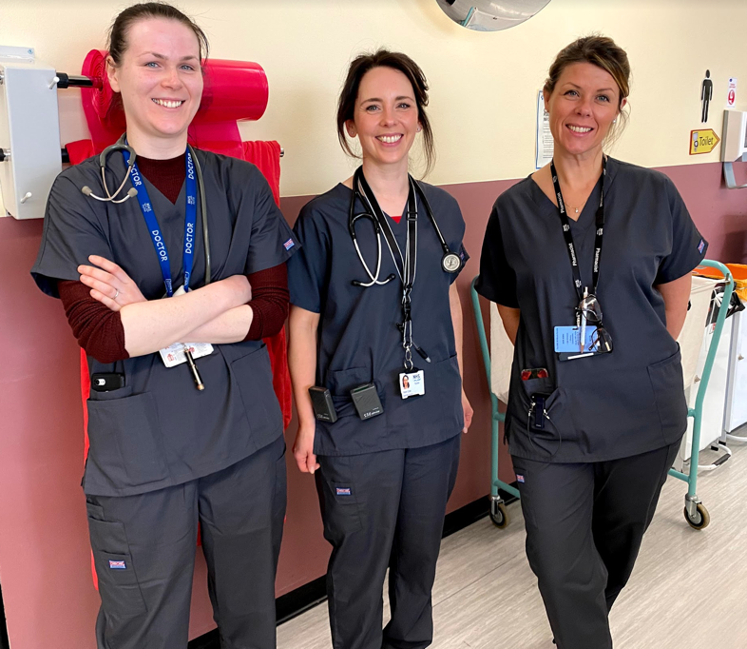
Acute Frailty Team
7 day working
Multidisciplinary approach and liaison with Acute Medical Team/other medical specialties
More timely assessments
Better training opportunities

Slide 28
Simultaneous Improvements
Enhanced Community Support
Hospital at Home (DECS-A)
Integrated Discharge Hub

Slide 29
Frustration!
Some improvement
No significant improvement in LOS
Still boarding and capacity issues
Many patients do require hospital admission

Slide 30
Acute Medicine for the Elderly Assessment Unit (AME)
Started as a trial using winter funding money
Aim for 72 hour LOS
Attempt to discharge majority of patients directly to home
Community links – discharge to assess
MDT working the essence of this

Slide 31
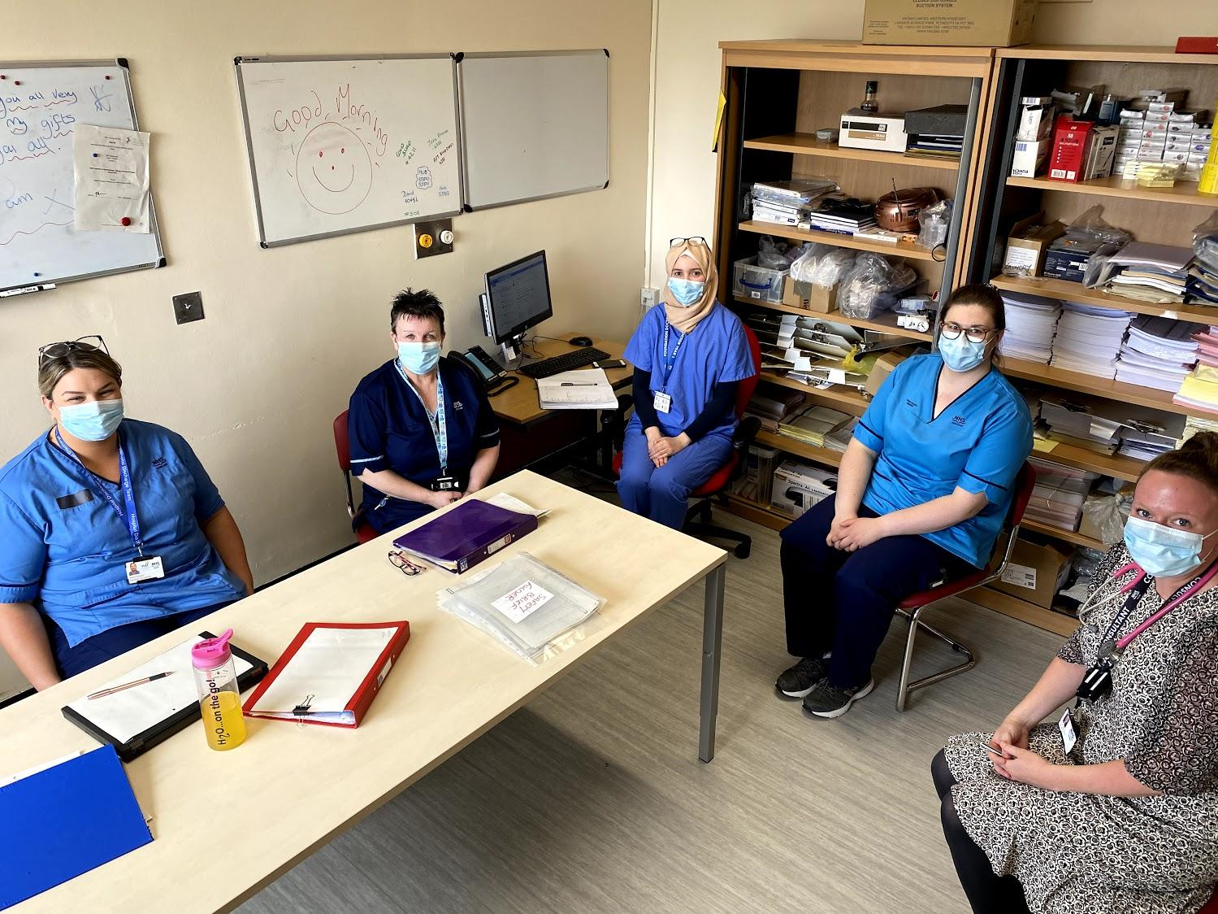
AME Multidisciplinary Team
I love working in AME because the patient is at the heart of everything we do. By the team valuing an respecting each others opinions we come together to create a personalised patient experience.
Jen (Senior Charge nurse)
Working within AME is a prime example of efficient MDT working. Everyone is respectful of each other’s roles and supports to achieve high quality of patient care with a focus to discharge to assess in people’s own environments.
Natalie (Occupational Therapist)
The AME ethos means that as an MDT we can quickly and effectively assess the patients needs/wants/goals. Ultimately this means the patients can enjoy more time at home.
Lynsey (Physiotherapist)
I enjoyed the mix of patients in AME from those with acute medical problems to complex social issues. I also enjoyed working with such a proactive MDT where everyone was very focused on early discharge planning and an optimum pathway for each patient.
Kirsty (ST6 – Geriatrics)

Slide 32
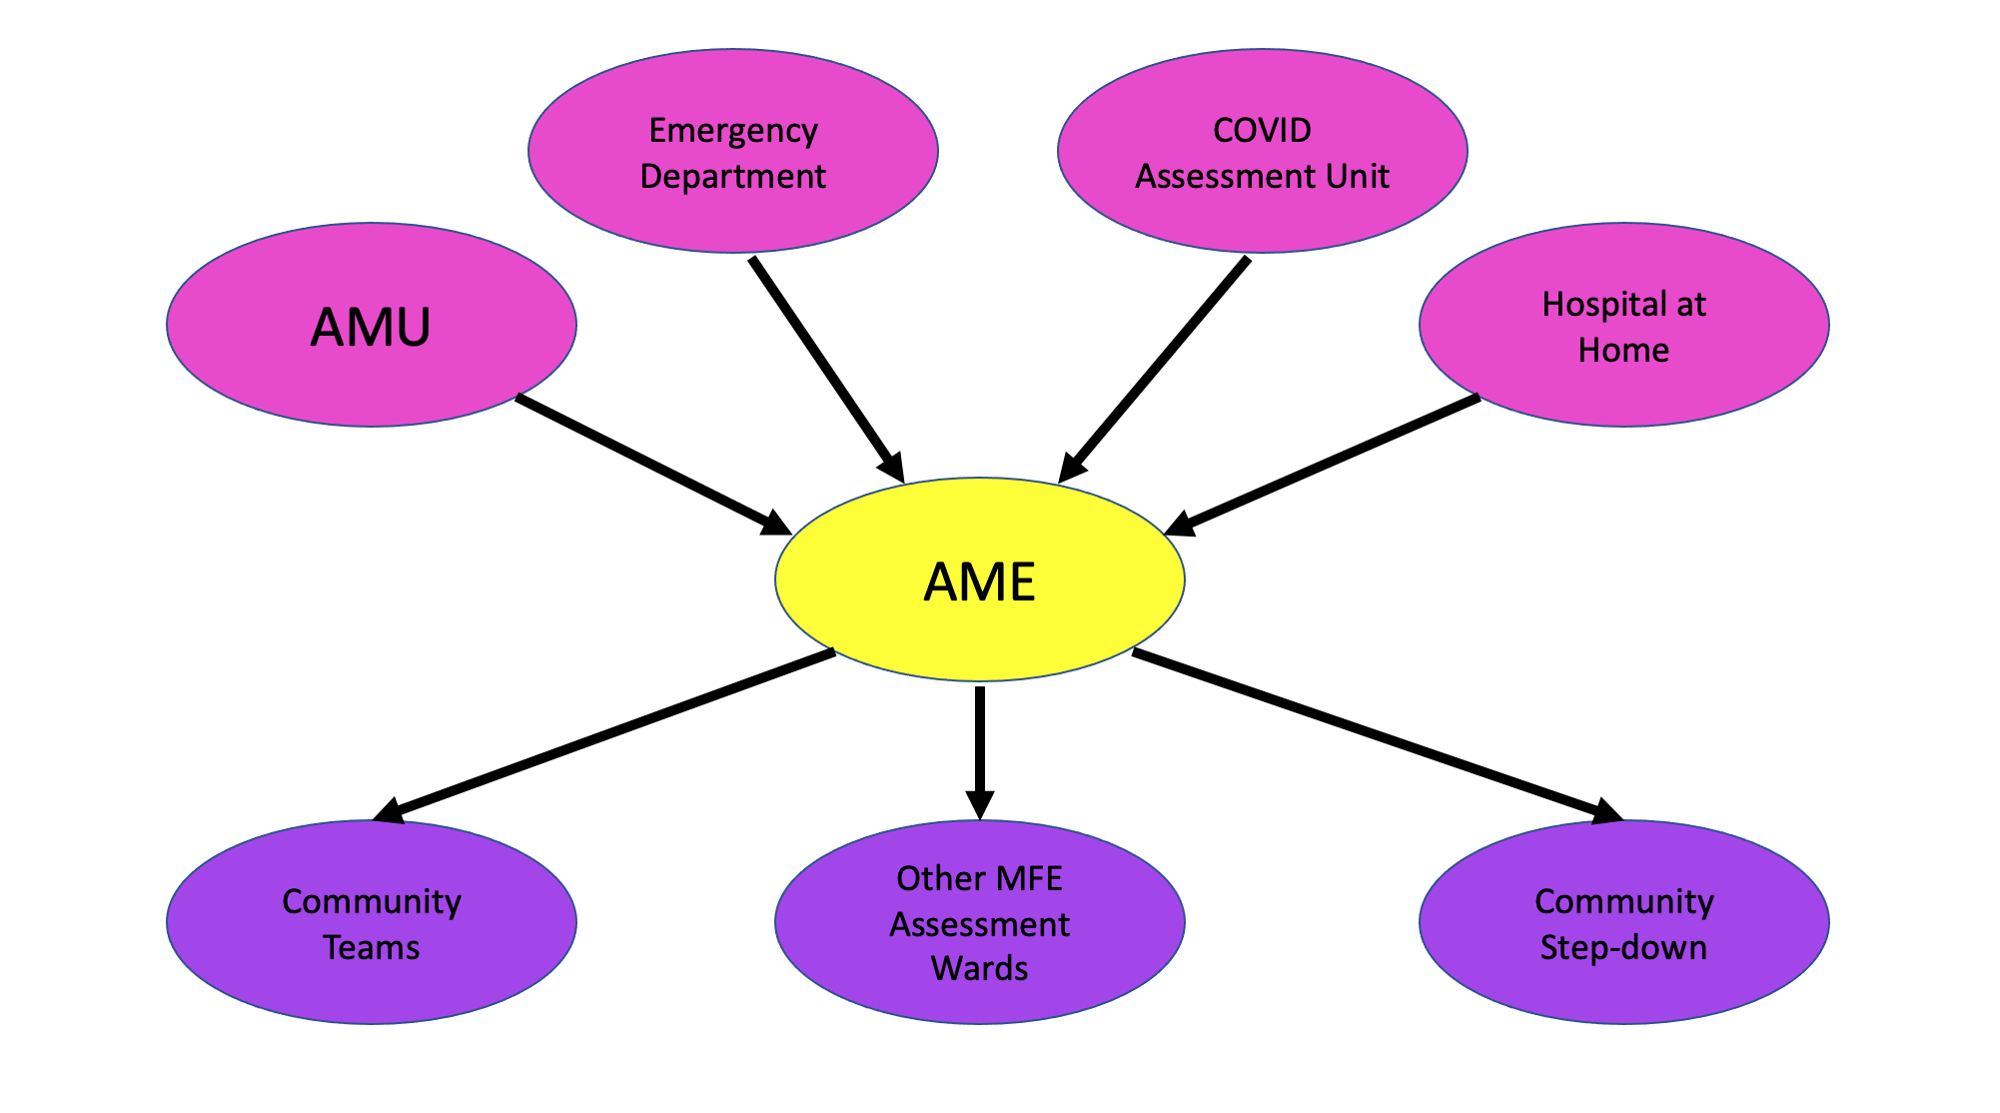

Slide 33
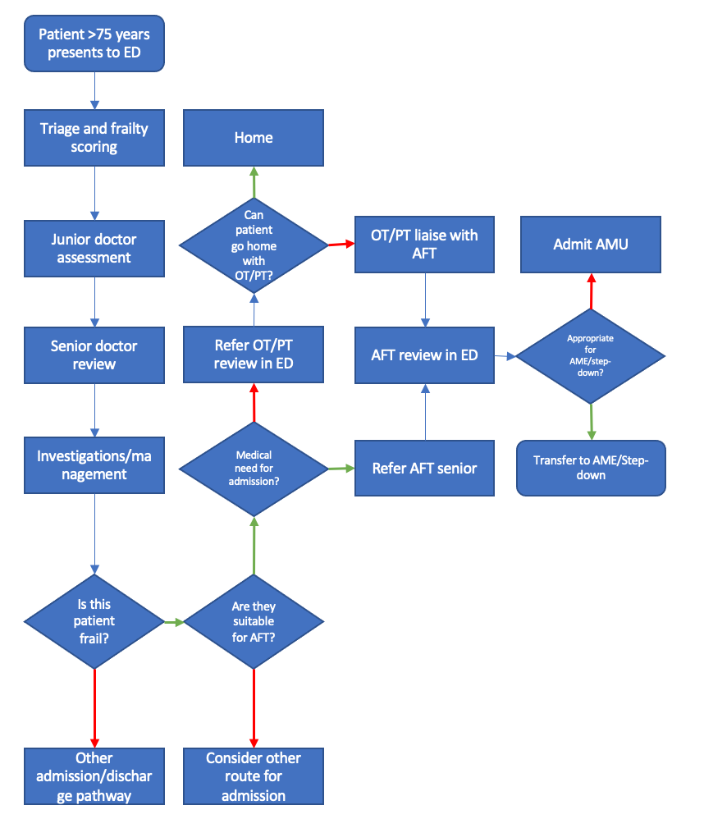
Other advantages of AME
New direct admission pathways
Stronger community links
Staff satisfaction
Training opportunities

Slide 34
What this Means in Practice – Mrs M
Referral from ED 1pm – Assessed and transferred to AME within 3 hours and management plan commenced
Investigations complete within 5 hours
Out of bed from time of transfer
MDT assessment 9am following morning
Transferred to community hospital within 24 hours
Discharged to home within 4 days.

Slide 36
Average LOS - Data

Slide 37
MFE Discharges

Slide 38
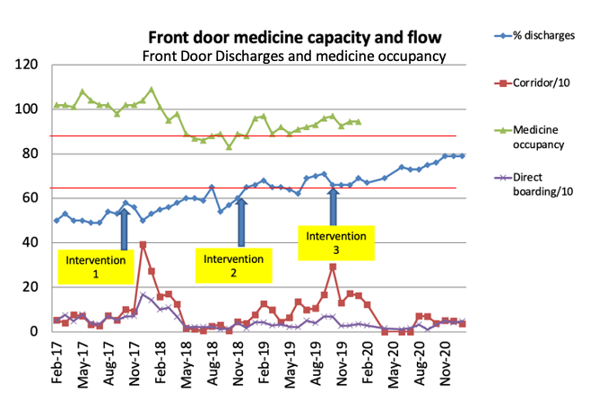
Wider Impact

Slide 40
Delayed Discharges

Slide 41
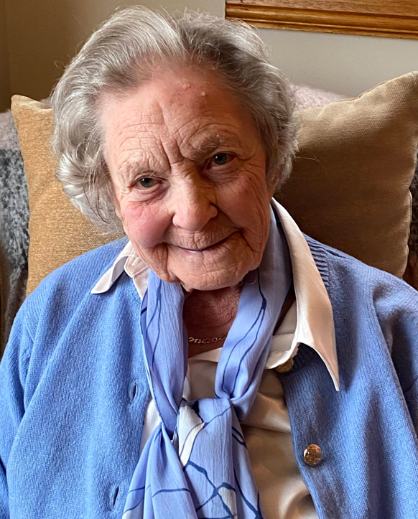
Summary
Always patient centred
Admission cannot always be avoided
Early discharge requires wide support structure
Experienced MDT is essential
Remember continuous multisystem approach and improvements
Impact on wider system enables remobilisation

Slide 42
Access QI – Improving Planned Care Pathways
Thomas Monaghan, Portfolio Lead – Access QI, Healthcare Improvement Scotland

Slide 43
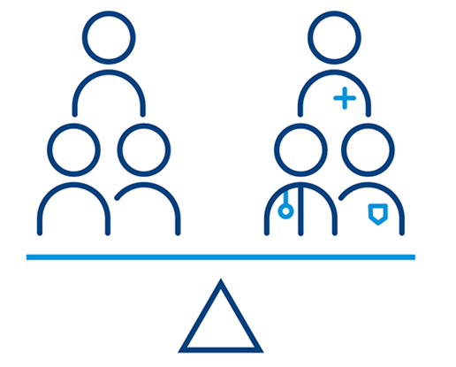
Access QI
Access QI is a collaboration between Healthcare Improvement Scotland, NHS Education for Scotland and participating NHS boards.
We work together to enable the application of quality improvement (QI) to sustainably and affordably improve waiting times.

Slide 44
Access QI – Improving Planned Care Pathways
Cathy Young, Head of Transformation, NHS Grampian

Slide 45
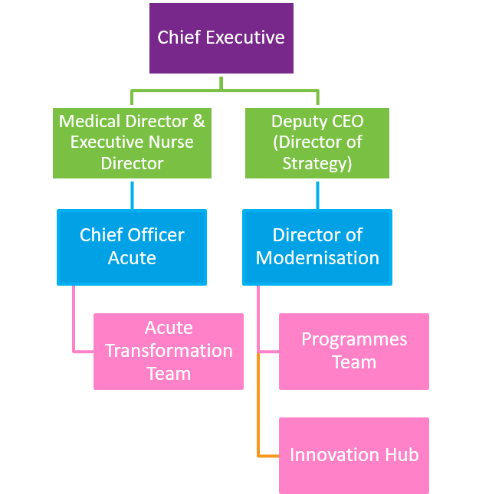
Board Buy-in as Accelerator Site
Three Service Areas involved: Urology, Gynaecology, Dermatology
Blended approach with Acute Transformation Team, QI Exec Lead, Modernisation
Each pathway had a skilled Improvement Advisor. All were completing the Flow Coach Academy programme
Fortnightly huddle to support cross pathway learning
Work continued in all pathways during COVID-19
The approach developed was then applied to other work required during COVID (e.g. cancer backlog, car park waiting rooms)
Informed the development of the Programme Management Office PMO for key areas of work

Slide 46
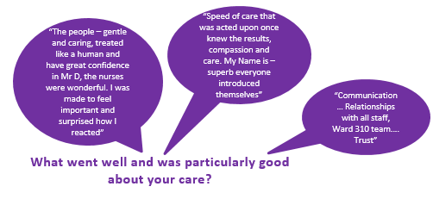
Understanding the System
Starting point for each of the three services was to understand the system:
Claims, concerns and issues exercise with MDT
Process mapping
Data regarding Demand, Capacity, Access and Queue
Patient Feedback
Development of an action plan and identification of performance measures

Slide 47
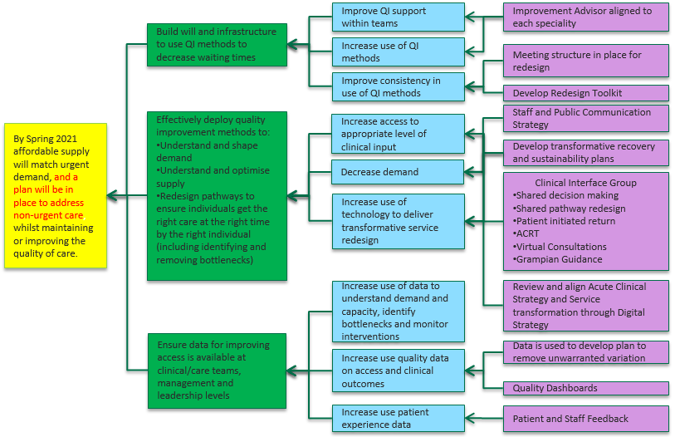
MDT Engagement with Clinical Leadership
Standard methodology across all Access QI projects through approach outlined in Driver Diagram
Process Map supported improved understanding of pathways and processes
Identification of areas for co-creation bringing two pathways, in different services together, as one
Clinical teams took ownership for the project and made significant progress despite pandemic response
Patients had an opportunity to shape the service redesign

Slide 48
Access QI – Improving Planned Care Pathways
Yeshi Bhushan, Consultant Gynaecologist and Clinical Lead, NHS Tayside

Slide 49
Gynaecology: Post Menopausal Bleeding
1. PMB e-referral route
2. PMB ‘One Stop Clinic’
11 potential Tests of Change
CURRENT
FUTURE

Slide 50
Test of Change 1: PMB e-Referral
Before Change
PMB referrals were coded as:
Test and implement
Gynaecology PMB referral route created
Updated clinical pathway
Communication to GPs
Referral Guidance strengthened
Urgent – suspected cancer:
19%
Urgent:
54%
Routine:
27%

Slide 51
Test of Change 1: PMB e-Referral
Outcomes
Percentage PMB One Stop Appointments Referred via PMB ePathway
Median 80%

Slide 52
Test of Change 2:
One Stop Clinic
Before change
Average of 137 days from ref. to hysteroscopy appt.
Average of 100 days between appts.

Slide 53
Test of Change 2:
One Stop Clinic
Test & Implement
New clinic launched 28 July 2020
In one hospital visit patient receives:
Clinic Appt.
Hyster-oscopy
One Stop Clinic

Slide 54
Patient Journey Time After Change
90% uptake
One Stop PMB appointment
Chose general anaesthetic
Clinical requirement
Hysteroscopy same day
All offered
Exceptions
From Referral to PMB Appt. –
2 Day reduction
(Average for 309 patients)
Save 618 Days / Year
From PMB Appt. to Hysteroscopy Appt. –
101 Day reduction (Average. for 63 patients)
Save 6,363 Days / Year

Slide 55
Access QI – Improving Planned Care Pathways
Thomas Monaghan, Portfolio Lead – Access QI, Healthcare Improvement Scotland

Slide 56
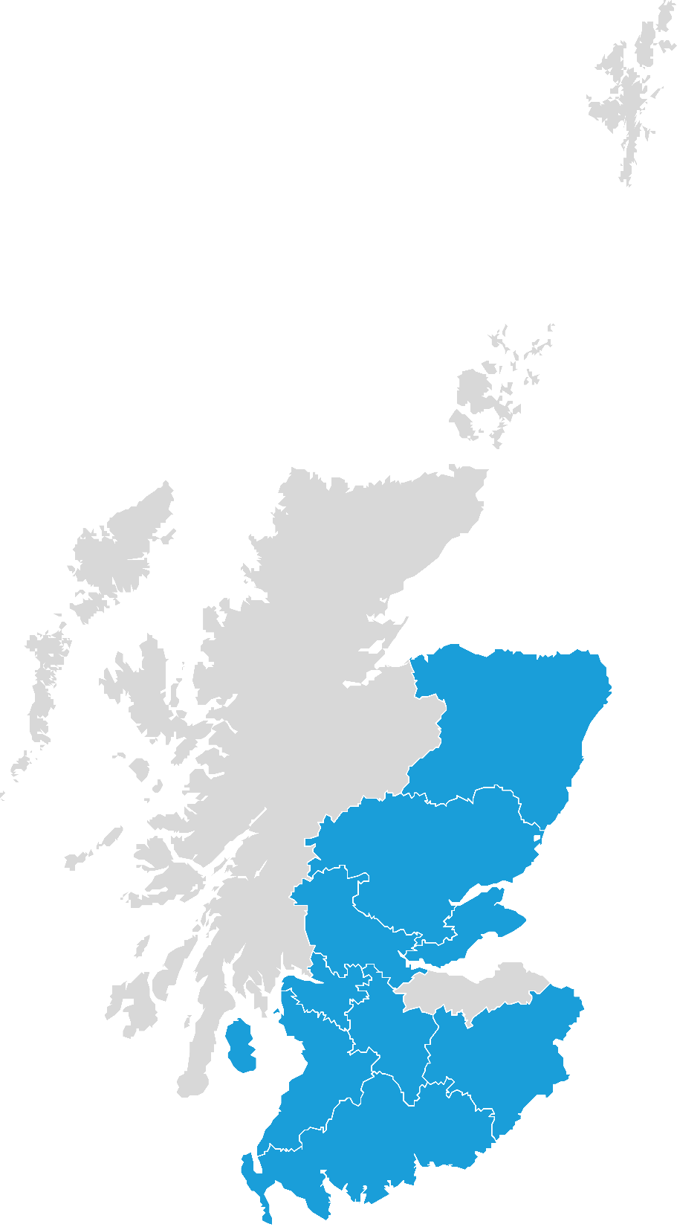
Spreading the use of QI to improve waiting times
NHS Ayrshire & Arran
CAMHS
NHS Borders
Psychological Services
NHS Dumfries & Galloway
Orthopaedics
NHS Fife
General Surgery
Orthopaedics
NHS Forth Valley
Drugs and Alcohol
Ear, Nose and Throat
Early Intervention in Psychosis
Endoscopy
Gastroenterology
Urology
NHS Grampian
Cardiac Physiology
Paediatric Cardiology
Radiology
NHS Greater Glasgow and Clyde
Adult Gender Identity Service
Cardiology (North)
Cardiology (South)
Plastic surgery
Podiatry
Respiratory Medicine (South)
Theatres and Anaesthetics (South)
NHS Lanarkshire
Rheumatology
NHS Tayside
ADHD and Autism Spectrum Disorders
CAMHS

Slide 57
Spreading the use of QI to improve waiting times
Toolkit, resources and project support with using QI to improve waiting times,
Training for planned care teams to use QI to improve access,
Training and coaching supporting to QI coaches and data analysts in NHS boards, and
Peer to peer learning from other NHS boards.

Slide 58
Join Access QI
Apply to join Access QI before the 30 June 2021 by visiting: https://ihub.scot/improvement-programmes/access-qi/join-access-qi/
Download QI resources for improving access at https://ihub.scot/improvement-programmes/access-qi/
Follow us on twitter @ihubscot to keep up to date with new resources, new examples form local services and our upcoming webinar and podcast series.

