Slide 1
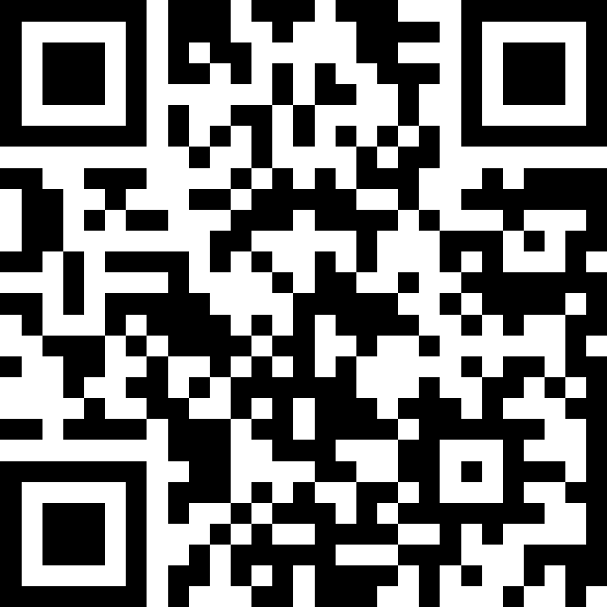
Improving Wellbeing and Working Cultures across NHS Scotland
Slido – QR Code
https://www.slido.com/ and enter the code NHSScot2025

Slide 2
Welcome
Fiona Hogg
Chief People Officer, Health Workforce,
Scottish Government

Slide 3


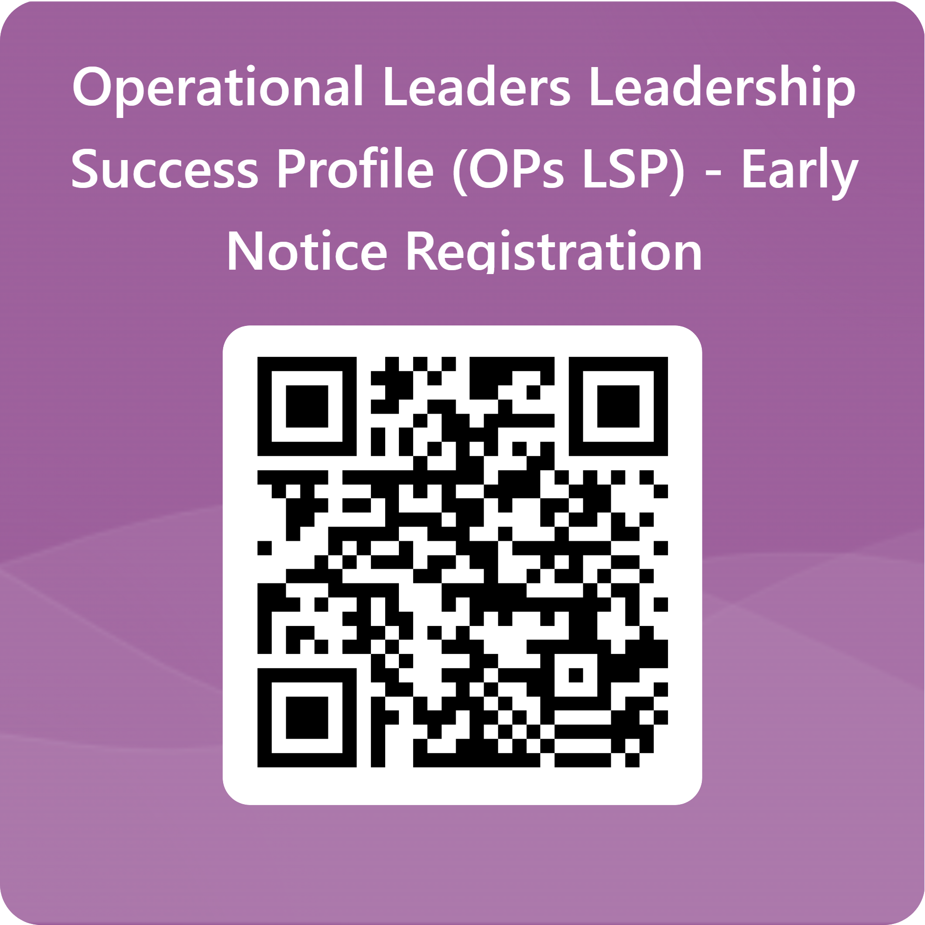

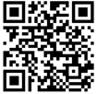
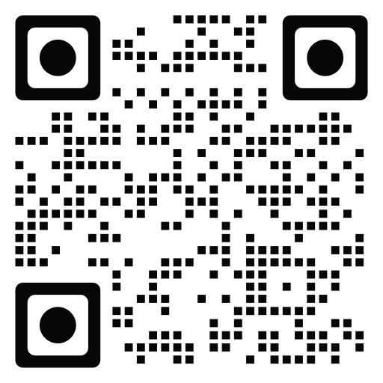
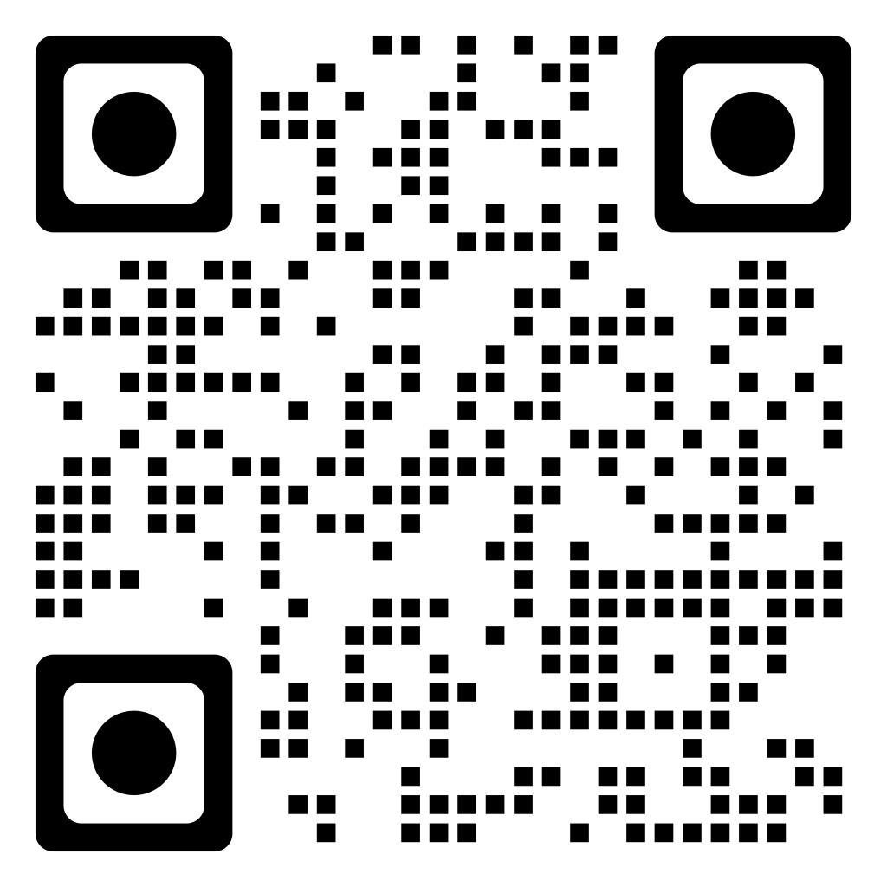

Improving Wellbeing and Working Cultures
Improving Wellbeing and Working Cultures Publication
Operational Leaders leadership Success Profile (Ops LSP) – Early Notice Registration
The National Wellbeing Hub
Anti-Racism Guidance
Notes:
In July 2024, Scottish Government published Improving Wellbeing and Working Cultures (IWWC), setting out our ambition to enhance working cultures through programmes of work at a national level that focus on the pillars of: wellbeing, leadership and equality. When these areas are prioritised, working cultures can improve.
This work builds on the National Workforce Strategy for Health and Social Care in Scotland, which sets out a national framework to achieve the Scottish Government’s vision of a “sustainable, skilled workforce with attractive career choices where all are respected and valued for the work they do.”
The delivery of national interventions under IWWC will support the delivery of our wider ambitions within health and social care, including staff retention, improving wellbeing, longer-term recovery and service reform. This also includes creating psychological safety in the workplace – where everyone feels heard, respected and valued – and where there is invitation to provide ongoing challenge to improve the status quo.
This work will support the wider reform of our health and social care service as our staff will be critical to the successful delivery of effective and lasting reform. IWWC outlines our approach to supporting our social care, social work and health workforce and can be considered as a crucial enabler to reach reform outcomes.

Slide 4
Our Agenda
Improving Wellbeing and Working Cultures – Fiona Hogg
Equalities – Public Health Scotland – Manira Ahmed and Dr Rishma Maini
Wellbeing – Scottish Ambulance Service – Jennifer Summers and Daren Nelson
Leadership – NHS Forth Valley – Jo Tolland
Questions – via Slido

Slide 5
Wellbeing

Slide 6
Preventing Sexual Harassment in the Ambulance Service
Jenni Summers, HR Manager & Sexual Safety Lead
Daren Nelson, Organisational & Development Lead

Slide 7


Slide 8
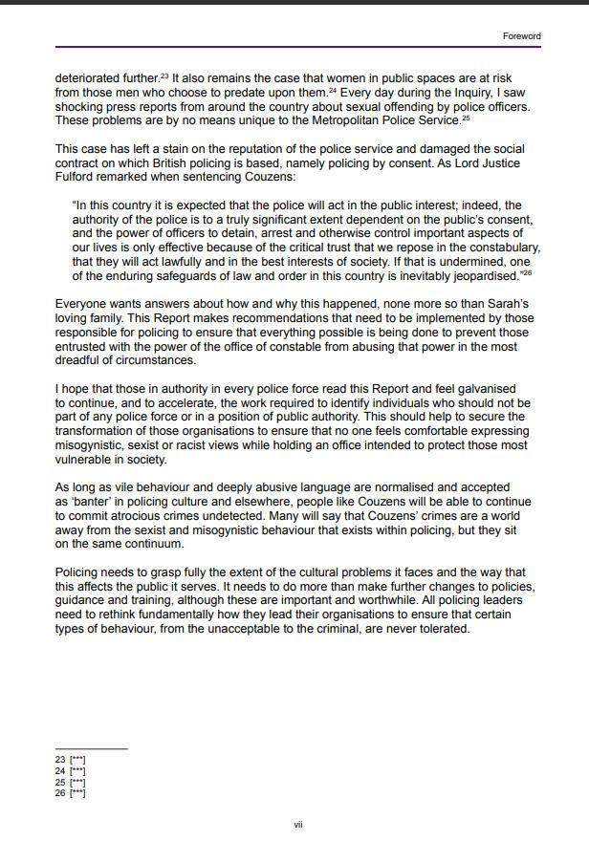

Slide 9
As long as vile behaviour and deeply abusive language are normalised and accepted as ‘banter’ in policing culture and elsewhere, people like Couzens will be able to continue to commit atrocious crimes undetected. Many people will say that Couzens's crimes are a world away from the sexist and misogynistic behaviour that exists within policing, but they sit on the same continuum

Slide 10
Policing needs to grasp fully the extent of the cultural problems it faces and the way that this affects the public it serves. It needs to do more than make further changes to policies, guidance and training, although these are important and worthwhile. All leaders need to rethink fundamentally how they lead their organisations to ensure that certain types of behaviour, from unacceptable to the criminal, are never tolerated.

Slide 11
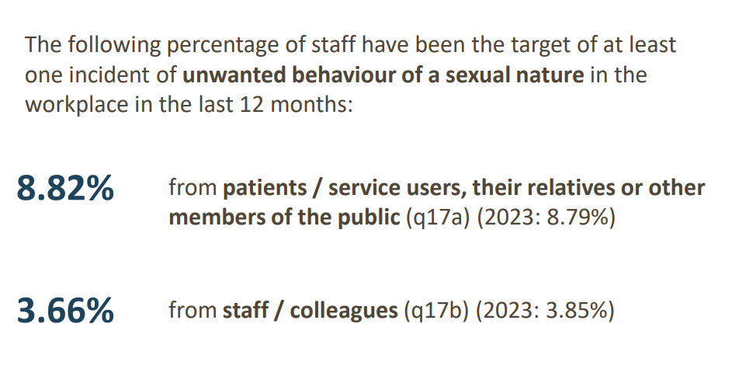
For those that are data driven...
www.nhsstaffsurveys.com/results

Slide 12
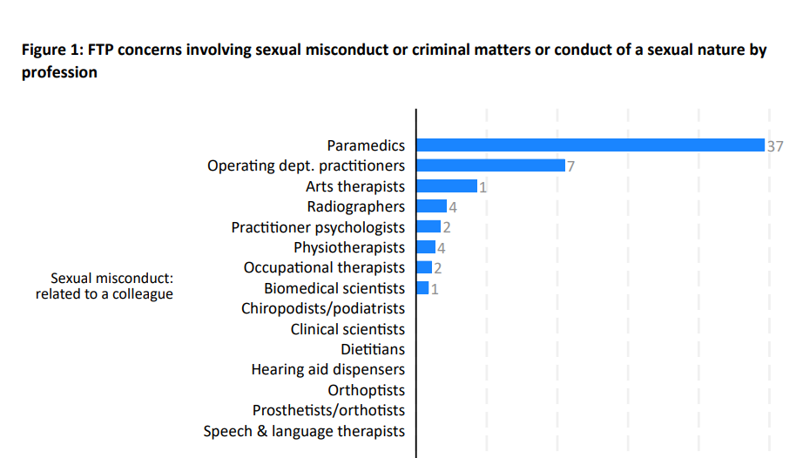
Fitness to Practice 2023/24
https://www.hcpc-uk.org/

Slide 13
GMC Publication
Of the 275 fitness to practice cases brought against doctors, nurses, midwives and allied professionals that included sexual misconduct, 232 of those related to sexual harassment or sexual abuse
It showed this commonly happened in general practice, surgical settings and mental health services
39% of these cases were about colleagues
(A 2019 report for the Professional Standards Authority)

Slide 14
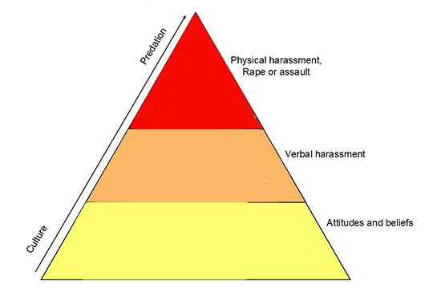
Sexual Safety Pyramid

Slide 15
Colleagues sharing sexualised photos on a work WhatsApp group

Slide 16
My colleague made a joke out of my underwear accidently being seen when I was bending down to treat a patient

Slide 17
My assessor said that they’d sign off my work in return for sexual favours

Slide 18
Unwanted compliments made by colleagues on my appearance

Slide 19
Unnecessary touching when being passed by a colleague, hands on my body

Slide 20
Being told that my chest looks great in my uniform

Slide 21
A colleague sent hundreds of unwanted messages to me, including porn and demanded to see my breasts

Slide 22
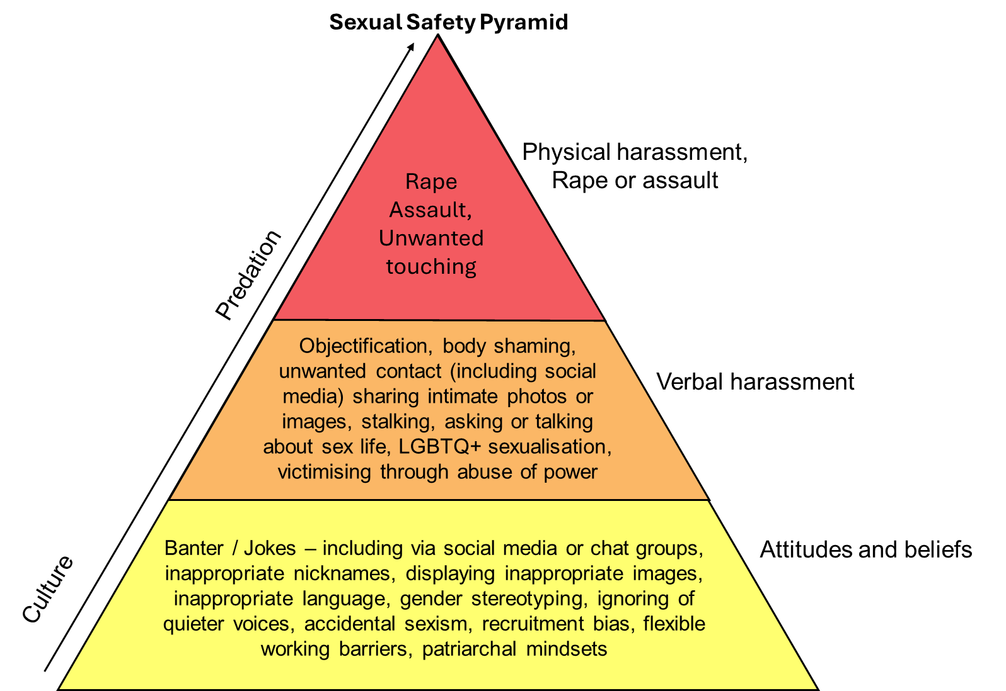
Sexual Safety Pyramid

Slide 23




Accountability & Awareness
Commitment to Organisational & Individual Learning
Confidential Reporting & Support

Slide 24
Leadership
NHS Forth Valley
Jo Tolland, Programme Director

Slide 25



Culture Change & Compassionate Leadership Programme
Our Continuing Journey
2023 - 2025

Slide 26





This is an opportunity for us to share our culture journey so far with a wider audience and highlight our learning and goals for the future of NHS Forth Valley.
We will explore how we created our Action Plan, which is based fully on the ideas and solutions of our colleagues who participated in a series of collaborative Design Workshops.
We will define our 8 project teams who have now taken ownership of the plans and are in the process of developing them further whilst honouring the work already completed.
We will discuss how we plan to continue to work collaboratively to build on the work of those who have participated in every step of our journey, as we work together to improve our culture.
Notes:
Session Overview

Slide 27




Our Programme Ethos
Notes:
This process started from conversations and surveys – we now have a plan which has been co-created by over 2000 colleagues.
Our intention and the values and goals we hold are central to it’s success so far.
Let’s continue to sustain the momentum and gather our supporters and champions around us to move forward.

Slide 28











Our Programme Roadmap
LAUNCH AND SCOPING PHASE
DIAGNOSTIC / DISCOVERY PHASE
SYNTHESIS PHASE
DESIGN PHASE
IMPLEMENTATION
PHASE
FEBRUARY 23 - APRIL23
MAY 23- JULY 23
AUGUST 23 - DECEMBER 23
JANUARY 24 - JUNE 24
JULY 24 ONWARDS
ELT EVENT
‘PITSTOP’
STAFF CONFERENCE
2022
Engagement
Marketing and Branding
Initial Communications
Culture Change Team Recruitment
Ongoing Promotion
Review of Engagement Methods
1:1 Sessions, Focus Groups, OOH Sessions and Targeted Events
Thank You Comms to Acknowledge Contributions
Programme Updates
Analysis of Findings
Sharing of Findings
Ongoing Wellbeing Support
Engagement Methods Reviewed
Variety of Design Workshops to Develop
Solutions in Collaboration
Initial Action Plan of Prioritised Solutions
Linking to Key Workstreams
Assigning Ownership
Continued Collaboration
Notes:
Key phases and milestones of the programme. A major achievement to get this far in the process and to have engaged so many staff from all parts of Forth Valley and the partnerships in the process.

Slide 29
Gathering our Data (1,210 colleagues)
Notes:
Scale of engagement across each phase – in addition 41 volunteers have now applied to join the project implementation phase.

Slide 30
Methods for Sharing our Findings (747 colleagues)
Notes:
Scale of engagement across each phase – in addition 41 volunteers have now applied to join the project implementation phase.

Slide 31
Turning Findings into Solutions (444 colleagues)
Notes:
Scale of engagement across each phase – in addition 41 volunteers have now applied to join the project implementation phase.

Slide 32
From Themes...to Workstreams
PROGRAMME THEMES
PROGRAMME PROJECTS
INVEST & CELEBRATE
DEVELOP OUR LEADERS
SAFE, WELL & HEARD
GREAT COMMUNICATION
LIVE THE VALUES
ATTRACT & RETAIN
LEARNING & CONTIOUS IMPROVEMENT
GET CONNECTED
Strategic Vision, Structure, Roles and Responsibility | Inequality, Fairness and Transparency
Leadership Behaviours | Living Our Values
Bullying and Incivility | Resources
DESIGN SOLUTIONS - VALIDATION &
PRIORITISATION
IMPLEMENTATION PLANNING
COMMUNICATION
The theme of communication threads through all of the overarching themes identified
Notes:
We have moved from themes to workstreams via Design – we are identifying the ‘clusters’ of solutions under key headings to address the issues by applying the design solutions. All activity will be groups under these workstream headings.

Slide 33

Collective Programme Goal
“Our collective aim is to identify those solutions which could have the greatest potential for positive impact on FV Culture - if effectively implemented!”
Notes:
Our mantra, purpose and criteria for solutions & workstreams identified through the Design process

Slide 34
Our Design Process
Stage 1 - Solution Design Sessions (3hr) x 7 Themes (April – May 2024)
Stage 2 - Validation & Prioritisation Sessions
(1hr x 14)
Define the problem
What does great look like?
How might we?
We could…
Solutions!
Stage 2 - Validation & Prioritisation Sessions (1hr) x 14 Sessions (June 2024)
Programme Action Plan
Validation
Review
Rank
Top 2
Ranked solutions & top 2
Notes:
Workshop Solutions are our key outcomes which were developed using a light-touch combination of a ‘Sprint’ solution design process based on the Scottish Govt Service Design process. The levels of energy, creativity and collaboration during this and all other phases have been humbling and overwhelming. We could not have achieved this without colleagues coming forward to get involved. Throughout we have been modelling the culture we aspire to as a programme. The design process allowed people to make new connections and share experiences from different roles and services – growing empathy and understanding as well as contributing to the delivery plan.

Slide 35





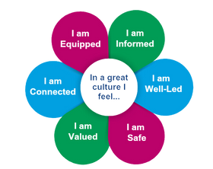





Our Projects
Invest and Celebrate
Develop Our Leaders
Safe, Well and Heard
Following the experiences and feedback you shared during the previous phases of the Programme, 8 key projects have been developed to progress the work needed to make the improvements we all want to see in our organisation.
Learning and Continuous Improvement
Great Communication
Attract and Retain
Live The Values
Get Connected

Slide 36










Implementation Phase - Project Roles
Culture Representative
Subject Matter Experts
Ensures the outputs of the projects are aligned to the findings and solutions which have been identified by colleagues throughout the Programme.
  Bring their various lived experience, skills and expertise to the project to ensure it’s fit for purpose and reflects our employee voice.
Deputy Culture Representative
Invest and Celebrate
Senior Representative
  Supports the Culture Representative to stay true to the Programme findings and approach. Can offer additional perspective of their experience of the Programme.
Develop Our Leaders
Safe, Well and Heard
  Brings their skills and knowledge to make operational links with a focus on requirements for implementing to business as usual.
Learning and Continuous Improvement
Great Communication
Programme Team Representative
Executive Project Sponsor
  Supports the Project Team to ensure key milestones are met and provides a link to the ongoing wider work of the Programme.
Attract and Retain
Live The Values
  Provides advice and joint problem-solving with a focus on enabling, empowering and clearing the path whilst being a senior ally.
Get Connected
Programme Director
Programme Sponsor
  Primary contact for all decision making associated with the programme and responsible for overall management of the programme. Has an overview of and links to wider local workstreams and makes connections.
  Approves the project structure to deliver the agreed aims and objectives and ensures adequate resources are made available to deliver the project within agreed costs and timescales. Has an overview of how the Programme fits with the bigger picture both locally and nationally.
Each project has a flat hierarchy with members contributing equally to the shared vision

Slide 37










Our Support Tools
Team Agreement
Project Tracking & Reporting Tool
Risk Register
Mapping
Senior Buy-In
Initial contracting between team members of each workstream to ensure effective collaboration and role modelling.
We manage, monitor and mitigate risk as part of our weekly programme team meetings and escalate via our governance structures as needed.
We continue to map our activity to make connections, acknowledge overlap, encourage collaboration and avoid duplication.
Although a bottom-up approach, senior buy-in has been crucial in helping us to extend timelines to ‘go slow to go fast’ and do things right versus just getting them done!
Keeps us on track! Our central repository for all Programme action logs, risk logs, issues and decision logs etc.
1
2
3
4
5
Notes:
Phased Mobilisation
Extended Timescales (Get it right Vs Get it done!
Collective Mobilisation Workshops
Connections & Overlaps
Tracking & Reporting
Escalation & Forward Planning

Slide 38
What Has Worked Well?
Diagnostic Phase
Synthesis Phase
Good engagement via multiple routes
Open & honest feedback with verbatim detail
Engagement of Culture Volunteer Team
Clear themes from comparison of data
Participation & support of culture volunteers & Subject Matter Experts
2-day process enabled participation and in-depth consideration of all the data
☺
Lack of representation from some key job families / areas
Data ambiguous due to question design
Lack of Data for some elements
Some additional data could have been useful but certainly enough for analysis
Not everyone was able to attend for the whole 2 days due to conflicting priorities
😐

Slide 39
What Has Worked Well?
Design Phase
Implementation Phase
Collaborative & inclusive approach
Extended timing
SG Service Re-design approach
Excellent solutions identification enabling development of action plan
Leadership & Representation roles
Bringing new energy, ideas, enthusiasm and determination
-Forming teams and working across services, hierarchies and job families
☺
Under-representation in some key areas and bands
Changes in leadership during this period
Service pressures on staff participation
Virtual sessions less successful
Resources stretched
Challenging to engage all areas and levels
Challenge to prioritise and commit with conflicting demands
Clarity re route to Business As Usual
😐

Slide 40
RECOGNITION & ACCEPTANCE
PERSISTENCE & PERSEVERANCE
TRUST, SUPPORT & BELIEF
INDICATORS OF CHANGE
HOPE & OPTIMISM
CREATIVITY & IMAGINATION
COLLEAGUE ENGAGEMENT
OPEN, HONEST & TRANSPARENT

Slide 41
RISK MANAGEMENT & MITIGATION
EXECUTIVE FLEXIBILITY & ADAPTATION
STAFF-SIDE INVOLVEMENT & SUPPORT
KEY ENABLERS
DEDICATED CORE PROGRAMME TEAM
SOUND & CONSISTENT GOVERNANCE
COLLABORATIVE DESIGN APPROACH
CULTURE VOLUNTEERS & SUBJECT MATTER EXPERTS

Slide 42
Scrutiny / Accountability
NHS Board
Governance / Escalation
Staff Governance
Programme Board
Delivery
Executive Sponsors
Culture Change Team
Steering Group
Programme Team
Implementation / BAU (Phase 1)
Project Team 1
Invest and Celebrate
Project Team 2
Safe, Well and Heard
Project Team 3
Great Communication
Project Team 4
Living Our Values
Implementation / BAU (Phase 2)
Project Team 5
Develop Our Leaders
Project Team 7
Learning and Continuous Improvement
Project Team 8
Get Connected
Project Team 6
Attract and Retain

Slide 43

The over-arching Goals of the Programme based on Staff Feedback
Notes:
What does good look and feel like? How will we know we’ve succeeded? When our colleagues feel like this everyday.

Slide 44


FV.culture@nhs.scot
Notes:
What does good look and feel like? How will we know we’ve succeeded? When our colleagues feel like this everyday.

Slide 45
Equalities
Public Health Scotland
Manira Ahmad, Chief Officer
Dr Rishma Maini, Consultant in Public Health Medicine

Slide 46




RACISM AND RACIALISED HEALTH INEQUALITIES
RACISM
  Structural
  Institutional
  Interpersonal
  Personal/internalised
SOCIAL DETERMINANTS OF HEALTH AMONG SOME GROUPS
  Socioeconomic status
  Living in urban areas
  Poor and overcrowded housing
  Low-paid, high-risk occupations
  Cultural barriers to healthcare
HEALTH INEQUALITIES AMONG SOME GROUPS
  Higher burden of chronic disease risk factor (e.g. Cardiovascular disease, Obesity and Diabetes)
ADDRESS HEALTH OUTCOMES AMONG SOME GROUPS
  Excess mortality and morbidity

Slide 47




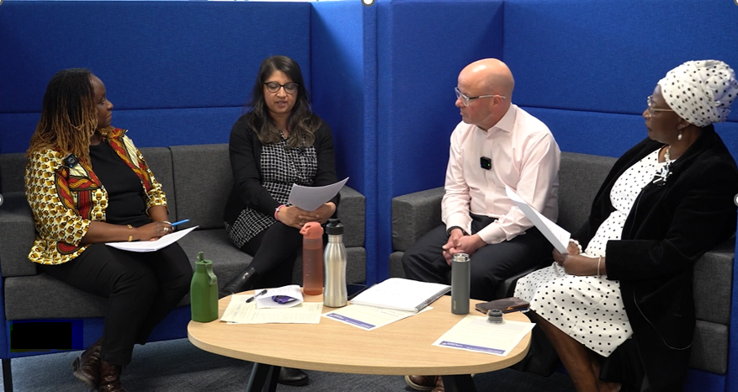
THE PHS JOURNEY
  Coalition for Racial Equality & Rights (CRER) conducted internal review of racism: February 2024
  All senior leaders attended anti-racism workshops
  Facilitation guide for managers to encourage discussion and conversation of anti-racism within teams/departments
  Development of an internal anti-racism learning programme for entire PHS workforce
  Rolling out anti-racism learning & development for all workforce
  Developing anti-racism resource library on staff intranet
  CRER returning in October 2025 to assess progress
  Review and revise Anti-Racism Development Plan in early 2026 to continue our anti-racism journey
ACTIONS COMPLETED
NEXT STEPS
GROUP PHOTO
Notes:
Anti-Racism Steering Group and representatives from PHS’ Minority Ethnic Representation Network (MERN) develop Anti-Racism Development Plan outlining the actions we will take to address the findings and recommendations of the CRER review – October 2024
Executive Team (ET) have an anti-racism objective in their PDPR

Slide 48





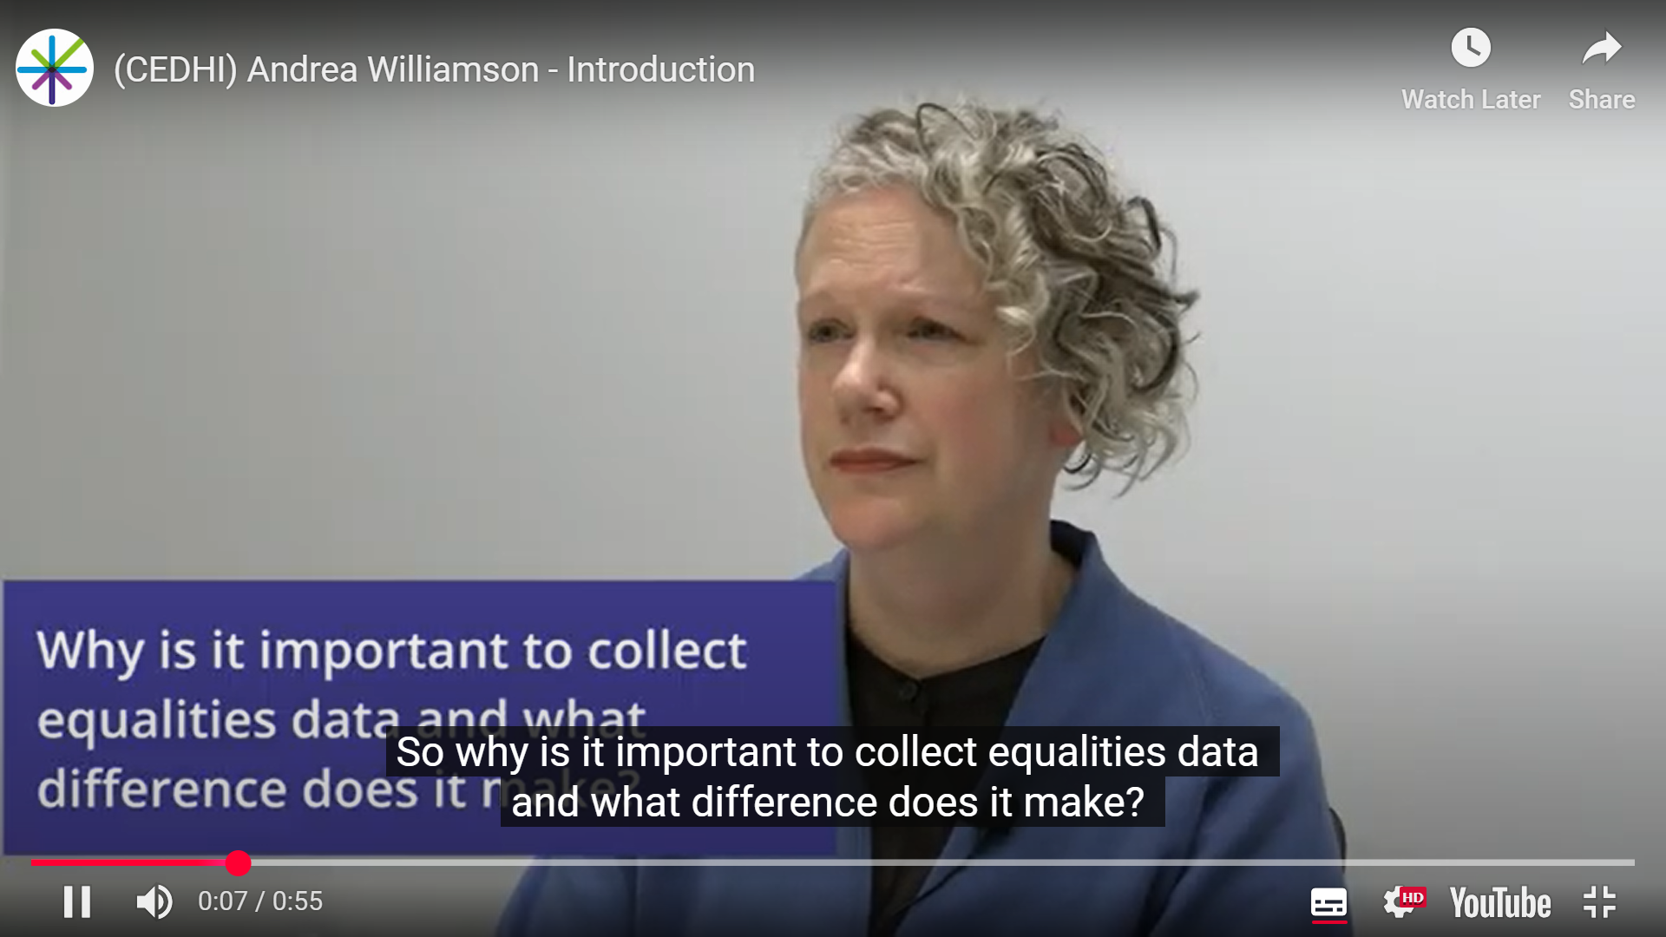
IMPROVING DATA
Equalities data collection resources to improve working culture in asking for equalities data
Watch the video from Prof Andrea Williamson on why collecting equalities data is important
Staff Booklet
Patient Booklet
Video Link: here
Notes:
Two information booklets to support the collection of equalities data:
one for staff
one for patients
'How to collect patient equality and needs data' learning hub for staff.
Produced using evidence gathered via engagement with the public, NHSScotland staff and the third sector.
Using data linkage to maximise the power of available data to identify and monitor racialised health inequalities.

Slide 49





CODE OF PRACTICE
Public Health Scotland is taking steps to ensure the safe and appropriate use of race and ethnicity data, including developing a Code of Practice for PHS staff on the collection, analysis and reporting of race and ethnicity data.
EMBEDS
ANTI-RACIST APPROACH TO DATA
OUTLINES STATISTICAL GOOD PRACTICE
ADDRESSES RISKS & SAFEGUARDS
REVIEWED BY EXTERNAL ANTI-RACISM EXPERT
CODE OF PRACTICE

Slide 50


COMMISSIONED REPORTS
In 2024/25, PHS commissioned two reports to further inform the Racialised Health Inequalities programme, as well as broader policy and practice.
AN INTRODUCTION TO RACIALISED HEALTH INEQUALITIES
A resource to help public sector professionals understand the fundamental concepts and correct terminology to use when speaking or writing about racism and racialised health inequalities
SCOTTISH EVIDENCE RAPID REVIEW
A systematic review to provide insight into the racialised health inequalities experienced in Scotland

Slide 51
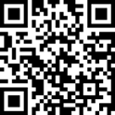
Question Time
via Slido
Slido code for Q&A Session OR
https://www.slido.com/
and enter the code
NHSScot2025
Email feedback to: LCW@gov.scot

