Slide 1
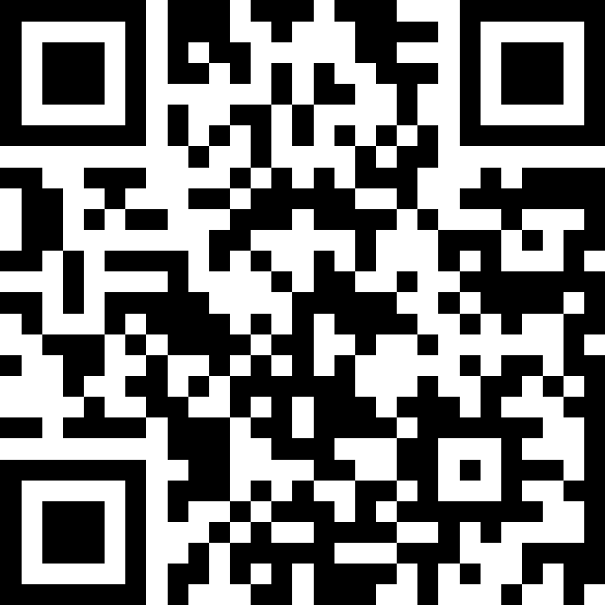
Transformation and Renewal: Delivering a Digital First Approach
Slido – QR Code

Slide 2




Reform and Renewal – Digital First
“Deploying … the first version of a personalised digital health and social care service which, over 5 years, will provide digital notifications, access to personal health information, and options for interacting online with health and social care services.”
“improve the care and wellbeing of people in Scotland by making best use of data and digital technologies in the design and delivery of services’
“Greater access, better insight, improved outcomes: a strategy for data-driven care in the digital age”
“new, better and more sustainable ways of delivering services and improving access for patients…helping patients have access to appropriate, clinically relevant information, to inform their decision making.”
Digital Front Door Programme
2
Notes:
Aligns to key strategic drivers across Health and Social Care, and will directly contribute to H&SC Reform and Renewal

Slide 3

Why do we need a Digital Front Door?
What’s going on?
Childcare
Planning and making time
Managing my health
Public transport
Not enough time
Not enough info
Letters
Complex care
Unpaid care
Waiting
Time off work
I have a complicated life
and it’s difficult to understand the system
Digital Front Door Programme
3

Slide 4

What is the problem we are trying to solve?
Worsening health
Missed appoint-ment
Duplication
Postage costs
Cancellations
Missed letters
Chasing
Lost earnings
Waiting lists
Delays
I don’t want to cause problems, but it can be difficult to manage my health and care
Digital Front Door Programme
4

Slide 5

The vision…
Access information in a way that suits me
I can get the right support
I’m managing my data and care
I’m informed
I’m advocating for myself
I feel in control
I can cancel in plenty of time
I get my letters
Trust
What I need is in my hand.
Digital Front Door Programme
5

Slide 6
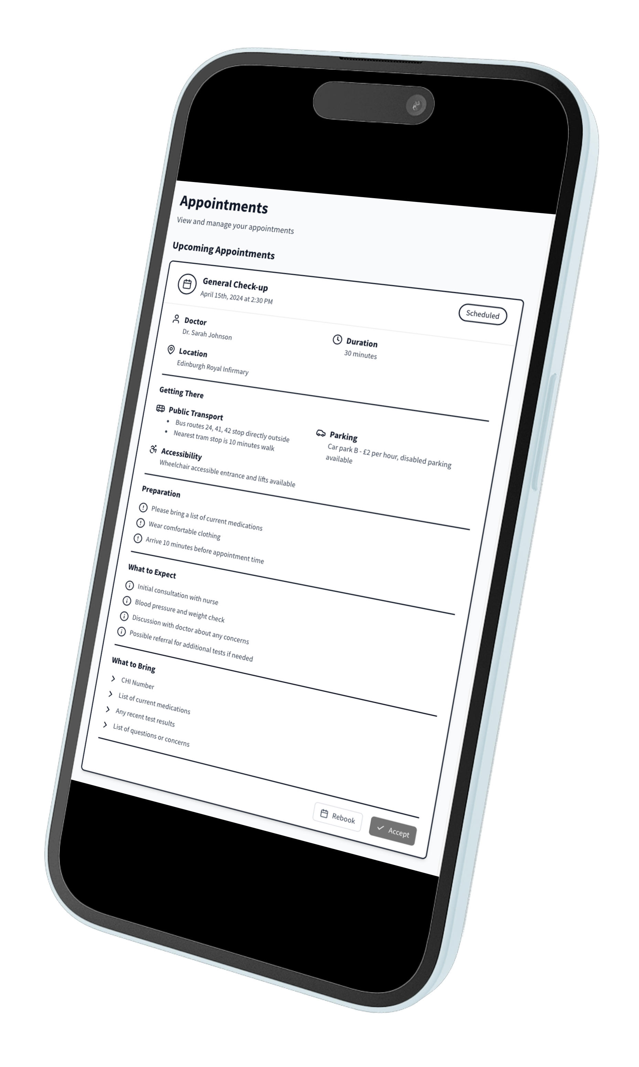
What is Digital Front Door?
Secure, digital access to data, information and services for all people in Scotland across multiple channels
For Health and Social Care
Announced by First Minister and will be launched in 2025
Initial focus on app delivery
Once for Scotland approach
Ambitious and exciting transformation programme
Digital Front Door Programme
6
Notes:
The Digital Front Door is a nationally delivered, locally integrated service platform
Different to NHS App in England as that is only for NHS services, in Scotland DFD is a programme for Health and Social Care
DFD will be Once for Scotland to maximise transformation opportunities and benefits
DFD is the name of the delivery\transformation programme, the products that users will use will have a different name

Slide 7
Tranche 1 (Initial Release) Overview
Identity
Digital Communications
Initial release in NHS Lanarkshire by Dec 25
Deliver core digital capabilities centred on outpatient appointments for Dermatology
Digital Identity required to underpin safe access to data and services
Appointments
Health & Care Record
Demographics
Service Finder
Digital Front Door Programme
7

Slide 8
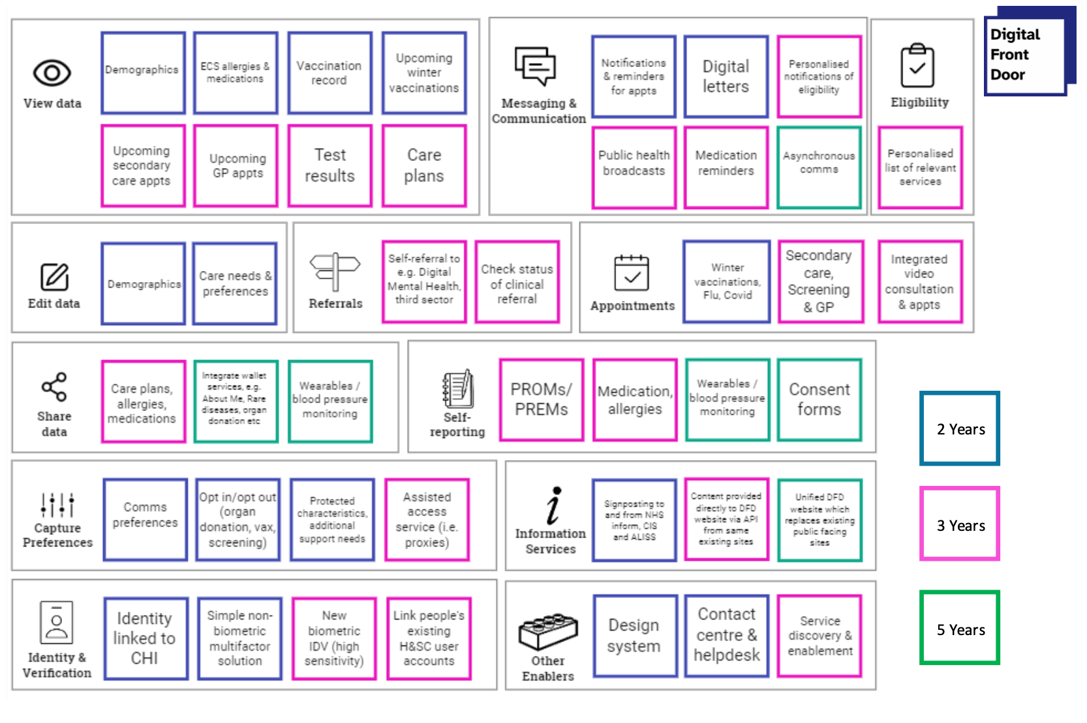
Longer Term Ambition
8
Notes:
Specific priorities and timings to be scheduled

Slide 9

Roadmap
Our initial release will allow us to collate feedback, measure impact and consider learning
We will identify and implement additional service areas collaboratively, developing them through a Service Development Framework
We will prioritise impact and need
A continually maintained DFD roadmap will show ongoing enhancements of DFD capabilities and features, as well as new service areas
Digital Front Door Programme
9

Slide 10


What you can do….
Champion conversations about DFD, digital first and transformation in your organisation and other care settings
Visit our DFD Sharepoint site from next week where you can find more information
Look out for more information on how you can actively get involved - we want to hear from you!
Digital Front Door Programme
10

Slide 11
Thank you for your time
Further discussion in the panel session
Digital Front Door Programme
11

