Slide 1
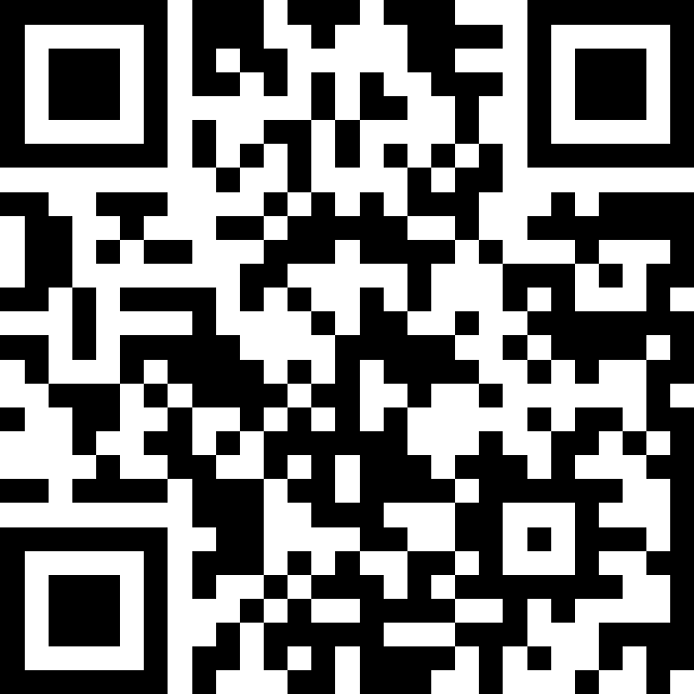
Launch of the Chief Medical Officer for Scotland's Annual Report
Slido – QR Code

Slide 2
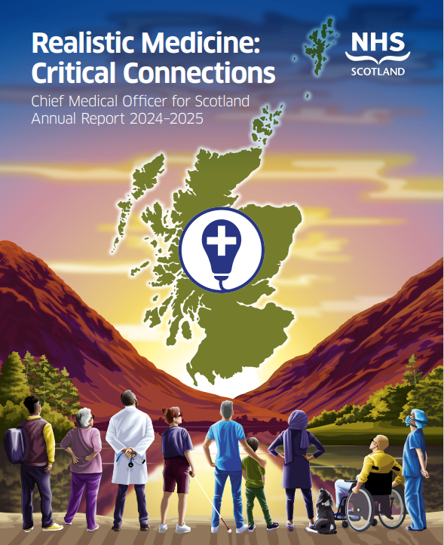
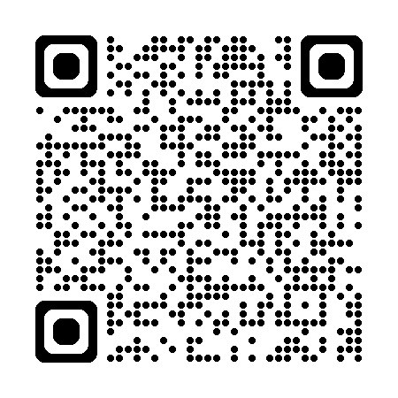
Ai
Submit questions at
slido.com
NHSScot2025
Access the report
with this QR code

Slide 3
Context
Burden of disease predicted to rise by 21% by 2043
People living in Scotland’s most deprived communities live more than a third of their lives in poor health
Premature mortality rate declined steadily from the late 1990s to around 2014- this progress has now stalled
Scotland continues to have the lowest life expectancy of UK countries.
Notes:
CONTEXT
The health and wellbeing of the population lie at the heart of our prosperity; it must continue to be an aim to reduce preventable disease and enable everyone in Scotland to live in good health for as long as possible. Improving and sustaining health requires action across multiple areas to influence the wide range of factors that determine our health.
It requires a shift in culture from illness management to prevention, and a shift towards a more whole-system approach to prevention with greater emphasis on strengthening the fundamental determinants of health across society. I am convinced that this broad approach is necessary if we are to reduce the significant burden of preventable disease experienced by our population now and the anticipated increase yet to come. Why? Because:
Burden of disease predicted to rise by 21% by 2043 → Opportunity now to prevent ill health in the future by practising RM and delivering VHB&C
People living in Scotland’s most deprived communities live more than a third of their lives in poor health compared to around 15% in the least deprived areas.
The leading causes of health loss are also where the greatest health inequalities are found - While the premature mortality rate (considered as deaths occurring before the age of 75) declined steadily from the late 1990s to around 2014, this progress has now stalled or even reversed- particularly in our most deprived communities.
Scotland continues to have the lowest life expectancy of UK countries.
Smoking remains a significant risk factor for cardiovascular disease, cancer and vascular dementia.
Obesity remains a major risk factor for type 2 diabetes, cardiovascular disease, cancers and other causes of ill-health, and the problem is growing
Evidence from the Scottish Health Survey suggests that following two years of decline, adult mental wellbeing improved in 2023, but remains lower in deprived groups.

Slide 4
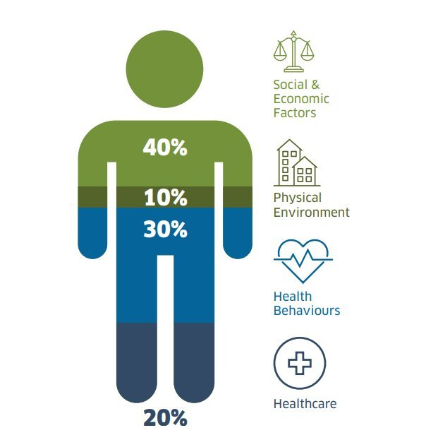
Notes:
THE CASE FOR PREVENTION
We will always have a role in managing ill health when it occurs, but we need to refocus our efforts on prevention of disease- less time in the repair shop, and more time focused on prevention.
We have a moral duty to do so.
Around 20% of what we do in healthcare at present contributes to overall health. 80% is made up of other factors.
That does not mean that we as healthcare professionals aren't responsible for influencing that- we need to think differently and practice differently to maximise the influence we have on that 80% for the people we care for.

Slide 5
“When we try to pick out anything by itself we find that it is bound fast by a thousand invisible cords that cannot be broken, to everything in the universe.” – John Muir
Notes:
CONNECTION
So how do we shift focus away from the repair shop to a whole system focus on prevention?
Connection to the people we care for, to each other and to our planet is absolutely critical:
Connection is the critical to understanding and supporting the people we care for to live longer, healthier lives by focusing on disease prevention and healthy ageing.
Connection is critical to tackling loneliness.
Connection with nature improves our wellbeing.
Connecting the teams we work with and the communities we serve is the key to better job satisfaction.
At the 78th World Health Assembly of WHO in May 2025, member states approved a first ever resolution on fostering social connection for improving health and its essential role in addressing loneliness, social isolation and inequities in health.

Slide 6
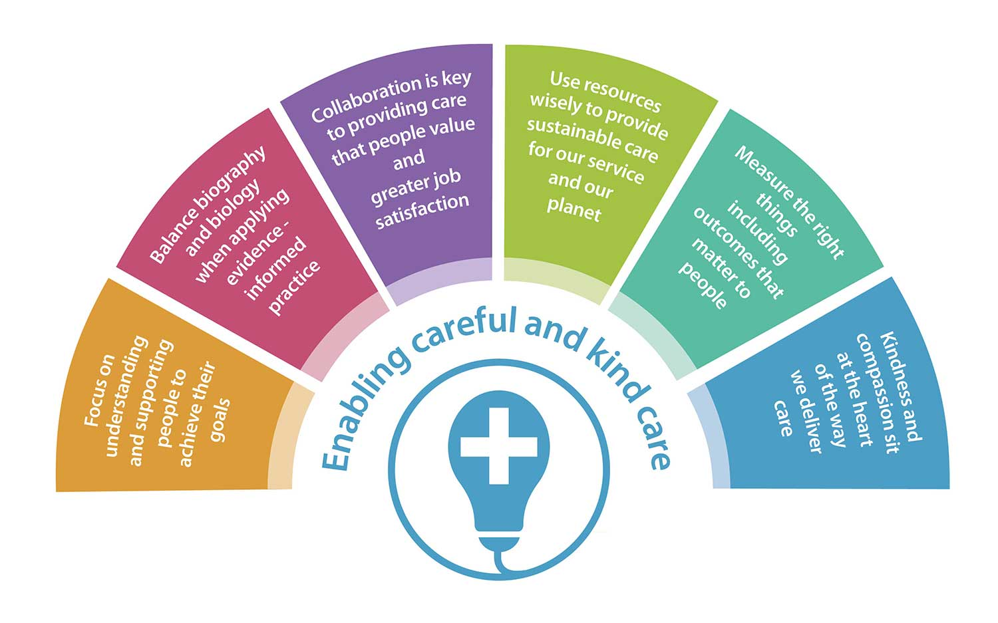
Notes:
PRINCIPLES OF CAREFUL AND KIND CARE
Fostering and maintaining connection with the people we care for goes hand in hand with careful and kind care:
We can apply the principles of careful and kind care to promote and maintain connections for health and wellbeing.
This is not just "nice to do"- the evidence tells us it is vital.
Lancet Commission on Dementia 2024 tells us that 45% of case of dementia are potentially preventable. Whilst age-related case rates are falling in high-income countries due to management of risk factors such as smoking and hypertension, there is more to do in terms of addressing social isolation, loneliness and allowing promoting healthy ageing to reduce individual risk.
We must change the way we deliver care to consistently provide careful and kind care, recognising the critical importance of continuity and relationship-based care in accounting for the biography as well as the biology of the people we serve. This can only be done as equal partners with our communities, viewing each person’s individuality and connecting with them through trust, continuity and shared decision making
Let me explain why and how....

Slide 7
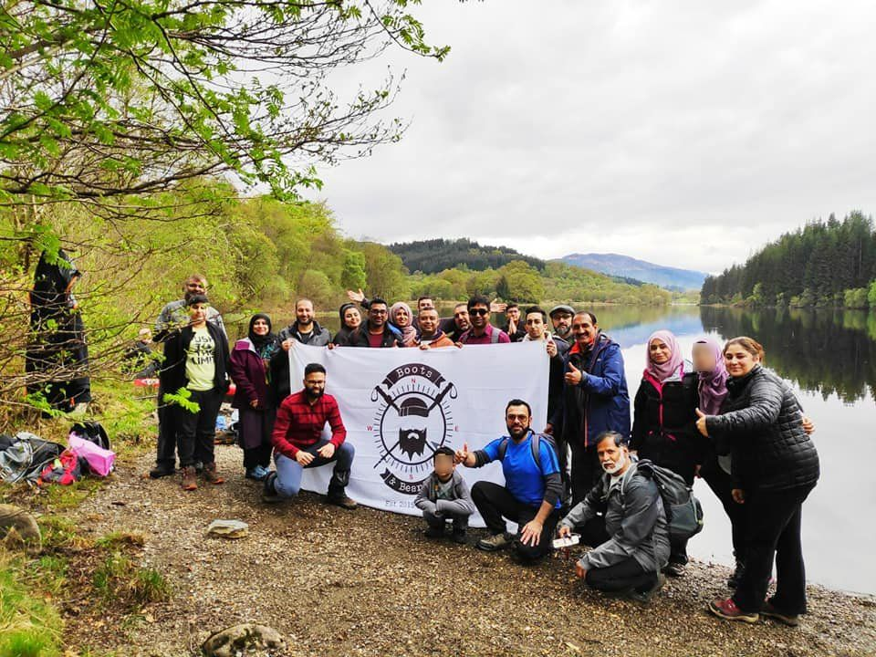
Notes:
OUR PLANET FOR OUR HEALTH
The triple planetary health crisis – climate change, loss of biodiversity and air pollution – remains the greatest threat to human health this century. It is a public health emergency, where healthcare systems around the world contribute substantially to the problem, producing around 5% of carbon emissions globally
For several years, I have highlighted the interconnected nature of the population health challenges we face, and the need for urgent action to address the unfolding planetary crisis to lessen the human health impacts that will follow. We must therefore look for the intersecting approaches that enable us to meet these interconnected challenges.
Connection is not only the key to understanding and supporting the people we care for to live longer, healthier lives, connection with nature improves our wellbeing.
Scotland is truly beautiful, and a resource we don't yet fully utilise for the benefit of our health. Our natural environment is an invaluable resource which we can harness to improve the health and wellbeing of the people we care for, the communities we serve, and our planet.
(Example of Loch Katrine diversion by Victorian Townplanners to reduce cholera. )
Evidence shows that exposure to nature-rich green spaces (prominently featuring vegetation such as grass and trees) and blue spaces (prominently featuring water including lochs, rivers and seas) can make a significant positive contribution to physical and mental health, and that these begin at the very start of the life course. Children and young people want spaces that are close to home, interesting and varied and include nature. They want to feel that they are safe and welcome in those spaces and that the space is valued and maintained
Social prescribing enables the people we care for to access a range of non-clinical services in their local communities. It can be used alongside traditional healthcare interventions such as medication for the betterment of health in a holistic way. Social prescribing offers us ways of enabling those we care for to benefit from nature.
Community organisations like Boots and Beards who you see here are enabling able people to use the natural world to improve their health and wellbeing through the provision of group exercise activities, including guided hill walks
In my report I talk about this in more detail as well as the need for:
Better use of NHS Greenspace
Promoting and facilitating physical activity in our communities
Empowering the people we care for to access help and support themselves- preventing the over-medicalisation of care.
Just as we as individuals do not exist in isolation, human and planetary health are intertwined. We are part of an interconnected ecosystem and whether it be new approaches to sustainable agriculture, materials or healthcare, this innovation is well established across Scotland.

Slide 8
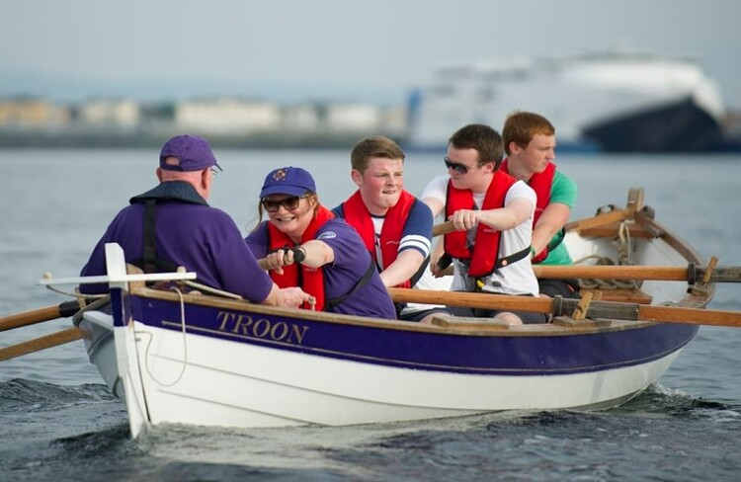
Notes:
HEALTHY AGEING
Connection binds us together. It shapes relationships, ideas and even the course of events over time. Connection fuels empathy, sparks creativity and helps to bring meaning to our lives. Social disconnection and detachment, however, can have wide-ranging and serious effects, impacting on our mental and physical health and our sense of wellbeing
There will be more older people and fewer younger people by 2047, and that is often held up in terms of challenges to health and care system.
But it is worth emphasising the benefits for everyone in a society which promotes and facilitates healthy ageing. By proportion, older people contribute more in volunteering and in childcare and also provide a significant proportion of unpaid care. Overall, they are net contributors to the economy (even after considering the costs of health and care) through their spending and their unpaid contributions through volunteering. The contributions from older people to the UK economy were estimated to be worth £40 billion per annum in 2011, and by 2030 are expected to rise to £77 billion.
Furthermore, in 2015, it was estimated that the unpaid contributions of older people across the European Union (EU) could be worth as much 1.4% of GDP, more than the defence spend of any EU country at that time.
If we can connect across the generations, what we stand to gain is truly exciting.
We need to recognise the opportunities that realigning our connections with each other presents in terms of realising healthy older age for everyone.
At a time when economies, healthcare systems and societies internationally are adjusting to a post-pandemic world, we must fully appreciate and capitalise on the contributions of our older people.
If we do that, we can benefit from the wisdom, experience, coaching roles in the workplace and voluntary contributions of older people.

Slide 9
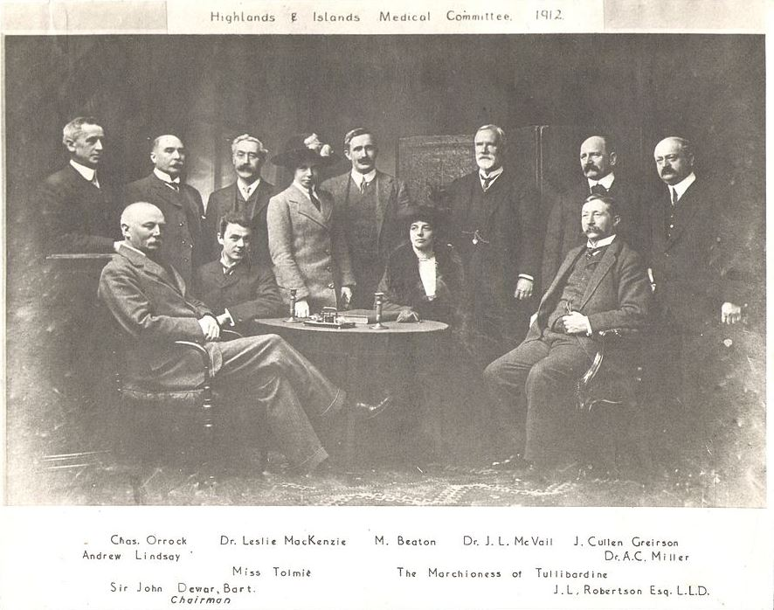
“It is more important to know what sort of person has a disease than to know what sort of disease a person has.” — Hippocrates
Image sourced from: Dewar Report – Scottish Rural Medicine Collaborative
Notes:
OUR PLACE IN OUR COMMUNITIES
Thirty-five years before the formation of the National Health Service in 1948, Scotland led the way in creating a state funded healthcare system to serve the specific needs of its remote and rural communities. Ballachulish GP, Dr Lachlan Grant’s evidence to the 1912 Dewar report highlighted the plight of those needing medical care in the crofting communities who, with no regular income, were not covered by the National Insurance schemes of that time. The resultant launch of the Highlands and Islands Medical Service provided medical care to over 300,000 people, over an area covering more than half of Scotland’s land mass, for the first time. This network of expert medical generalists embedded in their communities, practising according to local need, formed the foundations of what we would now recognise as the modern General Practice and served as a model for others around the world, including the NHS.
Over a century on, the challenges we face in healthcare have changed, but the importance of our relationship with the communities we serve has not. Given the increasing health needs of our population, driven by the growth in non— communicable disease and exacerbated by the pandemic, coupled with increasing societal expectations for convenience and immediacy, it is perhaps understandable that the speed of access to healthcare has become our primary focus. However, I am concerned that continuity of care, and the benefits that relational care brings both for those being cared for and for our wider system, are at risk of being compromised as a result.
As a GP, I had the privilege of relational continuity with the people I cared for and highly valued these relationships. The human connection fostered through relational continuity is not only professionally satisfying but is simply vital, if we are to truly understand the sometimes complex needs of people we care for. It is the polar opposite of industrialised, transactional care and not just a mechanism for healthcare delivery. There is a growing body of evidence that relational continuity of care positively influences clinical outcomes for people across the life course. GPs offering relational continuity identify more people at risk of cardiovascular events who will benefit from statins.
People living with diabetes have better glycaemic control when they have relational continuity with their health and care team. In our older population, people living with dementia who have good relational continuity with their GP have been shown to have 10% fewer hospital admissions, 35% fewer episodes of delirium, and 57% less incontinence. I’ve shared this quote with you before, but it sums up relational continuity perfectly: “It is more important to know what sort of person has a disease than to know what sort of disease a person has.” — Hippocrates

Slide 10
Notes:
Having considered the benefits of rebalancing services to focus on longer term human relationships, we should also consider how redesigning services to foster more meaningful relationships will benefit wider society too. In Scotland, clinicians have long enjoyed a position of public trust, which is essential in allowing us to serve our communities well. However, if we are to retain that trust, we must also be ready for the changes and challenges that lie ahead. As health and care professionals we cannot, and must not, fall into the trap of inadvertently becoming distant from the people we serve.
We must value the relationships not only with those that we care for in our consulting rooms, theatres and wards, but also our relationship with the public more widely. The word “doctor” is derived from the Latin “docere” which means “teacher”. Regardless of our profession, we all have a role in teaching and educating the public about their health. This role has never been more important than it is now
A CALL TO ACTION
Connection is critical to achieving the outcomes that matter in terms of the health of the people we care for, our planet and ourselves as healthcare professionals.
Allowing the value and role of the human relationship to be eclipsed by technological advances risks giving way to transactional, industrialised care to the detriment of everyone.
We must not let that happen.
Practising Realistic Medicine and delivering careful and kind care can ensure that it does not.
Thank you. You'll get the chance to ask me some questions soon.

Slide 11
Ai
Submit questions at
slido.com
NHSScot2025
Access the report
with this QR code

Slide 12



Embedding Prevention and Proactive Care in Angus
Working in partnership to support our communities to stay healthy, happy and independent for as long as possible
Notes:
Prevention & Proactive Care Steering Group formed in 2022 following £500k investment from ASHCP, AC and AA
Test of change pilot to move towards a more preventative way of working in Angus, primarily focusing on non-pharmaceutical interventions

Slide 13
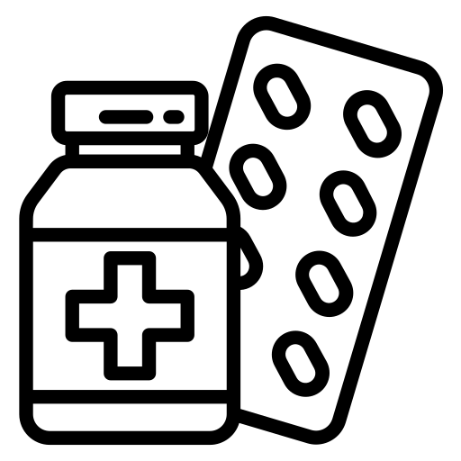

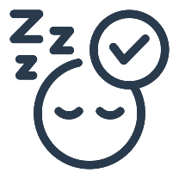



physical activity
Sep 14
Oct 28
increased self-esteem
Aug 10
Wonder Drug!
Sep 18
Nov 4
Dec 1
improved sleep
Today
Aug 2
Aug 19
Sep 28
Nov 11
Dec 15
2016
Oct 22
2016
Sep 7
Oct 9
Nov 1
improved mood and overall wellbeing
increased social connection
reduced risk of further
ill-health
Notes:
Hopefully this is an easy one for everyone in the room, but if there was one thing that could provide us with all of these amazing outcomes, wouldn’t we want to share it!

Slide 14









prehab & rehab before / after treatment
Support people to look after their own health in a way which is manageable for them
injury
health event
Improving physical,
mental health and wellbeing
long term condition(s)
mental health
Creating opportunities to live well
obesity
inactivity
at risk of long term condition(s)
Notes:
BALW supports a vast range of people to be more active – perhaps following health event or those diagnosed with 1 or more LTC, or those who are at risk of developing LTC
Physical activity contributes to a number of HSCP priorities as well as those within the Angus Community Plan
Overarching aim is to support demedicalising healthcare and treatment in Angus

Slide 15

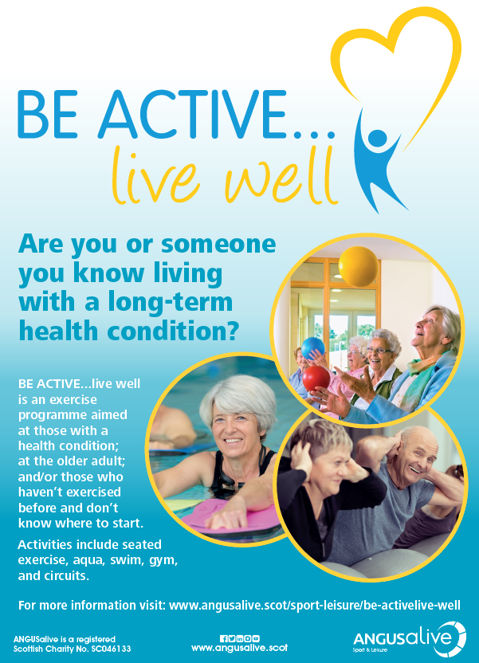
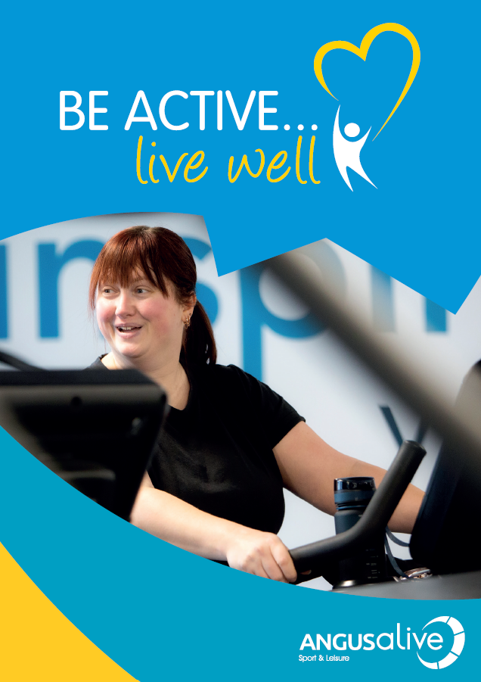
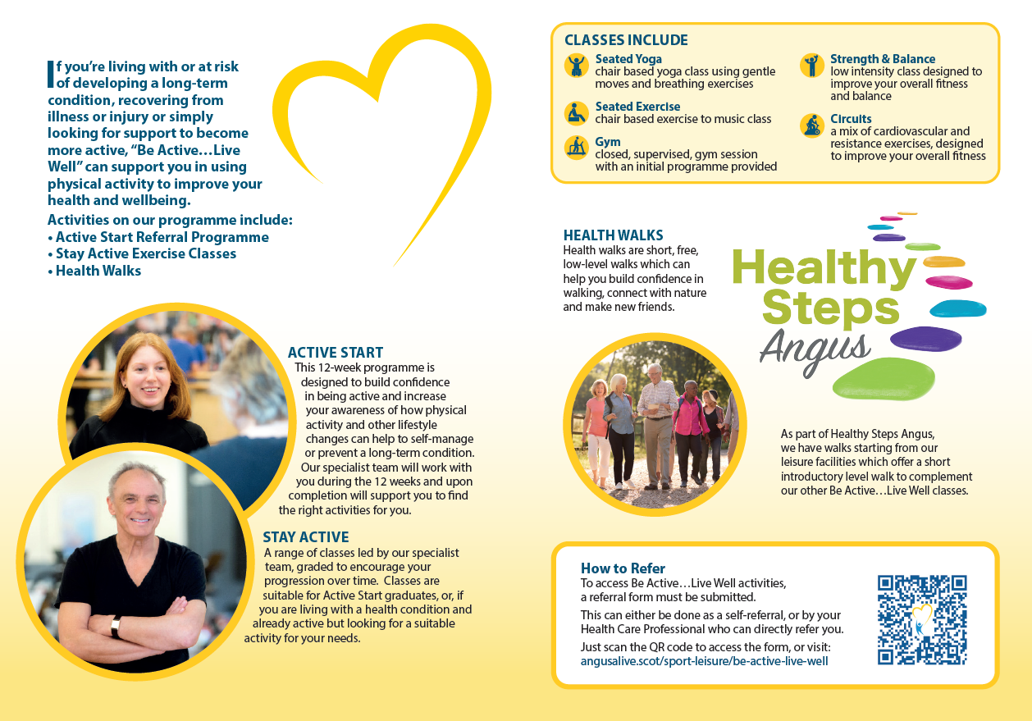
The Be Active…Live Well journey so far...
2003 – 2024
Exercise referral has evolved over the years
April 2024
Delivery of revised pathway underway
December 2024
Funding secured until March 2027
February 2024
Refer-All implemented
March 2025
Initial 12mths complete –onwards & upwards!
June 2023 – Jan 2024
H&W Team recruited
Ongoing engagement with partners
Programme evaluated & revised
Notes:
P&PC provided opportunity to evaluate and revise the BALW programme
Partnership working has been key to this process – both to identify new relationships and training opportunities, but also to ensure the referral process and programme fits the need
Investing in Refer-All to manage the referrals was a key investment and will provide robust reporting
Delivery of the revised pathway started in April 2024 and was secured through PPC until March 2025
December we were successful in securing funding until March 2027 which gives us 3yrs to test
------
Part of this was speaking to existing participants and looking at the marketing of the programme – very much targeted towards older adults and as we all know, health does not discriminate against age, so we decided to refresh the imagery being used to encourage people of any age to seek support through the programme

Slide 16





HCP Referral or Self Referral
Refer On / Signpost
No LTC / risk
Currently engaging in PA at levels above Live Well sessions
April 2015
3
Active Start (free)
12wk structured programme offering medium-high level support
April 2015
3
Stay Active (paid)
Low-level support / maintenance classes for people living with LTCs
Independently Active
Mainstream / Community Activity
Notes:
Shows Be Active Live Well as it was, with the paid pathway
------
Active Start forms the new pathway offering a greater level of support and supports health behaviour change, programme aligns with PARS
Programmes are not condition specific, but journey is person centred
Designed to build confidence and reassurance to encourage activity
Aim is to reach point of being independently active, whether with us or in the community
Healthy Steps Angus is ANGUSalive’s health walks programme and has also had investment from P&PC and forms an integral part of BALW and supports our aim to supports inclusive activity for all

Slide 17

957
referrals
received
1st April 2024 – 31st March 2025
60% professional referrals
45% Physio teams; 16% Mental Health Teams; 14% GP Practices; 14% Community Link Workers
35% SIMD q1&2 22% aged 16 - 44yrs 38% male
Leading conditions include: MSK, Respiratory, Hypertension & Mental Health
11 Active Start classes
217 currently participating / completed
35 Stay Active classes
375 currently participating / completed
Improved wellbeing (WEMWBS score)
Increased mobility
Increased physical activity levels
(IPAQ score)
Notes:
It’s been a busy first year!
Previously we saw around 300 referrals to the programme annually, so huge increase
The stats provide us with information on where we can improve, who is or isn’t referring, and we can use this for targeted approach
For example, we know the LTCs will increase with age and therefore naturally older adults account for the majority of referrals
Therefore, it’s encouraging to see younger adults coming through
Professional referrals include physios as you’d expect, and GPs, Community Link Workers (social prescribers), but it’s great to see mental health teams increasing on their referrals - this includes 3rd sector peer support and alcohol & drug services
Our other referrals come from social work and employability teams who often engage with vulnerable or at risk people
Leading conditions won’t be a surprise, we’re also seeing mental health increasing as the primary condition
------
Figures shown are just from those referrals during that time – as months progress, we are seeing a shift in the people referred being more appropriate for Active Start as referrers learn about it
------
About to undertake analysis of the 1st year data to better understand the impact and any correlations but already seeing positive outcomes at this stage

Slide 18

“I went from not leaving the house to signing up for the class and able to get the train by myself.
I'm now wanting to do more classes and have gained more confidence.”
“I felt good getting out the house and meeting new people.”
“Improved confidence - I can walk across the roads, too anxious to do this before.”
“It has encouraged me to regularly exercise and be more active.”
“My pain level has come down since I came to classes and feel more energetic since I started the classes and makes me feel more positive.”
“More energy after the class and kept motivation high after also attending PR.”
Notes:
Data is great, but as we are using a person centred approach to provide support, the qualitative impact is the most important message
These comments have all been fed back from the 12wk questionnaire when asked if they felt Active Start had made a difference to their health
Another I’d like to share from an Active Start participant:
“My family moved to Montrose 2.5yrs ago and I have been unable to walk down to the beach. Just before my last class I managed to walk down to the beach and back up. This is probably my biggest health achievement in over a decade. I believe that I will be able to reduce reliance on my wheelchair and open up my social opportunities.”
Stories such as these show just how powerful a physical activity intervention can be, and shows those outcomes we saw in an earlier slide coming to fruition for people

Slide 19


“As my husband is poorly I am rarely out and I have lost fitness hugely. It is great to walk in company and have a chat.”
“It has made me realise I am capable of more than I think.”
“Health Walks have been a lifeline for me since I lost my husband. I am now walking twice weekly with Health Walk groups and meeting new friends made out with the walks.”
“I feel more confident speaking to people now and happier when I've been on a walk. It actually makes me smile.”
12 walks led and delivered by Healthy Steps Angus
200+ registered Healthy Steps participants
20+ independent walks across Angus supported
Notes:
As mentioned, Healthy Steps is a key part of the provision and is growing rapidly across Angus
Be Active walks led by the team are the lowest level and are seeing greater support needs than the wider community walks
Amongst the independent walks supported are teams within Community Mental Health and Justice Services
The team also run Buggy Walks which tie in with Bookbug sessions and provide key activity and social opportunity for parents and carers at what can be a very isolated stage for many
Just completed a pilot of Nordic Walking for those living with Parkinson’s Disease and exploring intergeneration work connecting primary schools with a local walk or dementia centre
-----
Again, participant stories are key and these are just a few comments that have been shared at recent walks
Again, seeing the real impact that such a simple activity can have on people with social connections being at the heart of many of them

Slide 20
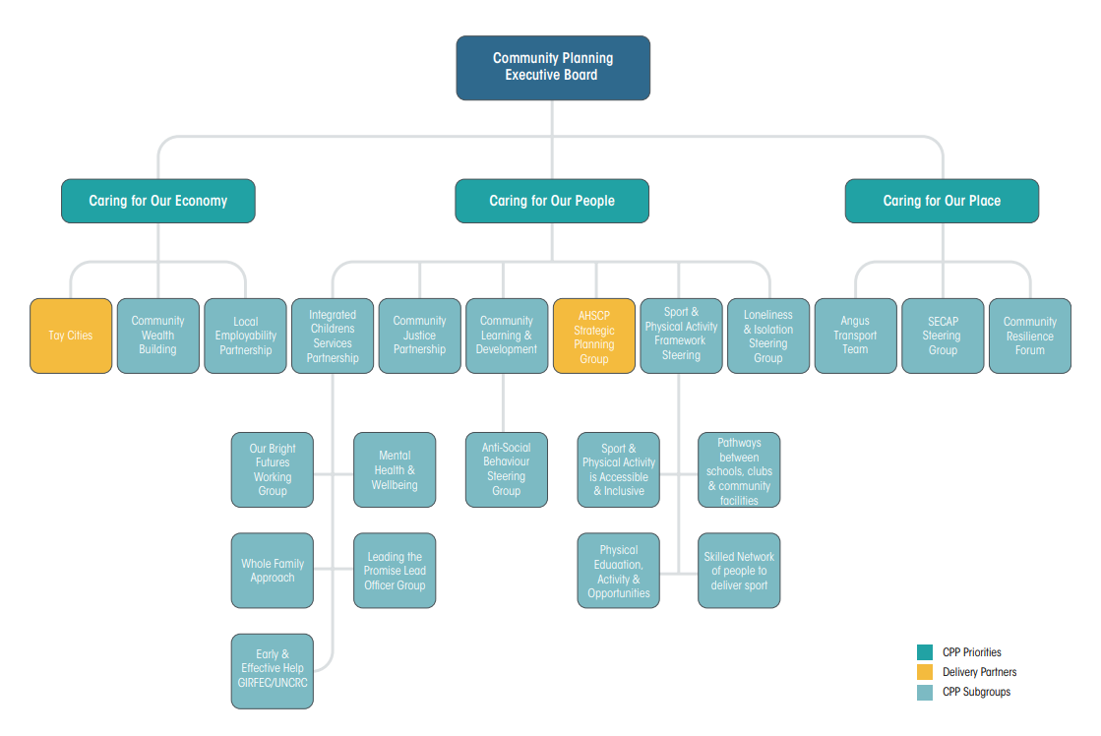

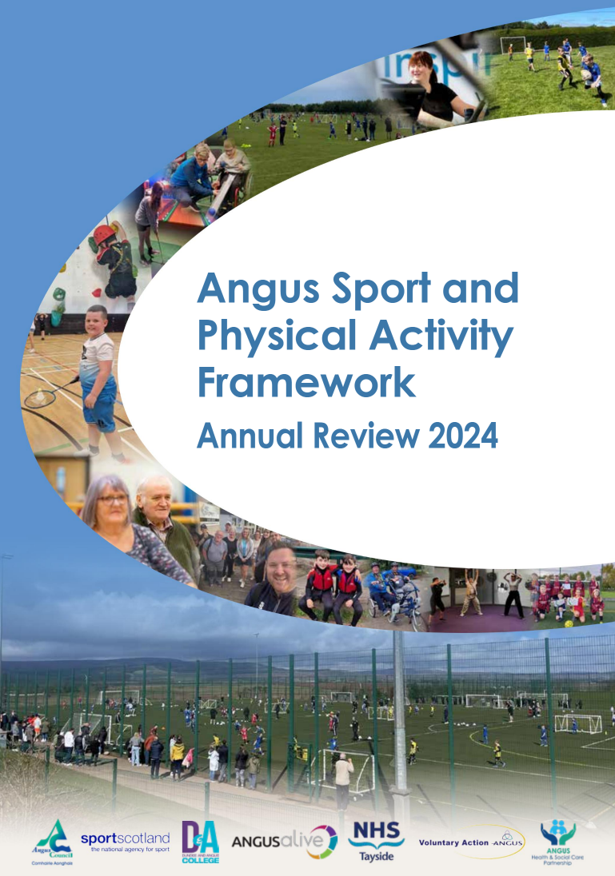
Notes:
Impact of physical activity on health is well evidenced and the Angus Sport & PA Framework was launched in 2020 using the Active Scotland outcomes to support working towards the vision that Angus is a place where an active life is accessible for all
Mentioned that partnership working has been key to P&PC, and building on these links has seen AHSCP become one of the partners involved in the framework
------
This supported the recent change to include the framework steering group within the CPP, and it now sits as one of the subgroups which means sport and physical activity is considered as a key part of how we care for people in Angus
Always learning and evolving, Flora Jackson recently presented to framework steering group on the whole systems approach and how we can use the PA for health framework

Slide 21










Build on partnerships, new and existing, within health & care sector, identifying new opportunities to provide support to healthcare professionals
Become a key, sustainable, part of health & social care
Use new and existing resources to provide health promotion within the community
Continue to upskill our team and volunteers to support communities
Promote ANGUSalive venues as alternatives to clinical settings
Notes:
So not one to rest, there’s lots more we can do!
We already have PR and Falls Prevention delivered in our sites by physios, but is there more that can be done to move some healthcare into community venues such as ours to support the transition away from traditional healthcare model
Want to keep building on how our skills within the health & wellbeing team and wider colleagues can support healthcare professionals
We want, and need, to empower people to know they can manage their health themselves and take back some control, not just expect it can all be solved with medication
------
But it’s not just sport & leisure – as a trust, we have a wealth of knowledge and skills across the service areas which can add value to the partnerships that have been formed with health over last 24 months through the P&PC work
For example, we are hoping to be an early adopter of Realistic Medicine & Libraries work following a pilot in Greater Glasgow & Clyde which aligns perfectly with the work done to date through P&PC and continues to build on those relationships
Trusts up and down the country are providing exercise referral such as Live Well, so if you’re not already connected, reach out to them
We’re all facing financial pressures, so use these existing relationships to explore new ways of working
------
Recognising the huge potential that programmes such as Live Well, and that of the wider trust, can have when brought into healthcare early enough - the biggest challenge is then how do we become a key, sustainable, part of health & social care?

Slide 22
Ai
Submit questions at
slido.com
NHSScot2025
Access the report
with this QR code

Slide 23


Newfield Medical Group
The First GP CO-OP in the UK
Power of connection for health…
through co-operation

Slide 24
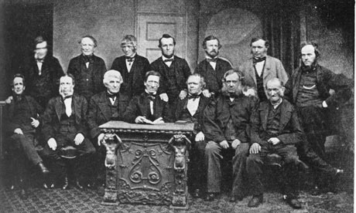
Cooperative Values:
Self-Help
Self-responsibility
Democracy
Equality
Equity
Solidarity
Cooperative Principles:
Voluntary and open membership
Democratic
Member participation
Autonomy and Independence
Education and training
Concern for the community
Cooperation amongst Cooperatives
The Co-operative Group has its origins in Rochdale, Lancashire. The Rochdale Pioneers Society was famously established in 1844 based upon the notion of ethical trading and belief that the profits of the business should be shared amongst members according to their purchases.

Slide 25

Connection with each other
Quality
Distributive Leadership
Teaching and Training
Community Participation
Green, Diverse, Inclusive
Innovation
Foundations of our GP Co-op

Slide 26

Connection with our patients
Higher GP:Patient ratio
Direct access to GP who answers the phone
GMS contract
Training Accreditation offering more choice of appointments.
Enhanced service (Family planning, joint injections, minor surgery) to meet need
Audit/QIA/QIP drives quality
Increasing list size (>7000pts from 1800 in 5 years)
Expanding Boundary to meet demand
Social media updates/use of website

Slide 27

Connecting with trainees
GP Training Hub
Med students > 150 so far
Scotgem
Brighton Elective students
FY
ST1-3
Pharmacists for IP training
School Reach programme

Slide 28
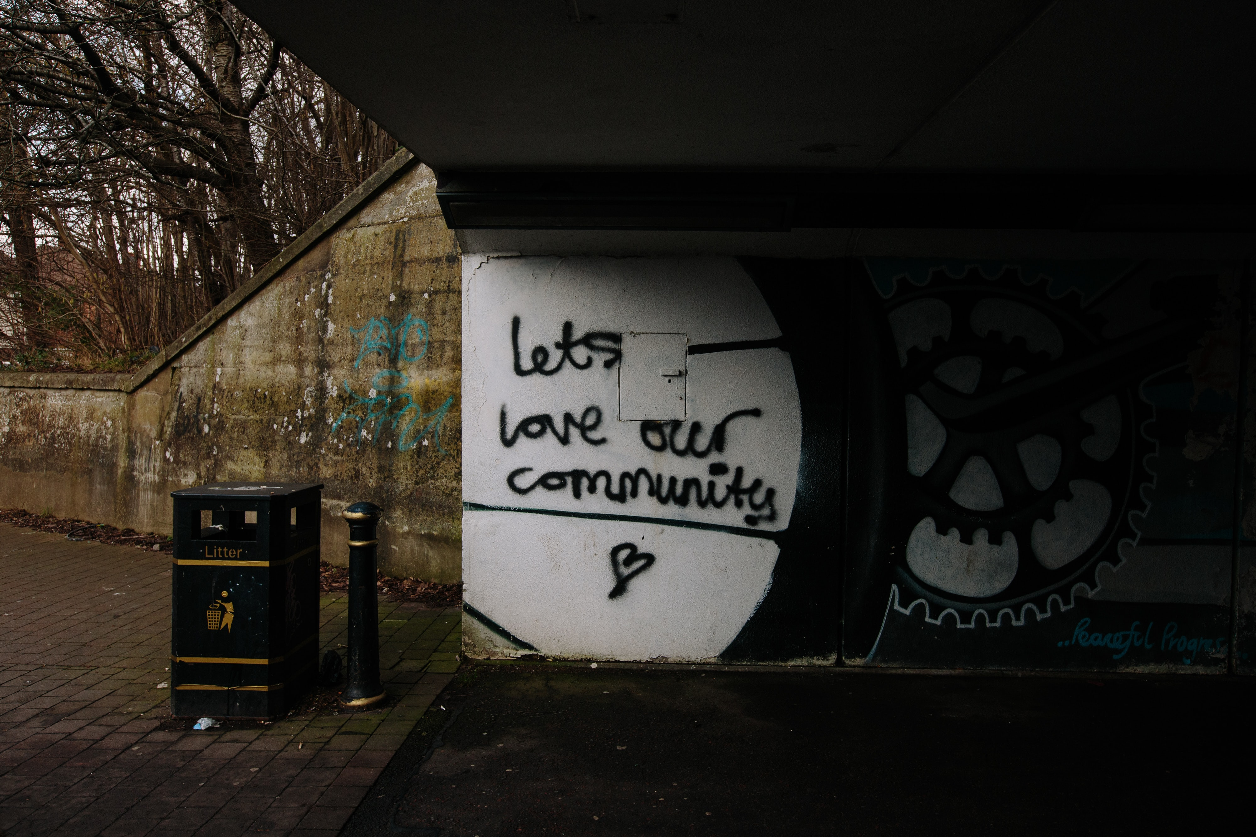

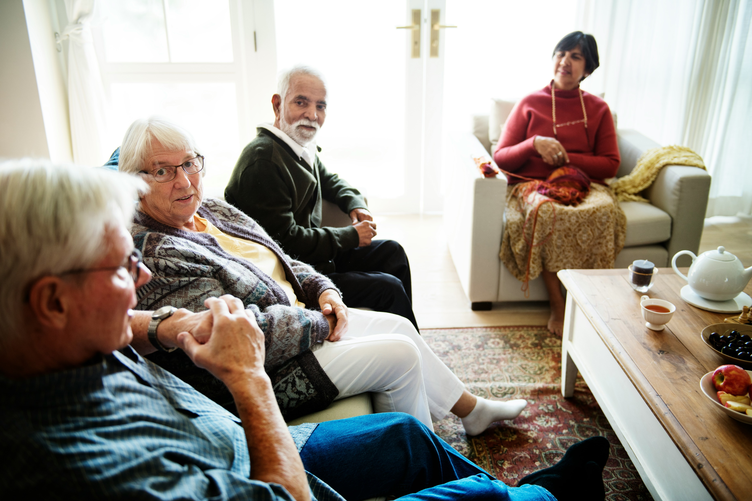

Connection with our Community
Newfield Community Group SCIO
Est. Sept 2023
3rd Sector connections
Practice Community
Coordinator

Slide 29
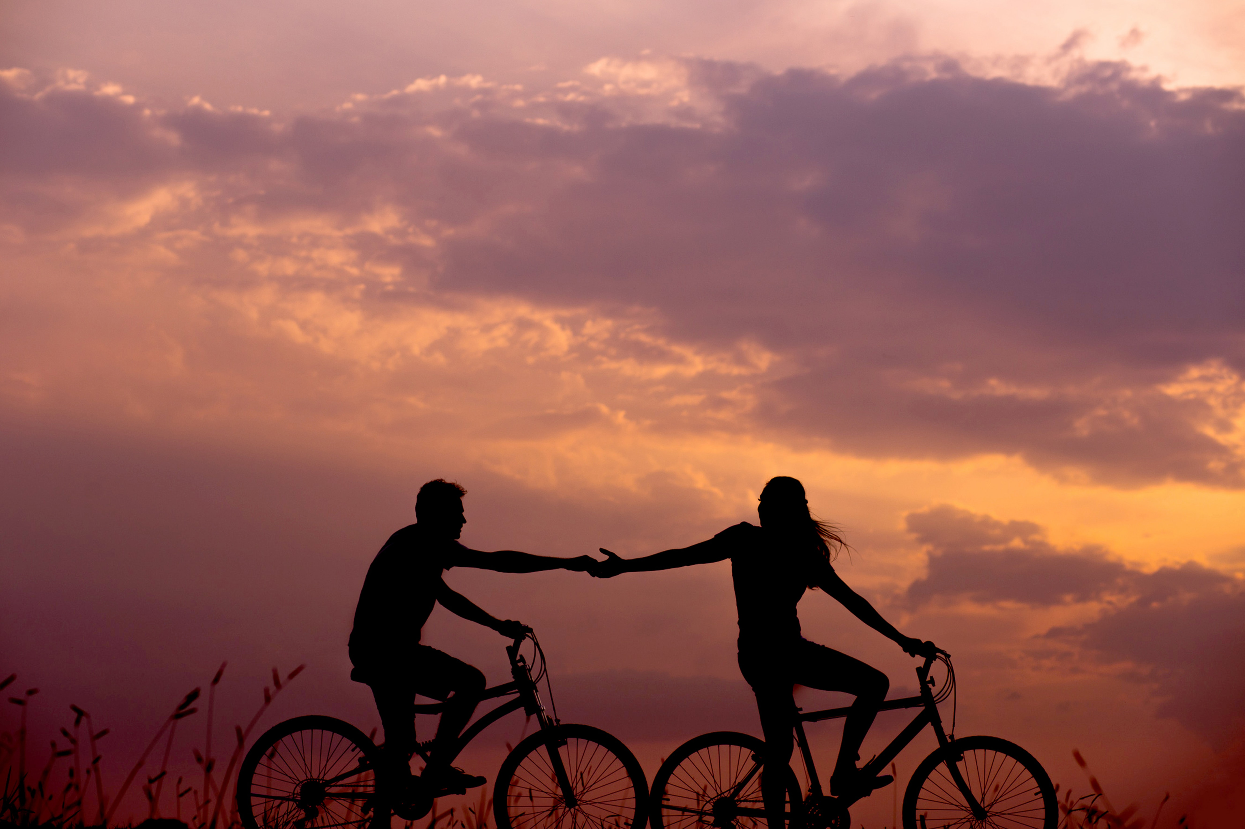
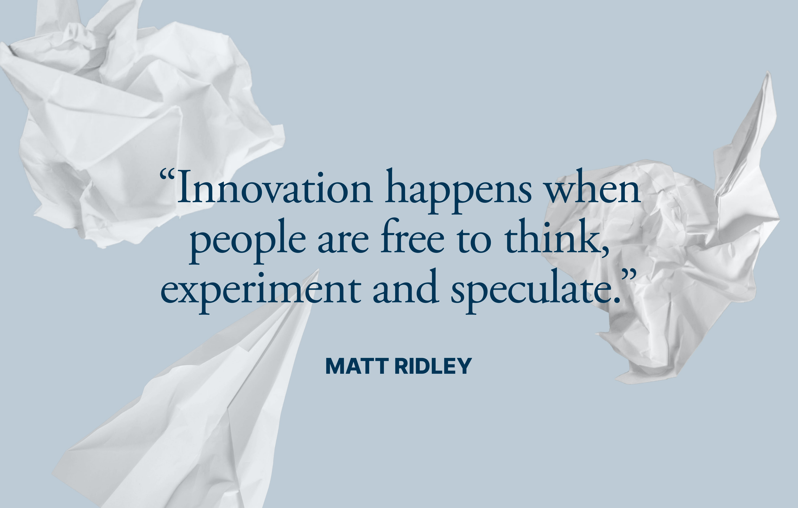
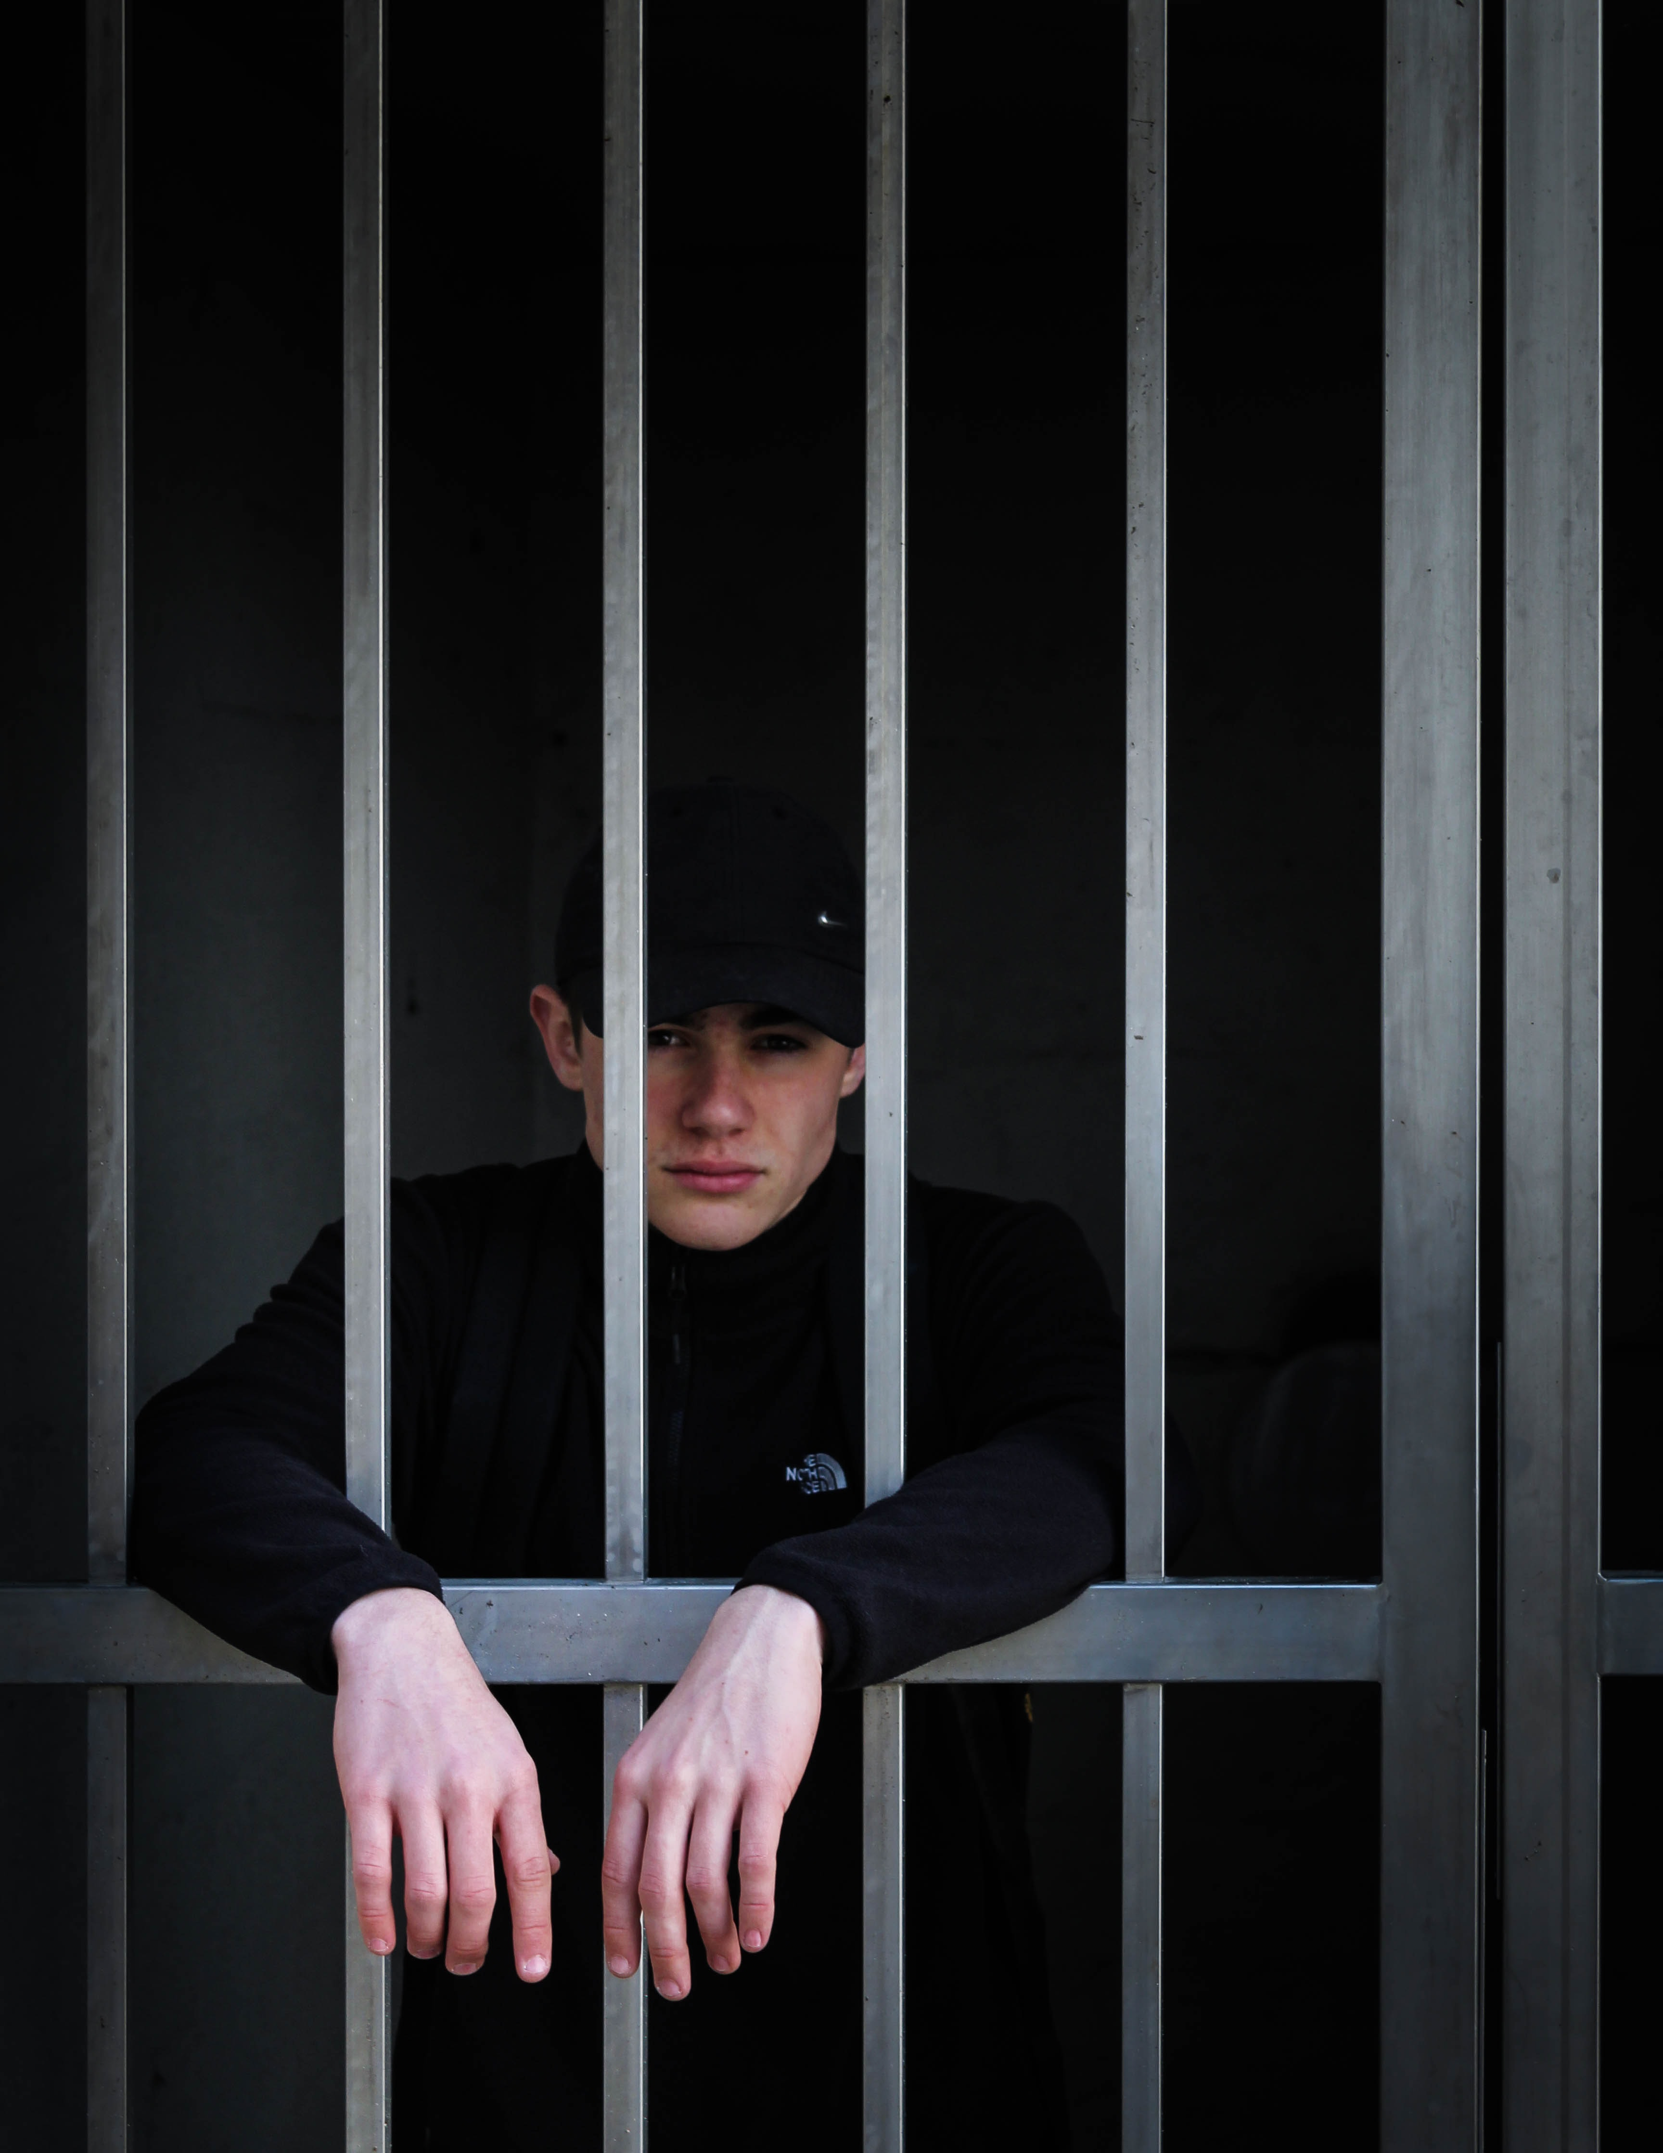

Connection with the future through Innovation
Improving access and services (vulnerable patients)
Prison (Castle Huntly/Bella)
Drug Recovery Service
Aberlour Women&Child recovery Unit
Mental Health Forum
Green Health Partnership
Tier 2 sponsor
Patient Volunteers
E-bikes/car
Membership benefits
(Gym/culture)
Gym Culture

Slide 30

Like branches on a tree, we may grow in different directions, but our roots remain as one.

Slide 31
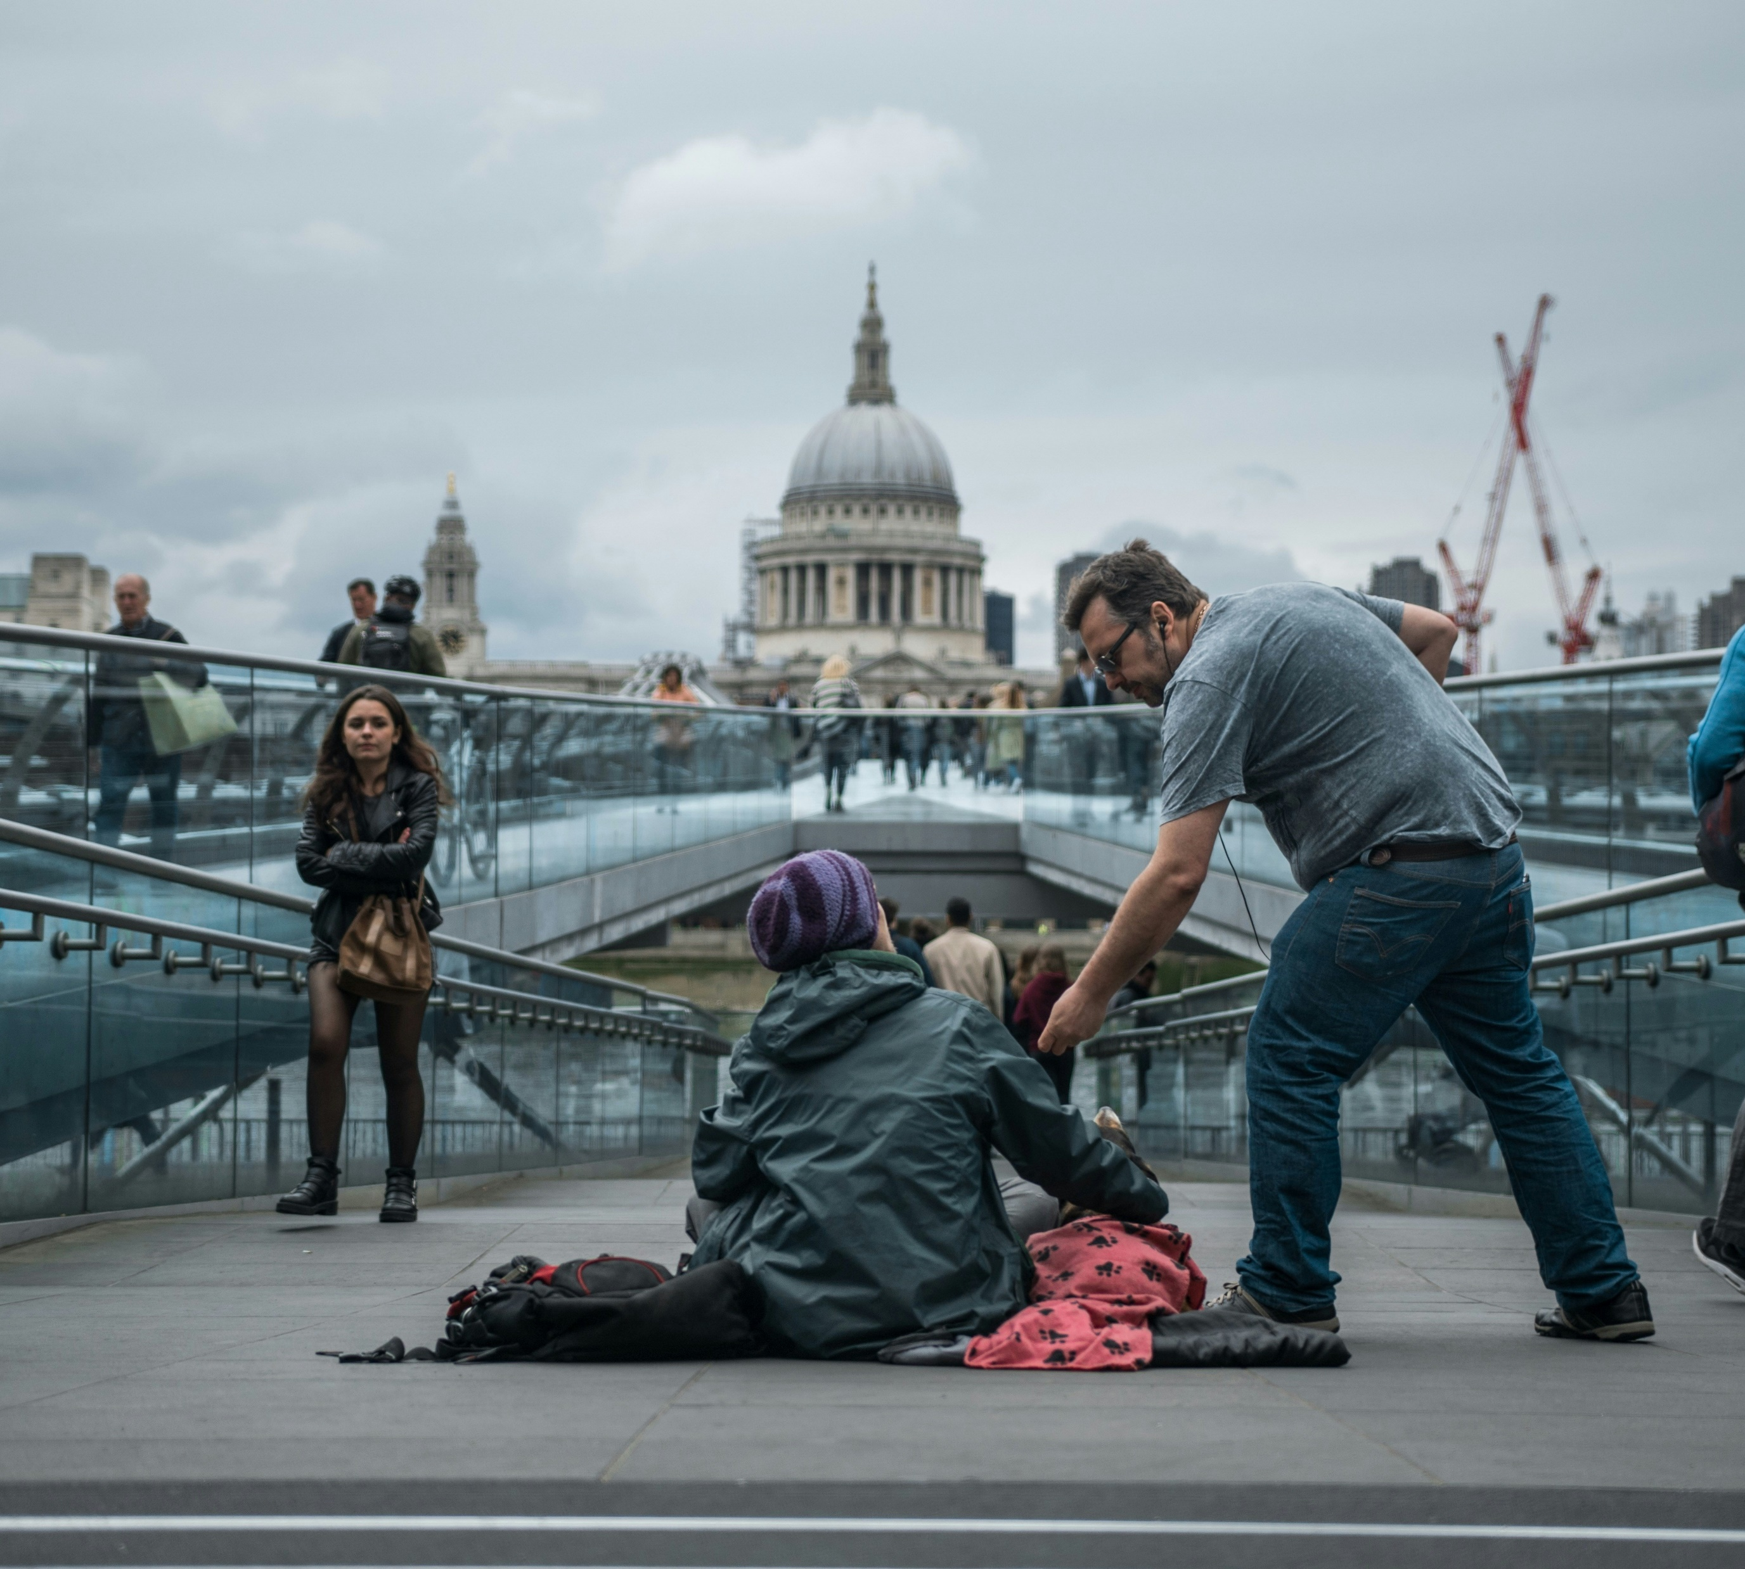
Take every opportunity to make a difference, no matter how small that may be.
“No one is useless in this world who lightens the burden of it for anyone else”
Charles Dickens
‘Our Mutual friend’

Slide 32


Slide 33
Ai
Submit questions at
slido.com
NHSScot2025
Access the report
with this QR code

