Slide 1
Interface Reform in Reality: The Bold, Human Approach Transforming Care
Slido – QR Code

Slide 2
Agenda
Interface Reform in Reality: The Bold, Human Approach Transforming Care
Role | Topic | Speaker
Chair | Opening/Panel | Louise Long, Chief Executive, NHS Lanarkshire
Speaker 1 | FNC+ Our Journey so far | Dr. Gordon McNeish, Consultant in Emergency Medicine, Associate Medical Director for Unscheduled Care, NHSL
Speaker 2 | Hospital@Home/ Virtual monitoring | Hazel Mitchell, General Manager, Interface Division, NHSL
Speaker 3 | Collaboration with SAS Partners | Islay Russell, Head of Services for SAS in Lanarkshire
Speaker 4 | Communication from the Inside Out | Euan Duguid, Senior Communication and Engagement Manager, NHSL
Panel | Speaker & Panel Q&A Open Q&A | Dr Mike Coates, Clinical Director Out of Hours, NHSL Bernie Harvie, Service Manager, NHSL Claire Ritchie, Interim Interface Director

Slide 3
Louise Long Chief Executive, NHS Lanarkshire
Opening

Slide 4
NHS Lanarkshire Values
1
2
Dignity & Respect
Care & Compassion
3
4
Openness, Honesty & Responsibility
Quality & Teamwork

Slide 6
How are you feeling today Mary?
Call Before
You Convey
Virtual Wards

Slide 7
Purpose
At the heart of this work are simple ideas
Keeping people safe at home
Creating a more responsive system
Connect the system – improve the patient journey
Leverage digital tech platforms to enhance care

Slide 8
Dr. Gordon McNeish Associate Medical Director, NHS Lanarkshire
Speaker 1
FNC+Plus: The story so far

Slide 9
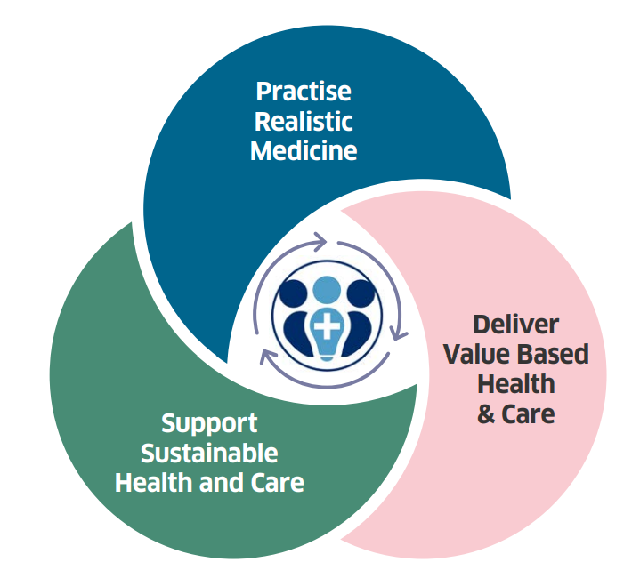
Interface Story
Local quad-helix approach
Value Based Healthcare
Getting it Right for Everyone
Innovation hub based on local Quad-helix approach, in collaboration with key partners.
Practising Realistic Medicine and delivering value based health and care, focusing on outcomes that matter to people.
GIRFE: Placing the person at the centre of decision making that affects them, with a joined-up consistent approach.
Notes:
Connection of services across the system
Test bed for innovation opportunity
Promoting opportunity for digital platforms to enhance care

Slide 10
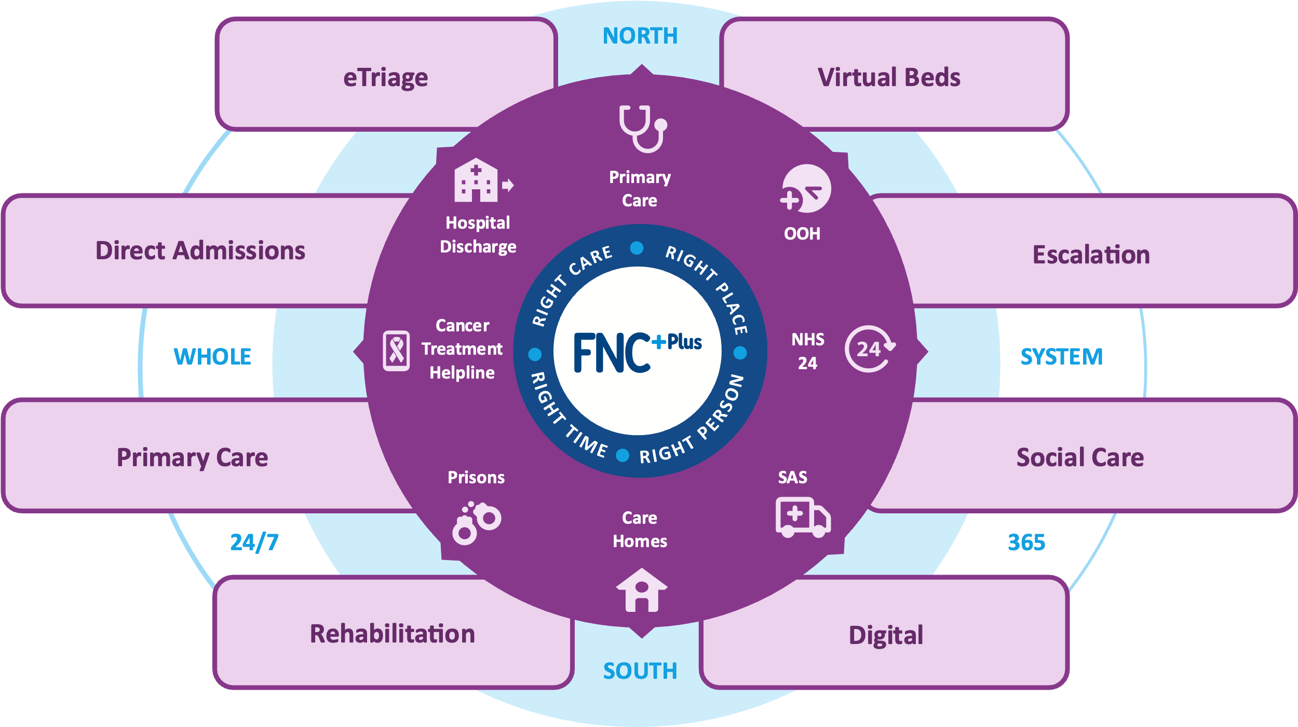
FNC+Plus Remit & Scope

Slide 11
FNC+Plus – Impact to date
Redesigning Care from the Inside Out
6k
>20
Pathways to support alternative delivery of care
Calls through FNC+ per month
>350
Weekly Patients directed away from acute hospital – improving trend
98%
20%
Care home patients avoided admission
Of total calls non conveyed in 9 mths
Growing bank of Patient impact stories

Slide 12
Hazel Mitchell General Manager, Interface Division, NHS Lanarkshire
Speaker 2
HOSPITAL @ HOME / Virtual Monotoring

Slide 13
Marlyn’s patient story
NOTE: VIDEO CLIP IN GOOGLE DRIVE TO BE EMBEDDED HERE
vimeo.com/1019774528/2ad251c90f

Slide 14
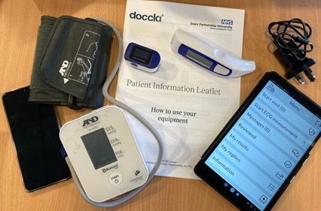
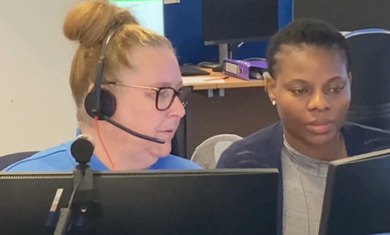
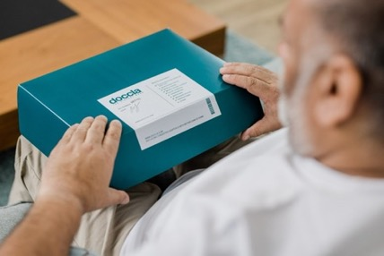
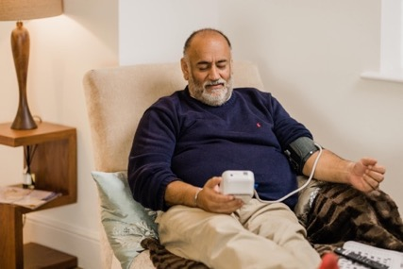
H@H/Virtual monitoring
Providing an alternative to hospital care
Delivered by a MDT team – Coordinated via FNC+
Pathways – Development
Training – Wholes System approach (treatment room access)
Supporting patient choice to get well in their own home
Notes:
We’re not claiming perfection — but this is evidence of what’s possible

Slide 15
First 400 patients
439
£1.6m
6.6
11.3
Patients on boarded to-date
Cost Avoided Bed Days
Average Length of Stay (11.3 = Diagnostics)
4.3k
98%
x5
Patients active days
Patient compliance
Patient Pathways

Slide 16
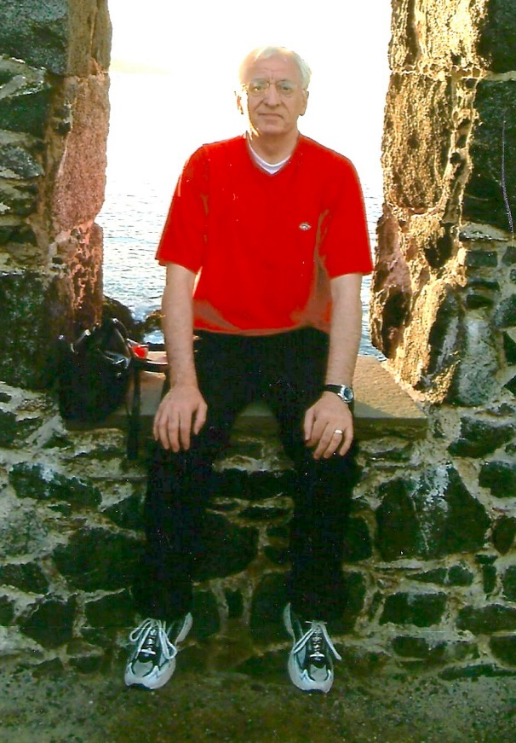
Virtual Wards — Patient Story
Topics: NHS Lanarkshire / Virtual Wards / Doccla
Glasgow bus driver’s journey to recovery
Virtual
Wards
A worldly-wise bus driver who spent years driving Glasgow’s toughest streets has revealed how Virtual Wards helped him navigate a recent health crisis — not from a hospital bed, but from the comfort of his own home.
“I didn’t want to be in hospital again. You’re more than just ill — you’re away from your life,” he says. “With the kit and the Hospital at Home team, I got to stay in my own bed and still get the care I needed. I could keep painting. That meant a lot.”

Slide 17
Islay Russell Head of Services for SAS in Lanarkshire
Speaker 3
Collaboration - SAS

Slide 18
Collaboration - SAS
Advanced Paramedic integrated into FNC+
System view
Access pathways
Integrated clinical HUB
Escalation points of system pressure
Introduced: SAS Advanced Practitioners to support crews and reduce ED reliance;
Fostered: collaboration between FNC+ and SAS;
Delivered: training for complex calls to ensure high clinical assessment standards.
Strengthened: collaboration with tripartite; SAS, NHS24, FNC+, and local services for integrated care.
Performance Data
Performance: All stations, average 42 weekly calls; 54% non-conveyance achieved;
Impact: Reduced ED admissions; improved SAS collaboration;
Target: working with crews to increase confidence/ awareness
Cost Avoided: Saves £350 per avoided admission (per bed day);
Capacity: Eases demand on acute beds.

Slide 19
Euan Duguid Senior Communication & Engagement Manager, NHS Lanarkshire
Speaker 4
Communication from the Inside Out

Slide 20
Clear direction, tough terrain
Our approach
A journey
A clear direction
Staying responsive to conditions

Slide 21
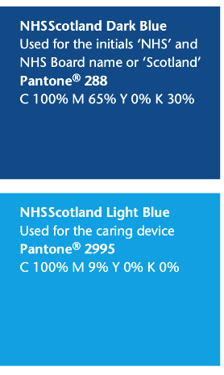
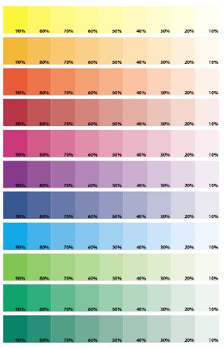
Clear direction, tough terrain
Clarity
Confidence
Credibility
Creating the conditions for people to understand
Growth of confidence and how to nourish it
Credibility: When messaging and actions align

Slide 22
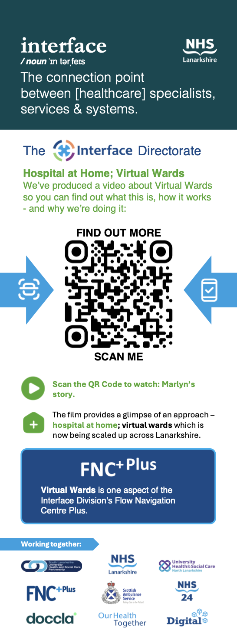
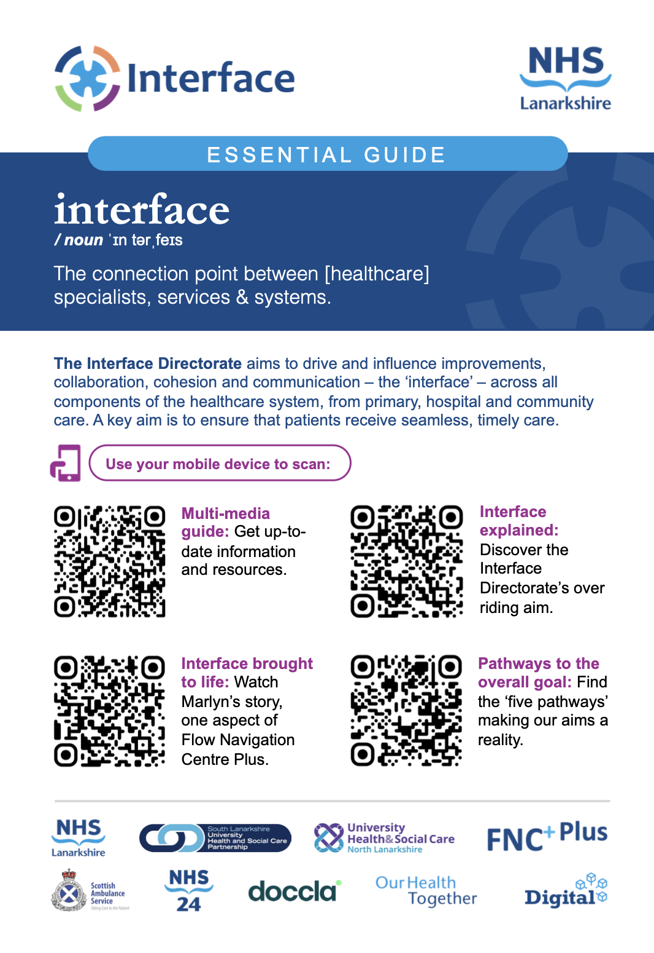
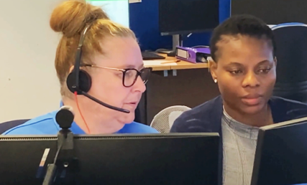
Extensive engagement
Posters & signage
Tried & tested and some Lanarkshire firsts
Red/Blue Team Exercises
Videos and animation
Community toolkits and human stories
Guides
Making full use of MS365
Training

Slide 23
Louise Long Chief Executive, NHS Lanarkshire
Panel

Slide 24
Your Questions – Let’s Talk
Perspectives from the People Behind the Progress

Slide 25
Louise Long Chief Executive, NHS Lanarkshire
Open Q&A / Closing Reflections

Slide 26
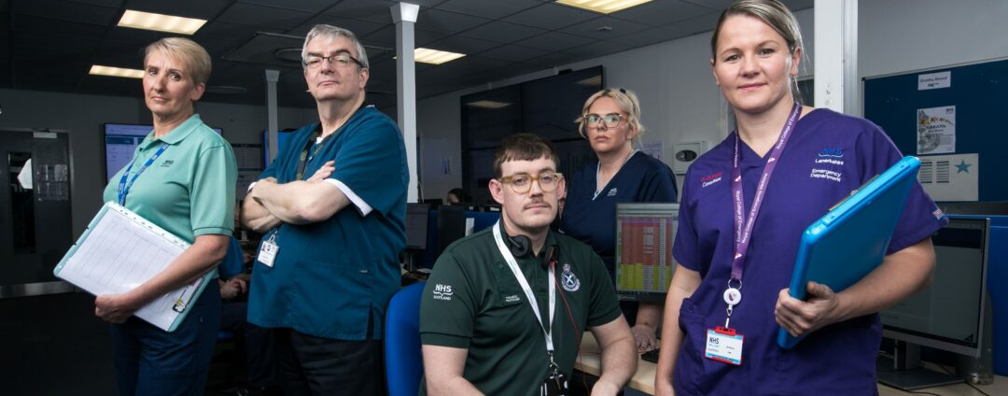
Closing Reflections
Reform Is Possible – and Personal
Not just transforming systems — transforming lives.
Thank you nhslanarkshire.scot.nhs.uk/interface/

Slide 27
Interface Reform in Reality: The Bold, Human Approach Transforming Care Thank you

Slide 28
H@H/Virtual Wards: Hospital Care & Comfort
1
2
3
4
5
Five access points to benefit from FNC⁺Plus & VIRTUAL BEDS:
999
GP
COMPLEX CASE
PRE HOSPITAL
SAS/NHS 24
FRONT DOOR
EARLY ASSESSMENT & SCHEDULING
DISCHARGE
DIAGNOSTICS/
FINAL MONITORING
HOME
CHRONIC CONDITIONS
REF | Speciality / Pathways
A | Frailty
B | Cardiology
C | Respiratory
D | Liver Pathway
E | Diagnostics
F | General Surgery
G | Orthopaedics
= Pilot Live / In Progress
= Preparing
= To scope

