Slide 1
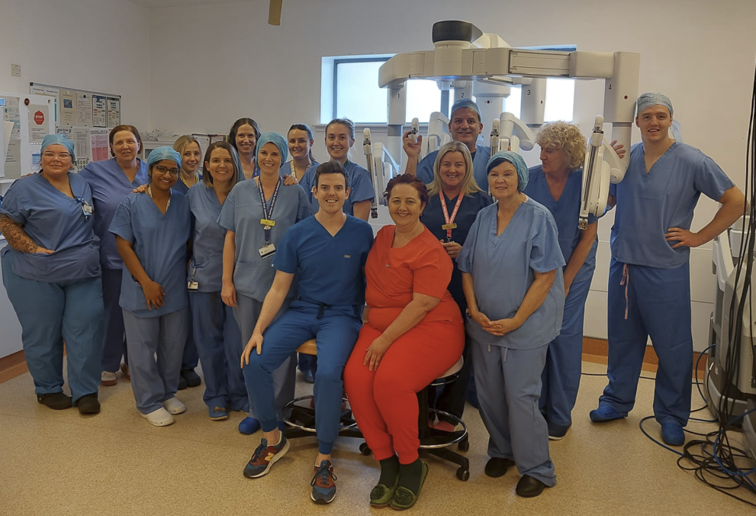

Bridging Gaps in Women's Health: Innovation, Access & Equity
NHS renewal – Protecting and Strengthening
Scotland ‘s Health and Care Services
Dr I Sokolova, Dr I Martin, Ms A Humphries, Ms E McCulloch
Slido – QR Code
Notes:
Women's health has historically been underfunded and overlooked, leading to disparities in access and outcomes.

Slide 2
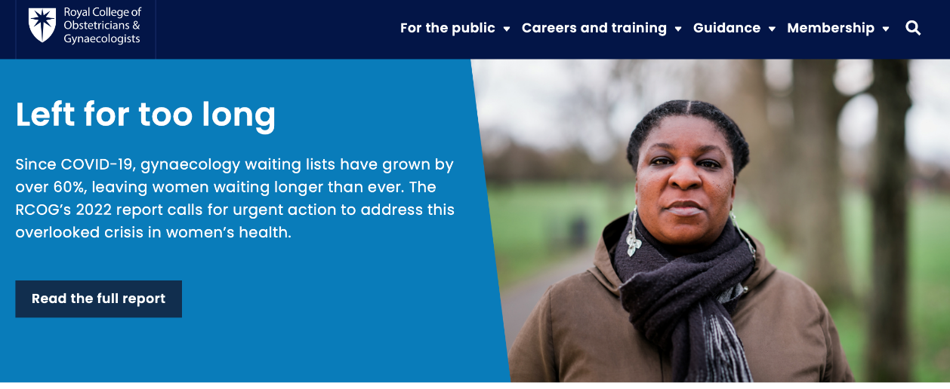
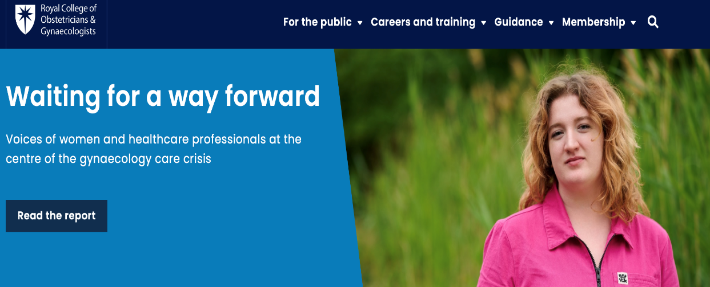
Is it all about men?
What I repeatedly hear is that RAS prostatectomy is the only area where (internationally) there is really good evidence around cost effectiveness and the significant clinical benefits that RAS gives in comparison to open of lap procedures… for everything else evidence less convincing …
agenda is focused on making sure every man getting a prostatectomy should be offered RAS….
Notes:
Be prepared to push back

Slide 3
Challenges and Solutions in Women's Health
Then
Now
Endometriosis surgery wait > 2 years
Same-day discharge routine
Open surgeries with 2-5 day stays
Robotic minimally invasive surgery
Out-of-area travel for complex care
Local access to complex care
Growing backlogs, costly bed days
Reduced waiting times

Slide 4

From Skepticism to Leadership
2019
2023
Identified need to improve complex gynae surgery
First robotic case performed
1
2
3
4
2021
2025
Robotics Business case
Over 300 cases completed

Slide 5



Why consider same day Hysterectomy
Benefits to patient
Benefits to Healthboard
Is it safe?
Reduced risk of cancellation, reduced pain scores, reduced post-op nausea, early mobilization, reduced risks of hospital acquired infections, comfort of own home
Decrease inpatient bed occupancy
More efficient use of theatre time
Decrease in waiting lists
Cost effective
Publications (2016 – 2022 including large cohorts of patients)
Models of the service running successfully in UK
Scottish initiative through Centre for Sustainable Delivery (Modernising Patient Pathways)

Slide 6
What about us?
Jan 2012- Jan 2023
2695 women
Surgical approach and Length of stay
Year | 2012/13 | 2014/15 | 2016/17 | 2018/19 | 2020/21 | 2022/23
Total Hys | 630 | 529 | 530 | 497 | 334 | 175
Lap/LapV | 15% | 34% | 42% | 53% | 52% | 57%
Vaginal | 24% | 18% | 11% | 13% | 8% | 2%
Open | 61% | 48% | 47% | 34% | 40% | 41%

Slide 7
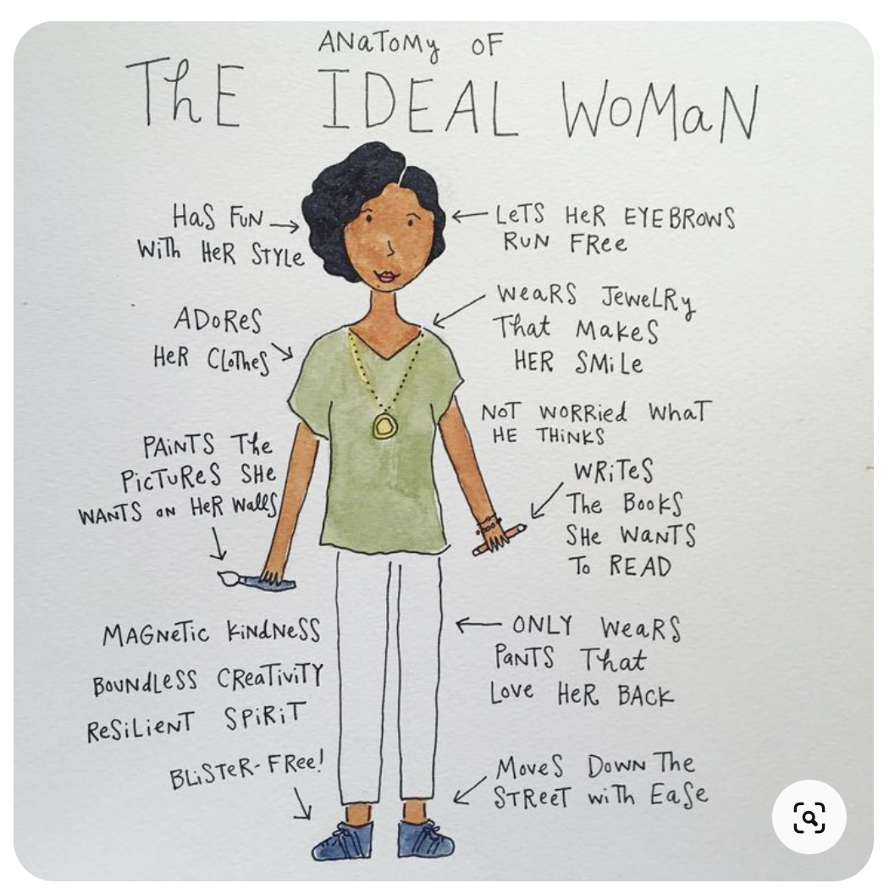

The Ideal Woman…
Notes:
normal BMI
No CS
No prev surgery
No comorbidities
Fit

Slide 8

Notes:
How can we get this woman through same-day hysterectomy pathway? (the average woman!)
GPAS REFERENCES
6.1.9: Protocols should be available to maximise the opportunity for patients with significant co-morbidities (eg. diabetes, morbid obesity, sleep apnoea) to be safely managed via a day case pathway. Preoperative assessment should be inclusive and not exclusive.

Slide 9

Background
Robotic-assisted surgery (RAS) has transformed surgical care
Key advantages:
  Enables endoscopic approach for previously challenging procedures
  Aligns with the philosophy of same-day discharge following major pelvic surgery
  Accommodates various patient characteristics
Offering same day hysterectomy since 2015
Since January 2023 – all patients go through DSU
Robotic surgeon July 2023
Notes:
Friday theatre list.
Very quickly realised
Extended applications of same day discharge to cases with increased surgical complexity
Allowed me to do surgery as efficiently as it would be for easy cases, therefore recovery from this was no different
Actually, what we set out to do is the default position is everyone is suitable for same-day discharge
Care is planned as ambulatory care
I’d like do share some of our initial results which illustrate that ethos

Slide 10
Study Design
Prospective case series
Period: July 2023 - August 2024
Inclusion: All benign robotic-assisted hysterectomy procedures
Intended management - day case
Patient demographics (BMI, age)
Clinical indication(s)
Surgical outcomes
  Conversion to laparotomy
  Length of stay
  Complications
Notes:
-have slide made up about day case and what are you doing differently
”We collected the demographics and indications before surgery and the length of stay and complications afterwards”.

Slide 11
Patient Demographics
RAS procedures: n=122
Age range 30-78 yrs
BMI: 33.2 kg/m² (range 18-55 kg/m²)
Functional status (DASI): 13.6-58.2
Most common indication: Uterine Fibroid (Myoma)
  Largest specimen: 36-week size uterus (2.9kg)
Notes:
Range of conditions pre and post-menopausal women
Largest BMI, so far, 55
Say verbally what DASI stands for.
The complications appear too low to be true, even if it is true!
Try to also add the minor problems e.g. UTIs, …etc.
Did this woman of 36 weeks uterus stay overnight? If yes, say so.

Slide 12
Key Results
No conversions to open surgery
Mean operating time 61 mins
Same-day discharge: 110 (91%)
Mean hours from surgery to discharge: 3.16 hrs
Average pain score 0.6/10 at time of discharge
Delayed discharge cases: 12 (9%)
  Social reasons (5)
  Pre-existing neurological condition (1)
  Prolonged surgical time (1) – developed AKI, resolved spontaneously
  Port site bleeding (1), additional analgesia needs (2), atelectasis after surgery (1), chest pain after surgery – kept 23 h for observation
Post-discharge complications:
  Minor port site bleeding (1)
  Constipation (1)
  No readmissions required
Notes:
-split slides into 2
These are things we traditionally look for as surgeons but for me what is the most important is how that translates into benefits for patients

Slide 13

Pioneering Same-Day Major Surgery
95%+
Same-Day Discharge
For all gynecological procedures
95%
Ambulatory Hysterectomies
~3 hours to discharge
161
Procedures in First Year
vs 90 projected over 3 years
<1
Day Hospital Stay
Reduced from 3-5 days

Slide 14
Dr. Inna Sokolova: Surgeon's own da Vinci, open, and lap data
Hysterectomy - Benign
Unpublished clinical outcomes with estimated cost savings – single surgeon experience
Length of Stay
(Days)
Same Day Discharge (%)
Operative Time
(Minutes)
Complications
(%)
Readmissions
(%)
Conversions
(%)
Cost
£407
£20
£3 728
£2 400
£2 221
(per day)ᵃ
(per minute)ᵍ
(per complication)ᵉ
(per readmission)ʰ
(per conversion)ᶜ
RAS using da Vinci systems (n=182)
Estimated Cost Savings Per Procedure
Estimated Total Cost Savings
Lap (n=1037)
£2,555 vs. Lap
£464,994 vs. Lap
Open (n=1259)
£2,417 vs. Open
£439,890 vs. Open
Dr. Inna Sokolova provided data for Hysterectomy - Benign, da Vinci: 7/2023 - 6/2024, Open: 7/2023 - 6/2024, Lap: 7/2023 - 6/2024: <<Dates>>. Outcome measures reported in this presentation are selected based on the surgeon’s interests and availability of relevant data.

Slide 15


Slide 16
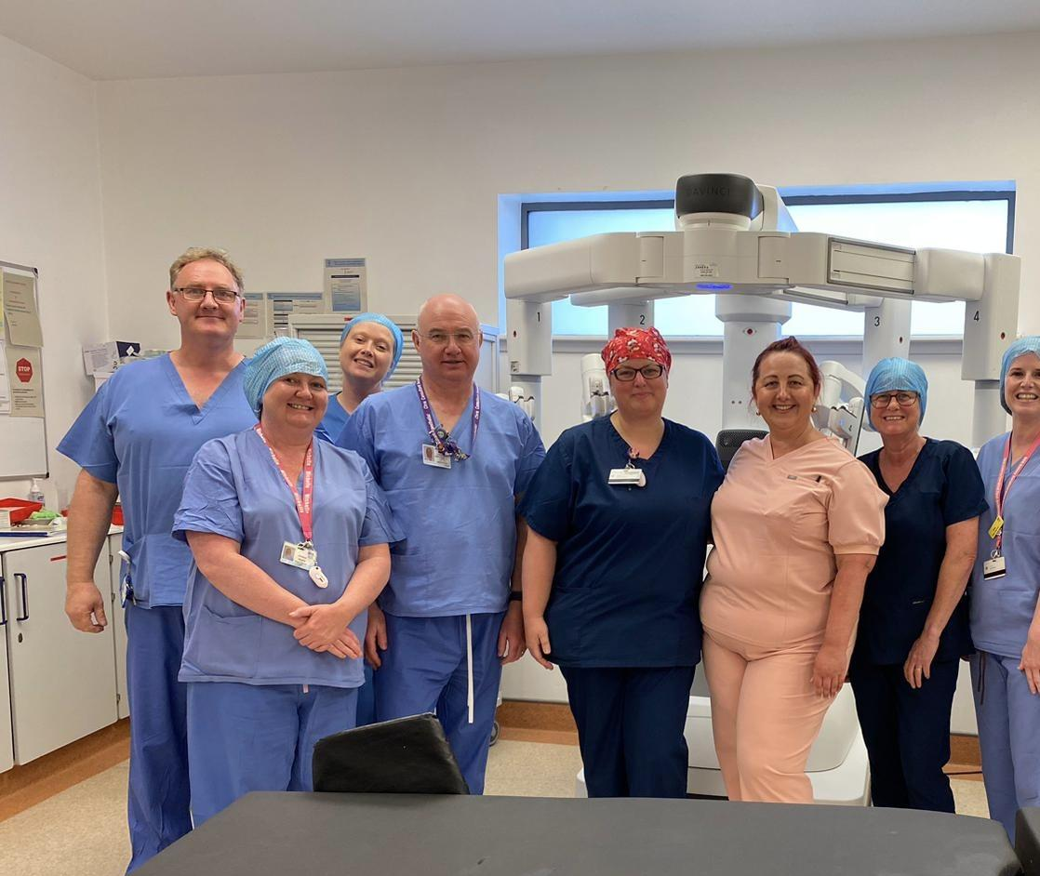
First 4 cases Day – Success!
Notes:
Team work
What were 2/3 things that made difference
Techniques used
Case selection
Planning
Team
Prompt start

Slide 17
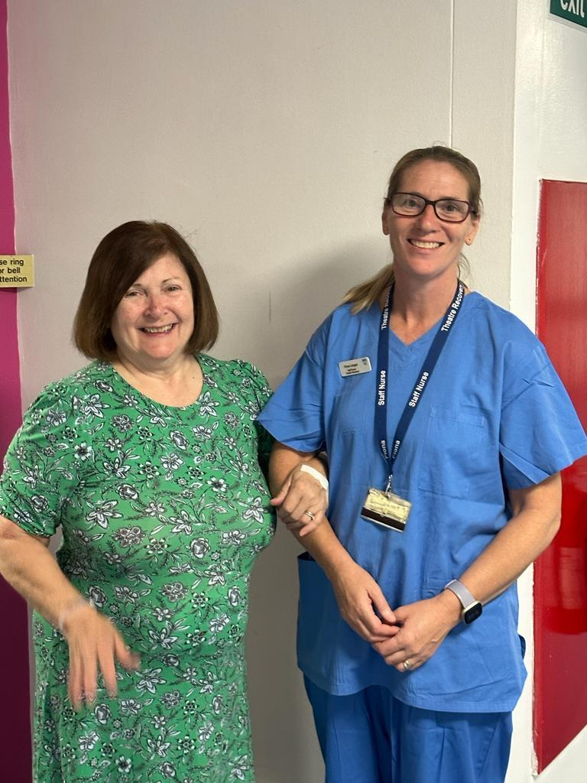
Stories of Change - Patient Experience
"I was in and out within 8 hours"
"I felt like I was in a 5-star hotel"
A life changing experience with fast recovery
I'd go through it all again in a heartbeat
"I will make it home for the school run"
Quicker recovery means return to family life

Slide 18
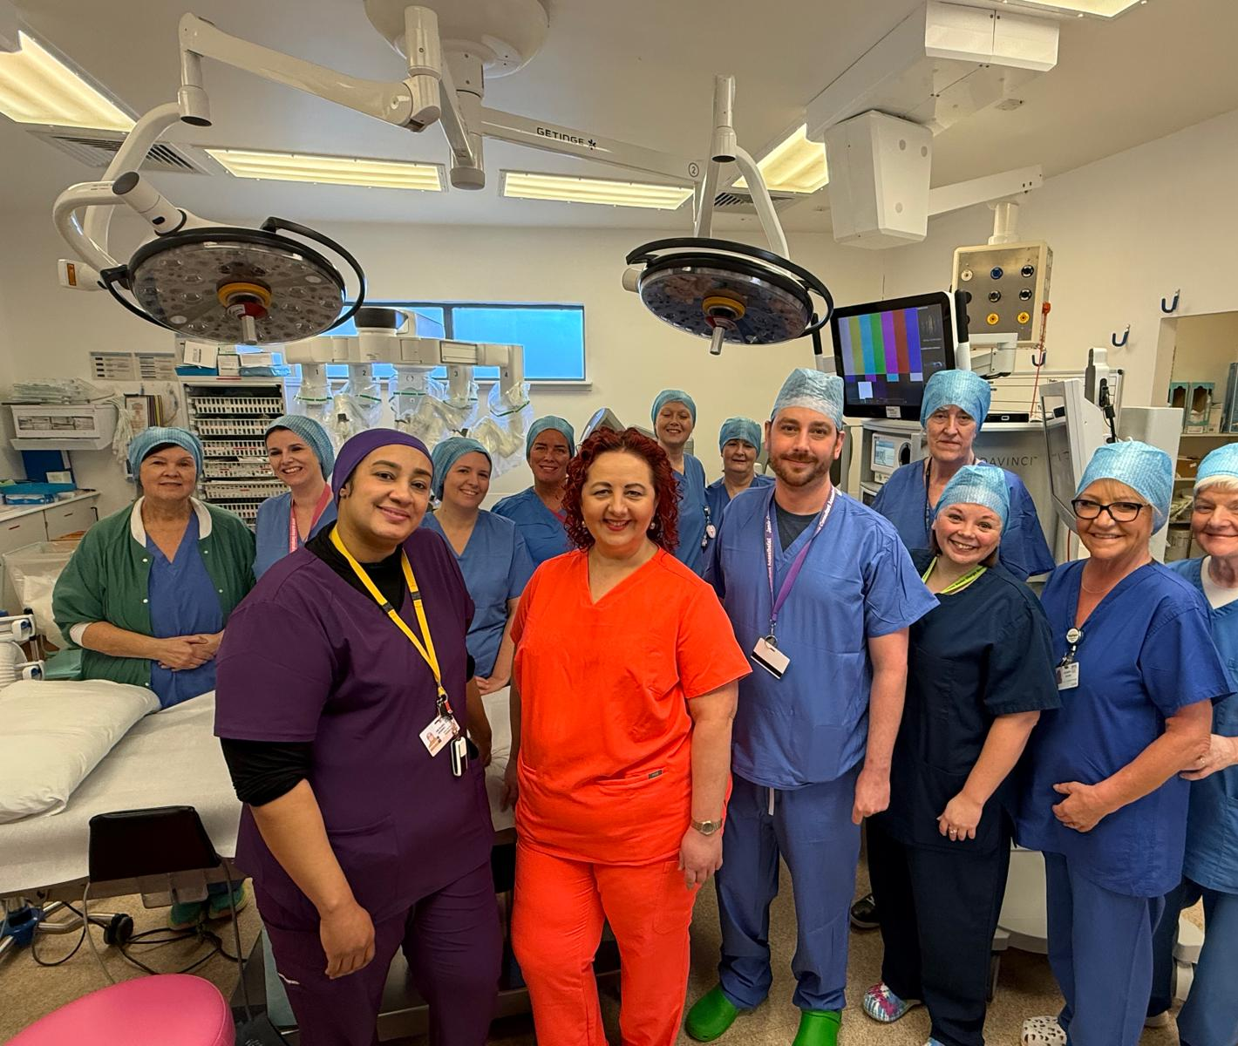




What's Next - Spreading the Innovation
? 100% Minimally Invasive Surgery
For all suitable cases in 2-3 years
Regional Endometriosis Centre
Multi-disciplinary with colorectal/urology
Extending Robotics
To prolapse, incontinence treatments
Knowledge Sharing
Annual "Same-Day Hysterectomy" training course

Slide 19
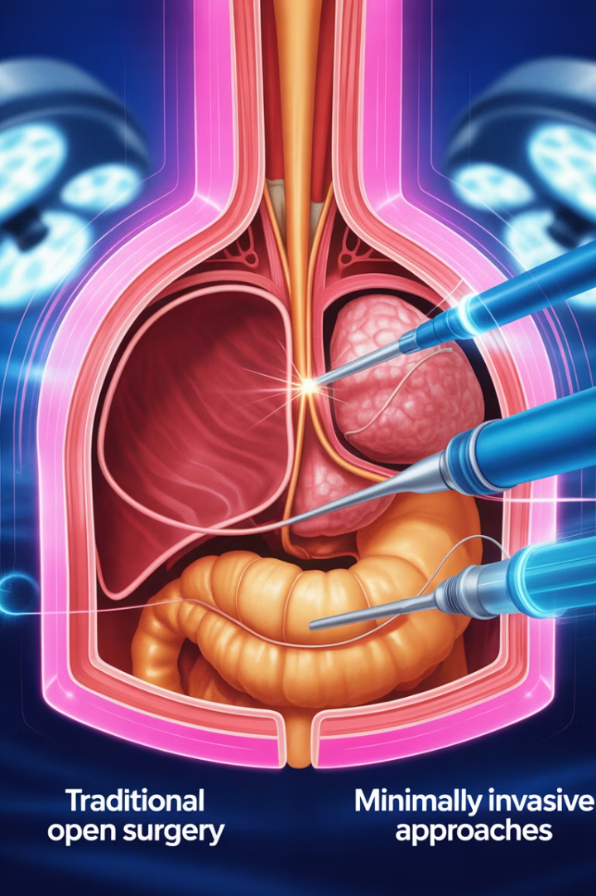



Minimally Invasive Gynaecological Surgery - The New Standard
Robotic Surgery
VNOTES
Precision control for complex procedures
Scar-free hysterectomy via vaginal approach
Outpatient Procedures
Hysteroscopy & ablation under local anesthesia

Slide 20




Changing Pathways: From Hospital Bed to Home
Pre-op Assessment
Day case is the norm
Same-Day Admission
No overnight pre-op stay
Minimally Invasive Surgery
Robotics or VNOTES
Discharge in 3 Hours
If stable with criteria met

Slide 21








Beyond Theatre: Holistic Women's Health
Faster Return to Work
Improved Mental Health
Economic well-being
Less disruption to life
Comprehensive Support
Better Fertility Outcomes
Surgery plus hormone management
When treated promptly

Slide 22






Lessons for Scaling Up
Invest in Training and Team
Skilled surgeons and staff
Adapt and Innovate Locally
Use what you have
Patient-Centered Design
Engage patients in pathway design

Slide 23





Keys to Success & Safety
Patient Selection?
Nurse Autonomy
Team Communication
Careful criteria, broadened with experience
Authority to make protocol decisions
Daily huddles and checklists
Data Tracking
Monitoring outcomes builds trust

Slide 24
Prepared Patients = Successful Outcomes
Education Tools
Patient Benefits
Simple explanations of robotic surgery
Reduced anxiety
Animated recovery videos
Active participation in recovery
Virtual tour of day surgery
Better adherence to instructions
Take-home pamphlets
Smoother discharge process

Slide 25





Case Study: Jane's Journey
7:30 AM
Jane arrives, meets nurse Emma
9:00 AM
Robotic hysterectomy begins
10:00 AM
Waking in recovery, pain controlled
1:00 PM
Discharged home, comfortable

Slide 26
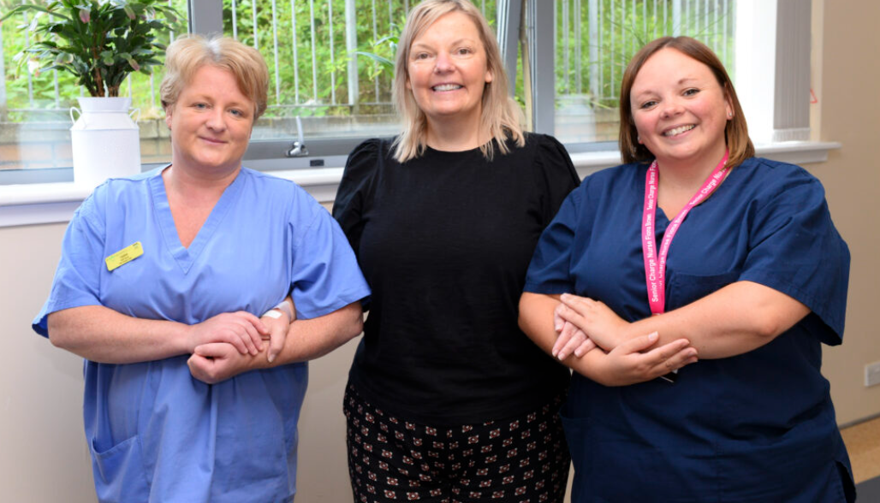

Slide 27
Patient Journey Touchpoints
1
Referral Received
Meet with Gynaecologist in Clinic
2
Pre-Assessment Clinic
Education and preparation
3
Surgery Day
Admission through discharge
4
Post-Discharge Support
Follow-up information / support and clinic visit

Slide 28

Your Role in Bridging the Gap
1
Start the Conversation
About day-case hysterectomies at your facility
2
Set Up a Test-of-Change
Small pilots lead to big improvements
3
Reach Out for Resources
We welcome site visits / run regular courses
4
Renew Your Commitment
To innovative, accessible women's healthcare

Slide 29




Conversion to same day discharge
Day Surgery
Trained staff familiar with same day discharge from other specialties
Location and capacity
Motivated group of anaesthetists and surgeons
Adapted surgical technique and anaesthetic protocol
Easy access to inpatient wards and senior cover 7/7
Patient preparation
ERAS
Written Patient Information

Slide 30





Enhanced Recovery Pathway
Pre-op
Education, nutrition, planning
Surgery Day
Minimal fasting, warming
Post-op
Early mobilization, oral pain control
Follow-up
Support access

Slide 31

Surgical Outcomes Comparison
<3%
0
100%
Readmission Rate
Conversions to Open
Pain Well-Controlled
For same-day discharge patients
In benign robotic cases
With oral medication only

Slide 32








Expanding Access to Care
Reduced Wait Times
Local Treatment
Faster throughput means more patients treated
No need to travel for complex care
Inclusive Care
More Options
Better for patients with co-morbidities
Multiple surgical approaches available

Slide 33





Anesthesia Innovations
TIVA
Total Intravenous Anaesthesia
Short-Acting Agents
Faster wake-up times
Anti-Nausea Protocols
Improved post-op comfort
Minimal Fasting
Clear fluids until 2 hours pre-op

Slide 34
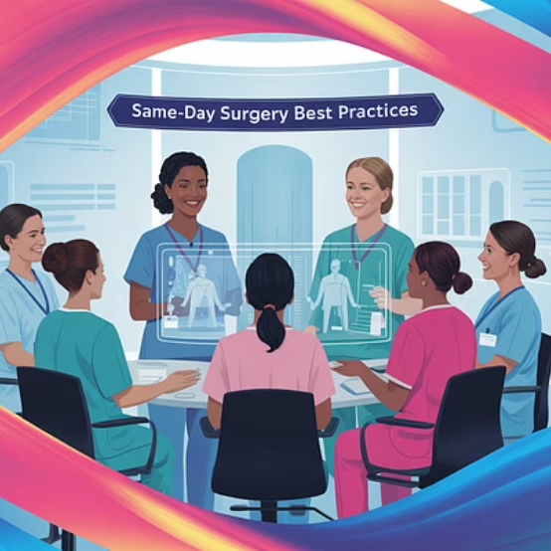


From Ayrshire to All of Scotland
Teams from other boards visiting to learn. Nurses as change agents for equitable women's health.

Slide 35

Notes:
Introduce yourselves –
Who you are, where you work, how long you have worked in DSU

Slide 36

Nurse-Led Enhanced Recovery - How It Works
Pre-operative Education
Nurse-run clinics, written info, anxiety reduction
Day of Surgery Care
Minimal fasting, warming, modern anesthesia
Post-op Recovery
Monitoring via specific criteria checklist
Discharge & Follow-up
Medications, wound care advice, contact if necessary
Notes:
Our day surgery unit is very much nurse led and this is a service that has been built up over many years.
For the service to be affective it relies on efficient pre-oping and patients being prepared for theatre and what to expect. If patients are aware from their initial clinic appointment they are for a same day discharge and then this is reinforced at pre-op then the patient is aware of the process and it allows for an effective enhanced recovery.
We have developed in conjunction with the surgeons a criteria led discharge protocol specifically for robotic gynaecological surgery which works well with our DSU nurse led discharge protocol.
Once patients return to DSU they are mobilised as soon as possible, encouraged to sit up/not lie in bed/trolley, eat and drink and pass urine when possible. Once these key elements are achieved the patient can be discharged with post op advice and analgesia. Generally 3-4 hours after wakening.

Slide 37


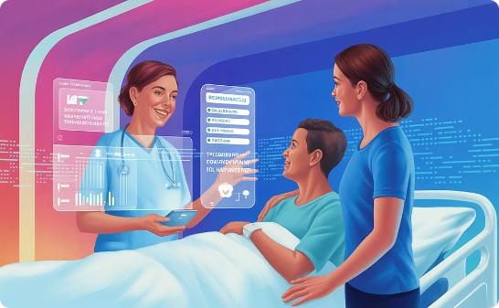
The Human Touch in High-Tech Care
Addressing Anxiety
Comfort Measures
Family Involvement
Warm greeting, hand-holding during anesthesia
Tea and snacks ready post-op
Discharge briefings with loved ones
Notes:
One of the unique aspects of DSU is that it can be the same nurse admitting the patient in the morning of surgery as well as receiving them back from theatre and then getting them discharged home. This continuity of care can help relieve anxieties and offer reassurances to patients by building a professional relationship of trust. Patients are always more compliant when they trust in the process and know what to expect.
As soon as a patient returns to DSU and they are able, oxygen is discontinued, IV fluids discontinued and diet and fluids are given – nothing beats hospital tea and toast! Removing all unessential monitoring and extra items allows patients to feel less like a patient. Isotonic sports drinks are proven to support patient’s recovery so these can also be offered post op.
If required in patients with heightened anxieties or any cognitive concerns or just on a patient’s request, discharge information can be explained while a family member is present.

Slide 38

What We Learned (Nurse Perspective)
Initial Doubts
Iterative Improvements
Overcoming ingrained beliefs about hospital stays
Adjusting protocols based on patient experiences
Support System
Mentorship and training for new nurses
Notes:
When the service commenced there were initial doubts if it would be successful or not as these patients would traditionally go to an inpatient bed post procedure for at least one night’s stay. However these initial doubts were quickly dissolved through the determination of the surgeon and the day surgery nursing staff. It was determined that is was much better for the patients as everyone wants to be in their own environment and in fact one patient was so delighted that she was getting away home in time to do the school run and it is these simple things that mean so much to patients.
There is not just a benefit to patients going home there is a benefit to the health board by reducing inpatient bed numbers and assisting to get waiting times down as the efficiency means more patients can be put through on a day

Slide 39
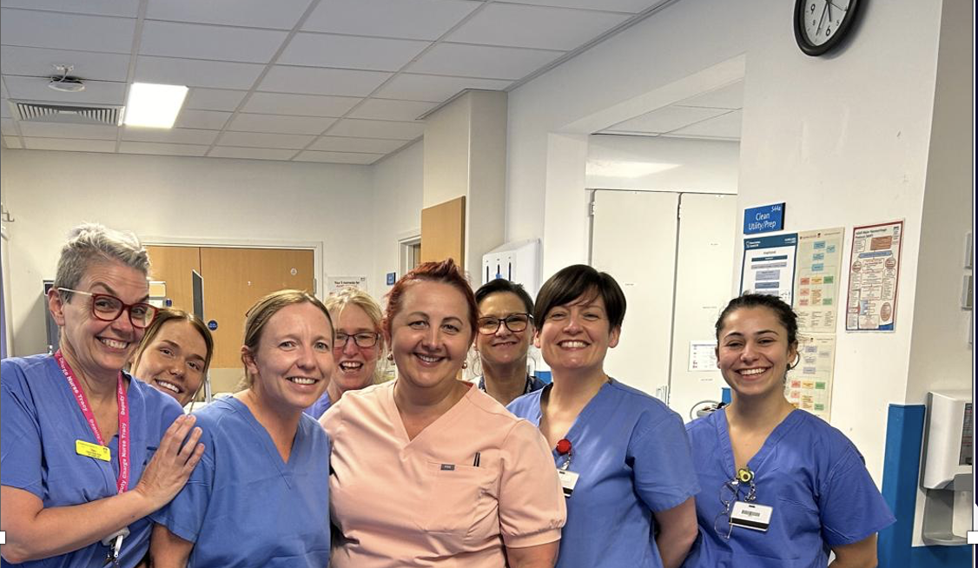
Nurse Training
Program
Discharge Assessment
Patient Education Skills
Enhanced Recovery Protocols
Safe decision-making
Robotic Equipment Orientation
Effective communication techniques
Learning pathway management
Understanding the technology
Notes:
To allow all staff to understand what was involved in the robotic gynaecology surgery, the surgeon invited all DSU to go into theatre on separate occasions to see what it involved. Staff found this to be of a huge benefit and it allowed them to discuss what happened to patients should they have any concerns.
An enhanced recovery is something all patients undergoing elective surgery should follow even if it is just a part of the process. We have already successfully adopted initiatives like sip to send for patients and this was predominately done through educations so hopefully promoting enhanced recovery is something that will just become the norm.
Hopefully we can start to teach the newly qualified nurses these principals so that from day one they are trying to achieve this for patients.

Slide 40

Discharge Criteria Checklist
Vital Signs
Stable observations for 1+ hour
Pain Management
Controlled with oral medication
Mobility
Able to walk independently
Nutrition & Elimination
Eating, drinking, and voiding
Notes:
We have a robust day surgery checklist that all patients must meet before allowing discharge. This criteria was made in conjunction with various surgeons which then allows for a nurse led discharge making for a more efficient service.
Day Surgery/Post-Operative Discharge Criteria
▪ Patient’s final set of observations must be within 10% of admission
baseline observation.
▪ Patient where possible should tolerate diet and fluids.
▪ Ensure no concerns with wounds /dressing
▪ Patient must have passed urine for specific surgeries. (i.e. all abdominal
laparoscopic surgeries)
▪ NEWS score 0-3 suitable for discharge, if 4> consult with senior staff
to discuss if discharge is appropriate - rational for discharge must be
documented in additional nursing notes section of peri-op care plan.
▪ Pain score 0-1 document analgesia given on discharge, 2> must have
a review / discussion with surgical team to ensure no post op
complication prior to discharge.
▪ Junior staff, student nurses who have not completed DSU clinical
competencies must obtain second signature from senior colleague
prior to patient discharge.
▪ Any concerns should be clearly documented and any rational given
for allowing discharge.
▪ Any patient who has undergone laparoscopic surgery should be given
dedicated patient information guideline and including details where to contact
out of hours i.e. ward/111.
All patients should be mobilised asap when able and food and drink given unless otherwise indicated. Patients are encouraged to dress back into comfortable clothes instead of remaining in theatre gown.

Slide 41

Addressing Common Patient Concerns
"Is same-day discharge safe?"
"Will I be in pain at home?"
Evidence shows equal or better outcomes
Effective pain management plan provided
"What if something goes wrong?"
"How will I manage at home?"
Direct line to clinical team 24/7
Practical support advice and resources
Notes:
Initially patients were unsure about going home on the same day of surgery but after reassurance from the surgeon which was then reinforced by nursing stay they realised the benefits of going home to their own environment and a quicker recovery overall.
All patients are provided with a care opinion card on discharge and encouraged to leave honest feedback as this is the only way that services can be improved upon is by knowing how patients feel
On the whole the feedback is always very complimentary about the service and the benefits of going home same day.
Patients are also given verbal and written instructions of what to expect, analgesia prescribed for home and who to contact if they have any concerns so they feel they are prepared even when at home.
Getting the right analgesia for home has proven to make a big difference and thankfully the anaesthetist are on board with providing adequate discharge analgesia for patients. This included, paracetamol, dihydrocodeine, +/- oramprph, antiemetic and laxatives.

Slide 42

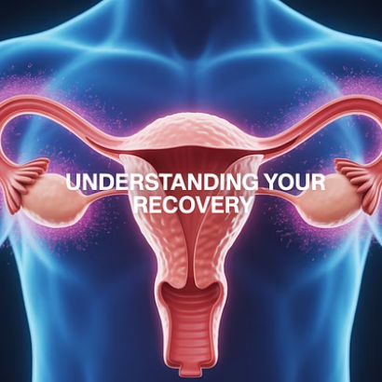
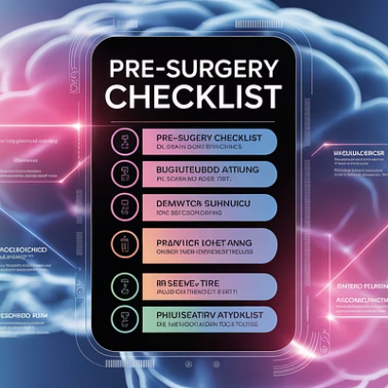
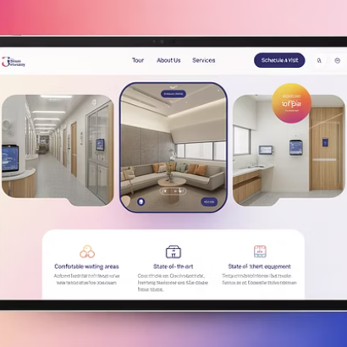
Patient Education Materials
Tools that demystify the surgical process and empower patients
Notes:
Patients are given an EIDO information leaflet at pre op and along with the information that is provided by the surgeon they should be fully equipped with all information they require for the day of surgery. This allows patients to be fully informed and gives them the power to ask any questions they require.

Slide 43
Patient Support Network
Pre-Surgery
Day of Surgery
Post-Discharge
Education sessions
Warm welcome
Written information
Preparation materials
Anxiety management
Direct line for concerns
Questions answered
Family updates
Follow-up appointment
Expectations set
Recovery guidance
Recovery resources
Notes:
Between patients having all information pre op and having spoken to the surgeon by the time they come in for surgery they should feel fully prepared.
Family should also be updated on the day of surgery so they know what to expect in regards to time frames and the process for discharge as having family support for the patient is a vital aspect in supporting same day discharge. If anyone doesn’t have any family or friends to support them initially post op at home then we are lucky that our DSU offers a 23 hour overnight service allowing this type of patient to stay and be discharged home first thing in the morning meaning it does not affect the overall flow of the department.
All discharge information is given to patients +/- family verbally but also in written leaflets in case they are unsure of anything. They will also have adequate contact numbers for concerns.

Slide 44

Notes:
Is very topical just now and we as a unit are doing everything we can to support the surgeons in building a better service for the women of Ayrshire.

Slide 45








Nursing Leadership in Innovation
Vision
Seeing possibilities for improvement
Team Building
Creating culture of excellence
Protocol Development
Designing evidence-based pathways
Outcome Measurement
Tracking and sharing results
Notes:
The surgeon’s vison to create a same discharge for robotic hysterectomy patients is now encouraging other surgeons to follow the same process as they have seen how successful it can be and the overall recovery benefits for patients.
DSU is a very team driven environment and this adapts well to promoting an efficient same day service as everyone has a common goal.
By working with the surgeon and anaesthetists it has allowed for the creation of relevant protocols and information leaflets ensuring for a safe streamlined service suitable for a nurse led discharge.
The most successful way we have of measuring our outcomes in relation to the nursing practice and service provided is through the use of patient feedback. We use the care opinion service which seems to provide patients with an outlet to leave their opinions freely. Due to the high volume of feedback received since commencing this service it has prompted the unit to create a feedback wall so that anyone visiting the department can view and see what a great service offered.

Slide 46

Mentorship in Nursing Practice
For New Nurses
For Experienced Nurses
Shadowing experienced staff
Leadership development
Structured orientation
Innovation coaching
Skills validation
Research skills
Regular feedback
Presentation opportunities
Notes:
Day surgery offers a unique opportunity to student nurses as it allows them to follow a patient from start to finish in their theatre journey. This allows them to not only learn the nursing process but also to see it from a patient’s perspective.
We also encourage students to spend time in all areas of the department as well as pre-op assessment, theatres and main recovery to see the full
process.
As with student nurses we have a competency booklet for all new staff into the department so that everyone is aware of the ethos of day surgery and how to achieve a successful same day discharge
We offer plenty of in house training sessions for all staff and this gives a perfect opportunity for staff to develop themselves.
Appraisals and revalidations for staff nurses also allow for staff to identify any areas they wish to gain more knowledge in provide avenues for discussion on how to achieve this.
DSU is an ever evolving department so it is essential that all staff keep relevant with current up to date practice to ensure patients are receiving the best high quality care.

Slide 47
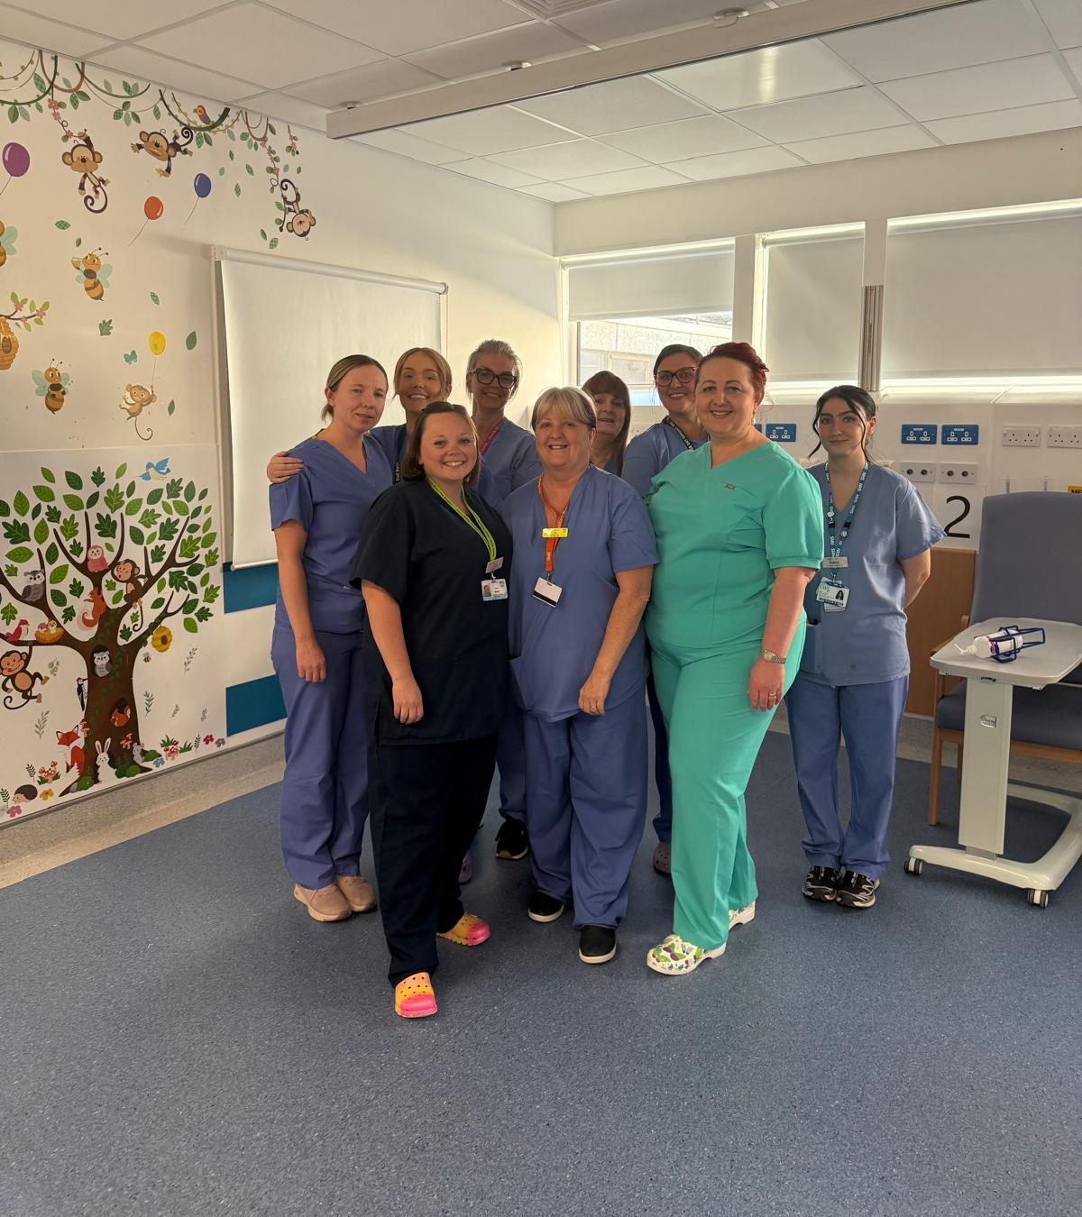



Team Communication Tools
Daily Huddle Board
Visual management of patient flow
Surgical Safety Checklist
Standardized communication
Structured Handover
Clear transfer of care information
Notes:
To assist in providing effective communication within the department we have adopted a morning safety huddle which discusses patients in the department, any clinical concerns and plans for the day ensuring everyone has a clear vision of the day ahead.
The theatre care plan has a clear documented plan from the surgeon of post op care allowing all staff to be aware of what is expected for the patient. This prevents disturbing surgeons while operating and distracting them which is not good practice.
We use an SBAR style handover ensuring that all relevant information is known about patients alleviating any mistakes from occurring

Slide 48




Overcoming Implementation Barriers
Skepticism
Share data and patient stories
Resource Concerns
Demonstrate cost-effectiveness
Workflow Disruption
Start small, refine, then scale
Staff Resistance
Involve team in design process
Notes:
The creation of the same day hysterectomy service has been an exciting process to have been part of and it is clear to see the benefits for the patients and how it helps promote a quicker recovery for them
We have been met with minimal resistance throughout the process and the longer we have been doing it the wider theatre complex/hospital has realised why it was created and its overall benefits to patients and the hospital.
As our DSU is displaced out of its purpose built department following covid this can pose a challenge as we do not have the same amount of recovery spaces. Sometimes this will create a backlog of patients into main recovery but we have many tools for helping to overcome this and make what space we do have work for us. Another reason for promoting a quicker discharge

Slide 49





Compassionate Care Elements
Emotional Support
Clear Communication
Physical Comfort
Addressing fears and concerns
Jargon-free explanations
Warm blankets, positioning help
Family Inclusion
Updates and discharge teaching
Notes:
All patients deserve compassionate care. Being compassionate is part of nurses NMC code of conduct and should come naturally to everyone. The simplest things can make a huge difference to patients,
Tea and toast
Listening ear
Warm blanket – a must for everyone
Explaining anything they are unsure of
By providing these simple things to patients it can help them to feel more relaxed and trusting of the process
Just because we promote a quick discharge – it doesn’t me we don’t care it means that we want patients to recovery quickly and get home to their loved ones as generally that is what is important to people.

Slide 50




Continuous Improvement Process
Identify Challenge
Team Discussion
Patient feedback or staff observation
Multi-disciplinary solution finding
Monitor Results
Protocol Adjustment
Track outcomes and satisfaction
Implement new approach

Slide 51
Nurse-Led Innovations: The Future
1
Pre-op Anxiety Reduction Kit
Breathing exercises, guided imagery
2
Discharge Preparation Timeline
Visual countdown to going home
3
Recovery Milestone Cards
Celebrating progress steps
4
Patient Partner Program?
Former patients mentoring new ones
Notes:
Hopefully as the prospect of same day discharge becomes more popular it is recognised as the way forward and we can adopt it for every speciality, giving every patient the opportunity to go home if able.

Slide 52
Notes:
Hopefully from a nursing point of view this has given you an insight into the service we provide. We are very proud of what we are able to achieve and hopefully it will just continue to keep growing for the benefit of all patients.
Questions?

Slide 53




Women's Health Equity Improvements
Reduced Wait Times
Local Access
From 2+ years to months
No travel burden for complex care
Less Family Disruption
Faster Return to Work
Home same day for caregivers
Economic impact for women

Slide 54

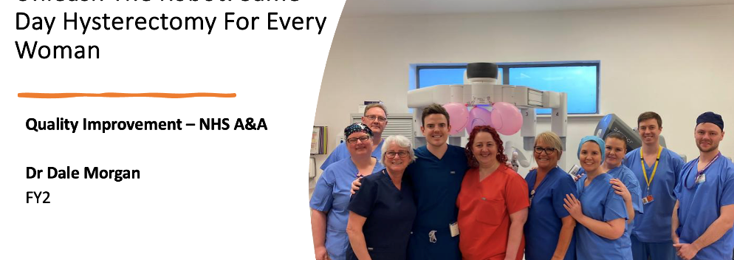


Sharing of Results
ERAS Conference 2024 Malaga
ESGE 2024 Marseille
BIARGS 2024 Liverpool
Notes:
- What has been achieved with progress

Slide 55
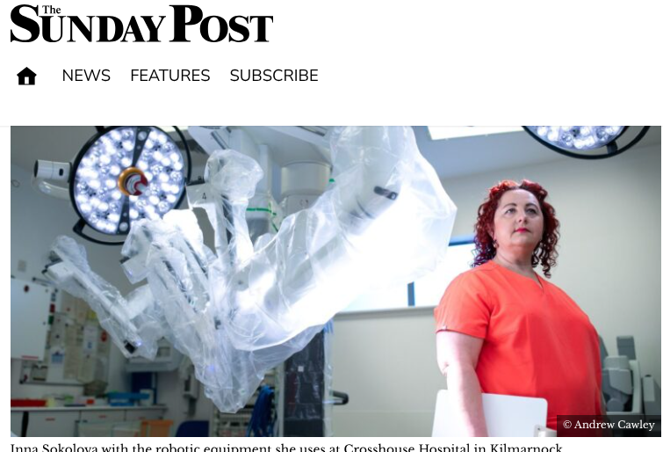
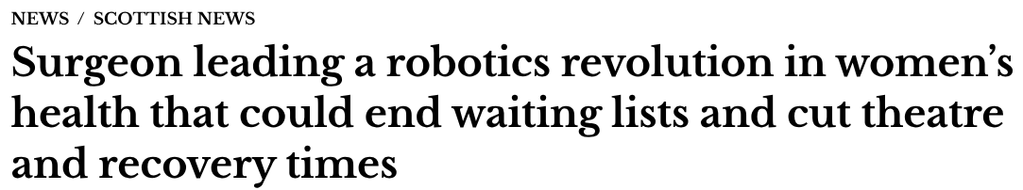

Slide 56
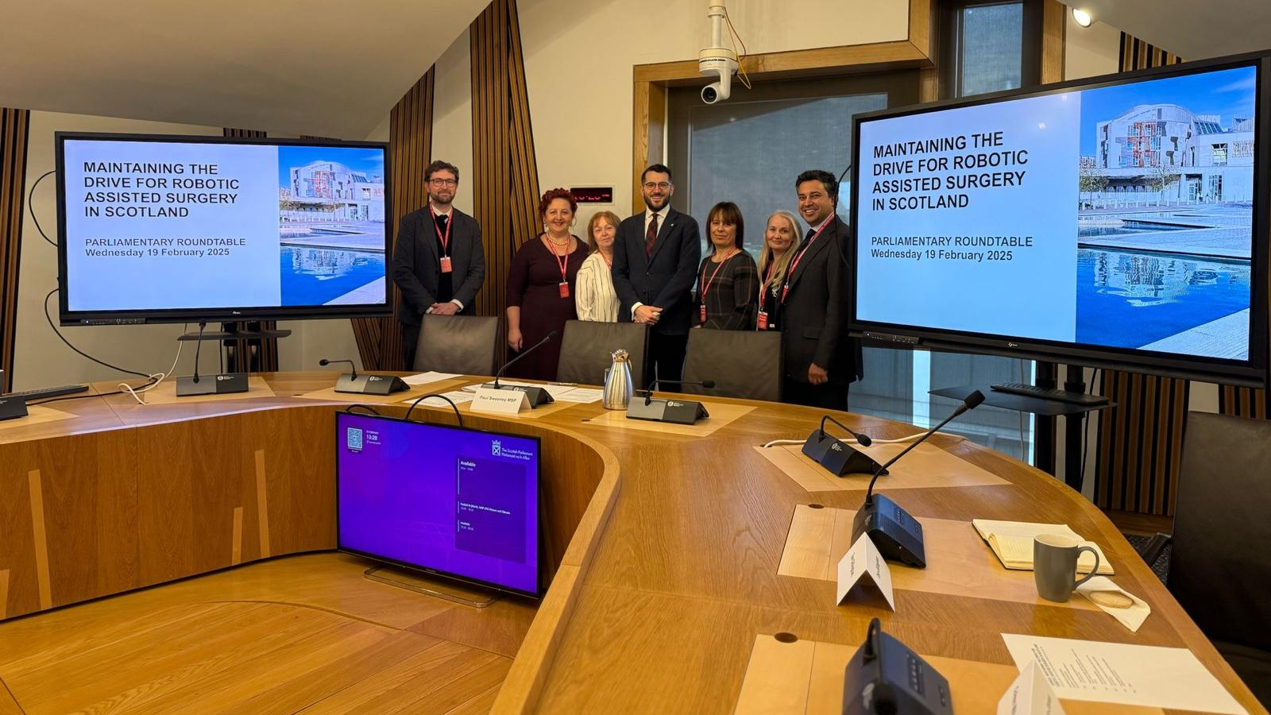

Slide 57

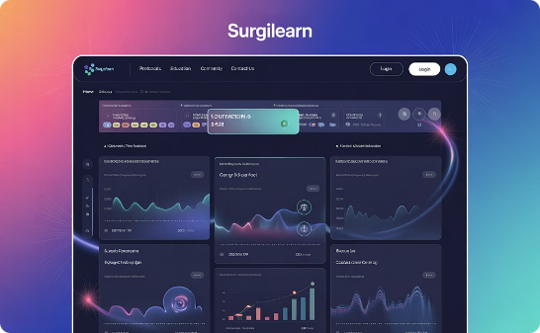
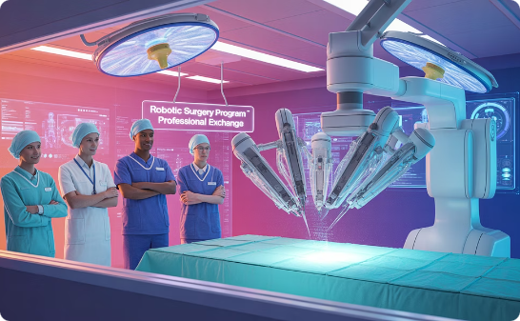
Knowledge Sharing Network
Training Course
Resource Sharing
Site Visits
Annual "Same-Day Hysterectomy" program
Protocols and materials available
Observational learning opportunities

Slide 58
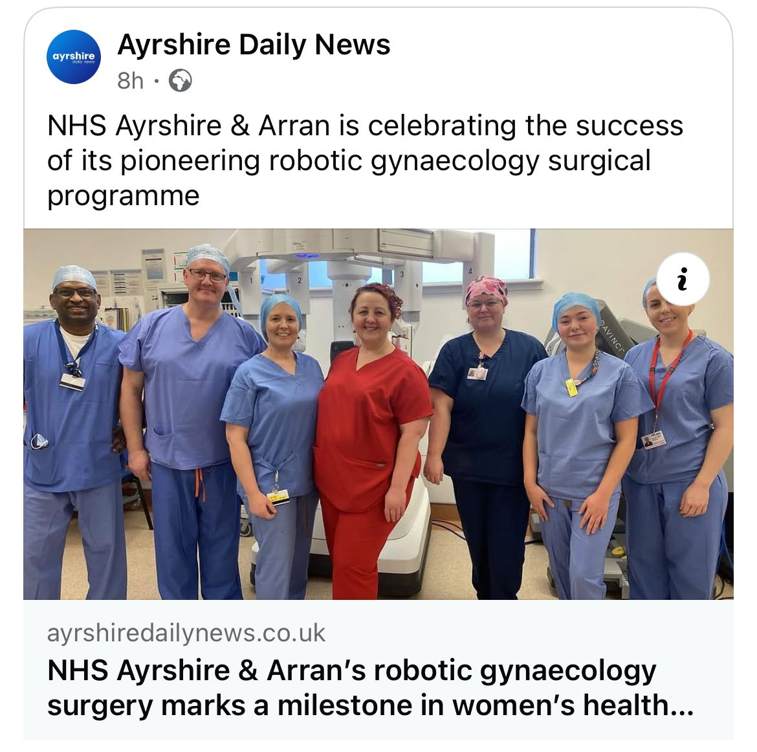




Renewing Women's Healthcare Together
Embrace Innovation
New techniques, pathways, technologies
Improve Access
Shorter waits, local treatment options
Ensure Equity
Address historical gaps in women's care
Collaborate Across Scotland
Share successes, learn together

Slide 59

Same Day Discharge Hysterectomy Course
1
When
5th September 2025, 8:45-5PM
2
Where
Medical Education Centre, Kirklands Hospital
3
Who
Expert faculty including Dr Sokolova, Dr Gherghe, Dr Martin
4
Apply
Email Sheryl.Houston@lanarkshire.scot.nhs.uk

Slide 60


We are the CHAMPIONS!
DSU team University Hospital Crosshouse
Same Day Hysterectomy Pathway
Ayrshire Achieves 2025 Finalists!

Slide 61


