Slide 1
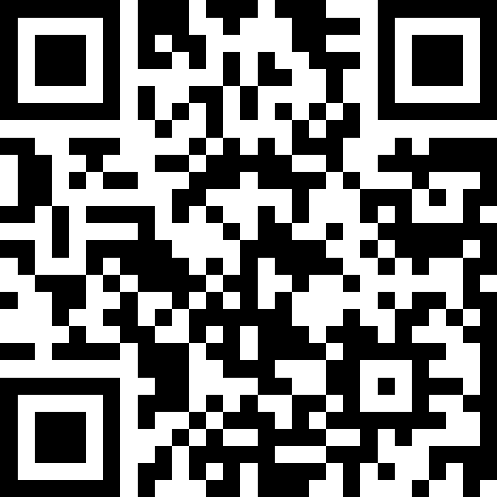
NHS Scotland Event 2025:
NHS Renewal; Protecting and Strengthening Scotland’s Health and Care Services
Integrated Clinical Hub - The Scottish Ambulance Service Evolution
Date: Monday 9th June
Session Time: 11:15 – 12:30
Slido – QR Code

Slide 2
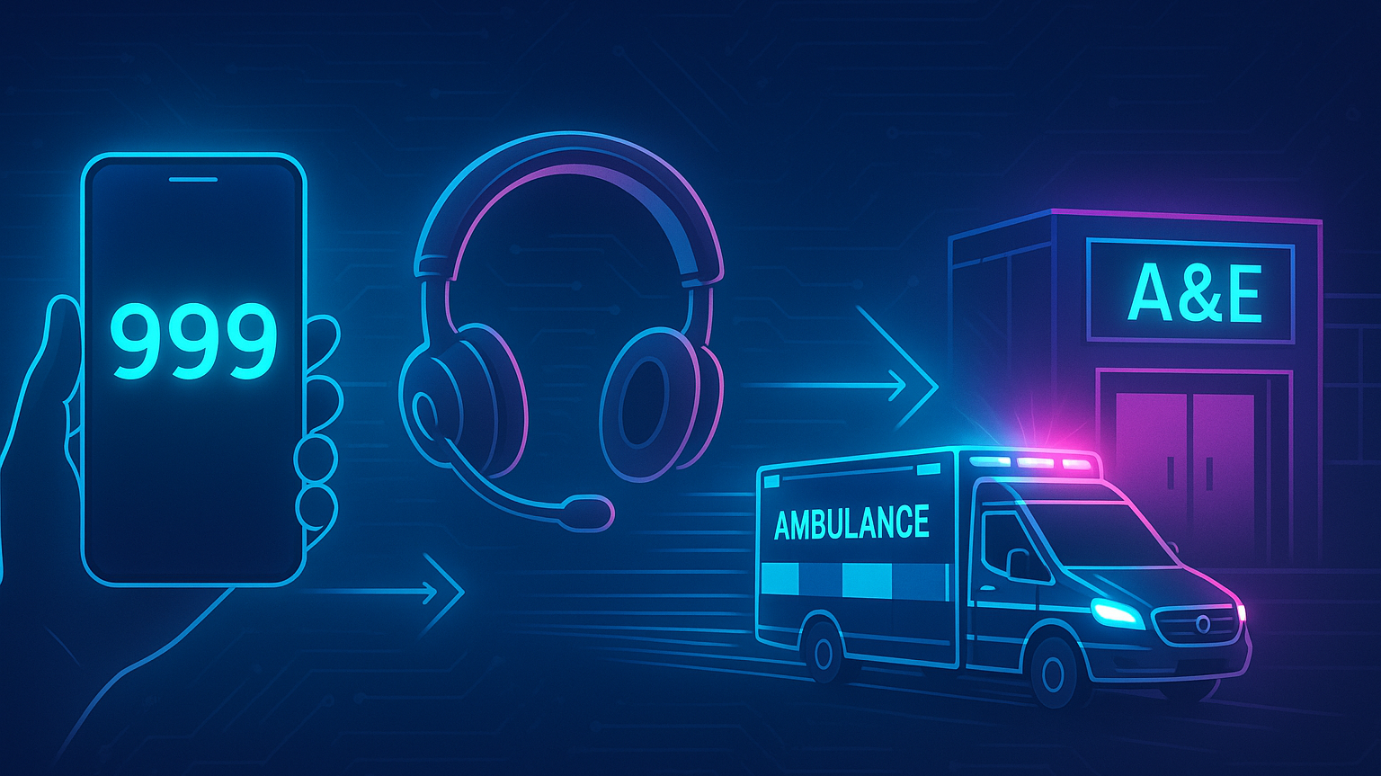

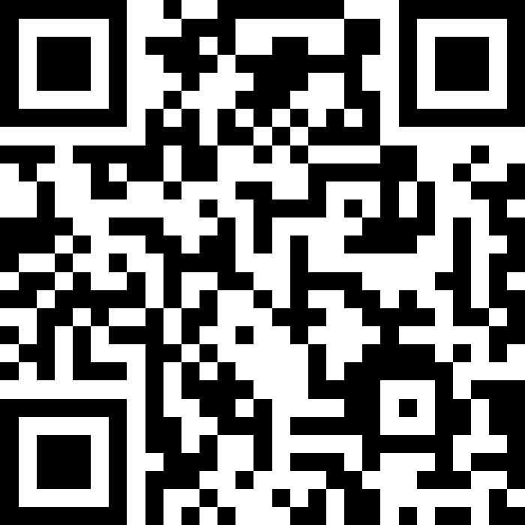
Welcome!
Q&A Link
Dr Jim Ward, Medical Director
Steph Jones, General Manager Integrated Clinical Hub
Julie King, Clinical Services Transformation Manager

Slide 3
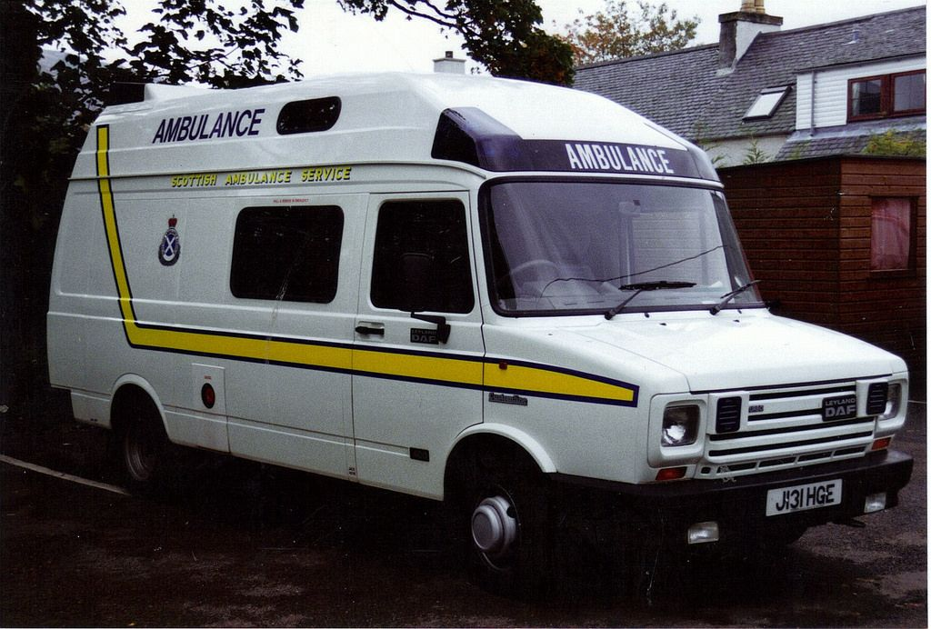
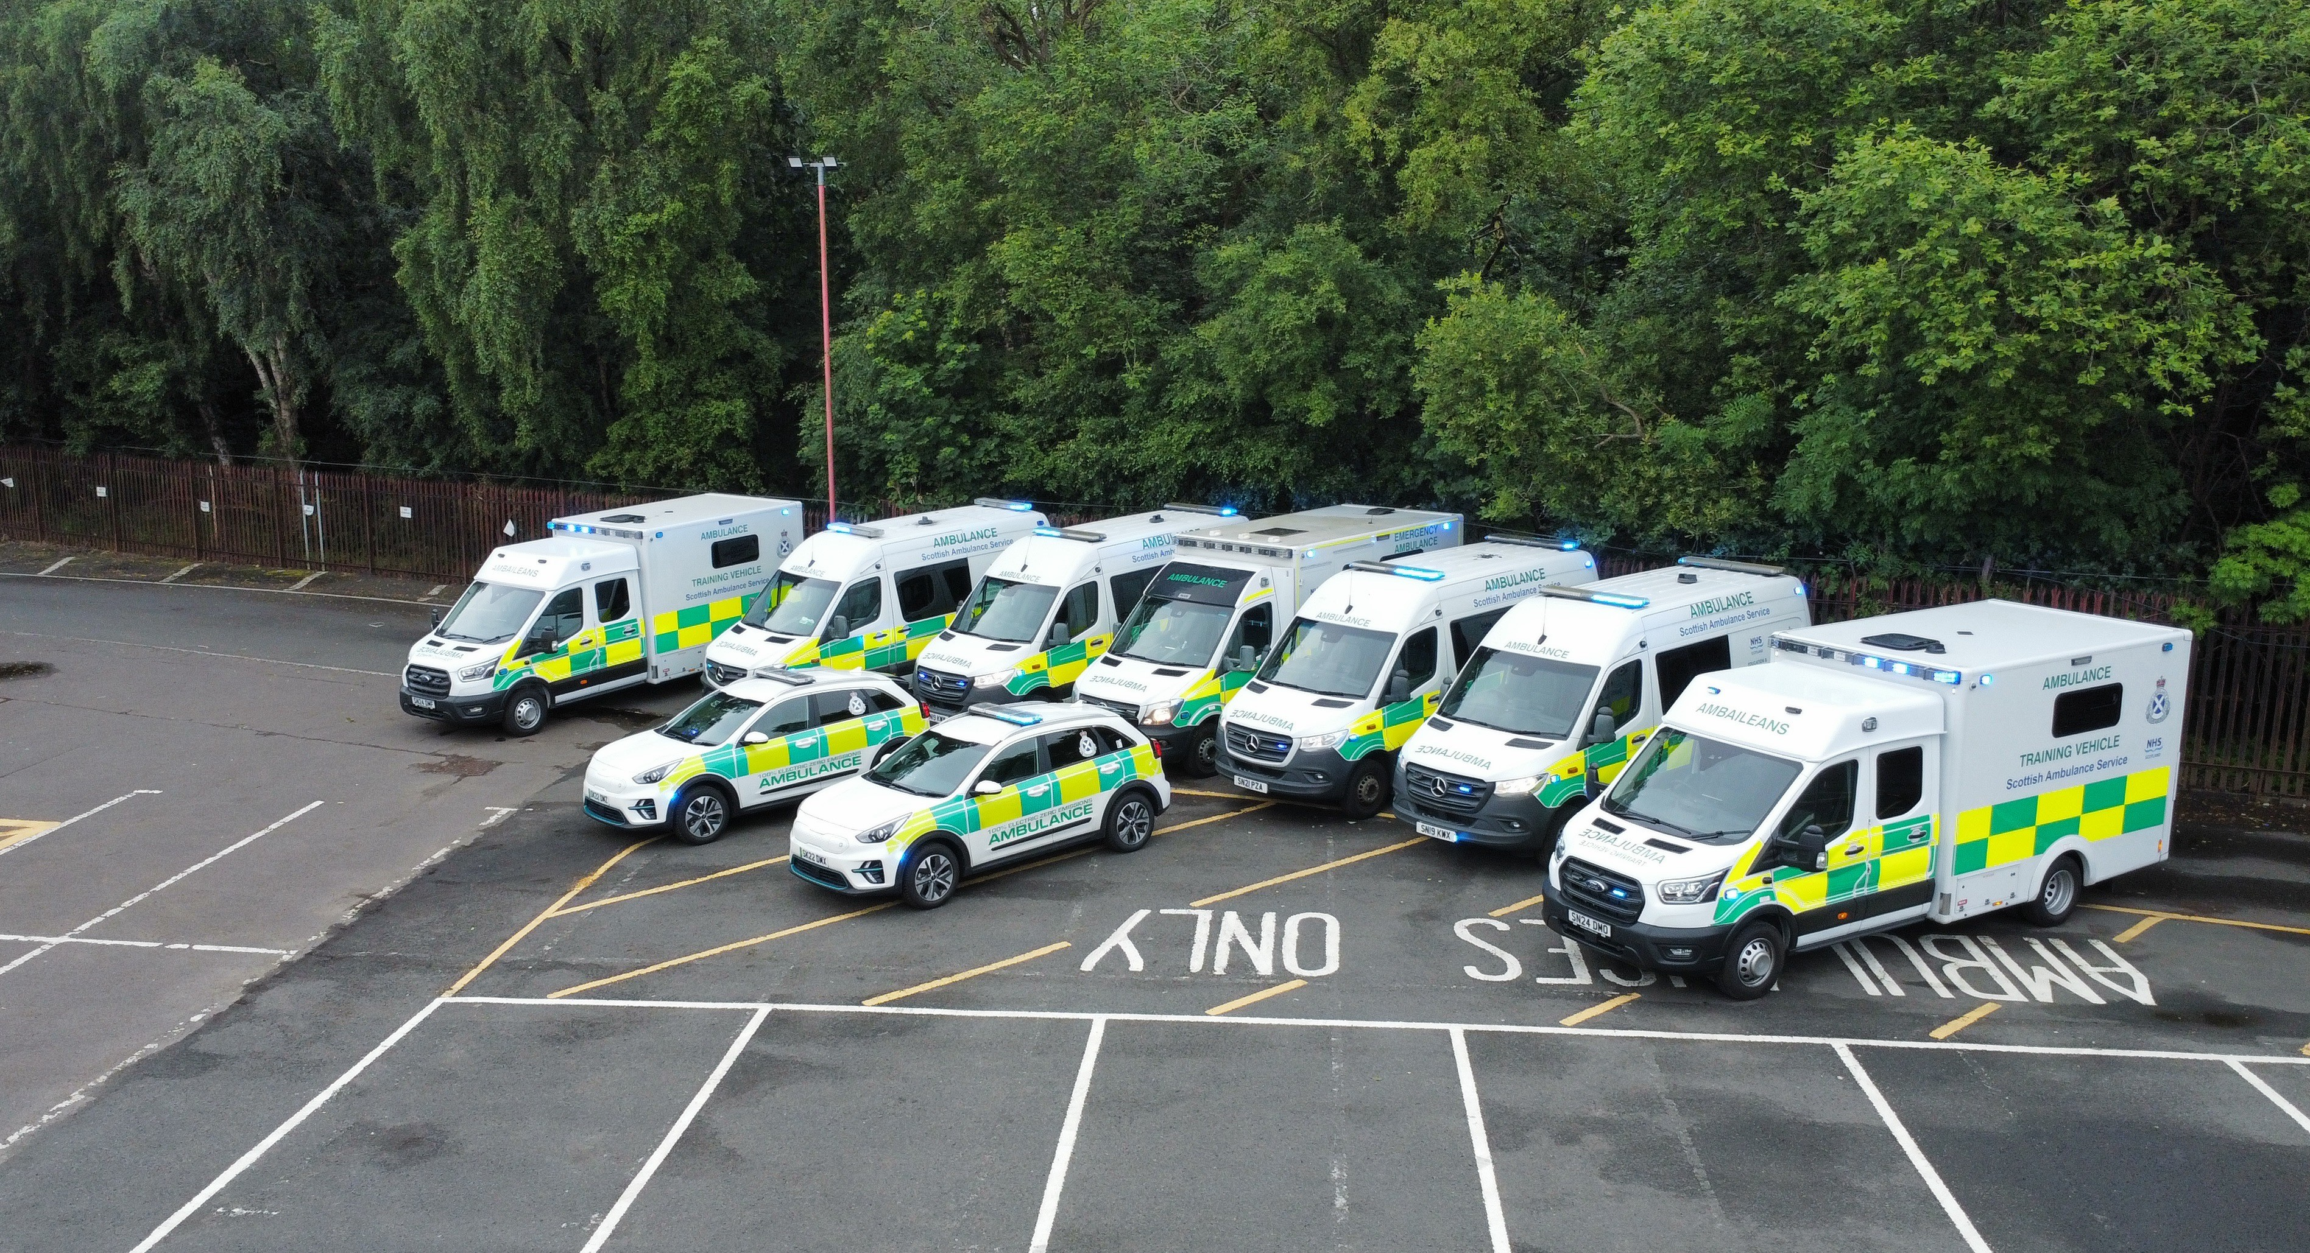

Slide 4
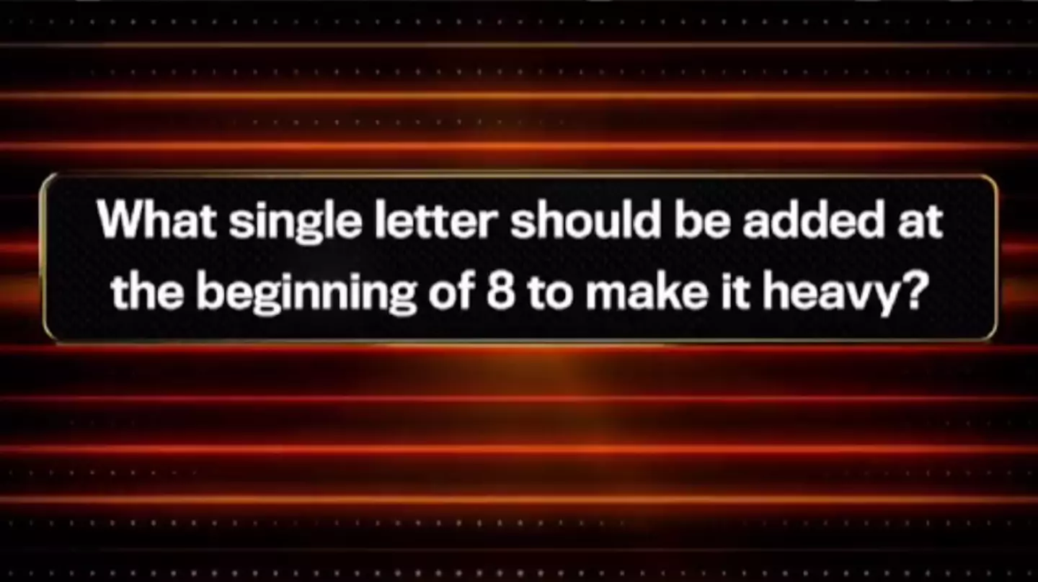

Q&A Link
Question:
What is currently out of scope of the Scottish Ambulance Service?
A
Taking sick patients to hospital
B
Referring patients directly into acute services
C
Putting out fires
D
Issuing prescriptions to patients as an alternative to an ambulance response

Slide 5
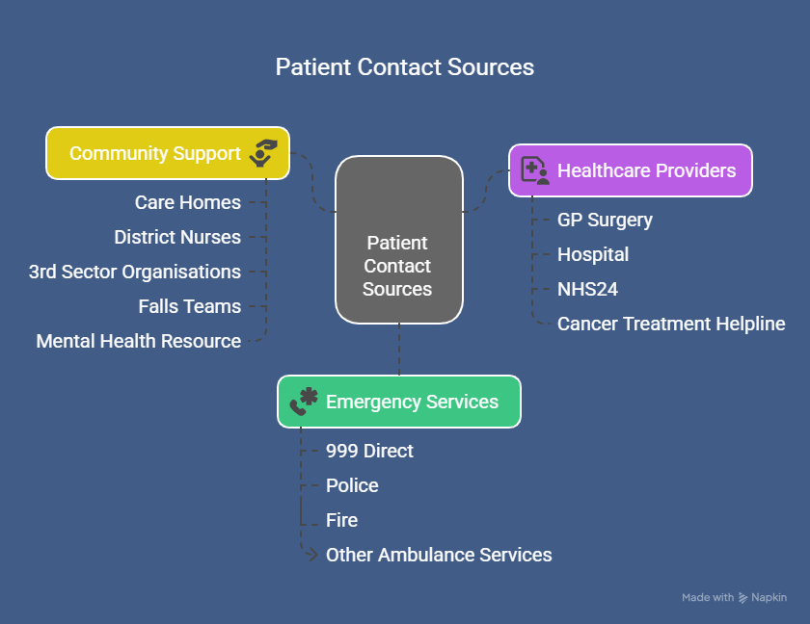

1,111,598 calls
in the past 12 months

Slide 6
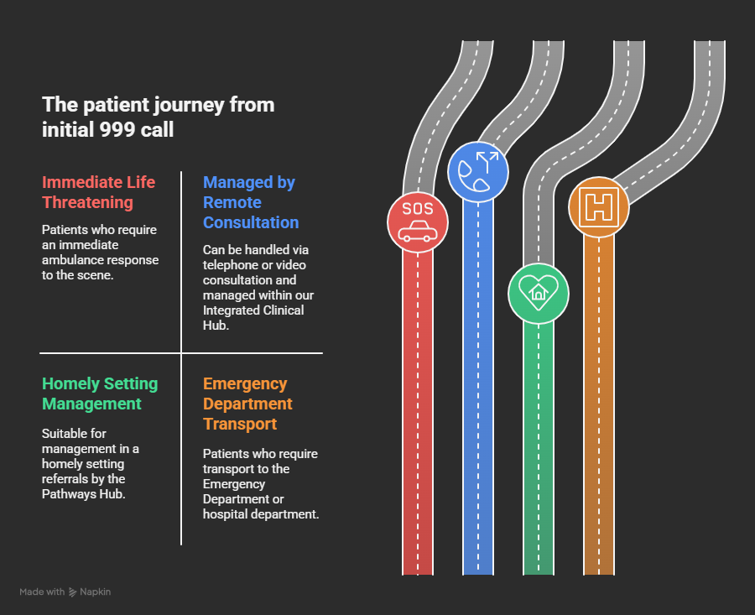

Slide 7
Q&A Link
Question:
On average how many people per day, do SAS manage by telephone/video consultation, or in a homely setting?
A
> 1
B
> 10
C
> 100
D
> 1000
Answer

Slide 8

The Concept
“SAS will provide pre-dispatch assessments for all patients who first present as non-Immediately Life Threatening (ILT) and may benefit from a further virtual consultation.
A blended clinical skillset will practice within an Integrated Clinical Hub defined by forecasted workforce planning functions. In order to achieve more appropriate clinical outcomes, increased patient safety and more suitable resource allocation.”

Slide 9

The Interactions

Slide 10
The Outcomes
55,000 saved ambulance journeys
20,000 patients had no further contact anywhere across NHS Scotland within 24 hours
999 call to patient assessment within 10 minutes for higher acuity patients and 25 minutes as a median time to interaction

Slide 11

The Concept
“SAS will strengthen our ability to deliver more care closer to home across all communities through upskilling our frontline clinicians, increasing access to pathways and availability of senior decision support.
Through practicing Realistic Medicine we will achieve more appropriate clinical outcomes, improve patient experience and support the wider system.”

Slide 12


Conveyors to Referrers
71% of respondents felt that SAS clinicians completely understood and addressed their concerns
81% felt that SAS clinicians fully explained the options available to them
92% of respondents felt involved in the decision-making process about their care

Slide 13
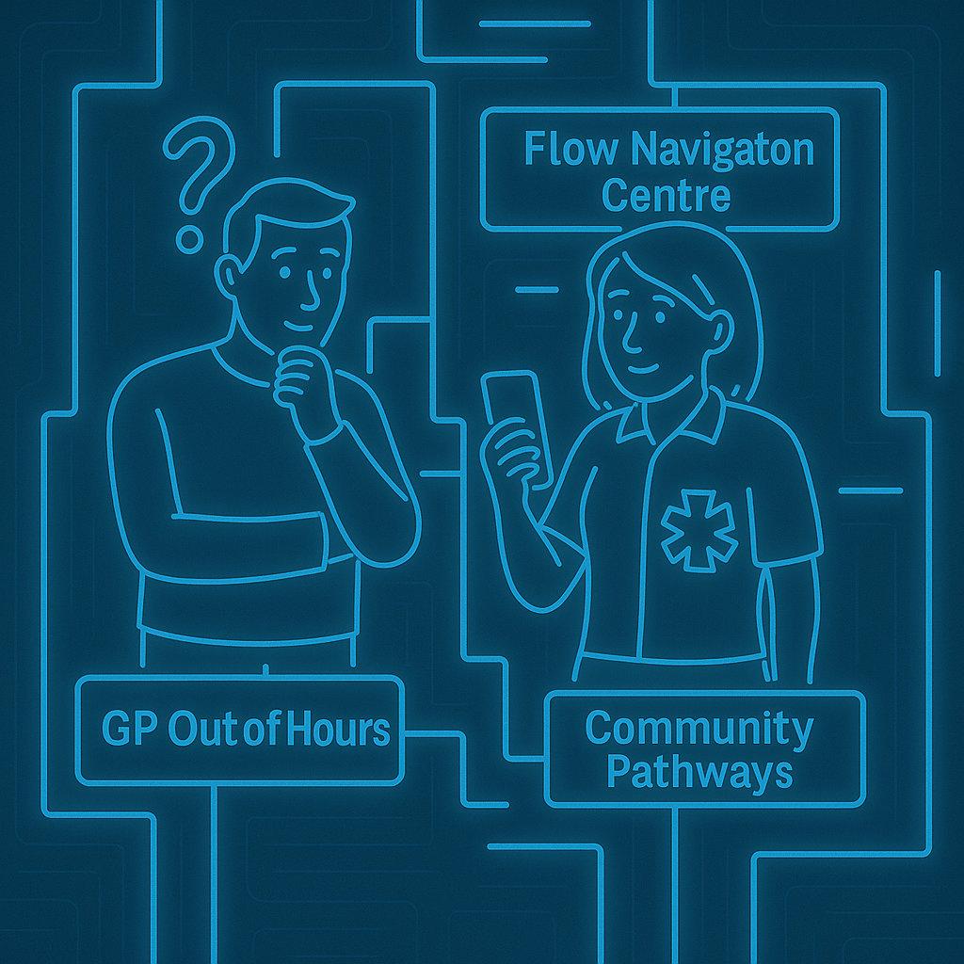
A “Complex” System
Every community is different
Availability and reliability of pathways matters
Joined up working benefits the whole system and those in it

Slide 14
Q&A Link
Question
If the average ambulance journey is 10 miles to the closest ED, how far could you travel, due to all the saved journeys in the past 12 months?
A
Glasgow is just up the road
B
Spain is lovely at this time of year
C
Bondi Beach here we come!
D
157 times round the planet!

Slide 15

Patient Feedback
The clinician I spoke to was an absolute Angel who reassured me and my daughter in a scary situation, gave us the appropriate medical advice going forward but also listened and cared! She was amazing, couldn’t have asked for better help !
“I was worried that it was not important enough to call 999, but both the call handler and the clinician made me feel that I had done the right thing. The clinician gave me instructions and stayed with me on the line until my blood sugars began to recover.”
“Video call was very reassuring unfortunately though although we attended A&E as suggested we did not get seen after waiting for 5 hours so returned home then saw doctor at surgery next day.”
“The service and care my son received gave me peace of mind knowing they were able to assess the situation - I didn’t want him to go to hospital and they left and told me you know where we are if you need us, and because my son does not have a voice and is blind, they gave me peace of mind.”
“SAS attended to my husband who had end stage lung disease. Thanks to their care and transporting him to hospice care. He had a more peaceful and settled last few days”
“I am extremely grateful to the amazing ambulance paramedics for their understanding, empathy and care. They made a very scary situation seem much less frightening and were very reassuring THANK YOU”

Slide 16

Collaboration Opportunities?
Where can we better work together for our patients?
How can SAS access more care pathways for patients in the community?
How can we help reduce demand on your services alongside you?

Slide 17
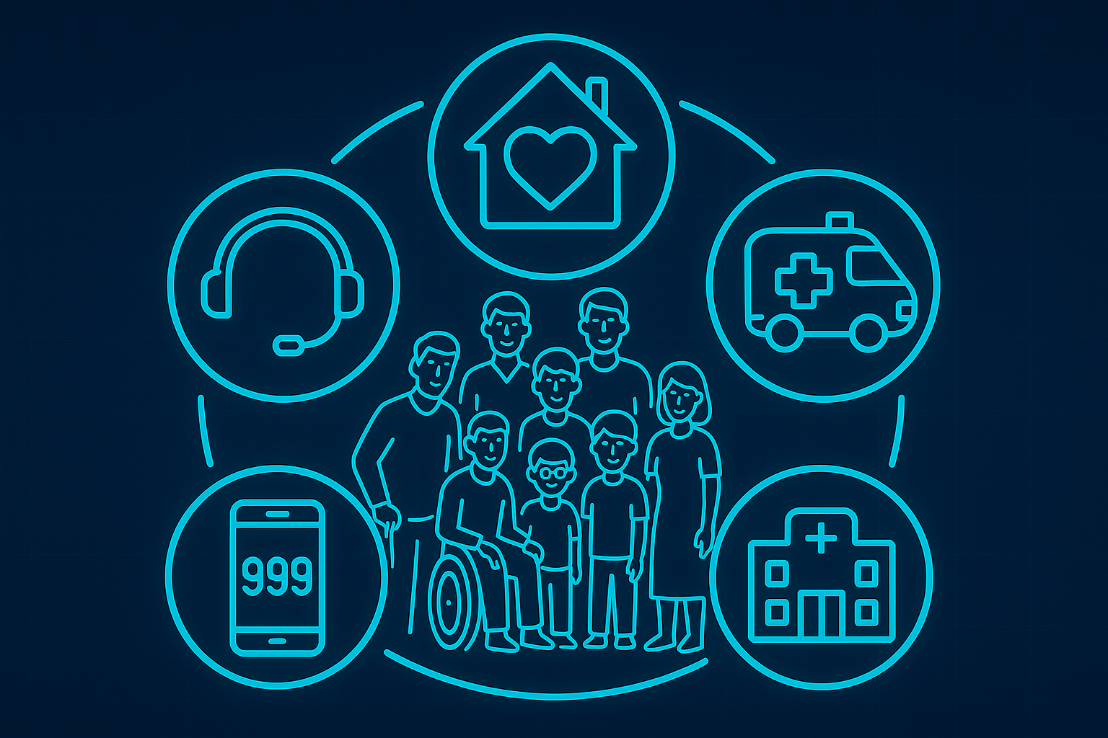

Slide 19
Thanks for listening!
We would love to hear your questions!
Q&A Link

