Slide 1

Discharge (Home) to Assess:
Shifting the Balance of Care
Slido – QR Code
Session Time 13:30 – 14:45

Slide 2

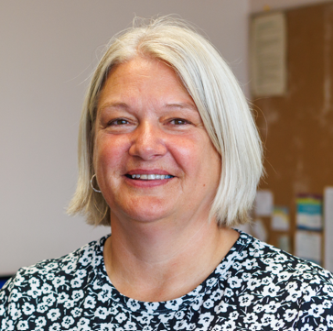

Speakers:
Rob Murray
Director for Scotland
British Red Cross
Lynne Morman
Associate Locality Manager Urgent & Unscheduled Care
Dundee HSCP
Lyndsey Dunn
Service Manager, Community Flow, Integrated Discharge Teams and Community Specialist Services
Fife HSCP

Slide 3

Questions

Slide 4




Introduction
The British Red Cross (BRC) has been supporting health and social care systems since the NHS was established.
We are focussed on health equity by improving access to care and support for those experiencing the greatest barriers to improved health and wellbeing.
We are trusted by the people we support and organisations we work with. We have a strong track record, a national infrastructure, combined with our responsiveness and local flexibility to ensure the highest quality services.

Slide 5
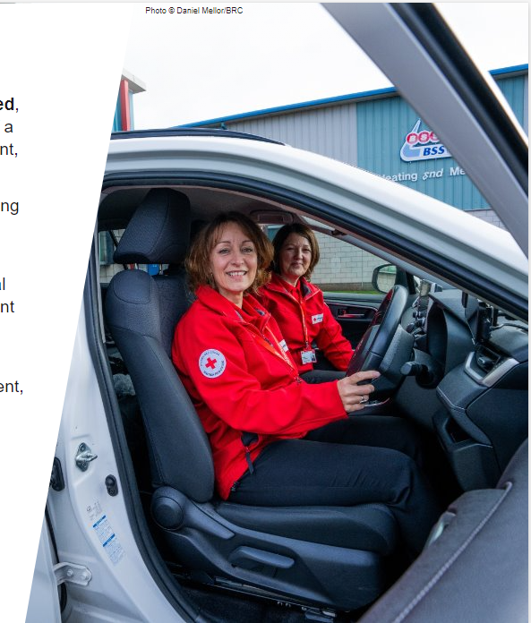
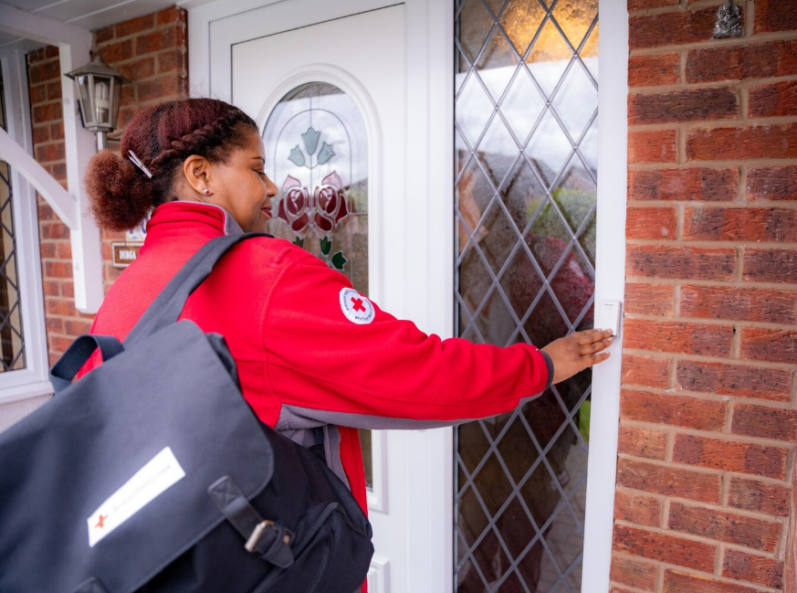
Discharge/Home to Assess
Service enabling people to leave hospital as soon as they are clinically able.
Continuous assessment in their home over the 21-day period.
Person-centred care and personalised support.
Short-term model - typically up to 21- 28 days, with 24-hour wrap around care where required.
Registered service – under Care Inspectorate.

Slide 6




Utilising technology and digital solutions
Reduce hospital admissions
Reduction in hospital bed days
Supporting carers
Core objectives
Reducing the reliance on care homes
Reduce level of care packages
Building up independence of the supported person

Slide 7
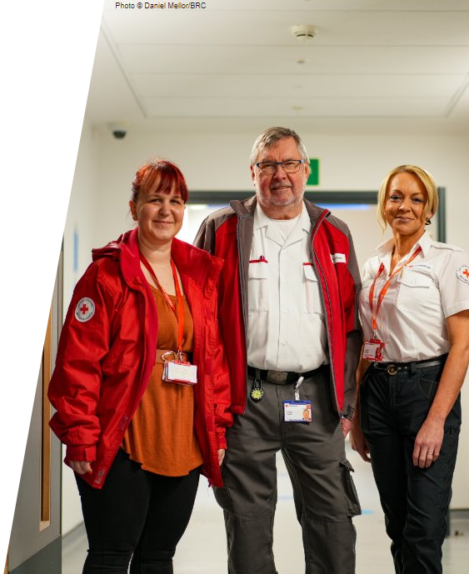
The model
Activities undertaken by the service include:
  Assessment and support planning
  Personal care
  Medication administration
  Support with daily living activities
  Signposting / referrals to other community services

Slide 8
The model
The Discharge to Assess (D2A) model is adapted to align with each area's needs and pathways.
Hospital Care
Assessment Period (up to 21 days)
Typical Destinations
Hospital Discharge
& Front Door
Teams
British Red Cross D2A
British Red Cross & Multidisciplinary Team
British Red Cross D2A
British Red Cross
D2A
Assessments carried out in a person’s home
Ongoing assessment and review.
No ongoing support package required (e.g. use of assisted tech etc)
Candidate patients identified (uncertainty around ability to cope at home)
Bespoke, outcome based, support plan agreed with a person and multi-agency team
Conclusion of Support
Typically tapering of support
Candidate patients referred to D2A Service
Person remains at home. Support transferred to long term community care provider
Person transferred to 24 hour care setting
Readmission to hospital

Slide 9
The difference we made

Slide 10
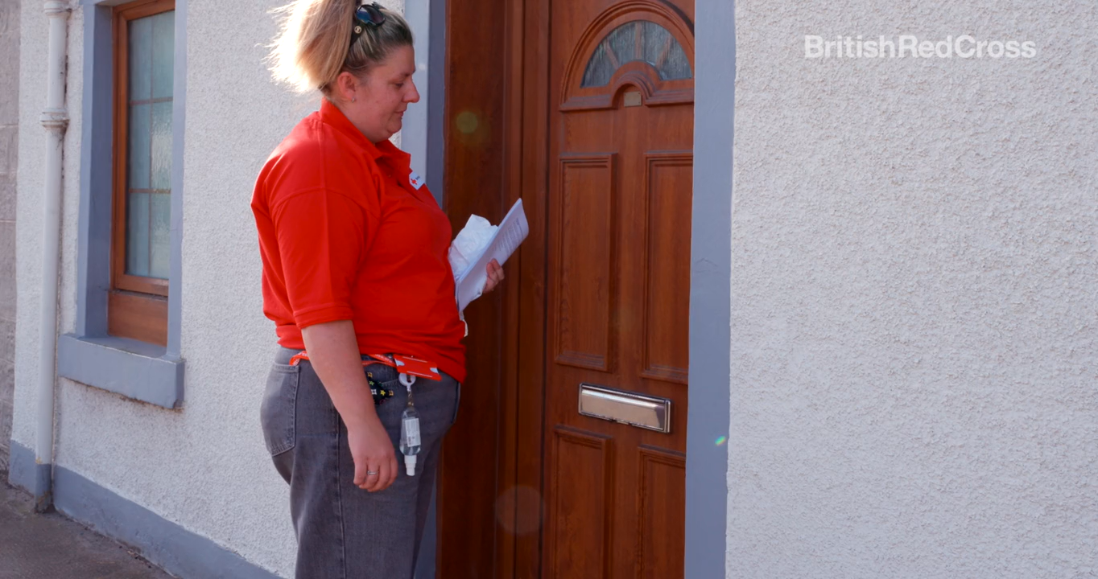
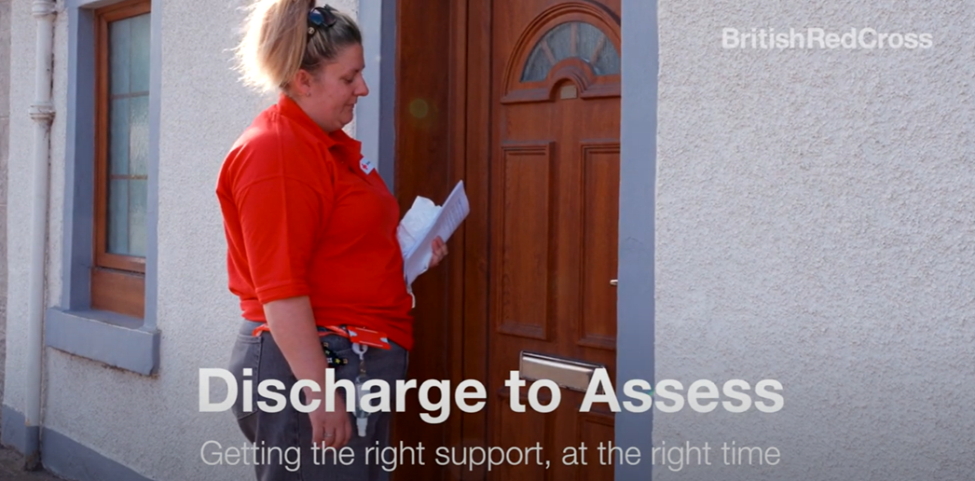

Video

Slide 11
Dundee Service

Slide 12
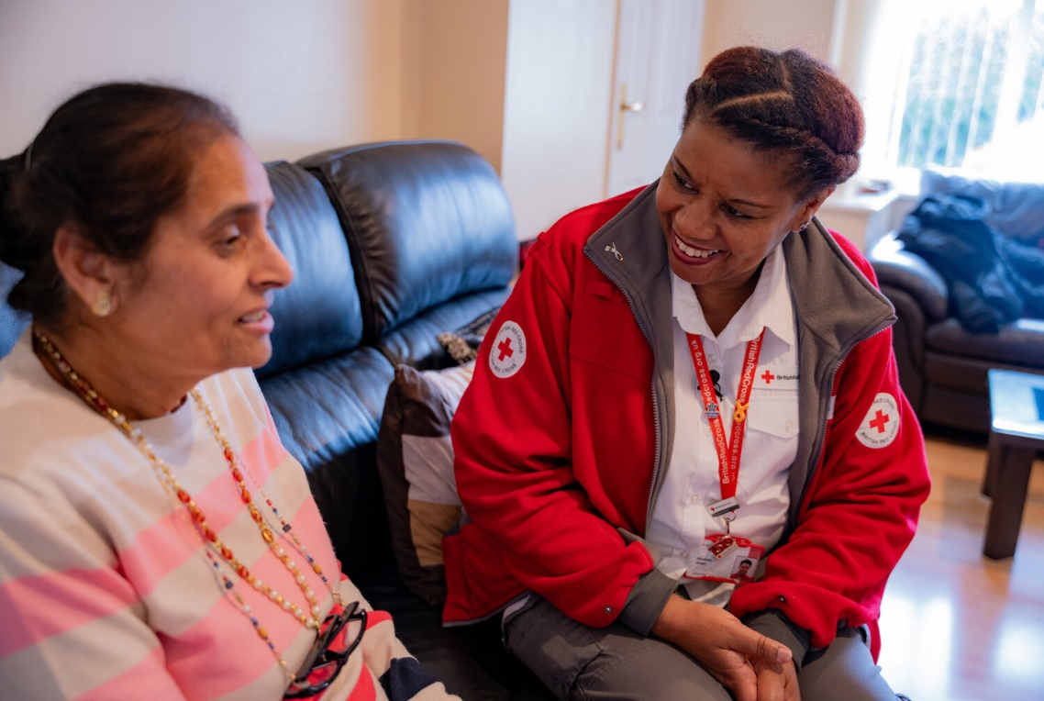
Dundee D2A
Dundee HSCP D2A Test of Change (Phase 1) ran between April 2023 and July 2024.
Based out of Ninewells Hospital in Dundee. The team work as partners with Dundee's Discharge Team.
The D2A service was born based on the success of the previous Red Cross Assessment service in Dundee.

Slide 13

75%
Impact
Our Discharge to Assess tests of change focus on people initially assessed in hospital as requiring a care home placement or uncertainty about their ability to live at home and our service offers an alternative option.
of the people supported
remained at home
36%
of the people remaining
at home, required no
further package of care
Only
6%
of the people we supported required to go into residential care
These impacts were achieved from Dundee test of change April 2023 - July 2024 with 140 people supported.

Slide 14
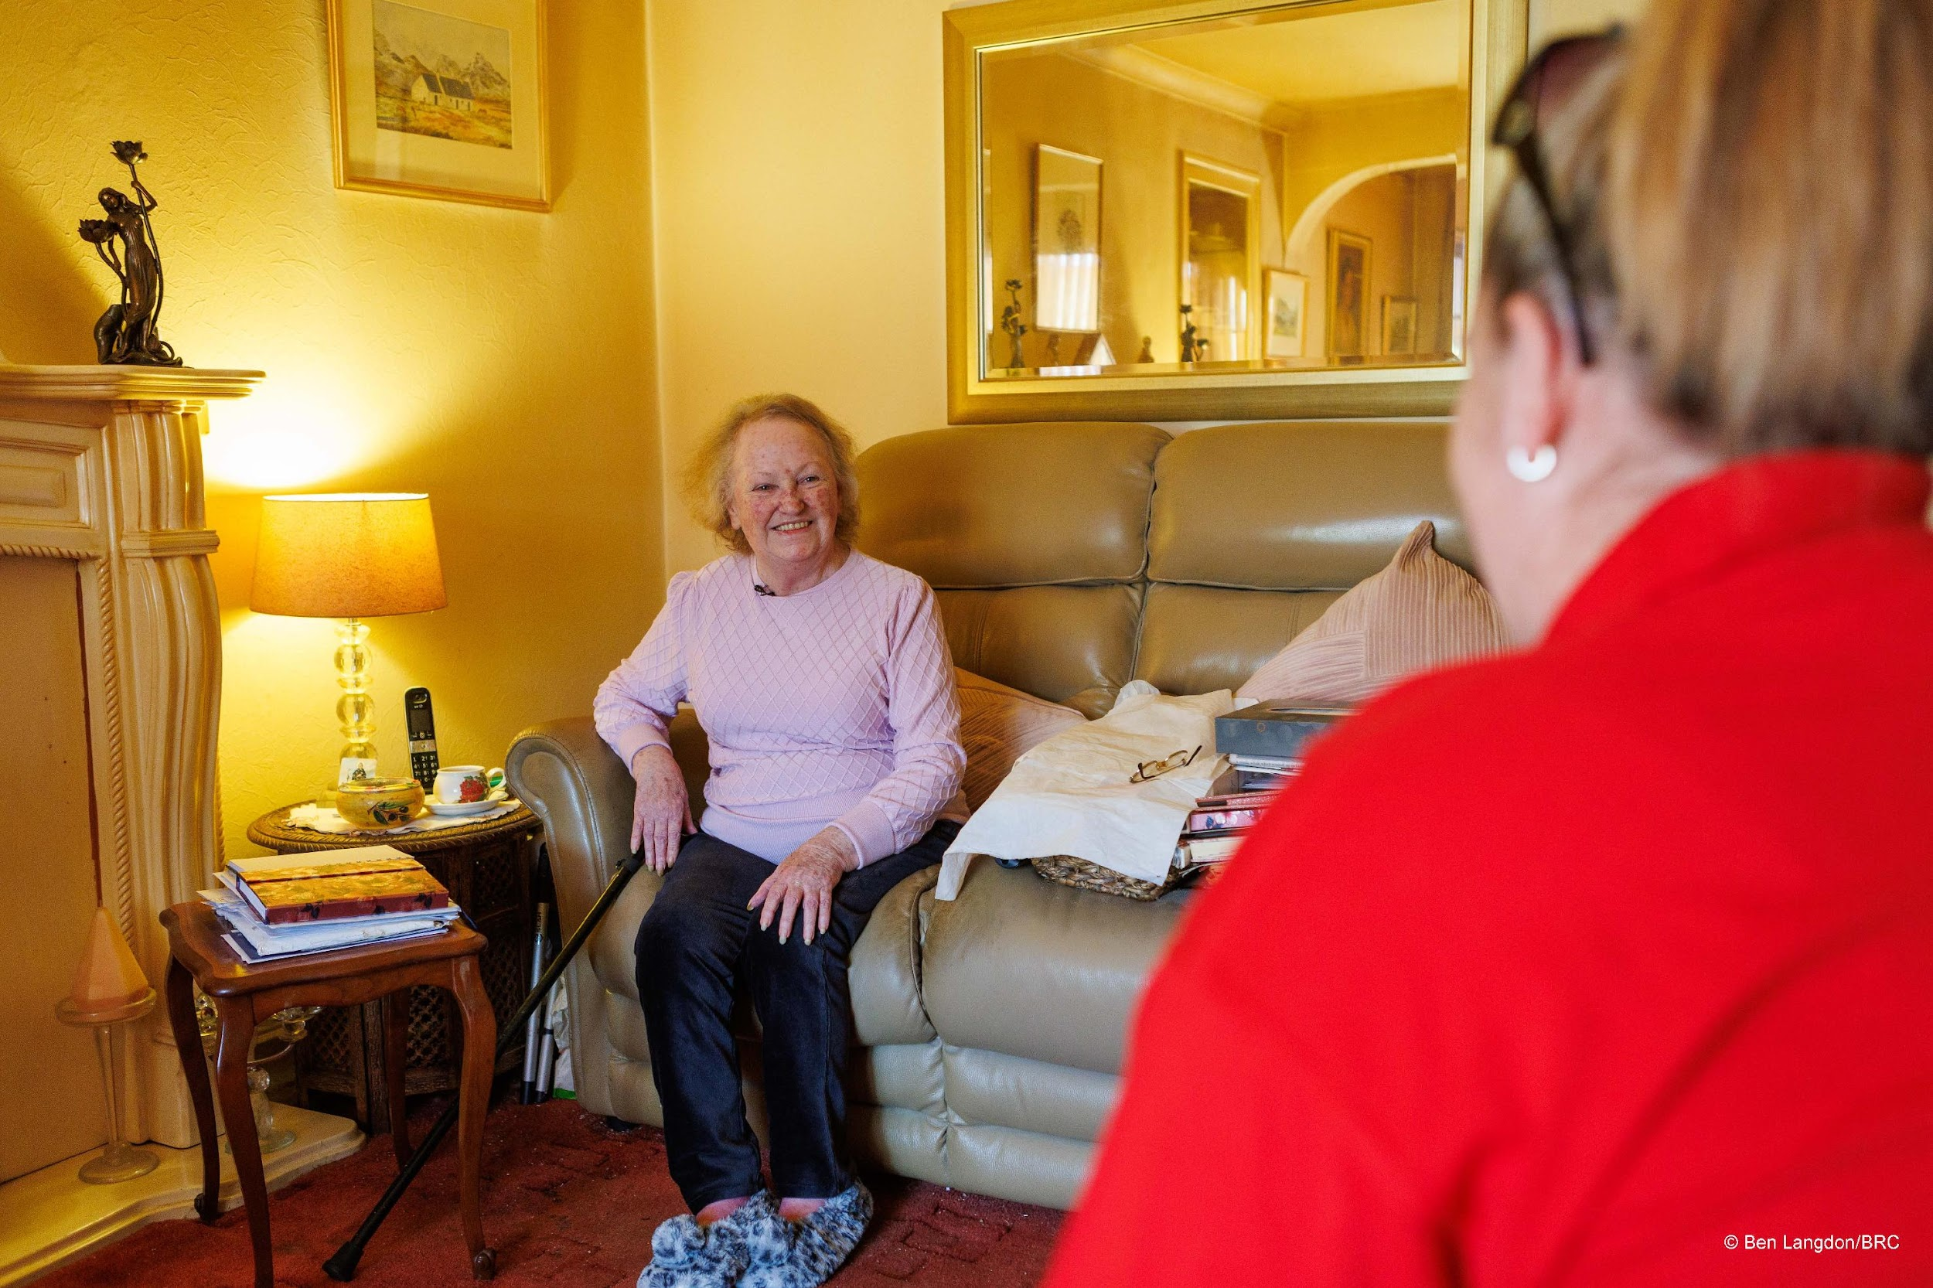
Phase 2
In light of an emerging frailty model and opening of another Acute Medicine for the Elderly (AME) unit, Phase 2 of the service was launched.
Phase 2, moved away from Dundee Enhanced Care at Home Team (DECAHT) and instead would support the front door.

Slide 15

D2A Assessment Outcomes
Only 16% of patients discharged with D2A resulted in a move to 24-hour care.
84% patients remained at home with services – requiring either a POC less than was anticipated on discharge, or no care package at all.

Slide 16

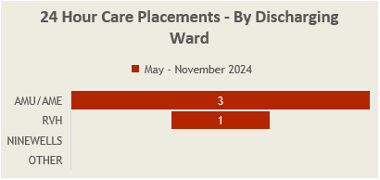
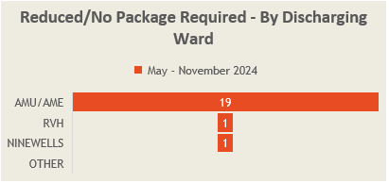
D2A Assessment Outcomes
The majority of patients assessed as requiring 24-hour care were discharged from AMU/AME.
Likewise, the majority of patients who were able to stay at home with/without services were discharged from the front door area.

Slide 17

D2A Assessment Outcomes
Since Phase 2 commenced, we can see a sustained reduction in the number of bed days lost to delay in the front door area (AME).
In July and November, there were no delays at all.

Slide 18
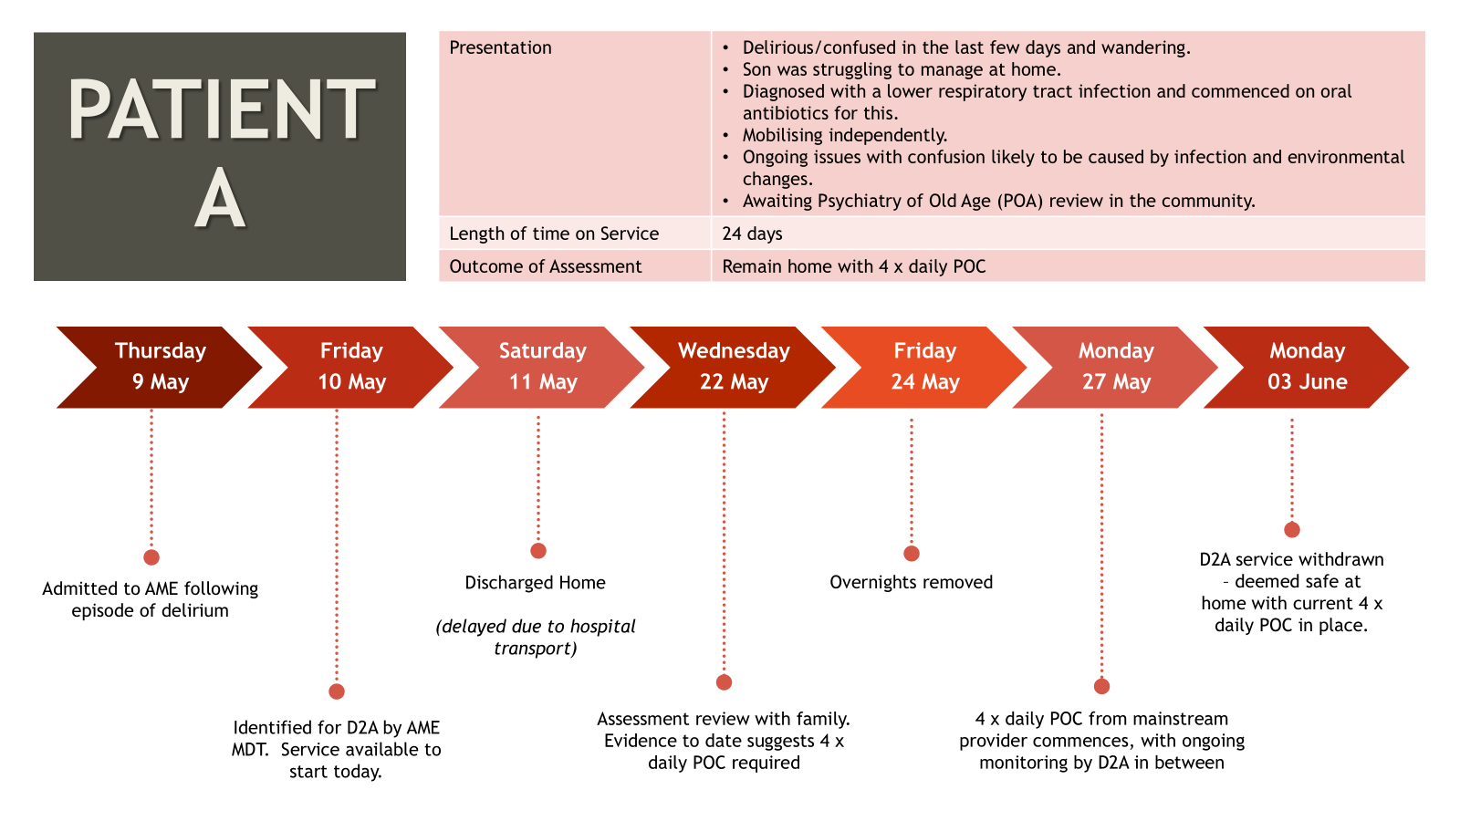

Slide 19
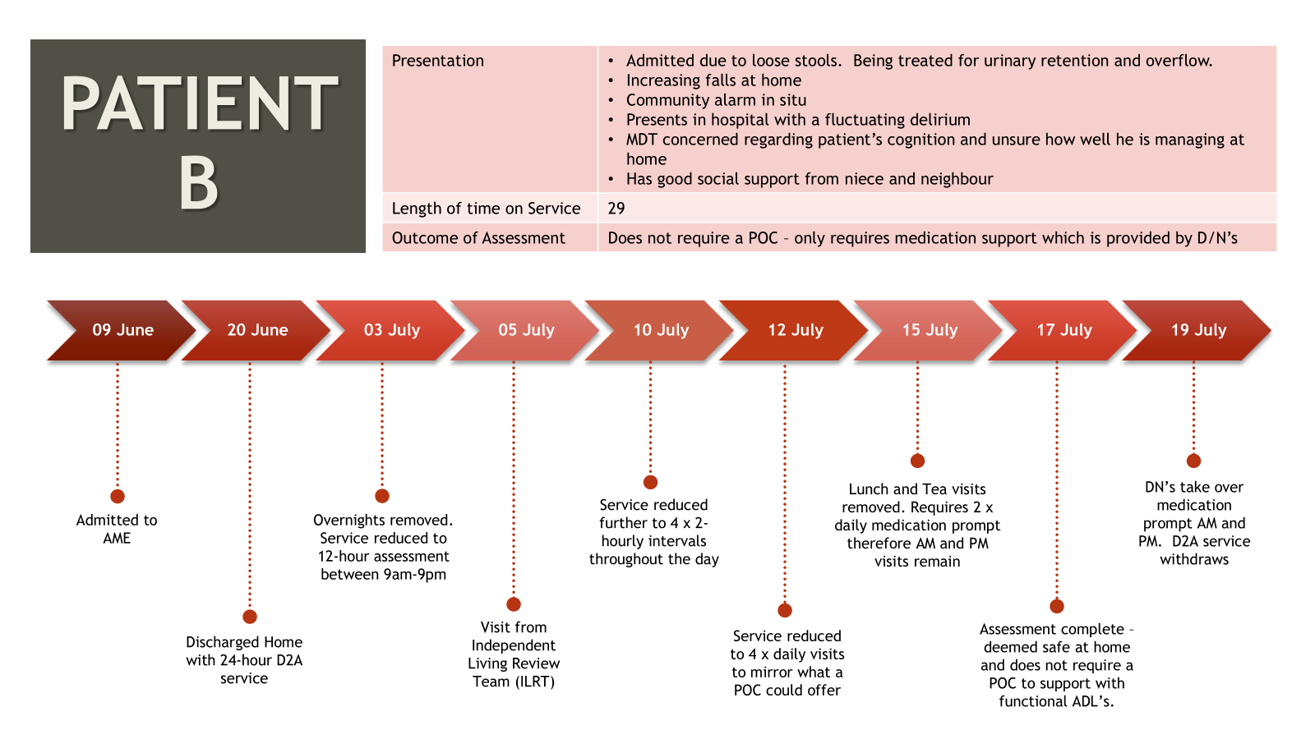

Slide 20
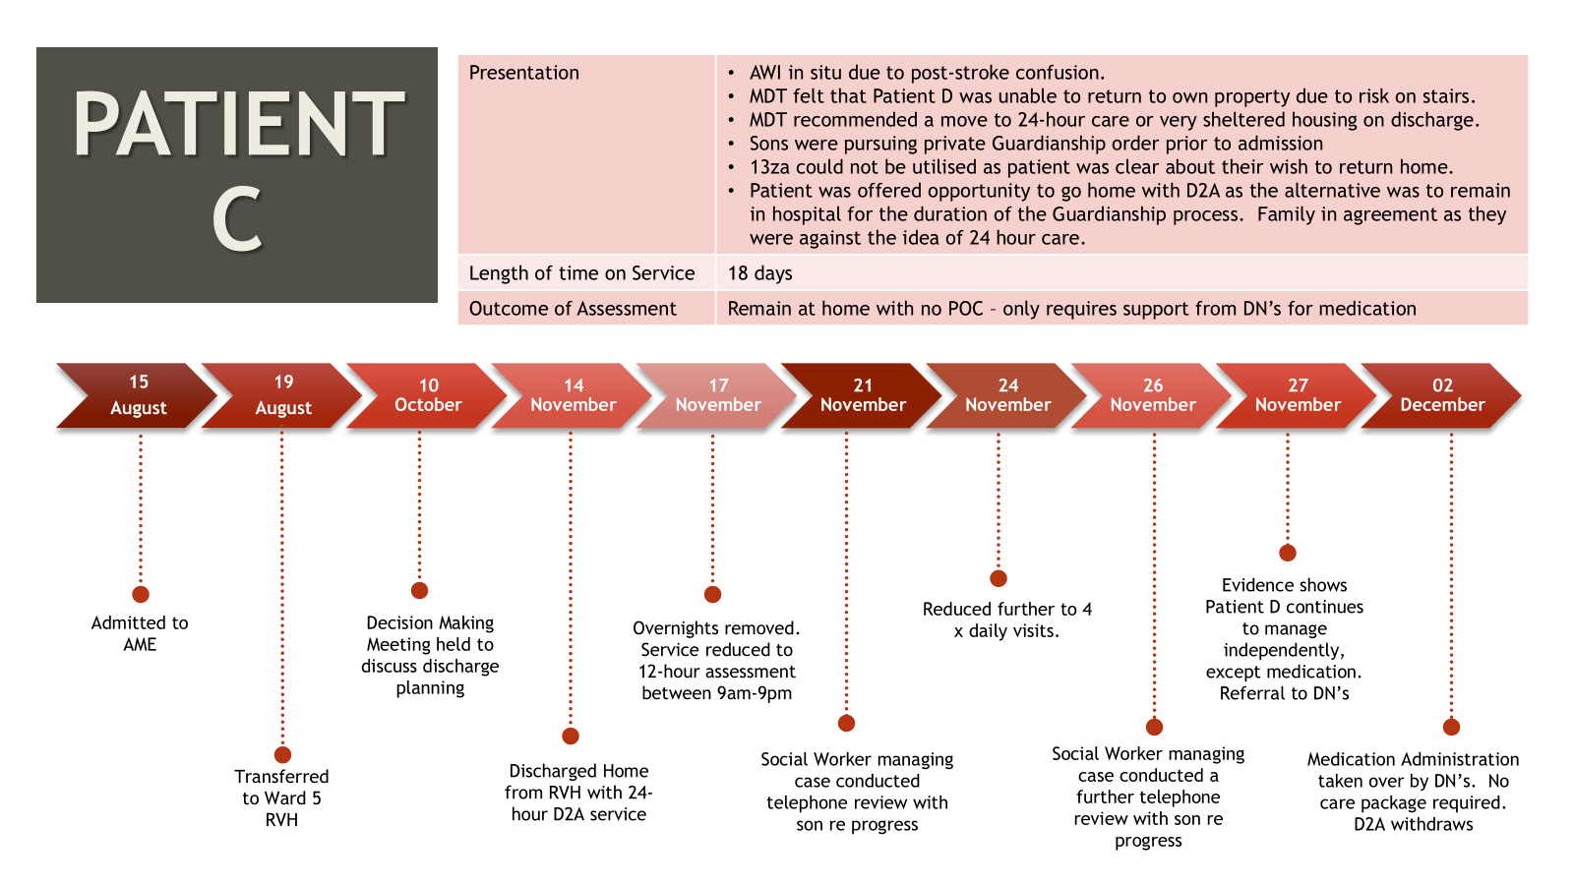

Slide 21
Fife Service:
Home to Assess

Slide 22

Fife H2A
Home to Assess (H2A) is based on the Dundee D2A model.
A test of change began in May 2024.
The service works alongside the Discharge Teams at Victoria Hospital and Queen Margaret Hospital.

Slide 23
Date | Standard delay position | Standard delay position (inc standard LD/MH codes) | Overall delay position (inc code 51x and code 100) | Notes | Degree of confidence/ Tracker
Starting point: 18/11 | 71 | 87 | 120 | Reduce by 15% in 1 week (23/11/21) =74
30/11 | 48 | 62 | 102 | Sustain this level for 1 week and Set a further stretch reduction of 10% reduction in 1 week - Target 56 | SUSTAINABILITY TARGET ACHIEVED AND FURTHER 10% REDUCTION ACHIEVED
8/12 | 30 | 42 | 91 | Sustained 56 and achieved a further 25 % reduction = 42 achieved In last week = 32% reduction From staring point a 51% reduction | SUSTAINABILITY TARGET ACHIEVED AND FURTHER 25% REDUCTION ACHIEVED

Slide 24
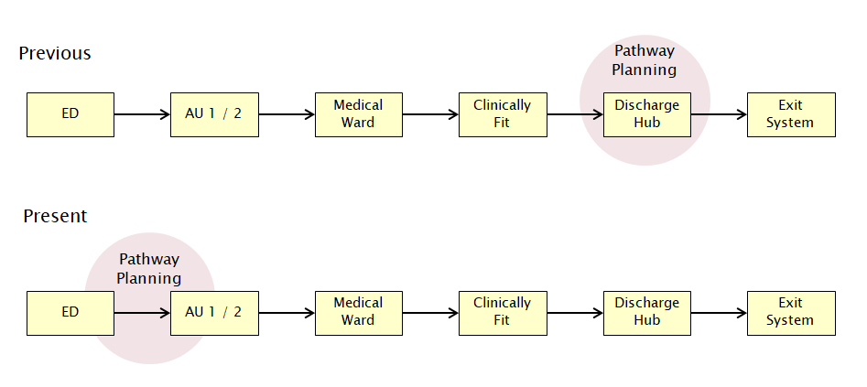
Earlier in the Journey

Slide 25

Implementing a Home First approach sets down strong foundations for tomorrow’s health and care delivery – today
The Home First approach encourages all health and care professionals to ask the question "Why not home, why not today?" at every stage of the hospital journey from the front door, through admission to discharge. It requires risk to be properly managed putting the individuals needs and wishes at the forefront and center of any decision making
Evidence-based, person-centered transition focused on keeping patients living in their own home environment for as long as possible
Hospital admission should only occur when someone needs acute medical care and for no other reason

Slide 26
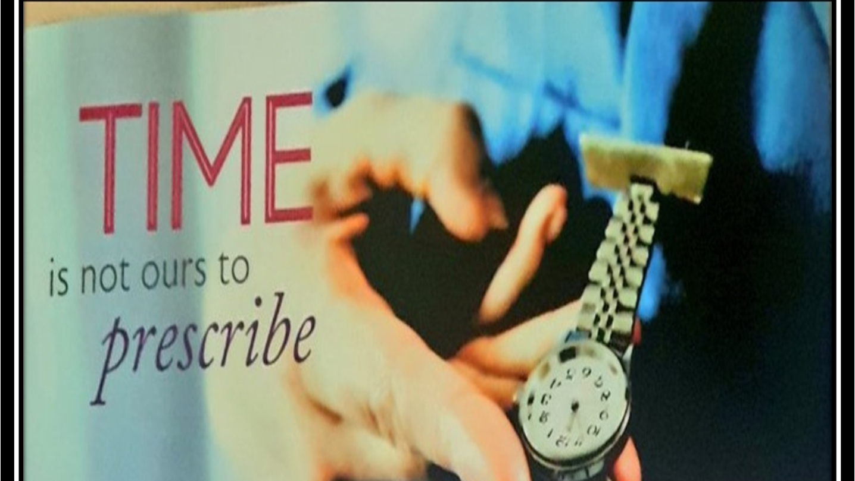
What Matters to Me?

Slide 27
Impact
82%
Before the H2A service, the majority of people who were on an assessment bed in a care home did not return home and moved to a permanent care home placement.
The H2A service offers an alternative option and is supporting people to remain at home.
of the people supported remained at home
7%
of the people we supported required to go back into hospital
7%
of the people we supported required to go into residential care
These impacts were achieved from Fife's test of change May 2024 to date.

Slide 28



Mrs. Smith’s Journey Home
Intervention
Instead of immediate relocation, Mrs. Smith was referred to the Fife H2A service for a comprehensive assessment of her needs and abilities.
Findings
During the assessment, Mrs. Smith showed she could manage her daily life independently, but her home was in a poor condition.
Mrs. Smith, a 62-year-old woman living alone, was admitted to hospital following a period of self- neglect.
The hospital team who examined her initially recommended for her to move into a care home permanently.
Support
The team supported her improve her living conditions by providing cleaning assistance, organising her belongings, and making necessary repairs to ensure her home was safe and habitable.
Outcome
After the assessment, the decision was made that she would remain in her own home. To support her continued independence, she would receive a short-term care package of 4 hours of housing support per week.
Impact:

Slide 29
”
“
“It has been life changing and allowed my cousin the ability to go home from hospital”
Family felt she "got on a lot better at home than she did in the hospital setting”
Family of person supported
Family of person supported
“I feel the staff have improved my quality of life”
“Things are very much in your hands, she’s [the support worker] not doing things to you, she’s helping you, it’s that feeling of control”
Person supported
The service "gave me my confidence back"
Person supported
Person supported

Slide 30
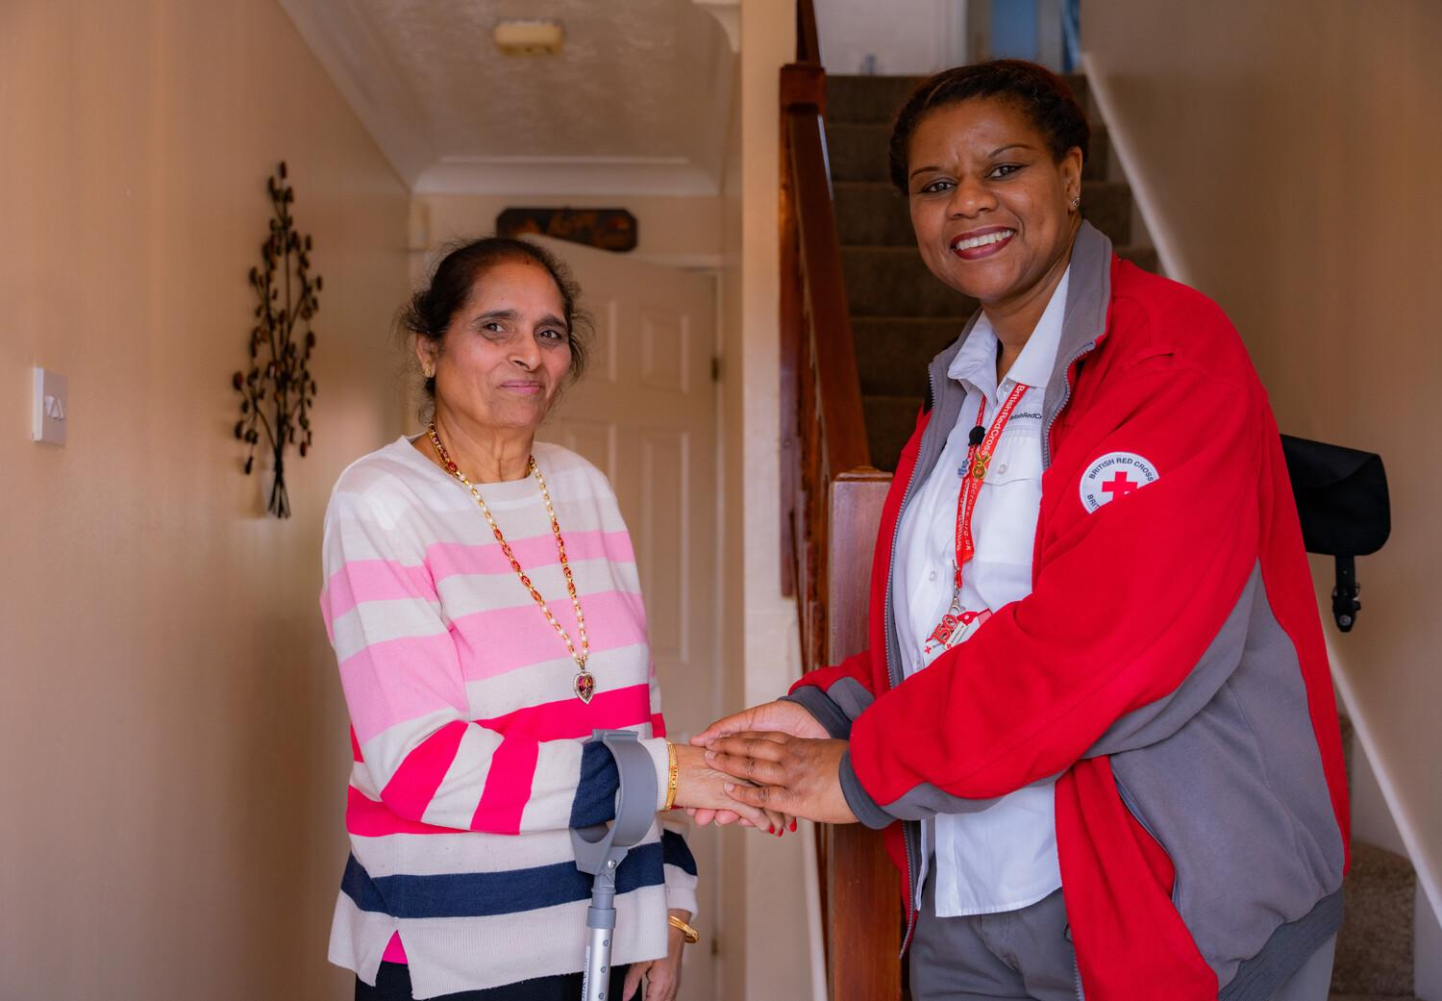
Questions

Slide 31
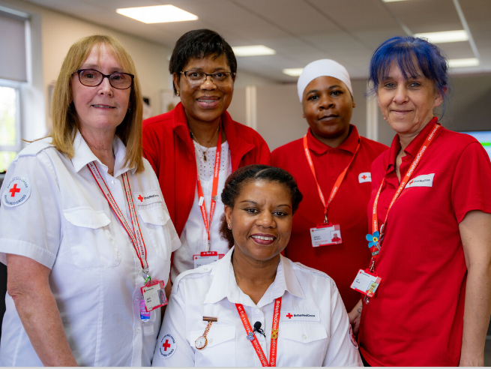
Contact Us
Louise Sinclair
Senior Business Development Manager – Scotland
HCScotlandBDT@redcross.org.uk

