Slide 1

Community Pharmacy Sunday Opening – Delivering Pharmacy First Plus Scotland
Kirstin Cassells
Lead Pharmacist – Community Pharmacy, Public Health & Integrated Services
Slido – QR Code

Slide 2
Background to Pilot
Two Community Pharmacies opened from 10am – 5pm on 6 consecutive Sundays between December & January
Long standing relationship between OOHs and Pharmacy in Forth Valley
Building on local and national work around Pharmacy First & Pharmacy First Plus
Previous work with Community Pharmacist Independent Prescribers in OOHs
  What did we learn?
Learning from pilot in Greater Glasgow & Clyde
  Criteria & Referral process

Slide 3
What did we do?
Public Health surveillance from Australia was a driver
Engaged with Community Pharmacy Forth Valley (Contractors Committee)
  Sought agreement for contractors to participate in advertising campaign and direct patients
Secured funding from OOHs
Communication plan to raise awareness of Community Pharmacy Services

Slide 4
Upskilling Community Pharmacy Independent Prescribers
Hollie Houghton
Independent Prescriber, Community Pharmacy Development Team

Slide 5
IP Training
To achieve our aim we knew it would be essential to up skill the Community Pharmacists
Why
Why was up skilling a good idea?
What
What we did to support IPs up skilling?
Benefit
The benefits of up skilling?

Slide 6
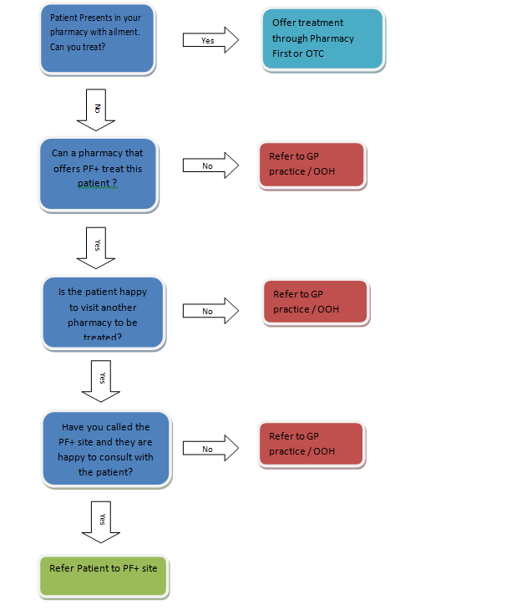
IP Training
Referral process from CPs to CP IPs
  Thoughts behind
  Benefits

Slide 7
Out of Hours Care in the Community Pharmacy Setting
Jonathan Burton MBE FRPharmS
Community Pharmacist, Right Medicine Pharmacy, Bridge of Allan

Slide 8
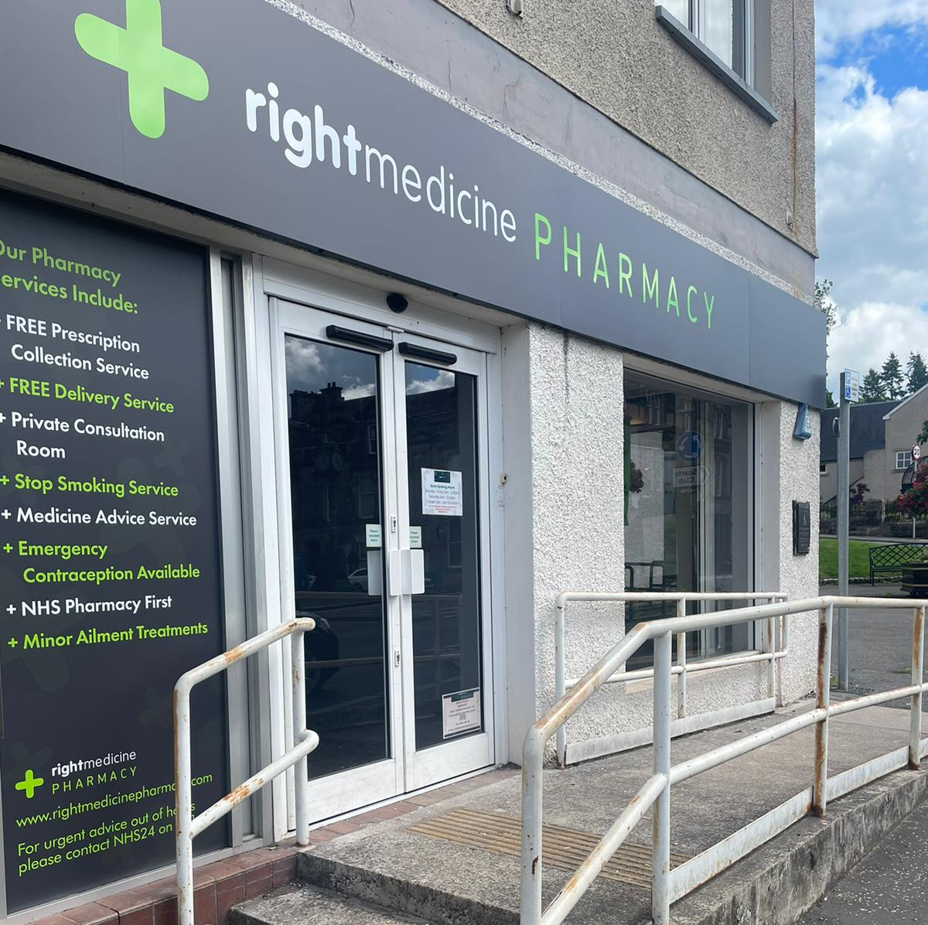
My background
Community pharmacist for 25+ years
Right Medicine Pharmacy group
Involved in early development of the Pharmacy First and IP led Pharmacy First Plus service
IP for 9 years
Common clinical conditions
ENT, Dermatology, Respiratory, UTIs
DPP
NES Teach & Treat lead for Forth Valley

Slide 9
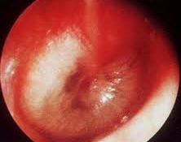
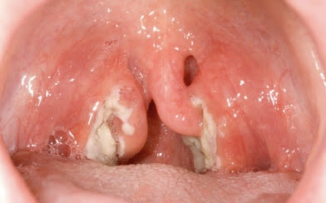
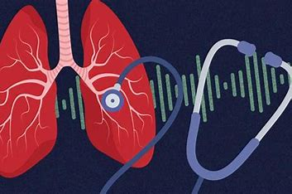
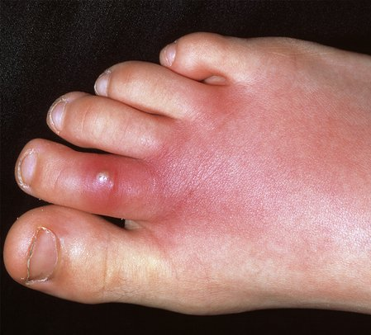
What do we typically see in community pharmacy?

Slide 10
What happened on the Sundays?
Date | Total Patients Seen | RTIs
15/12/24 | 17 | 9
22/12/24 | 19 | 7
29/12/24 | 25 | 9
5/1/25 | 16 | 10
12/1/25 | 15 | 3
19/1/25 | 8 | 2
Demand for consultations was consistently high
Typically between 15-25 appointments per day (10am – 5pm)
Sunday opening seemed to ‘turbo-charge’ the corresponding Saturdays, where 25-30 appointments per day was common (9-1, 2-5.15pm)

Slide 11

What did we see?
Presentations were varied but a far larger number and proportion of respiratory cases than normal (especially when ‘flu numbers spiked)
On Sundays patients would often be very unwell & at the more complex end of the spectrum of presentations I could safely assess & treat
Age / Gender
Co-morbidities
Immune suppression
Body location
Atypical symptoms
These presentations required additional clinical judgement in order to assess the risk / benefit of quick treatment in the community setting as opposed to immediate referral to OOH/hospital settings. Managing these cases was challenging but rewarding. Many were subject to telephone or in-person follow up 24-48hrs after first presentation.

Slide 12

What now?
It’s great to feel useful ☺….BUT!
Community pharmacy is potentially a massive untapped resource in out of hours NHS care
As a ‘front door’ NHS provider we are still hugely isolated from the rest of the service (not just OOH btw!)
Access to medical notes and methods of communication & referral are a big issue now
Isolation can be frustrating, time consuming, energy draining & in a worse case scenario can affect patient safety

Slide 13

A future vision…
Structured & supported arrangements for OOH provision through community pharmacies
Closer ties with OOH services, a ‘one service’ approach to planning & delivery
Pharmacists supported to gain credentialling at foundation, advanced and consultant levels of practice
Adequate levels of clinical supervision to increase competence & confidence levels in the workforce
Evolution of pharmacy support staff education & training to keep pace with service offering

Slide 14
Next Steps and Future Developments
Laura Byrne
Director of Pharmacy

Slide 15
Impact of Pilot in Forth Valley
Pilot was included as part of the FV Winter Plan
Final report and data shared with key stakeholders
Principles of service has been tested and concept proven locally
Pathways development? Joined up approach.
Is this sustainable? How do we scale up?

Slide 16
Future Developments
Work with OOHs to determine periods when demand is highest
Further work required to ensure service is sustainable
  Training of CP IPs to the level of competence required to deliver the service
  Professional assurance
  Clinical Supervision (increase both competence & confidence)
  Peer review (increase both competence & confidence)
  Teach and treat – Local vs NES support?
  Define and develop a Service Specification
  Information back into the system (SBAR) – single patient record /what else?
  Clinician to clinician? Mechanism? (CP lone worker)
  Increase public awareness
2026 Pharmacist IPs (future opportunities/requirements)

Slide 17
Questions?

