Slide 1

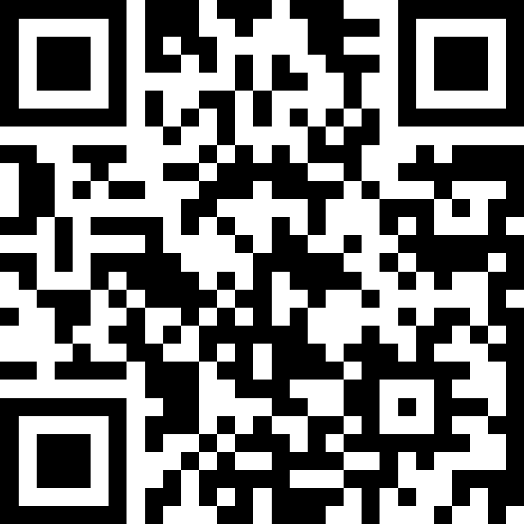
Welcome to the
Slido – QR Code

Slide 2
Dr John Harden
NHS Scotland Event Chair, National Clinical Lead for Quality and Safety

Slide 3


Slide 4
Caroline Lamb
Director General for Health and Social Care, and Chief Executive, NHS Scotland

Slide 5
Neil Gray MSP
Cabinet Secretary for Health and Social Care

Slide 6
Get involved
Slido
Scan the Slido QR code

Slide 7
Neil Gray MSP
Caroline Lamb
@neilcgray
@Carolineslamb
Dr John Harden
@JohnHardenED

Slide 8
Thank you
Slido

