Slide 1
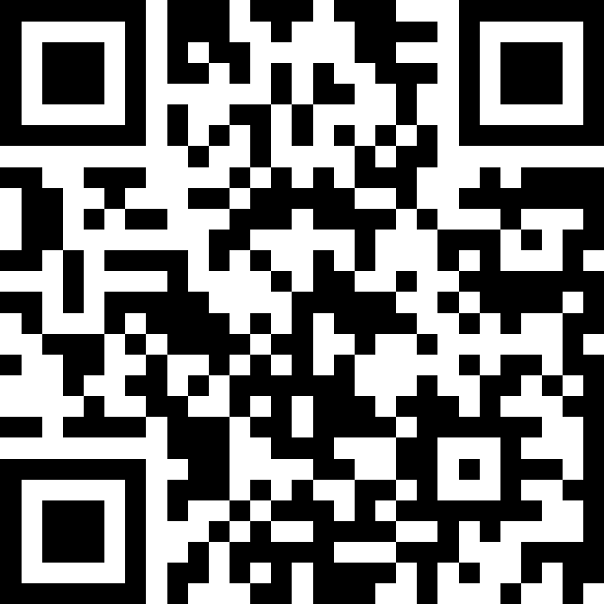
Prevention Matters: A Collaboration for Health Equity in Scotland
Slido – QR Code
Notes:
Presentation
Please find the attached presentation title slide.
Formatting - Please ensure you list your session title on the pink slide with a font style of “calibri light”.
Sizing: To format your additional slides please go into presentation, click on the design tab, along the top pane (on the right hand side) click “slide size” then click “widescreen (16:9)” and select “ensure fit”.
We have supplied a white template for your use if you do not have a template for the additional parts of your presentation.
Please upload your running order, presentation, including any video content to this Google Drive folder - https://drive.google.com/drive/folders/1c-jFFGNtHbo-y-k3cib9viZe2S9-vM2f?usp=sharing
If you have access issues please contact the Events Team for an alternative arrangement (WeTransfer, Dropbox etc).
Presentation guidance can be found in the “Guidance on Planning Sessions Document” issued on Wednesday 26 March 2025

Slide 2
Michael Kellet, Director of Strategy, Governance and Performance

Slide 3
Paul Johnston, Chief Executive

Slide 4
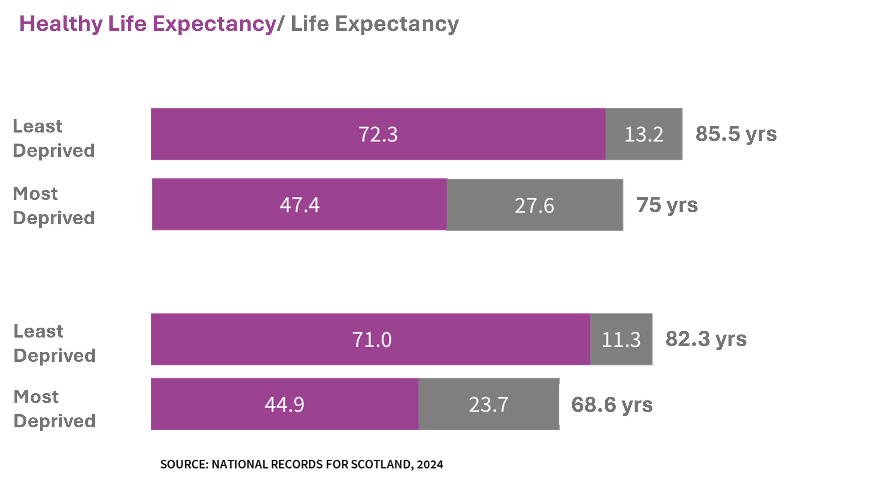
LIFE IN SCOTLAND
Scotland faces significant health challenges…
Female
HLE Gap
24.9 yrs
Male
HLE Gap
26 yrs
Notes:
People in Scotland die younger than other parts of the UK and younger than other countries in Western Europe. And while average life expectancy has improved for decades, since 2010, improvement has stalled. For some communities, life expectancy has declined.
However, we have seen some improvement from 2021-2023. It increased by 4.8 weeks for females and 12.8 weeks for males. However, it remains below pre-pandemic years. We continue to have poor overall health relative to other similar countries.

Slide 5
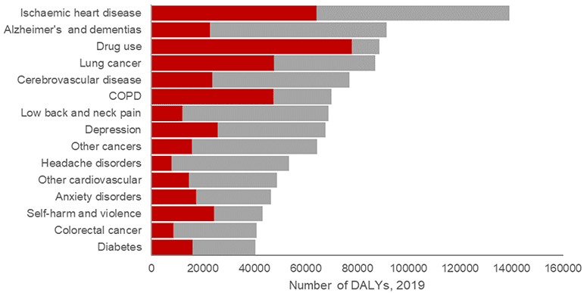
THE IMPACT OF DEPRIVATION-BASED INEQUALITY ON HEALTH
Around a third of the burden of disease is attributable to inequalities in multiple deprivation, and therefore preventable
The leading contributors to the disease burden are making the largest contribution to health inequalities
For 15 of the 20 leading causes, at least a quarter of the disease burden was inequality-attributable
Attributable to inequalities in multiple deprivation
Not attributable to inequalities in multiple deprivation
Grant I, Chalmers N, Fletcher E, Lakha F, McCartney G, Stockton D, Wyper GMA. Prepandemic inequalities in the burden of disease in Scotland due to multiple deprivation: a retrospective study. BMJ Public Health. 2023;1:e000191. doi: https://doi.org/10.1136/bmjph-2023-000191

Slide 6
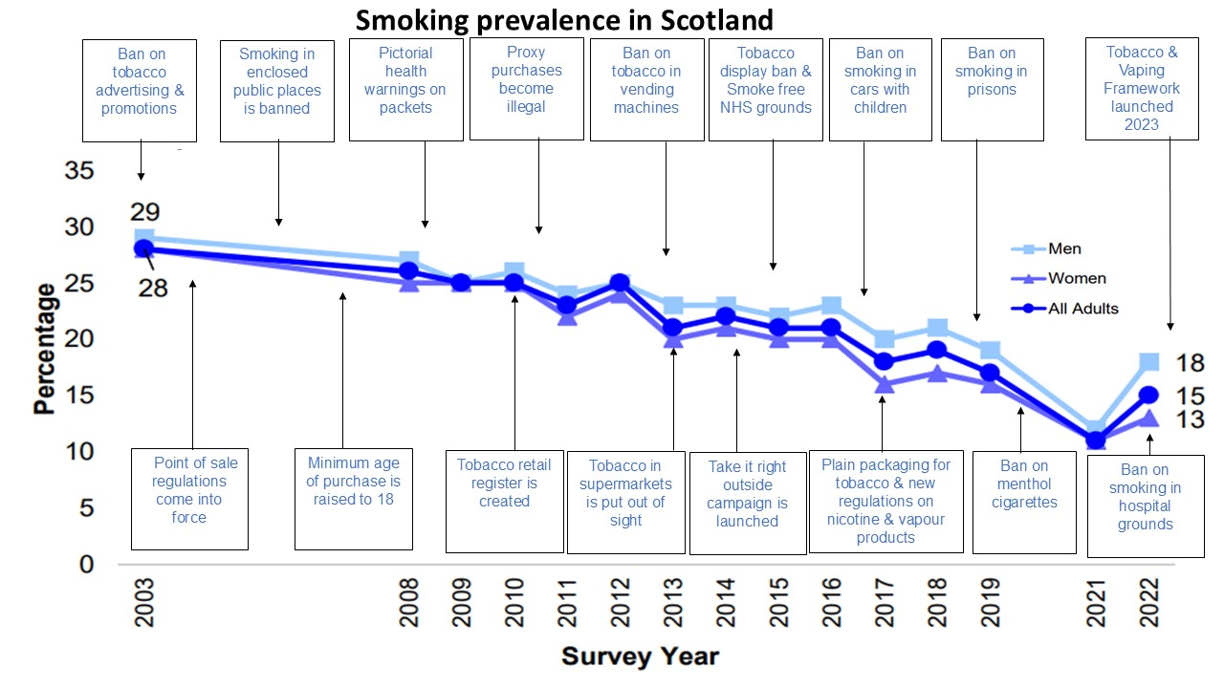
PREVENTION IN ACTION: 19 YEARS OF TOBACCO CONTROL
Notes:
Example of prevention

Slide 7


8 MARMOT PRINCIPLES
Give every child the best start in life.
Enable all children, young people and adults to maximize their capabilities and have control over their lives.
Create fair employment and good work for all.
Ensure a healthy standard of living for all.
Create and develop healthy and sustainable places and communities.
Strengthen the role and impact of ill health prevention.
Tackle racism, discrimination, and their outcomes.
Pursue environmental sustainability and health equity together.

Slide 8


PARTNERSHIP AND COLLABORATION
The Collaboration for Health Equity in Scotland (CHES)
Aberdeen City
A two-year collaboration working to strengthen and accelerate the action already underway to:
Improve Scotland’s health
Increase wellbeing
Reduce health inequities
South Lanarkshire
North Ayrshire

Slide 9
POPULATION HEALTH FRAMEWORK
Aim: By 2035 we will improve Scottish life expectancy whilst reducing the life expectancy gap between the most deprived 20% of local areas and the national average.
Prevention Focused System – Strengthen collective accountability for population health outcomes and inequalities.
Social and Economic Factors – Improve the social and economic factors that support better health and reduce inequalities.
Places and Communities – Create healthy and sustainable places by working in and with communities.
Enabling Healthy Living – Develop supportive environments that promote health and wellbeing and reduce health harming activities.
Equitable Health and Care – Foster a health and social care system that delivers equity, prevention and early intervention.

Slide 10
PUBLIC SUPPORT FOR CHANGE
Agree industry should have more responsibility for the harm its products causes
DIFFLEY PARTNERSHIP, 2023
85%
62%
Support reducing tobacco availability using licensing
THE HEALTH FOUNDATION/IPSOS, 2024
75%
Strongly support action on health inequalities related to income
THE HEALTH FOUNDATION/IPSOS, 2021
59%
Support taxing high fat salt and sugar products
THE HEALTH FOUNDATION/IPSOS, 2024
72%
Strongly support action on health inequalities related to geography
THE HEALTH FOUNDATION/IPSOS, 2021
Notes:
PHS exists to improving population health, but this is not just a matter for the NHS. Better health is important for economic growth. It could boost labour supply, productivity, potentially increase earnings, while also increasing tax yield. It is vital that Scotland invests in creating and widening access to good work as a building block of our economy and our health for:
PHS sees the PHF as an invaluable tool in contributing to a more prosperous Scotland. We will be aligning our new 10-year strategy to actively deliver against its ambitions.
The Public Health Framework and Reform provides a strong foundation for public health action; we are committed to working to implement the most impact interventions set out in the framework. This includes:
Social and Economic​
Economic inactivity: Part of the focus of CHES in North Ayrshire, South Lanarkshire and Aberdeen City is to better understand through data and evidence the key drivers of economic inactivity in young people with mental health conditions to inform effective interventions.
Community Wealth Building: PHS work, linked to the Child Poverty Action Plan is exploring ways the NHS and Local Government as employers can maximise their contribution to increasing income for parents and how that could be replicated across the public sector.
Equitable health and care
Vaccinations & Immunisations: increase uptake with a renewed focus on tackling misinformation on the benefits, particularly online.
Reduce healthcare inequalities: PHS endorses implementing the Marmot concept of proportionate universalism. The successful Childsmile oral health improvement intervention, for example, is founded on these principles.
Healthy Living​
Alcohol, drugs, and tobacco: deliver on the ambition to restrict the affordability, availability and accessibility of health harming products and commodities (HFSS, MUP for Tobacco etc.) by integrated legislative and fiscal policy interventions.
Place and community​
Planning: support local systems to protect spending for preventative services by reforming place-based funding models. ​
​Our CHES work is linking with CPP’s in North Ayrshire, South Lanarkshire, and Aberdeen City to identify key drivers of inequalities. Work in South Lanarkshire is already pivoting to look at more work to combat poverty.
Prevention Focused System​
Accountability: strengthen arrangements to give greater priority to a whole system focus on primary prevention. ​Use existing work to do this i.e. Public Service Reform Strategy, National Outcomes Review.
​Evaluation & Learning: if the PHF works we need to know why. PHS is already involved in helping to shape ways of evaluating and monitoring how this progresses.

Slide 11
Leanne McBride, Community activist and facilitator for Chance2Change

Slide 12
Panel discussion
Angiolina Foster CBE, Chair of Public Health Scotland
Jane O’Donnell, Chief Executive of COLSA
Richard Foggo, Director of Population Health, Scottish Government
Dr Carely Lunan, Chair of Scottish Deep End Project
Dr Susan Webb, Director of Public Health, NHS Grampian
Craig Hatton, Chief Executive of North Ayrshire Council

Slide 13
A Scotland where everybody thrives?
Ruth Glassborow, Director of Population Health and Wellbeing

Slide 14

MEET LOUIS & LORCAN

Slide 15
What next…
Notes:
Paul – to summarise and ask each attendee to consider what 1) they and 2) their team/service can do to improve health equity.

Slide 16
Thank you for attending the NHS Scotland Event 2025
Please share your highlights from today
Notes:
Presentation
Please find the attached presentation title slide.
Formatting - Please ensure you list your session title on the pink slide with a font style of “calibri light”.
Sizing: To format your additional slides please go into presentation, click on the design tab, along the top pane (on the right hand side) click “slide size” then click “widescreen (16:9)” and select “ensure fit”.
We have supplied a white template for your use if you do not have a template for the additional parts of your presentation.
Please upload your running order, presentation, including any video content to this Google Drive folder - https://drive.google.com/drive/folders/1c-jFFGNtHbo-y-k3cib9viZe2S9-vM2f?usp=sharing
If you have access issues please contact the Events Team for an alternative arrangement (WeTransfer, Dropbox etc).
Presentation guidance can be found in the “Guidance on Planning Sessions Document” issued on Wednesday 26 March 2025

