Slide 1

Scan for Safety – innovative Point of Care Scanning transforming healthcare
Slido – QR Code

Slide 2
Andy Malyon
National Clinical Lead

Slide 3

An introduction video

Slide 4
Cumberlege Review: Recommendation 7
“A central patient-identifiable database should be created by collecting key details of the implantation of all devices at the time of the operation. This can then be linked to specifically created registers to research and audit the outcomes both in terms of the device safety and patient recorded outcomes measures.”

Slide 5
Cumberlege Review Recommendation 7
“A central patient-identifiable database should be created by collecting key details of the implantation of all devices at the time of the operation.
This can then be linked to specifically created registers to research and audit the outcomes both in terms of the device safety and patient recorded outcomes measures.”
RECALL
OUTCOMES

Slide 6
Recall

Slide 7
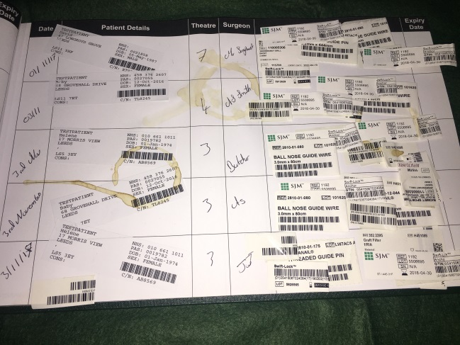
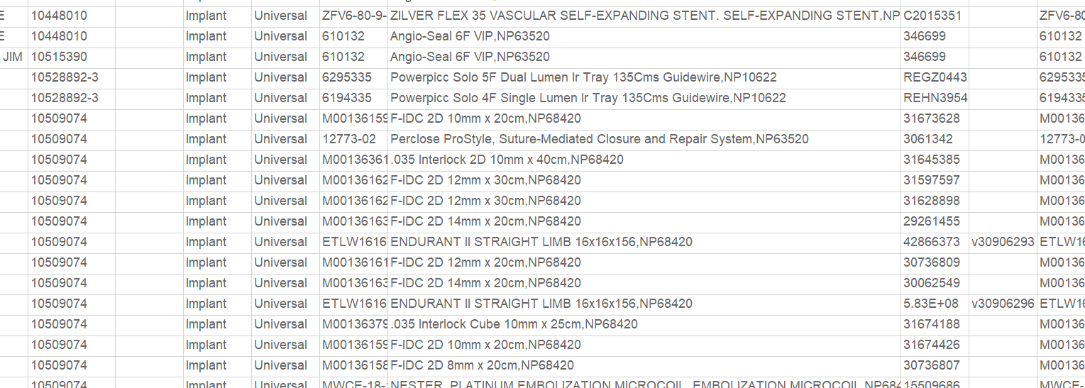
Recall
  Speed of ascertainment
  Accuracy of ascertainment

Slide 8


NHS Scotland: Point of Care Scanning Progress
NHS Highland Ophthalmology
Mar 25
NHS Borders Ophthalmology
Mar 25
  21,693
  Patients
NHS Lothian Interventional Neuro Radiology
Aug 24
GJNH Cardiac Surgery
Oct 23
GJNH Orthopaedics
Jan 2024
NHS Lothian Interventional Radiology
Aug 23
GJNH Ophthalmology
Nov 23

Slide 9
Outcomes

Slide 10

Healthcare world
Patients
High
Street
IHPN
Data Sharing

Slide 11

Healthcare world
Patients
High
Street
IHPN
Common
standards
Data Sharing

Slide 12


Medical Device Data Hub (MDDH)
Traceability
Clinical Implant Record
Patient Implant Record
Existing clinical systems
Local and national reporting
MDDH
Registries
National audits
Direct data entry

Slide 13
Primary device procedure
Patient
SMR Data
National Audits

Slide 14
Primary device procedure
Patient
PROMS / PREMS
SfS Data
Secondary device procedure(s)
Corrective action
National Audits
Device Performance
FSN / DSI / PSA
IRIC / MHRA yellow card
Recall

Slide 15
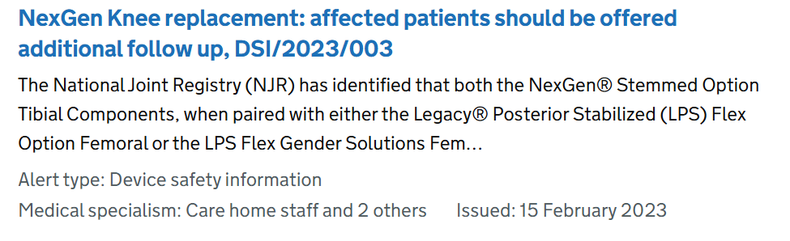

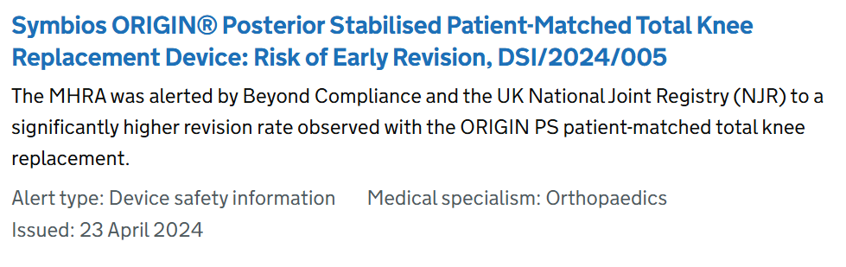
Data Scrutiny

Slide 16
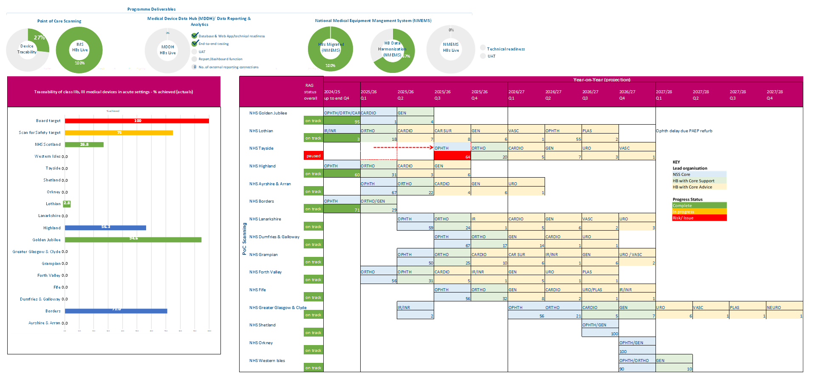

Slide 17
Jamie Hetherington
General Manager
NHS Lothian

Slide 18
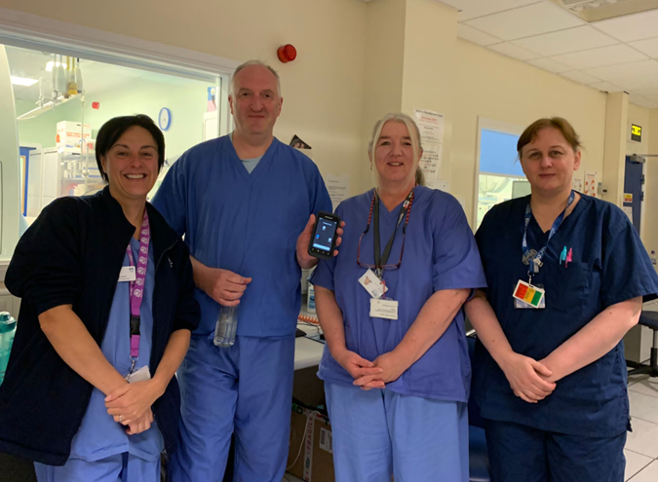
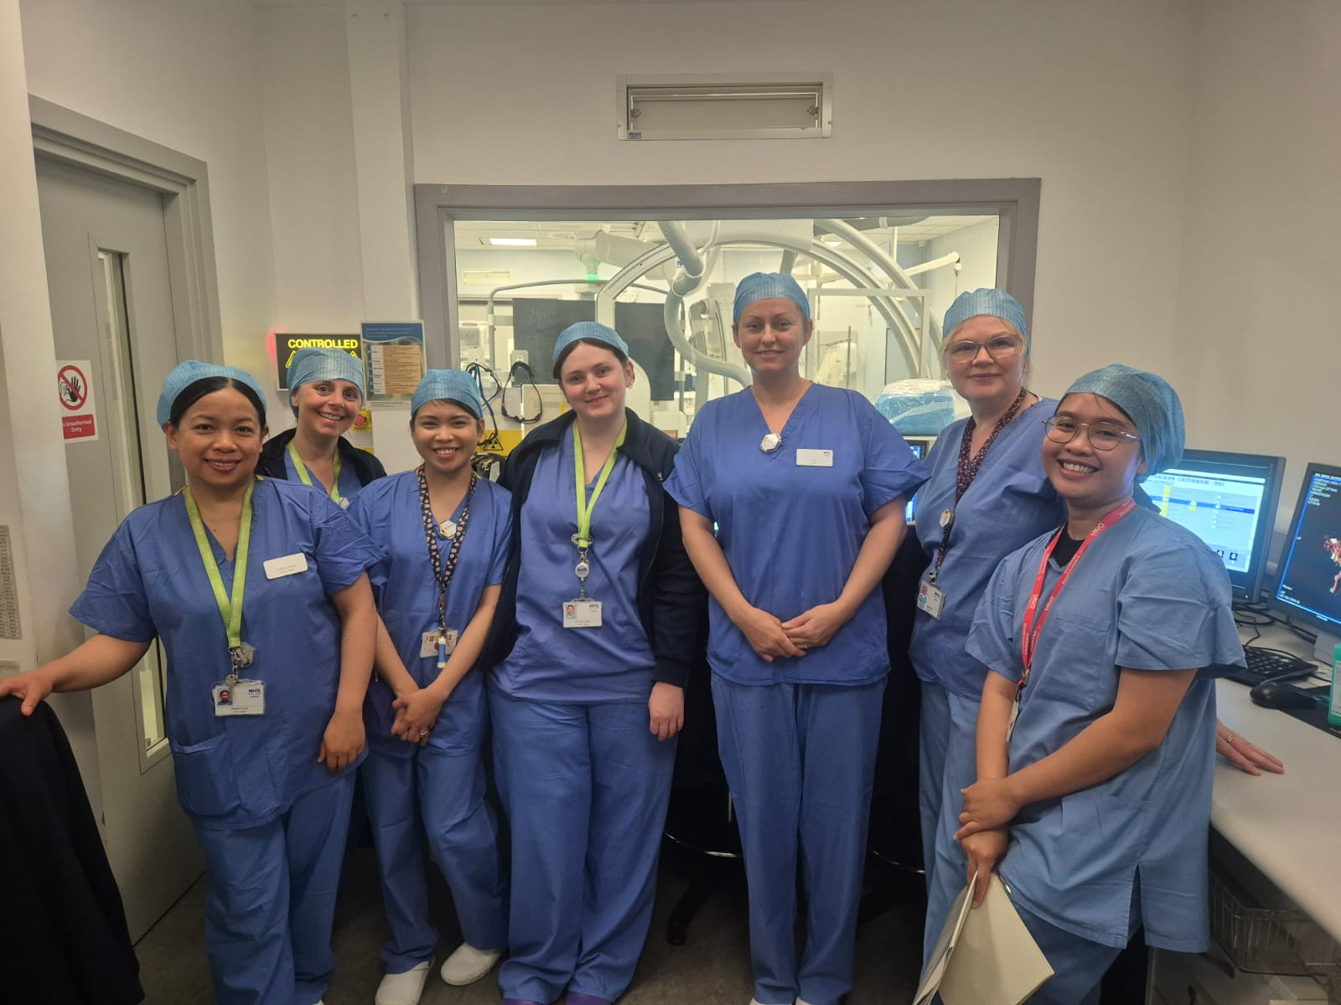
Interventional Radiology Department, Royal Infirmary of Edinburgh
11 surgeons and 29 clinical staff working across 5 operating rooms
1,800 procedures per year, 133 different types of procedures
Interventional Neuro Radiology at the Department of Clinical Neurosciences
10 surgeons and 12 clinical staff working across 1 operating room and 1 mobile team
350-450 procedures per year, 13 different types of procedures

Slide 19
The Lived Experience…
Align motivation:
  Clinical benefits & business benefits: “win-win”, not “either-or”
Embrace flexibility:
  Establish the core team & wider orbit
  Adapt and thrive
Harness the energy or the willing:
  Support personal and professional growth
  Capture the learning (and people) within the wider rollout

Slide 20




NHS Lothian PoC Update
  NHS Scotland
NHS Lothian Overall (Go live Aug 23 – 25th April 2025)
  3,640 procedures carried out across 7 Theatres/Labs
  2,667 Individual patients
  44,769 products captured
  Value £6,540,370
Interventional Radiology (Go Live Aug 2023)
    3,172 procedures carried out across 5 Labs
    2,265 Individual patients
    36,722 products captured (3,697 implants)
    Value £4,167,213
Interventional Neuro Radiology (Go Live Aug 2024)
    468 procedures carried out across 2 Labs
    406 Individual patients
    8,047 products captured (832 implants)
    Value £2,373,047
  1,986
  Individuals
  21,693
  Patients
  32,670 Products
  93,818 Products
  2,692 Procedures
  48,654
  Procedures
  £4,403,170
  Value
  £23.07m
  Value

Slide 21
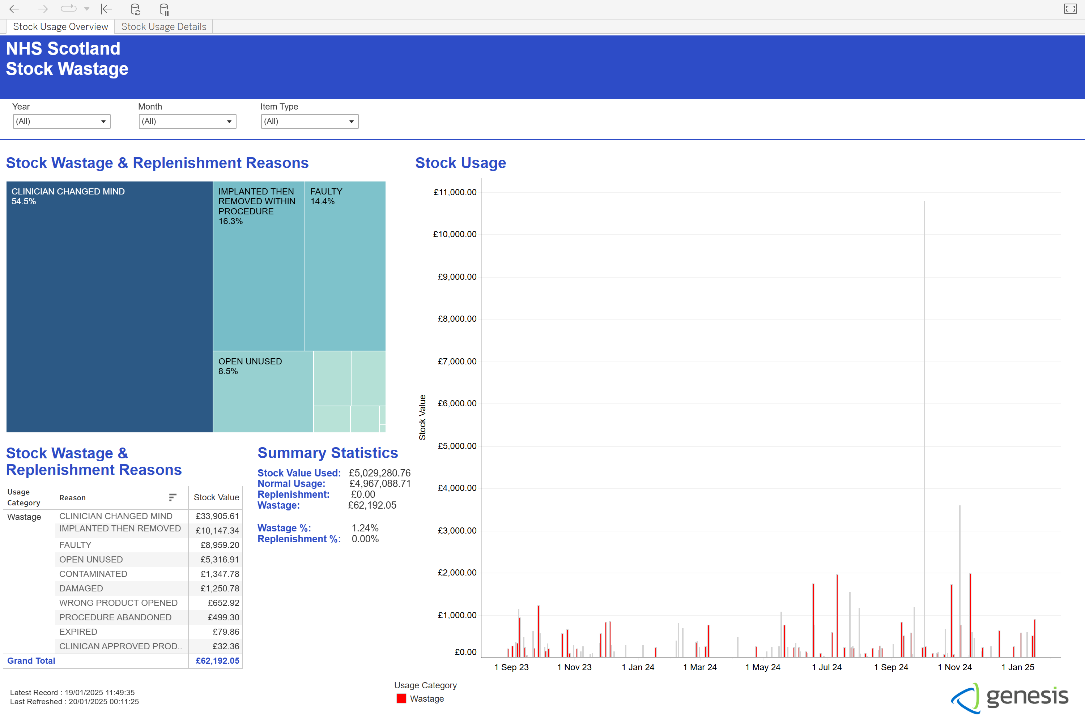
NHS Lothian PoC:
Proactive Stock & Waste Management

Slide 22
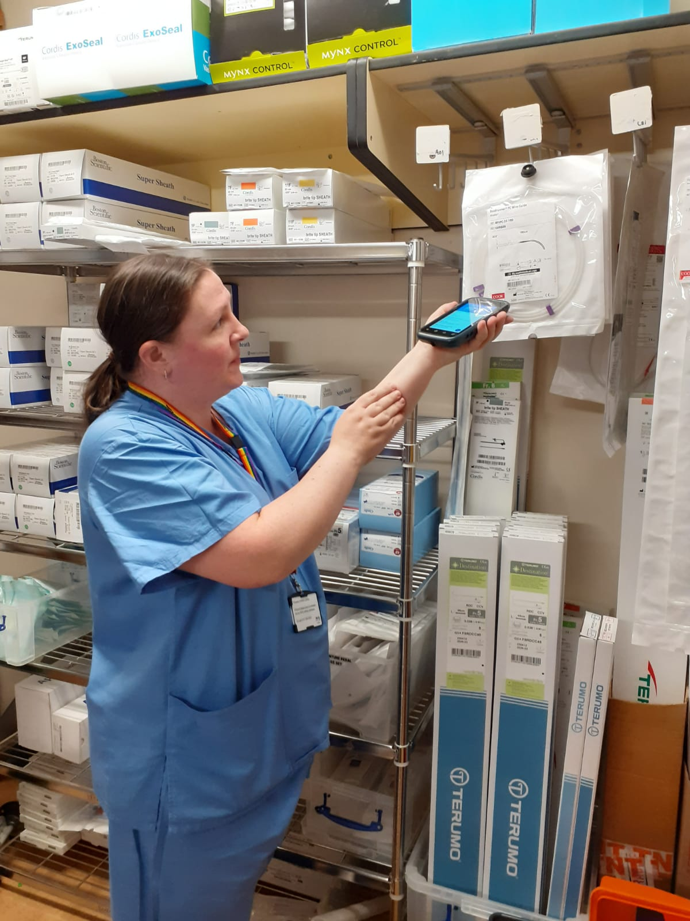
In truth, my job was 100 times harder before, than it is now. Since Scan for Safety has been implemented, it has – on average – released an hour and a half of time back for me every day.
I get to manage my time far more effectively and for our department, I can now far better manage the overall stock control including getting the time needed for mini stock takes.
This means my stock is always accurate. From a financial point of view, we now always know exactly where we stand.
“
”
Julie Macdonald
NHS Lothian IR Stock Controller

Slide 23
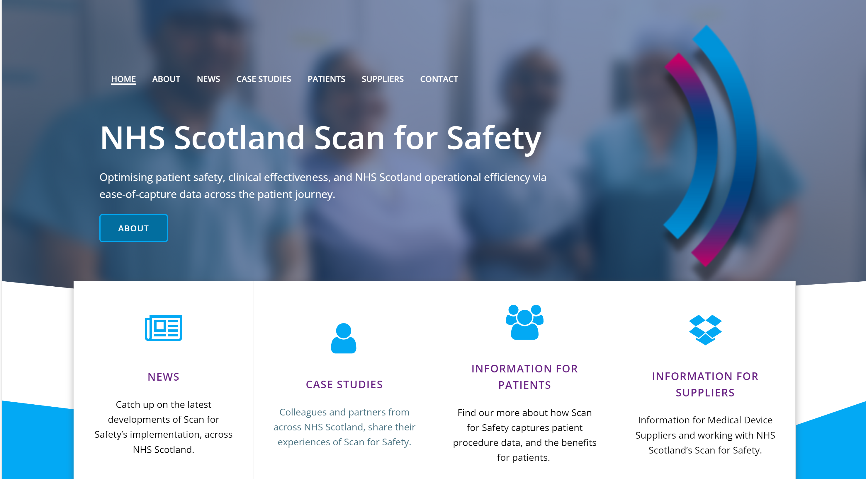

Get in touch: NSS.ScanForSafetyProgramme@nhs.scot
scanforsafety.nhs.scot
Notes:
For more info please contact:

