Slide 1
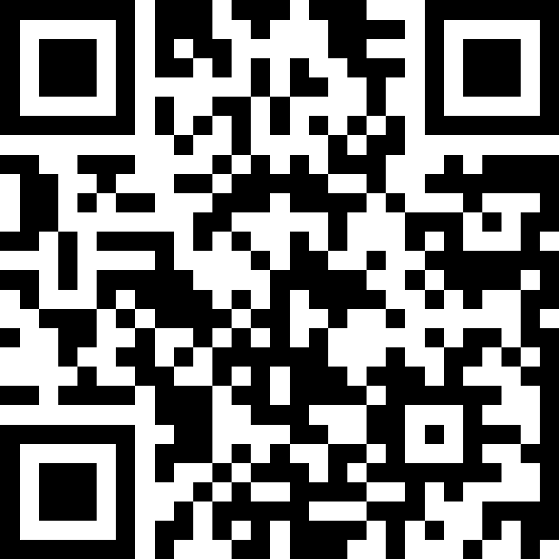
Changing people's behaviour will reduce GP demand
Slido – QR Code

Slide 2
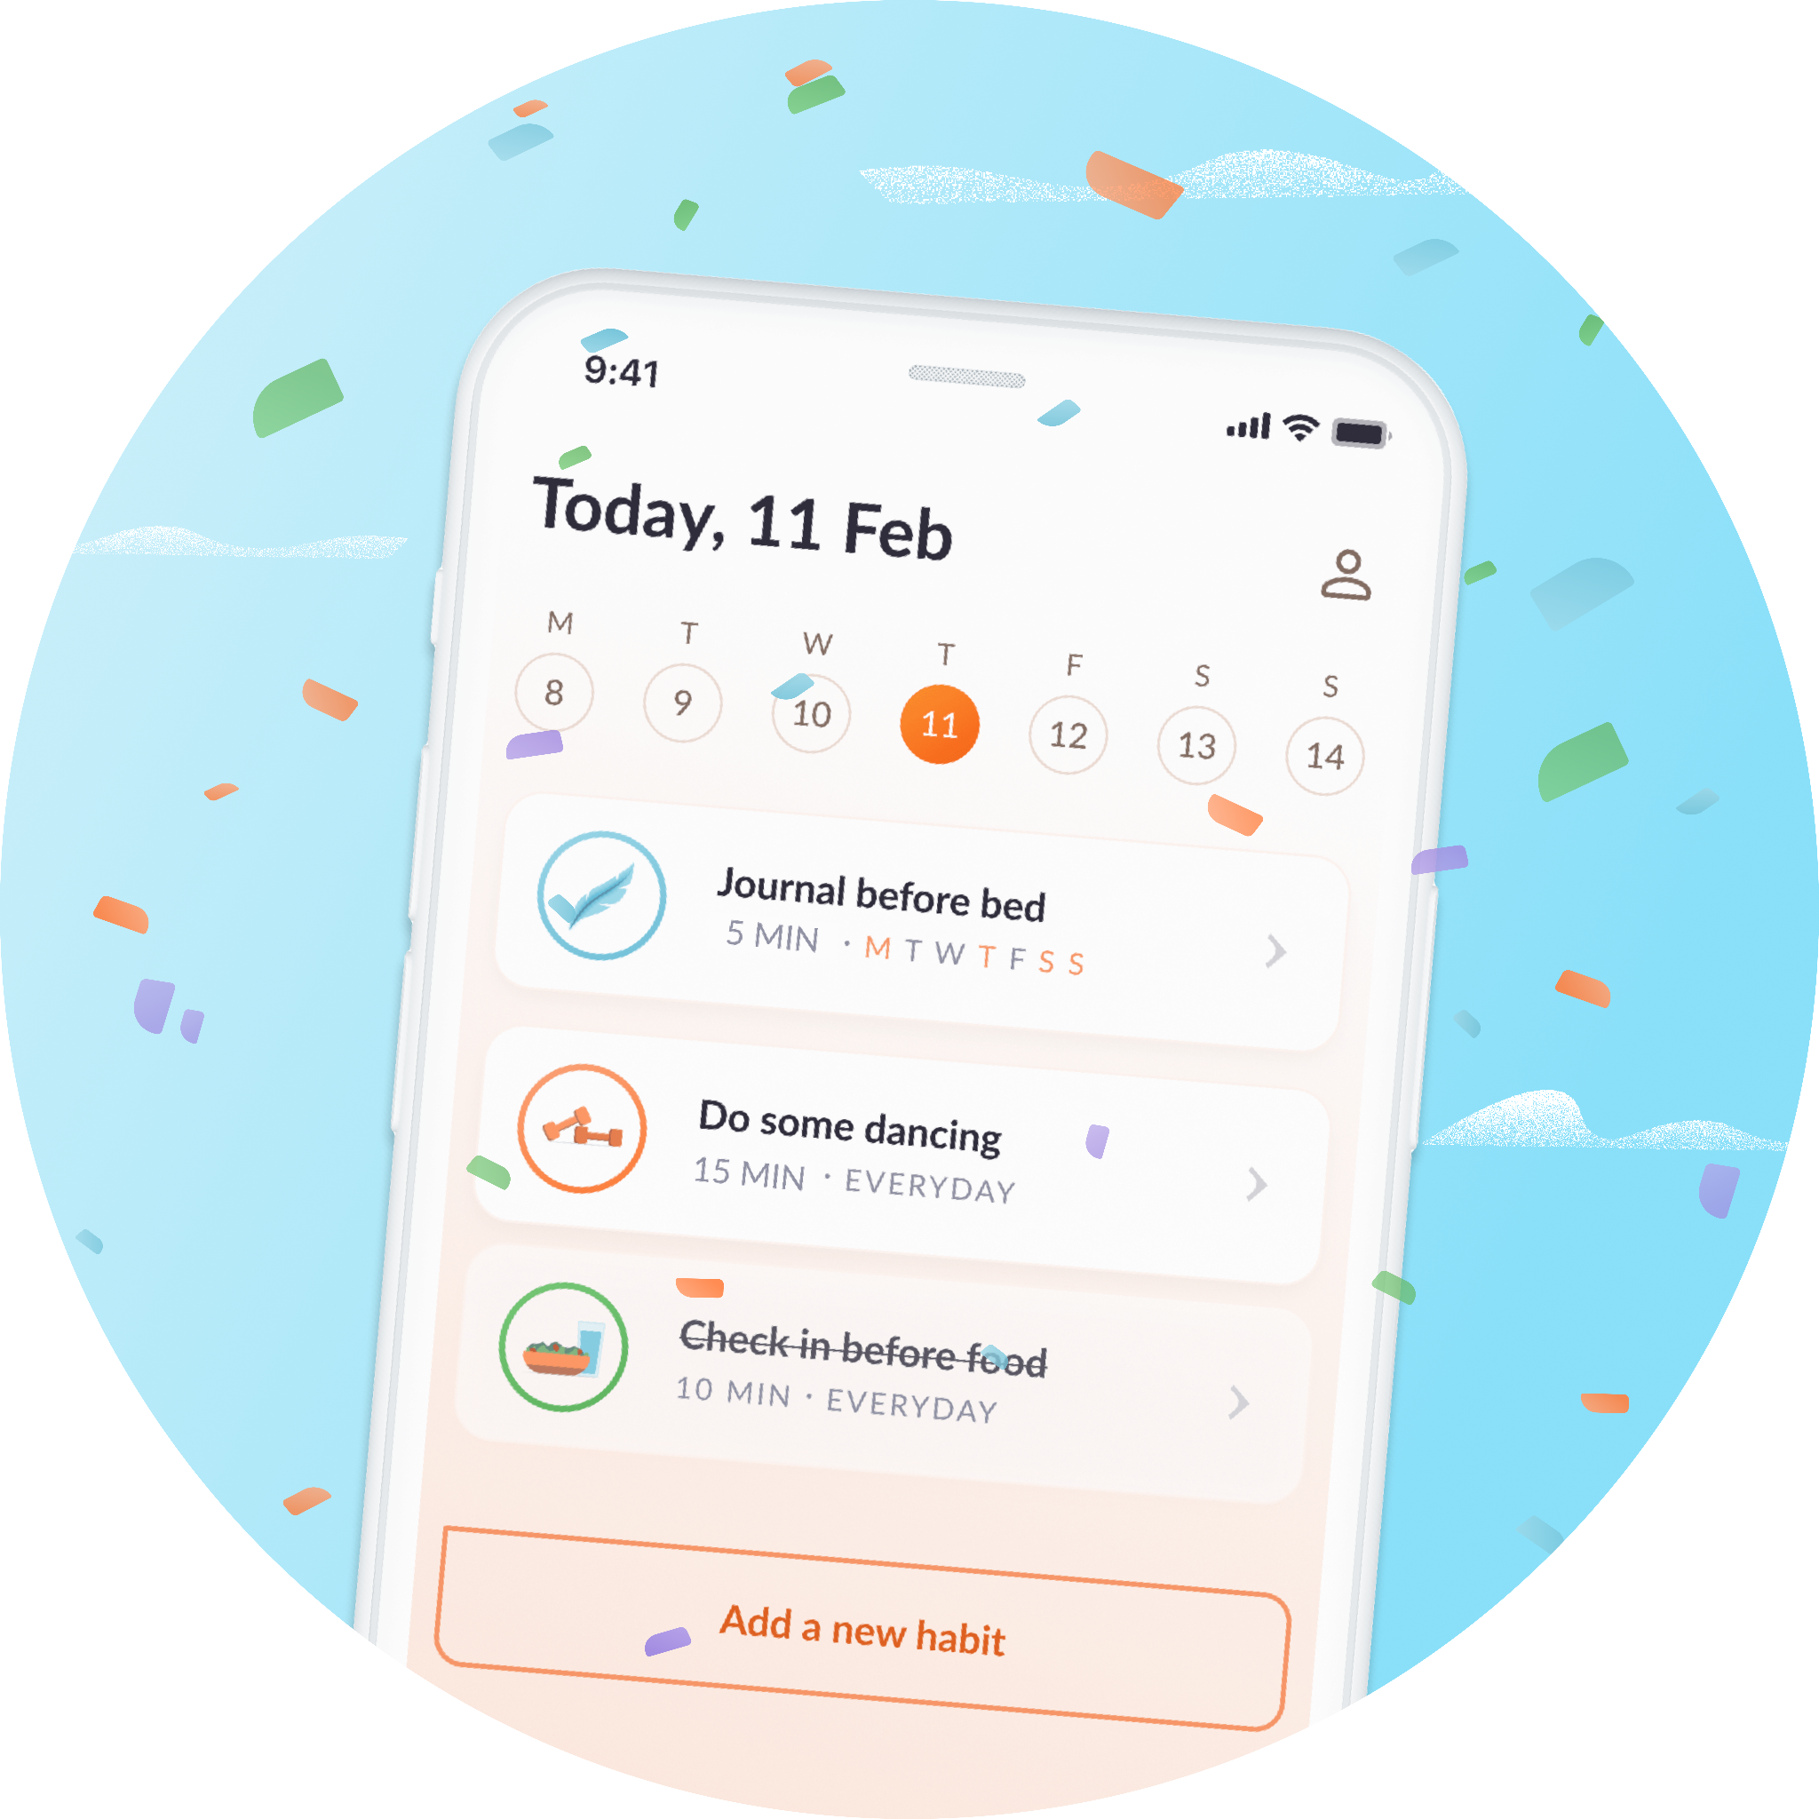


"Changing people's behaviour will reduce GP demand”
Tackling long term condition challenges and lifestyle risk factors, at scale, with holistic digital coaching.
Dr Alexia Pellowe & Grace Gimson

Slide 3
Ayrshire & Arran Specific Challenges
● Rising rates of long-term conditions caused by lifestyle risk factors
● Prescribing Reform
● Capacity v Demand
● Access to funding
● Need for scalable support delivered further upstream, to help people to stay well/prevent decline
● Lifestyle change support must meet people where they are at, and be able to scale at low cost
Notes:
Alexia – background setting out local challenges, reform work, wants and needs etc.

Slide 4


Example GP practice data modelling
List size approx 13770 people
30% of over 25s at this practice are obese
Expected monthly prescribing cost for Type 2 diabetes (on metformin, SGLT2, GLP1 and statin)
£113,628.69/month
Type 2 Diabetes - 1019
Numbers diagnosed increased from 42 in 2020/21 to 70/yr in 2022/23
Risk factors include Obesity, inactivity and high GI diet
Harms: Heart disease, stroke, vision loss, kidney failure,
Non-Alcoholic Fatty Liver Disease (NAFLD) - 584 people
Numbers diagnosed raised from 25/year in 2020/21 to 68/yr in 2022/23
Risk factors include being overweight, high BP, high cholesterol, smoking, t2dm
Harms: Fibrosis, Cirrhosis, Liver failure, Liver Cancer
Notes:
Alexia - Closer look at the local data from a GP practice perspective. Basline data indicating rises in LTCs and prescribing costs. Known harms to not preventing etc - End with needing to find a scalable low cost approach to prevention, and we found hollyhealth!

Slide 5

The Overall Challenge
🤒
🍎
📈
Rising LTCs caused by lifestyle risk factors
System wide capacity issues & lack of training for lifestyle coaching
Must solve problems further upstream to keep people well
Minimal prevention funding (funded services must have impact at scale)
Which led us to select Holly Health.
Holly Health: Personalised fully digital health coaching to help the public with LTCs and emotional wellbeing, to increase self-management and alleviate NHS pressures, affordably. 200+ GP practices supported in England, Scotland and Wales
Notes:
Grace – so what is hollyhealth/why created etc?

Slide 6
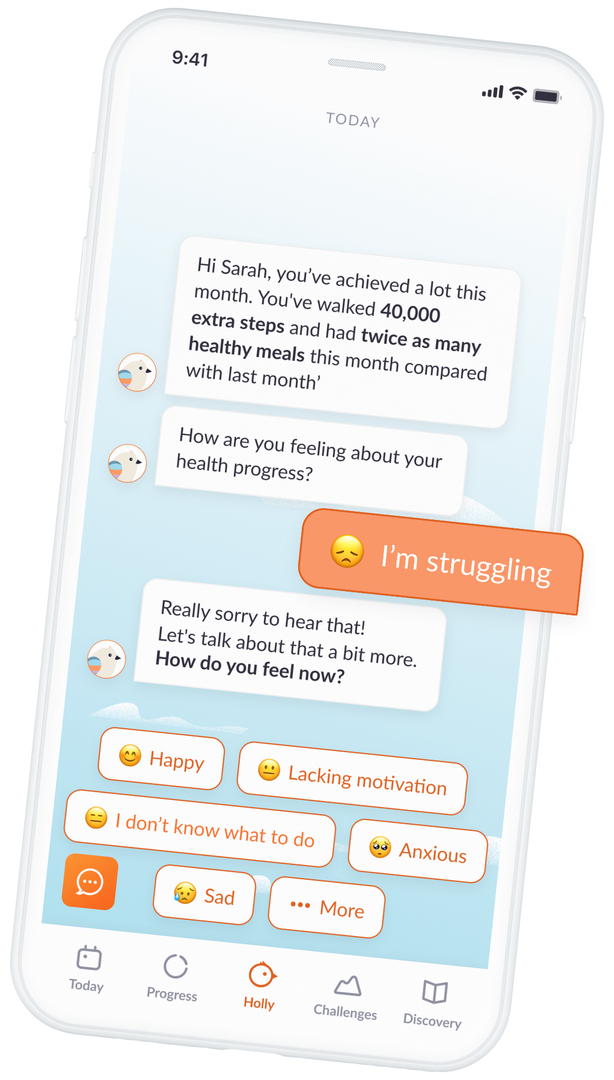
What We Did: Funding & Launch
Commissioned & launched evidence based digital health coaching tool (Holly Health)
Provided 12+ months coaching access per person
Deployed proactively (e.g. SMSs to 18-75 yrs)
Reviewed baseline health & changes after 8 weeks + 6 months
(using a pre-post survey method)
Funding & Governance Process
Creative route to funding: HSCP Innovation Fund
Expansion to other HSCPs within first 6 months.
Pan Ayrshire funding via business case and strong ROI
Notes:
Alexia

Slide 7
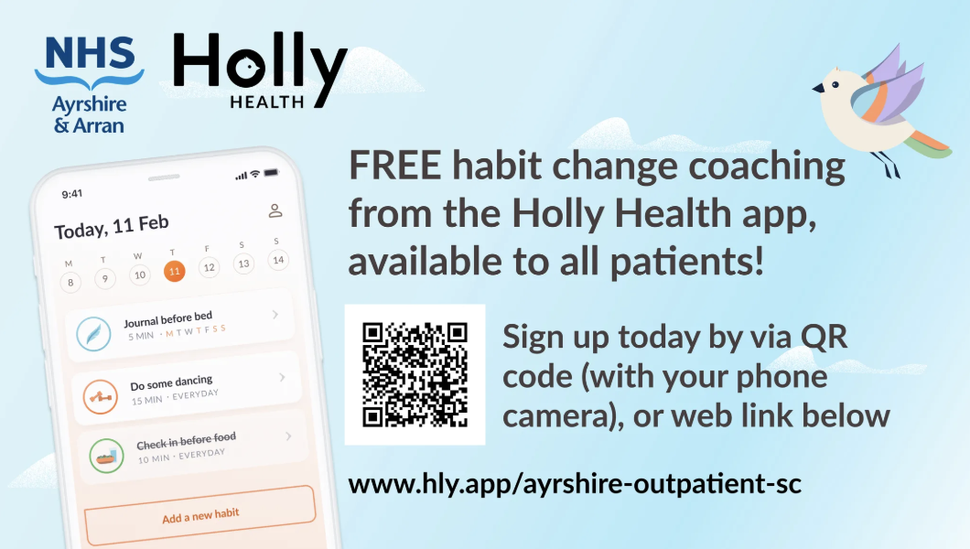
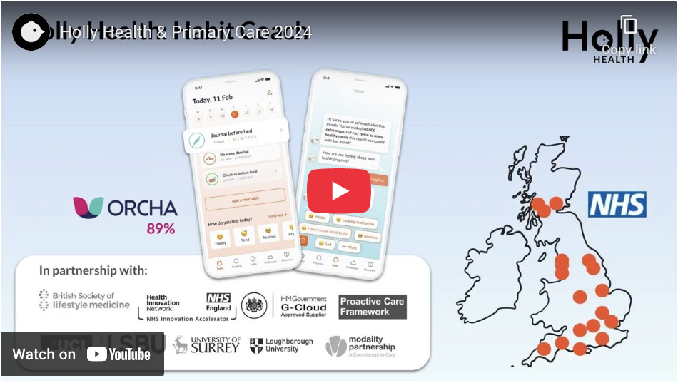
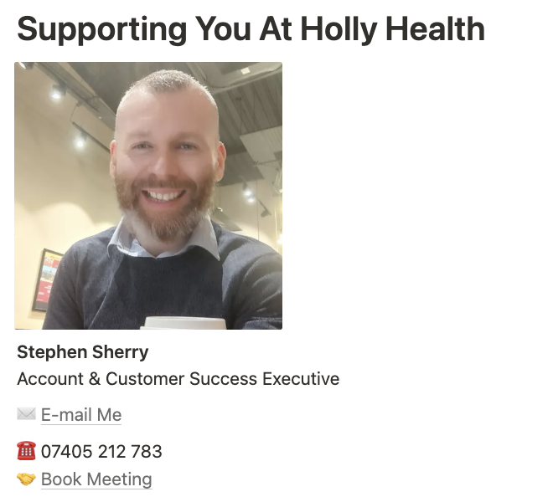
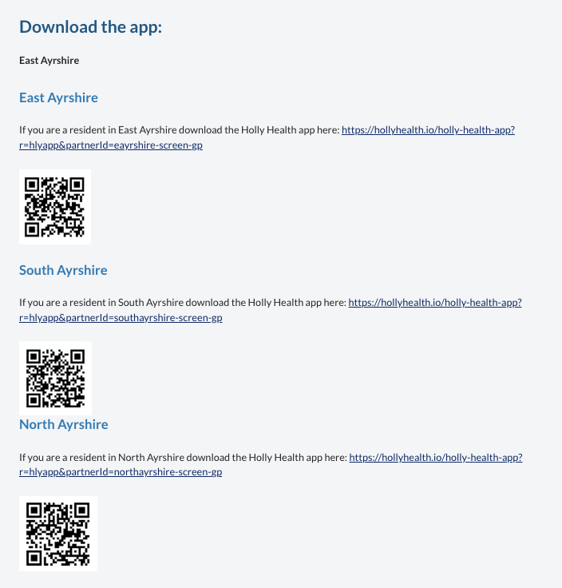
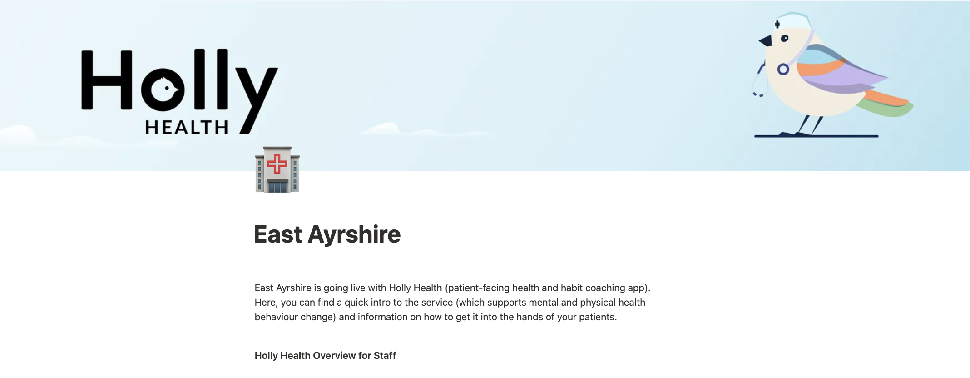
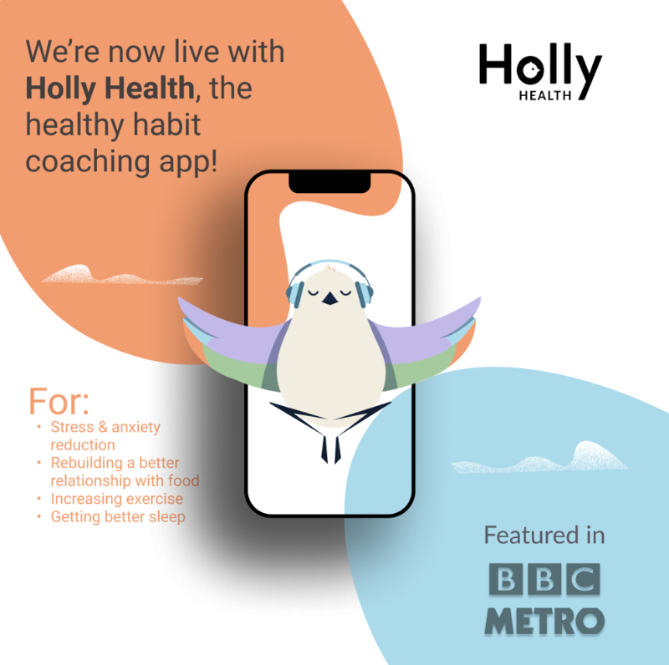

What We Did: Launch Assets
SMS blurbs & URLS
QR codes & flyers
Staff Info Portal
Partnerships Account manager
Holmhead GP has partnered with Holly Health to offer patients 12 months of free habit coaching (to help sleep, exercise, eating and mental wellbeing). The app may serve as an extra tool to help feel physically and mentally better. You can sign up here: http://hly.app/holmhead_gp
Tailored landing pages for each practice
Notes:
Grace – maybe mention what you find helps hscp's and practices most, what reaches people best etc

Slide 8
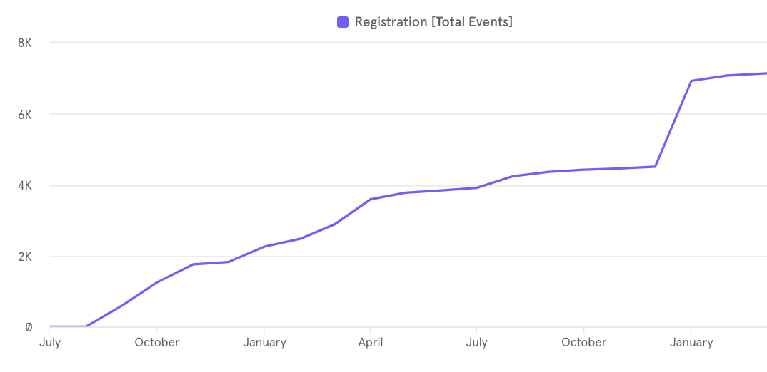
What We Did: Service Development
We started in East Ayrshire, then expanded to South and North
Created specific reporting for local high priority conditions: NAFLD & Type 2 diabetes
Unique signup links, QR codes etc. for each service (GP practices, hospital services departments (e.g. cardiac rehab, perioperative), community flyers etc.)
Enhanced the measurements process e.g.
  Medication adherence questions
  Chronic pain management
January new year campaign & hospital support
North Ayrshire Launch
South Ayrshire Launch
East Ayrshire Launch
Notes:
Alexia

Slide 9
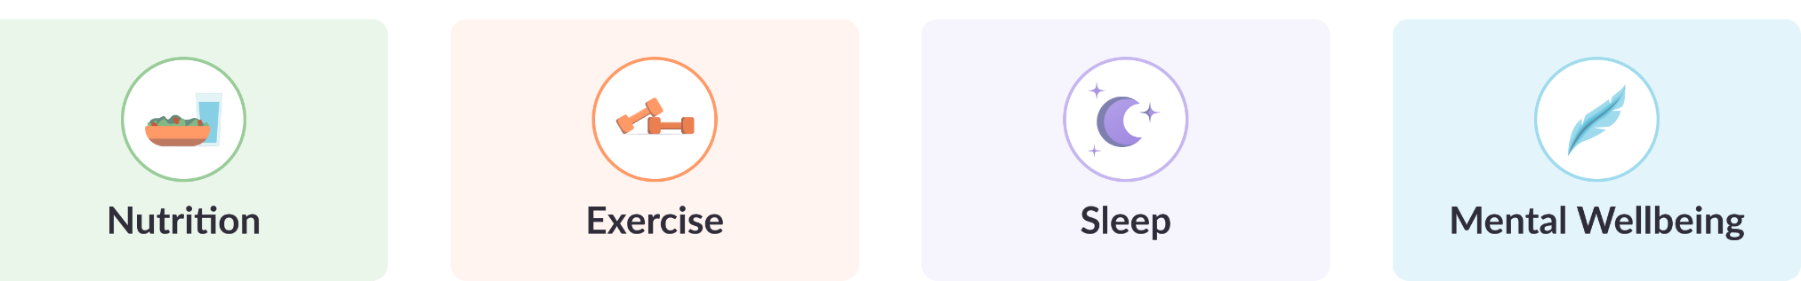
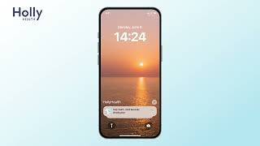




The Holly Health Service
Human-like, compassionate, personalised habit coaching
Top 2% of apps (rated by ORCHA)
Highly tailored to each individual: Specific habit recommendations, friendly nudges, reminders, tracking, coaching
>100 science-backed habits (mental & physical health)
Rich data insights (for users and B2B partners)
Built by psychologists, to achieve long term mindset & habit change
90%
4.5/5 app store rating
>60,000 users >200 NHS Partners
Notes:
Grace - Talk about the team

Slide 10

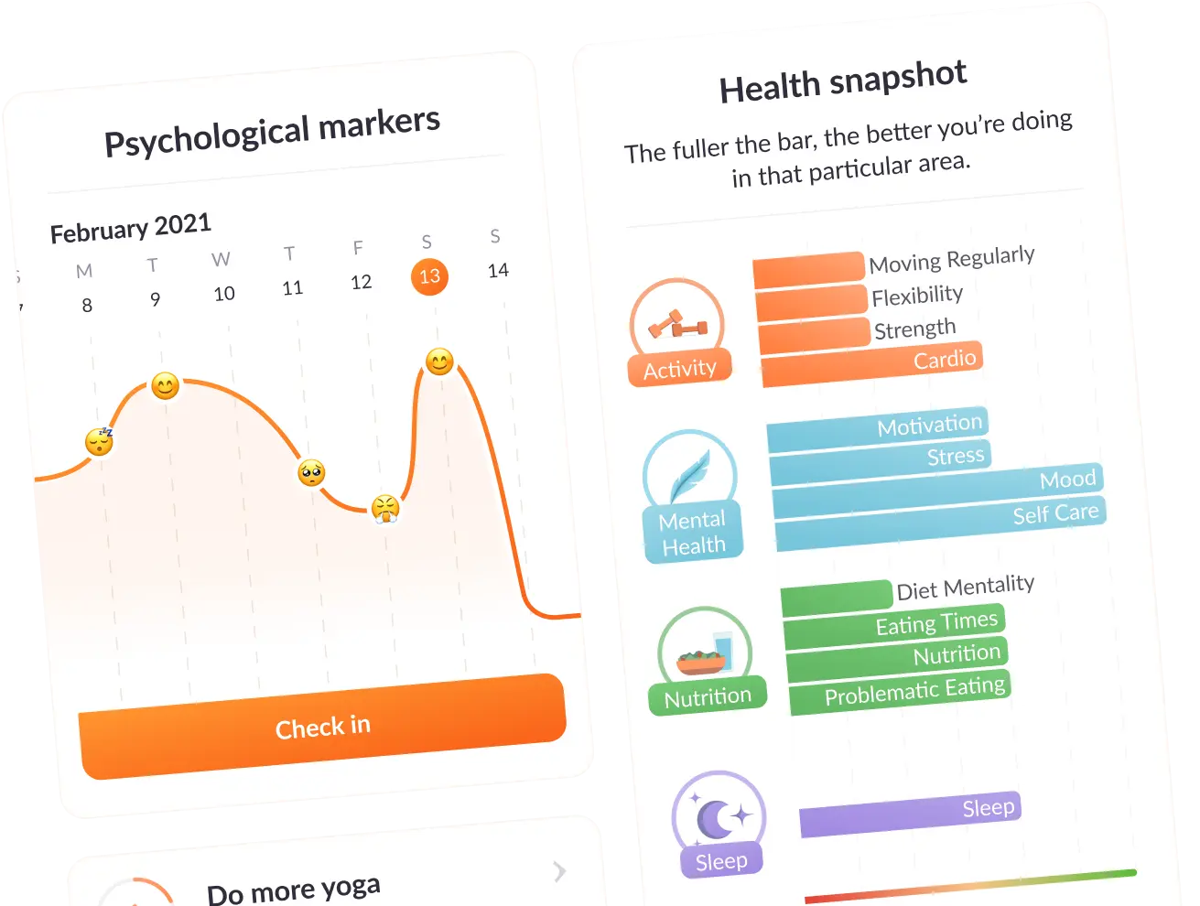
Holly Health User Experience
User Journey:
Invitation to use Holly (e.g. SMS from GP)
Service tailoring, through ‘wellbeing check’ conversation with the Holly bird on web
Log in to the app
Daily nudging, compassionate coaching, gamified habit & wellbeing tracking & 24/7 chatbot support
Health changes assess in surveys a 8 weeks and 6 months
Tested and iterated over 5 years with 60,000 users​
Around 7-10 min full onboarding process​
Around 20 questions span holistic lifestyle health areas and are based on validated questionnaires e.g. ONS4 for quick picture of personal wellbeing​
Tone of voice: friendly, motivational, 'friend in your pocket'
Chat interface and web onboarding: good for accessibility (iterated through healthy ageing projects)​
Multiple choice/button responses. Traffic light/Likert scores
Service features gamification & 'Boosts' (friendlier version of nudges which helps people to align actions with their personal goals)
Notes:
We have a beautiful front end….. and complex, intelligent backend.
The typical user journey is to receive an invitation from you doctor to use Holly. You signup on web and the Holly bird gets to know your current behavioural health and goals through a conversational chatbot interface. Through complex human-like decision systems, Holly makes makes recommendations on the best habits, content and coaching for you (across mental and physical health).
We’re delivering high compassionate personalised coaching, with the added bonus of being highly scalable, and there for patients every day - each step of the way.

Slide 11
Digital Inclusion Approaches
Multiple entry routes: People are made aware of the service via SMS invite, physical flyer, or a screen in their GP surgery
Easy signup and onboarding: takes place on web (rather than in an app), on mobile, tablet or computer
Onboarding process can be completed in any language, and most answers involve easy button responses
App download: At the end of the onboarding flow, users are shown step-by-step instructions on how to download the app
No smartphone: Support is also provided for people who do not have a smartphone (they receive habit recommendations and a printable habit tracker sheet)
Community services: E.g. Holly Health has worked directly with the Alcohol and Drug Partnership (ADP) lived experience team, where the app was well received
Mindful of rural deprivation levels – the proactive messaging drives awareness

Slide 12
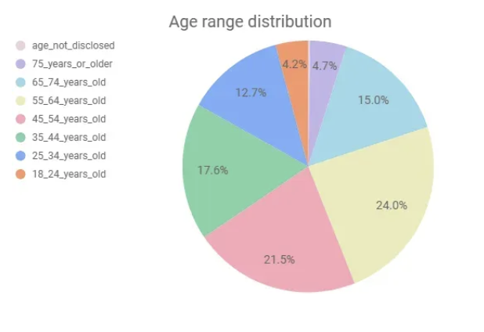
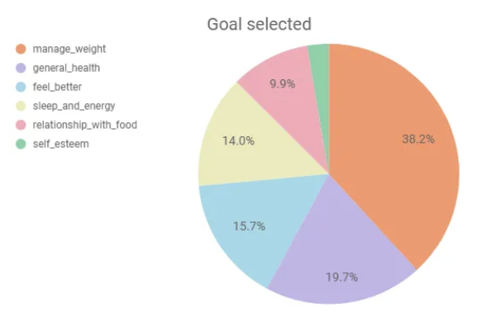
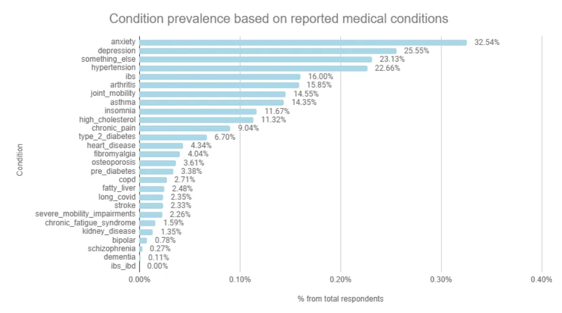
Demographics from almost 10,000 signups
👵 Average age 50 (range 18-80s)
👩🏻 Majority are women
🤒​ Average LTCs at signup: 2.5 (24% have 4+ LTCs)​
🧠​ Anxiety/Depression prevalence of 39%
Anxiety: 33%
Depression: 26%
Hypertension: 23%
IBS: 16%
Arthritis: 16%
Insomnia: 12%
Notes:
Alexia

Slide 13
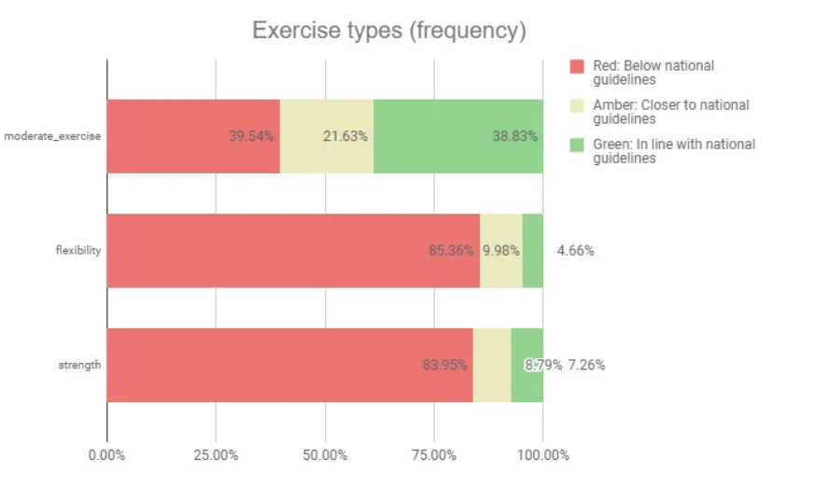
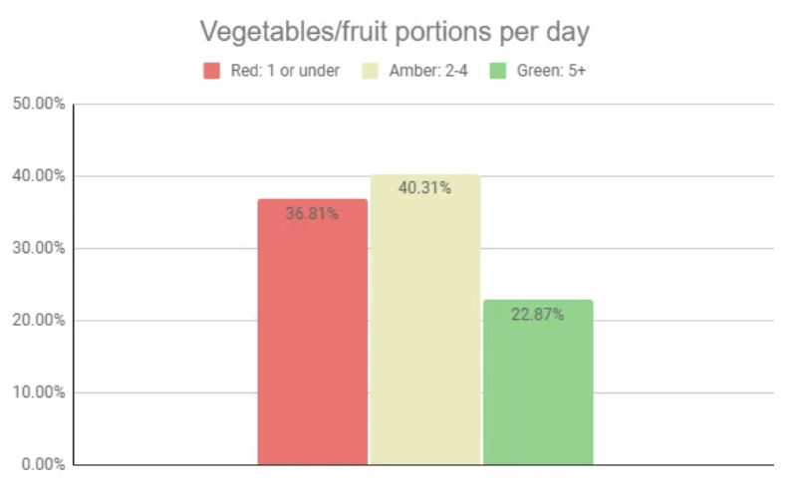
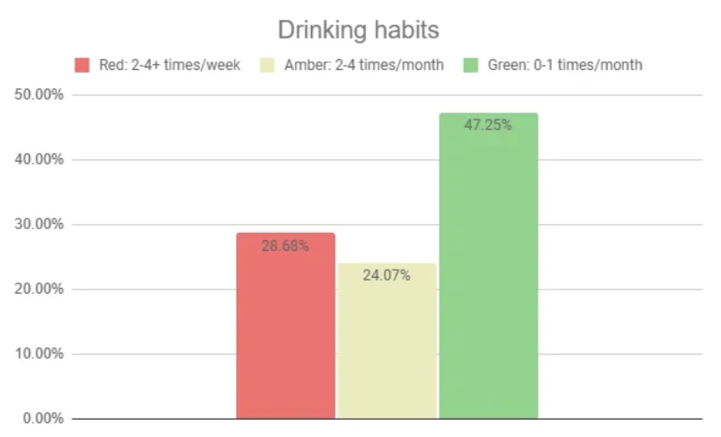
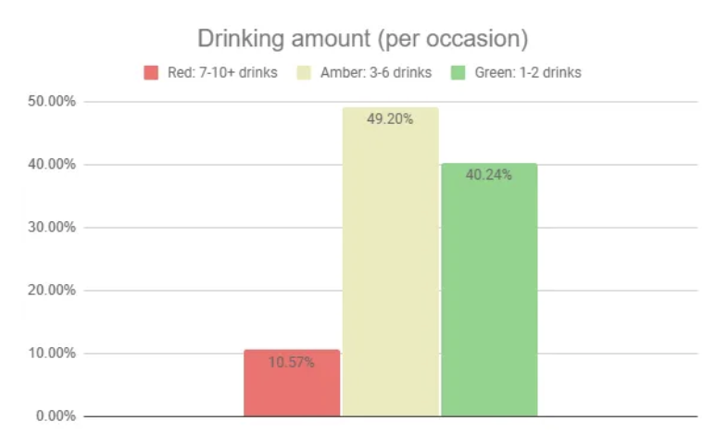
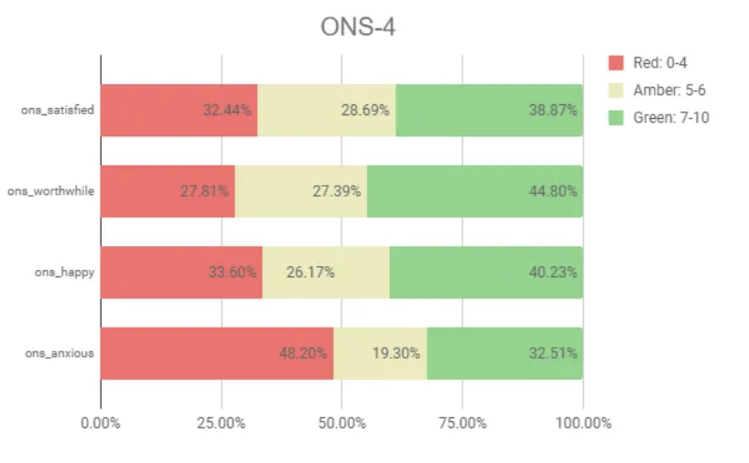
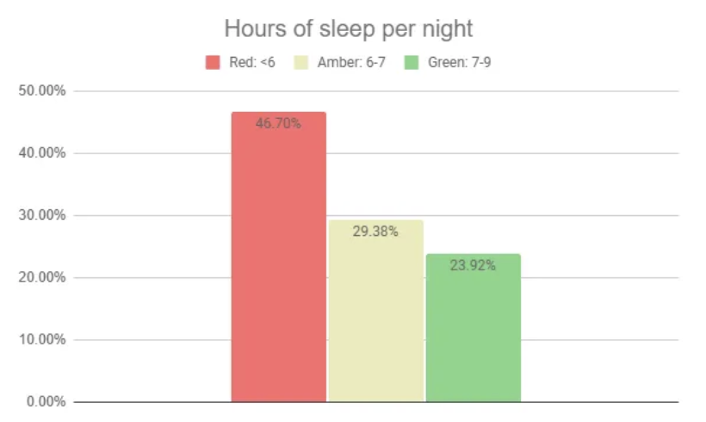
Habits at baseline
27% drink 2-4 times a week, or more
39% achieve national moderate exercise guidelines
37% eat 1 or under portion fruit or veg
48% have signs of high anxiety
47% sleep under 6 hours a night
10% drink 7-10+ drinks per drinking day
Notes:
Alexia

Slide 14
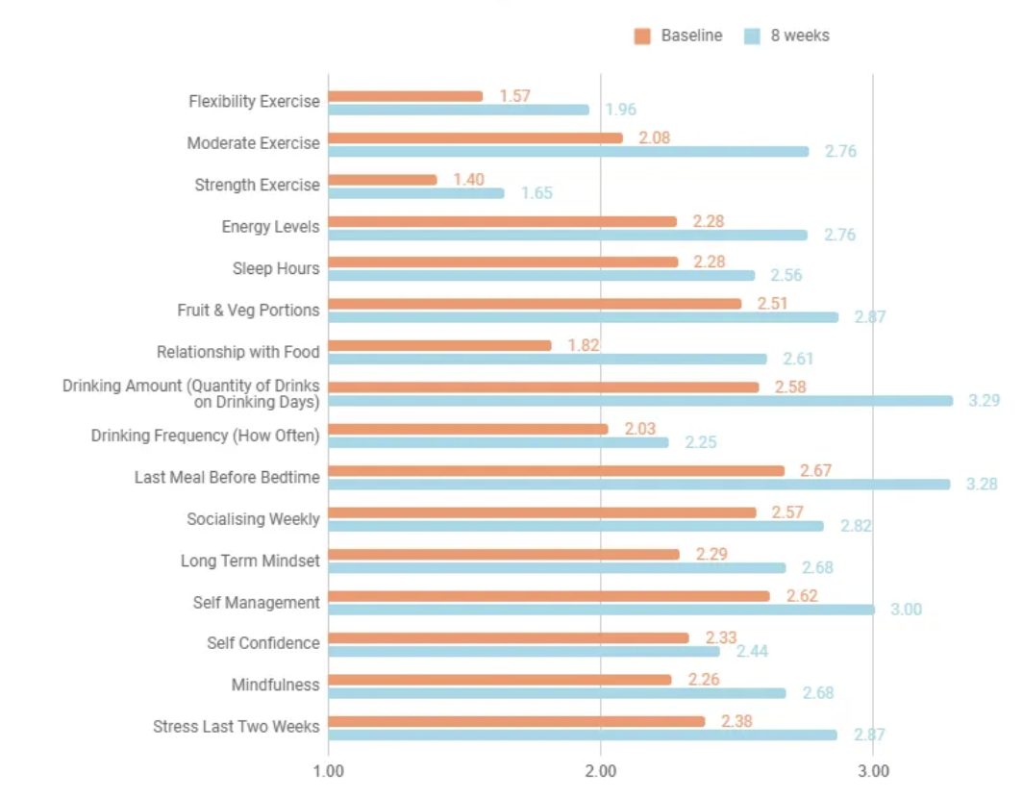
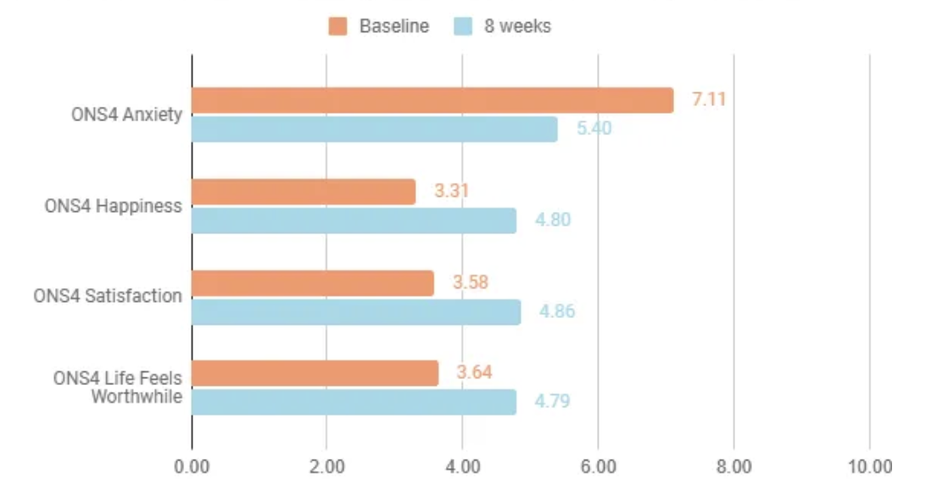
Health Changes (Pre-Post)
Average improvements at 8 weeks vs baseline:
Moderate exercise: 33%
Flexibility/balance exercise: 25%
Fruit & Veg: 14%
Stress: 20%
ONS4 Wellbeing: 34%
Drinking frequency: 11%
Drinking amount: 28%
Sleep hours: 12%
Energy: 21%
(In people that started with low to medium scores at baseline and completed follow up surveys)
Similar change levels at 6 months, so initial changes generally sustained
Average weight loss after 6 months = 5% (in people tracking this)
Systolic BP average reduction after 6 months = 4mmHG (in people with high BP)
Notes:
Grace

Slide 15
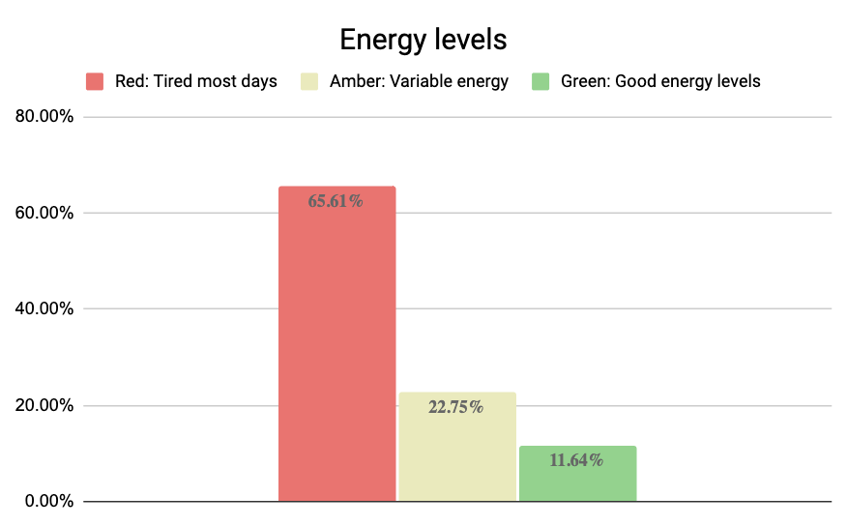
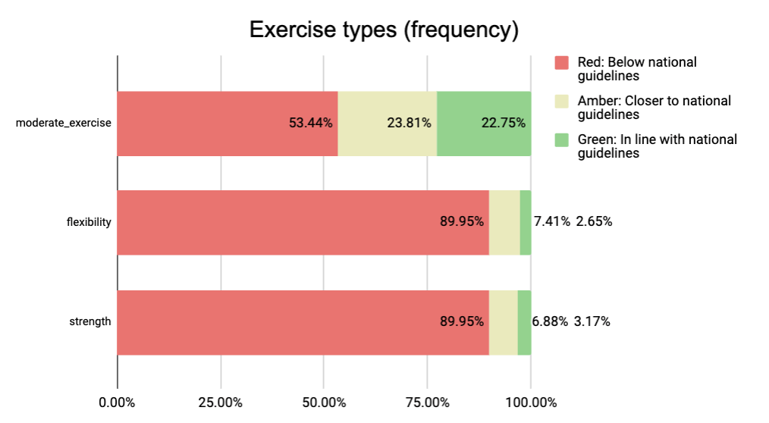
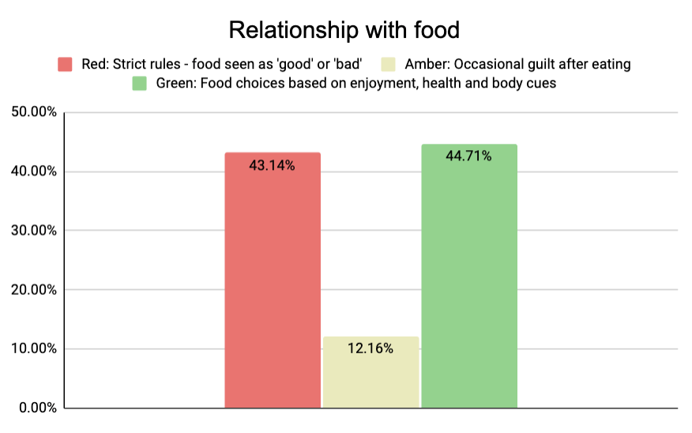
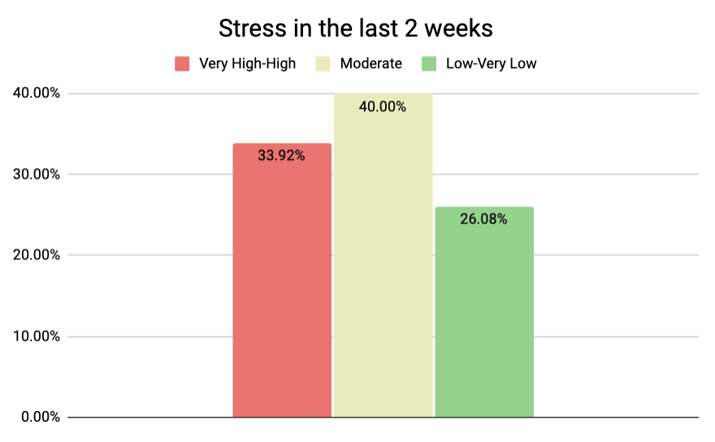
Health Changes (Pre-Post)
NAFLD & T2 Diabetes
NAFLD 8 week changes
Energy: Started particularly bad with 66% tired most days. There was an 8 week average improvement =27%
Resistance/Strength: Started particularly bad with 3% achieving national guidelines. 8 week average improvement =28%
T2 Diabetes 8 week changes
Stress: Started with 33% experiencing high or very high stress. 8 week average improvement =28%
Relationship with food: Started with 43% have potential problematic relationship with food. 8 week average improvement =31%
Weight: People tracking weight at both intervals saw an average 4% weight loss in 8 weeks
(In people that started with low to medium scores at baseline and completed follow up surveys)
Notes:
Grace

Slide 16
GP Appointment Changes & ROI Estimations
Statistic: MIND charity estimates that nearly 40% of GP appointments feature a mental health component
Statistic: People with LTCs account for approximately 50% of all GP appointments
Group | Appointments per 8 weeks (baseline) | Appointments per 8 weeks (after 8 weeks) | Outcome | Potential value saved per year (£40 per appointment)
All users | 1.51 appointments | 1.25 appointments | Average 0.26 reduction over 8 week time period (translating to a potential reduction of 1.7 GP appointments per person, per year) | £88,400 (based on 20% of onboarded users experiencing this change)
High service users (3 appointments per 8 weeks or 20 per year) | 4.20 appointments | 2.53 appointments | Average 1.7 reduction over 8 week time period (translating to a potential reduction of 11 GP appointments per high service user person, per year) | £143,000 (based on 5% of onboarded users experiencing this change)
​
“Holly supported me to make small, achievable, lasting changes that have made me more active and reduced my pain and fatigue a bit.”
Estimated ROI of 6x

Slide 17
Dr Alexia Pellowe & Grace Gimson
Alexia.Pellowe@aapct.scot.nhs.uk grace@hollyhealth.io

