Slide 1
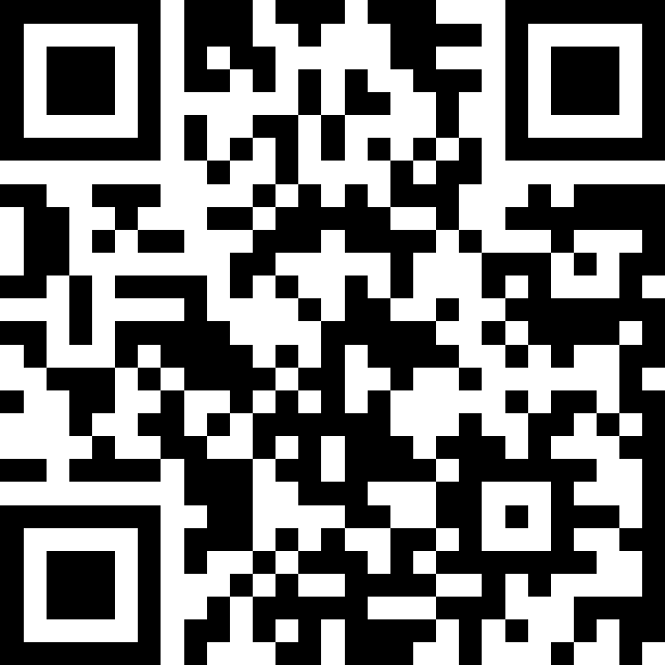
Strengthening Our Services: The National Elective Coordination Unit's (NECU) Approach for Dermatology
Slido – QR Code

Slide 2

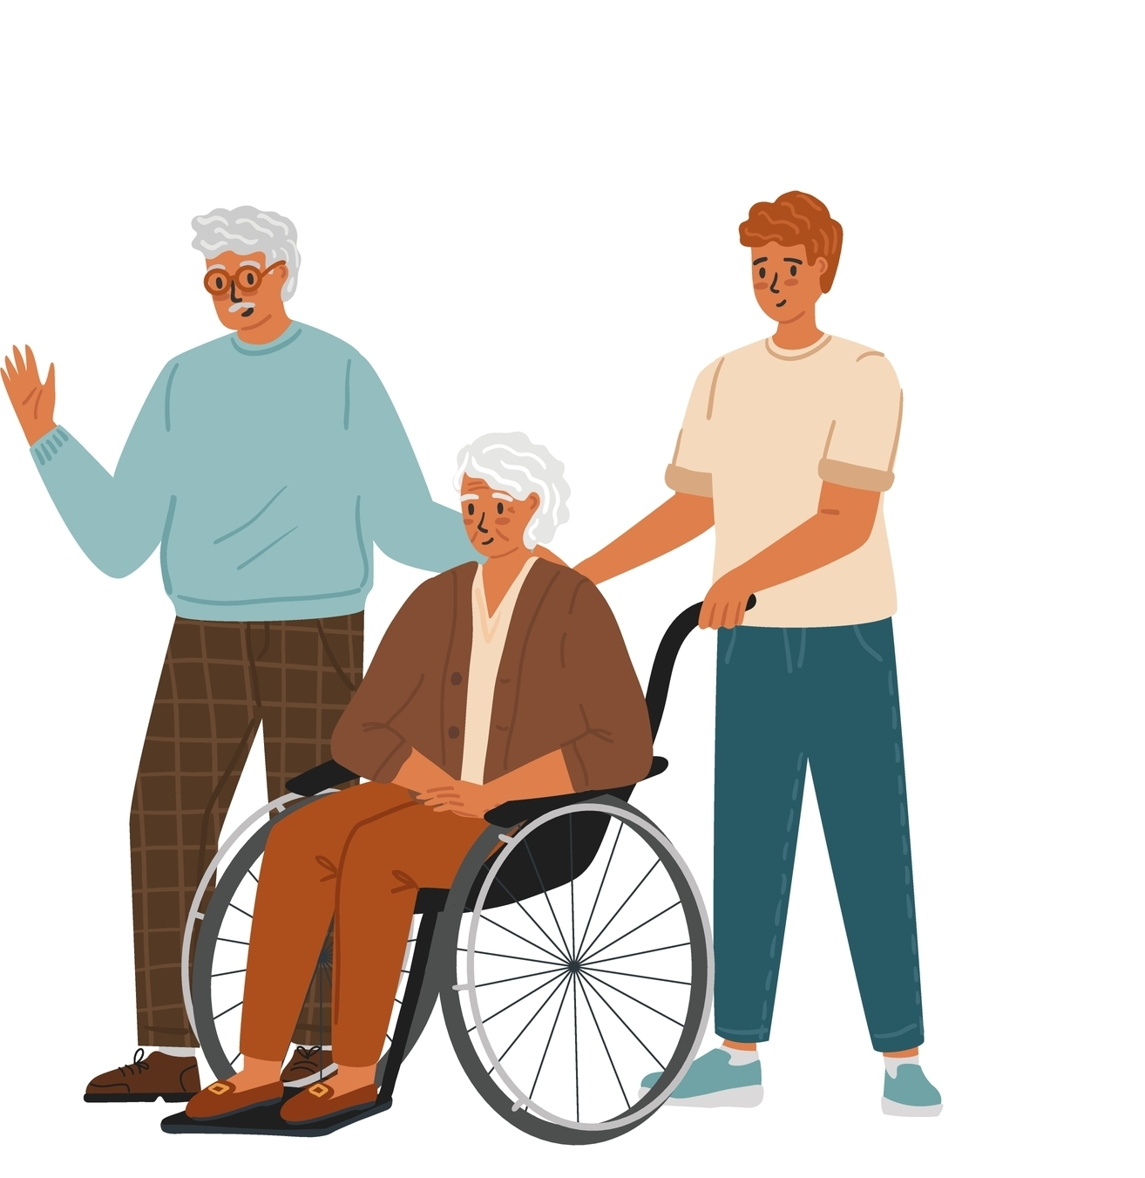

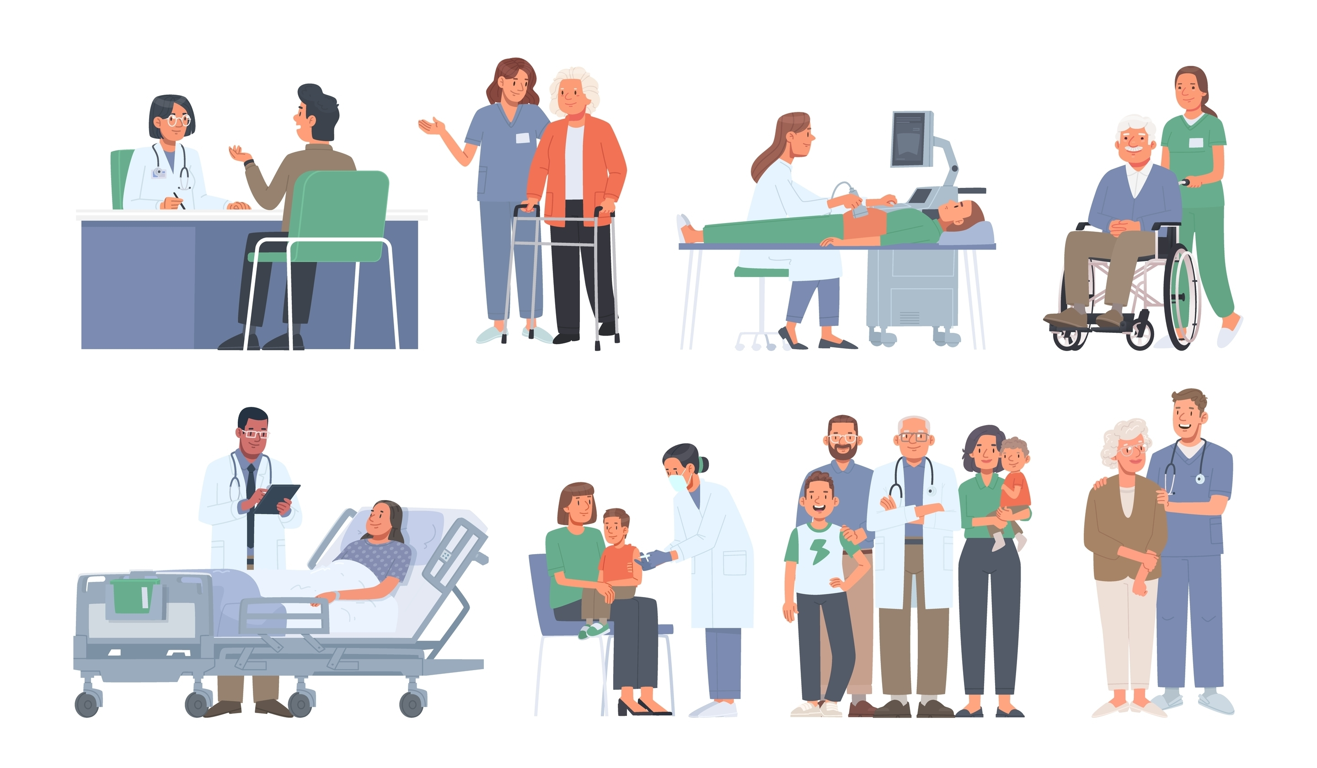
Transforming Access and Equity
Through collaborative, sustainable, and integrated care, NECU is transforming access across NHS Scotland.
• Supported over 250,000 patients
• Enabled treatment for 15,000+ patients through 40 campaigns
• Optimised waiting lists and reduced missed appointments
• 98% positive patient feedback
• Digital 'once for Scotland' approach to cross-boundary working
Made an anxious experience much easier.
Experience was excellent from start to finish.
Overall, a great experience.

Slide 3
Building on Our Foundation
Since establishment, NECU has achieved:
• Validated over 250,000 patients
• Treated an additional 15,026 patients
• Avoided 20,887 wasted appointments
• Generated cost avoidance of over £9.4M
• Direct cost saving of £568K
• Maintained 97% patient satisfaction rate
• Working with all NHS Scotland Health Boards

Slide 4

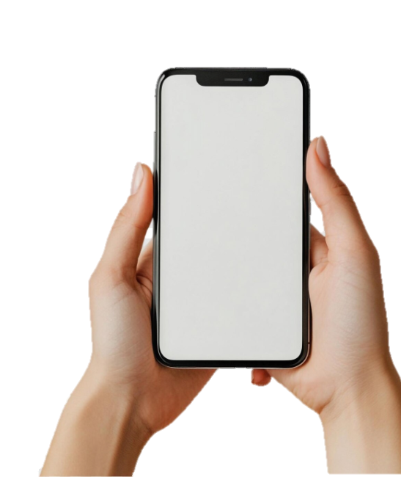
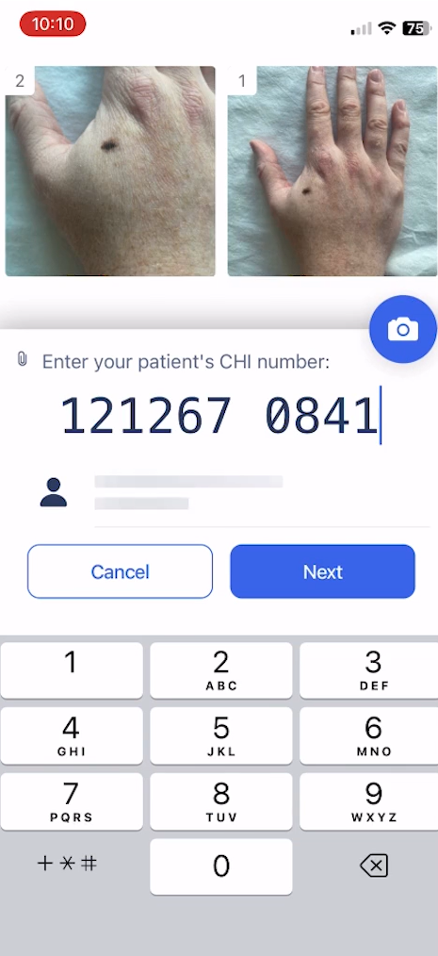
Transforming Dermatology Care
National Context:
• 61k patients on dermatology waiting list nationally
• 11,400 over 52wks
Service Improvements:
• Cross-board capacity for image capture and remote triage
• Digital infrastructure for multi-board patient management
• >70% demand reduction into secondary care
• >1.5% USC pick-up rate for non-urgent referrals
• >2,000 additional patients triaged (Feb-June 2025)
Digital Innovation:
• Pass-through app for safe image acquisition
- App already in use nationally through ANIA Digital Dermatology Pathway
• Cloud-based web application for image viewing
• Share point platform to enter triage info and generate patient letters

Slide 5
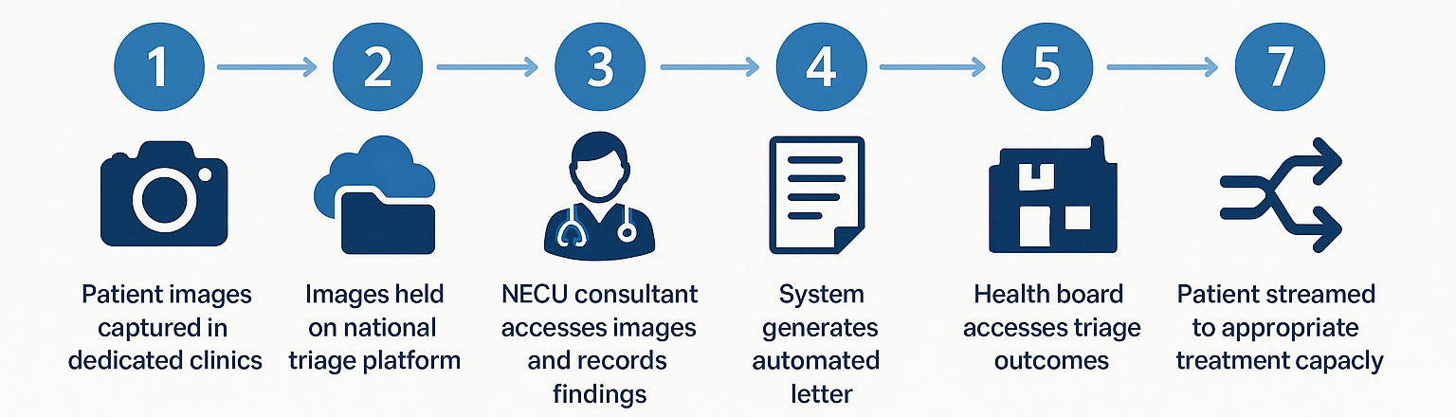
Streamlined Digital Process
7-Step Digital Dermatology Pathway

Slide 6
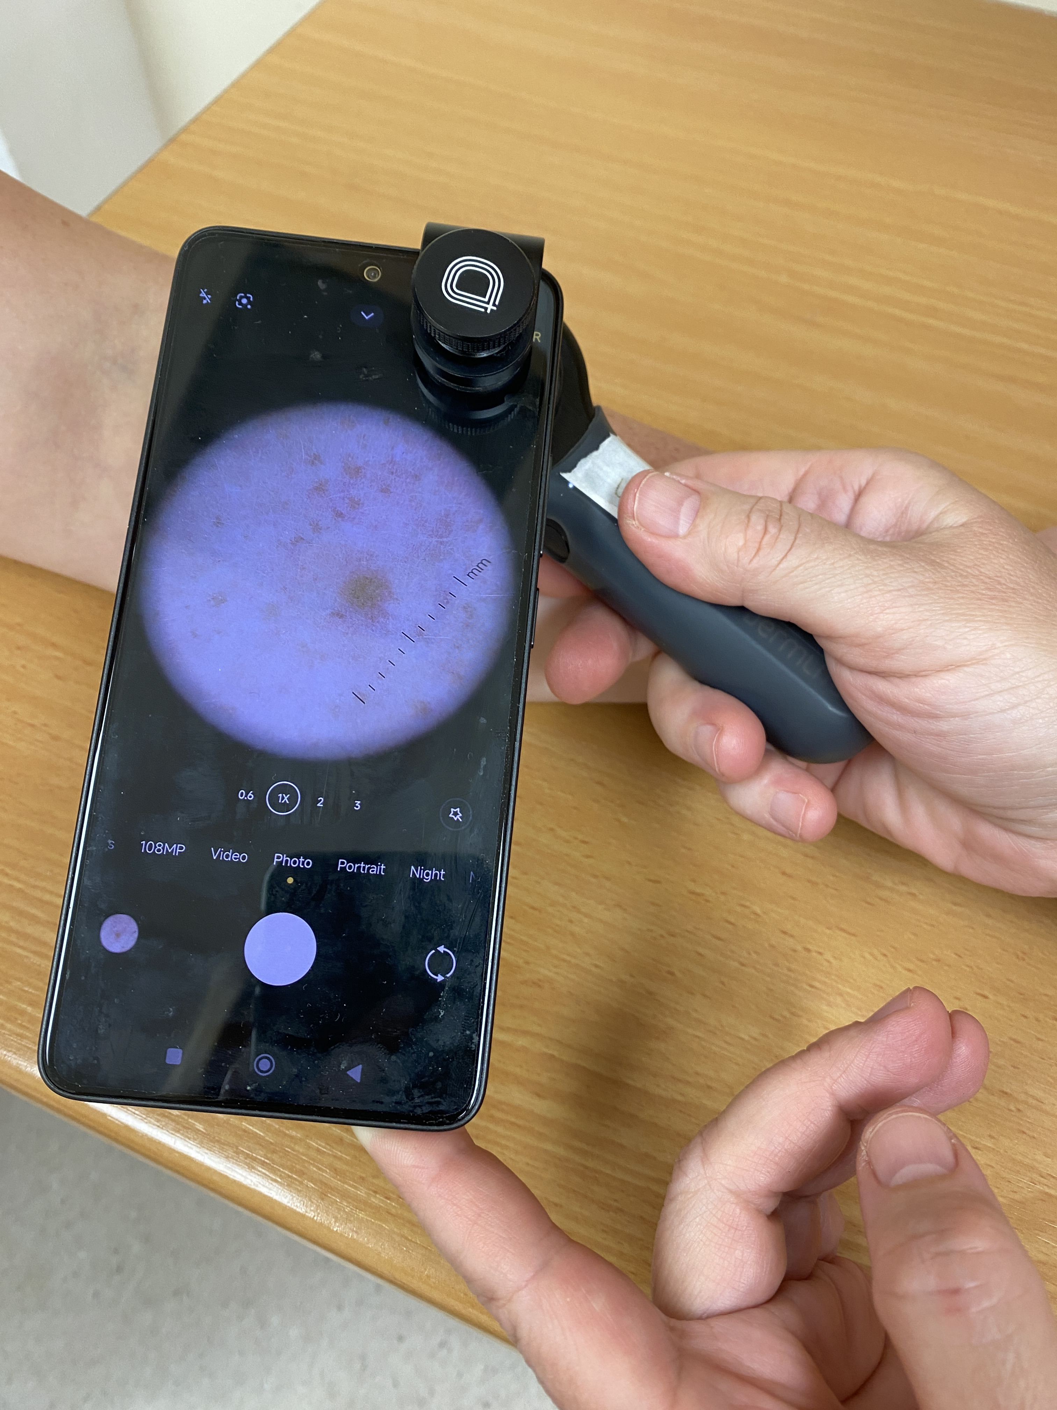
Clinical Context and Logistics
Staffing Model:
• Clinical photographers + Band 3 nursing staff
• Consultant-led triage and decision making
Technology Stack:
• SIM-less smartphone + dermoscope (Dermlite DL4)
• Consultant Connect app for image acquisition
• Comprehensive patient questionnaire system
MS Azure Patient management system
Clinical Assessment:
• History of change and symptoms
• Patient factors relevant to possible biopsy
• Standardized triage protocols and outcomes

Slide 7
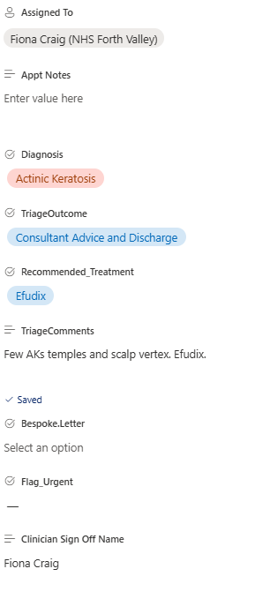

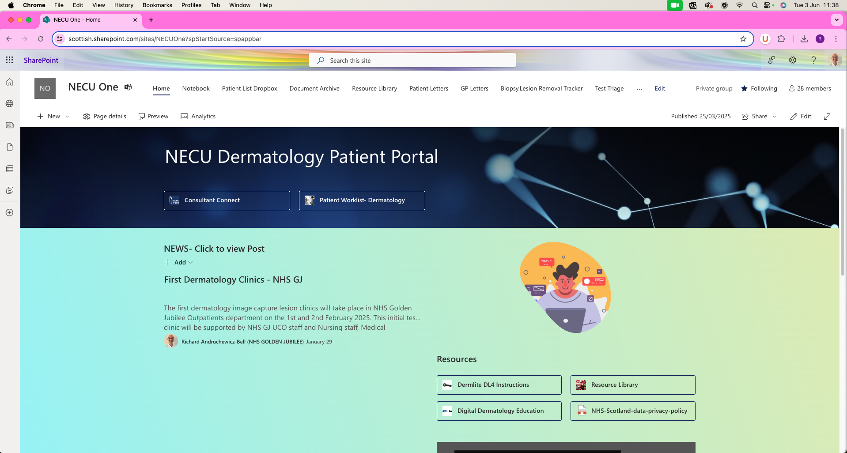
NECU One Triage Platform

Slide 8
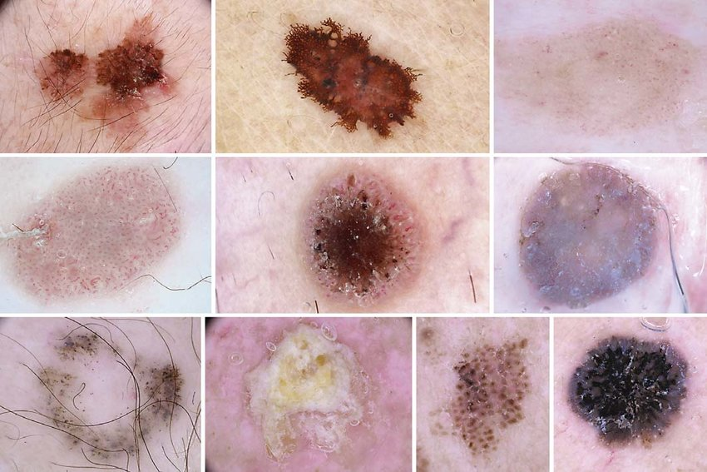
High-Quality Image Capture
Clinical images demonstrating:
• Smartphone camera technology supports high resolution image capture.
• Consultant connect offers excellent image manipulation, (zoom, pan etc) without loss of resolution.
• Dermascopic images improve diagnostic accuracy and contextual analysis.
• Professional clinical photography protocols
• National approach built upon technology pilots within large health boards as part of COVID recovery.

Slide 9
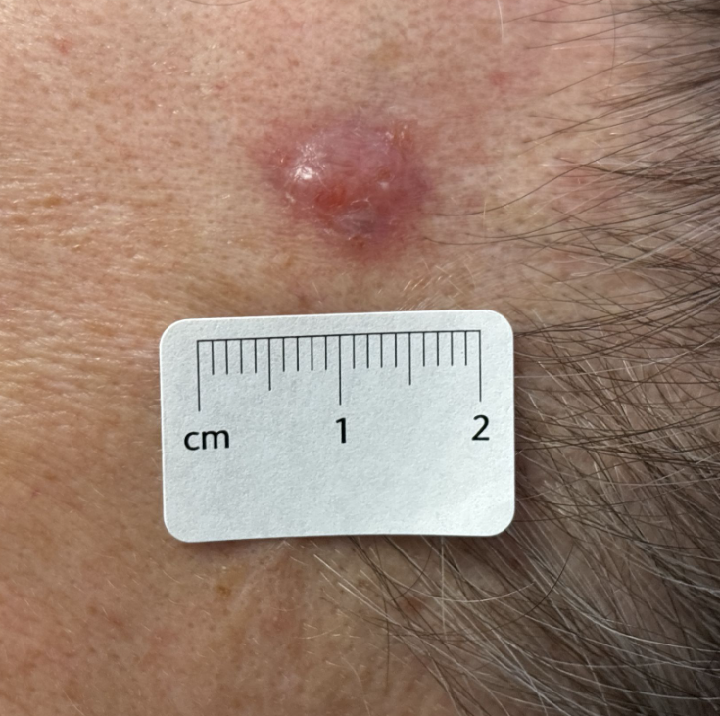
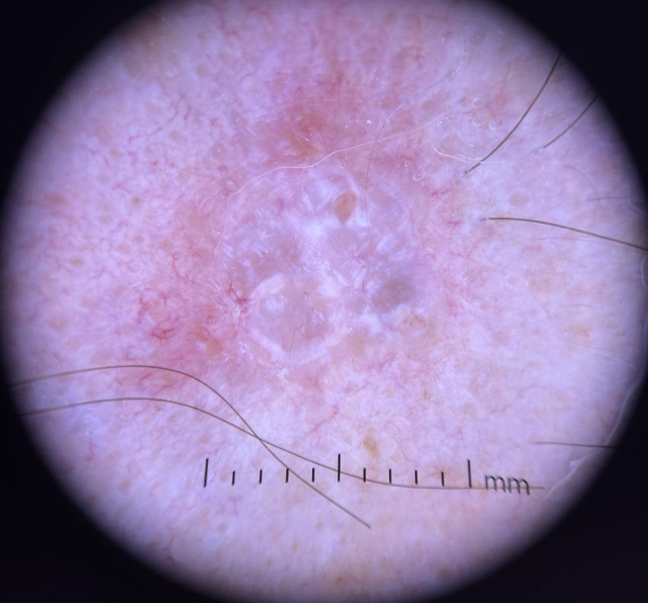
Case Study 1: Skin Malignancy
Case Study 1
55 y.o. male
Referred April 2024, lesion L temple
Attended image capture 9/2/25
Triaged – basal cell carcinoma
Letter explaining diagnosis and plan for excision
Lesion excised 1/3/25

Slide 10
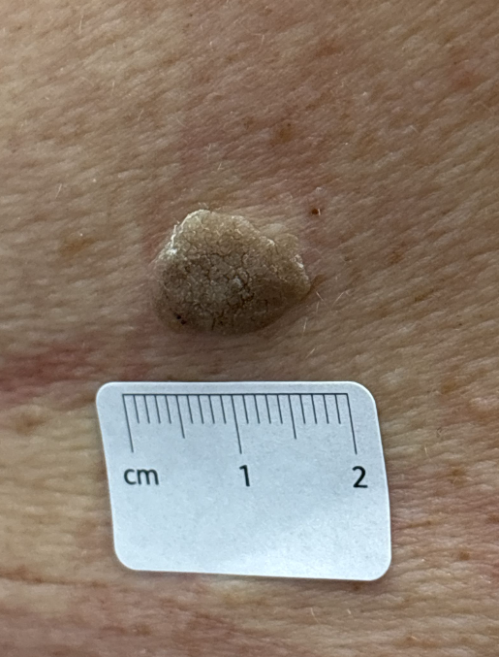
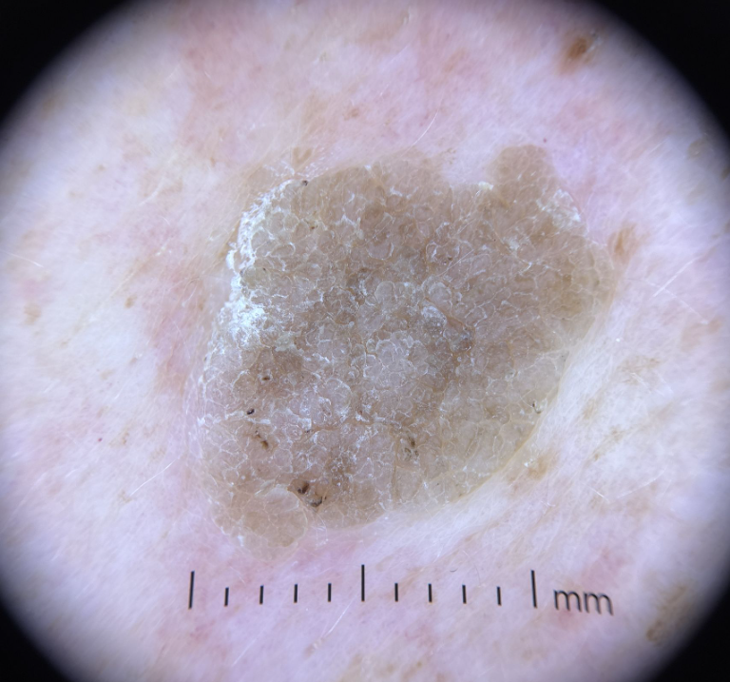
Case Study 2: Benign Lesion
Case Study 2
70 y.o. female
Referred May 2024, lesion L mid back
Attended image capture 23/2/25
Triaged as seborrhoeic keratosis
Letter of reassurance sent to patient and GP

Slide 11
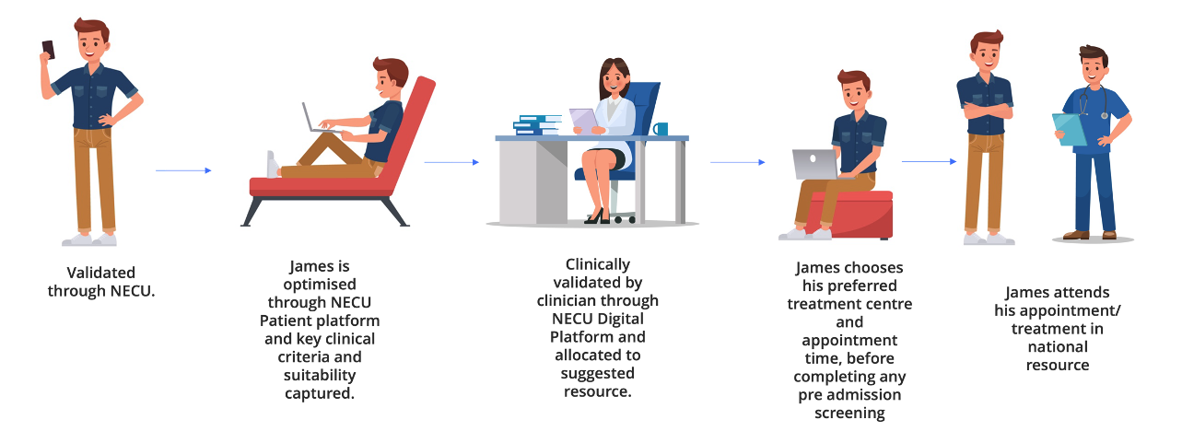
Downstream Surgery Coordination
Surgical Support
• Plastics-based skin surgery teams from NHS Lanarkshire and NHS Forth Valley
• NECU staff administration of surgical lists
• Local pathology examination in home board departments
Patient Choice at the centre of our approach

Slide 12
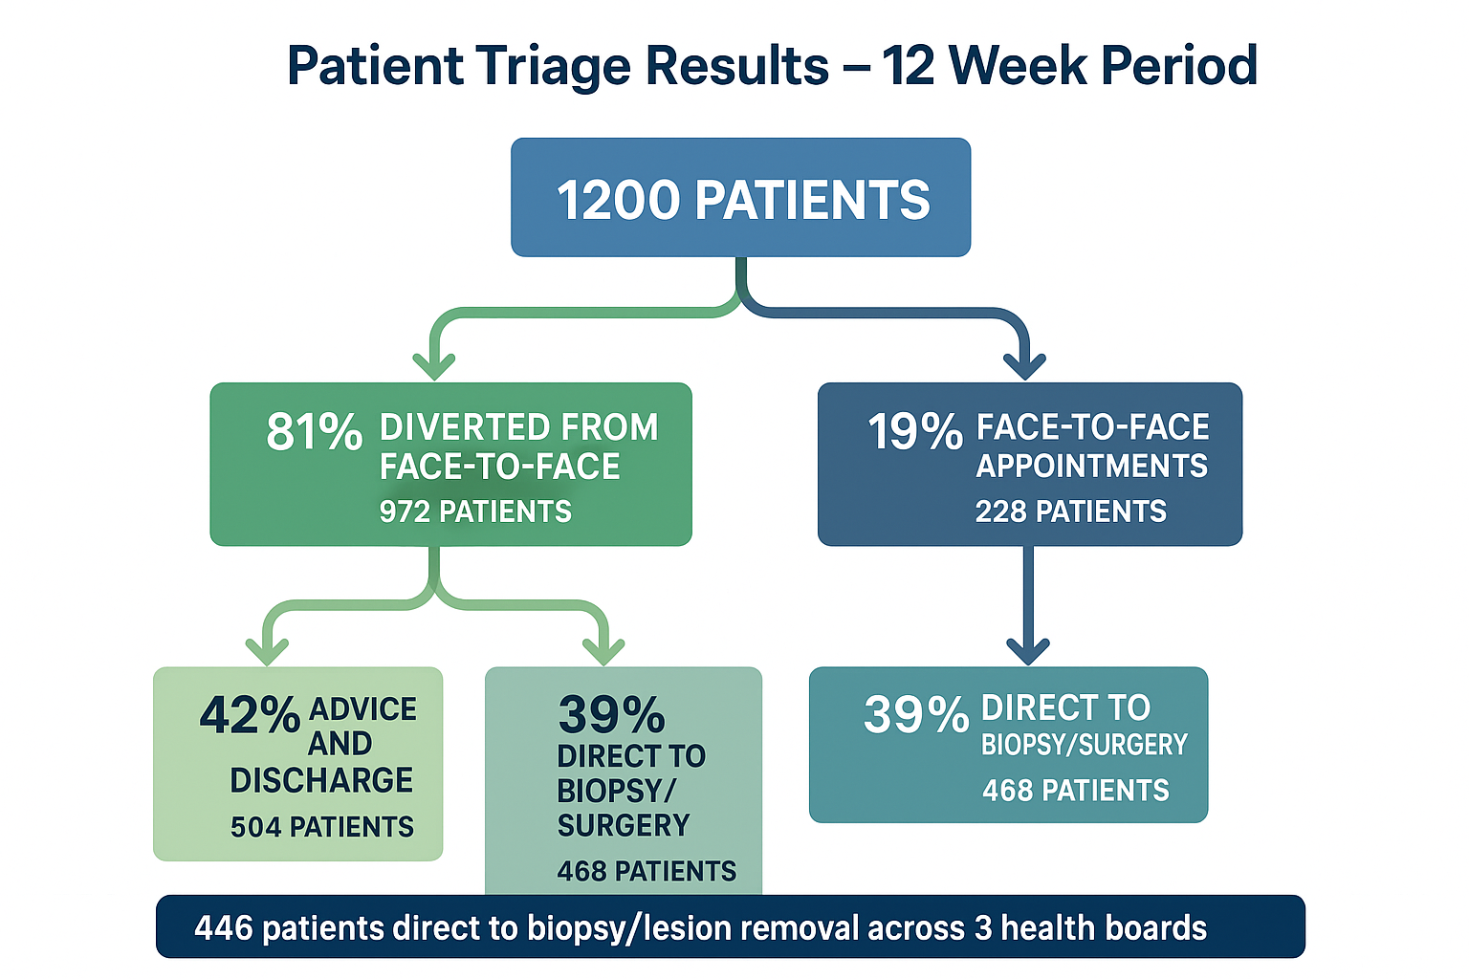
Impact

Slide 13
Challenges and Lessons Learned
Key Challenges Identified:
• No two boards use identical IT systems
• Difficulty with remote access between boards
• SCI store and regional portal provided limited visibility
Solution Developed:
• Created unified solution for clinicians across any board
• Standardized digital platform for seamless collaboration
Limitations
• No integration of images into home board portal/ medical image manager

Slide 14

Transforming a Fragile Service
Service Context:
• Dermatology nationally recognised as fragile service
• Challenges in workforce, capacity, and demand
NECU Solution:
• Cross-board approach linking workforce capacity
• Supporting patients with longest waits in NHS Scotland
• Commissioned for further year to March 2026
Patient Flow Optimisation:
• Only 19% patients require face-to-face appointments
• 39% diverted to appropriate treatment capacity
• 42% discharged at triage with advice and guidance

Slide 15
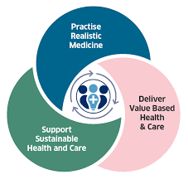
Patients at the Heart of Innovation
Core Philosophy:
• Patient-centered approach remains central to all NECU activities
• Maintaining and developing operational efficiencies across national campaigns
Sustainable Impact:
• Continued focus on equity and access
• Evidence-based service delivery
• National collaboration model for future expansion
• 98% patient satisfaction maintained throughout transformation

Slide 16

“
Thank You
“

