Slide 1

Social Prescribing Secret Weapon: Therapeutic Gardening and Health in Scotland
Slido – QR Code

Slide 2
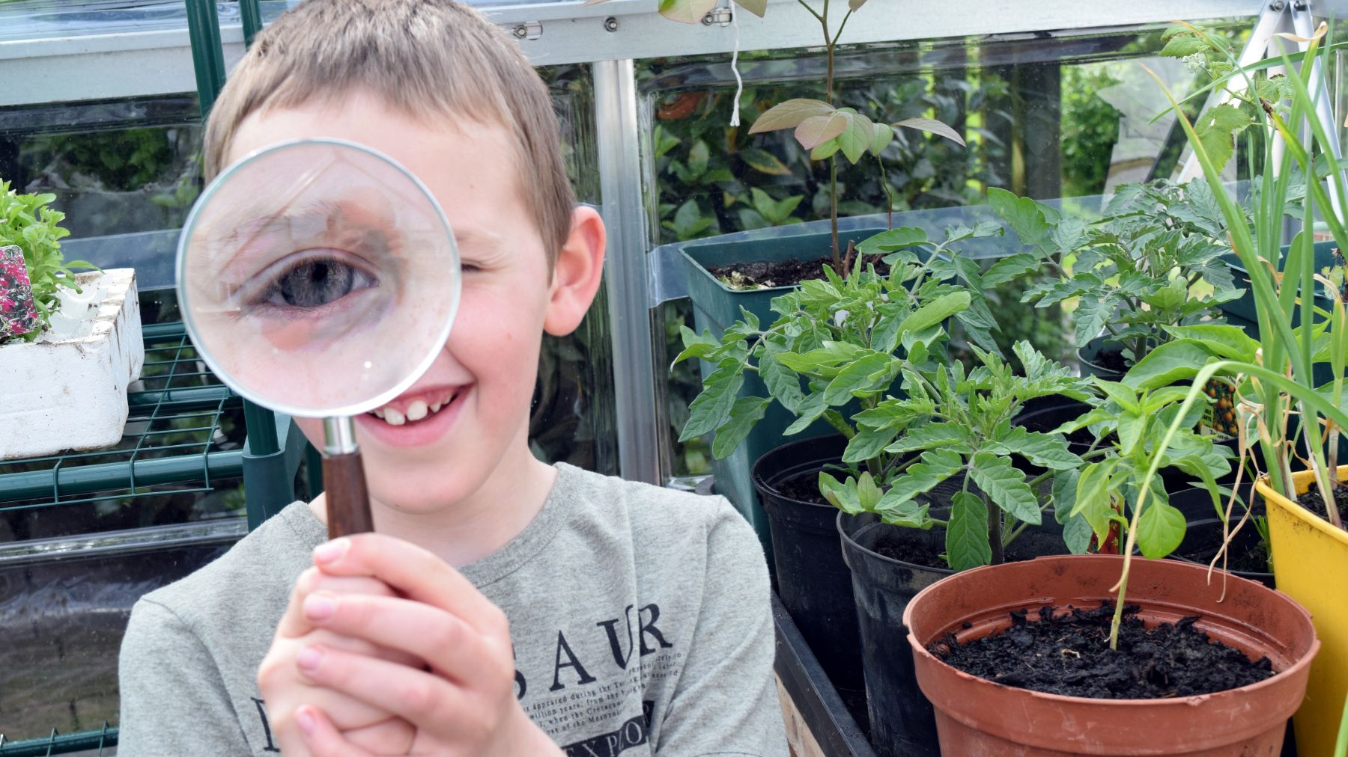

Therapeutic Horticulture: social prescribing secret weapon
©Copyright Trellis, all rights reserved

Slide 3
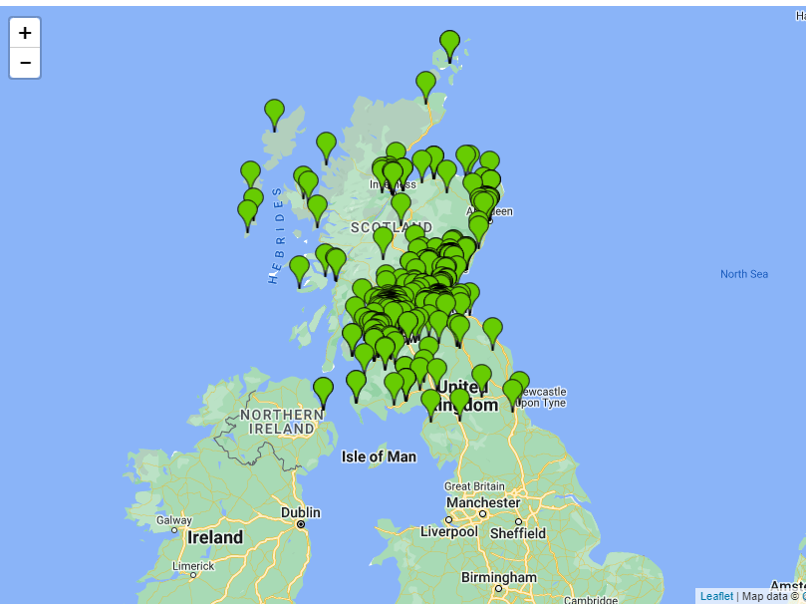
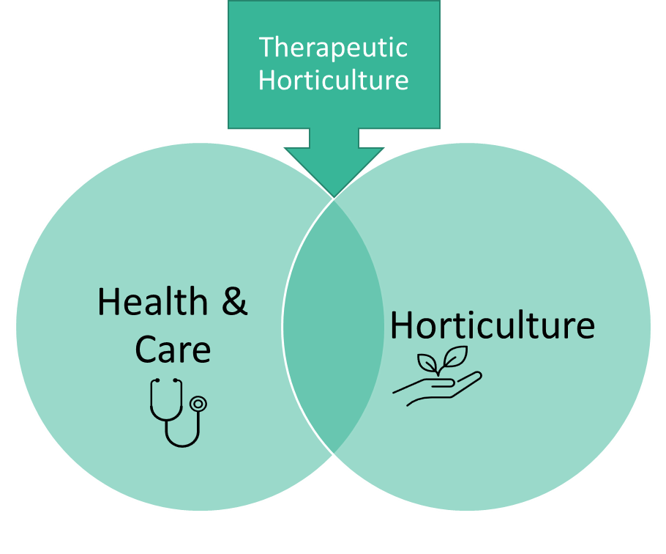
Scale: 530 groups across Scotland (and many more across the UK and in other countries).
Impact: Each group supports average 27 beneficiaries. Together we help c 14,500 people every week.
Northernmost project: Kirkwall, Orkney.
Most Westerly group: Barra, Outer Hebrides
Trellis Project Network

Slide 4
Recovery, rehab & prevention. Person-centred, evidence-based
Can help anyone, in any setting
Social prescribing benefits + nature exposure on top
Open to all – no clinic hours
Cost-effective, very popular
Sustainable effects, so…
Can reduce strain on services and
Help pivot ➔preventative services
Help towards climate targets
A secret weapon?

Slide 5
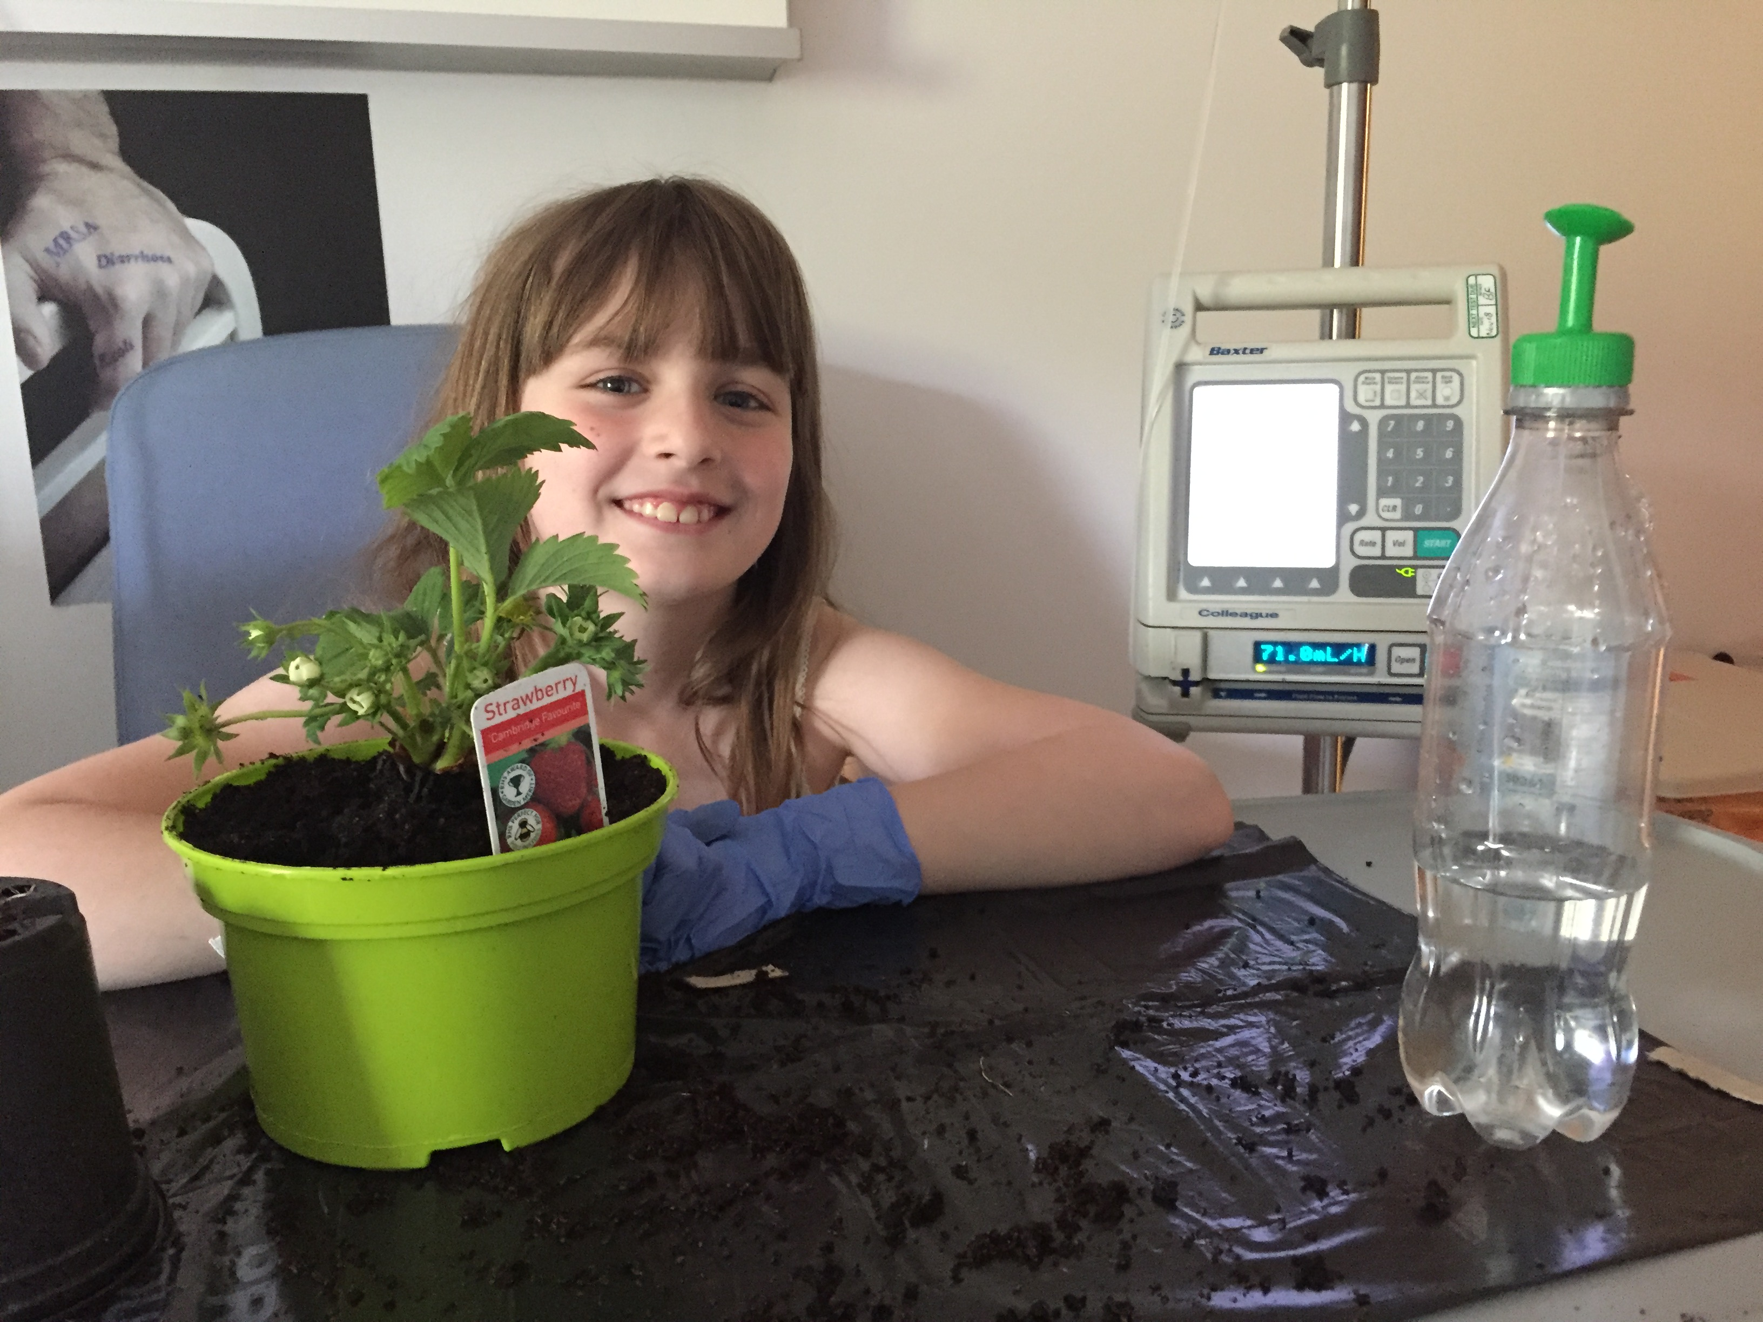
Now
Difficult times for health & care services: stressful working conditions, staff leaving, strike threats, waiting lists, public concern & headlines
Hard to pivot to preventative focus
Therapeutic horticulture can work alongside existing services: reduce strain, help move towards prevention & gentle transformation (rather than radical reform).
Staff wellbeing improves when patients get involved in therapeutic gardening

Slide 6

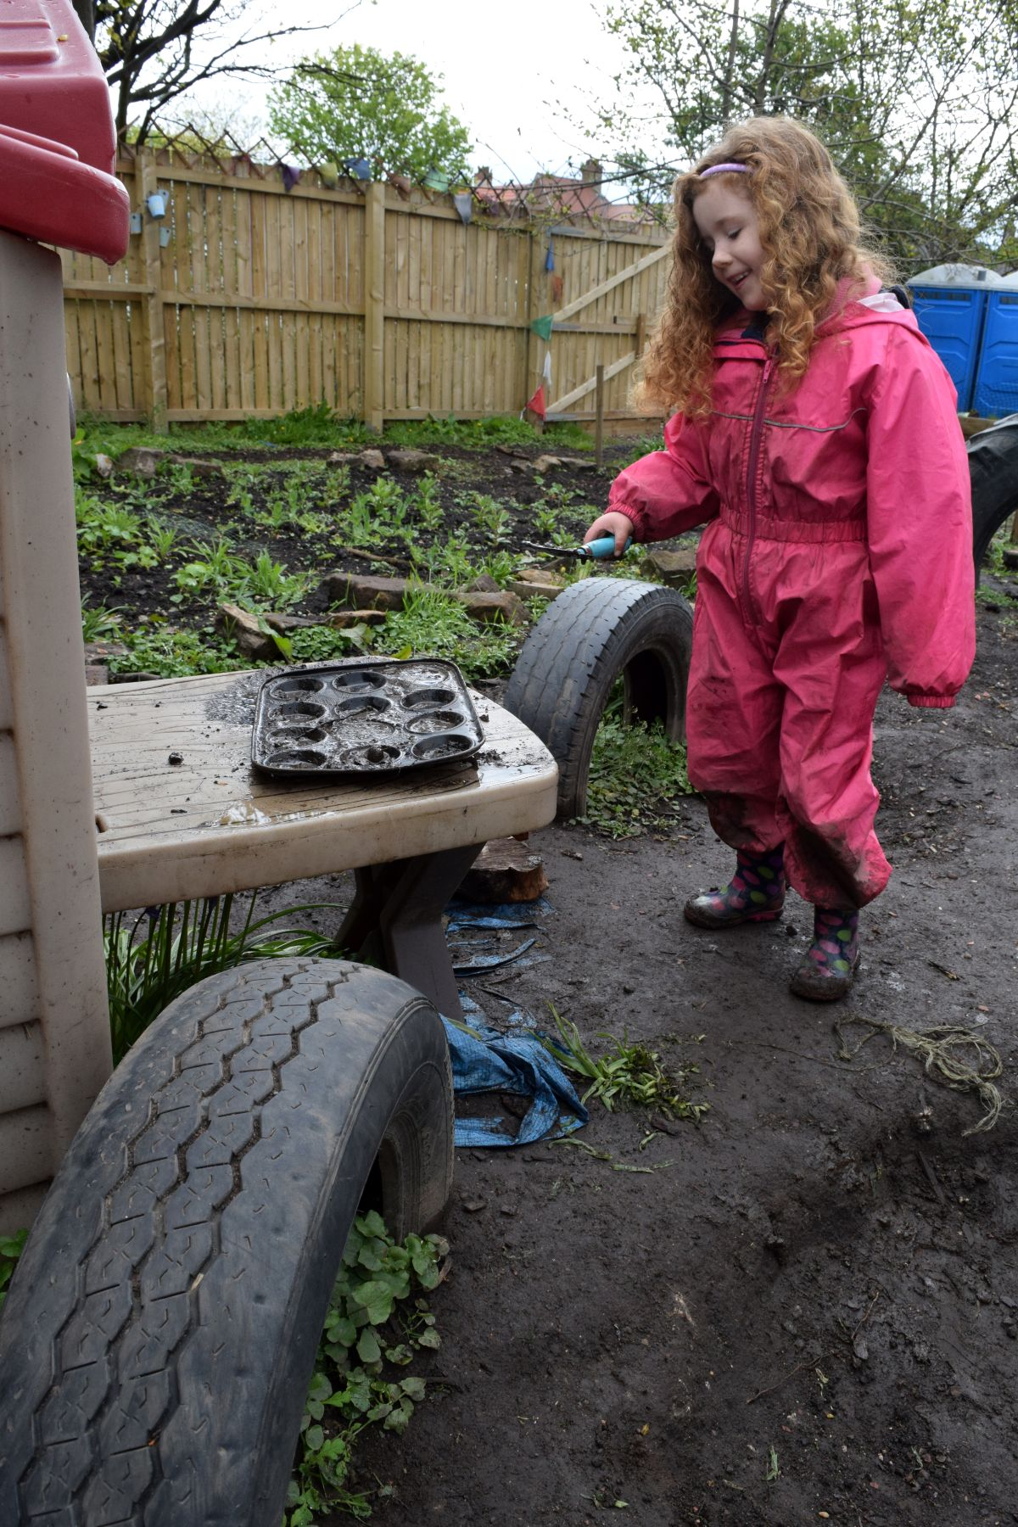
Benefits of therapeutic gardening
Brain health – calming, memory benefits, less agitation/aggression in dementia.
Physical activity: helps cardiovascular health, diabetes & back pain, (sustainable).
Diet: pride/curiosity = trying new foods. Gut microbiome.
Mental Health: Depression, anxiety & stress reduction,& better sleep.
Improved learning & emotional regulation. Boosts immunity, Vit D, mood. May help reduce childhood myopia.
Social benefits – reduces isolation, increased life satisfaction.
General health/risks – lowers BP, heart rate, pain, inflammation.

Slide 7
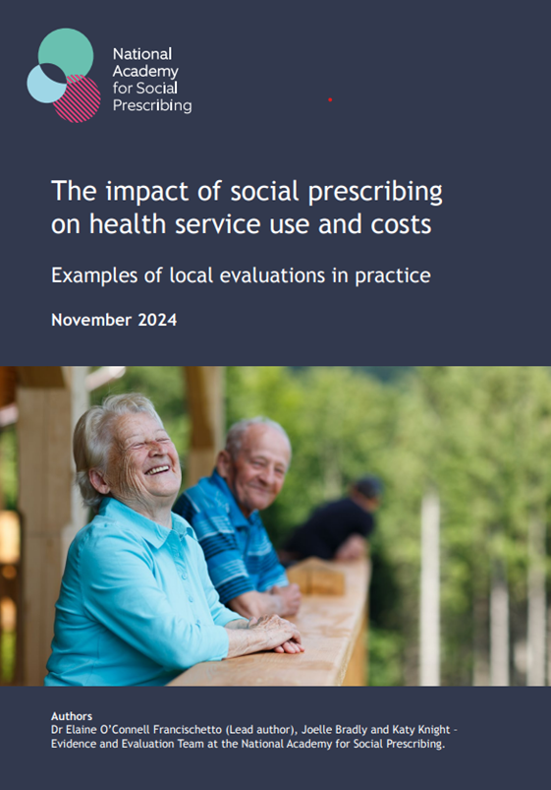
Social prescribing
Green Social prescribing
Specific benefits of TH:
All of the cited social prescribing benefits apply, plus nature exposure
Sustainable – benefits last, lifestyle/habit changes easier to maintain. Contributes to environmental sustainability too.
Living things – fascination, sustain attention, antidote to screens
Induces mindful ‘flow’ state without the breath counting/chanting
Exercise as a side effect of meaningful/joyful activity
Tameside & Glossop, GP appointments reduced by 42%; Kent, A&E attendances down by 23% for people accessing social prescribing
Kirklees, 50% fall in GP appointments for high frequency users; A&E attendances down 66%
Rotherham, A&E attendances for high frequency users reduced by up to 44%.

Slide 8
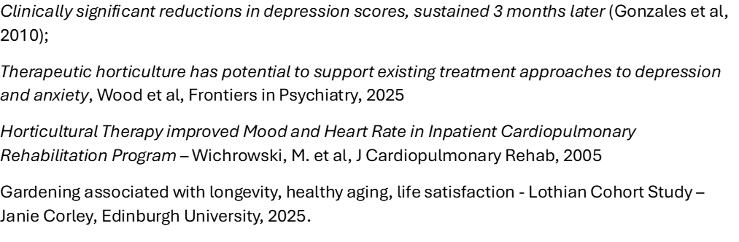


Evidence base
  Engagement with the elderly population of the hospital has … (seen) clients responding positively to a diverse range of winter activities, in some cases leading directly to improved patient experience … and earlier than predicted discharge.
  –practitioner, OT dept, psychiatric hospital, Fife

Slide 9
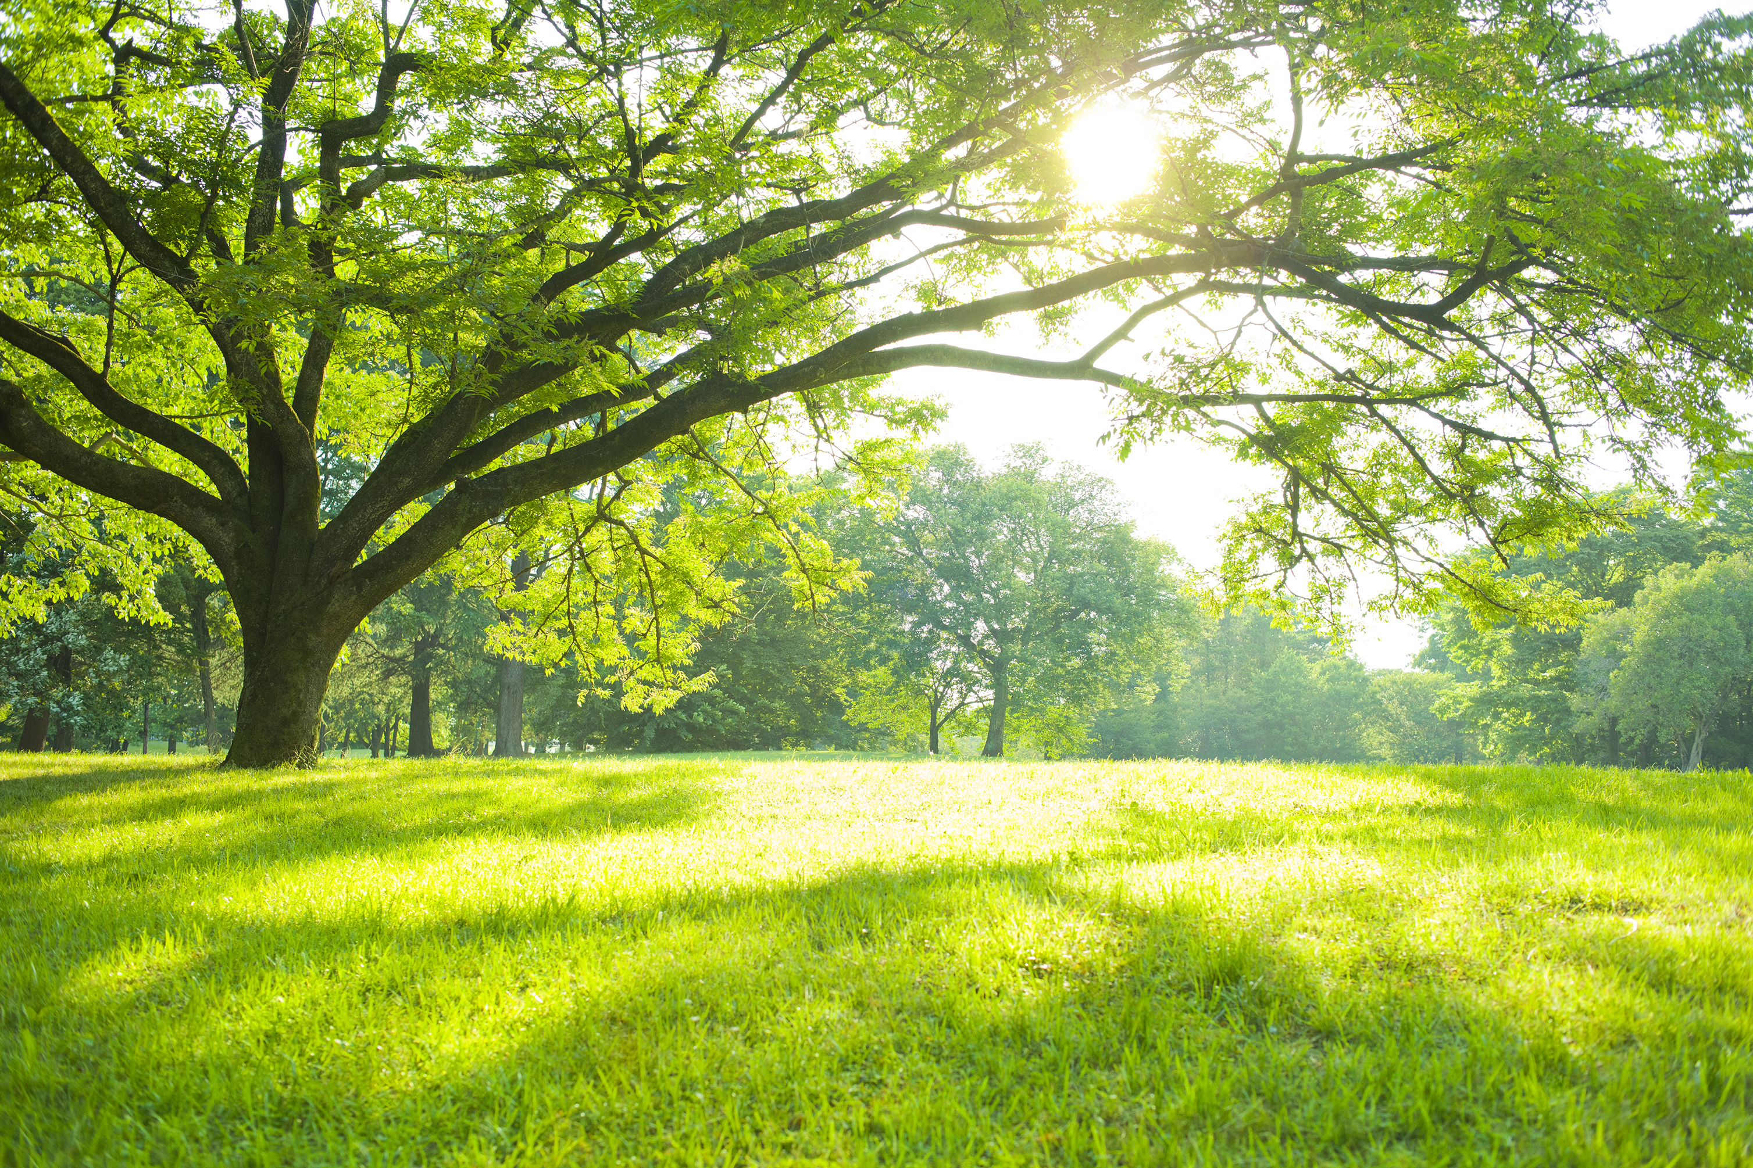
Let’s take a moment for ourselves. How do you feel?

Slide 10
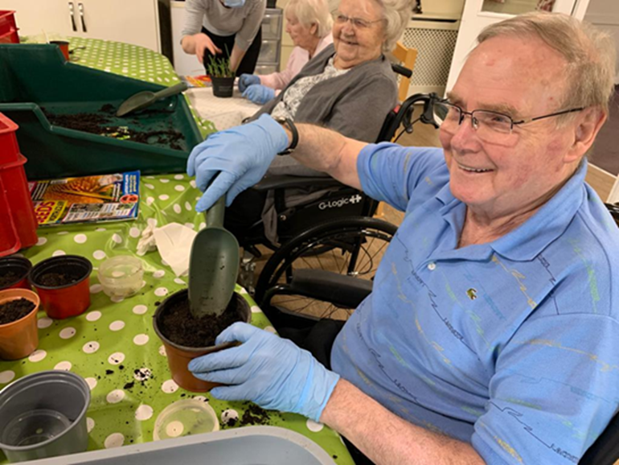
Therapeutic Gardening: referral & onwards
How long to feel a benefit? Typically, from first session - optimum improvements may take 10-12 weeks (@ 1 session/week).
Adherence: people really stick to gardening! Consistent attendance in TH programmes contrasts with low adherence for other regimes: an effective, cost-effective route to recovery.
Side effects and overdose: no known risks.
Measuring improvements:
Depression, anxiety & general health/wellbeing scales,
Life satisfaction & loneliness surveys, sleep quality
Learning/school outcomes
Pain/symptom measures
Diaries & informal feedback
Blood pressure, medication levels
Lower frequency of repeat appointments
Skills/achievements, measures of function/occupation, SMART targets
Engagement in activities & sense of belonging & connection

Slide 11
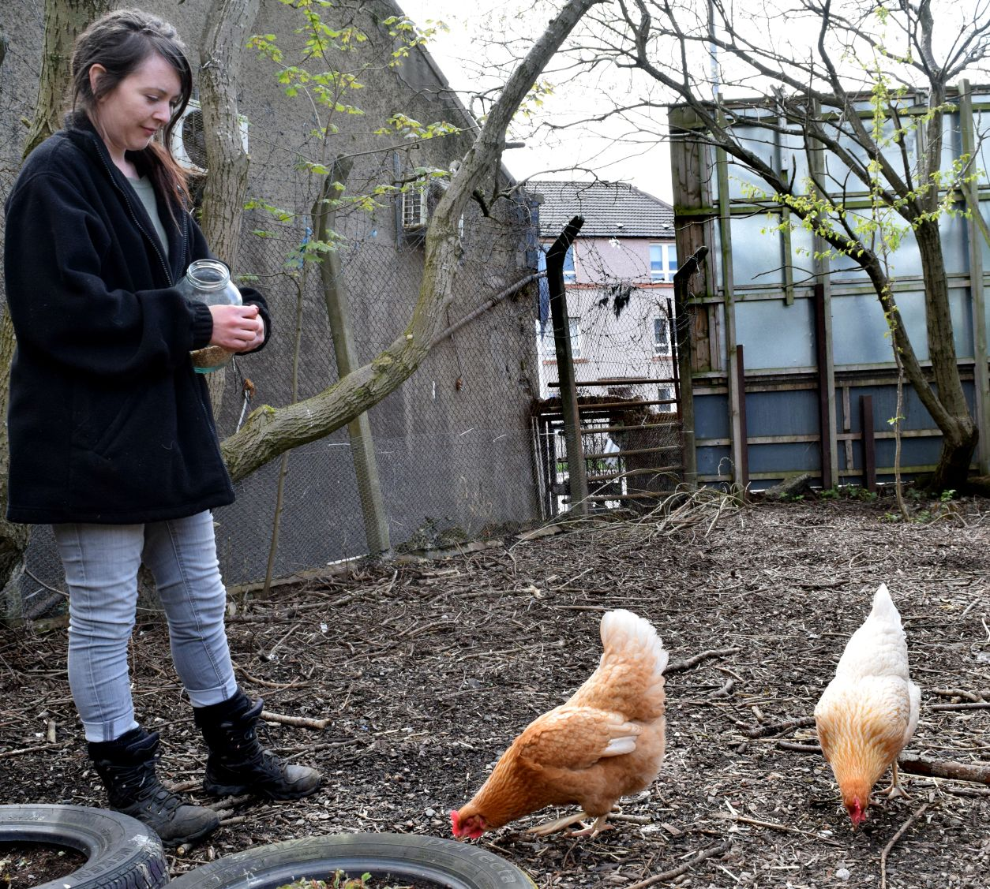
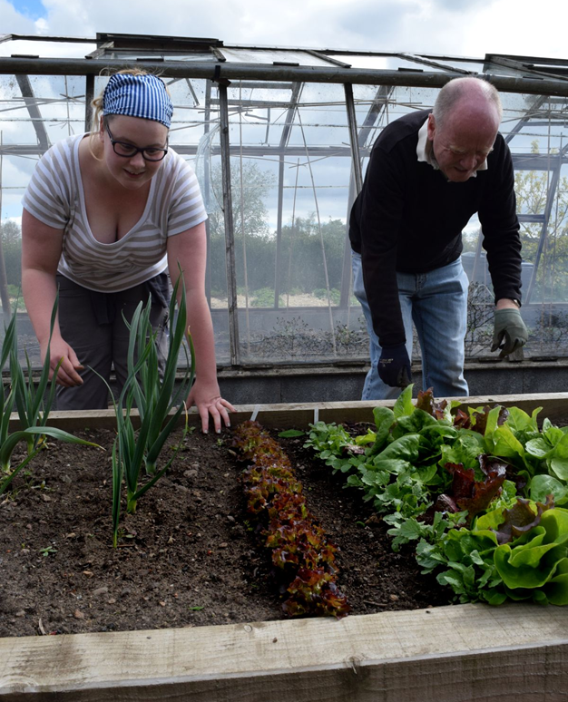
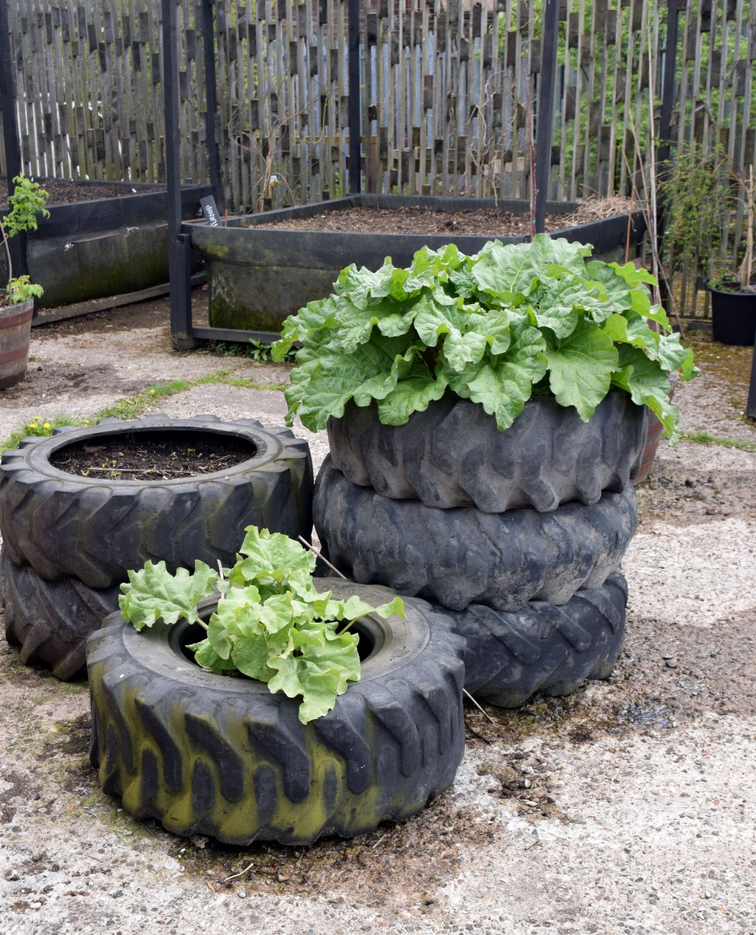
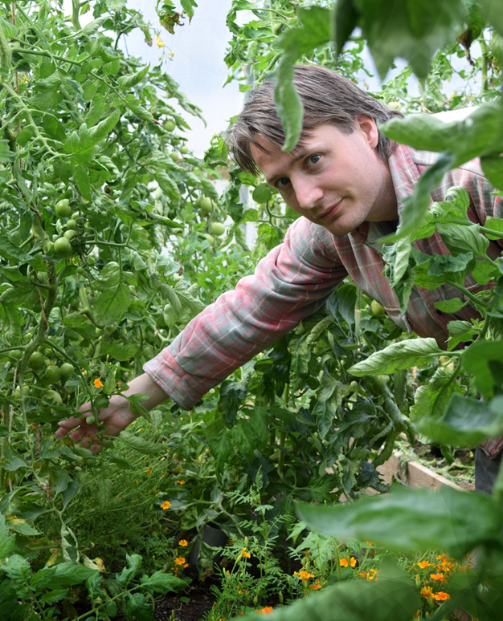











Benefits everyone, no matter who or where
Growing food
Gardening’s possible anywhere: HMP Barlinnie, green brought to concrete landscape, hospices, high secure units, Aberdeen Royal Infirmary roof garden, indoor gardening in Hong Kong’s apartment blocks,

Slide 12
Big plans: scope to quietly transform the health & care sector?
Gardening in every care home
GP pilot, East Lothian – then
nationwide?
Therapeutic garden/national centre of excellence in TH training - Scone

Slide 13
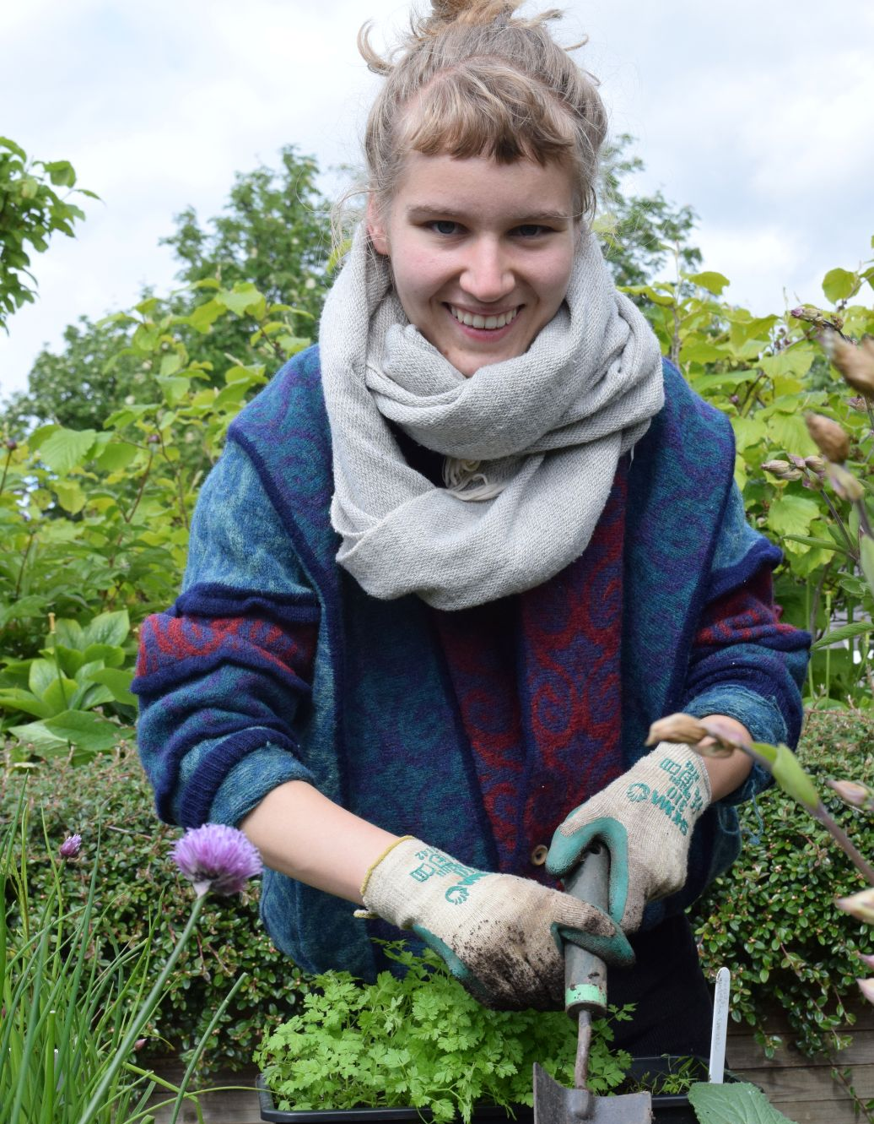
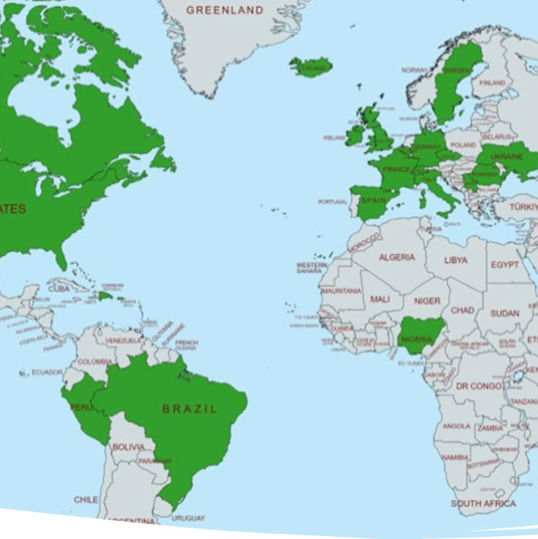
Can Scotland take a distinct & different approach?
Pioneering initiatives & sharing with our global network:
UK Professional Association established by Trellis, setting standards for practitioner registration, code of ethics etc.
PDA practitioner qualification undergoing SQA approval
World Therapeutic Horticulture Day, 18 May: Trellis initiative
International Seminar Series, November: all welcome
Invited to train practitioners, new UK NHS Rehab Centre, Notts.
Supporting partners in Ukraine to develop TH practice.

Slide 14
Got the gardening bug?
Try these next steps to explore the difference TH can make in your life & practice ➔
Sounds great! What next?
Get involved in work to develop the UK Professional Association.
Visit the Trellis map & directory to find projects to perhaps refer patients.
Consider starting gardening activities at your clinic/ base, perhaps with link worker(s). Contact Trellis for help.
Try our free Live Demo events & Activity Sheets to learn more, find inspiration &
network.

Slide 15
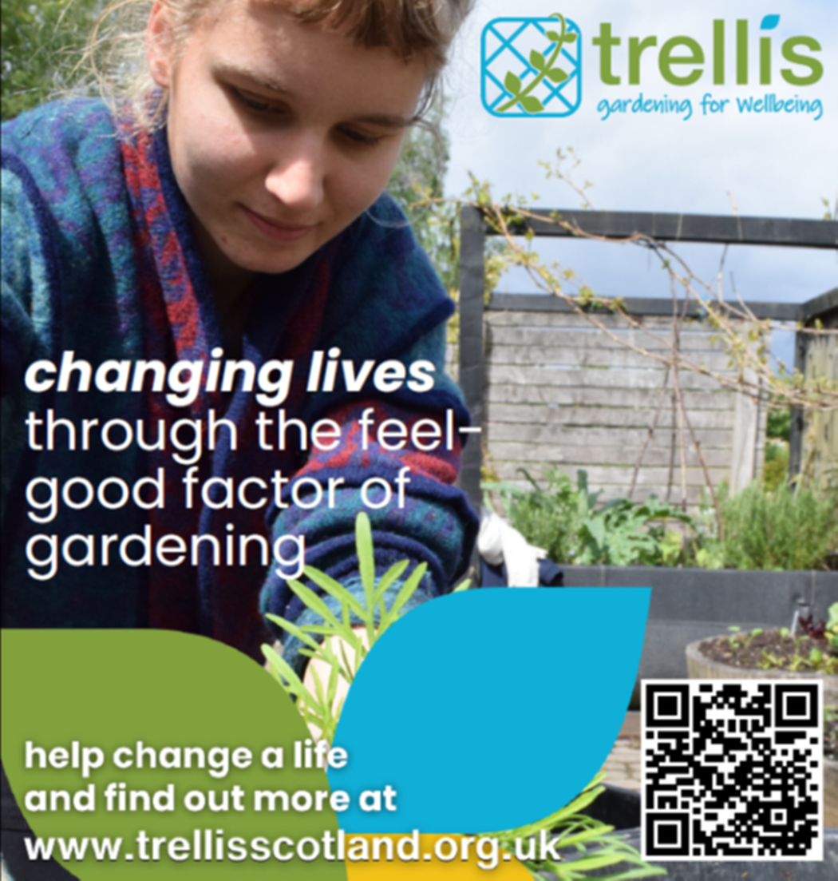
Thank you for listening!
We can help enable:
access for all
pivot to a preventative service
www.trellisscotland.org.uk
info@trellisscotland.org.uk
We look forward to hearing from you.
Notes:
ft

