Slide 1

An enhanced model of community respiratory physiotherapy care
Slido – QR Code

Slide 2





East Dunbartonshire:
Seasonal and Demographic Pressures
Second highest life expectancy in Scotland
Ageing population = higher rates of chronic illness and complications
Winter spike in emergency admissions NHS pressure
Highlights need for strategies to reduce avoidable admissions
Shift the balance to community

Slide 3
Respiratory illness in East Dunbartonshire
2nd
65+
13
3rd
leading cause of hospital conveyance and admission among residents
Residents aged 65+ account for the 3rd longest length of hospital stay
Average stay: 13 days (12.7% of all admissions)
In 2023, respiratory disease was 3rd leading cause of death in Scotland
Source: Public Health Scotland East Dunbartonshire Emergency Admissions (Age 65+), 2023/2024
(to January 2024)

Slide 4


Chronic Obstructive Pulmonary Disease
Growing COPD burden in Scotland
COPD cases expected to rise by 63% by 2044
From 134,257 cases (2019) to 218,962 cases
+84,700 people living with COPD
Most patients admitted for COPD exacerbations are treated with:
Standard medications (e.g. nebulisers, steroids, antibiotics)
Respiratory physiotherapy
Exacerbation of COPD #1 reason for emergency admission

Slide 5



Financial implications
Hospitalisation | Standard Treatment
Acute Bed Cost (2021/22): £345 per day £2415 for 7 days excluding SAS, treatment, imaging, discharge costs | Nebulisers, oral antibiotics, steroids Doxycycline (7 days): £1.28 Prednisolone (5 days): £1.24 Salbutamol nebulisers (5 days): £9.31 Specialist Physiotherapist: £37 per hour
£2415 Vs <£50
Figures from Department of Health and Social Care (March 2023) & Scottish Drug Tariff (May 2025)

Slide 6
New Model of community-based Respiratory Physiotherapy Care
WHAT | Specialist physiotherapy support to COPD patients within their home setting
BY | Focusing on recurrent exacerbations of COPD Identifying frequent attenders to A&E +/- admissions Educating patients to improve COPD self-management Reducing emergency attendances and admissions

Slide 7
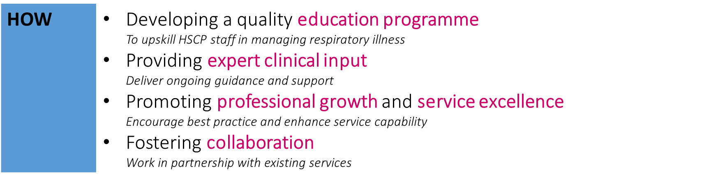
New Model of community-based Respiratory Physiotherapy Care

Slide 8



Enhanced Respiratory Care Model for COPD
Key features:
Education: COPD symptoms, breathlessness management, chest clearance techniques, signs & symptoms of an exacerbation and what to do
Respiratory medication review: Inhaler technique, mucolytic, nebulisers, rescue medications and oxygen needs
Home-based pulmonary rehabilitation: Improves confidence, lung function, exercise capacity and quality of life

Slide 9
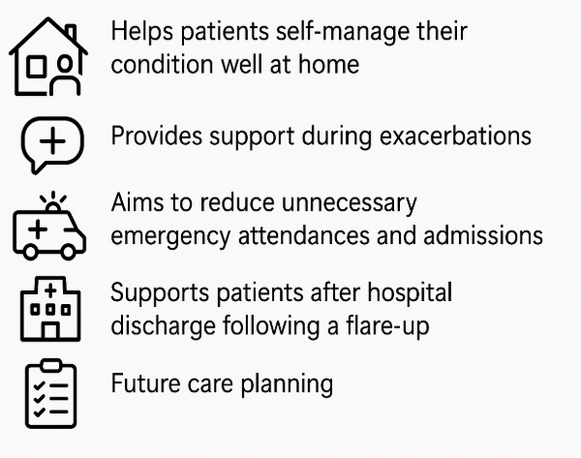
Enhanced Respiratory Care Model for COPD

Slide 10

Service Analysis
Retrospective vs prospective comparison of data:
  Frequent attenders
  Emergency admissions for respiratory illness
  Length of Hospital Stay (LOS)
Data collection:
  Exacerbations safely managed at home
  Unscheduled admissions under community care
  Reason for admission

Slide 11
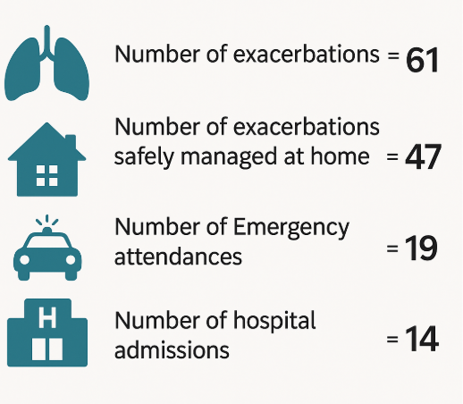
Under respiratory physiotherapy care

Slide 12
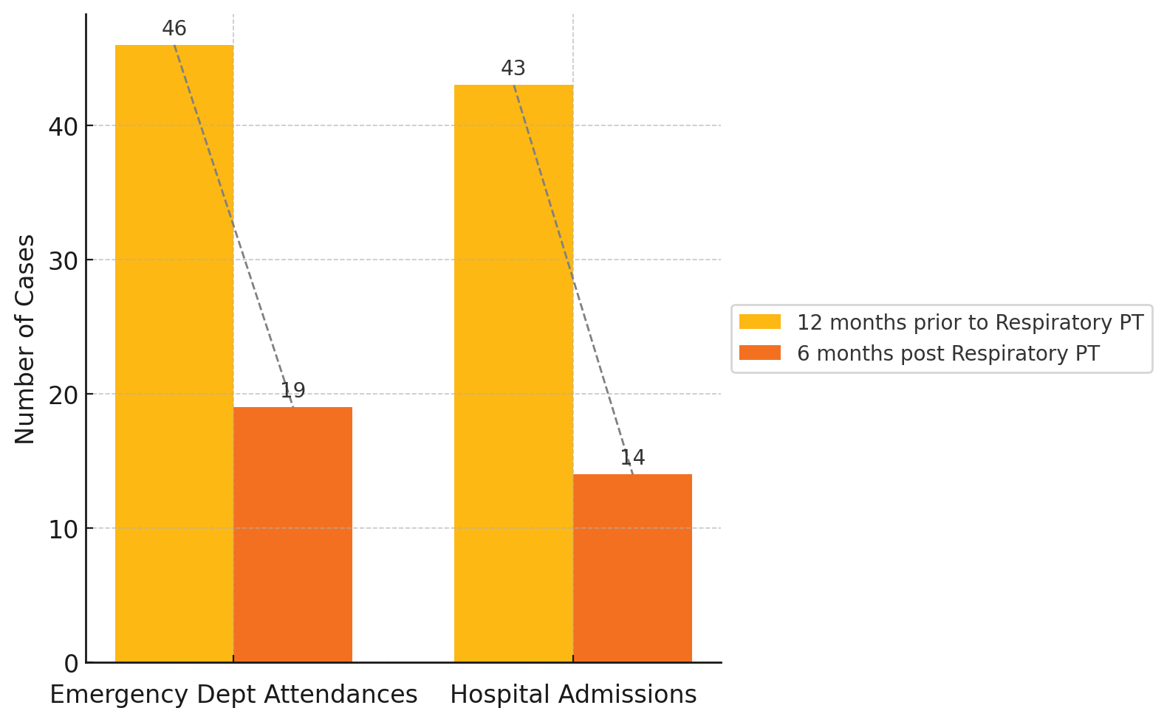
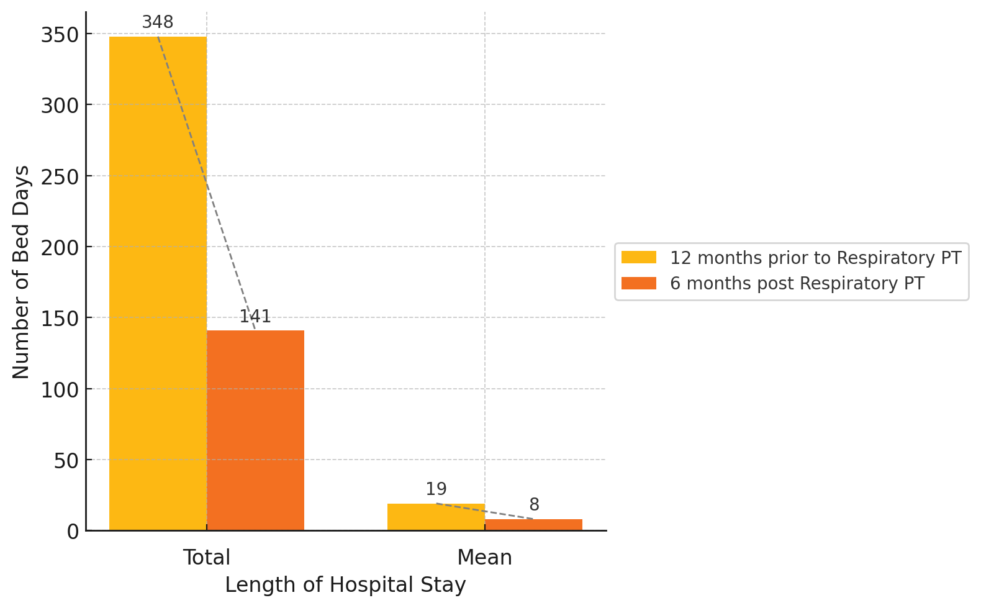
Hospital admissions
Unscheduled
Length of hospital stay

Slide 13
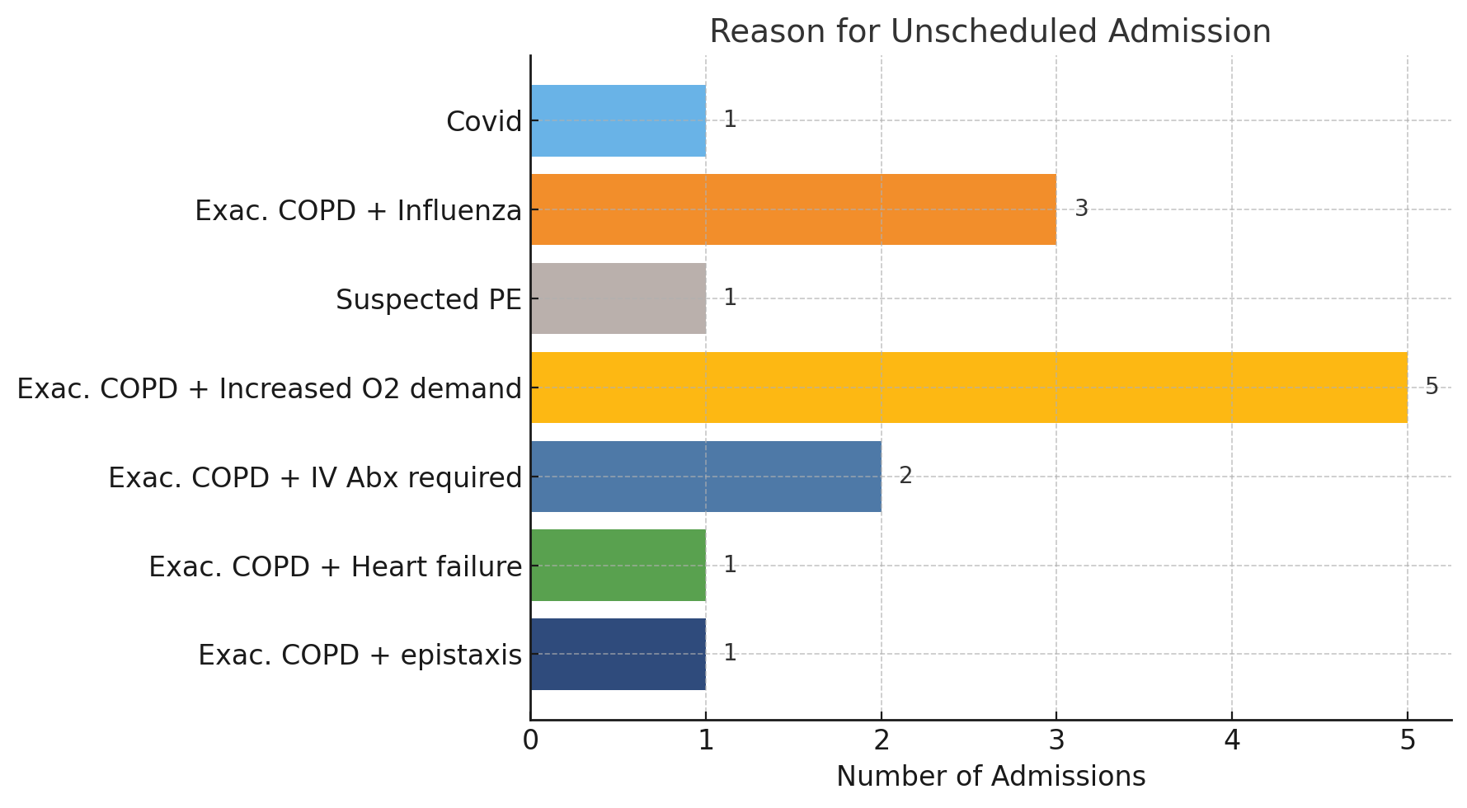

Slide 14
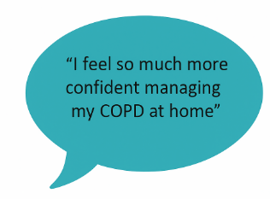

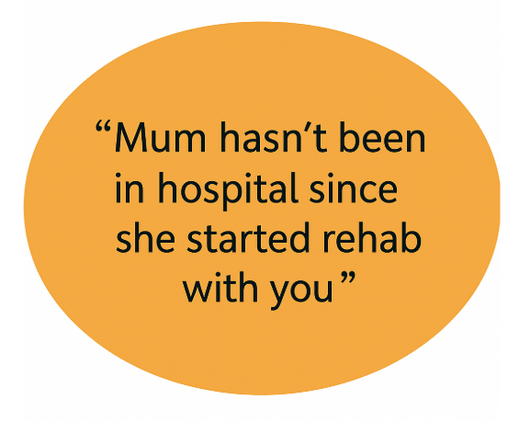
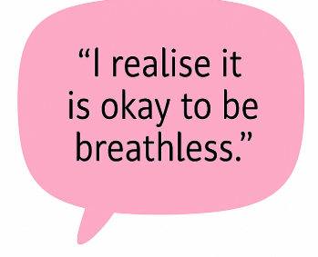

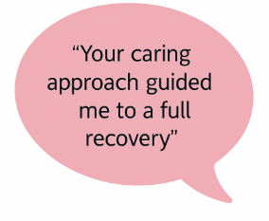

Analysis of Patient Outcomes
Pre and post respiratory physiotherapy input:
Health VAS (perceived health)
CAT Score (symptoms)
EQ-5D-5L (quality of life)
Patient feedback

Slide 15
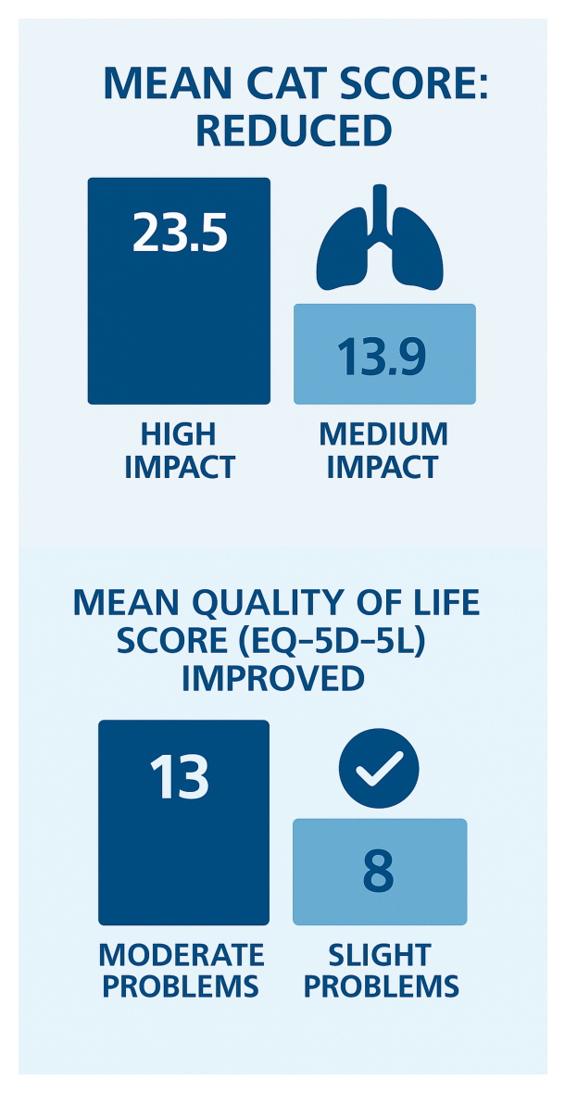
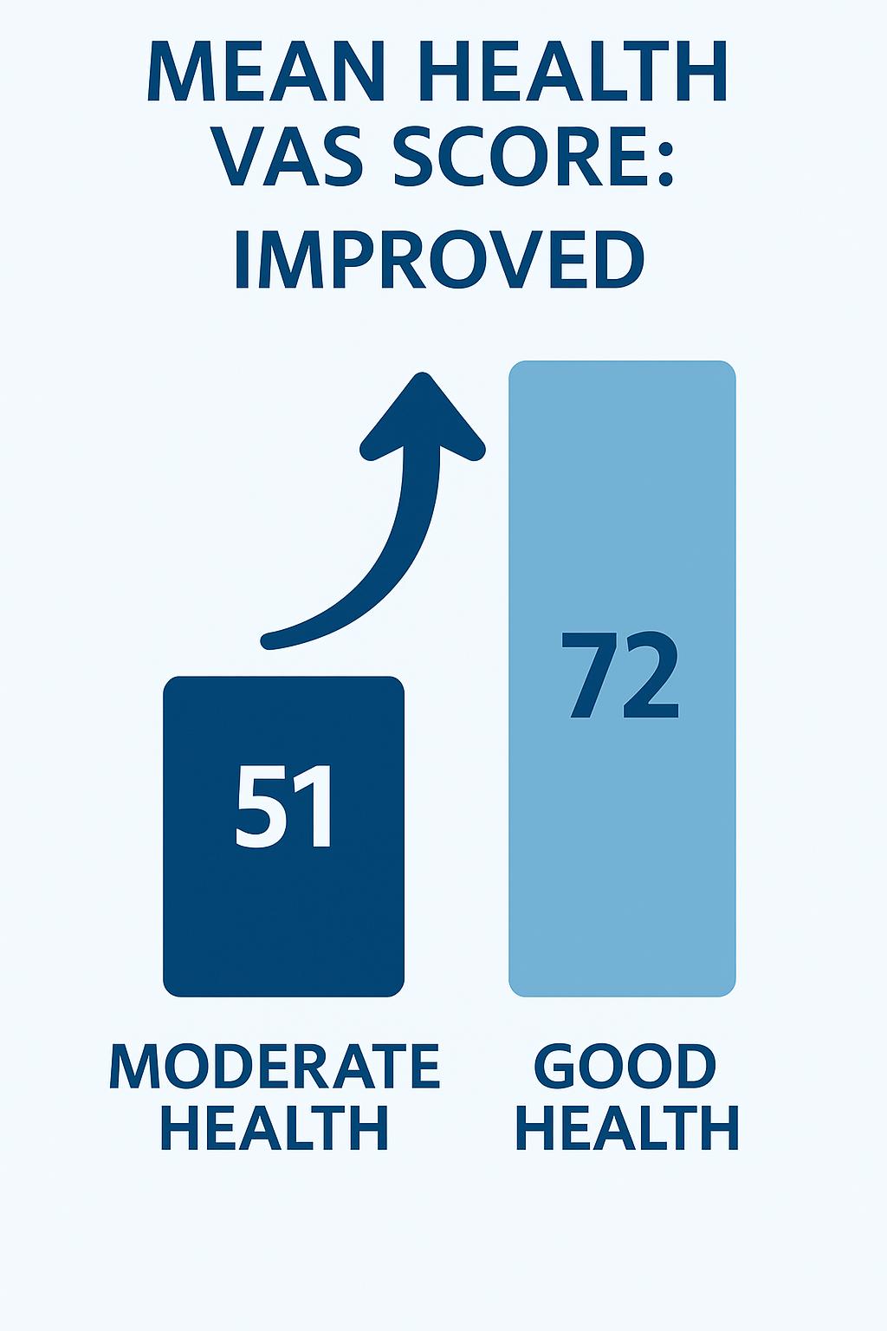
Patient Outcomes post physiotherapy input

Slide 16
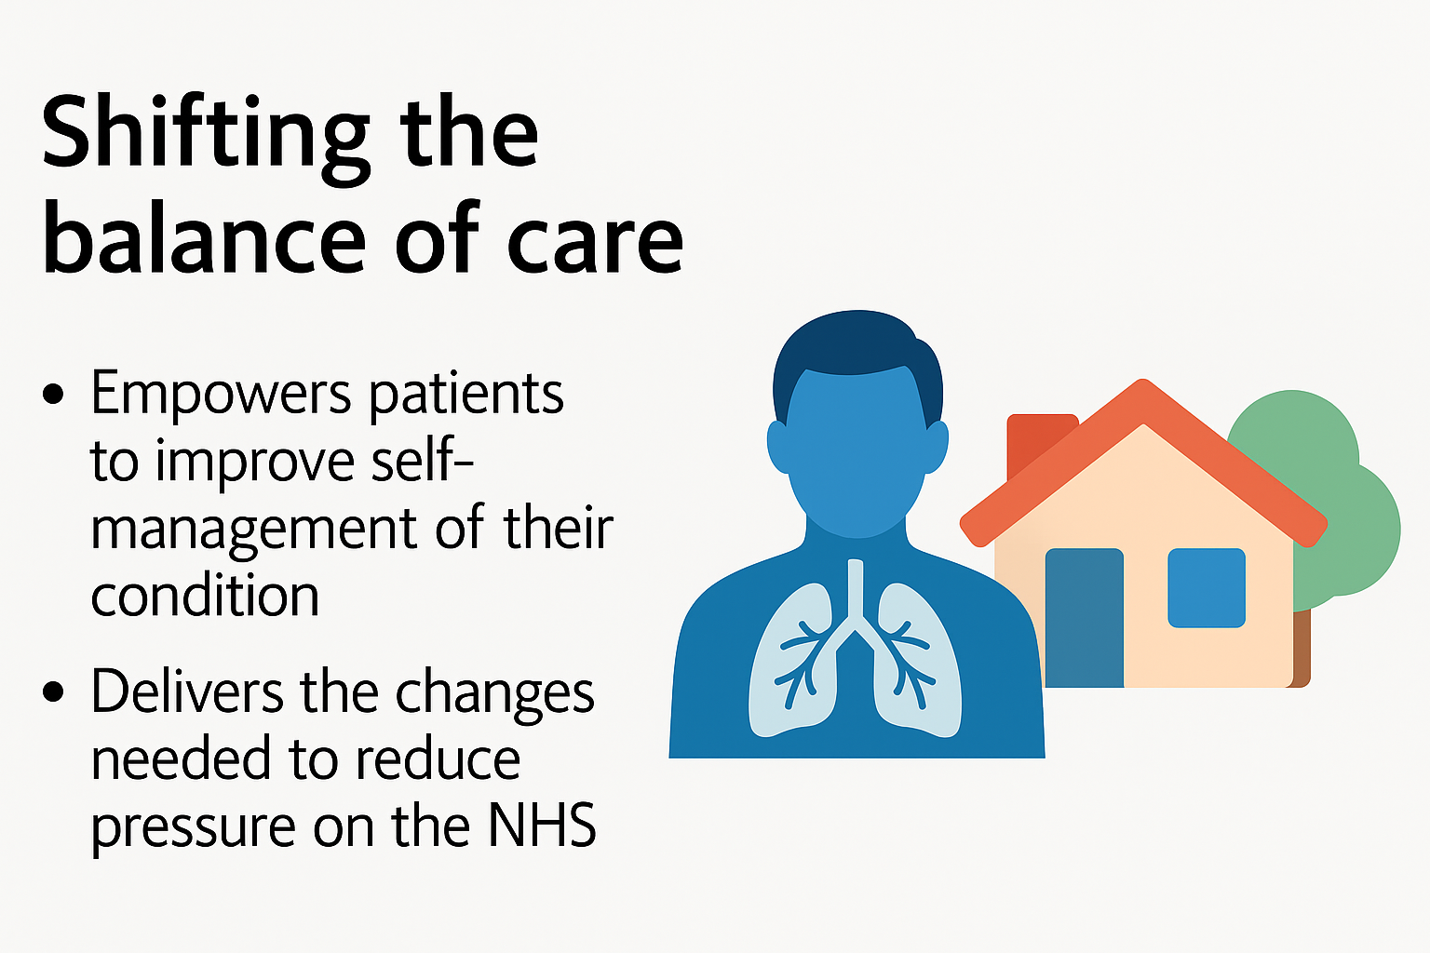
Key takeaways

Slide 17

Questions?

