Slide 1

Not Just Another Pilot: Combining Primary Care Policy, Improvement and Delivery
Slido – QR Code

Slide 2
Developing a sustainable model of multidisciplinary team delivery
Andrew Chapman, Primary Care Policy, Scottish Government

Slide 3
Policy context
Spring 2023 – challenging juncture in delivery of primary care multidisciplinary teams
Rethinking our approach
Making effective use of limited resources
Collaboration between policy, improvement and delivery
Informing the way ahead

Slide 4


Developing the primary care phased investment programme
Belinda Robertson Associate Director of Improvement Healthcare Improvement Scotland
Leading quality health and care for Scotland

Slide 5



Primary Care Phased Investment Programme aims
Objective one: To develop a culture of continuous improvement across primary care settings
Objective two: To improve key regulated priority areas - pharmacotherapy and CTAC services - whilst maintaining other elements of the contract
Objective three: To build evidence to understand the national context for implementation

Slide 6
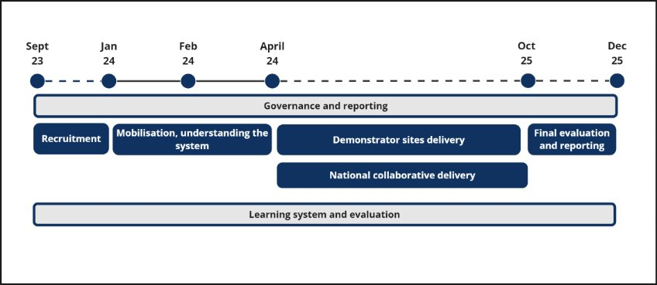
Programme timeline

Slide 7
Core programme components
Demonstrator Sites
System level improvement
Using QI to design and improve implementation
National Collaborative
Process level improvement
Evaluation
Qualitative data
Quantitative data
Learning system
Economic evaluation
To share learning within and across PCPIP
Series of rapid QI ‘sprint’ programmes
To share learning with the wider primary care system

Slide 8
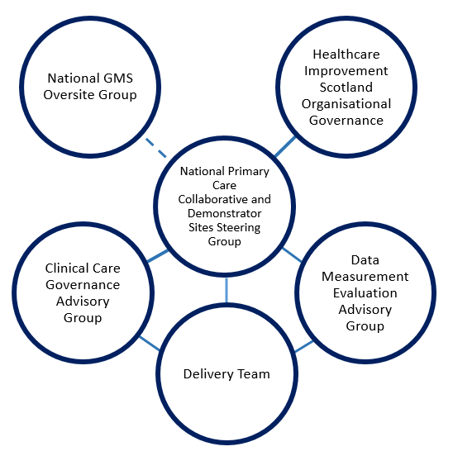
Tripartite Approach
Understanding the system
DCAQ
Leadership
Data
Evaluation
Recommendations
Business case

Slide 9
Designing & Delivering Frontline Services: Impact & Lessons
Anthony McDavitt – Director of Pharmacy & Depute Chief Officer CHSCP
On behalf of the PCPIP project members

Slide 10
Implementation challenges to date
Infrastructure and recruitment challenges
Lack of clear delivery framework
Fragile trust and relationships
Limited insight and accountability

Slide 11
“How can we, as NHS Shetland, ensure that we have safe and effective systems in place that protect people against the wider system contexts and challenges?”

Slide 12
Benefits of the Approach
Focus on quality and learning
Stronger collaboration and alignment between policy and delivery
Shared delivery responsibility and supportive scrutiny
High team engagement
Clear measurement framework

Slide 13
Key Lessons for the Future
What’s Been Learned:
Data is both critical and scarcely available
Systems are poorly optimised for volume and complexity
Stronger system-wide understanding beyond delivery is limited
Future policies can be more system-fit whilst allow localised implementation
IT maturity is underassessed
Beyond Scope – i.e. First Contact Physio remains underassessed and unanswered

Slide 14
Balancing Consistency & Adaptability
HIGH
WHO is doing it and WHY
WHAT to do
HOW to do it
WHO is doing it and WHY
Adaptability
LOW
WHAT to do
HOW to do it
Consistency
HIGH
LOW

Slide 15
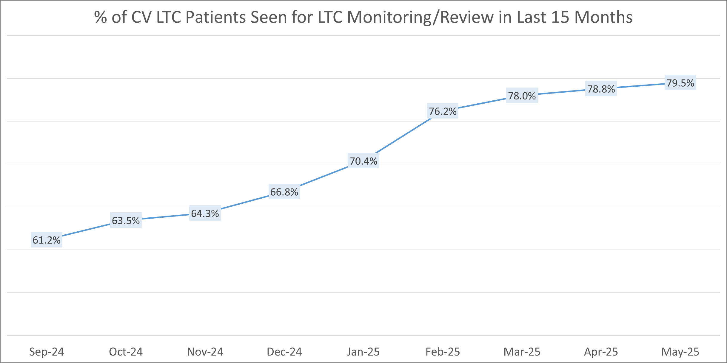
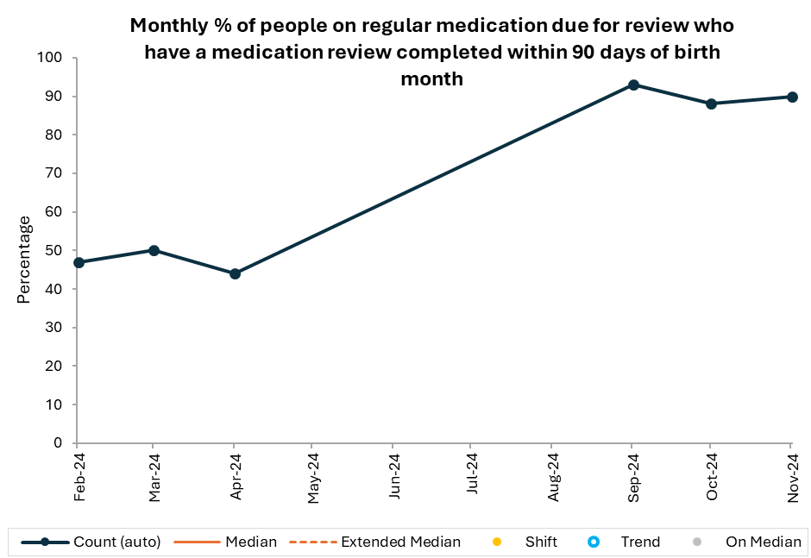
The Role of Localisation
Importance of Localised Delivery:
Local adaptations and flexibility are critical given HOW it has to be different
Developing system-fit policy that can be tailored to local contexts is essential
Aligning policies to real-world challenges ensures more relevant, impactful outcomes
Emphasis on local buy-in and engagement for successful implementation
No data collected in May, June, July and August.

Slide 16
Simplicity isn’t simple (and the Bonini Paradox)
Complex challenges become Complicated when we understand their components.
Complicated tasks become Executable through clear planning and iteration.
Executable actions become Simple with practice and refinement and ultimate enable others to do.

