Slide 1
Cancer Prehabilitation - A toolkit to Inspire Local Service Development

Slide 2
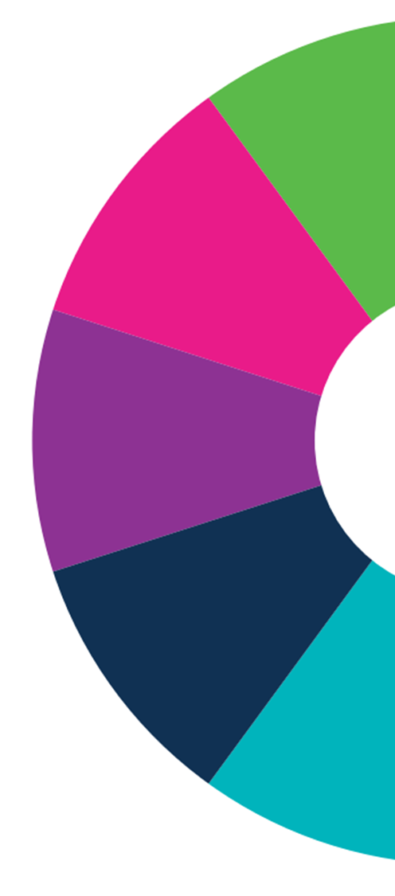
Debbie Provan
Clinical Advisor, Cancer Policy, Scottish Government
Debbie.Provan2@gov.scot
Hannah Grüneberg
Counselling Psychologist, Maggie’s Fife
Hannah.Gruneberg@maggiescentres.org

Slide 3
Introducing Prehabilitation
Introducing Prehabilitation Film

Slide 4
A Little Bit More About Prehab…
Adapted from Carli et al., 2005
Notes:
Multi-modal, multi-phasic, multi-disciplinary

Slide 5
Action 24: Test and Evaluate
Start as early as possible
Run in parallel with usual decision making processes
Should be part of the rehabilitation continuum
Multi-modal including exercise/activity, nutrition and psychological support
All should be screened to determine the level required (universal, targeted, specialist)
Screening should be recorded at MDT alongside performance status
Validated tools for individualised assessment, care planning and outcomes measurement (targeted and specialist)
All should have a co-produced personalised care plan
Available at: https://www.prehab.nhs.scot/for-professionals/key-principles/
Notes:
The ‘Key Principles for Implementing Cancer Prehabilitation across Scotland’ are based on those set out within ‘Principles and guidance for prehabilitation within the management and support of people with cancer’.
The intention is that this shorter version will provide a basic standard, supporting the development and adoption of
prehabilitation within Scotland.

Slide 6
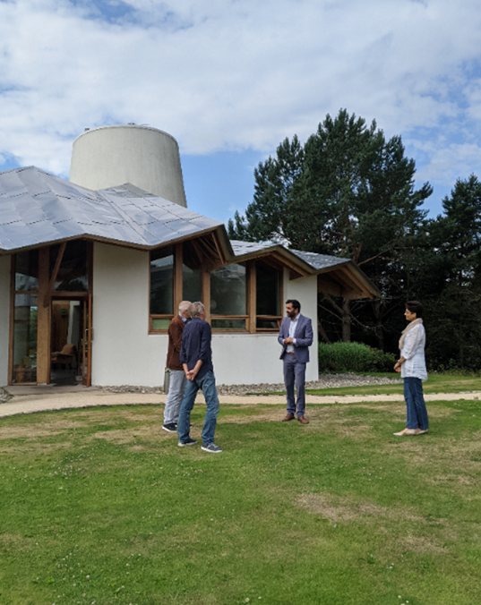
Action 24: Test and Evaluate
Maggie’s Pilot – universal offer available at all 8 centres
Aberdeen (ARI)
Dundee (Ninewells)
Edinburgh (Western General)
Fife (Victoria)
Forth Valley (FVR)
Glasgow (Gartnavel)
Highland (Raigmore)
Lanarkshire (Monklands)

Slide 7
Maggie’s Impact To-Date
Overall total attendees to 30th April 2022: 342
Total feedback received: 211
Response rate: 62%

Slide 8
Maggie’s Impact To-Date

Slide 9
Action 25: Prehab website
https://www.prehab.nhs.scot/

Slide 10
Action 26: Nutrition Framework
Nutritional issues affect up to 80% of people with a cancer diagnosis
Undernutrition remains both under-identified and undertreated
Consequences include:
physical and functional decline
poorer quality of life
increased the risk of infection
increased length of hospital stay
increased risk of mortality
Notes:
Defines the nutritional care that should be available to all adults affected by cancer in Scotland (ages 16 years and above) and provides a structure for delivery of care.
Equally relevant to all professions and services providing care and support to people affected by cancer, independent of their sector or setting i.e., health, social care and third sector; acute and community care.
Brings existing services together in a collaborative manner and illustrates a good practice model to drive equitable and efficient access to appropriate nutritional care.

Slide 11
Action 27: Psychological Therapies and Support Framework
Emotional challenges are normal but many people do not know how to access support.
Post-treatment, ~50% report the psychological impact of cancer is more difficult to cope with than physical and practical concerns.
~1/3 of people living with cancer report experiencing mental health problems.
Available at: https://www.prehab.nhs.scot/for-professionals/psychological-framework/
Notes:
Sets out an agreed, evidenced based model to increase understanding of what good, person-centred psychologically informed care and support looks like.
Also includes tools to support practical application including case studies, referral guidance and an audit template linked to quality standards.
The Framework is equally relevant to all
services independent of their sector i.e., health, social care and the third sector.

Slide 12
Your Toolkit for Implementing Prehabilitation Locally

Slide 13
References and Resources
https://www.prehab.nhs.scot/
https://www.prehab.nhs.scot/for-professionals/key-principles/
https://www.prehab.nhs.scot/for-professionals/psychological-framework/
https://www.maggies.org/cancer-information/cancer-treatment/prehabilitation-getting-ready-treatment/
https://www.macmillan.org.uk/healthcare-professionals/news-and-resources/guides/principles-and-guidance-for-prehabilitation
Carli, F., and Zavorsky, G.S (2005) Optimizing functional exercise capacity in the elderly surgical population, Current Opinion in Clinical Nutrition and Metabolic Care: 8(1):23-32
Macmillan Cancer Support (2006) Worried sick: The emotional impact of cancer. Opinion Leader Research, UK. Available at: https://www.macmillan.org.uk/documents/getinvolved/campaigns/campaigns/impact_of_cancer_english.pdf
Mehnert, A., Brähler, E., Faller, H., Härter, M., Keller, M., Schulz, H., Wegscheider, K., Weis, J., Boehncke, A., Hund, B. and Reuter, K. (2014) Four-week prevalence of mental disorders in patients with cancer across major tumor entities. Journal of Clinical Oncology, 32(31), pp.3540-3546.
Mental Health Foundation (2018) Supporting the emotional and mental health needs of people with cancer. Available at: https://www.mentalhealth.org.uk/sites/default/files/mh-needs-people-with-cancer.pdf
van Cutsem, E. and Arends, J. (2005) The Causes and Consequences of Cancer-Associated Malnutrition. European Journal of Oncology Nursing, 9, 51-63 doi.org/10.1016/j.ejon.2005.09.007
Stratton, R., Smith, T.A., Gabe, S. (2018) British Association of Parenteral and Enteral Nutrition. Managing malnutrition to improve lives and save money. Available at: https://www.bapen.org.uk/pdfs/reports/mag/managing-malnutrition.pdf

Slide 14
Debbie Provan
Clinical Advisor, Cancer Policy, Scottish Government
Debbie.Provan2@gov.scot
Hannah Grüneberg
Counselling Psychologist, Maggie’s Fife
Hannah.Gruneberg@maggiescentres.org

