Slide 1
Innovating Across the Whole System: digital health and care supporting citizens and service delivery
Panel
Jenni Woods
Health & Business Intelligence Lead (HBI Team)
NHS Tayside
Craig McArthur
Director Of Health and Social Care / Chief Officer East Ayrshire Integration Joint Board
Ann-Marie Gallacher
Chief Information Officer & SIRO
NHS 24
Chair - Scott Heald , Director of Data and Digital Innovation, Public Health Scotland
Speakers - Ryan Anderson Policy Lead for Data & Intelligence
Scott Henderson Head of Programme, Digital Front Door Digital Citizen Portfolio and Innovation Digital Health and Care Directorate, Scottish Government

Slide 2
Scotland’s Digital Health and Care Strategy
Notes:
Scotland’s refreshed Digital Health and Care Strategy sets out how we will work together to improve the care and wellbeing of people in Scotland by making best use of digital technologies in the design and delivery of services, in a way, place and time that works best for them. It builds upon the digital successes which were accelerated as a result of Covid-19, such as Near Me video consulting; greater digital capability in care homes; and the increase in remote monitoring and self-management of conditions from home.

Slide 3
Notes:
Vision – to improve the care and wellbeing of people in Scotland by making best use of digital technologies in the design and delivery of services.

Slide 4
Our Citizens and Users: Key Messages
Digital needs to be a choice
‘Do digital right’
Address infrastructure
Develop skills and confidence in digital
Tell my story once

Slide 5
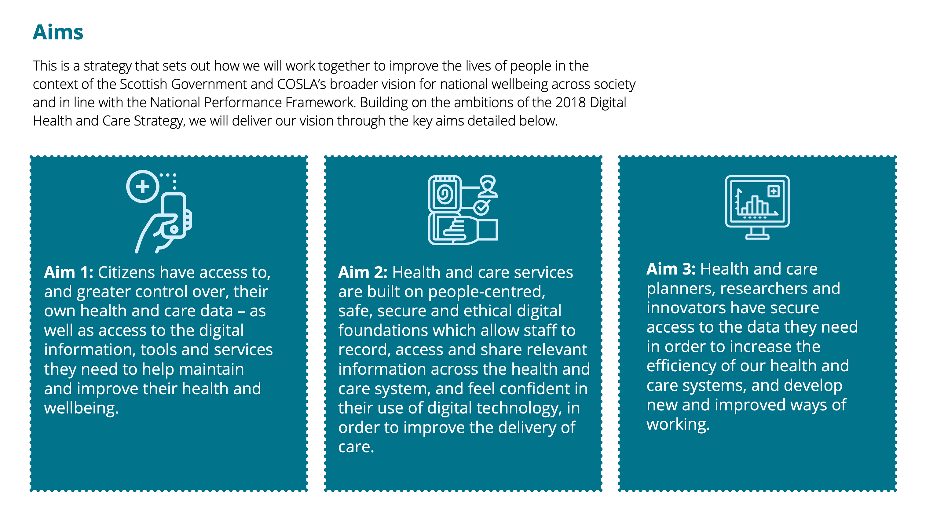
Notes:
Underpinning our vision, our three aims are:
1 – Citizens have access to, and grater control over, their own health and care data – as well as access to the digital information, tools and services they need to help maintain ad improve their health and wellbeing.
2 – Health and care services are built On people-centred, safe, secure and ethical digital foundations which allow staff to record, access and share relevant information across the health and care system, and feel confident in their use of digital technology, in order to improve the delivery of care.
3 – health and care planners, researchers and innovators have secure access to the data they need in order to increase the efficiency of our health and care systems, and develop new and improved ways of working.
These will be delivered through 6 priority areas:

Slide 6
Data Strategy for Health and Social Care

Slide 7
Notes:
Our vision for the Data Strategy is simple. To improve the health and wellbeing of the people in Scotland through data.
But what does that vision actually mean? How can we create a strategy that has the ambition of this statement but is actually able to deliver against it and in a way that is meaningful for the people impacted.

Slide 8
Notes:
Does anyone know how you eat an elephant? – (pick on audience member)
Bit by bit.
That’s exactly how we have to tackle creating a Data Strategy for Health and Social Care. We have an enormous scope and we want it to be. If we’re setting out a clear direction of travel for the use of data in Health and Social Care we can’t exclude data sets. It has to cover patient data, care data, management information, logistical data and more.

Slide 9
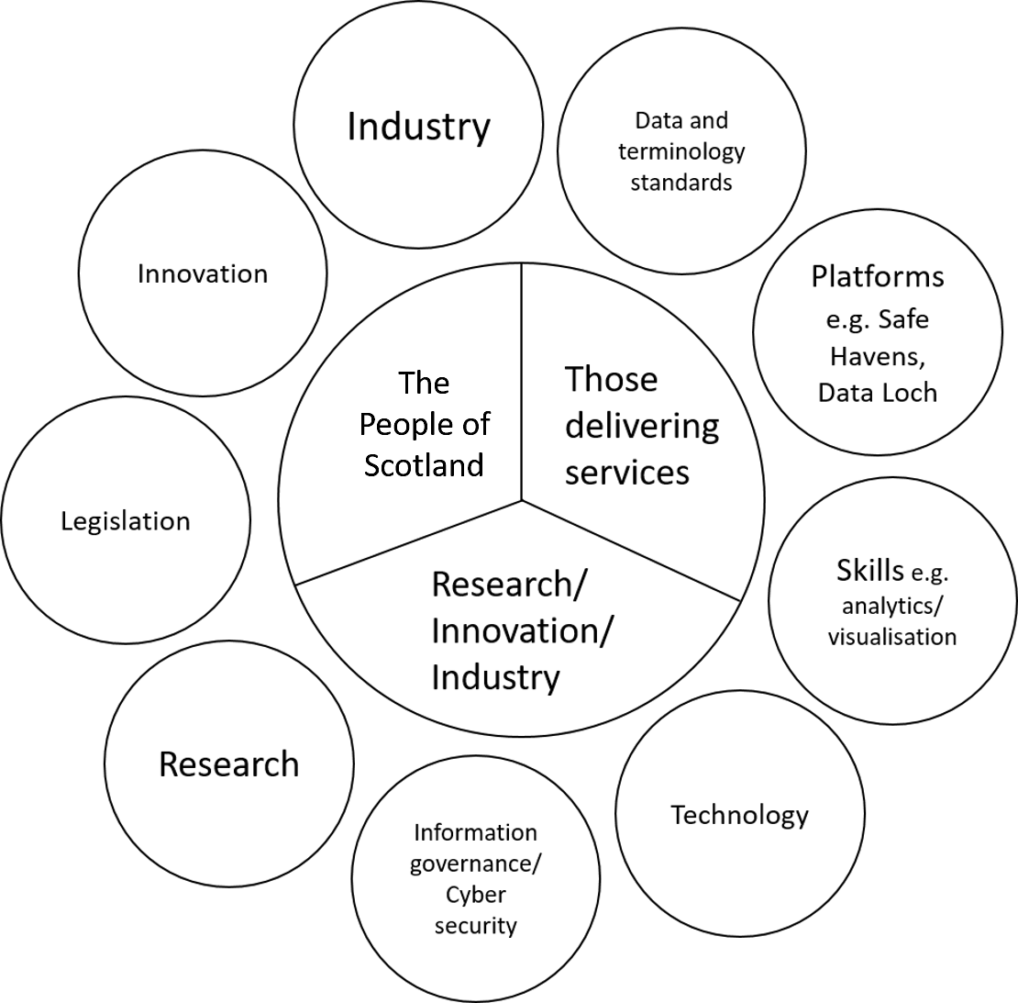
Scope
Notes:
We have a big vision. But making it meaningful and delivering against it means we need to break it down, bit by bit.
So to start with we looked at areas to incorporate within the strategy and then we looked at the users and beneficiaries of data in a health and social care context.
Keeping it high level meant we have set out three clear ambitions for the strategy to support our engagement and to provide us with focus.
We have 3 ambitions:
The people of Scotland – to have greater access and control over their own health and social care data
Staff and Organisations that provide health and social care services – provide ways of recording and sharing information to make good decisions and provide better services
Research and Innovation – to make sure data is used to develop better ways of working, better treatments etc.
We have used these three ambitions to structure our consultation and will break them down further once we develop the strategy itself.
[Include lines on IG review and how work there is being incorporated.]

Slide 10
Themes
Communication & Engagement
Ethical Approaches to Data
Data Access
Industry & Innovation
Technology & Infrastructure
Information Governance & Security
Talent & Culture
Data Standards & Interoperability
Notes:
Summarise key points from all section.
Include lines to say there is th

Slide 11
Notes:
Above all and running through many of these themes and our engagement so far is the word empower.
The strategy needs to empower individuals and organisations to improve their use and interaction with data.

Slide 12
Notes:
The strategy must also align existing pieces of work and provide clarity on the direction of travel.

Slide 13
Notes:
It will provide a set of guiding principles in order that they can be referred to support forward planning, future proofing and alignment across sectors

Slide 14
Notes:
And you want us to deliver.
You don’t want this to be a strategy that talks a good talk you want it to actually deliver against its aims.
This is where ongoing engagement with you all will continue to be crucial.
We need your help in developing the aims but we need your help in delivering them too.
Link into DFD and how it is delivering against the themes of the data strategy and will be a key part in meeting vision.

Slide 15
Thank you
Ryan Anderson
Policy Lead for Data & Intelligence
Digital Health and Care
HSCDatastrategy@gov.scot

Slide 16
A Digital Front Door to Health and Care services

Slide 17
Strategic Imperatives
Digital Health & Care Strategy
Programme for Government
NHS Recovery Plan
Data Strategy for Health and Care

Slide 18
The transformation challenge
Dispersed service network
DIGITAL FRONT DOOR
Many information
services / websites
(incongruence)
Fewer, congruent information
Services
Access to some disaggregated data / low or no control
Access to and management of data
Some transactions depending on where you live / some national
Broad range of centralised transactions

Slide 19
Benefits and Drivers
Consistent national approach for citizens
Enabler for local service transformation
Provide a framework and toolset to accelerate digitally enabled service provision
Reduce wider system cost and technical debt
Reduce administrative workload on local staff and services

Slide 20
Vision
A service OF services for citizens
A service FOR service providers
Single digital service
Web and App with alternatives
Authorised proxies
Safe & secure with verified ID
Information shared appropriately
Access to national infrastructure
Citizens and staff
Collaborate with national teams
Consistent & congruent
Regulations, standards, good practice
User centric co-design
Once for Scotland

Slide 21
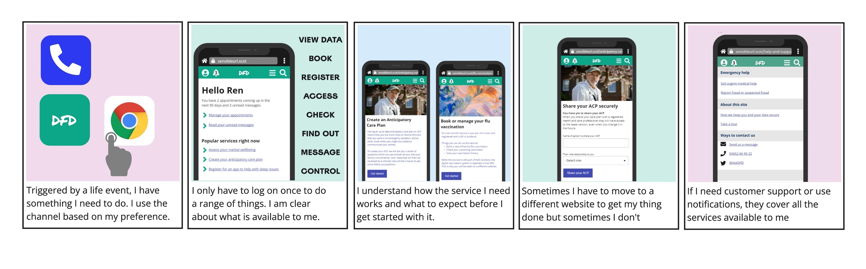
The experience for people
Indicative high level journey for validation and refinement through participative work

Slide 22
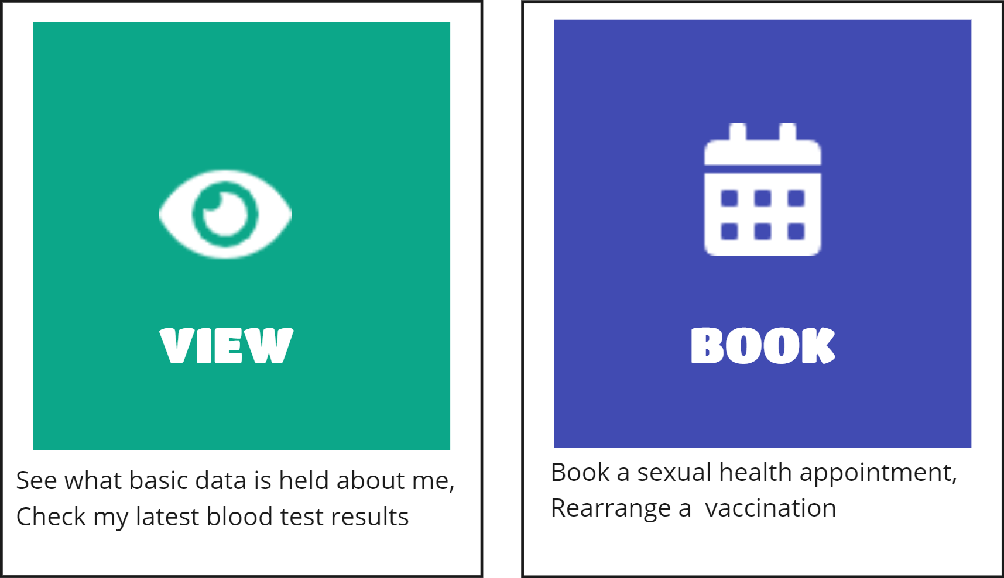
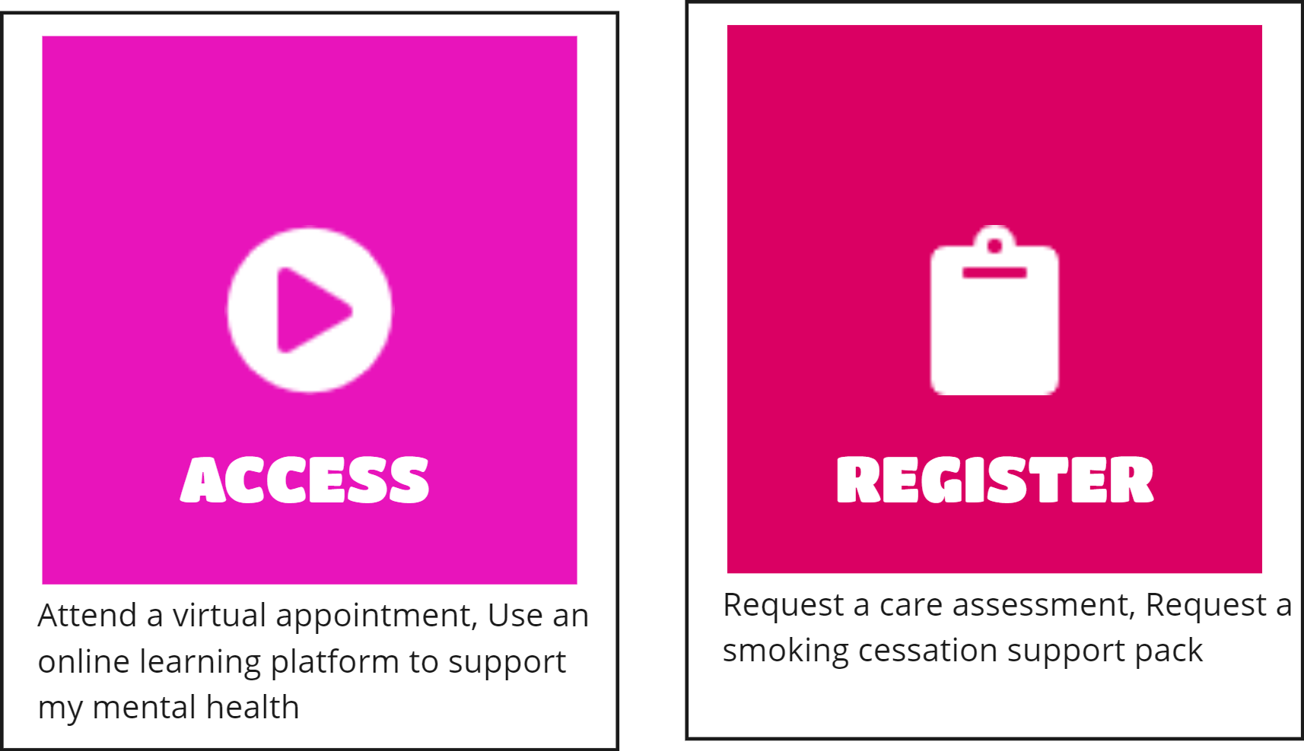
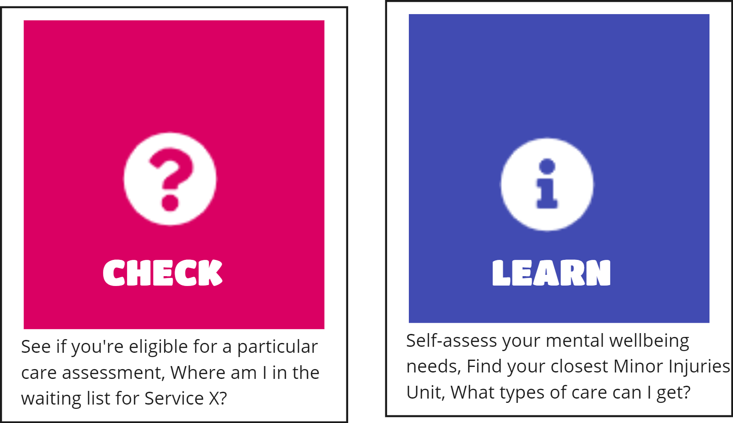
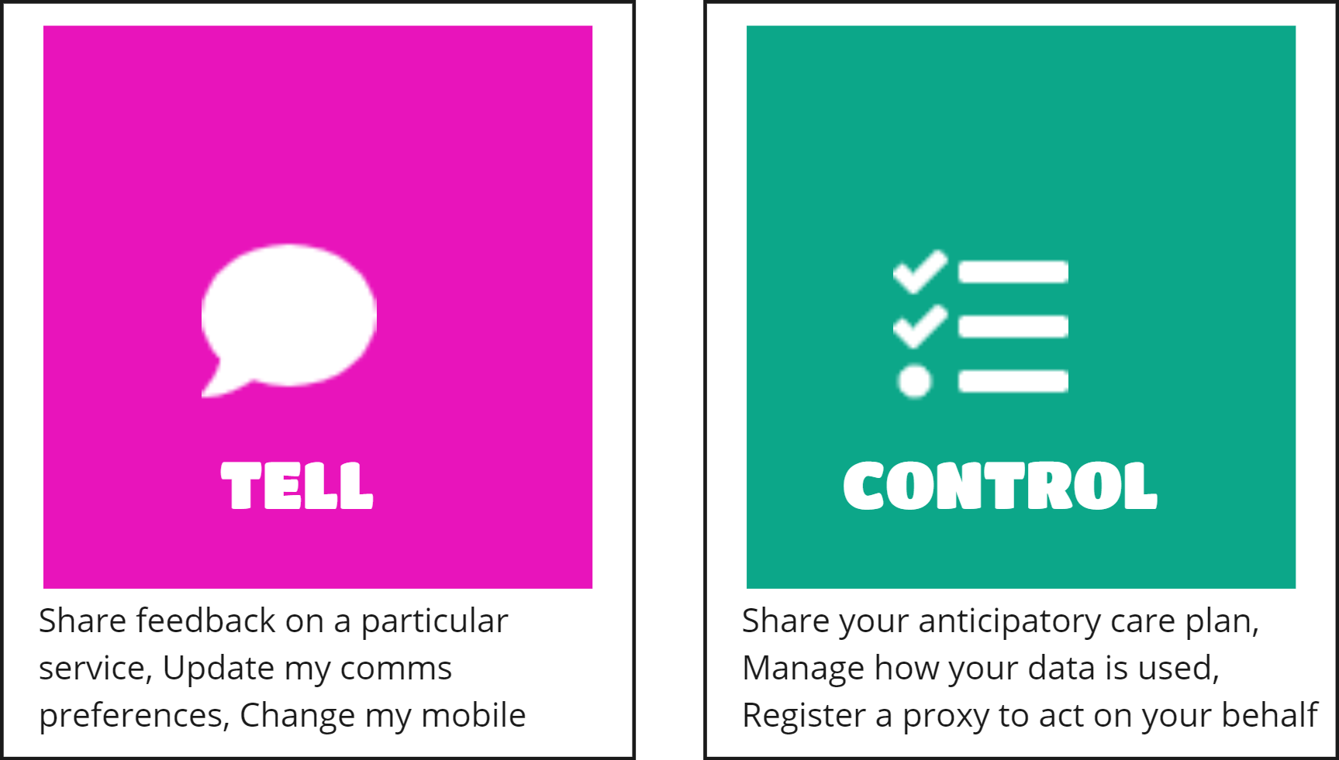
Citizen Journey: Service types

Slide 23
Scope & Sequence Challenge:
DHAC Strategy
Lots of business customers (complex needs)
Care & Wellbeing Portfolio
& NCS
Wider Policy
Diversity of other Programmes’ Timelines
National Digital Services (e.g. DIS)
DFD
Local Services
NHS Recovery Plans
Balance longer-term strategic intent against urgent demands

Slide 24
A multi-track approach
2022/23
2023/24
2024/25
2025/26
Strategic DFD Capability & Service Development
R1
R2
R3
R4
DFD Requirements
Transition Prioritised existing National services to DFD
DFD Requirements
Transition Prioritised NHS Recovery Services to DFD
DFD Requirements
Transition prioritised existing Local services to DFD
C&W Portfolio prioritised requirements and service development
NCS prioritised requirements and service development

Slide 25
Roadmap timeline
Summer / Autumn 2022
Business case authorised
Programme Initiated
Q3/4 2023/24
Release 1 live
Release 2 scope & timeline agreed
Business case reviewed
Spring / Summer 2024
Release 2 live
Release 3 scope and timeline agreed
Business case reviewed
Spring / Summer 2025
Release 3 live
Release 4 scope and timeline agreed
Business case reviewed
Winter 2025
Release 4 live

Slide 26
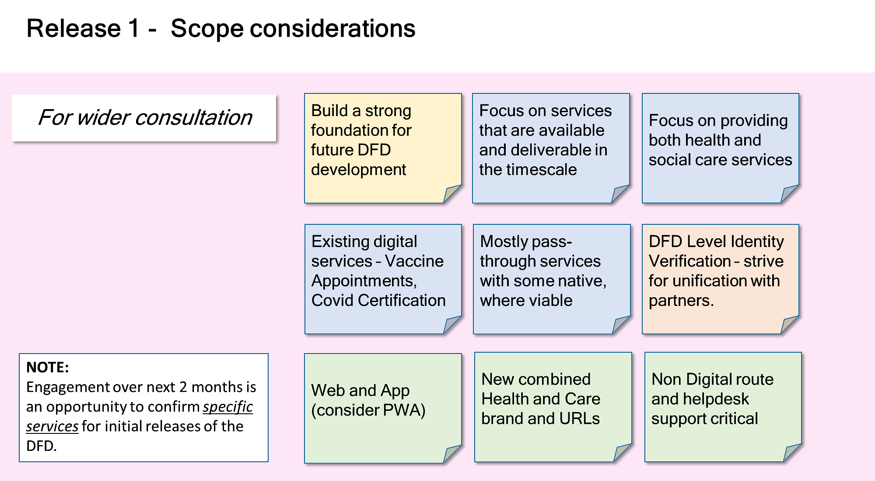
Engagement

Slide 27
Thank you
Scott Henderson
Head of Programme, Digital Front Door
Digital Citizen Portfolio and Innovation
Digital Health and Care Directorate
Scottish Government

Slide 28
Discussion with the Panel and the audience.

