Slide 1
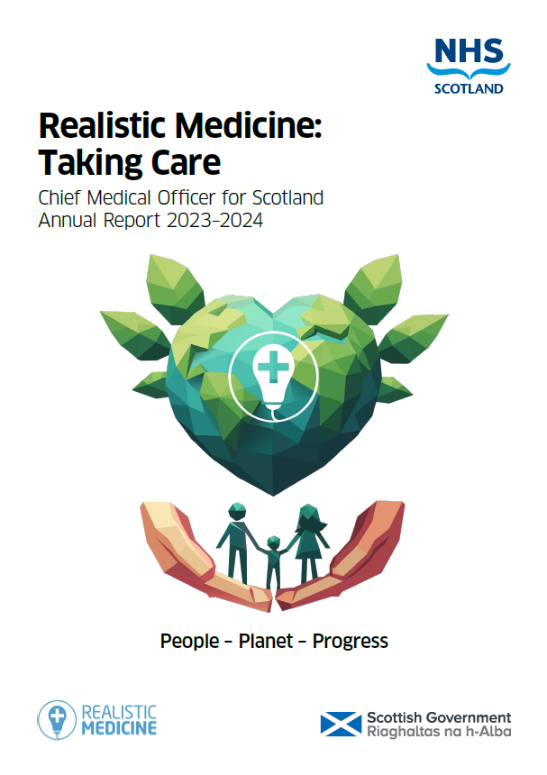
Realistic Medicine: Taking Care Professor Sir Gregor Smith Chief Medical Officer for Scotland
People – Planet – Progress - Purpose
#realisticmedicine

Slide 2
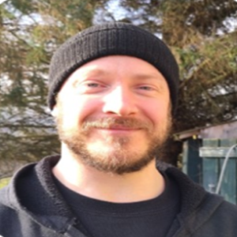
Promise
James Hickson
#realisticmedicine

Slide 3
1. Taking Care of Our People
2. Taking Care of Our Planet
3. Taking Care of Progress
4. Our Purpose: The Health of the Nation
People – Planet – Progress - Purpose
#realisticmedicine

Slide 4
“Nobody cares how much you know, until they know how much you care”
- Theodore Roosevelt
#realisticmedicine

Slide 5
By nurturing trust, by understanding both the biology and the biography of the people we care for, we can make meaningful connections and
deliver careful and kind care
#realisticmedicine

Slide 6
Six principles to enable careful and kind care
#realisticmedicine

Slide 7
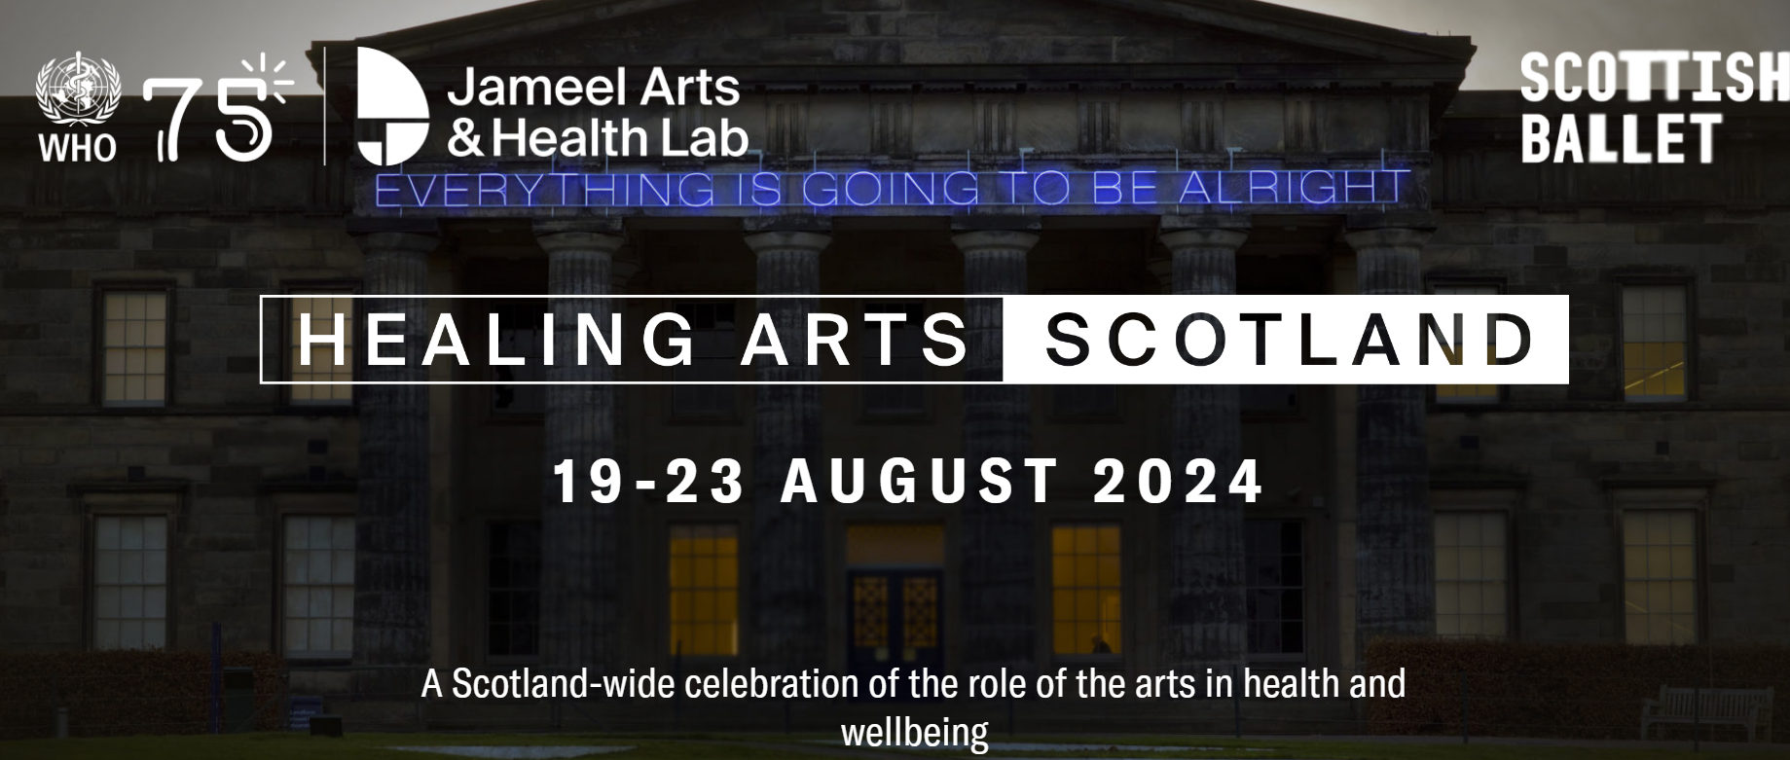
Taking Care of Our People: | Maximising independence
#realisticmedicine
People – Planet – Progress - Purpose
Notes:
Dance for Parkinsons class

Slide 8
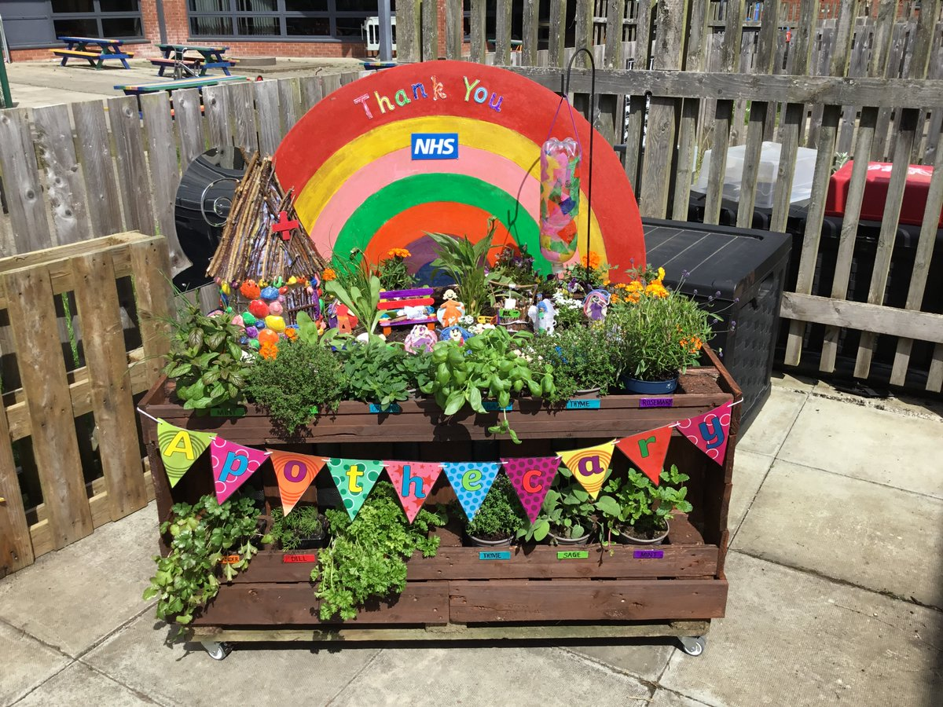

Slide 9
Celebrating CSO@50
#realisticmedicine

Slide 10
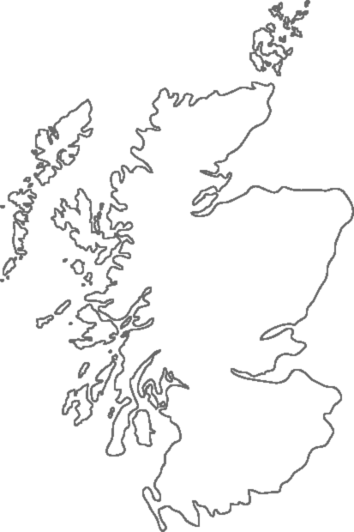
Taking Care of Progress

Slide 11
1. Taking Care of Our People
2. Taking Care of Our Planet
3. Taking Care of Progress
4. Our Purpose: The Health of the Nation
People – Planet – Progress - Purpose
#realisticmedicine

Slide 12
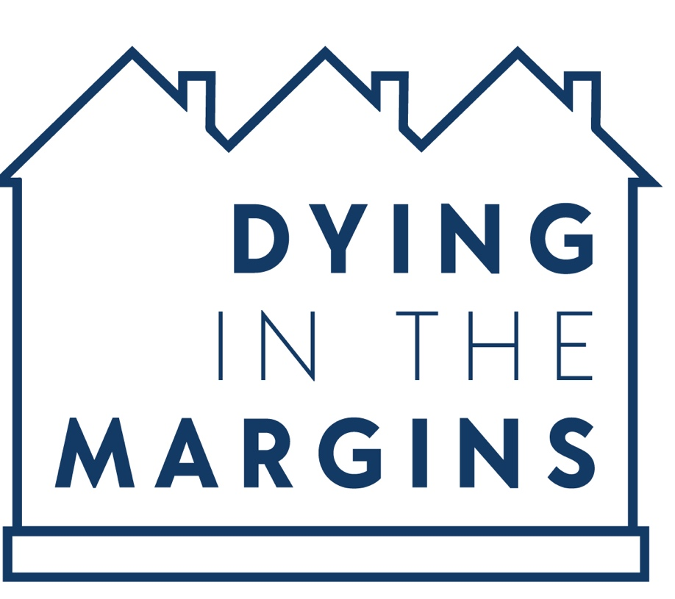
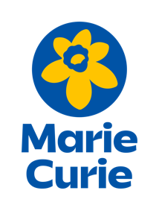
Outline
Dr Naomi Richards, University of Glasgow
Naomi.Richards@Glasgow.ac.uk
@Dying_Margins

Slide 13
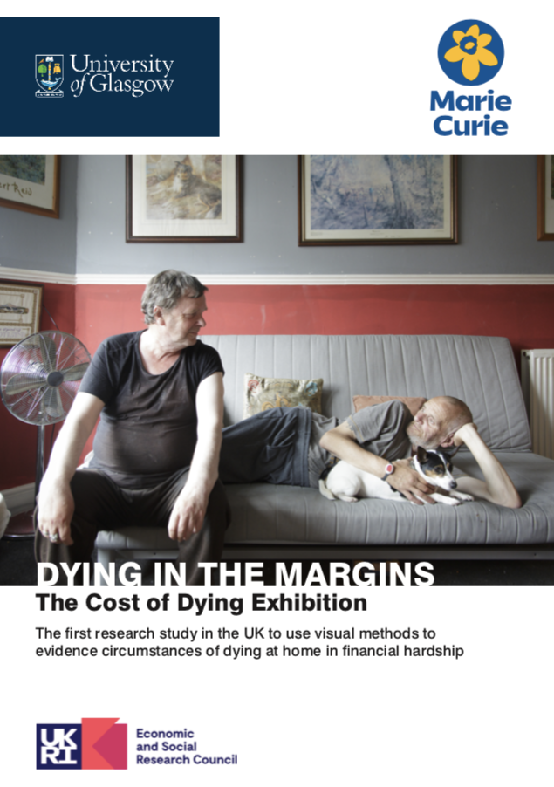
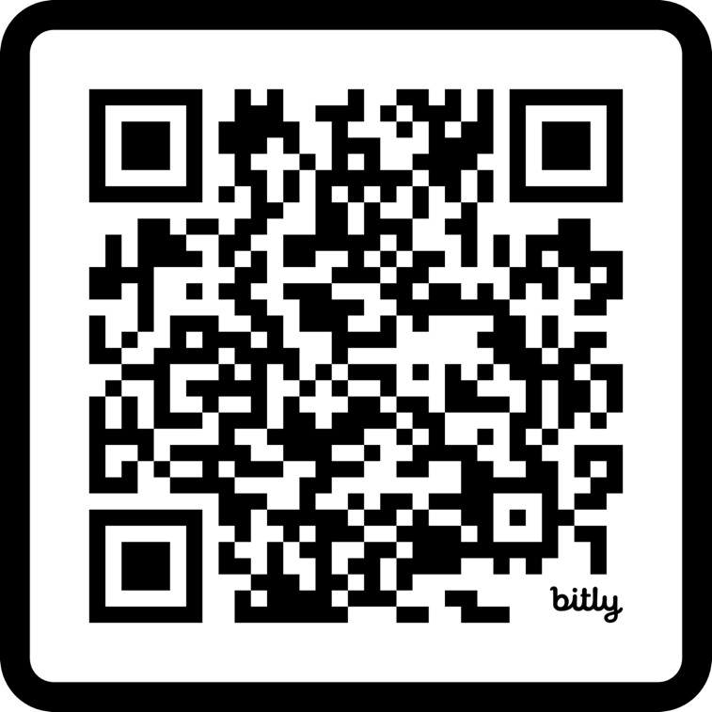

Slide 14
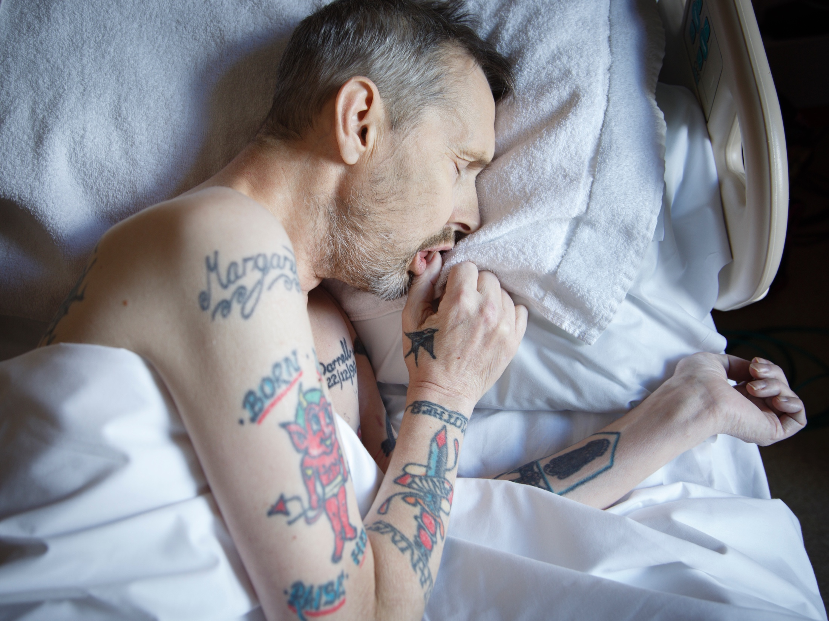
Photograph by Margaret Mitchell

Slide 15
Photograph by Margaret Mitchell

Slide 16
Photograph by Margaret Mitchell

Slide 17
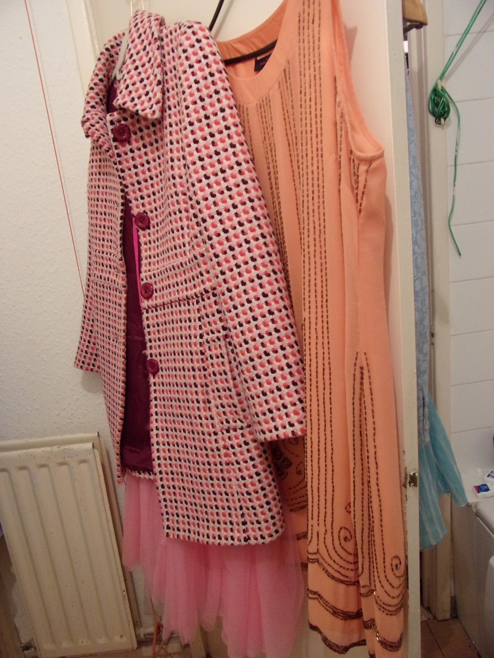
Photovoice by Liz
Notes:
Accommodation not maintained, people not prioritized

Slide 18
“I’m always here, I see this as my safe place.”
Photovoice by Liz

Slide 19
Photograph by Margaret Mitchell
Notes:
And of heating – this is Liz – she used her local library which she called her ‘safe place’, as a place to be warm which she didn’t have to pay to heat – so-called ‘warm banks’

Slide 20
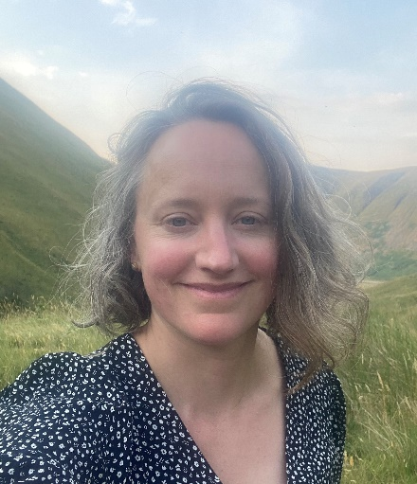
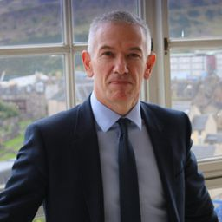
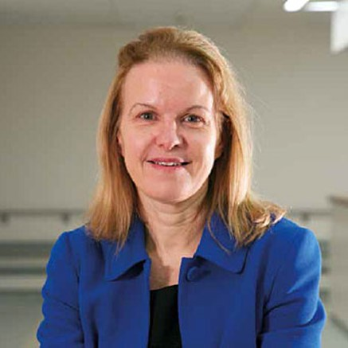
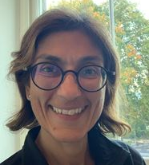
Meet the panel
Dr Naomi Richards Director of the End of Life Studies Group, University of Glasgow |  | Dr Deepa Shah GP and Chair of NE Scotland Greener Practice Group |  | Professor Sir Gregor Smith Chief Medical Officer for Scotland |  | Professor Julie Brittenden Surgeon and Director of Research & Innovation, NHS GGC |  | Dr Fatim Lakha Consultant in Public Health Medicine, PHS & NHS Tayside
#realisticmedicine

Slide 21
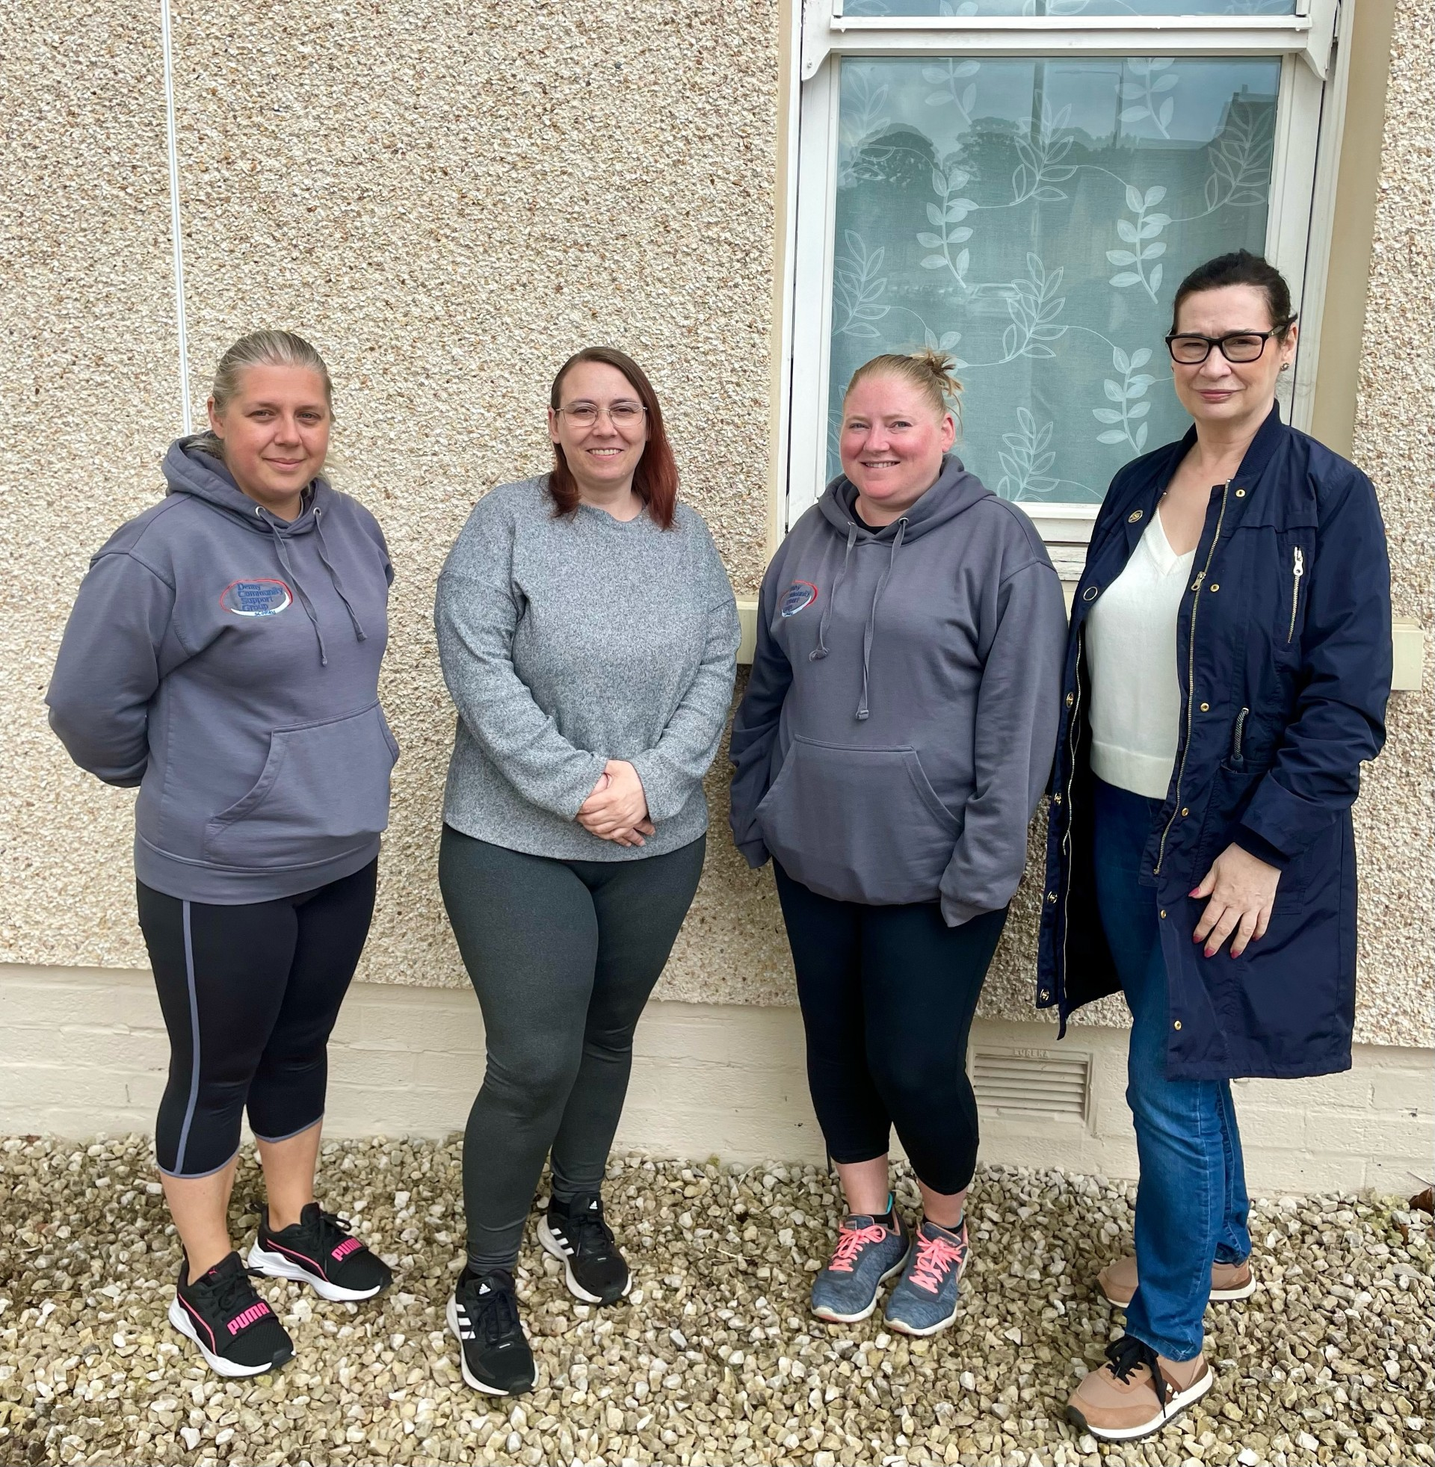
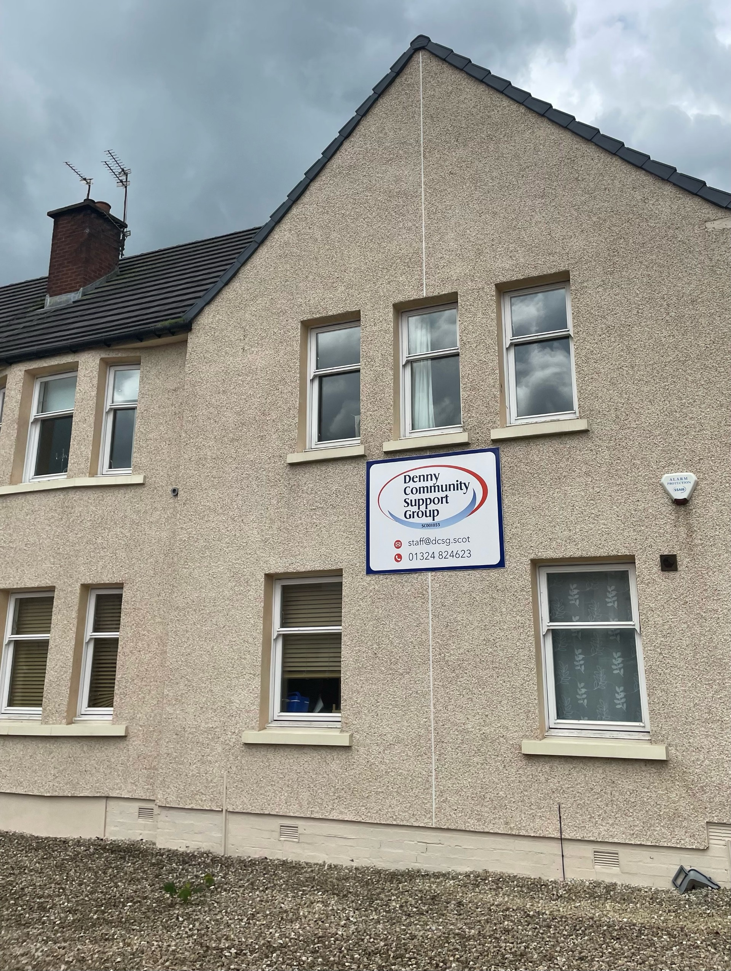
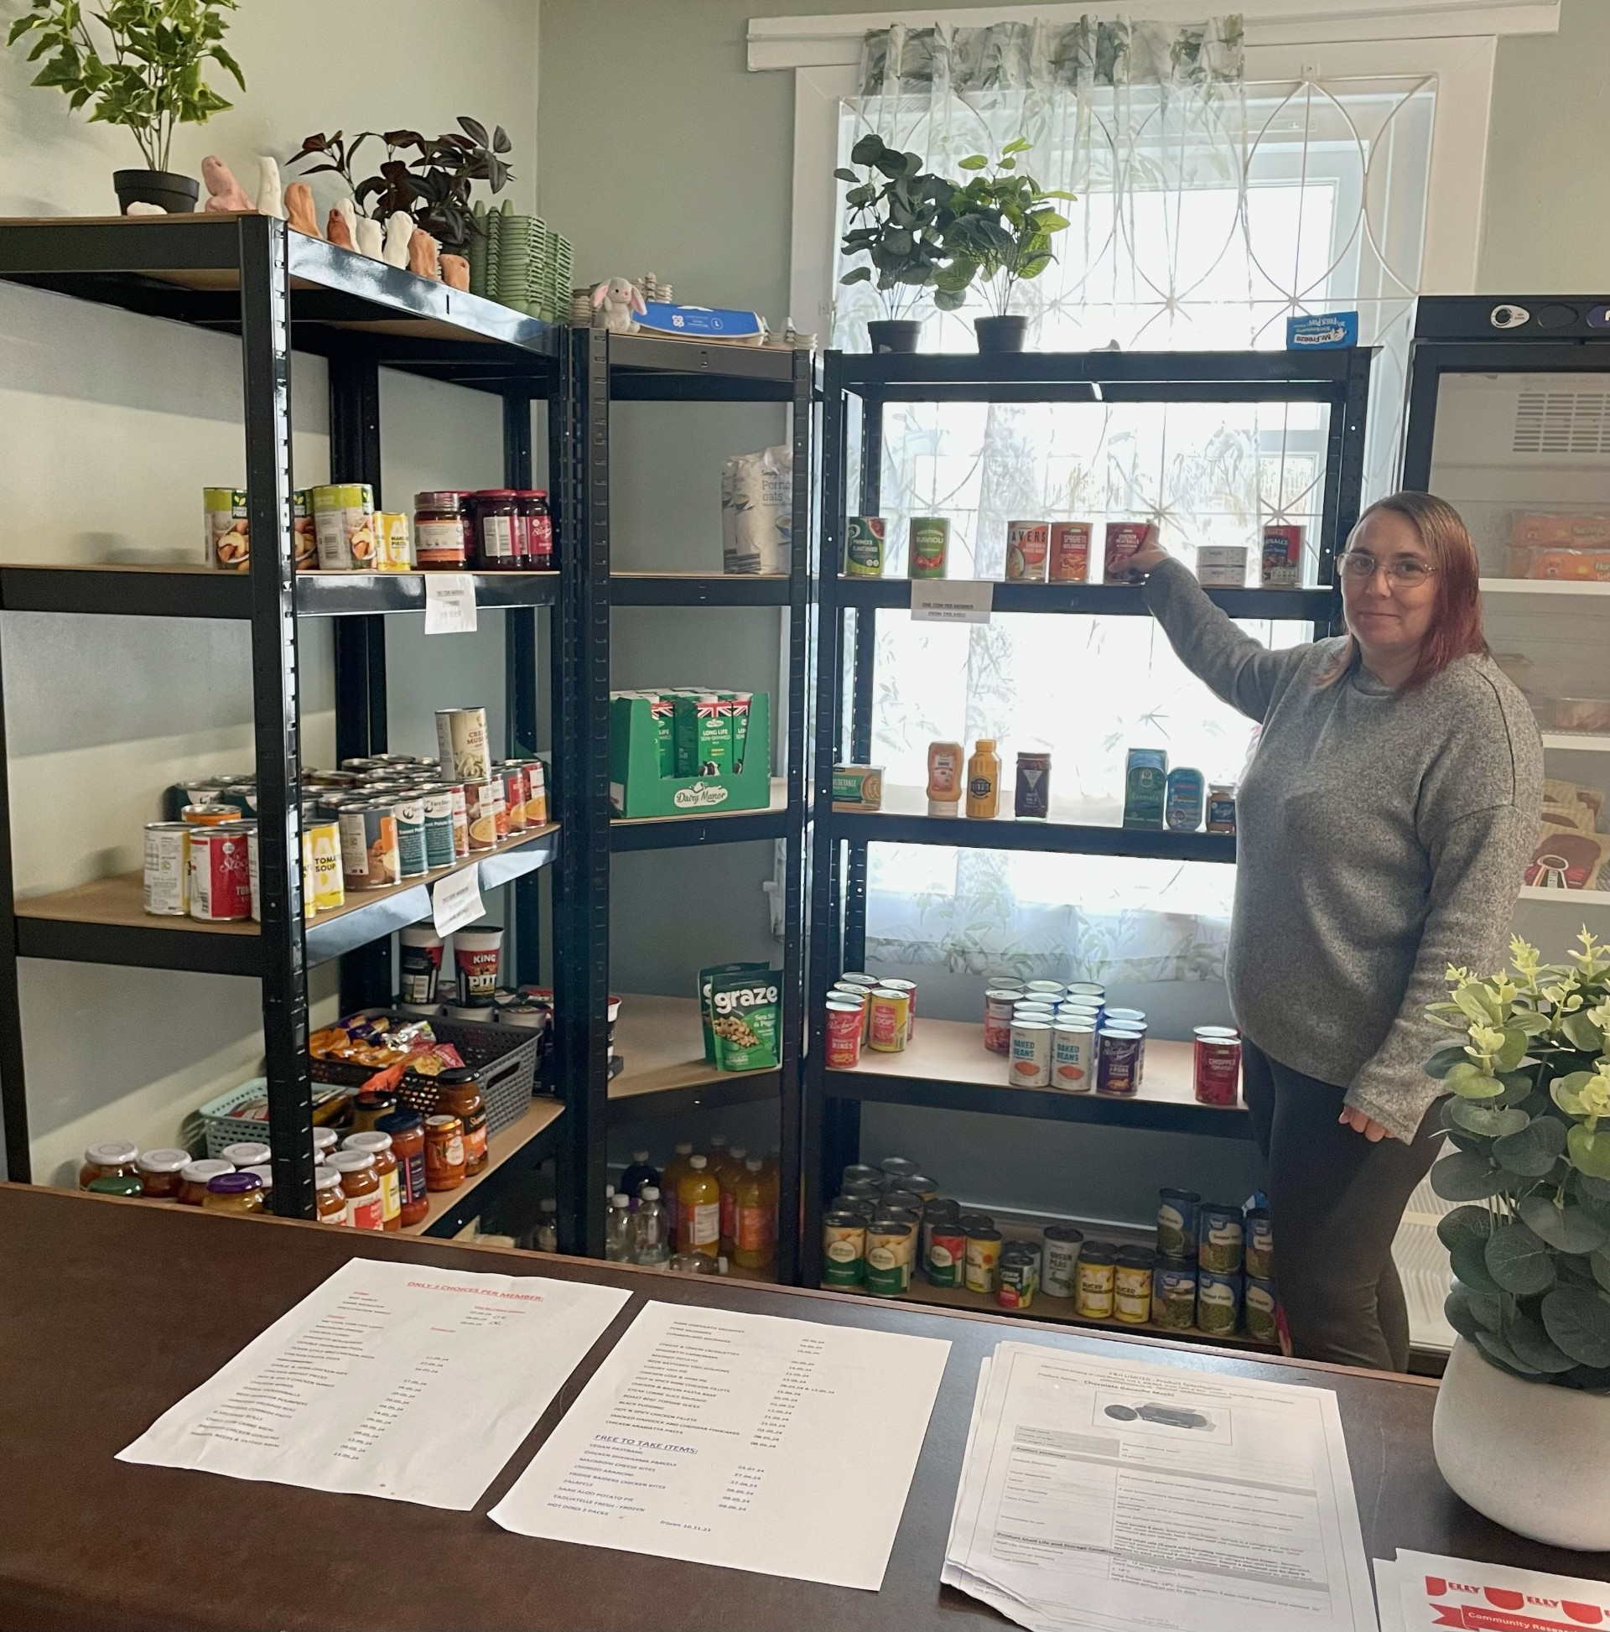
Mind the Equality Gap Type 2 diabetes prevention in communities
Jennifer Hynes, Type 2 Diabetes Early Intervention Lead fv.diabetespreventionteam@nhs.scot

Slide 22
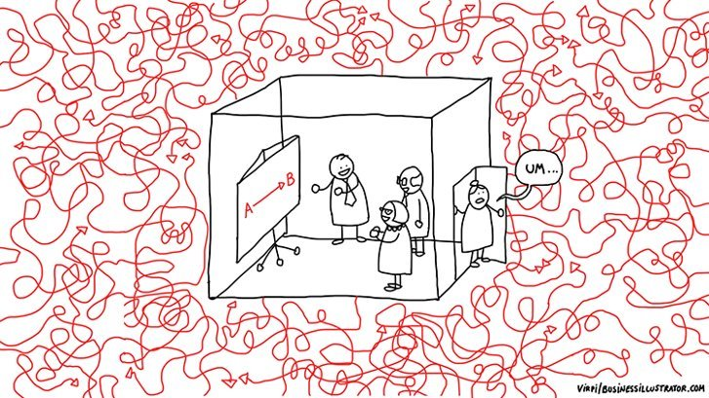
Understand the complexity of people’s real lives, and through exploration and experimentation, learn together what will make a positive difference to them

Slide 23
Up to 82% of those who do not attend Allied Health Professional clinic appointments are people who live in areas of highest multiple deprivation ASPIRE 2: A Transformational Plan for AHPs in Forth Valley 2022-2027

Slide 24
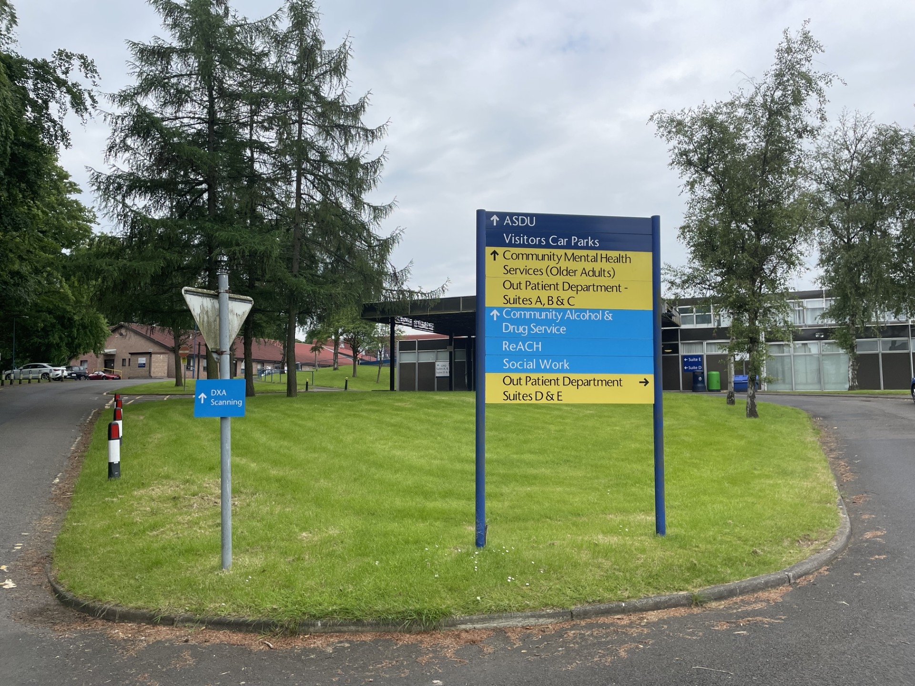
Traditional pathways

Slide 25
Being Human

Slide 26
I will put my family's health above my own
I want to tell you my story without judgement
I need to trust you to tell you what is really going on for me
I can't always share your priorities
Having a person led conversation might help me to confront my behaviour drivers for the first time
What do people want us to know?

Slide 27
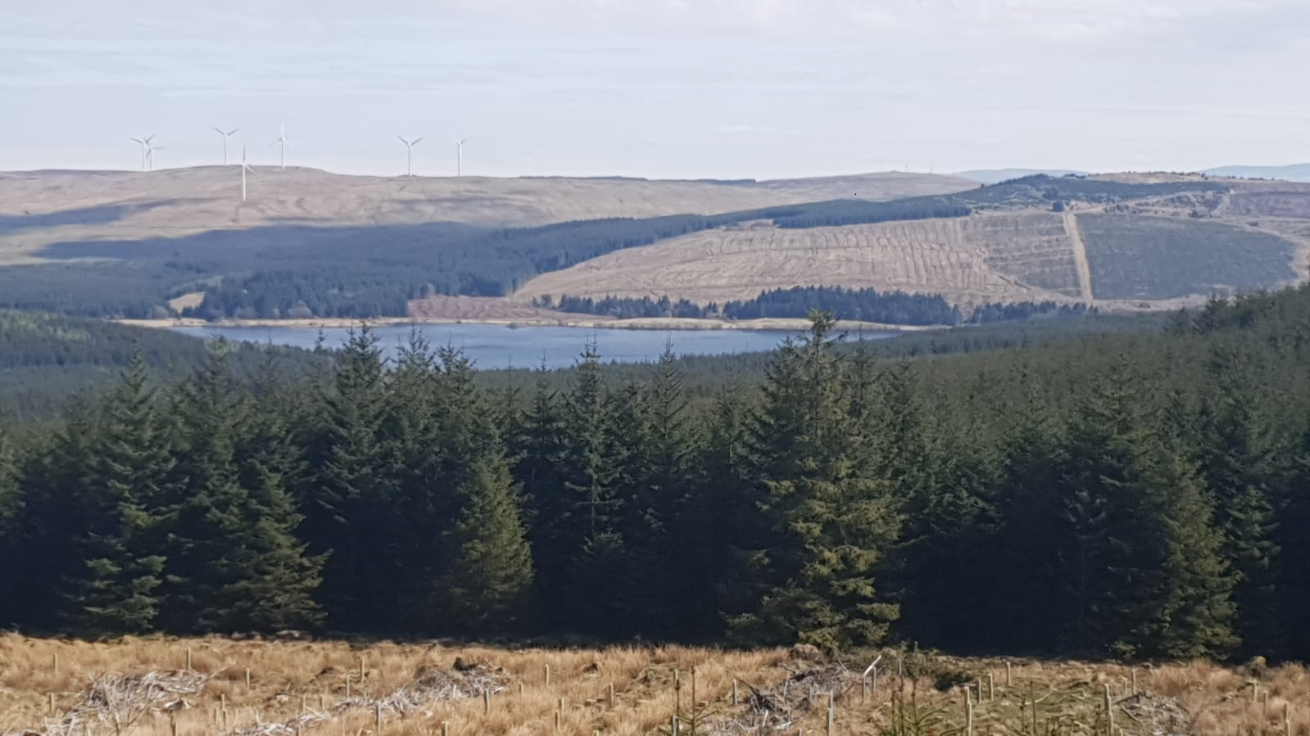
“I’ve learned that people will forget what you did but people will never forget how you made them feel” – Maya Angelou

Slide 28
Realistic Medicine: Taking Care Professor Sir Gregor Smith Chief Medical Officer for Scotland
People – Planet – Progress - Purpose
#realisticmedicine

