Slide 1
Optimising Medications Reducing Inappropriate Polypharmacy and Enhancing Patient Care
Dr Alison McCulloch
Consultant and Clinical Lead in Medicine for the Elderly
Ninewells Hospital, NHS Tayside
Karen Lowdon
Lead Clinical Pharmacist, Medicine for the Elderly
Ninewells Hospital, NHS Tayside

Slide 2
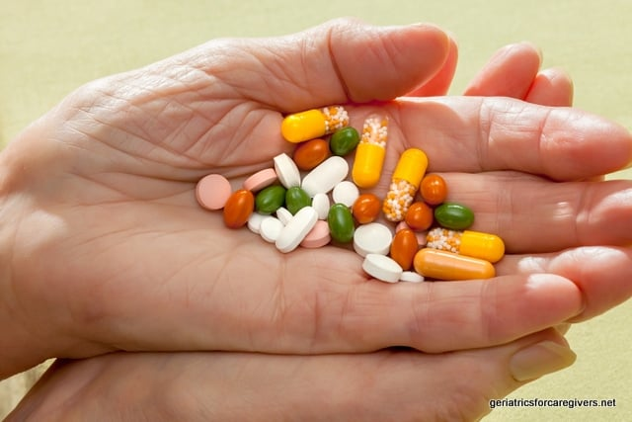
Polypharmacy Challenge
advances in medical management
evidence-based medicine
ageing population
multi-morbidities
complex care needs

Slide 3
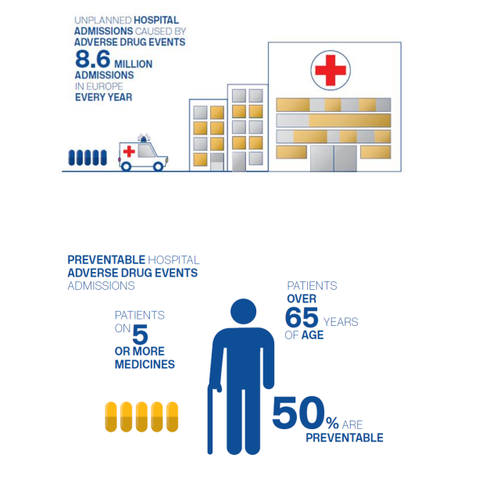
Reference 1: Polypharmacy - Effective Prescribing and Therapeutics

Slide 4
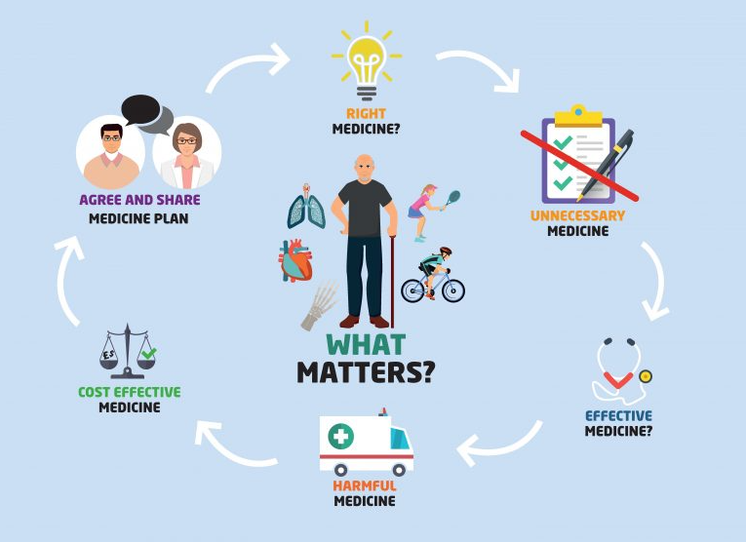
Notes:
Step 1 (Aims);
Identify aims & objectives of drug therapy
Step 2 (Need);
Identify essential drug therapy
Step 3 (Need);
Identify any unnecessary medication
Step 4 (Effectiveness);
Are therapeutic objectives achieved?
Step 5 (Safety);
Has the patient experienced any ADR’s or are they at risk of adverse events?
Step 6 (Cost-effectiveness);
Is drug therapy cost-effective?
Step 7 (Adherence / Patient centredness);
Is the patient willing and able to take medication as intended?

Slide 5
What Does Optimising Medications Mean To You?

Slide 6
What Does It Mean To Us?

Slide 7
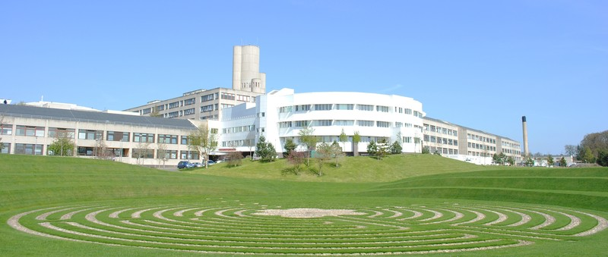
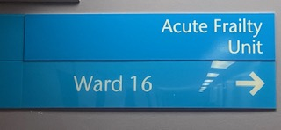
Our Experience Within Acute Frailty Team

Slide 8
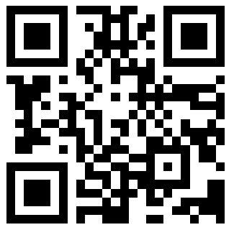
Our Experience Within Acute Frailty Team
212 patients admitted over 5 month period
Clinical Frailty Scale (Rockwood)
Range 2-8
Scan for more information about Clinical Frailty Scale
Mean age 84 years (range 70-98 years)
Mean number of regular medications on admission 7.4

Slide 9
Our Experience Within Acute Frailty Team
380 medication interventions
210
stopped
82
started
88 dose adjustments

Slide 10
What Do You Think Most Commonly Stopped Medications Were?

Slide 11
Medications Stopped

Slide 12
Medications Started

Slide 13
Learning Points From Our Data
Opportunity for medication review during admission
shared decision making
realistic medicine
Improve engagement with all prescribers
55.3% de-prescribing activity
Increasing frailty - need for more assertive de-prescribing decisions
Notes:
(e.g. bisphosphonates in dependent patients, statin therapy, DOACs, replacement therapies)

Slide 14
Points To Consider
Consider iatrogenic presentations and missed presentations
Prescribing cascades – are you starting a new medication to manage the side effects of another?
Culture change & transforming best practice

Slide 15
So Why Does This Matter?
With thanks to Hilary Provan (Improvement Academy, NHS Tayside)

Slide 16
Case Example
86 year old female. Retired lecturer. Clinical Frailty Scale 6.
Admitted to hospital with falls and poor oral intake.
Past medical history: Atrial fibrillation, hypothyroid, hypertension, polymyalgia rheumatica
No known drug allergies

Slide 17
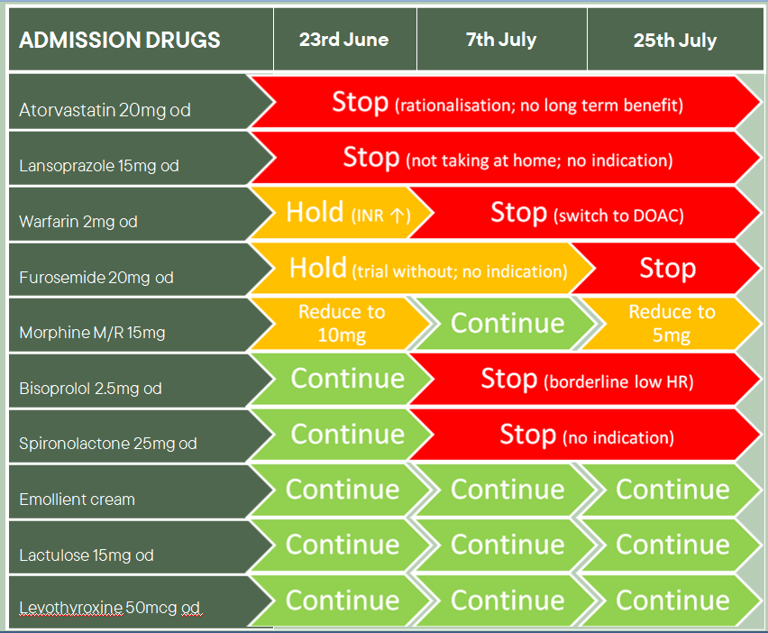

Slide 18
Your Experiences Of Medication Reviews....
Who is involved?
Is this part of your daily practice?
What is involved in a medication review?
How is this done?

Slide 19
Where are we now?

Slide 20
Strategic/Leadership Vision
Optimising Medication Management
AIM
Primary Drivers
Secondary Drivers
Workstreams
The aim is to optimise medications for patients admitted to Acute Services, NHS Tayside.
Identify patients for review
Early identification of patients for medication review
Education
Undertake medication review
Shared Decision making -
What matters to the patient?
Service delivery
Reliable communication of medication review
Utilise digital systems to support development
Digital Innovation
Reduce number of inappropriate medicines
Culture change and champion reduction of inappropriate polypharmacy
Culture change
Develop education and share best practice
Public health
Educate and share learning
National drivers and principles to consider
Quality Strategy
Realistic Medicine
What Matters To You?

Slide 21
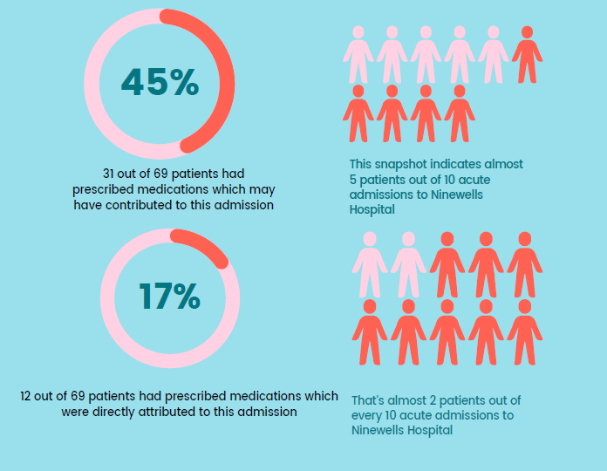
Local Day of Care Audit

Slide 22
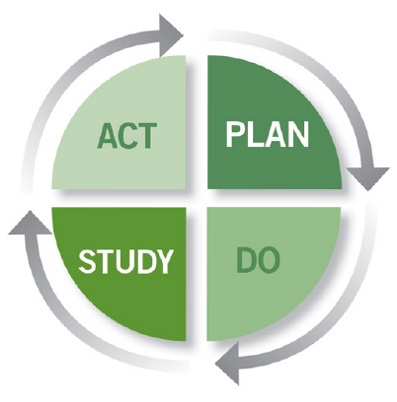
Our Current Work
Review, refine and spread across NHS Tayside
Improve communication of medication reviews across the interfaces of care
Determine number of documented medication reviews and communication on discharge letter
Utilise digital platforms to support robust documentation and communication

Slide 23
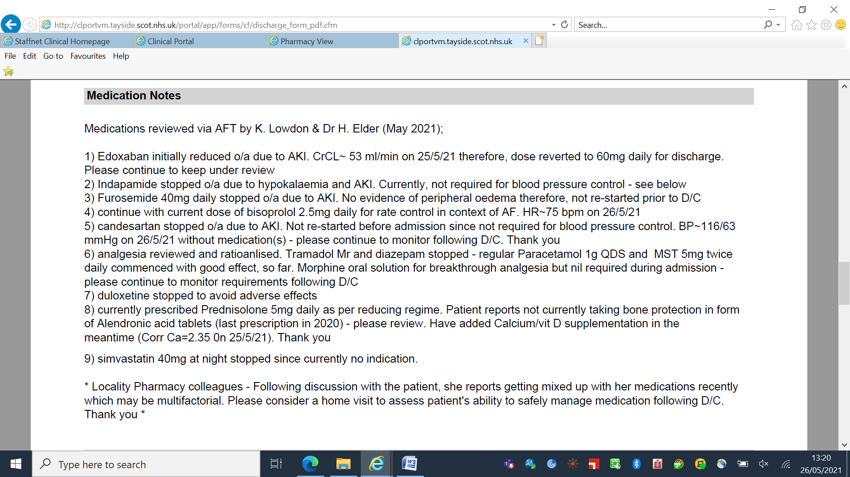
Example Discharge Communication

Slide 24
Conclusions
Optimising medications matters to everyone
Patient centred care
Culture change
Whole system approach with the patient at the centre

Slide 25
Questions?

Slide 26
References
1) Scottish Government Polypharmacy Model of Care Group. Polypharmacy Guidance, Realistic Prescribing 3 rd Edition, 2018. Scottish Government
https://www.therapeutics.scot.nhs.uk/wp-content/uploads/2018/09/Polypharmacy-Guidance-2018.pdf

