Slide 1
“Right Care, Right Place – Patient, System and Environmental Wins”

Slide 2
Learning Outcomes
Have a greater understanding of how NHS Tayside’s Flow Navigation Centre (FNC) can be used to deliver a more patient centred approach to care using Right Care, Right Place, Right Time and the impact of reducing unnecessary attendances to the Emergency Department and benefit the environment in reducing patient miles travelled
Have a greater understanding of the approach taken within NHS Greater Glasgow and Clyde's to develop a collaborative model to support care homes to allow residents to stay at home and avoid unnecessary admissions
Have a greater understanding of opportunities within their own organisations to work innovatively and collaboratively

Slide 3
Right Care, Right Place, Right Time
Building the National Care Service
A resilient health and social care system
Climate change and health services
Innovation and future paths
Quality, Values & Experience
Sustainable Care: Value Based Health & Care
Cross cutting themes – integration, sustainability and innovation

Slide 4
Session Overview
|__________|______________________________|____________________|_______|
5 min
Close
10 min
Welcome
And
Introduction
40 min
Speakers (3x 10 mins + Q&A)
20 min
3 Horizons
Small Group Session

Slide 5
Green Flow Navigation Centre (FNC)
David Mackinlay
Specialty Doctor
Emergency Medicine
NHS Tayside

Slide 7
Flow Navigation

Slide 8
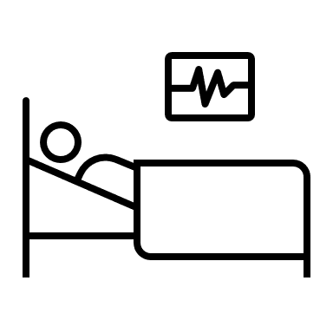
ED now
Scheduled care appointment
Call NHS24 on 111
Referral direct to Specialties
If meets criteria for a callback, file is sent to Adastra for FNC clinician to review case
Local MIIU
Triaged by NHS24 call handler
Self-care advice
Primary Care services

Slide 9
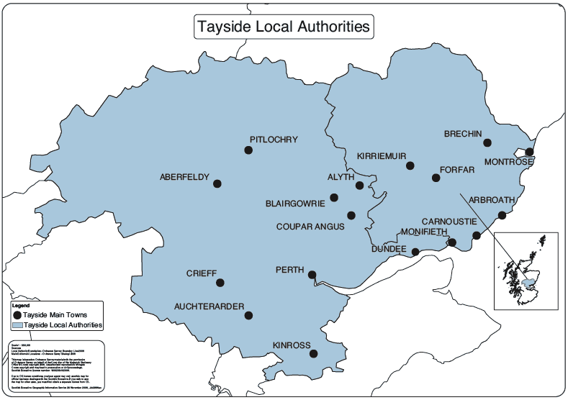
Heat Map for Calls Taken
45.0%
27.7%
24.2%
3%

Slide 10
Heat Map for Miles Saved
81.6%
10.3%
5.2%
2.9%

Slide 11
On average, a UK car emits 221.4g/mile^{3,4}
20,778 miles saved by use of FNC in May
55.2 tonnes of CO₂ saved annually

Slide 13
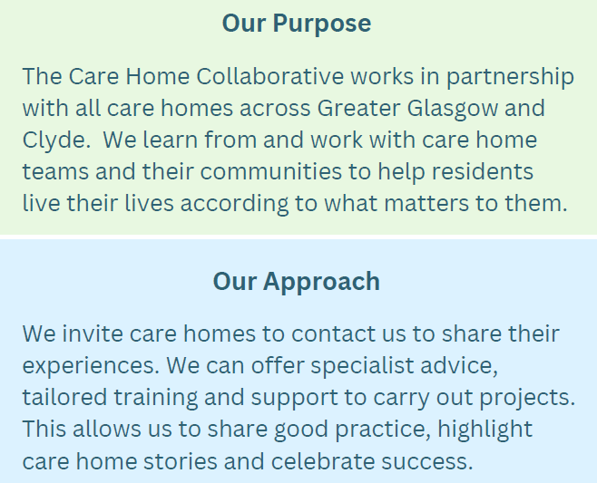

Slide 14
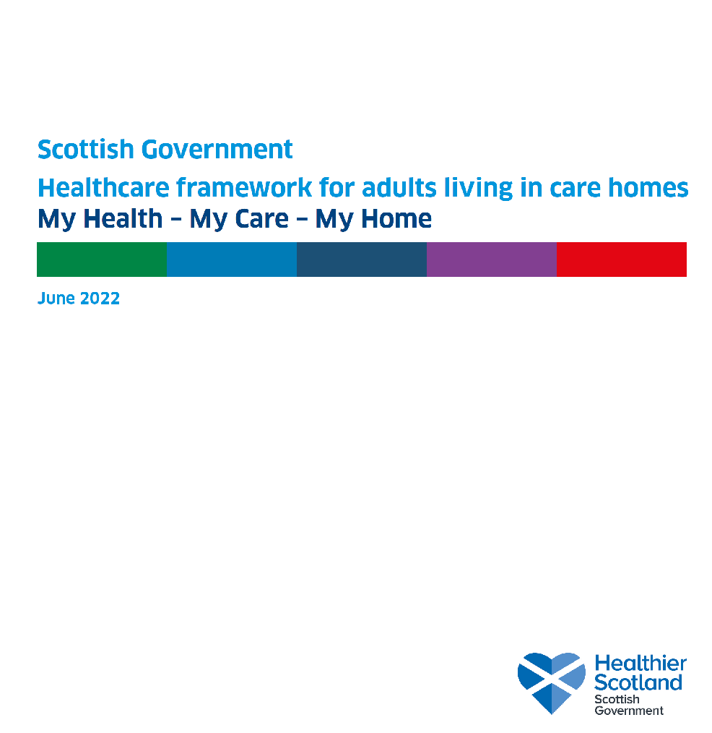
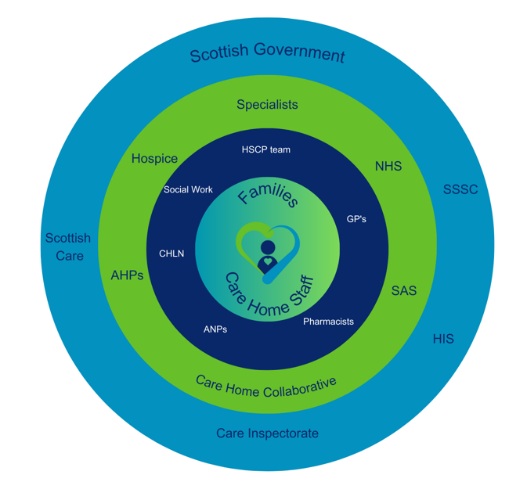
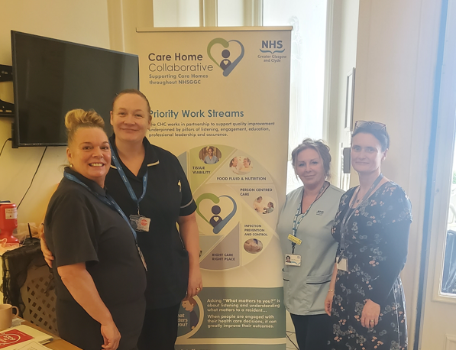

Slide 15
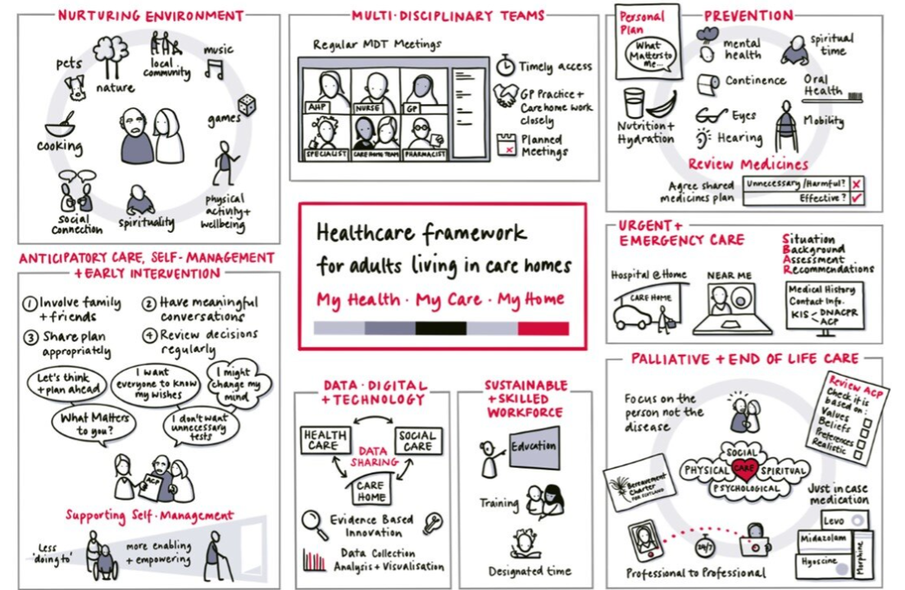

Slide 16
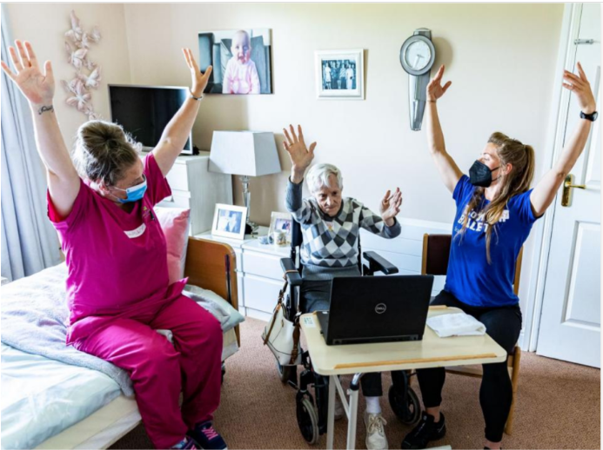
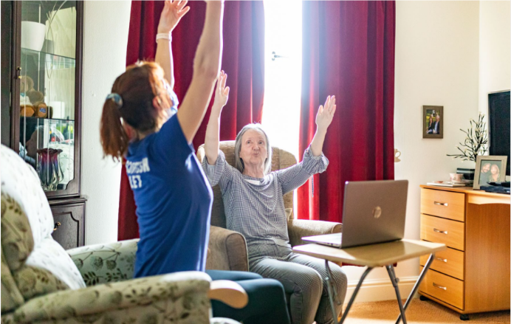
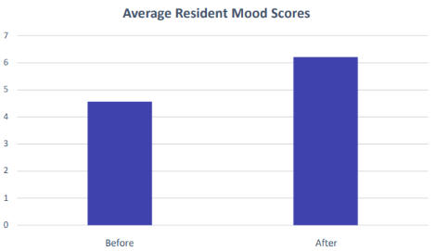
Scottish Ballet Duet
Larkfield, Newark and Campbell Snowdown Care Homes, Inverclyde
Problem identified: In the wake of the Covid-19 pandemic, Scottish Ballet sought to develop creative activities that could be used independently by carers within care homes
Aim: To evaluate the impact of SB Duet on the physical, mental and social well-being of care home residents
Tests of Change
Introduction of Scottish Ballet Duet digital resource package
CHC staff supported the care home to run these sessions
Qualitative Data
Residents and staff reported positive changes to the residents’ physical well-being
Staff also felt that the gentle movement also benefited their own physical well being
Evidence of engagement in meaningful social interaction and physical activity
Staff reported that using the SB Duet resource was a positive experience
Quantitative Data
Average 35% improvement in mood after the session, no decreases observed
Average resident mood scores pre-post SB Duet use
Spread: CHC provides additional support to care homes to facilitate the delivery of the resource and continues to offer and evaluate these session in care homes.

Slide 17
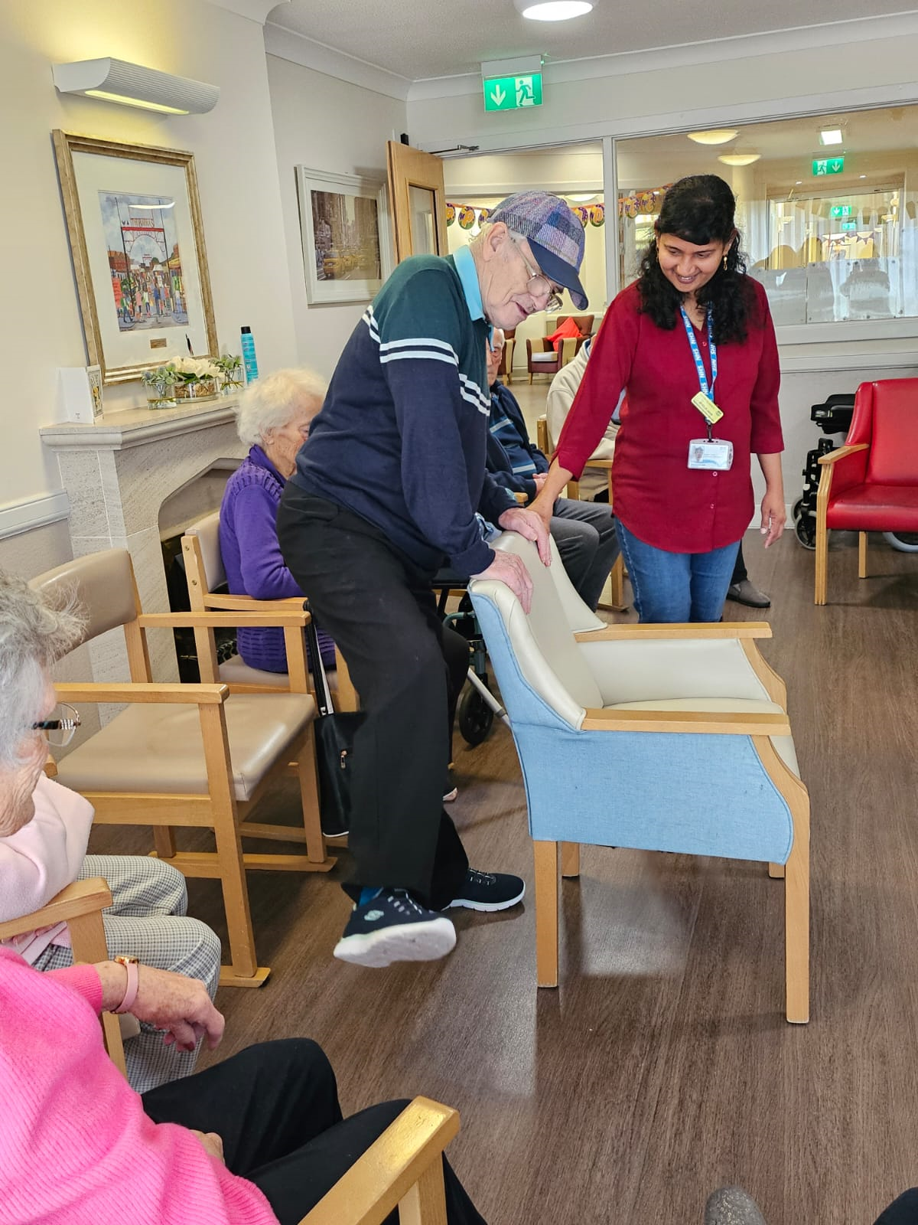
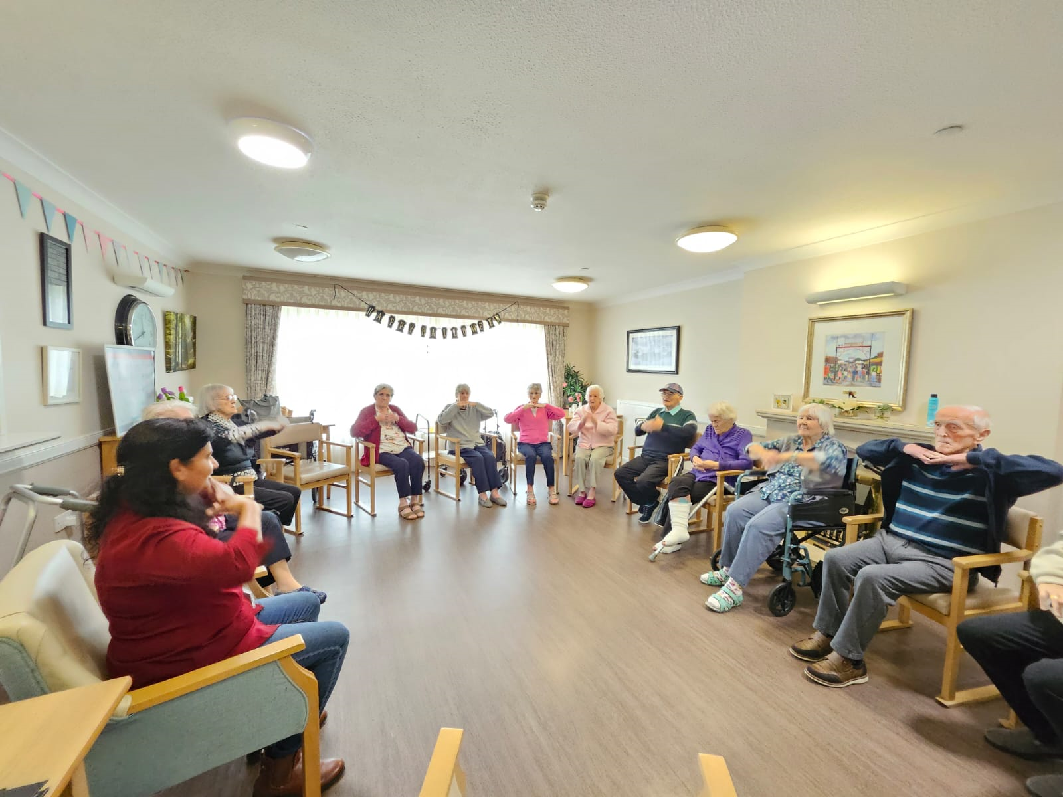
Improving physical activity and reducing falls
Mosswood and Braemount Care Homes
Tests of Change
Introduction of ‘Paths for All’ strength and balance training program, three times per week
CHC staff supported the care homes to run the initial sessions
Quantitative data
An improved Berg score and the number of Sit-to-Stands were noted
Reduction in the number of falls for the participating residents.
Qualitative data
Residents J’s daughter reported that she can see a big change in her dad’s mobility and mood after attending classes.
Staff reported a positive impact on the mood of the residents who attend regularly.
Problem identified: Low levels of daily activity and high number of falls amongst the care home residents.
Aim: By April 2024, 10 residents at two care homes will increase their physical levels and reduce falls by 25%, in line with the Health and social care standards and principles of CAPA
Feedback from resident’s daughter
My mum had a stroke and was in hospital for about six weeks. When she was discharged she struggled to get up out of a chair and walk.
We are so grateful that mums care home has partnered with your team to come into the home and show residents how exercises can help.
She attends classes three times a week, she loves going along as it is quite sociable too!
At first she needed help to stand up and she found it difficult to walk and keep her balance. She faithfully did these simple exercises and she was able to do more each week. Her balance is much better now although she still walks with a zimmer. Sometimes she forgets she needs the zimmer and has been ‘caught’ walking without it!.
In the last 4 weeks she has been walking more, she can walk right round the unit at a good pace. In fact I believe she walks better now than she did before she had her stroke.
Thank you for helping get some of her independence back.
Spread: Paths for All to train staff in a further 18 care homes within NHSGGC

Slide 18
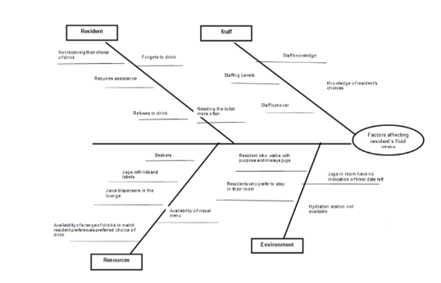
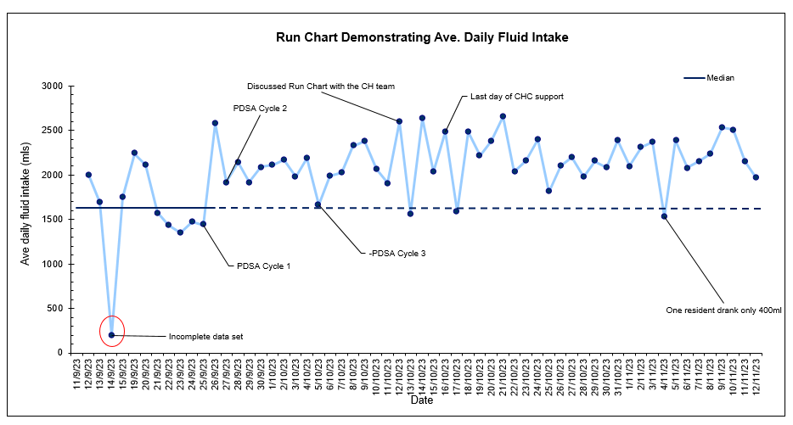
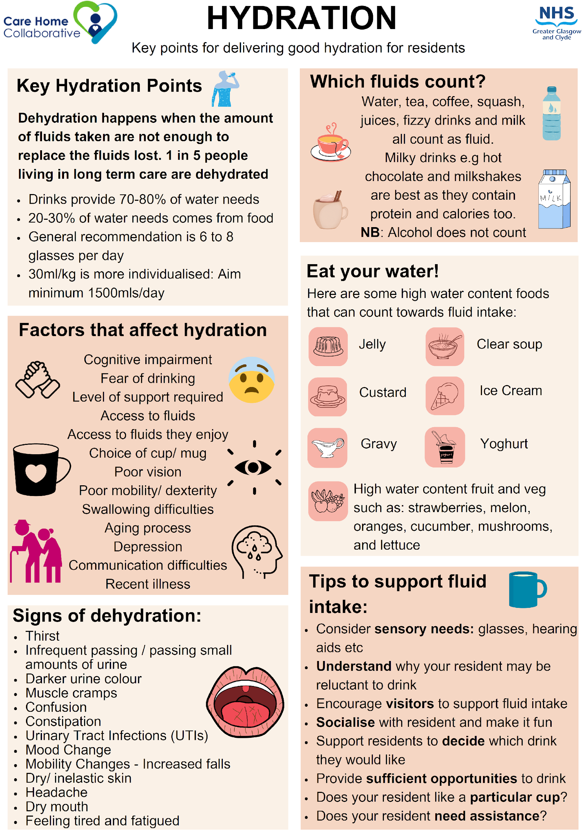
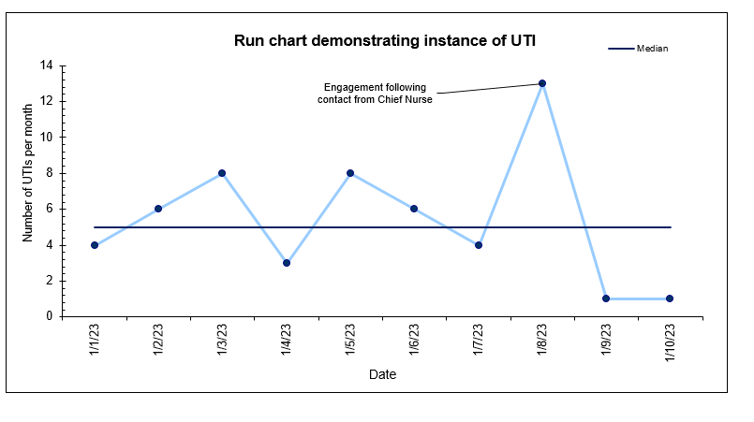
Hydration
Belleaire Care Home
Problem identified: Increase in the number of residents experiencing urinary tract infections
Aim: By November 2023 there will be a 10% increase in fluid intake for the 5 residents with the most frequent instance of UTI aligned with the Scottish Government ‘Health Care Framework: My Health My Care My Home’ (2022) and ‘Eating and Drinking Well in Care’ (Care Inspectorate, 2018).
Fishbone analysis
Tests of Change
Introduction of Hydration posters
Introduction of a visual drinks menu to offer a variety of drinks
Introduction of a hydration station to improve access to fluids
Introduction of meaningful activity prior to hydration round
26% (average of 300mls) increase in daily fluid intake
Qualitative data
Staff felt that increased hydration had a positive impact for the residents
It's been interesting to see the changes and how UTIs have decreased at the home which is an improvement
Improved hydration and reduction in UTIs from 6 to 1 per month
Spread: Change package and suite of resources to support the spread of the project to other care homes

Slide 19
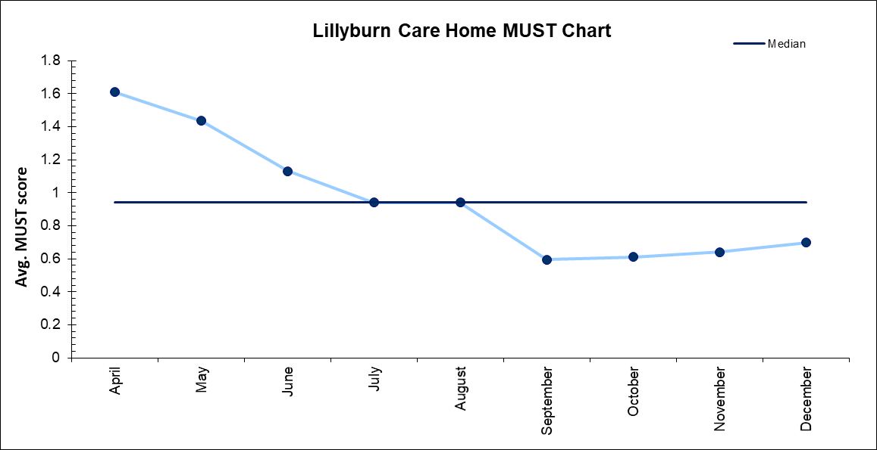
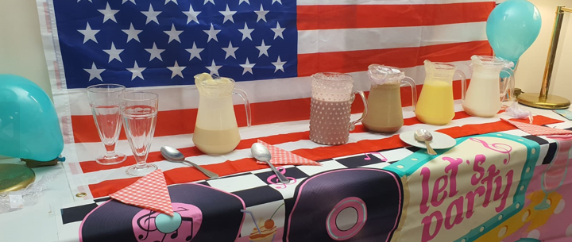
Improving food fortification when nutritional risk is identified
Lillyburn Care Home
Tests of Change
Introduction of milkshakes for residents on MUST Step 5
Lillyburn chefs preparing the milkshakes daily
Milkshake tracking folders to review if residents enjoyed each flavour
Qualitative data
Staff morale improved as the full care home was involved in the project
Residents became more engaged in activities
Home using themed activities such as American 50s diner to promote milkshake use.
Quantitative data
In the first 6 months there was an average of 12 falls per month, in the last 6 months this has reduced to 9 (25%)
Problem identified: MUST Step 5 is an NHSGGC pathway for residents identified with a nutritional risk (MUST of 1 or above). A key part of this is food fortification for residents meals and fluids. Scoping highlighted inconsistent practice with fortified fluids or milkshakes.
Aim: All residents at Lillyburn care home with an identified risk (MUST 1 or above) will have access to fortified milkshakes as part of the MUST Step 5 pathway.
Reduction in risk of malnutrition and 25% reduction in falls
Spread: Change package and spread plan in development.

Slide 20
Reduce incidence of pressure ulcers
Hawthorn House, Glasgow City
Problem identified: 10 care acquired pressure ulcers in a residential care home between March and July 2022 (over 150 days)
Aim: By December 2022 there will be a 50% increase in the days between identification of Grade 2 and above avoidable pressure ulcers in line with Health Improvement Scotland Standards for Prevention and Management of Pressure Ulcers 2020
Fishbone analysis
Tests of Change
PUP / Skin check at each flash meeting
PUP alert in communication book
Introduction of cPURA
SSKINS care bundle / repositioning chart
Pressure relieving equipment as stock
Development of a Pressure Ulcer Escalation Process diagram
Education / training
The Care Home had no Grade 2 and above pressure ulcers for 243 consecutive days
Spread: cPURA change package developed for residential care homes, and rollout continues in Glasgow City, Renfrewshire and Inverclyde

Slide 22
“Right Care, Right Place – Patient, System and Environmental Wins”
Renfrewshire Care Home Nursing Support Team
Linda Bias- Lead ANP
NHS Scotland Event
10th June 2024
Notes:
Welcome. My name is Linda Bias and I have been the Lead ANP for Renfrewshire Care Home Nursing Support Team since March 2022.

Slide 23
Background
Renfrewshire population approx. 177,257
Renfrewshire HSCP 16 Nursing and 8 Residential Care Homes
Primary Care Improvement Plan Funding
Development of Renfrewshire Care Home Nursing Support team
Notes:
Renfrewshire population is approx. 177,257. Within Renfrewshire HSCP, there are currently 17 Nursing Homes and 8 Residential Homes (approximately 1324 resident beds). There was a CHLN service that supported nursing homes as a conduit between practices and homes
However through PCIP funding was allocated to provide service away from GP practice, improve proactive and reactive care and continuity – aim for improved person experience that meets their needs. ANP posts were developed and worked collaboratively with the CHLN nurses to develop a unique team
The Care Home Nursing Support Team service is underpinned by the Scottish Government Vision Transforming Nursing Roles; The Quality Strategy Ambitions of Safe, Effective, Person Centred Care and the Scottish Government 2050 Vision for the Future Provision of Health Care in Scotland.
The service specification sets out the vision for the service ensuring it is fit for the future

Slide 24
Local and National Drivers
Renfrewshire Strategic Plan
My Health, My Care, My Home
Right care, right place, right time
Palliative Care Strategic Plan
What Matters to Me
Facing the Future Together
Frailty at the Front Door
NHSGGC Unscheduled Care Delivery Plan
Notes:
Many national and local drivers impact this model of approach.

Slide 25
Current Service Model
Renfrewshire Care Home Nursing Support Team:
1 Lead Advanced Nurse Practitioner (ANP)
5 ANPs
3 Trainee ANPs,
1 Practice Development Nurse
4 Care Home Liaison Nurses (band 6)
2 Band 5 Nurses
Providing a model of both Scheduled and Unscheduled Care
Notes:
This model has been a journey over the last 3 years of learning and development and supporting the transition from trainee ANP to qualified. As this happened there were more opportunities for service improvement and development of competencies in different areas. This was not done in isolation but in collaboration with GP partners who provided learning opportunities to complete competency sign off and from more recently acute based consultant geriatrician. This support has helped the team develop and become more confident and has strengthened relationship and therefore opened up opportunities for further development.
The ANP team run a model offering scheduled and unscheduled visits to all care homes for a variety of acute conditions ie UTI. LRTI, Cellulitis, Palliative care, sepsis, heart failure. The unscheduled model allows care home staff to send a referral direct to the service and arrange for same day triage and assessment as applicable. This is complimented by the support from the CHLN who also offer both scheduled and unscheduled visits supporting with wound, MUST, catheter and future care planning. The band 5 nurses provide additional support to the residential care homes and the PDN supports with awareness sessions and supports with QI projects.
We offer a service to all Renfrewshire elderly care homes, with exception of one home which has there own employed ANP.
We offer both scheduled and unscheduled care to residents registered with a Renfrewshire GP practice; Monday to Friday between 08.30 hours and 16.30 hours, except public holidays.

Slide 26
Service Improvement
Innovative, nurse-led service
Focus on right care at the right time in the right place
Proactive advice and support and opportunities for teaching and learning
Collaborative working with wider teams
Joint working with NHSGGC Care Home Collaborative
Notes:
The vision of the CHNST is to Deliver:
Innovative, nurse led service which empowers safe, effective resident centred care through supporting the health care of resident's;
Prevention of unnecessary conveyance to hospital, to remain within the homely setting using a combination of reactive and proactive care and advice to support residents and care home staff.
As a functioning team, we are always seeking ways of improving the current service provision through audit, feedback and quality improvement.

Slide 27
Case of the week
91 year old female, care home resident
PMH Atrial Fibrillation, alzheimers, frailty
GP had discontinued all oral medication due to increased frailty and deterioration
Presenting Complaint- 2 day history of swelling, red area discolouration, firmness and pain to right lower calf.
Deep venous thrombosis and frailty
MDT working with local COTE consultant
Resident restarted on edoxaban (dosage as per guidance for DVT treatment) and remained within the care home setting
Conveyance to hospital was prevented
Notes:
Case of the Week: 91 year old female in nursing home. Hx AF, dementia and frailty. GP had discontinued all oral medication due to increased frailty and deterioration – including edoxaban for AF. Resident presented with a 2 day history of swelling, red discolouration and firmness /pain to right lower calf. After assessment, DVT diagnosed. However given level of frailty and time of day, consideration given regarding alternatives to conveyance for further assessment and confirmation of DVT. Call made to COTE DME and situation discussed. Agreed likely DVT however decision made not to convey. Commenced edoxaban dosage as per guidance for DVT treatment. Remained within homely setting and is currently settled and conveyance prevented.

Slide 28
Data Collection- CB4YC
Call Before You Convey Pathway
Data from Jan 23 to March 24
Test of Change over 7 days
96% non conveyance
Notes:
The CB4YC pathway is something that the CHNST adopted over 15 months ago Monday-Friday.
However, this pathway was extended from December 2023 to March 2024 to provide support from 3 DN ANPS and 1 Care Home ANP on a Saturday and Sunday to 6 Residential Care Homes for the following specific conditions: Palliative Care , LRTI, UTI and cellulitis.
Data has shown that from the 798 calls, 96% were not conveyed to hospital.

Slide 29
Moving Forward to the Future
Notes:
Successes- We are a unique team because of the diverse skills and wide range of experiences who have amalgamated to deliver person centred care for residents to remain within their homely setting. Our recent success being, achieving the HSCP Innovation of the Year award. Once the remaining 3 trainee ANPs are qualified around September time, the team will review the current service model with the view to supporting the GPs within the hours of 08.00-18.00. With the support from the COTE DME, we are also seeking opportunities to further push the boundaries of non conveyance.

Slide 30
Thank You
Notes:
Thank you very much for listening and does anyone have any questions?

Slide 31
3 Horizons Group Discussion
Notes:
Welcome. My name is Linda Bias and I have been the Lead ANP for Renfrewshire Care Home Nursing Support Team since March 2022.

Slide 32
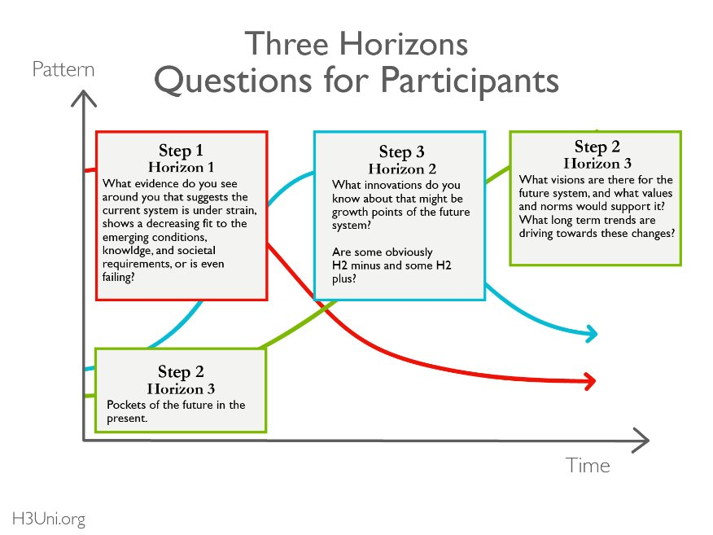

Slide 33
References
Getting the care in the right place, at the right time. 2015. NHS Providers. Available from: https://nhsproviders.org/news-blogs/blogs/getting-the-care-in-the-right-place-at-the-right-time
About urgent and unscheduled care. 2023. Public Health Scotland. Available from: https://publichealthscotland.scot/our-areas-of-work/acute-and-emergency-services/urgent-and-unscheduled-care/about-urgent-and-unscheduled-care/overview/redesign-of-urgent-care/
Yurday, E. 2023. Average CO2 Emissions per Car in the UK. Available from: https://www.nimblefins.co.uk/average-co2-emissions-car-uk (accessed 29th Nov 2023).
Department for Transport. 2022. Transport and environmental statistics 2022. Available from: https://www.gov.uk/government/statistics/transport-and-environment-statistics-2022/transport-and-environment-statistics-2022 (accessed 29th Nov 2023).

