Slide 1
Working innovatively and collaboratively to create health and social care communities

Slide 2
Stirling Health & Care Village Green Project
Clackmannanshire and Stirling Health and Social Care Partnership
Elaine Cochrane, Senior Health Improvement Officer, CSHSCP
Krissy Stevenson, Senior Project Officer, TCV

Slide 3
Session outcomes
An increased awareness of how to create collaborative partnerships which
enable people to access support and activities to improve their health.
A greater appreciation of the untapped opportunities available within communities and of how to harness these for wider benefit.
Exploration of some of the practical mechanisms used, constraints and
solutions that arise when using a community development approach .

Slide 4
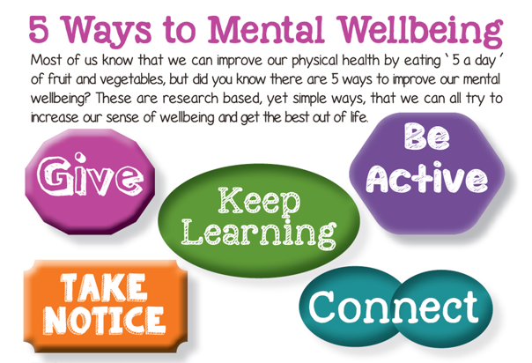
Health Improvement overarching aims
Reduce health inequalities
People already onsite
Targeted interventions
Community groups
Community link workers
Social prescribing
EQIA
Accessible site
Free at the point of use
Improve mental wellbeing

Slide 5
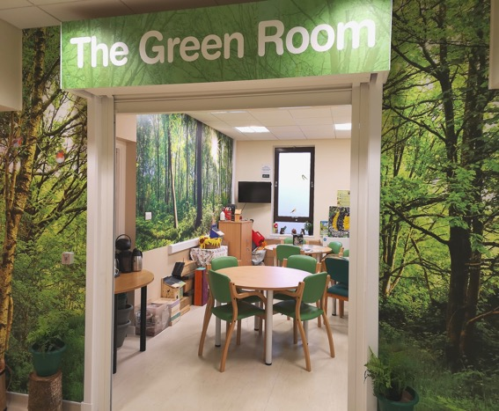
What?
Maximise the health and wellbeing potentials of the available space
Social prescribing hub
Encouraging people outdoors
Outdoor clinical spaces
Link inside to the outside
Provide indoor and outdoor venues
Underpinned by
increase biodiversity
circular economy
accessibility

Slide 6
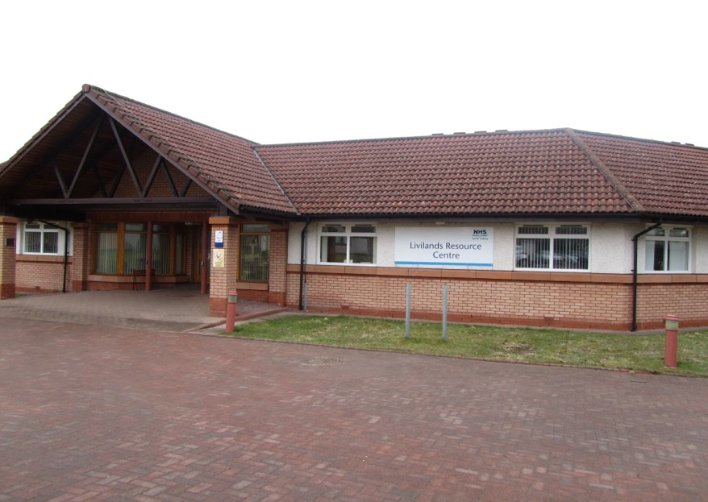
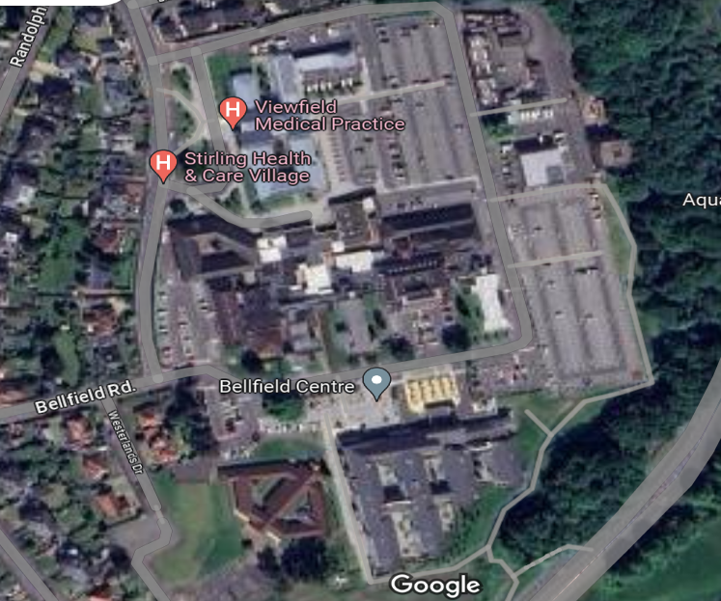
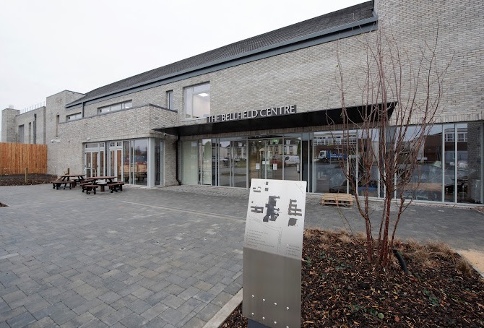
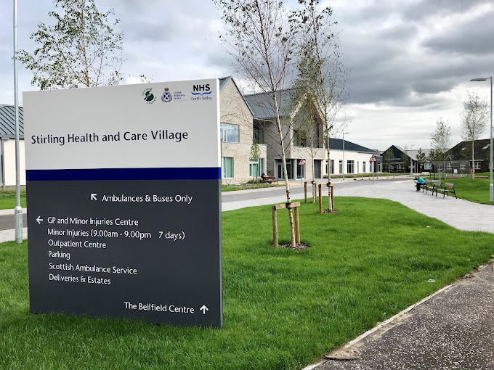
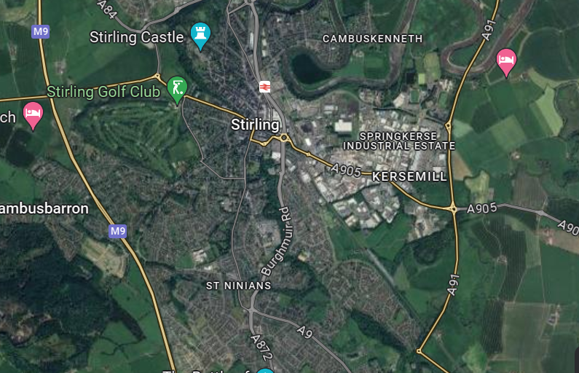
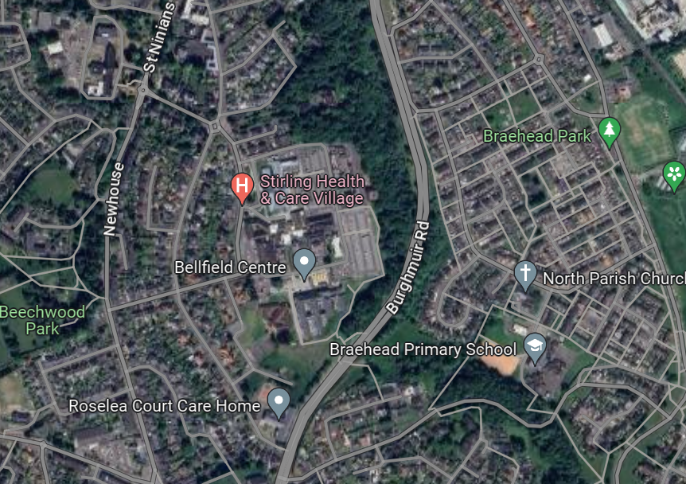
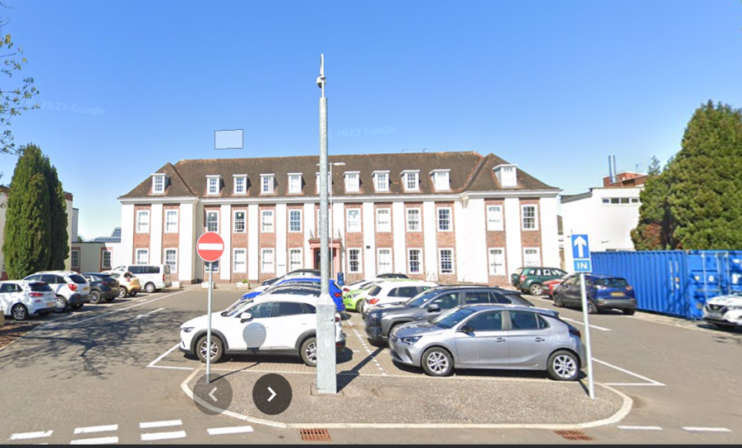
Where?
Stirling Health
and
Care Village

Slide 7
How?
TCV
Scoping exercise
Stakeholder sign up
Steering Group
Working Groups
Flexibility

Slide 8
Who?
Designed to benefit:
Patients
Staff
Relatives/visitors
Community groups
Residents

Slide 9
Why?
Develop social prescribing opportunities
Financial cutbacks - pooling resources
Strong evidence of benefits of nature on mental & physical health
Green spaces - important role to play in tackling health inequalities
Linking small isolated green spaces
Integrate a coordinated use of limited space
DL38 - improve sustainability and biodiversity

Slide 10
When?
Sept 2021
April 2022
June 2022
March 2023
April 2024
Ongoing
Sept 2024
Feasibility Study of
outdoors
Village Green developed
Community development of the site
Online stakeholder meeting
Green Room opened
Outdoor key structures completed
Development of a Social Prescribing Hub

Slide 11
Practical issues - Barriers and Solutions
NHS policies and procedures
PFI contracts
Project management tools
Flexibility
Engaging clinical staff - OTs
Domestics to grounds men
Stakeholders differing needs
Creative synthesis of experience
Match funding
Volunteers

Slide 12
Social prescribing opportunities
Mindfulness opportunities
Covered seating
Workshops
Blether Bench
Positivity Pebbles
Sensory Stops + videos
Enchanted garden
Create & Co
Environmental education – BB Hunt
Volunteering and employability
Growing spaces
Yarn bombing
Bellfield Big Tea Parties
Village Green
Green Activity Trail
Green Gym

Slide 13
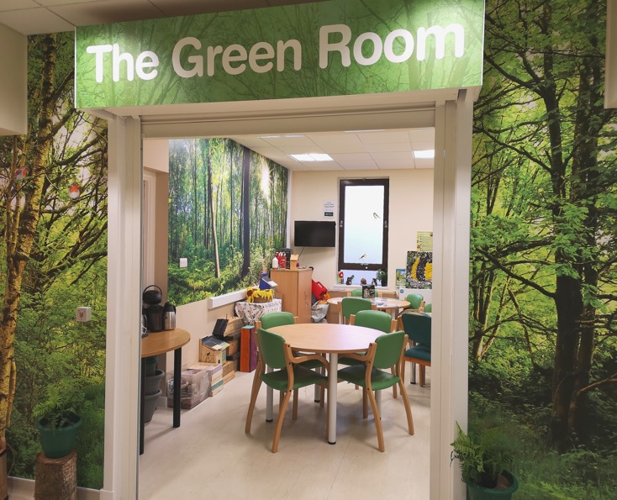
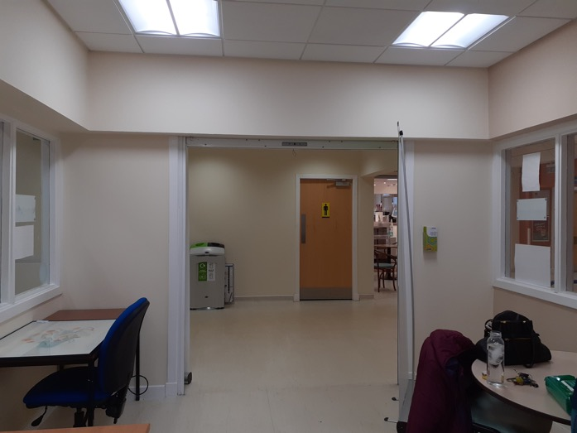
Practical examples – Green Room

Slide 14
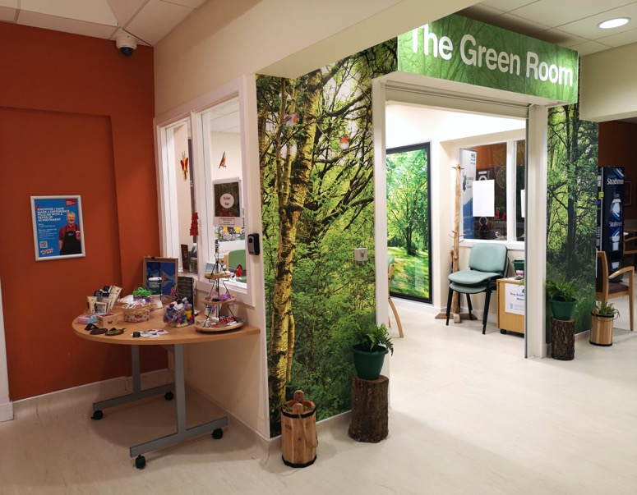
Practical examples – Green Room

Slide 15
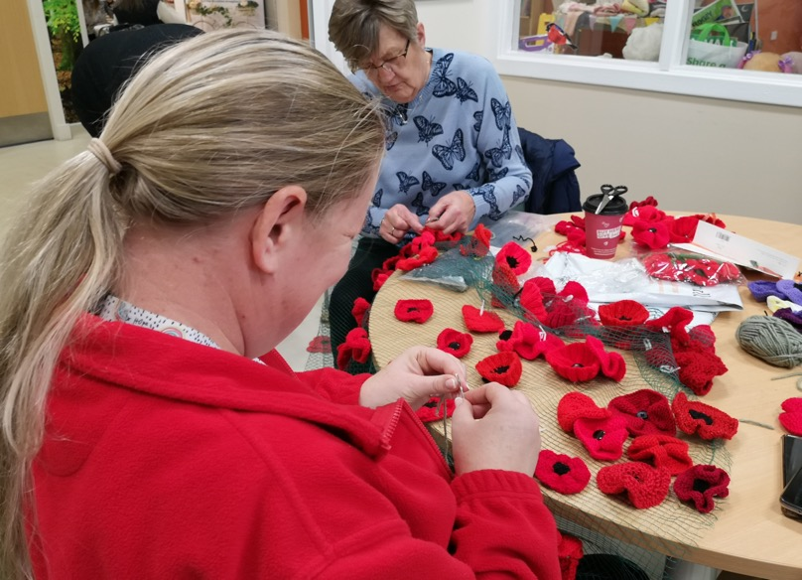
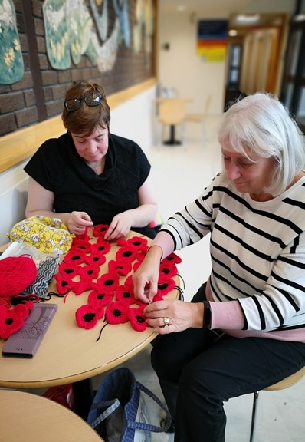
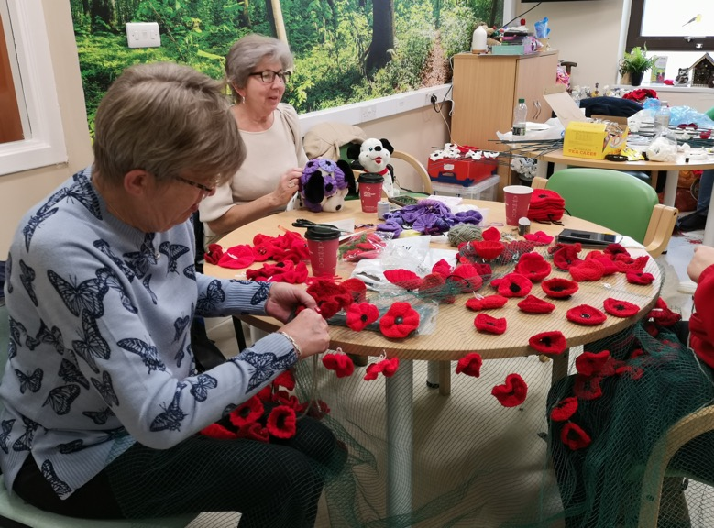
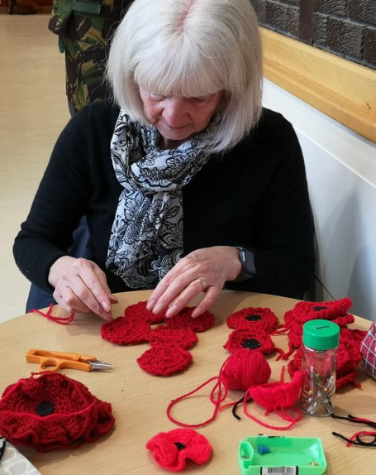
Practical examples – Yarn bombing

Slide 16
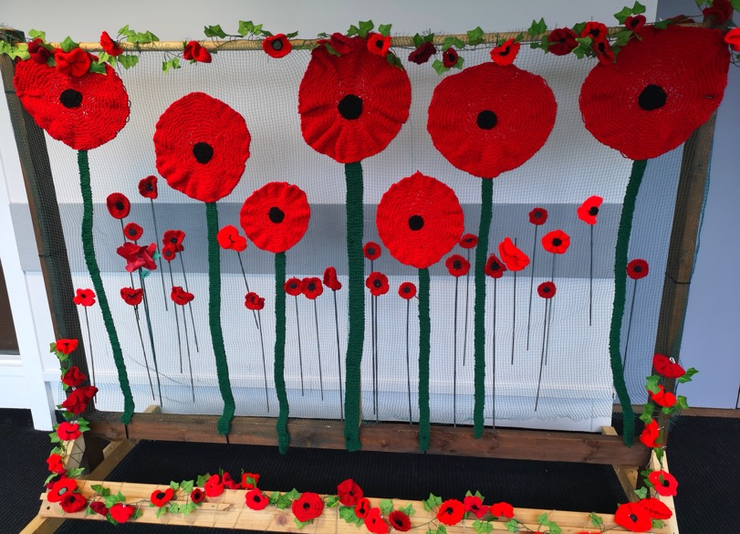
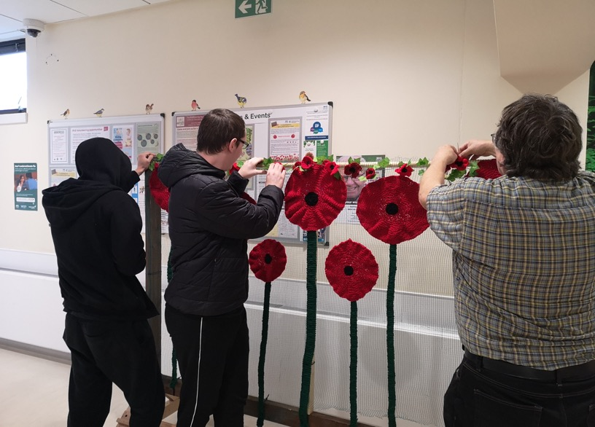
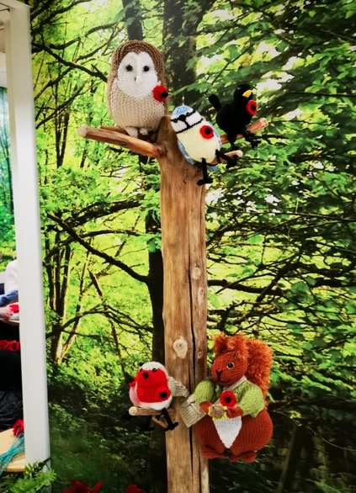
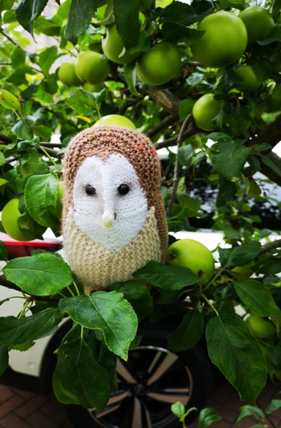
Practical examples – Yarn bombing

Slide 17
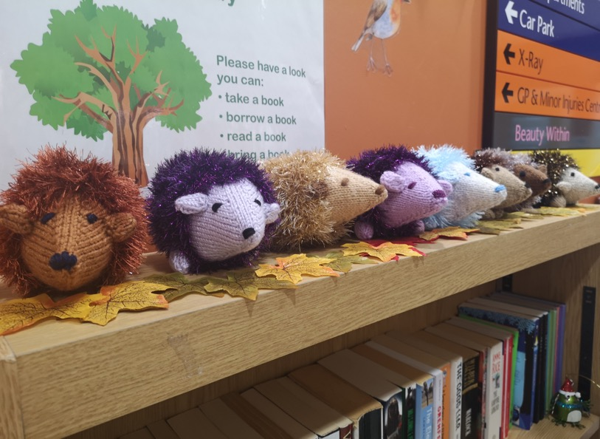
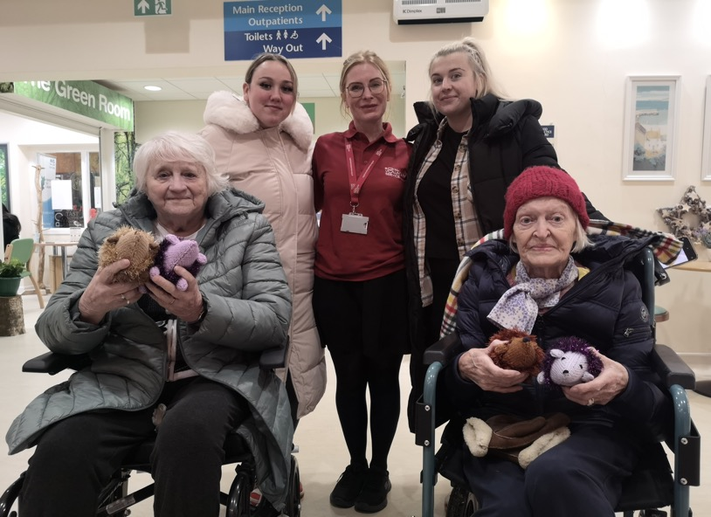
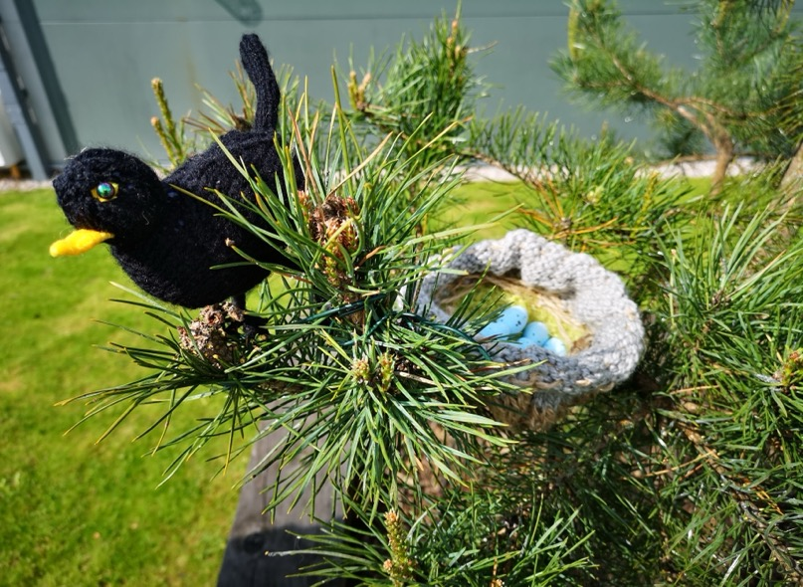
Practical examples – Yarn bombing

Slide 18
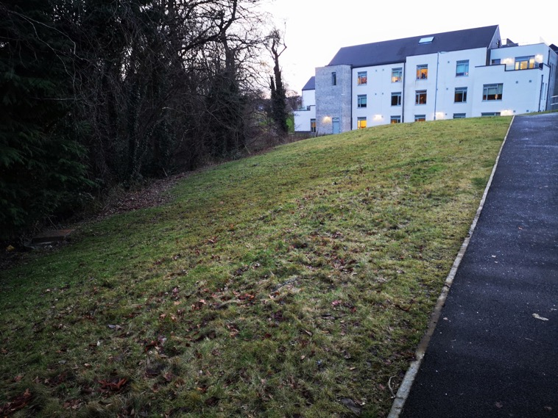
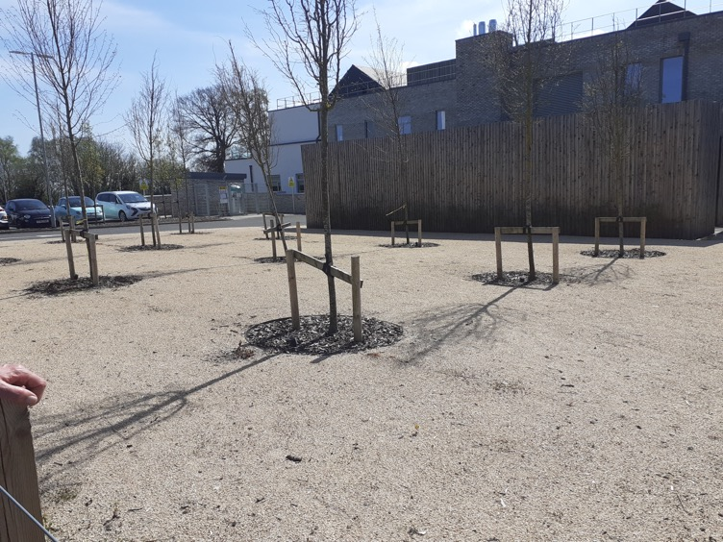
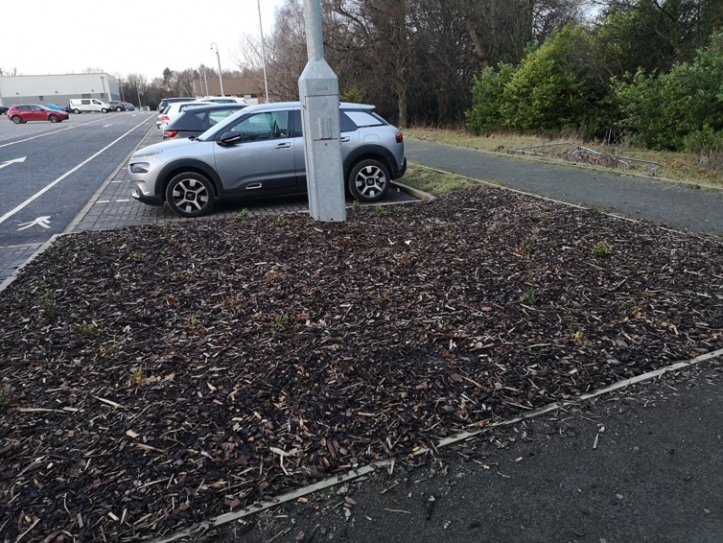
Practical examples – Green Activity Trail
More people to
move more often,
in a more
engaging way.

Slide 19
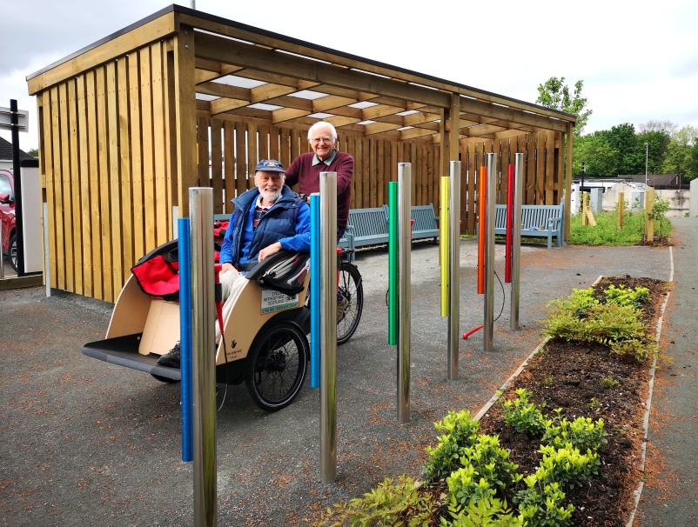
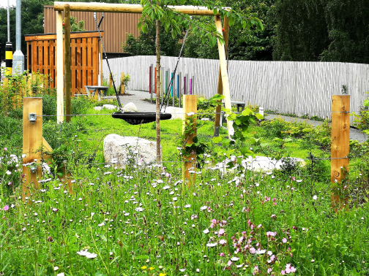
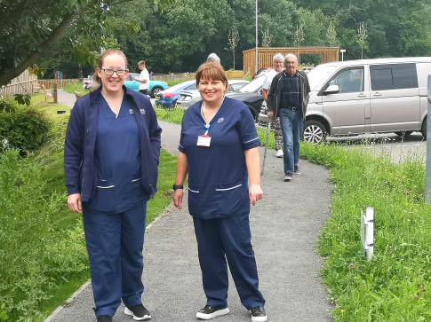
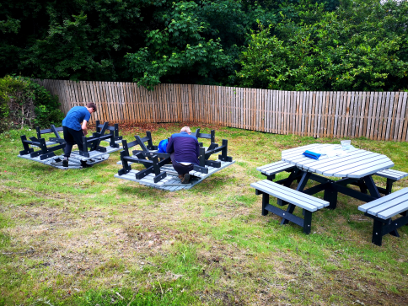
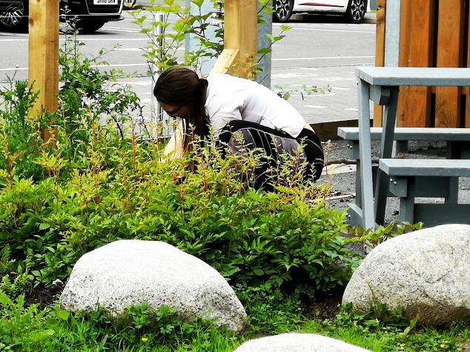
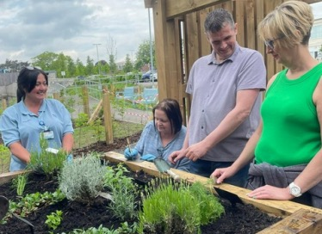
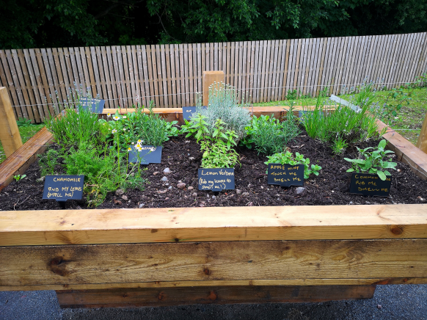
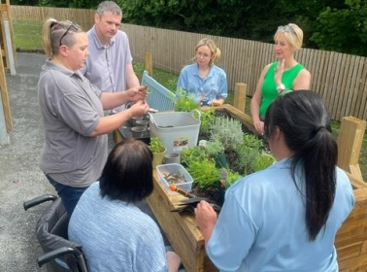
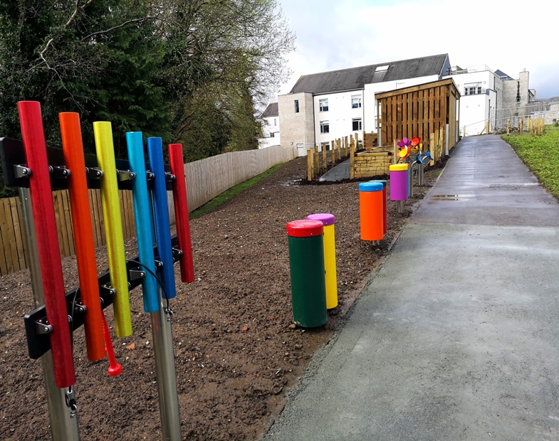
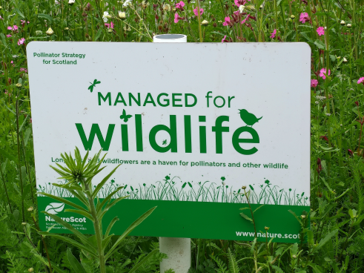
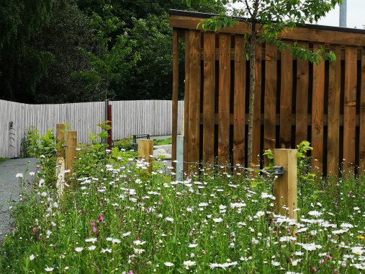
Practical examples – Green Activity Trail

Slide 20
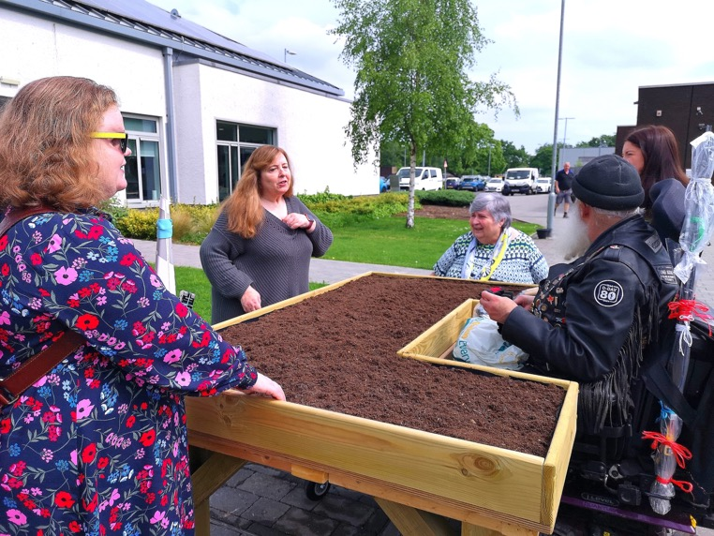
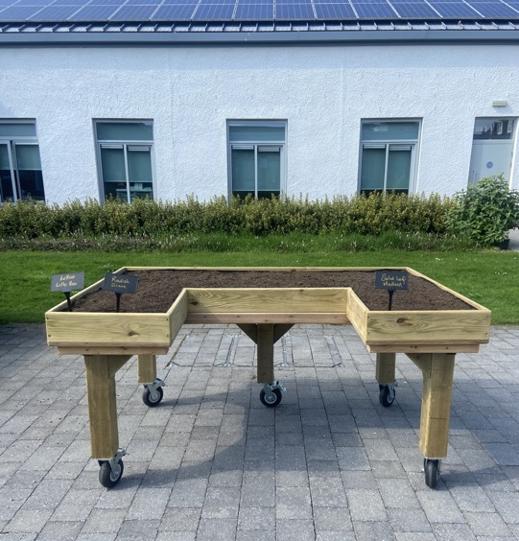
Practical examples - Accessibility planter
CSHSCP
Estates
ReUse Hub
Access Stirling
TCV
Local school
Stirling University
RHS
RVS

Slide 21
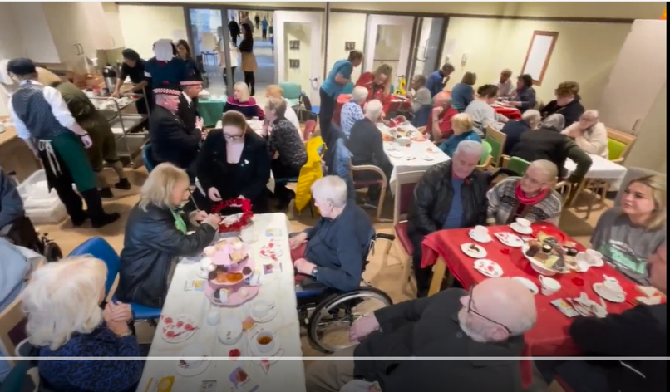
Practical examples - Bellfield Big Tea Party
CSHSCP
ReEngage
RVS
TCV
Bellfield
RHS
Argyll & Sutherland
FTfE
+++

Slide 34
Our Journey to the
Aberdeen City Vaccination & Wellbeing Hub
Aberdeen City Health & Social Care Partnership
Caroline Anderson
Programme Manager, Vaccinations & Wellbeing Hub, ACHSCP
and
Stephen Main
Lead Nurse for Vaccinations & CTAC, ACHSCP

Slide 35
Session outcomes
An increased awareness of how to create collaborative partnerships which enable people to access earlier support, self management tools & social engagement to improve their health & wellbeing.
Increased awareness of making every opportunity count to support early intervention & prevention with an audience of people attending the hub.
Exploration of some of the practical mechanisms used, barriers and solutions that arise when implementing positive change.

Slide 36
How did we get here?
2018
2020/2021
COVID 19 Pandemic
Mass Vaccination Programme
March 2022
Vaccine Transformation Programme Complete
Relocated to City Centre (John Lewis)
Vaccine Transformation Programme (VTP) Commenced – Moved from GP to Partnerships
P&J Live – Exhibition Centre
June 2023
Relocated to Bon Accord Shopping Centre Unit – Open on 19th June

Slide 37
Our Aim
Create a Health & Wellbeing Hub which delivers an easily accessible location where a range of health, social care and voluntary organisations work together to meet local need, improve health & wellbeing outcomes and reduce pressure on primary & secondary Care.

Slide 38
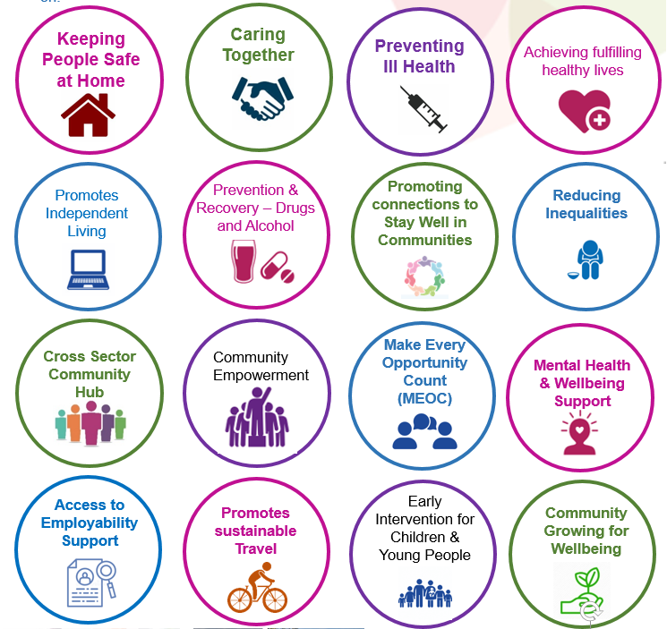
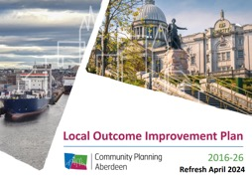
Our Priorities

Slide 39
What did we do?
Scoping Exercise to identify key priorities.
Needs Assessment – Public Questionnaire
Staff Engagement at Training Days & Working groups
Staff Training in Making Every Opportunity Count (MEOC)
Made Connections – with Health, Social Care Voluntary & Third Sector Organisations
Designed Layout of Hub – Inclusive & flexible to support clinical and community spaces
Recruited Volunteers for community cafe
Communication Strategy
Gathered Data & Feedback for Evaluation
MEOC

Slide 40
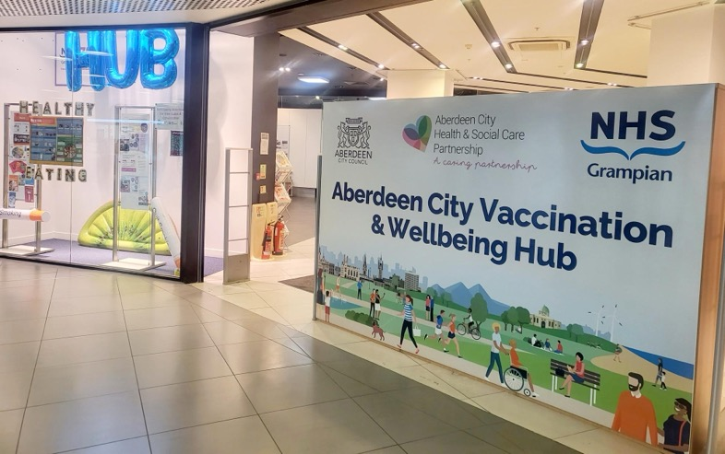
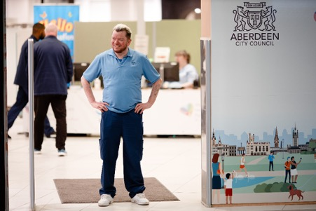
Let’s Take you on a Tour….

Slide 41
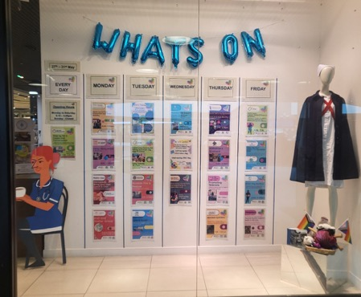
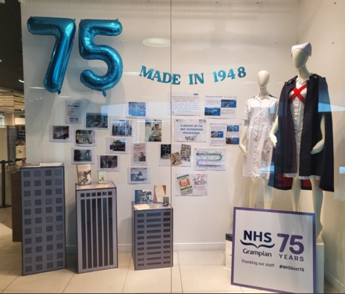
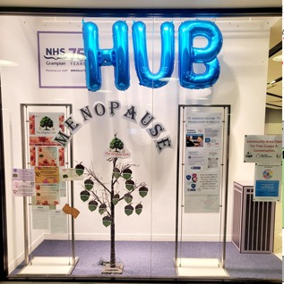
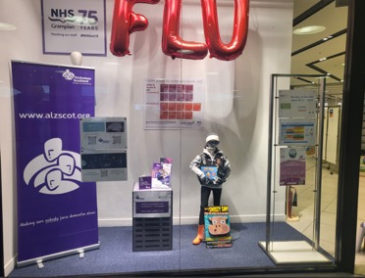
Window Displays

Slide 42
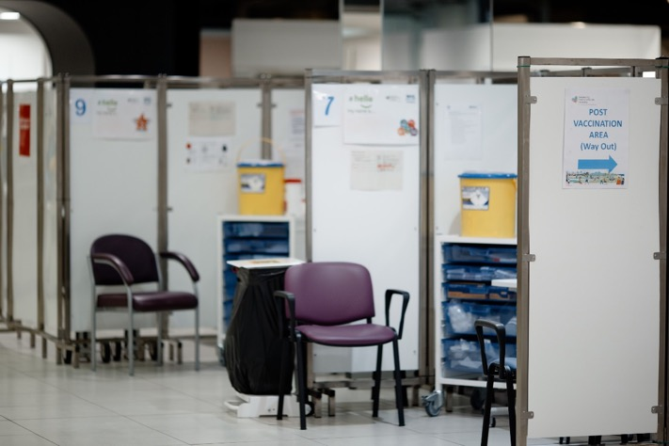
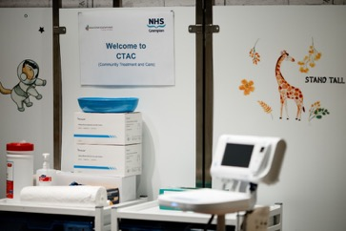
Clinical Space

Slide 43
Community Space

Slide 44
Workshop Space

Slide 45
Wellbeing Groups

Slide 46
Community Health Information

Slide 47
Learning Disabilities Week 2024

Slide 48
Over 70 Community Partners
Notes:
Mental Health & Wellbeing
Recovery from Addictions
Cost of Living Support
Independent Living Employability
Unpaid Carers Support
Safer Mobility
Home Safety
Women’s & Men’s Health
Health Conditions

Slide 49
Targeted Public Health Promotions Campaigns & Social Media

Slide 50
Clinical Services at the Hub
Community Treatment & Care (CTAC)
Other Clinics & Health Checks
Vaccinations
Pre School Drop Ins
School Catch Ups
Blood
Tests
Vitamin B12
Injections
Health Visitor Health Checks
Community Respiratory Clinics
Spina Bifida Health Checks
Adult Routine & Non Routine
Flu & COVID
Chronic Disease Management
Coming Soon….
Learning Disability Health Checks
Atrial Fibrillation Health Checks

Slide 51
Collaborative Working
Notes:
All costs associated with operating the vaccination and wellbeing hub were met within the existing revenue budget

Slide 52
Making Every
Opportunity Count (MEOC)

Slide 53
Making Every
Opportunity Count (MEOC) – 6 Week Period
1517
MEOC
Conversations
40% (593)
provided with Literature
16% (244) signposted to Services

Slide 54
Getting the Best Start in Life – New Development
Summer Activity Clinics – Increase Uptake
Based on Pilot from Merseyside in 2018 to increase childhood vaccine uptake.
Co-produced with Health, Social Care & Voluntary Organisations
Inviting Families and Children Outstanding Vaccine Schedules
Children’s Activities
Voluntary Organisations promoting support with Cost of Living, Income, Housing, Employability, Healthy Eating, Sport, Oral Health etc.
To support Children having the best start in life and reducing Child poverty.

Slide 55
Practical Issues - Barriers & Solutions
Infection, prevention & control (IP&C) policies - Use of a non clinical Space for clinical activity
Timescales for change (Pre-COVID procedures)
Timeframe to plan and engage – Initial lease 1 Year
Resistance to Change
Communication & Promotion – Not everyone uses Social Media
Services capacity to engage
Car parking charges
Open plan environment – Noise Reduction
Volunteers

Slide 56
Service Provider Feedback

Slide 57
Public Feedback

Slide 58
Key Points from Evaluation
Focus on Early Intervention & Prevention
Community Space for Social Isolation & loneliness.
Making Every Opportunity Count
Cost Effective
Multi-skilled workforce
Co-located & co-produced services
Networking opportunities
Environmental impact
Accessible
Supports Inclusivity offering access for everyone to receive the same support.
Collaboration to improve inclusivity
LD Week 2024
Continuous Feedback
Connecting Communities
Reduce Barriers by offering drop in for support.
Public - 98% were satisfied with service & 98% felt location was accessible.
Providers – reported 54% of people they engaged with at hub would not have contacted their service otherwise.
Notes:
Footfall quote: Prevention
Focus on Prevention & Early Intervention:
Vaccinations at the hub align with the Scottish National average.
Accessible 6 days/week for drop-ins and community space use.
Community space for workshops addressing social isolation and loneliness.
Health Information point with resources (e.g., Period Products, Condoms, BBV Home testing kits).
MEOC Conversations: Enhanced staff knowledge for effective signposting.
Known as a "Warm Space" for social interaction and support.
Current Development – Childhood Prevention & Early Intervention
Summer Holiday Activity Clinics (July-August 2024):
Collaboration with Pre-school Immunisation Team, ACC Children’s Services, PEEP, Health Visitors, Home Start, Childsmile, and others.
Focus on cost of living, income, housing, healthy eating, and oral health to support child wellbeing and reduce poverty.
Effective
Feedback: 98% satisfaction and accessibility reported by 659 respondents.
Budget: Costs met within existing revenue, anticipated same for 2024/25.
Collaboration: Voluntary organizations benefit from networking opportunities.
Environmental Impact: Reduced trips by offering over 60 services under one roof.
Accessibility: 54% of people engaged wouldn’t have otherwise contacted services.
Workforce: Multi-skilled workforce enhances cost efficiency.
Inclusive
Accessibility: Easy access by bus, train, and car; all services on one level.
Support for Hearing Impairments: Portable loop system, collaboration with NESS for BSL-assisted clinics.
Translation Services: Use of language line, links with GREC.
Community Engagement: Hosting GREC workshops, collaborating with local groups to promote inclusivity.
Learning Disabilities Week: Safe, welcoming environment with positive feedback from over 100 attendees.
Meets Need
Feedback Implementation: Collaborated with Harlaw Academy to develop and implement feedback mechanisms.
Barrier Reduction: Drop-in support available from over 60 voluntary organizations.
Community Connections: Sharing information through Wellbeing Walls and digital folders to promote local group connections.

Slide 59
By fostering a collaborative and inclusive environment, the hub effectively meets the needs of the community, ensuing that support is available early for all. This success highlights the value of integrated care and community centred approaches in creating a healthier and more resilient population.

