Slide 1
Saving and Improving Lives
Clinical Research in our NHS

Slide 2
SPEAKER
Fiona Fleming

Slide 3

Clinical research is the single most important way healthcare is improved – by identifying new means to detect, diagnose, treat and prevent disease.

Slide 4

Today
Session outcomes
Understand research is an essential part of an effective, modern NHS
Understand the infrastructure in place across Scotland to support clinical research
Learn more about the UK vision for clinical research and the subsequent benefits this will bring to NHS
Learn more above research projects happening across Scotland
Focus

Slide 5
A research ready nation
Unified health service
Stable population of c.5 million
Nationwide research infrastructure
Internationally leading clinicians
World-class academics
Exceptional health data and informatics
Focus
“Scotland is home to a vibrant and innovative research environment…world-leading research is led, supported and delivered across our NHS and universities. This has already transformed the lives of patients in Scotland, UK and around the world.”
Jeane Freeman (former Cabinet Secretary for Health), March 2021
Notes:
Before we go into some of the detail of how research is supported and delivered in Scotland. It is important to highlight some of the attributes that make Scotland quite unique when it comes to clinical research.
Our single unified health services is a significant benefit in terms of national approach and collaboration
We have a stable population, low rates of migration and an urban, rural and ethnically diverse population mix which is important for research
and whilst we are unfortunate to have high levels of complex disease in Scotland, it also presents an opportunity to find treatments that can transform the lives of patients, not only in Scotland but also around the world
We have a nationwide research infrastructure that includes Clinical Research Facilities around the country, Topic networks and specialty groups (of which there are 28 covering everything from cancer, diabetes, dementia and mental health through to hepatology, gastrointestinal and reproductive health). We have strong links across universities and industry often referred to as ‘the triple helix’
We are home to world leading expertise in our NHS and universities
We have strong health data and informatics thanks to the CHI number which is included in records each time a person interacts with the NHS. It records entire medical histories from birth (conception) to death, which links with GP data, hospital records, drug prescriptions, morbidity and mortality. In terms of research this is well protected with NHS Data Safe Havens providing a secure platform for use of NHS electronic data including data linkage, feasibility assessments and real world evidence.

Slide 6


Research infrastructure
Focus
NHS Research Scotland is a partnership of Scottish NHS Boards and the Chief Scientist Office (CSO) of Scottish Government.
Supports the placement, setup and delivery of clinical research studies, and innovative research collaborations, from all sectors and therapy areas.
Work to ensure NHS Scotland provides the best environment to support research, and contributes towards a thriving life sciences sector.
Notes:
So now we know the benefits Scotland offers for research, in terms of delivery NHS Research Scotland was set up as a partnership between Scottish NHS Boards and the Chief Scientist of Scottish Government.
It supports the placement, setup and delivery of clinical research studies, and innovative research collaborations, from all sectors and therapy areas, and works to ensure NHS Scotland provides the best environment to support research, and contributes towards a thriving life sciences sector.

Slide 7
Research delivery
Over 1400 studies delivered across NHS Scotland during 2021-22
Over 43,000 people in Scotland took part in vital clinical research trials
78% say it is important the NHS offers participation in health research*
Focus
Notes:
Over the last year this has involved 1400 studies being delivered across Scotland
Over 43,000 in Scotland took part in these trials
And a recent survey showed that 78% say it is important the NHS offers participation in health research – which we will touch on a little more later, and more detail on this survey is at poster RC21 for those interested in learning more.

Slide 8


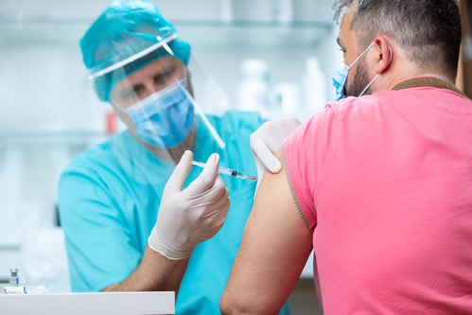

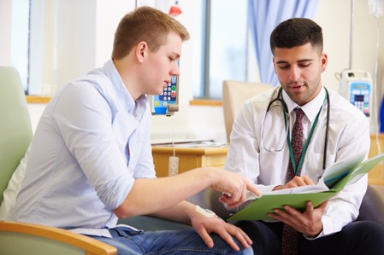
COVID-19 Research
Focus
120+
COVID-19 studies since start of pandemic
Surveillance
how the disease transmits across groups
Understanding
how and why it affects people in particular ways
Treating
Identifying and testing therapeutics to treat people with COVID-19
Preventing
Vaccine development to prevent the disease spreading further
Long term impact
Tackling wider impacts on health, social care and society
Notes:
Important work is ongoing to restore the portfolio of research across Scotland that was impacted by COVID-19 and to ensure Scotland can attract and deliver more research studies for the benefit of patients.
But it is important to highlight just how important Scotland’s contribution to COVID-19 research has been.
Over 120 studies have been delivered across Scotland since the start of the pandemic ranging from
Surveillance – how the disease transmits across groups
Understanding – how and why it acts in particular ways
Treating – identifying and testing therapeutics to treat people with COVID-19
Preventing – vaccines to prevent the virus spreading further
Long term impacts – the wider impact on health, social care and society including mental health, long COVID and many more

Slide 9



COVID-19 Research – Examples
World’s largest randomised controlled trial for COVID-19
Identified the first proven treatment for the virus
Studied DNA of 2700 patients in 208 ICUs
Identified 5 genes associated with severe COVID-19
Notes:
To give some specific examples,
RECOVERY was the world’s largest randomised controlled trial for COVID-19 and open in most Scottish health boards. It identified the first proven treatments for the virus. This included findings that
steroid dexamethasone can cut deaths by up to a third in patients on ventilators
tocilizumab reduces the need for a mechanical ventilator and shortens the time COVID-19 patients spend in hospital
Importantly it also provided vital evidence about which treatments don’t work, so we now know:
no benefit from antibiotic azithromycin
no benefit from convalescent plasma
GENOMICC was led by University of Edinburgh and studied the DNA of 2700 patients across 208 ICU departments around the world. It provided the ability to predict the effect of drug treatments on patients, because some genetic variants respond in a similar way to particular drugs. This is important – the results highlight which drugs should be at the top of the list for clinical testing. Since we can only test a few drugs at a time, making the right choices can save thousands of lives.
These are short summaries of important studies, but more information is available online or by visiting the stand.

Slide 10

COVID-19 Research – Examples
Vaccine Trials
Over 33,000 people in Scotland signed up to the NHS COVID-19 Vaccines Research Registry; and thousands have come forward to participate in trials
NHS Greater Glasgow & Clyde and NHS Lothian trialled the Oxford/AstraZeneca vaccine
NHS Grampian delivered Phase 3 trials of Novavax COVID-19 vaccine
NHS Tayside delivered Phase 3 trials of Janssen COVID-19 vaccine
NHS Greater Glasgow and Clyde and NHS Lothian opens trial of Valneva COVID-19
NHS Grampian delivered Phase 3 trials of Medicago COVID-19 vaccine
NHS Greater Glasgow and Clyde opens Cov-Boost study
Notes:
Research brought about the approval of COVID-19 vaccines which are our lifeline back to normality.
This wouldn’t be possible without the support of the public participating in these trials. When the COVID-19 vaccine registry was launched in over 33,000 people across Scotland signed up to express their interest in participating in these trials.
5 different vaccine trials took place in Scotland.
Oxford/AstraZeneca – was trialled in Glasgow and Lothian
Novavax – was trialled in Grampian
Janssen – was trialled in Tayside and also recruited the first global patient – testament to the strong support from the public
Valneva – was trialled in Glasgow and Lothian – as the only inactivated, adjuvanted (an ingredient to create a stronger immune response) vaccine in clinical development in Europe
These 4 vaccines are all now approved by MHRA with Oxford/AstraZeneca and Janssen part of the vaccine roll out programme in Scotland.
Other trials, which are complete but not yet approved by MHRA for use in the UK
Medicago in NHS Grampian – a plant-derived COVID-19 vaccine candidate
And other studies have been delivered, and continue, looking at the impact of third doses on patients immune responses helping to inform future booster programmes.

Slide 11
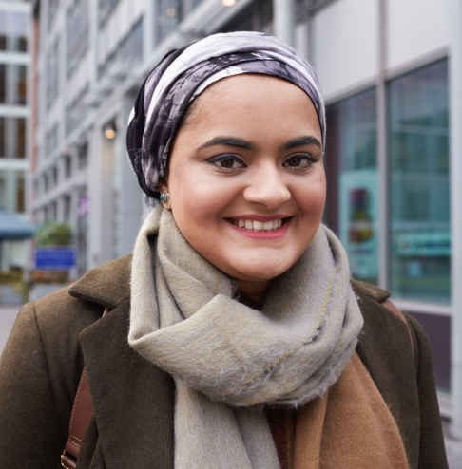
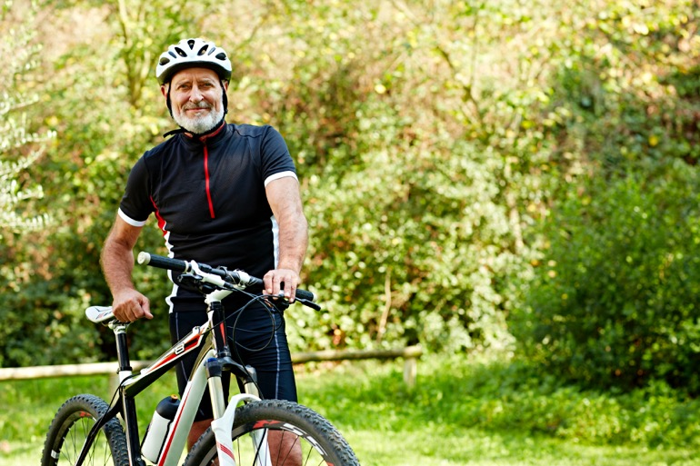

All figures, unless otherwise stated, are from YouGov Plc. Total sample size was 1009 adults. Fieldwork was undertaken between 13th - 17th May 2021. The survey was carried out online. The figures have been weighted and are representative of all Scotland adults (aged 18+).
A survey about awareness and understanding of coronavirus research showed…
#BePartofResearch
Notes:
All of this has been vital work, and COVID-19 has raised profile of research in minds of many….
To better understand this NHS Research Scotland worked with partners across the UK to run a survey on public awareness and understanding of coronavirus research
The sample size in Scotland was 1009 adults aged 18+ and whilst there are many detailed findings that can be shared (some of this is on poster RC21 in the main hall) some key points to highlight….

Slide 12
It is important that the NHS offers participation in health research to everyone as part of routine care
Notes:
There is significant support for research.
When asked if it is important NHS offers participation in research as part of routine care the vast majority agree (78%) so you will see breakdown as:
33% strongly agree
45% tend to agree
14% don’t know
7% disagree
Just 1% strongly disagree

Slide 13
To the best of your knowledge, has your local NHS hospital offered opportunities to take part in health research into Coronavirus (COVID-19)?
Notes:
However whilst the support for research is there, most people don’t know if there hospital offered opportunities to take part in COVID-19 research
65% answered ‘don’t know’
28% answered ‘no’
Only 7% were aware
The reality is almost every health board across Scotland was active in COVID-19 research

Slide 14
To the best of your knowledge, has your local NHS hospital offered opportunities to take part in health research unrelated to Coronavirus (COVID-19)?
Notes:
Asking the same question but for non-COVID-19 research, the responses were broadly similar
73% don’t know if their local NHS hospital offers research opportunities
14% said no it doesn’t
Just 13% said yes it does

Slide 15
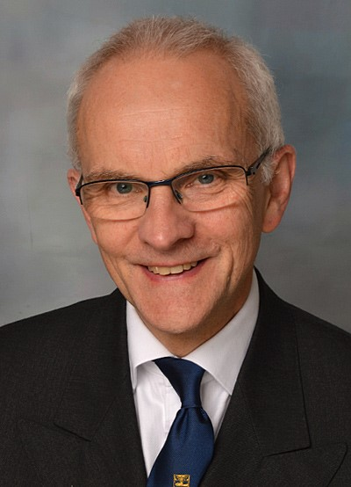
#BePartofResearch
“The COVID-19 pandemic has brought into sharp focus the importance of research. We must build on this momentum, the exceptional collaboration of all partners and strong public support for research to extend these efforts into all areas of heath.
Ensuring patients and the public are aware of research that is taking place around them, and the opportunities to take part is vital to help improve future health care and treatment.”
Professor Crossman, Former Chief Scientist (Health)
Scottish Government
Notes:
This is a challenge that must be addressed and an important message from former Chief Scientist sets out the need to use the lessons of COVID-19, the importance of research in tackling the pandemic and build back a more resilient system….

Slide 16






The Future of UK
Clinical Research
Delivery
Saving and improving lives
Notes:
This work is being supported through an ambitious programme of work across the UK.
The Future of UK Clinical Research Deliver is a four nation programme, and the strategy first launched on 23 March 2021

Slide 17

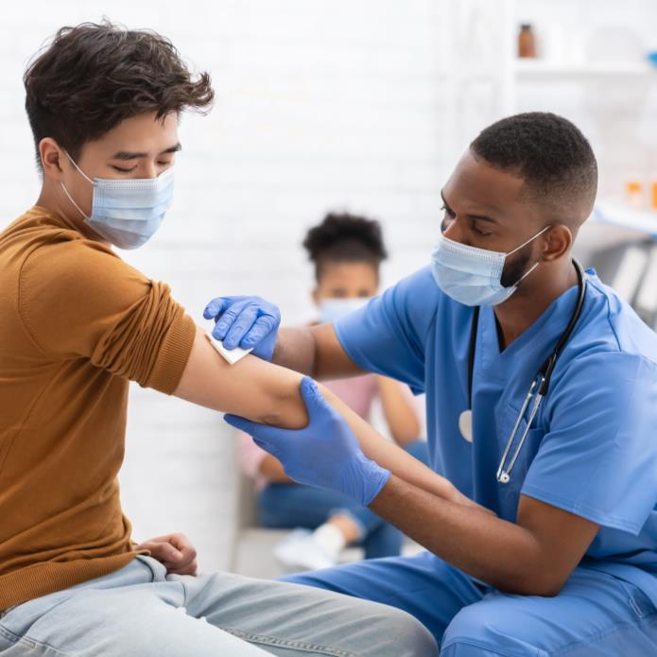
UK Clinical Research Recovery, Resilience & Growth
A UK-wide cross-sector coordinated programme of work that is:
Ensuring the restoration of clinical research activity that was underway pre-COVID
Maximising opportunities to build back a better and more resilient clinical research system
Committed to making the UK the leading global hub for life sciences
Focus is on clinical research delivery
Notes:
The aim is to
Ensure the restoration of clinical research activity that was underway pre-COVID
Maximise opportunities to build back a better and more resilient clinical research system
Make the UK the leading global hub for life sciences

Slide 18












UK Clinical Research Recovery, Resilience & Growth
Notes:
This is a large piece of work and Scotland has worked alongside the UK nations to develop the vision, with input from NHS, regulators, medical research charities and life sciences industry.

Slide 19
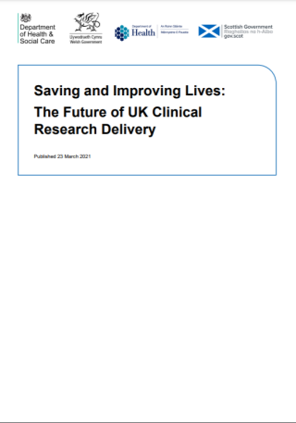
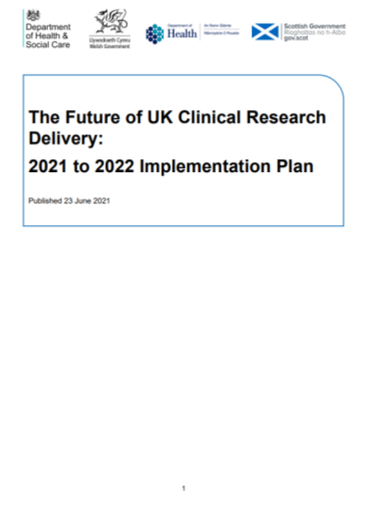
UK Vision and Implementation
Initial work has focused on recovery of research activity and using the lessons learned from COVID to build back a more resilient research system.
In March 2021 the UK government and devolved administrations launched a bold and ambitious vision
to transform the delivery of clinical research in the UK.
This was followed in June by the publication of the 2021 to 2022 implementation plan for the first phase of activity. This plan looks to ensure research will lead to better health outcomes and allow more patients to be involved in, and benefit from, research of relevance to them.
Notes:
As we said, this launched on 23 March 2021 with a vision to transform delivery of clinical research in UK
An implementation plan followed in June 2021 setting out the first phase of activity, and we are now about to publish phase 2 of the implementation plan over the next week or two.

Slide 20
UK Clinical Research Recovery, Resilience & Growth
Phased implementation
Our UK-wide vision for clinical research is being delivered in phases:
SET-UP PHASE:
The vision for the future of UK clinical research delivery was published in March 2021
PHASE 1:
Our underlying action plans and strategies for improvements to be delivered during 2021 to
2022 were published in June 2021
PHASE 2:
Now delivery in 2021 to 2022 is underway, we are setting our sights even higher, publishing detailed plans for the future, which will deliver on our vision and unleash the true potential of UK clinical research.
Notes:
It is essentially a phased programme of work, delivered collaboratively with input across the sector.
The full vision and plans are available to read online or you can visit Stand 42 for fuller information. But in summary….

Slide 21
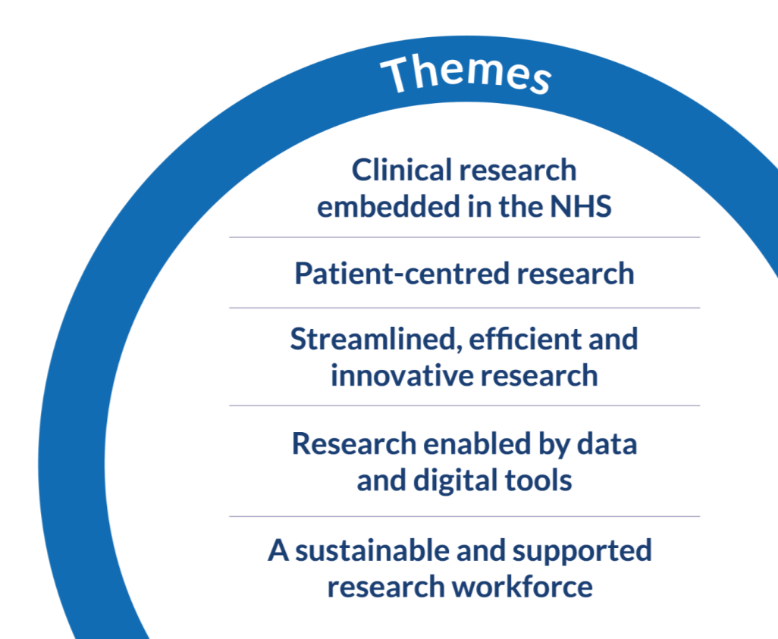

UK Vision
5 overarching themes
Notes:
The vision has 5 overarching themes, which I’ll say a little more about

Slide 22

UK Vision
5 overarching themes
To create a research-positive culture in which all health and care staff feel empowered to support and participate in clinical research as part of their job.
Notes:
As per screen

Slide 23
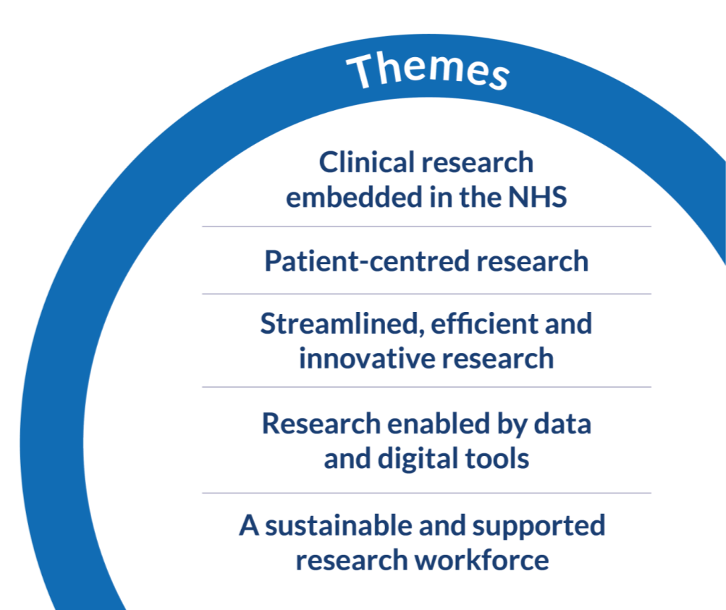
UK Vision
5 overarching themes
To make access to and participation in research as easy as possible for everyone across the UK, including rural, diverse and under-served populations
Notes:
As per screen

Slide 24
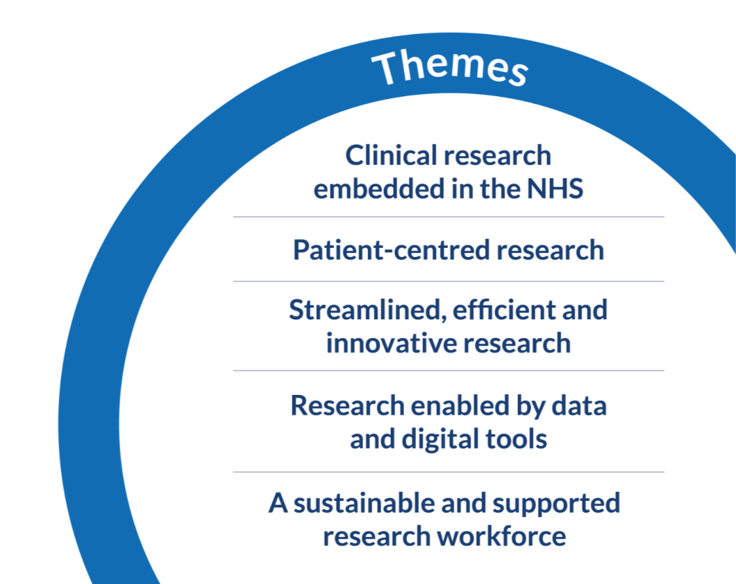

UK Vision
5 overarching themes
So the UK is seen as the best place in the world to conduct fast, efficient and cutting-edge clinical research
Notes:
As per screen

Slide 25
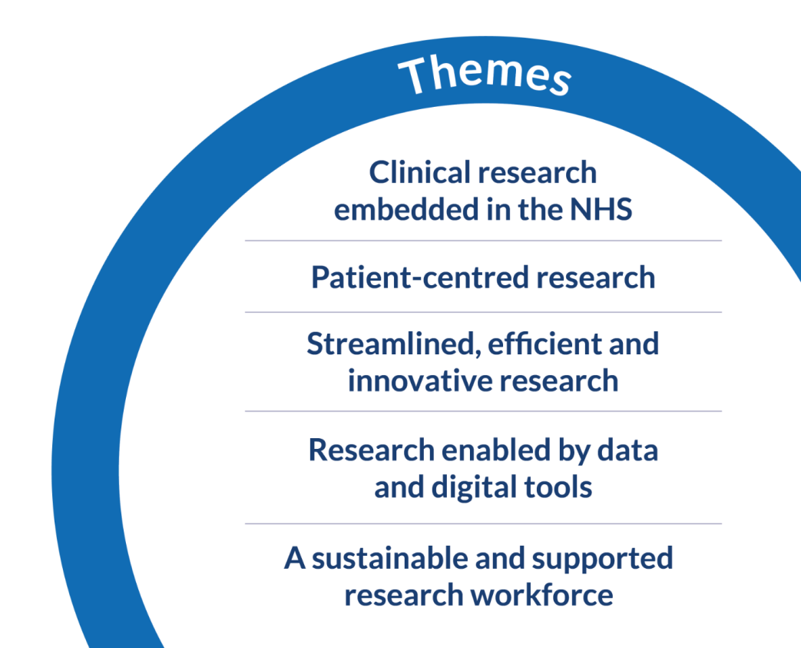

UK Vision
5 overarching themes
To ensure the UK has
the most advanced and data-enabled clinical research environment in the world, which capitalises on our unique data assets to improve the health and care of patients across the UK and beyond
Notes:
As per screen

Slide 26

UK Vision
5 overarching themes
Which offers rewarding opportunities and exciting careers for all healthcare and research staff of all professional backgrounds – across commercial and non-commercial research
Notes:
As per screen

Slide 27
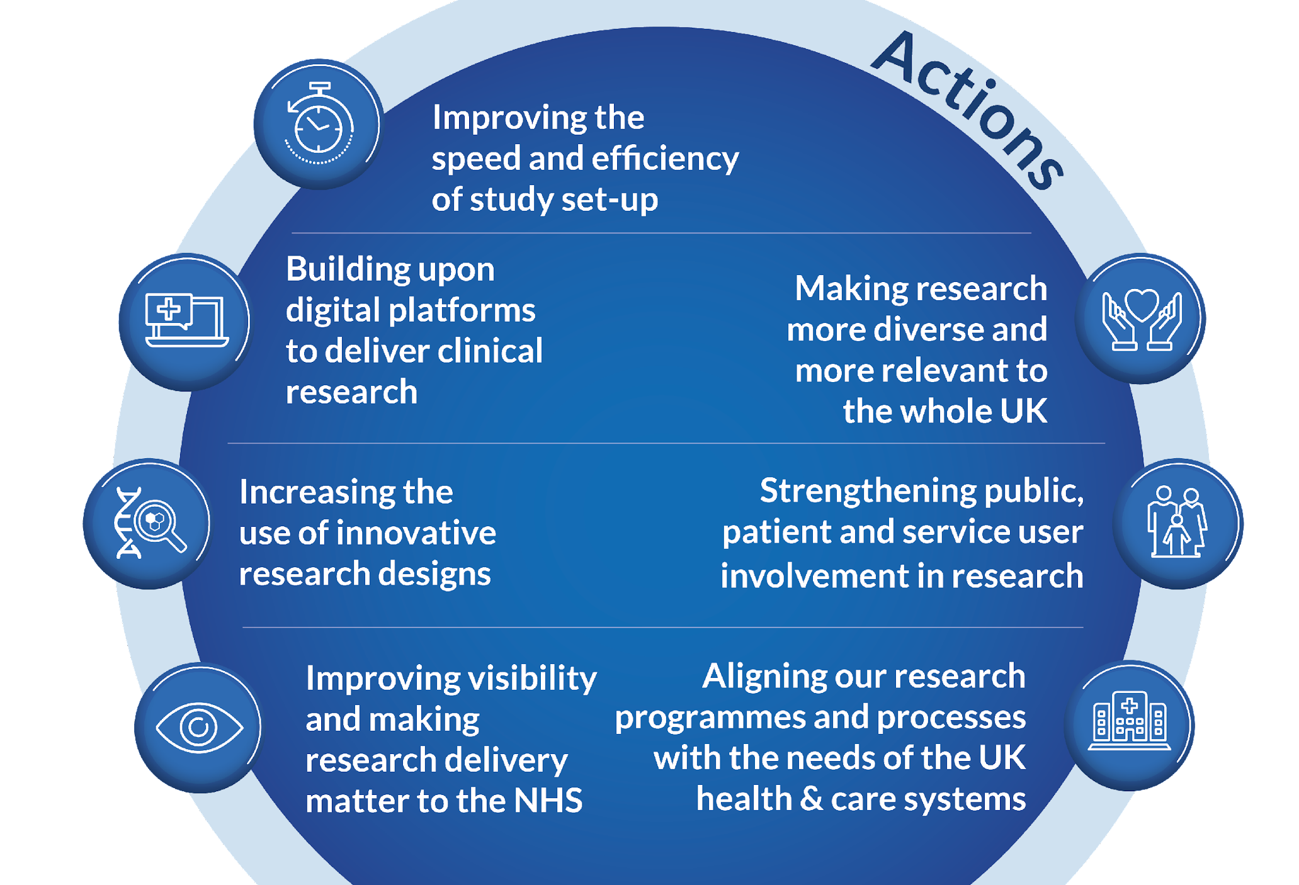







UK Vision
7 areas
for action
To understand more about
each ACTION click on the icon
Notes:
The five themes, are supported by 7 more specific areas of action which are
Improving speed and efficiency of study set up
Building upon digital platforms to deliver clinical research
Increasing use of innovative research design
Improving visibility and making research delivery matter to the NHS
Making research more divers and more relevant to the whole UK
Strengthening public, patient and service user involvement in research
Aligning our research programmes and processes with the needs of the UK health and care systems

Slide 28




Stay in touch
www.nrs.org.uk
@NHSResearchScot
NHS Research Scotland
communications@nrs.org.uk
Visit NHS Research Scotland on Stand 42
Notes:
As you can see there is a lot going on and additional presentations will show some specific examples of research currently taking place in Scotland.
Research does have the power to change and save lives, improve outcomes for patients and drive a modern, innovative NHS.
The CMO Annual Report launched today provides a chapter on research and I’d encourage you to visit the stand, visit our website and get in touch for more information.

Slide 29



Precision Medicine Alliance Scotland
Precision-MS
Professor David Hunt
Head of NHS Lothian Multiple Sclerosis Services, Anne Rowling Clinic
Wellcome Senior Clinical Fellow, University of Edinburgh

Slide 30
Precision Medicine Alliance Scotland programme
Precision Medicine is defined as delivery of the right treatment at the right time to the right patient.
The aim is to stimulate NHS research and delivery of Precision Medicine that will tackle health conditions of major importance in Scotland, including diseases that disproportionately impact on those at risk of socioeconomic disadvantage.
Four research programmes were funded that target the space between research and adoption into clinical practice.

Slide 31
NHS Lothian/University of Edinburgh
PMAS research programmes
Multiple Sclerosis
CI: David Hunt
Liver Disease
CI: Stuart Forbes
Critical Illness
CI: Manu Shankar-Hari

Slide 32
NHS Lothian/University of Edinburgh
PMAS research programmes
Multiple Sclerosis
CI: David Hunt
Liver Disease
CI: Stuart Forbes
Critical Illness
CI: Manu Shankar-Hari

Slide 33
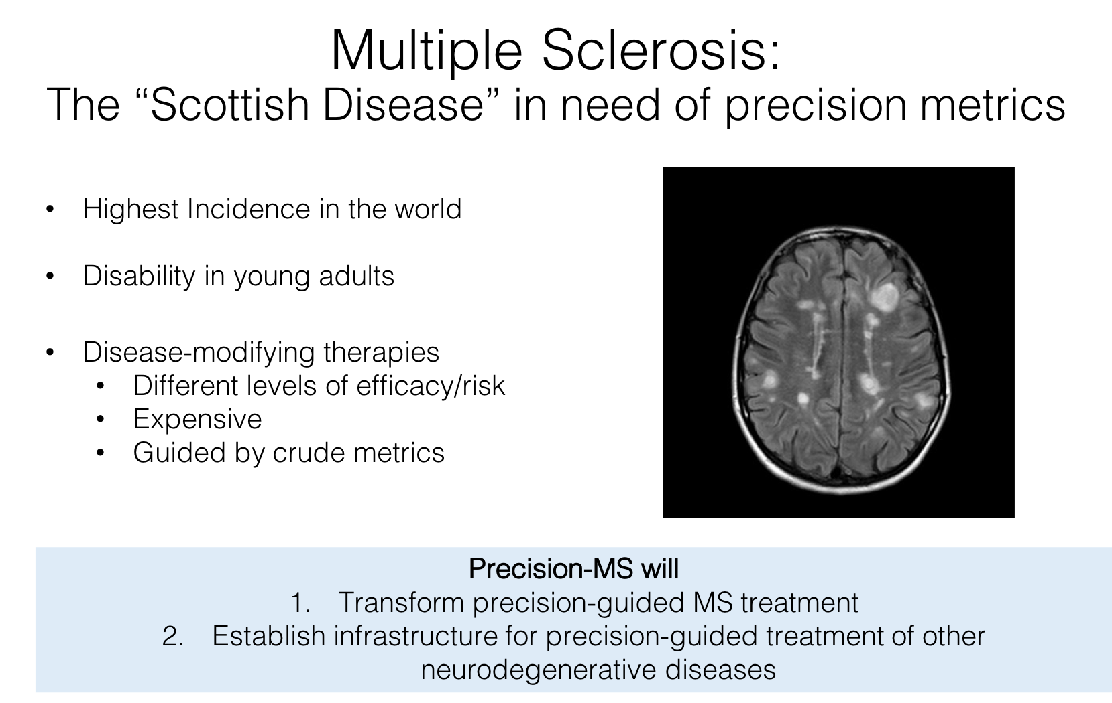

Slide 34
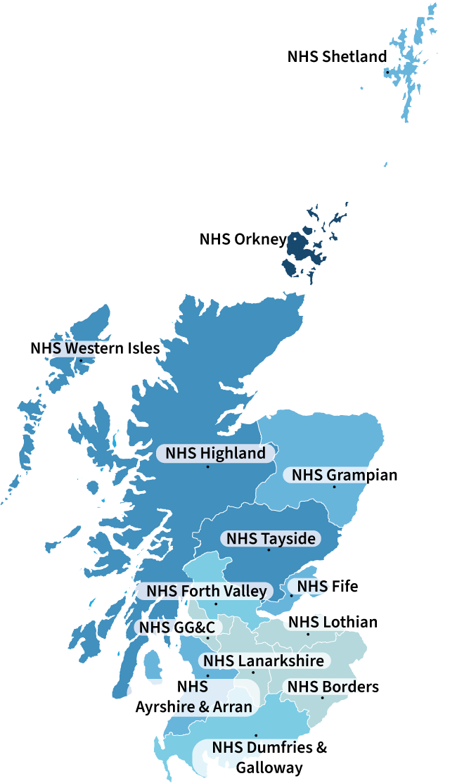
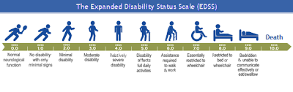
Multiple Sclerosis in Scotland

Slide 35
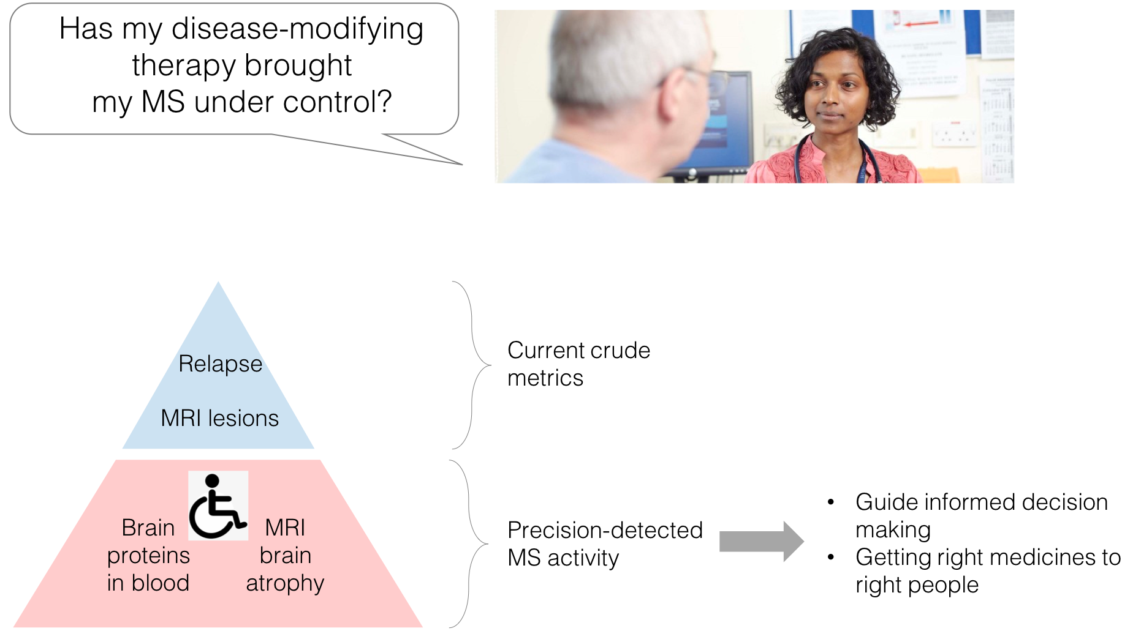

Slide 36
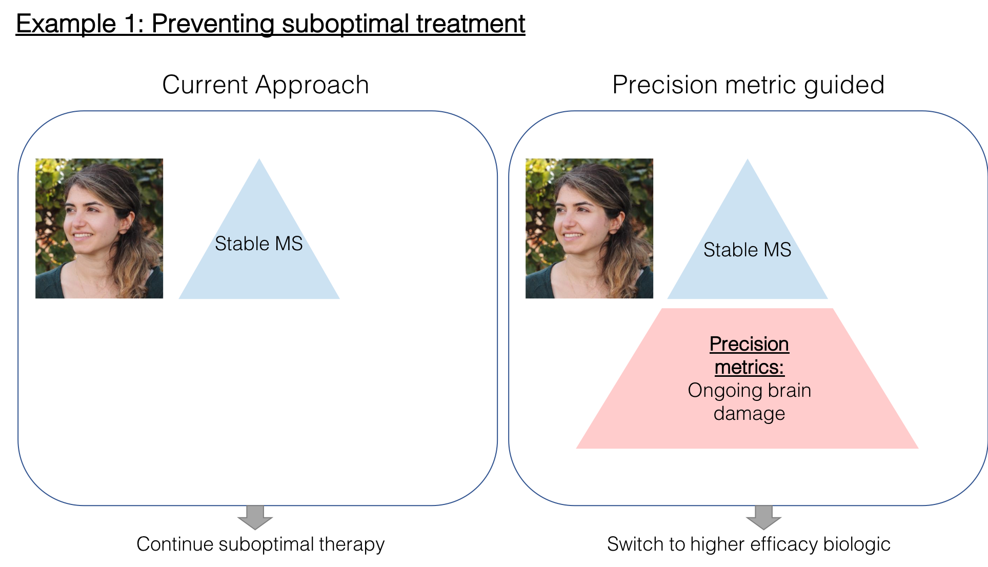

Slide 38
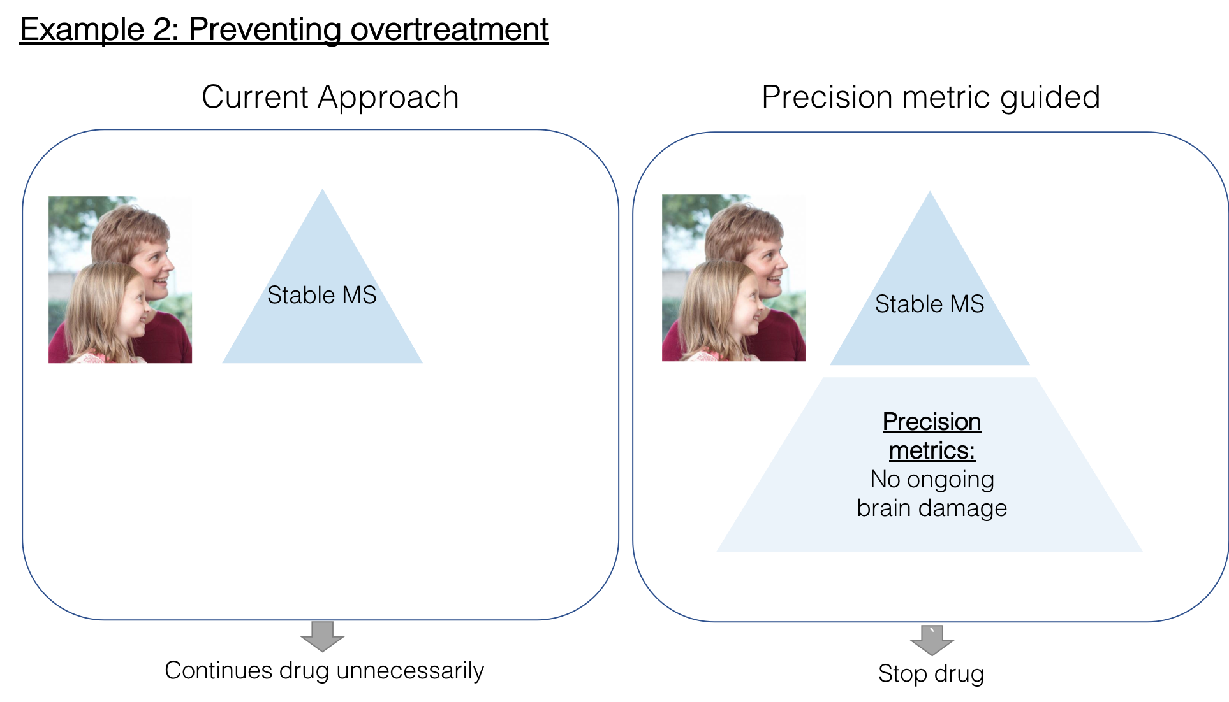

Slide 40
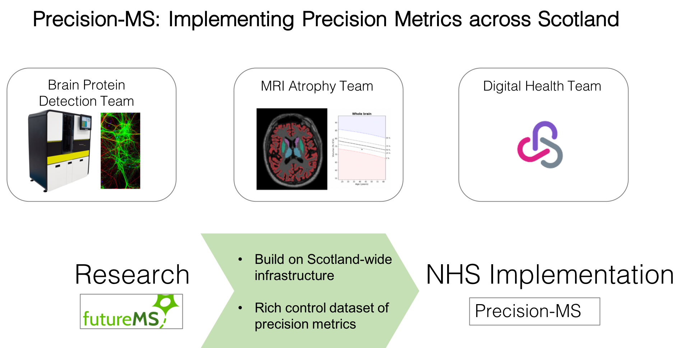

Precision-MS Project
Routine Clinical Care
Research

Slide 41
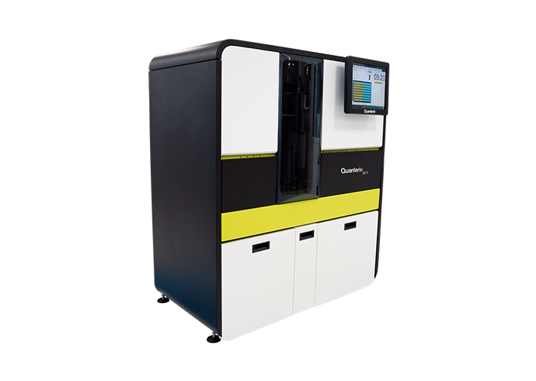

Ultrasensitive detection of neurofilaments in blood

Slide 42
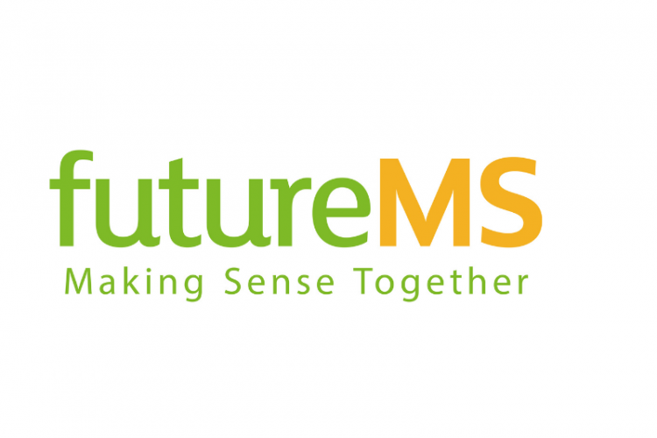
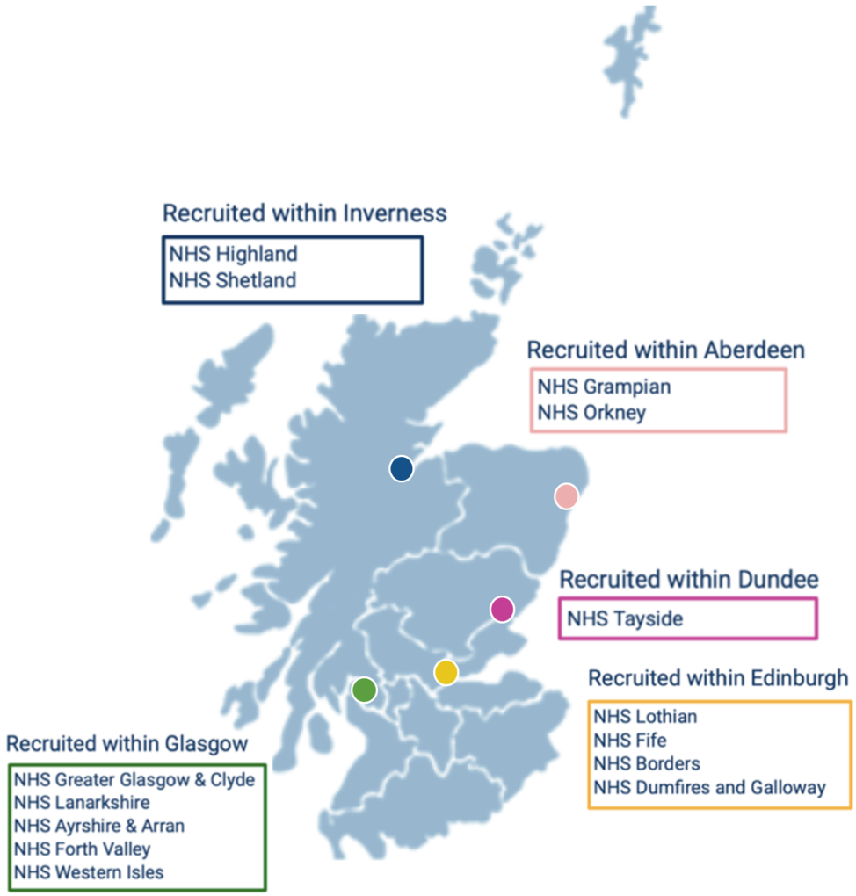
Precision Medicine Scotland: Scottish Funding Council

Slide 43
Blood NFL predicts relapse frequency

Slide 44
Blood NFL predicts relapse frequency

Slide 45
Would patients have chosen different initial DMT if they had known?
Patients who chose no or low efficacy treatments
P=0.04

Slide 46

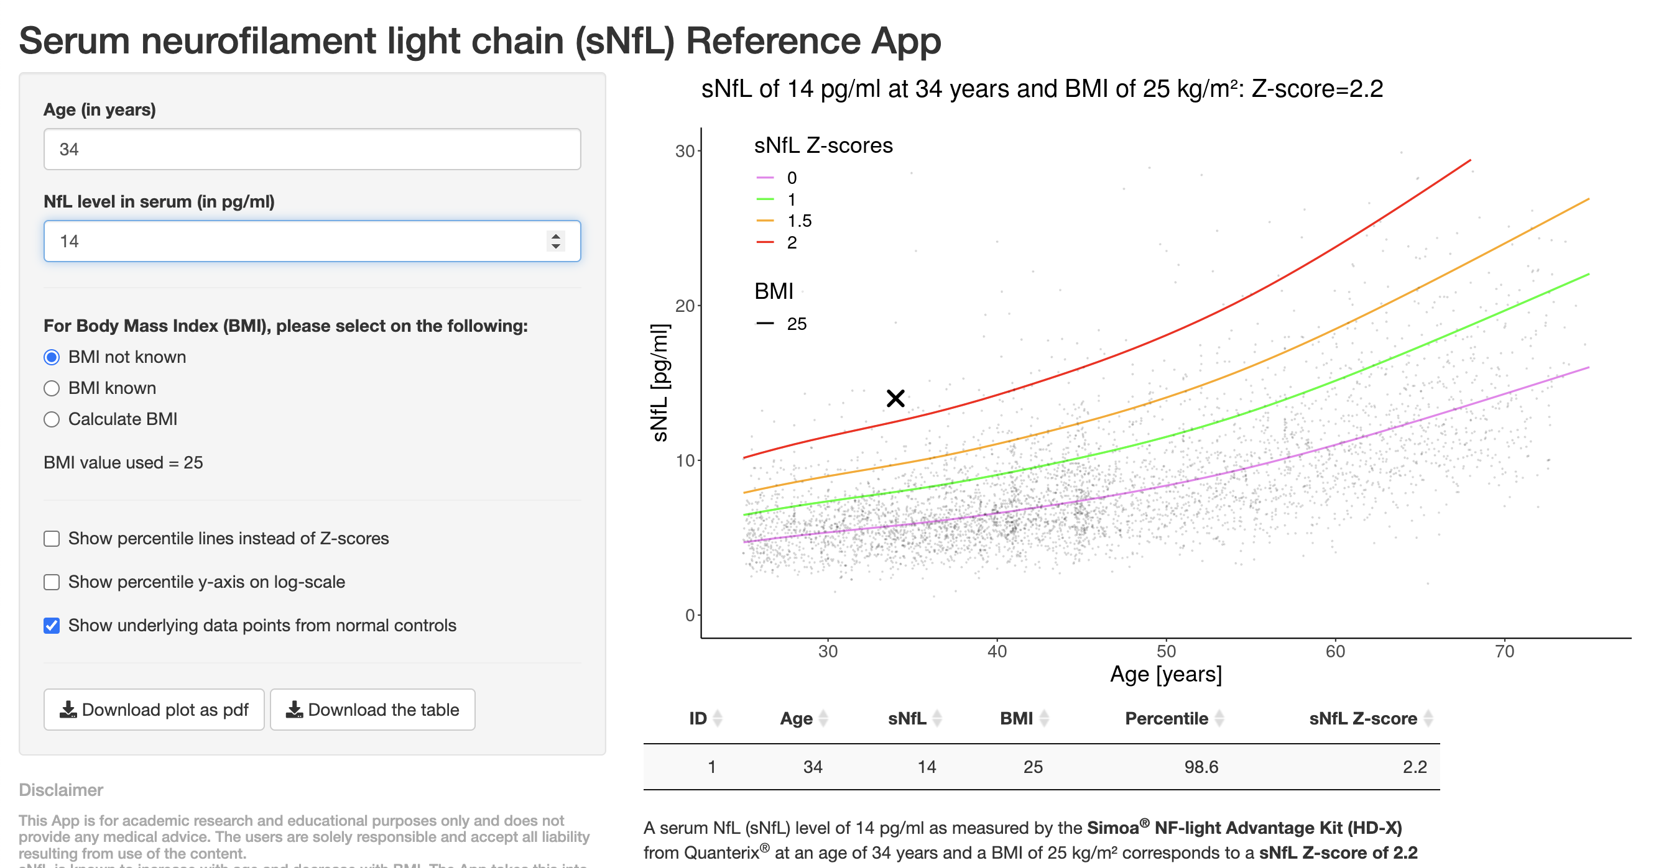

Notes:
Your blood NFL is elevated.
This means you are at double the risk of relapse in the next year compared to a normal NFL
People with elevated NFL have double the risk of brain atrophy
Higher efficacy treatments will reduce this risk

Slide 47
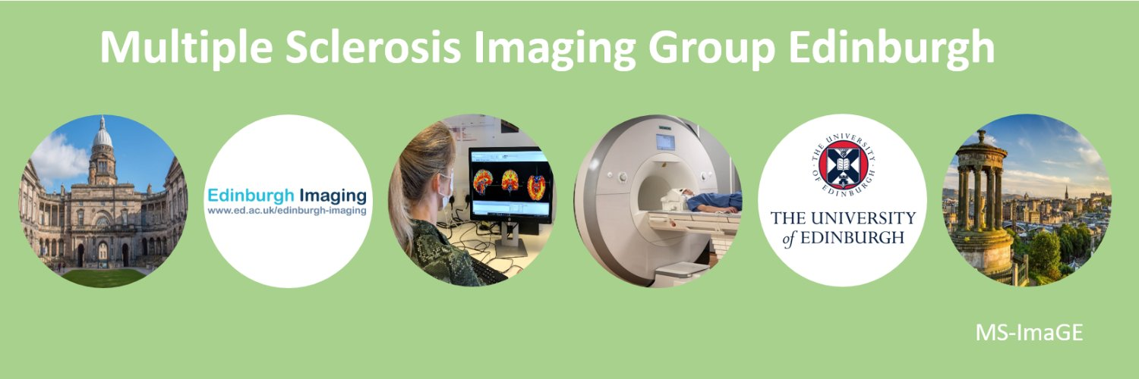
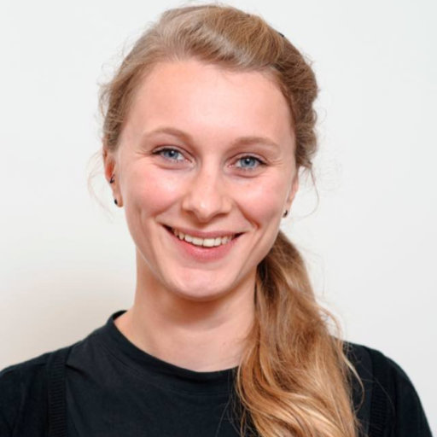
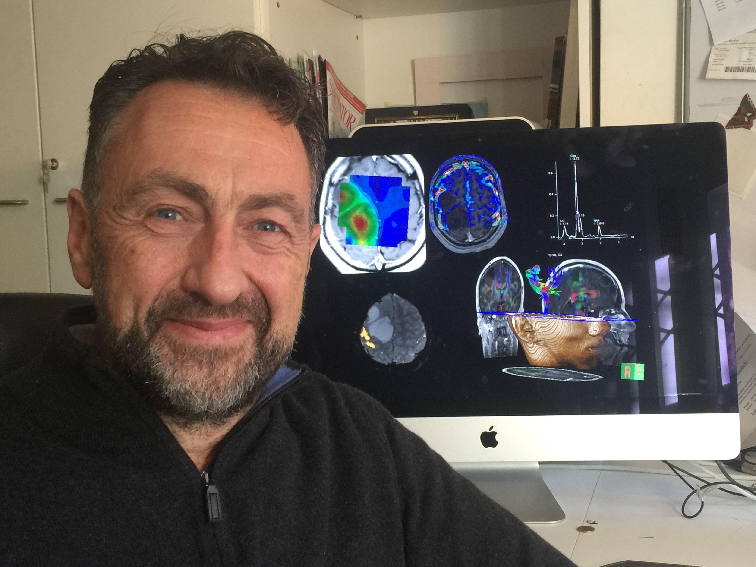
Blood NFL predicts early brain atrophy
Variable | Estimate | P value | P value summary
NfL | -1.188 | <0.0001 | ****
GFAP | 0.2392 | 0.5618 | ns
Tau | 0.08530 | 0.8117 | ns
Age | 0.0002781 | 0.9682 | ns
Prior relapses | -0.1903 | 0.0162 | *
EDSS | -0.09842 | 0.0924 | ns
MRI lesion load | -16.97 | 0.1487 | ns

Slide 48
Precision-MS Project
Routine Clinical Care
Research

Slide 49
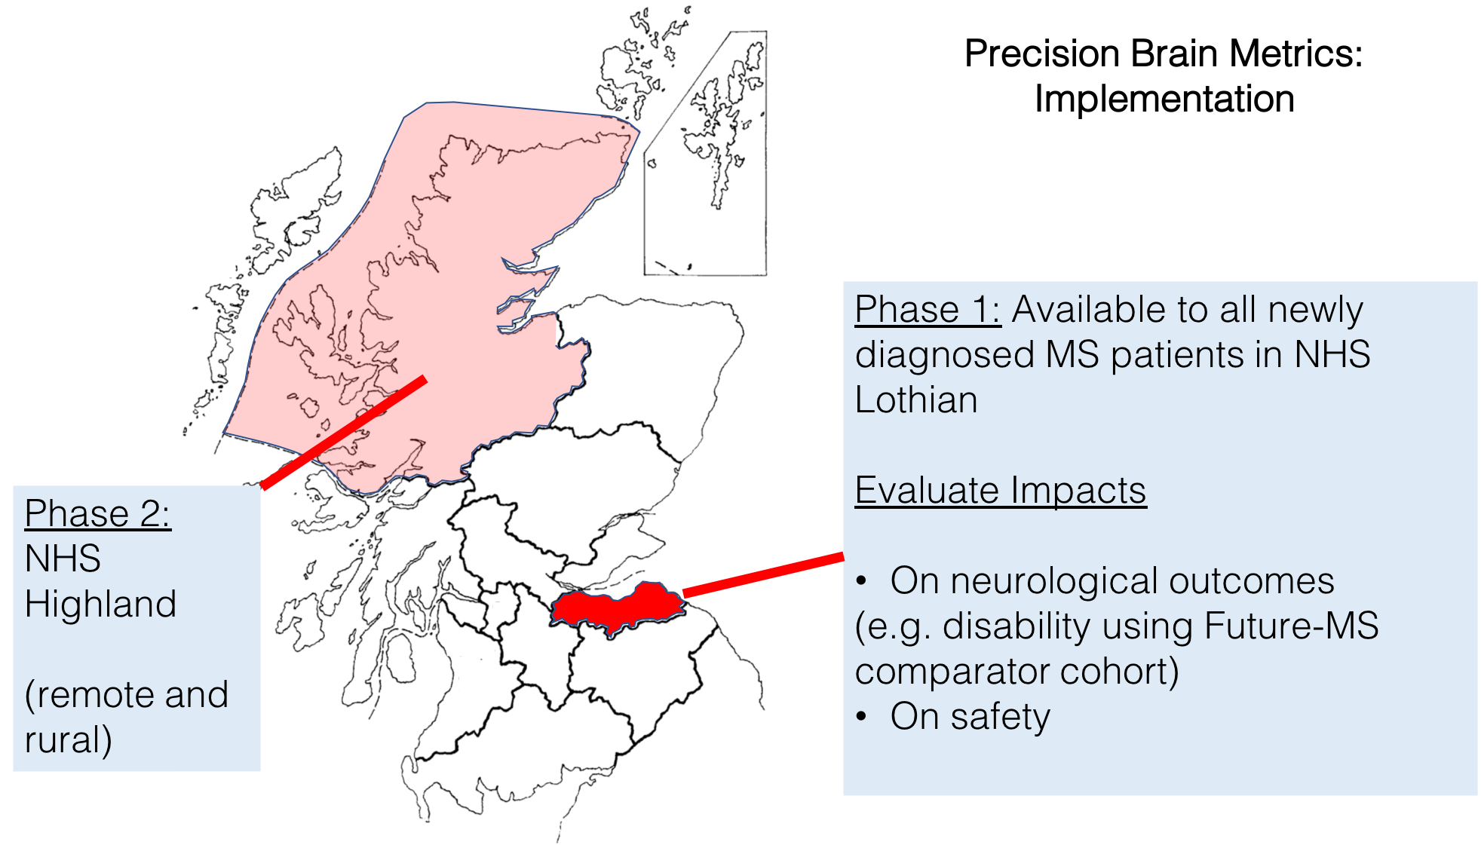

Slide 50
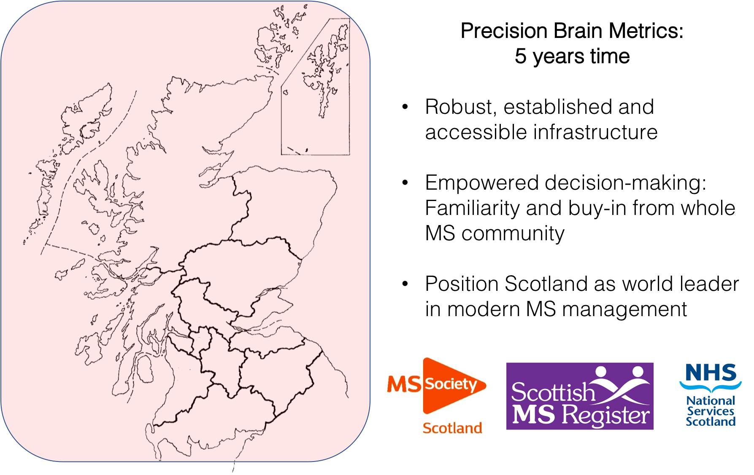

Slide 51
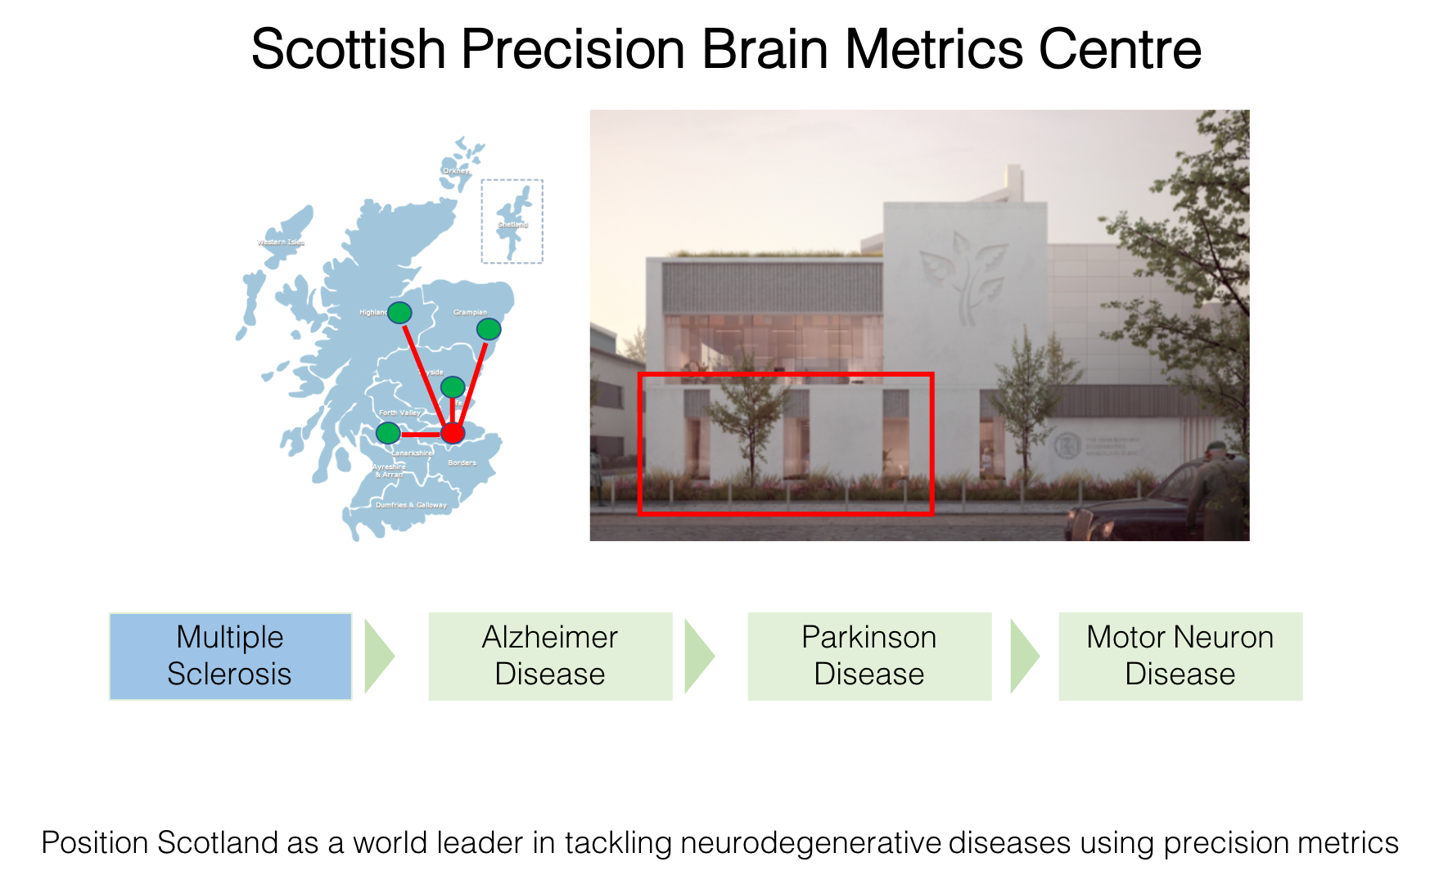

Slide 52
NHS Lothian/University of Edinburgh
PMAS research programmes
Multiple Sclerosis
CI: David Hunt
Liver Disease
CI: Stuart Forbes
Critical Illness
CI: Manu Shankar-Hari

Slide 53
NHS Lothian/University of Edinburgh
PMAS research programmes
Multiple Sclerosis
CI: David Hunt
Liver Disease
CI: Stuart Forbes
Critical Illness
CI: Manu Shankar-Hari

Slide 54
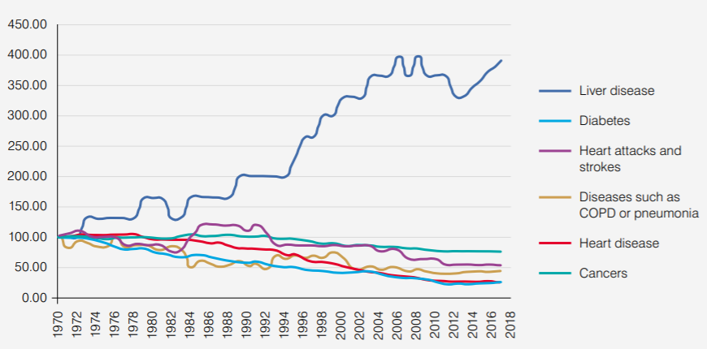
Centre for Precision Cell Therapy for the Liver
Standardised UK Mortality Rate
Scottish chronic liver disease mortality rates are 70% higher than UK average

Slide 55
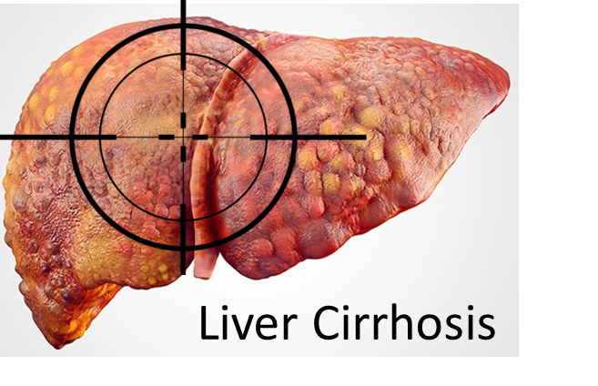
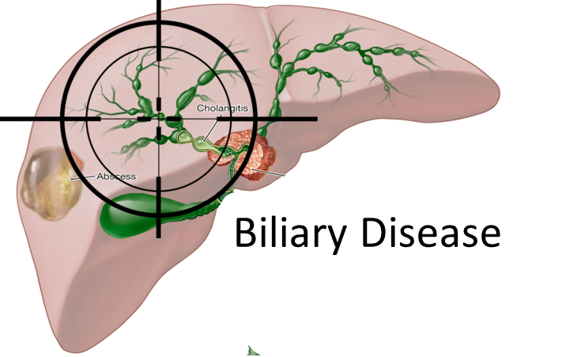
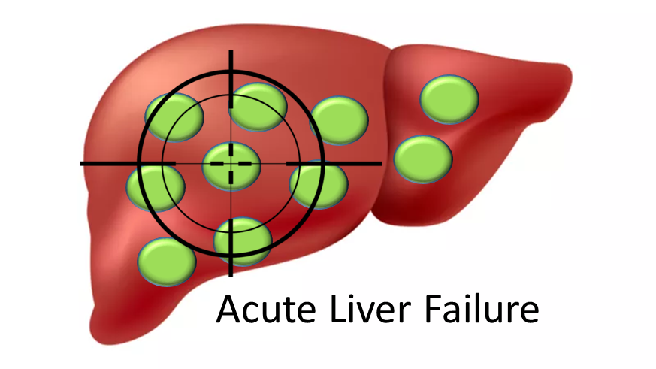
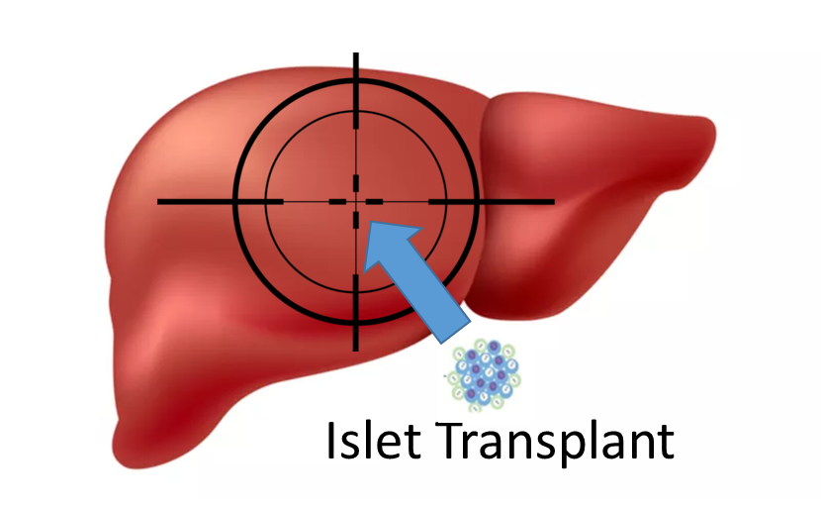
Different diseases need precision approaches
Need: scar break down, regeneration
Need: duct replacement & regeneration
Autologous monocyte derived macrophages
Hepatic duct cells from untransplantable liver
Need: rapid necrosis resolution
Need: less inflammation, increased vascularisation
Allogeneic alternatively activated macrophages
Allogeneic cord derived MSCs

Slide 56
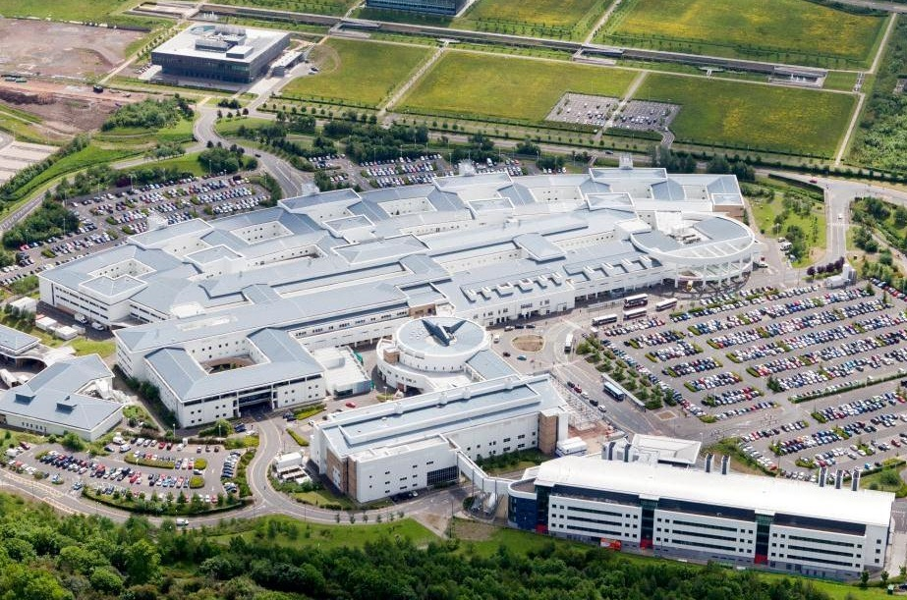
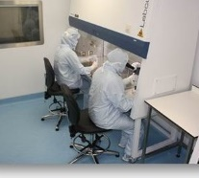


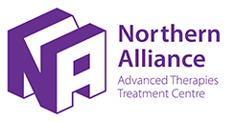



Centre for Regenerative Medicine
SNBTS GMP cell therapy laboratory
Royal Infirmary
of Edinburgh->900 beds
MHRA accredited Phase 1 Unit
Cell Apheresis Unit
Clinical Research Imaging Centre (CRIC)
Hepatic Imaging

Slide 57
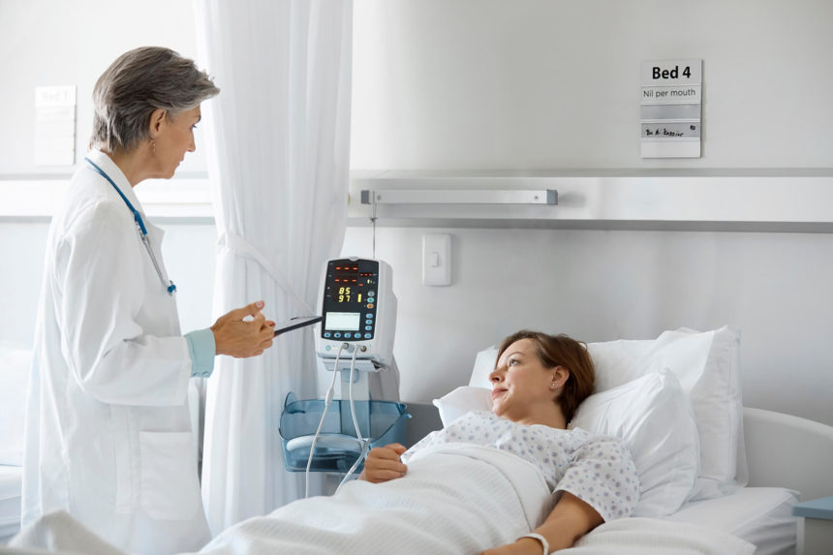
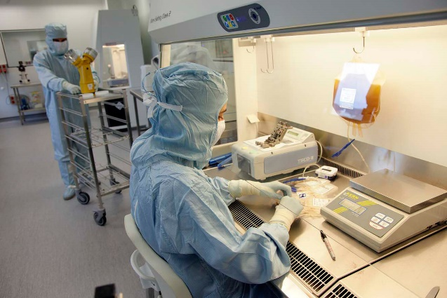

Funding focused on “bottleneck areas” in the delivery of these therapies
Project Manager
Pharmacist
SNBTS resources
Bioinformatician
Trial Manager
Liver perfusion technician
Patient & Public Involvement & Engagement

Slide 58
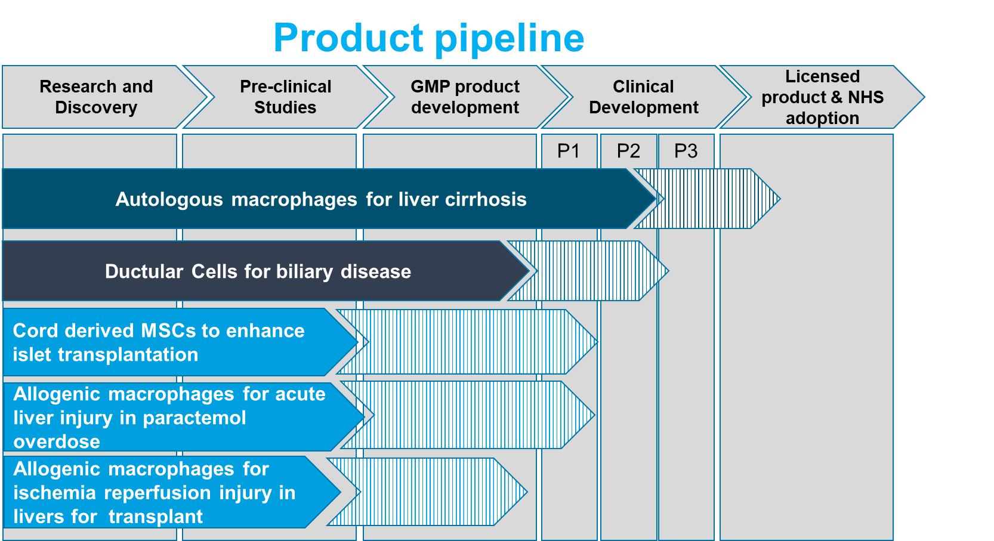
Centre for Precision Cell Therapy for the Liver
Engineer product
Analyse responders

Slide 59
NHS Lothian/University of Edinburgh
PMAS research programmes
Multiple Sclerosis
CI: David Hunt
Liver Disease
CI: Stuart Forbes
Critical Illness
CI: Manu Shankar-Hari

Slide 60

Thanks
Future-MS Team
Precision-MS Team
Consultants, registrars and nurses across Scotland
Funded: Precision Medicine Scotland
Javier Carod Artal (NHS Highland)
Niall MacDougall (MS Register)
Adam Waldman
Siddharthan Chandran
Katy Murray
Peter Connick

Slide 62
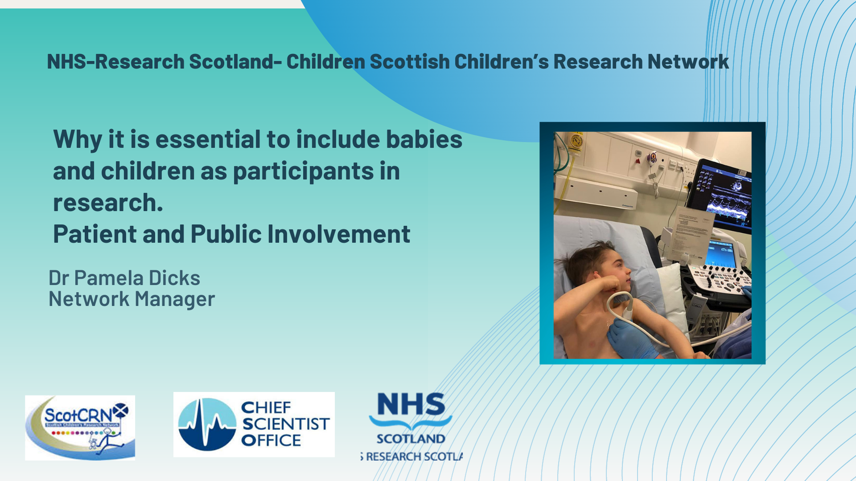

Slide 63
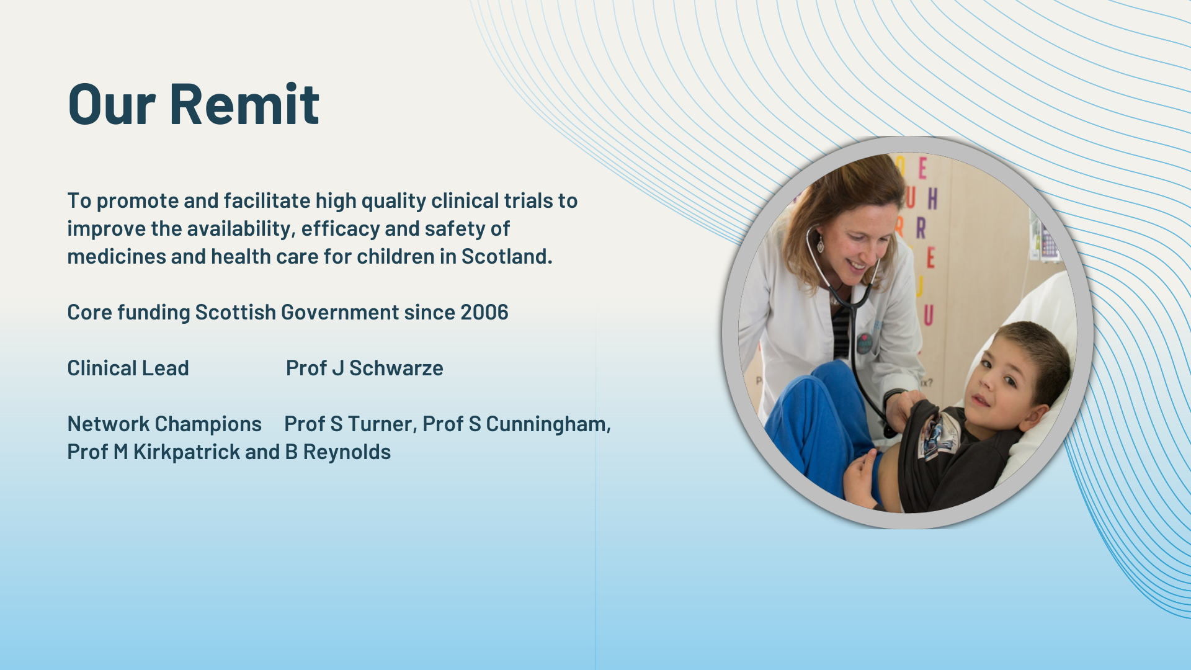

Slide 64
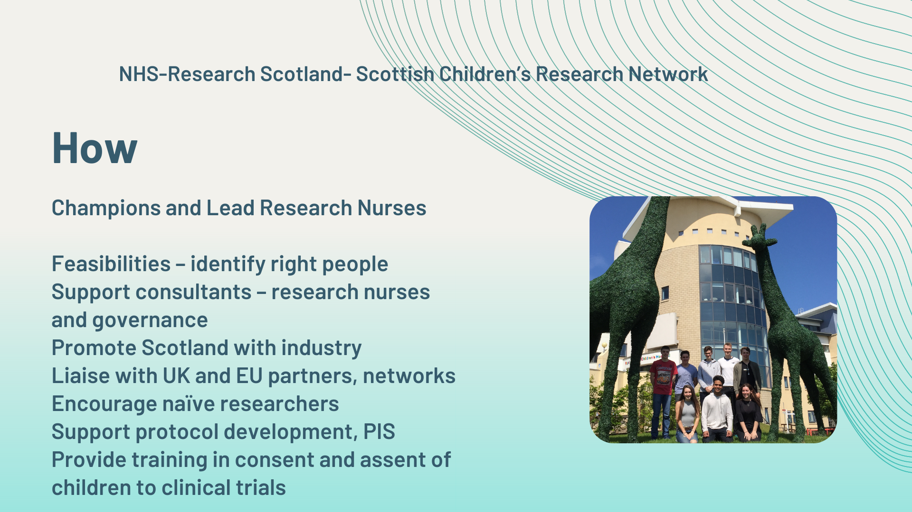

Slide 65
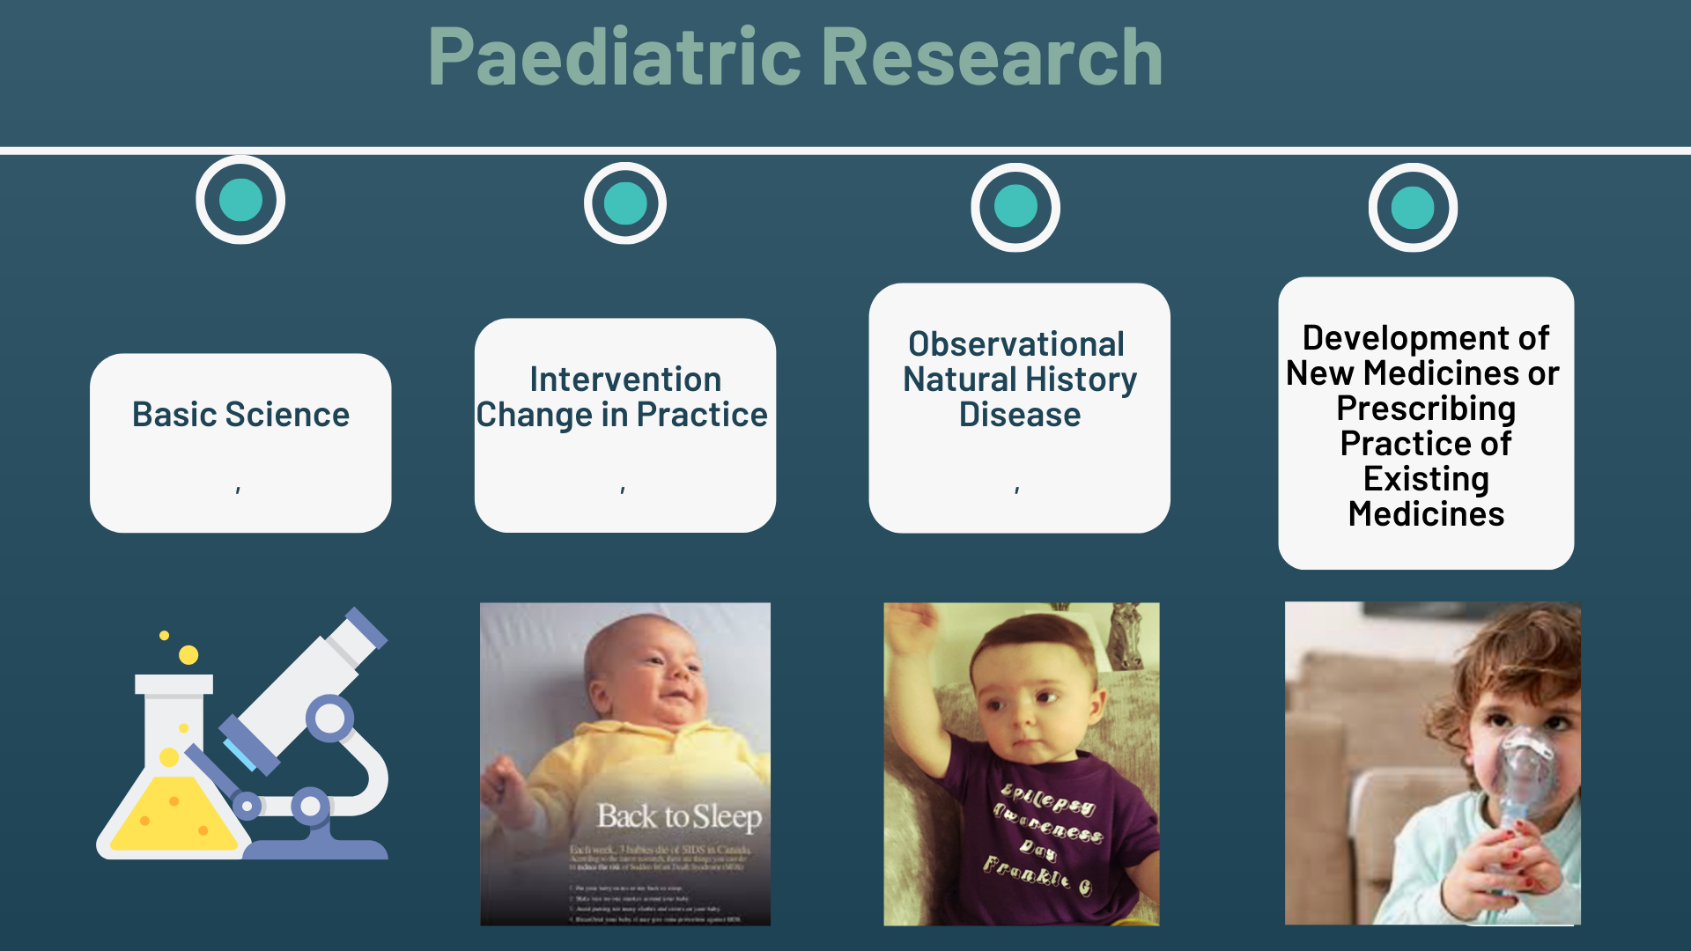

Slide 66
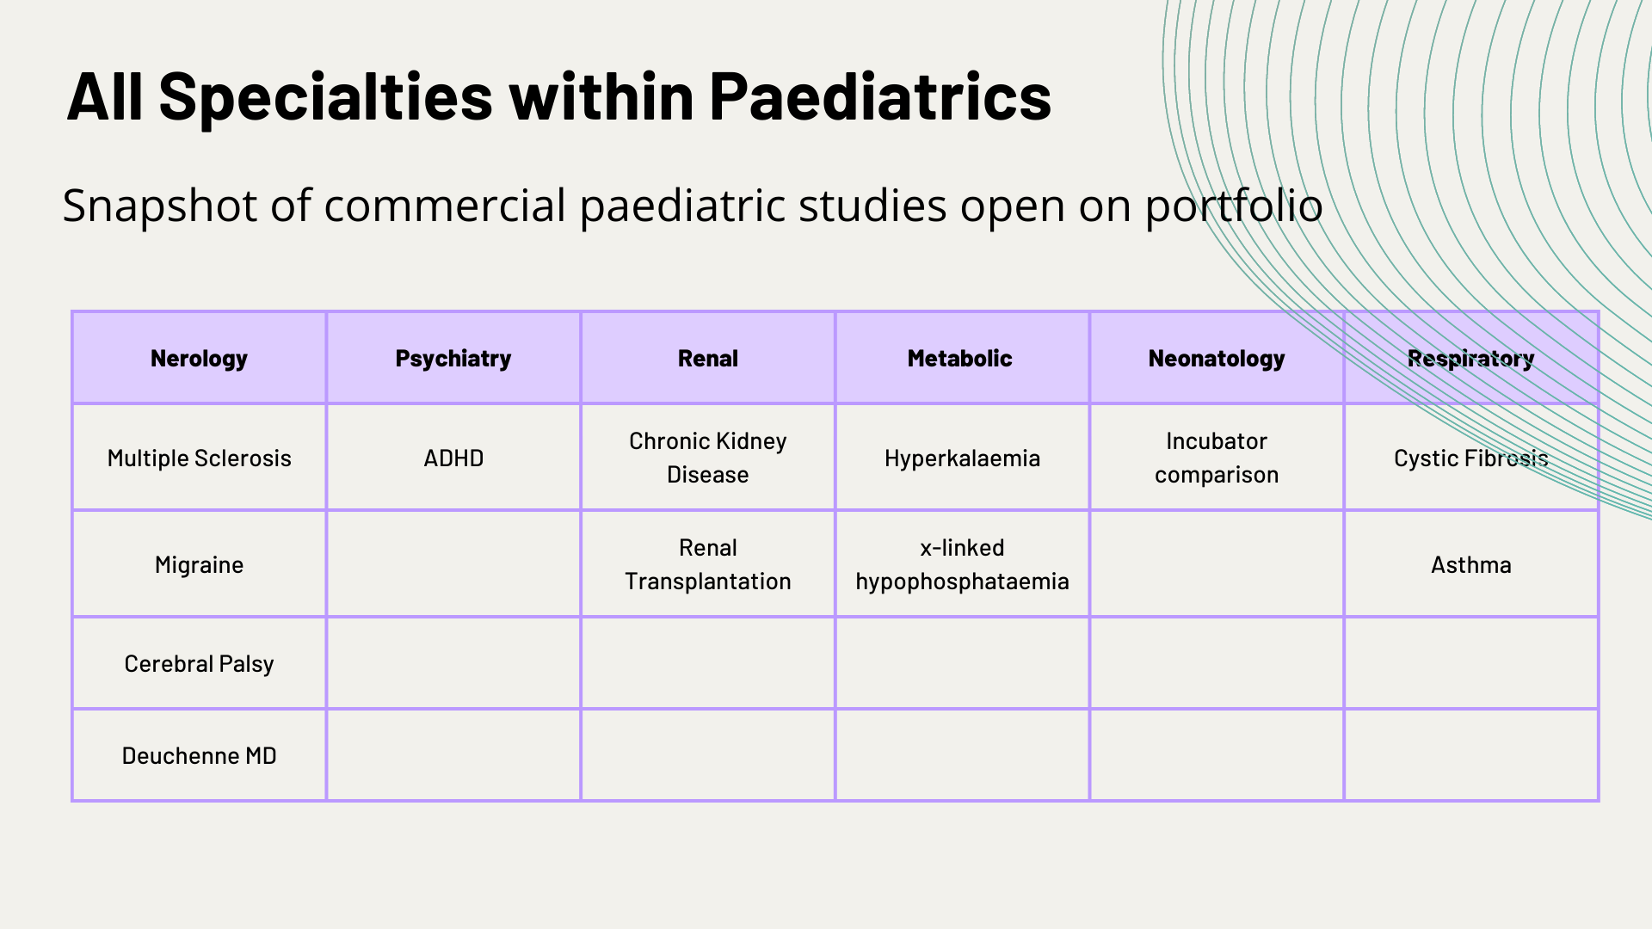

Slide 67
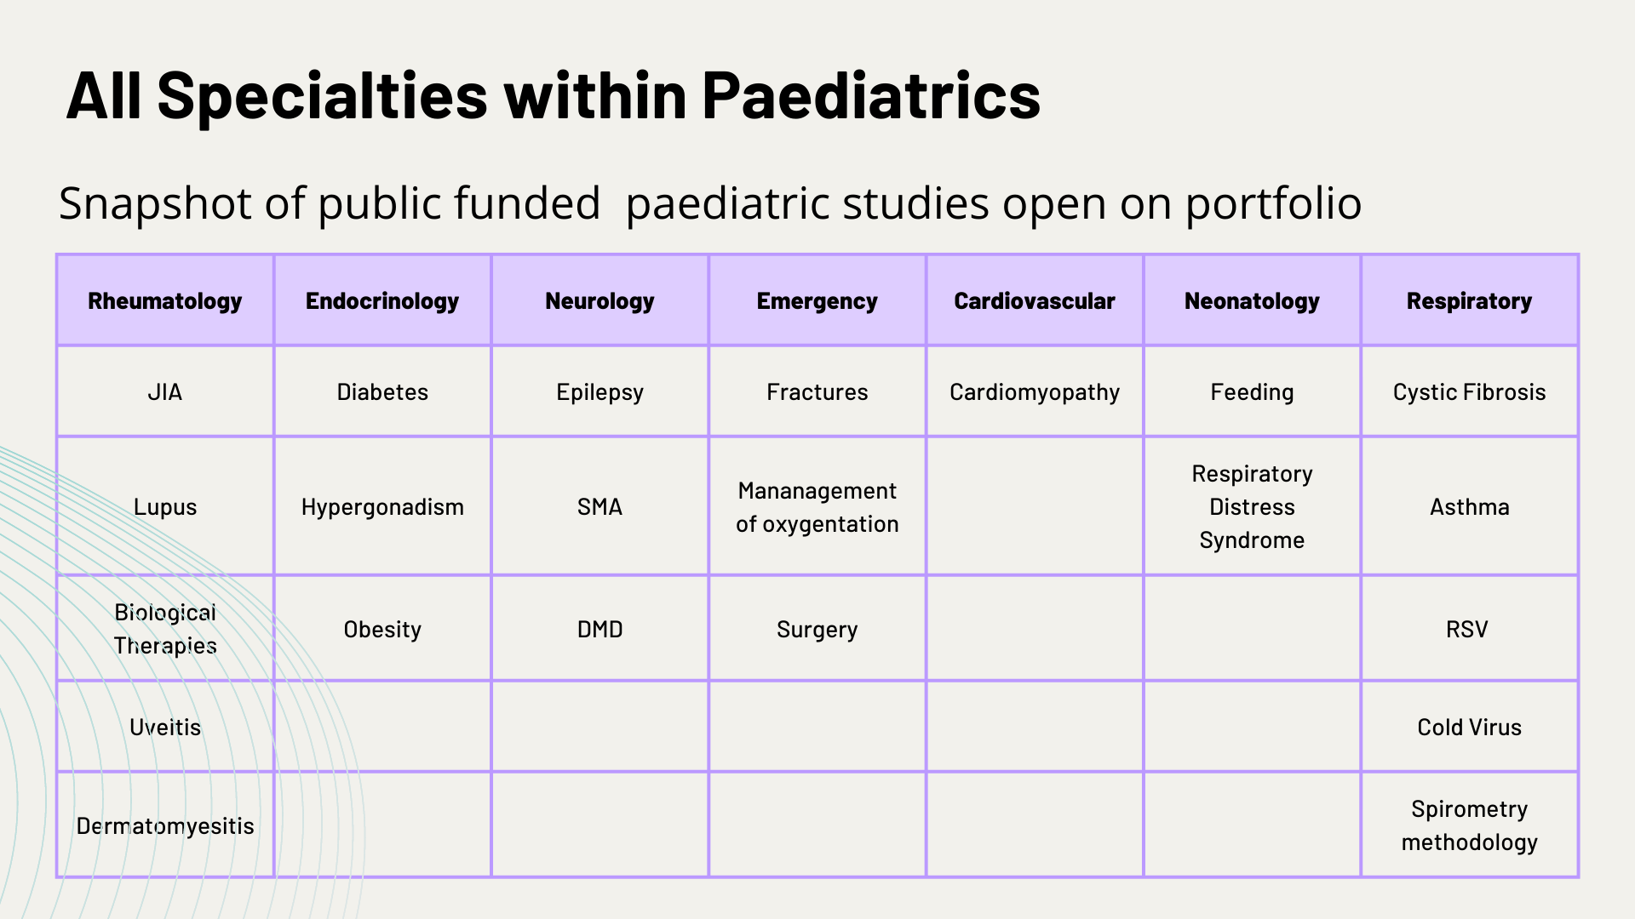

Slide 68
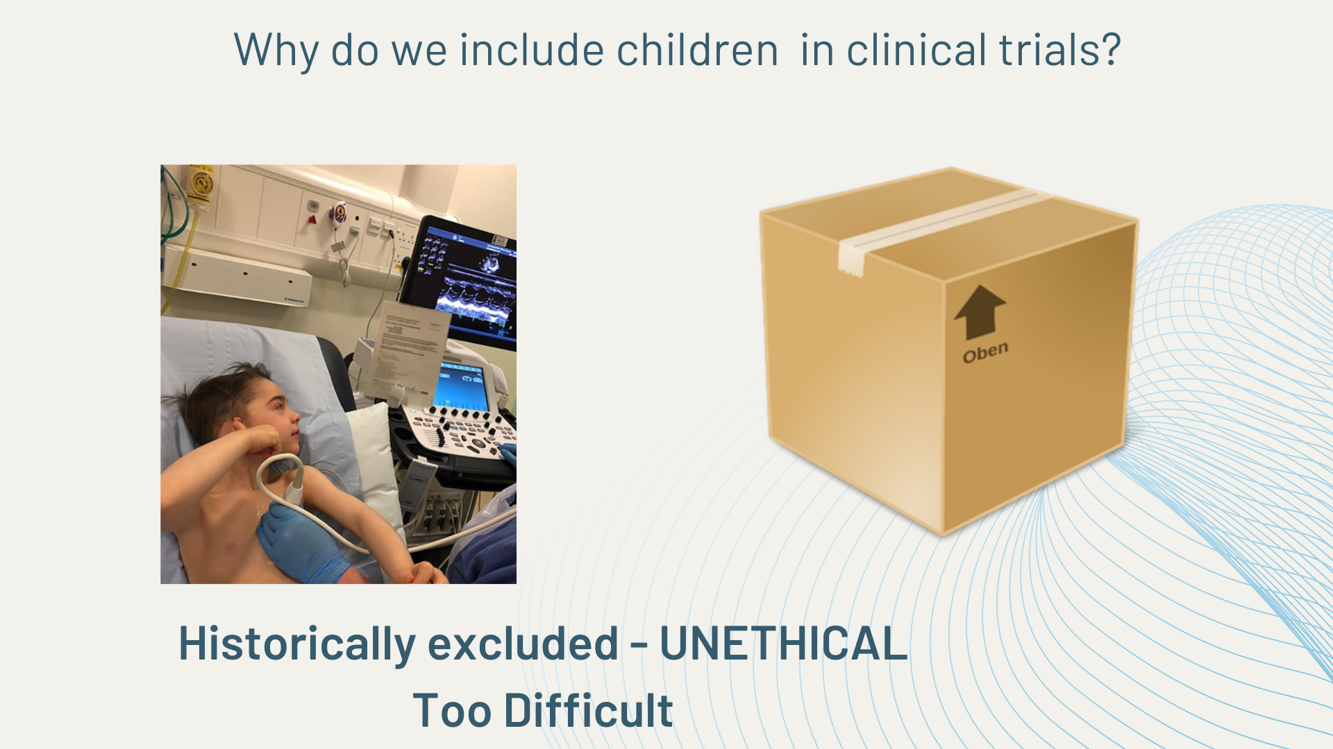

Slide 69
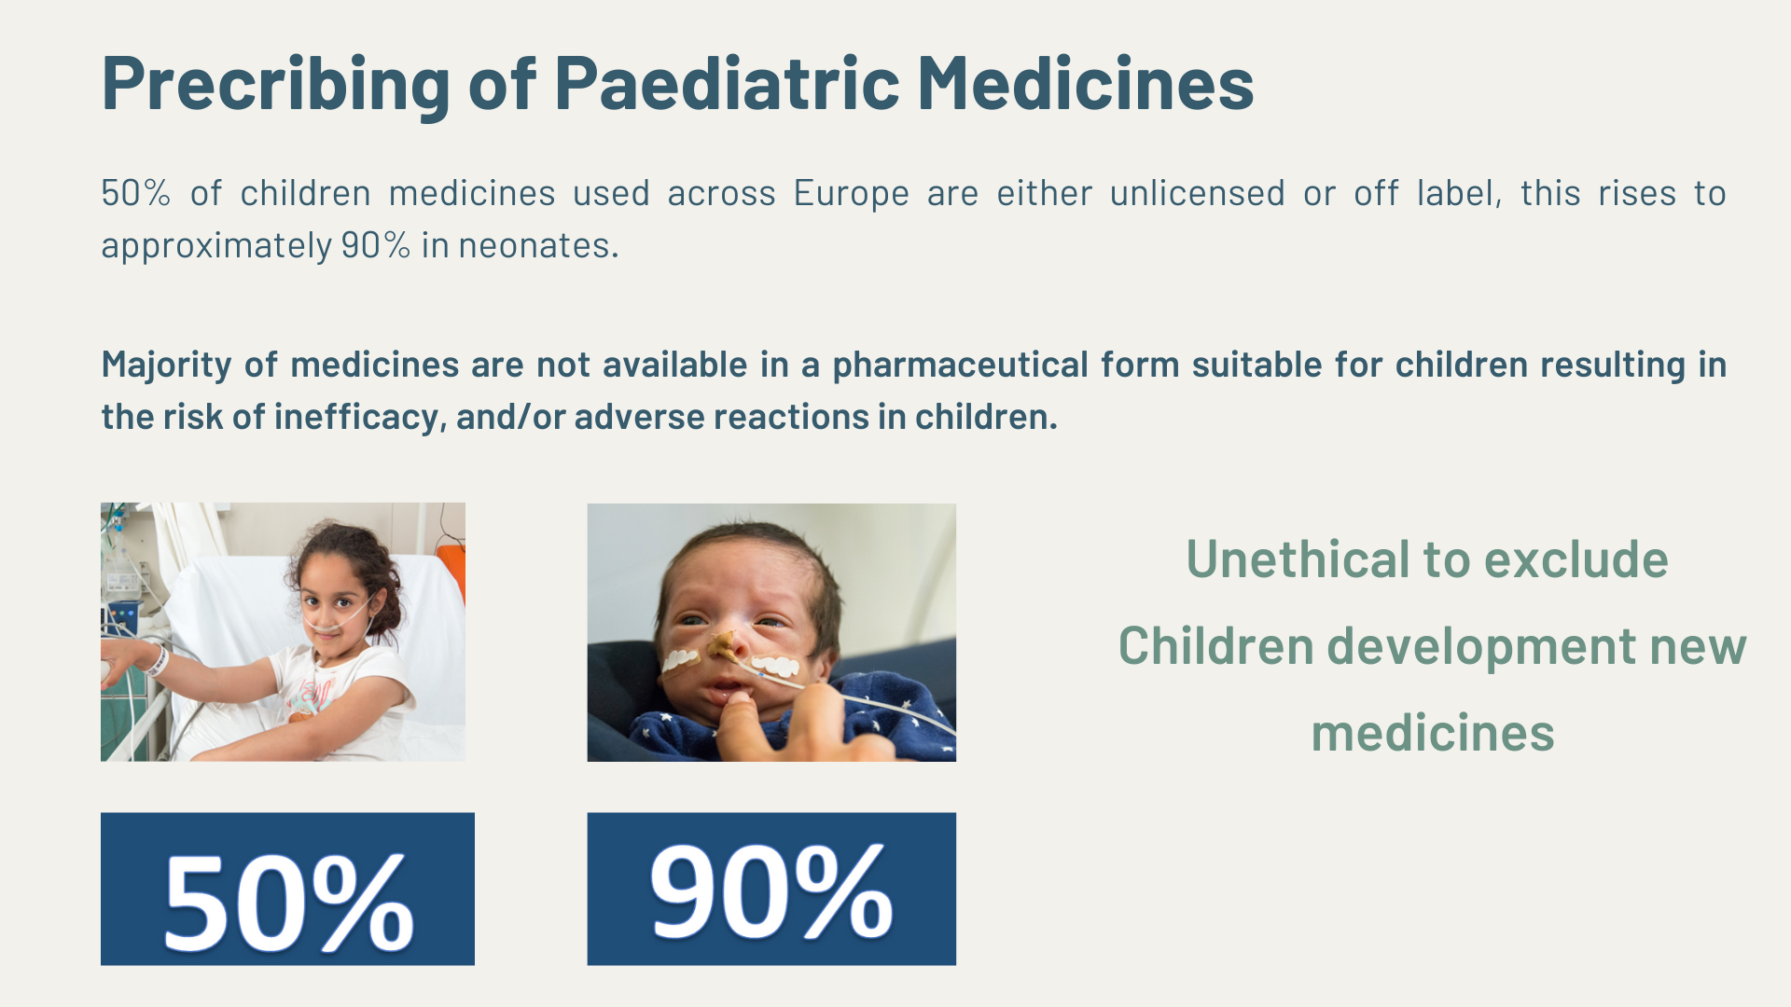

Slide 70
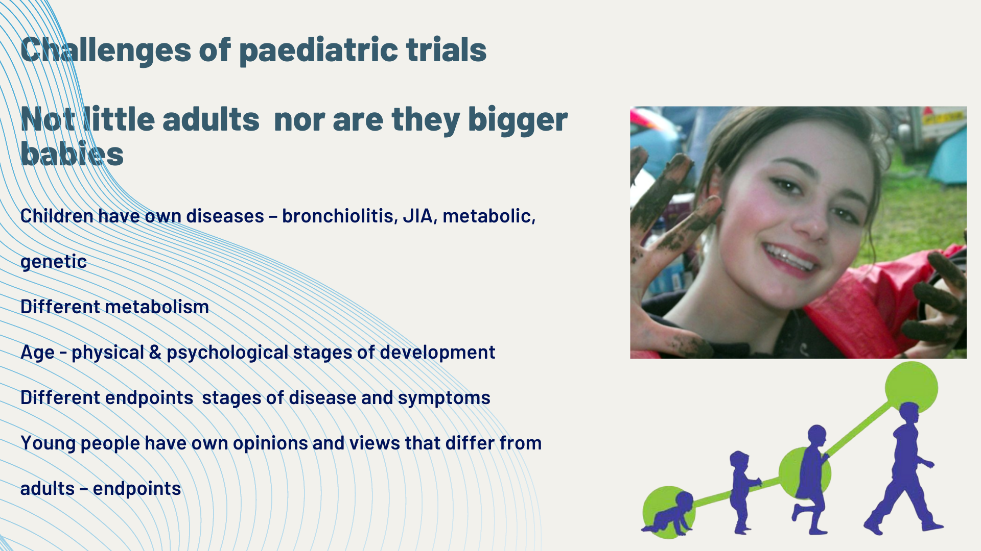

Slide 71


Slide 72


Slide 73


Slide 74


Slide 75


Slide 76


Slide 77


Slide 78


Slide 79


Slide 80


Slide 81


Slide 82


Slide 83


Slide 84


Slide 85


Slide 86


Slide 87


