Slide 1
My “Tailored Talk” Long COVID Digital Pathway Jack Francis Dr Amy Small

Slide 2
Background
The Digital Pathway has been developed as a partnership between NHSL, CHSS, Pogo Studio supported with funding from Edinburgh & Lothians Health Foundation
Allows healthcare professionals and citizens themselves to ‘search and select’ from a library of content, to build up bespoke information resources for patients in form of a “Tailored Talk”
Facilitates digital referral to CHSS Long COVID Support Service for further advice and support
The novel MyTailoredTalks Long COVID Pathway is a new Long Term Condition Management platform that aims to be part of a wider Long COVID solution.

Slide 3
Aim of the Pathway
To provide HCPs and citizens themselves with a referral pathway to enable people to better understand their condition with support from CHSS to manage its impact on daily living
Intended to run in parallel with the ongoing clinical management of the person
Provide information tailored to the specific needs of the person living with long term impact of the virus
To create a seamless digital pathway for the sharing of data that will both enable and inform practice

Slide 4
Covid Impact
1.96 M people in Scotland have had Covid¹
155K people in Scotland are estimated to be living with long covid²
53K people have been living with long covid for at least 12 months²
38K people report it is limiting their day to day activity²
82% if people living with long covid are of working age
Large proportion of people living with Long COVID are health and social care workers
Many experienced initial illness on their own with no medical input
Increasing social isolation
Increasing burden to society
1. GitHub - CSSEGISandData/COVID-19: Novel Coronavirus (COVID-19) Cases, provided by JHU CSSE
2. Prevalence of ongoing symptoms following coronavirus (COVID-19) infection in the UK - Office for National Statistics (ons.gov.uk)

Slide 5
The Digital Pathway

Slide 7
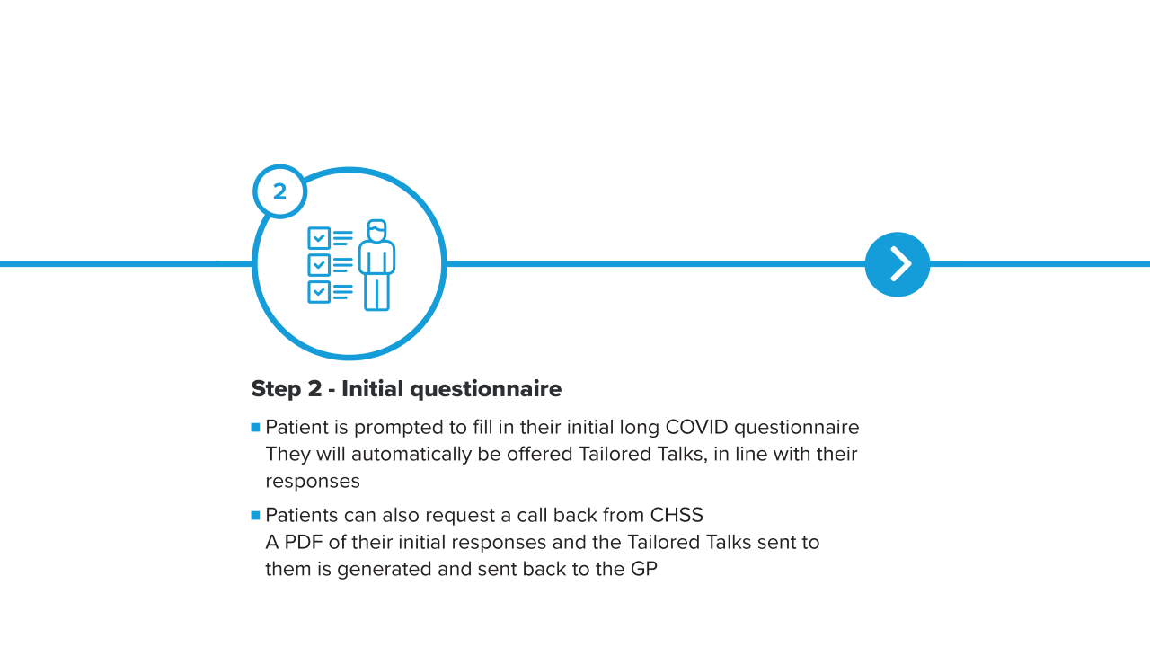

Slide 8
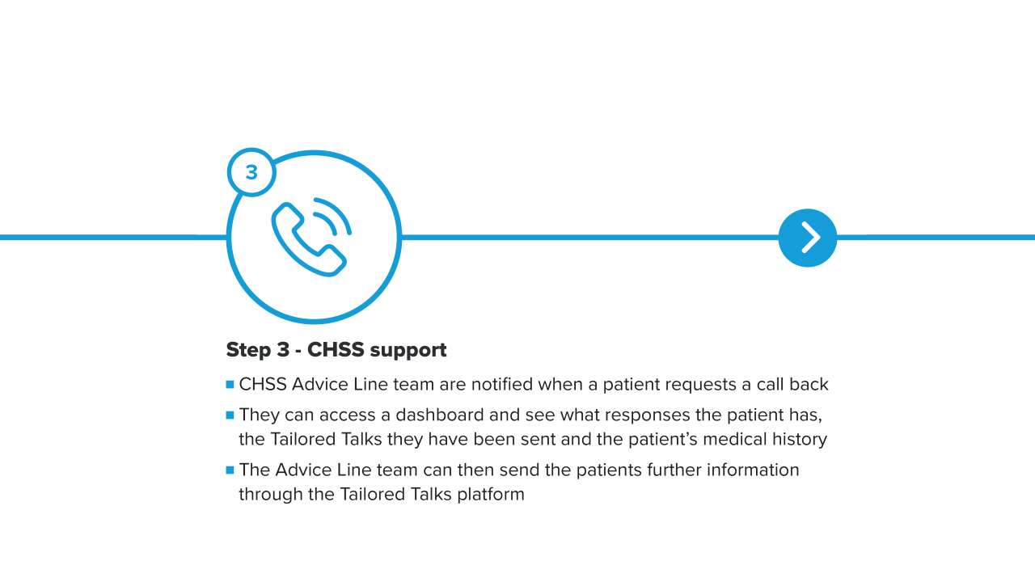

Slide 9
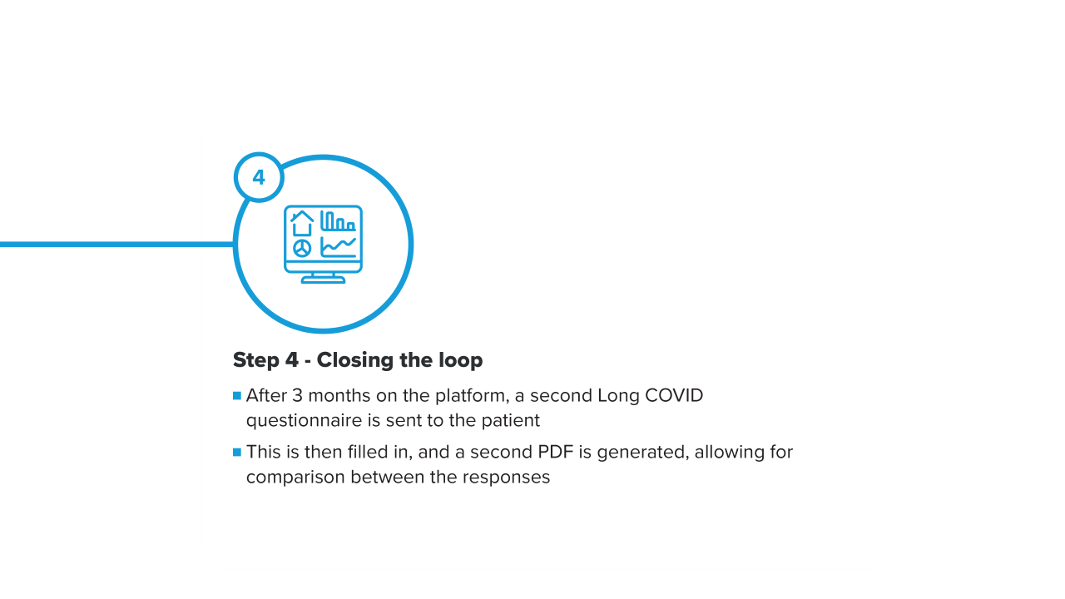

Slide 10
Demo
Link to Demo:
https://invis.io/6H12RY87EMDA#/467609494_Start-Screen-5

Slide 11
Why our platform?
Complex patientSIGN long covid guideline released in December 2020 – helpful for definition but little management
Multiple undifferentiated systems affecting multiple organs
GPs time limited
No current multidisciplinary long covid clinics therefore having to refer to multiple different specialities and AHPs
Simple referral process using SCI gateway
Patients can fill out the questionnaire in their own time in a comfortable unpressurised setting
Patients can decide if they want further support from CHSS
Information in the Tailored Talks has been developed with people living long covid
3. Managing the long-term effects of COVID-19 (sign.ac.uk)

Slide 12
CHSS Advice Line
Fatigue and breathlessness the two most common reported syptoms (2)
Fatigue management
Pacing Advice
Advice on managing breathlessness
18 months of expertise on managing patients living with long Covid
Signposting to:
Peer support group
Community support service
Physical activity
Kindness support service
CHSS publications

Slide 13
A GP’s perspective
All GPs in the pilot reported that the process was simple and easy to use
All GPs in the pilot would recommend the platform to colleagues
Many GPs in the pilot commented on the applicability of the platform to support management of other chrnoic conditions

Slide 14
Living with Long COVID
Lived Experience Link:
https://youtu.be/sP2lu-4ktWU

Slide 15
Thank you

