Slide 1
NHS Scotland Event
AI Scotland
^{Prof David J Lowe}
^{Clinical Director - SHIP}

Slide 2
NHS Scotland Event
AI Scotland
^{Prof David J Lowe}
^{Clinical Director - SHIP}
Notes:
Thanks
Test beds want to work in the clinical environemnts with clinican / patients
Fragment
Health what do we
No conflicts of interest work in this sphere
What does a successful bid or consortia for UKIS funding look like?
How do I navigate the policy landscape?
How can I make the bid stand out from the competition?

Slide 3
Rising Demand
Notes:
Success of previous what has worked what not worked
Federated model
Embedded into NHS to leverage

Slide 4
Data

Slide 5
Notes:
Decision support

Slide 6
Answer THE HARDER QUESTIONS
Who among my population is at highest risk?
What are the drivers
of my future costs?
When to proactively
mitigate risk?
How can we optimize care for outcomes, cost, and quality?
Predict Population Health Risk by identifying future patterns of clinical and cost outcomes.
Model the complex interplay of disease progression and utilization to anticipate chronic and critical illness.
Optimize Care Coordination at out-patient, in-patient and home care levels by using predictive risk stratification
Identify and intervene to reduce variation in outcomes, quality, and cost measures.

Slide 7
NHS is on an unsustainable course
Growing Volume
28% increase in hospital admissions over 10 years
Reduced Resources
3 in 5 consultant radiologist vacancies have remained unfilled for a year or more
Increased Costs
£157 million/annum spent on radiology outsourcing

Slide 8
Notes:
30% Workload
£116 Million Outsourcing
26,000,000
CXRs performed annually in UK
330,000
Chest X-Rays in the UK have been waiting >30 days to report.

Slide 9
Actionable Insight
Can we identify Normal Radiographs?
Can we integrate into Clinical Workflow?
How do we monitor and evaluate performance?

Slide 10
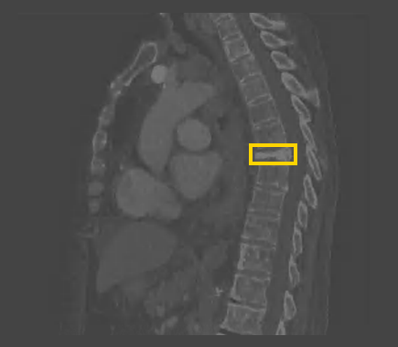
Osteoporosis
Notes:
SafeHaven digital electronic health record
1.2 Million People
12 year of orion clinical portal HER
Community / Mental health / prescribing data
Standardised information governance and data management
Scalable and flexible
Adding value
Scottish Mortality Data – Inpatient data
Community Prescribing – Encashed prescriptions
Comorbidites – found through ICD10 codes
Labs – All test results are available in SCI Store
Attendance data – some, not all may be available via TRAK, SMR – not GP attendance data
Phenotype data– all data items may not always be available
Tertiary Centre
Unique socioeconomic with geographical element
QEUH – trauma centre

Slide 12
Notes:
30% Workload
£116 Million Outsourcing
26,000,000
CXRs performed annually in UK
330,000
Chest X-Rays in the UK have been waiting >30 days to report.
Growing Volume
28% increase in hospital admissions over 10 years
Reduced Resources
3 in 5 consultant radiologist vacancies have remained unfilled for a year or more
Increased Costs
£157 million/annum spent on radiology outsourcing

Slide 13
Heart Failure
Notes:
Scale
Resource need to sit with instructure
Equity of access
Infrastrucure capabity
Existing infrastructure leverage

Slide 14
HF Challenge
The HF Diagnosis Challenge
Worldwide
The OPERA Heart Failure Service
Value Proposition
To create a streamlined digital service that can effectively address diagnosis backlogs and reduce waiting lists for echos in the Glasgow area, while demonstrating new AI technology in the Heart Failure diagnosis pathway.
The human and financial cost of HF is large and growing worldwide
HF accounts for 1-2% of healthcare spending in developed countries
52% of patients die within 5 years of diagnosis
HF prevalence is predicted to rise by 46% by 2030
HF diagnosis is complex, and often delayed by operational or system level issues
Communication between primary and secondary care
Shortage of echo specialists, long waiting lists (eg. UK: 132,000)
Variable access to tests such as NTProBNP or standard Echo Early diagnosis can improve outcomes and reduce costs
Early diagnosis can improve outcomes and reduce costs
Today up to 80% of HF diagnoses are made on emergency admission
Risk factors can be managed or treated if identified earlier
Easy referrals
Integrated with secondary HF service to prevent miscommunication. Referral process within the platform
ensures fewer errors, delays and missed appointments
Post-diagnosis
Diagnosis
Data dashboards
Relevant EHR data and diagnostics are available to clinicians across primary and secondary care (no manual entry)
Diagnostic tests
Referral to secondary care
Primary care follow-up
Data remains on the HF integrated platform and is accessible to primary care clinicians after diagnosis
GP presentation

Slide 15
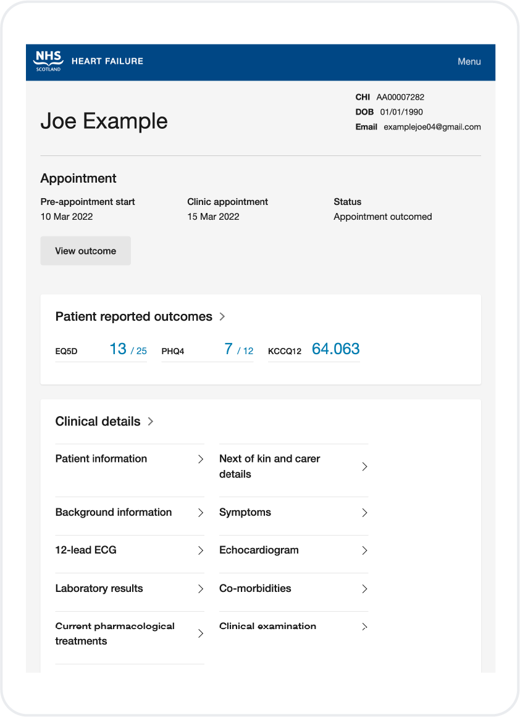
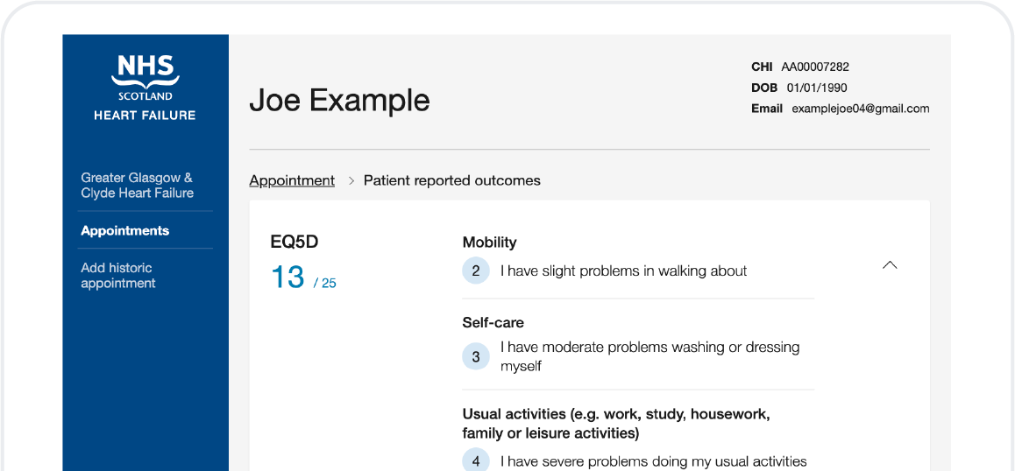
Developed with NHS GGC, Supported by AstraZenca, Roche and DHI
OPERA Heart Failure
Screening
Delivers Heart Failure screening service to support centralised data collection and workflow across nurse specialist and cardiologists .
12 months → < 12 weeks
Reduction in diagnostic waiting times within 4 months of service use
Patient App
Patient can contribute data in advance of f2f appointment to speed up
30%
2x
Fewer in-person diagnostic referrals
Management plans delivered
Workflow
Nurse specialist collects clinical data as part of f2f appointment.
Patient sent for tests and test results can be either integrated or re-keyed into system for cardiologist review
Outcome Letter
Letter for GP and Patient record auto generated by system and can be downloaded or automatically sent to EHR & GP Systems.
Digifest 2021, eposter, Murphy, et al.

Slide 16
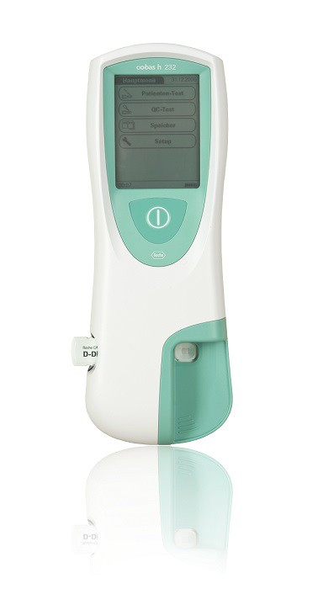
A letter is generated and sent to the patient’s EHR and GP
Clinicians review and respond with outcome and arrange further actions as required
OPERA HF Service Workflow
Clinicians access their full clinical dashboard integrating shared data
Integration of handheld echo
AI assisted echo exam and image analysis can be performed in much less time than a full stack echo and requires far less training.
Potential to greatly improve access to echo in the community
Clinician Interface
The heart failure screening and virtual management service supports:
Clinical exam data entry
Appointment management
Case workflow and management
Patient and EHR data integrations
AI echocardiogram integration
Patient shares info and answers PROs to complete a self-assessment
Post-diagnosis
Diagnosis
New pathways unlocked
A digital service across the HF pathway integrates siloed systems, reduces manual work and time between touchpoints
All relevant data to make quick and accurate diagnoses is presented to clinicians at the right time
Diagnostic tests
Patient referred to HF Service is sent a registration link by the clinical team
Referral to secondary care
AI echo
possible
AI echo
possible
AI echo
possible
GP presentation

Slide 18
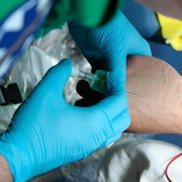
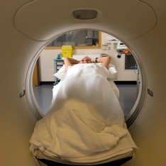
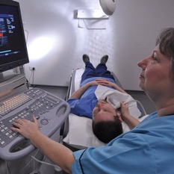
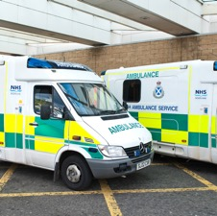
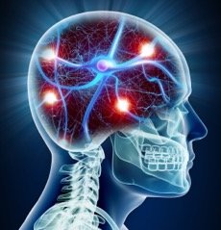
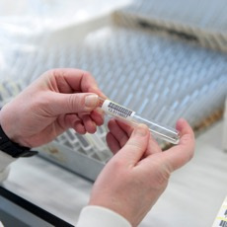
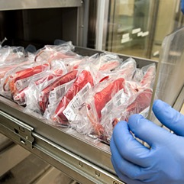
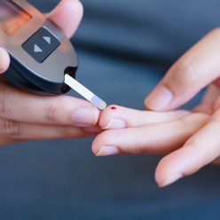
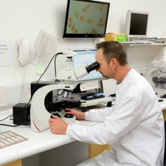
Thanks

Slide 19
Contact
Professor David Lowe
Consultant Emergency Medicine
National Clinical Director
Health Innovation Partnership (ScotGov)
SHIP@gov.scot
@djlmed

