Slide 1
Taking Care of Yourself to Take Care of Others - Why Wellbeing Matters

Slide 2
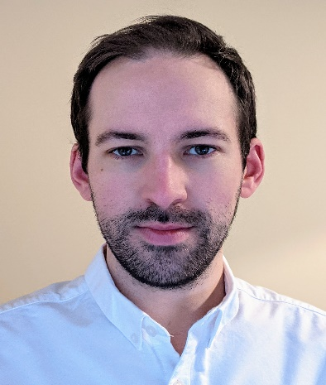
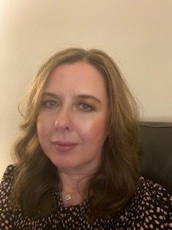
Our Panellists
Alison Macleod
Strategy and Transformation Lead
Aberdeen City HSCP
Tom Andrews
Emma Hepburn
Alex Pirrie
Health Workforce Wellbeing Comms Lead
Scottish Government
Clinical Psychologist and We Care Programme Lead
NHS Grampian
Strategy and Transformation Manager
Aberdeenshire HSCP
Join at
www.slido.com
Participant Code:
nhsscot22
Room
Conference 1B

