Slide 1


Slide 2

Prevention of Drug Deaths – Creation of an Early Warning and Response System in Scotland
Drugs Team
Dr Tara Shivaji: Consultant in Public Health
Vicki Craik: Public Health Intelligence Adviser
Hailey Zislis: Health Improvement Manager
21 June 2022: 11.45 – 13.00
22 June 2022: 14.00 – 15.15
Notes:
Introductions

Slide 3
Housekeeping
Question and answer at end of session
Content warning
Information guide collect at end of session
Slido

Slide 4


Join at slido.com
#drugdeaths
ⓘ Start presenting to display the joining instructions on this slide.

Slide 5
Session objectives
Recall key information on drug-related deaths in Scotland.
Describe how data from public sector organisations, can be brought together to inform whole system approaches.
Discover how models of co-production have been utilised to develop the drugs early warning system (RADAR).
Reflect on the power of developing nurturing relationships to support collective action that prevents drug-related harms.

Slide 6

What do you hope to get out of today's session?
ⓘ Start presenting to display the poll results on this slide.

Slide 7
Section 1: Drug-related deaths

Slide 8
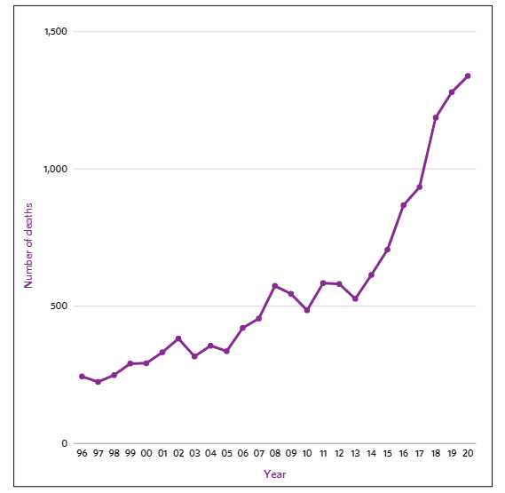
What are drug-related deaths and why does it matter?
Source: National Records of Scotland, nrscotland.gov.uk
Notes:
1339 people died in 2020
5% increase since 2019
90% increase since 2015
129% increase since 2011

Slide 9
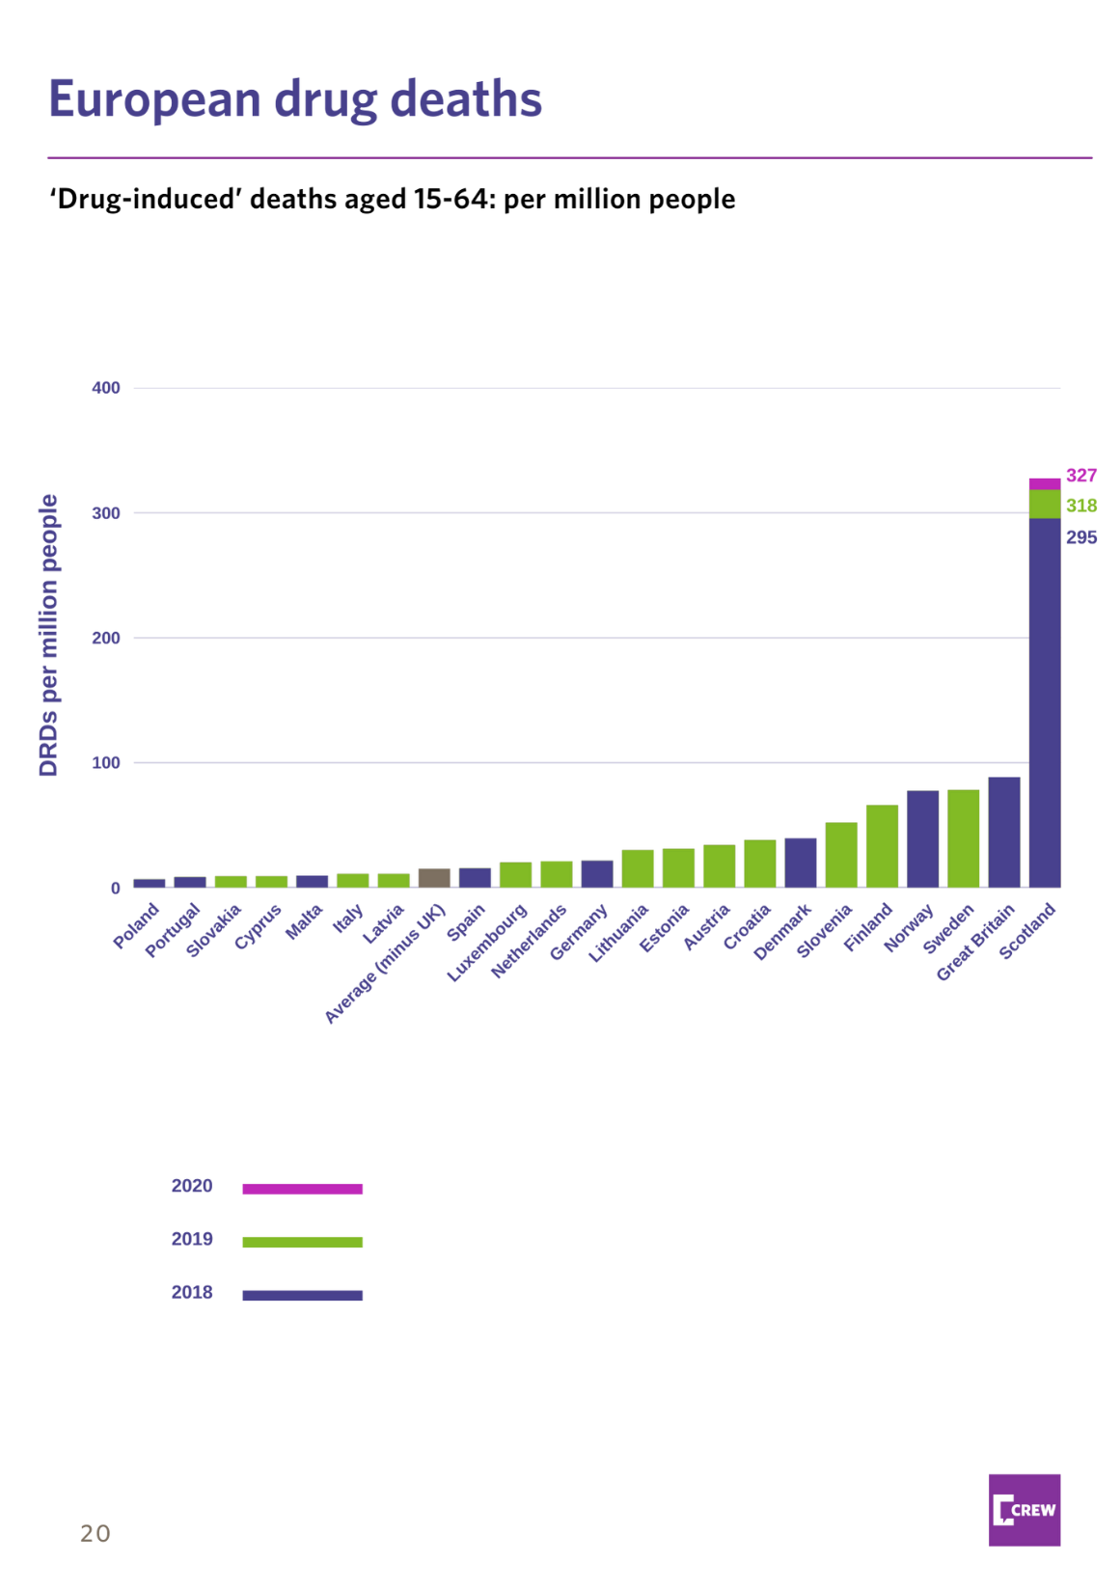
‘Drug-induced’ deaths, aged 15-64, per million people
Source: National Records of Scotland, nrscotland.gov.uk, European Drug Report 2021, EMCDDA
Notes:
Contribution to stall in life expectancy
In Scotland in 2020:
More men aged 65 and under died from a drug-related death than from COVID-19.
An estimated £4.4 billion was spent on the consequences and wider social impacts of drugs.

Slide 10
Key figures – age and sex
 | 2000 | 2020
Male deaths | 239 | 973
Female deaths | 53 | 366
Average age | 32 | 43
Source: National Records of Scotland, nrscotland.gov.uk
Notes:
Since records began in 1996, male deaths have increased by 426% (185 to 973).
Female deaths have increased by 520% (59 to 366).
Male:female ratio decreased from >4 during 2000 to 2.7 in 2020.
The proportion of female deaths in Scotland (27%) is higher than the European average (23%).
Most people who die are aged between 35-55

Slide 11
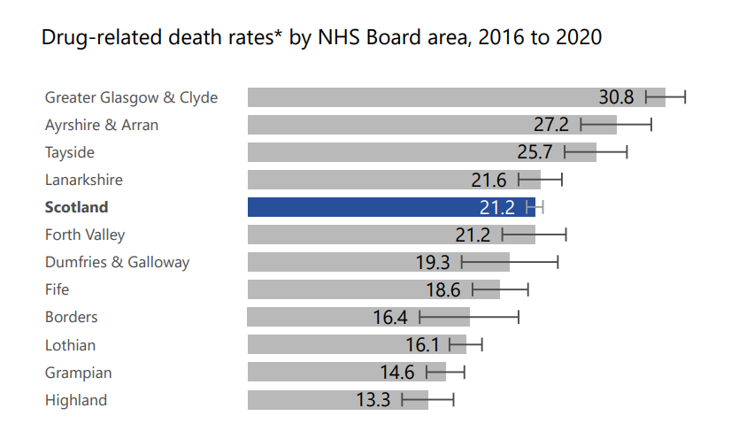
Source: National Records of Scotland, nrscotland.gov.uk

Slide 12
Key figures – polydrug use
In 2020 among the 1339 people who died of a drug related death in Scotland
93% were classified as "deaths due to accidental poisoning"
86% of people had two or more drugs implicated in the cause of death
The average number of drugs implicated in a death was 3

Slide 13

Why are deaths so high in Scotland? (choose 3)
ⓘ Start presenting to display the poll results on this slide.

Slide 15
Minister for Drugs Policy Angela Constance

Slide 16
Section 2: Describe how data from public sector organisations including Police Scotland, can be brought together to inform whole system approaches to prevent drug-related deaths

Slide 17




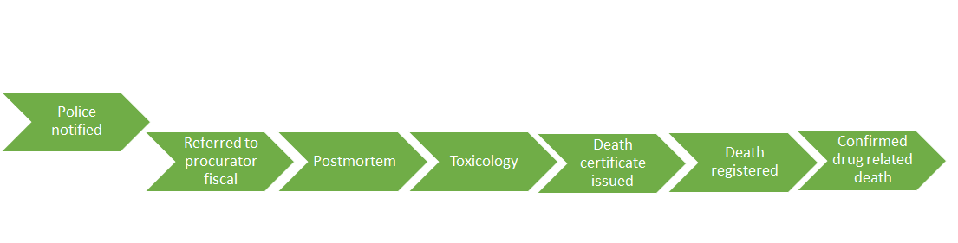


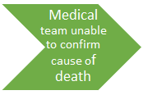
Drug-related death reporting

Slide 18
Why data from other public sector organisations?
It is difficult for a single, specialist service to assess the risk of drug related death alone.
There are temporal, spatial and social network relationships that influence the risk of drug harm.
In 2016, among people who died a drug related death in Scotland:
Around one in two people were in contact with specialist drug treatment services
Almost all were in contact with another public service; primary or secondary healthcare, justice, housing, social work
Four in five of all people who died a record of recent problematic substance use
Source: Public Health Scotland, National Drug Related Death Database 2015/16
Notes:
Signal might be in another public sector organisation – may be that most appropriate immediate response is by another public sector organisation

Slide 19
What source of data are we looking for?
Routinely collected
Drug harm is systematically recorded
Date and location
Examples
Police Scotland suspected drug-related deaths
University of Glasgow Forensic Medicine Service
Drug related presentations to emergency departments
Naloxone administration by the Scottish Ambulance Service

Slide 20
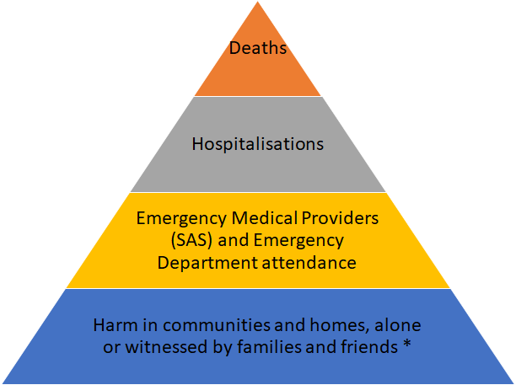






The challenges and opportunities of "real-time data"

Slide 21
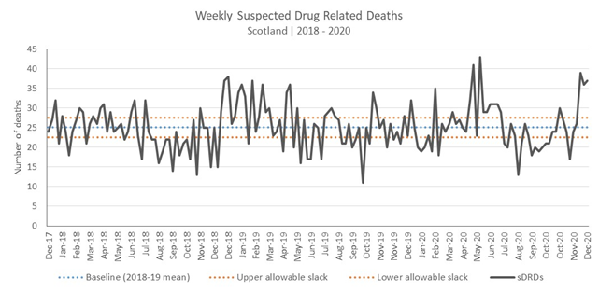
Making sense of patterns to inform timely action
Notes:
•High levels of sDRDs are identified by visual inspection of the time series chart.
•Focus on comparing recent sDRD levels with; 1. previous months levels, 2. pre-pandemic levels.
•A retrospective and subjective approach
•

Slide 22
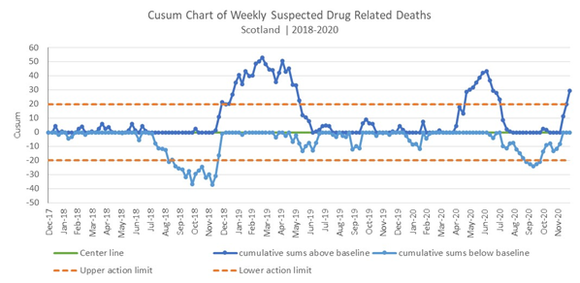
Confident prospective monitoring
Notes:
The CUSUM chart monitors the difference between the number of sDRDs each week and the baseline sDRDs level.
For the CUSUM chart the baseline is 0, no difference between the weekly sDRDs and the baseline level.
The ‘cumulative sum’ is the sum of these differences across sequential weeks. As with the time series chart the CUSUM chart has a pair of control/action limits that provides contingency to accommodate for the noisy data.
Our focus is high levels of sDRDs, so deviations above the baseline level.
The dates marked on the CUSUM chart indicate the periods where the difference across sequential weeks in the number of sDRDs relative to the baseline level are sufficiently frequent and large to exceed the action limits indicating periods of high sDRDs.
The cumulative nature of this approach means that the occasional / isolated week of high sDRDs is insufficient to cause an alert, but requires sufficiently frequent and large sDRDs across sequential weeks to exceed the action limit and thus flag as a shift towards high sDRDs.

Slide 23
Bringing together data from public sector organisations to prevent drug related deaths
Opportunities for prevention by building on the trusted relationships that people have established with non-drug treatment agencies.
Setting appropriate thresholds to identify when extra resources need to be deployed to a particular area quickly
Limitations – incomplete, insensitive to certain types of harm or harm experienced by certain population subgroups

Slide 24
Section 3: Discover how models of co-production have been utilised to develop the drugs early warning system (RADAR) and learn about its importance to the system’s continuous improvement

Slide 25
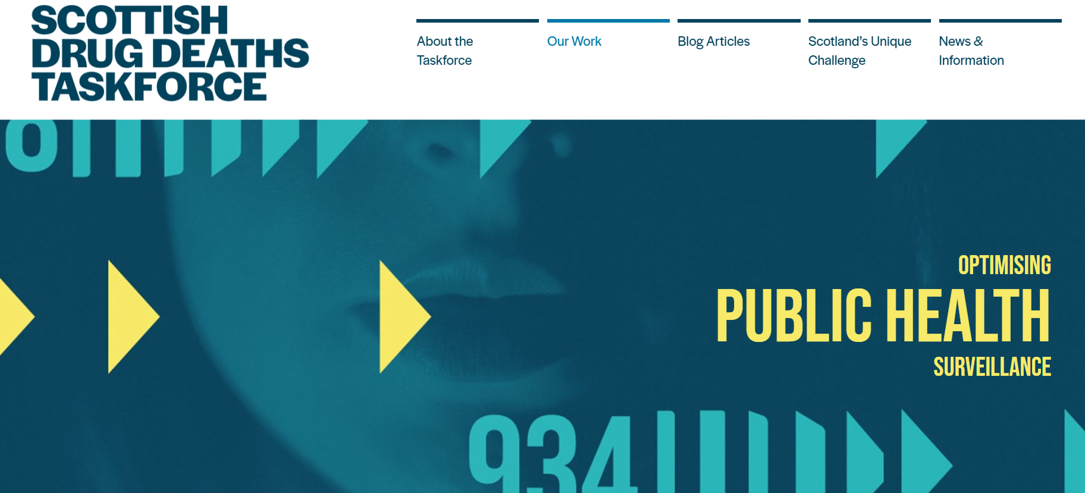
Optimising public health surveillance
Online workshops to decide priorities
PHS Surveillance Operations Group
Identified need for an Early Warning System
Notes:
Bringing together data from different places
Community involvement – collating more – collecting new data – service knowledge – personal relationships

Slide 26


Slide 27
RADAR objectives
Identify trends, risks, and overdose and intoxication clusters
Respond to new and emerging substances, harms and other relevant scenarios
Advise on and implement immediate harm prevention
Provide high-quality current public health information
Inform decision making about resource allocation

Slide 28
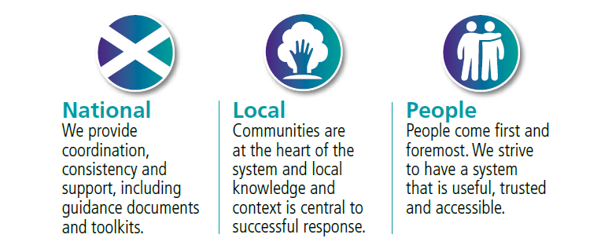
Who is involved?

Slide 29

Have you ever drank alcohol?
Have you experienced any positive effects from alcohol use?
Have you experienced any adverse effects from alcohol use?

Slide 30
Who is involved?

Slide 31
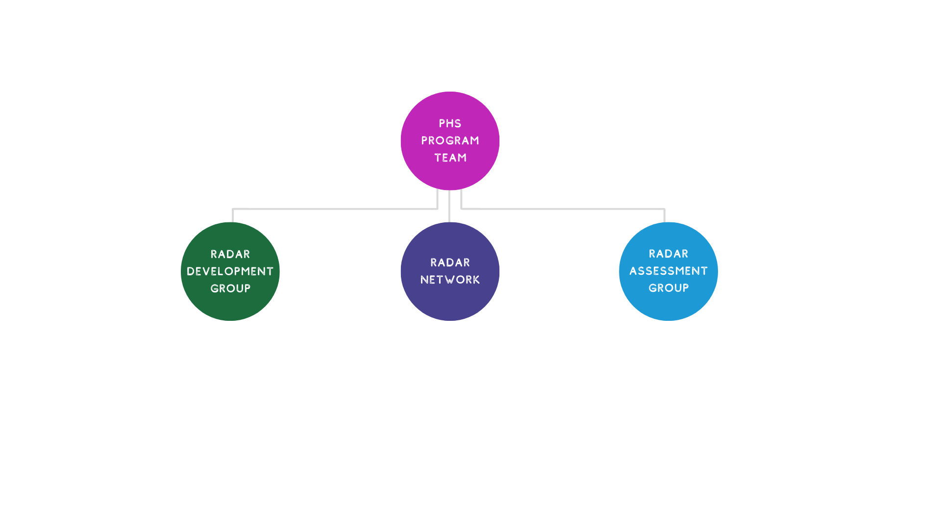
Structure Development
Notes:
Circle back to useful trusted and accessible

Slide 32
What type of incident does RADAR respond to?

Slide 33
What drug was implicated in the highest number of DRDs in Scotland in 2020?
ⓘ Start presenting to display the poll results on this slide.

Slide 34
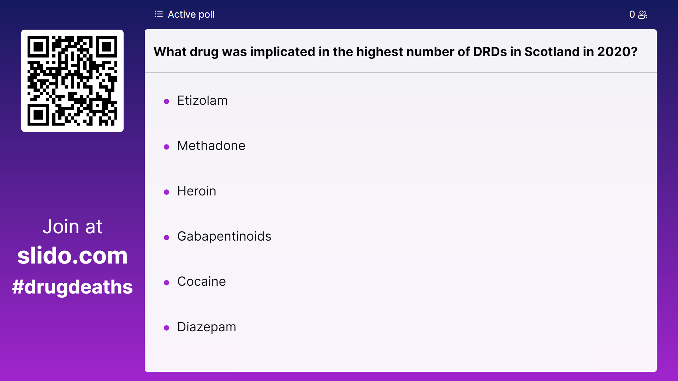
806
708
605
502
459
194

Slide 35
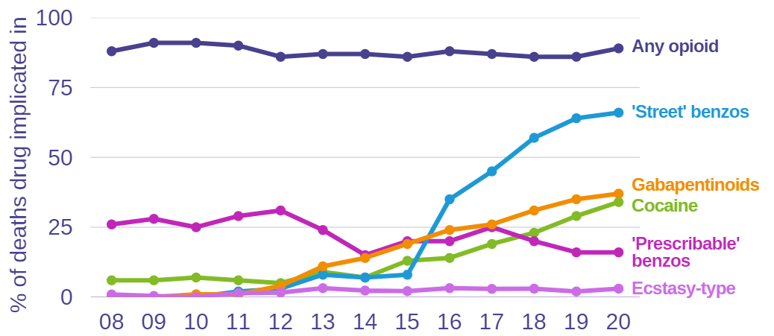
Drug-related deaths 2008-2020
Source: National Records of Scotland, nrscotland.gov.uk
Notes:
Different risk profiles

Slide 36
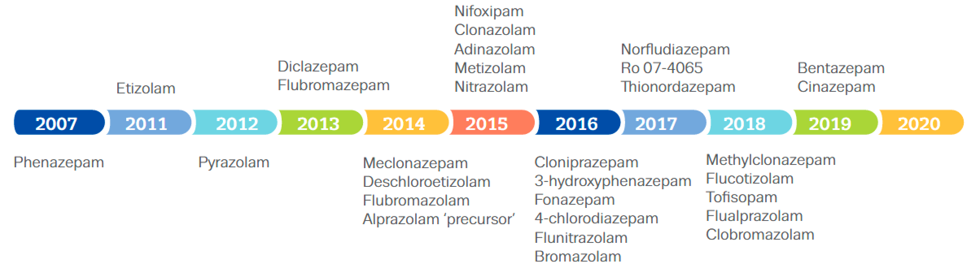
Timeline of benzodiazepines notified to EU EWS
Source: Timeline of benzodiazepines reported to the EU for the first time, EMCDDA
Notes:
Market, not talking about heroin, complex global synthetic drugs market, local and international manufacturing, new products, responsive

Slide 37
How does RADAR respond?

Slide 38
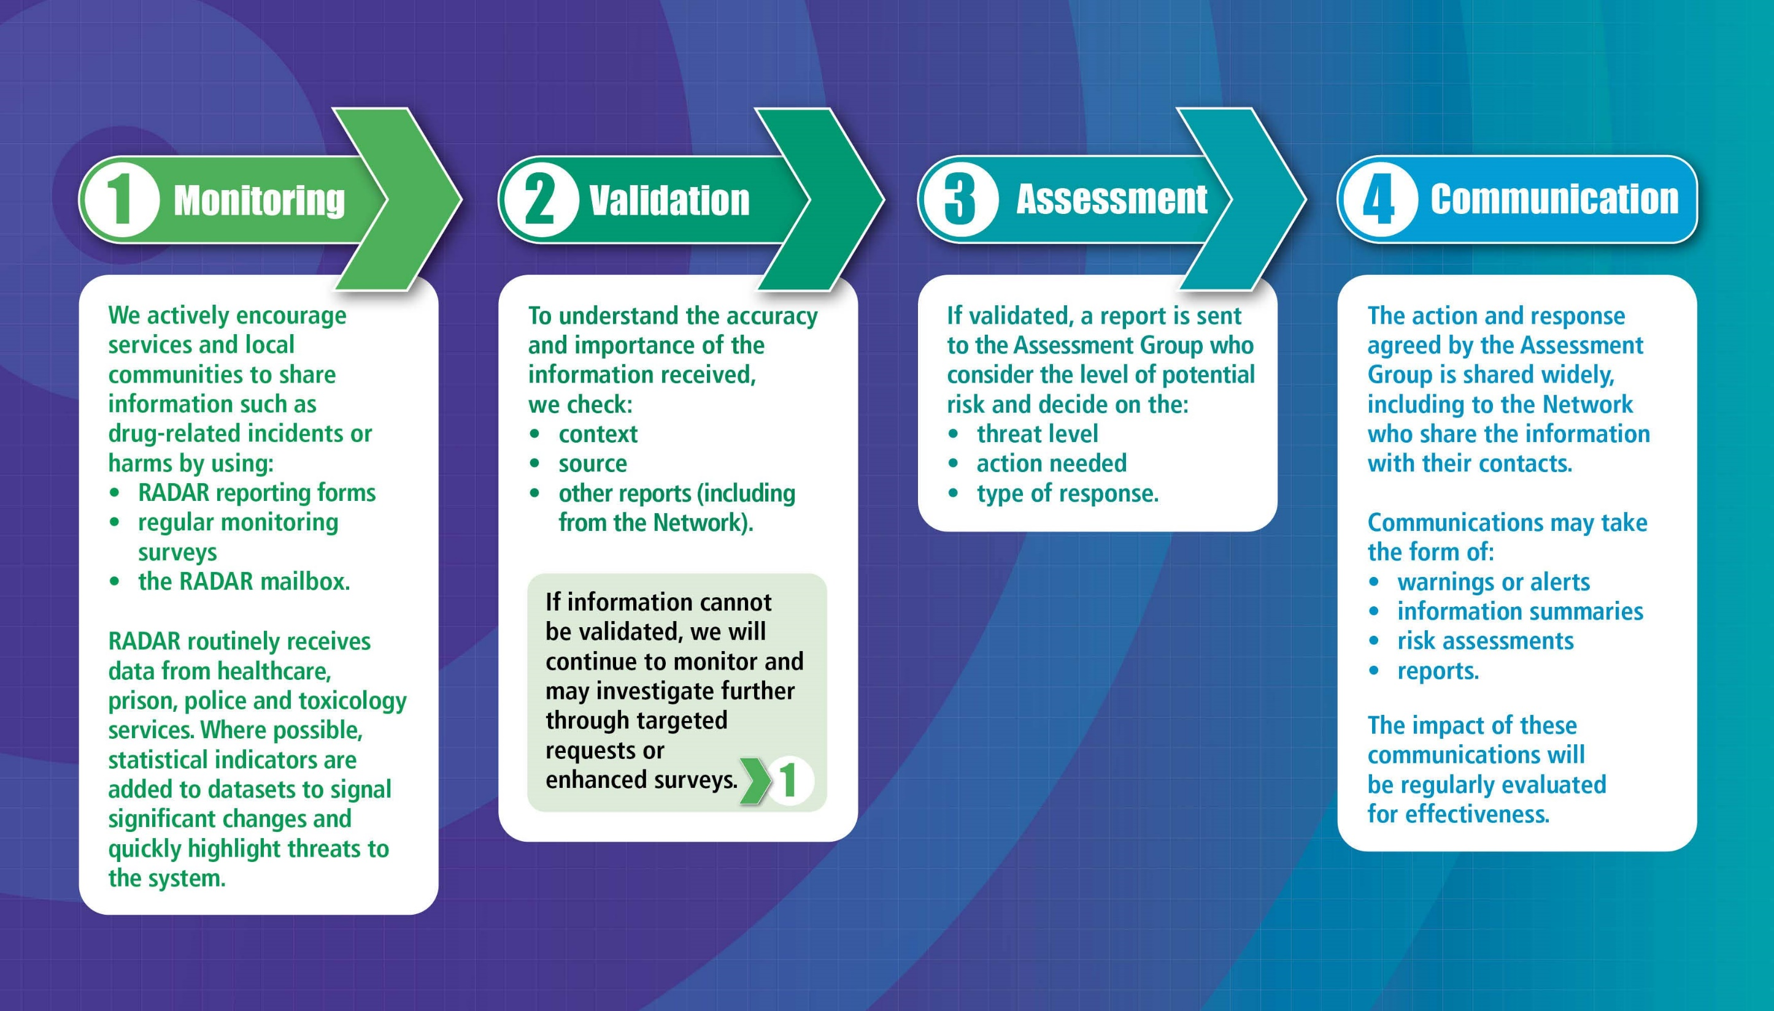

Slide 39
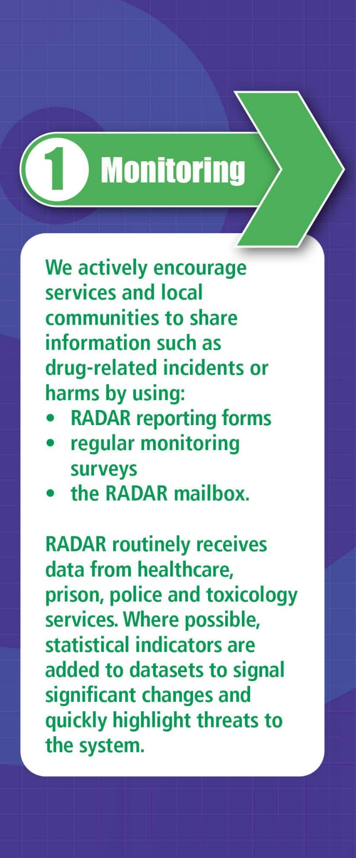
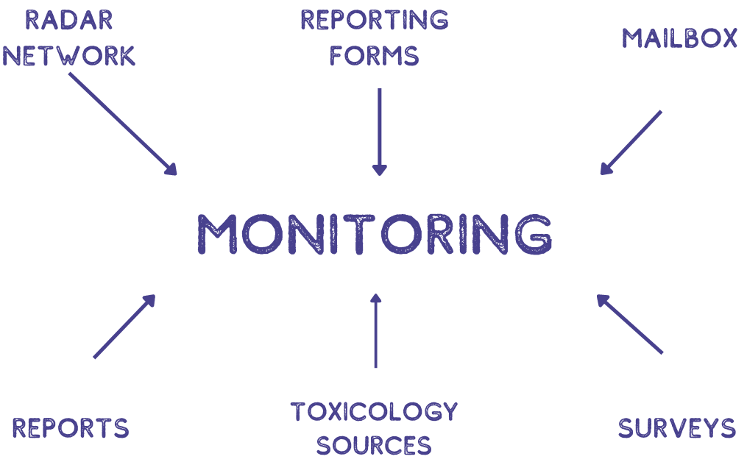
Active data collection

Slide 40
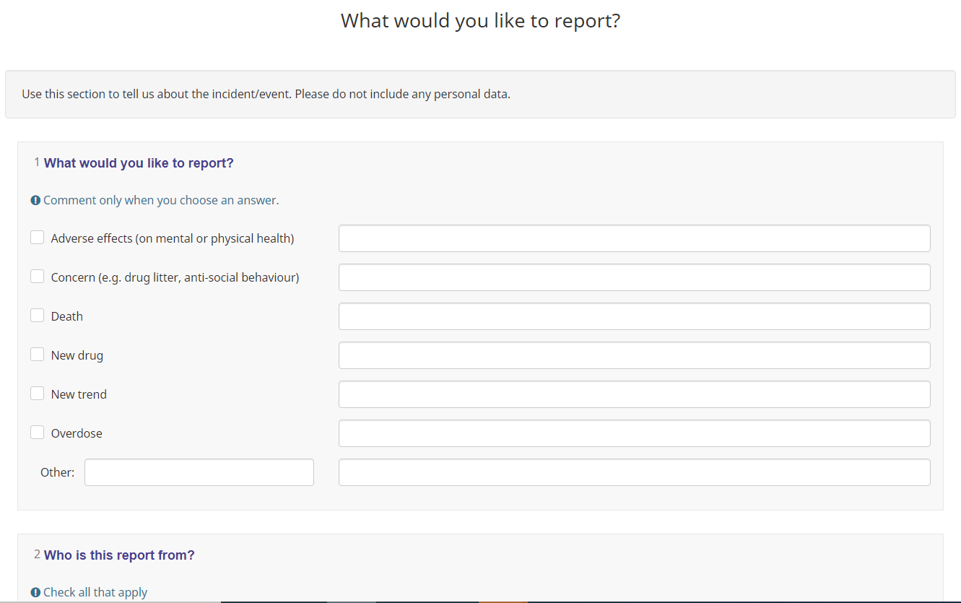
Active data collection
What happened?
Where did it happen? Location? Setting?
When did it happen?
Who did it happen to? To how many?
Why did it happen?

Slide 41
What are we monitoring?
Increasing stimulant markets
  crack cocaine, cocaine injecting, methamphetamine and cathiones
Changing benzodiazepines
  etizolam to clonazolam
Counterfeit pharmaceuticals
  ‘street’ to ‘fake’
Synthetic opioids
  ‘tonitazenes’

Slide 42
Example
Report from prison toxicology
  Lab-based
Synthetic opioid in SCRA
  Metonitazene detected in an infused paper sample seized along with Cumyl-4CN-BUTINACA

Slide 43
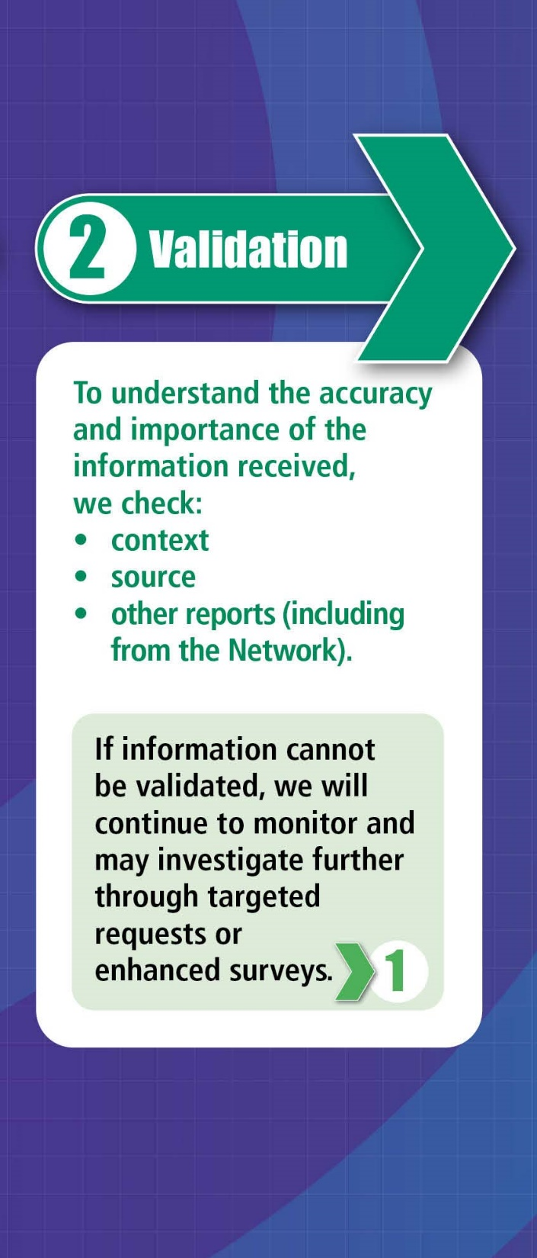
Context
First detected in UK in 2020
Detection of similar drug in Northern Scotland for the first time in 2021
Not controlled by the Misuse of Drugs Act (1971)
Metonitazene is a potent synthetic opioid of the benzimidazole group of compounds. Synthetic opioids are lab-made drugs which have similar effects to opiates e.g. morphine, heroin
As of 04 May 2022, the UNODC EWS has received 33 reports of isotonitazene identification since 2019 and 5 reports of metonitazene identification since 2020
CHECK!
Notes:
Context
First detected in UK in 2020
Detection of similar drug in Northern Scotland for the first time in 2021
As of 04 May 2022, the UNODC EWS has received 33 reports of isotonitazene identification since 2019 and 5 reports of metonitazene identification since 2020

Slide 44
2) Validation
Check reports of ‘itazenes’ in Scotland
Scottish Police Authority Forensic Services drug seizure testing
Scottish Prison Service and University of Dundee non-judicial drug testing
Check reports of ‘itazenes’ in UK
6 detections (1 in Northern Scotland) from UK hospital toxicology project
National Crime Agency identified 46 overdoses and 16 deaths linked to isotonitazene in 2021, Public Health England issued a National Patient Safety Alert in August 2021
Alert from Midlands after increase (doubling) in expected acute opioid toxicity

Slide 45
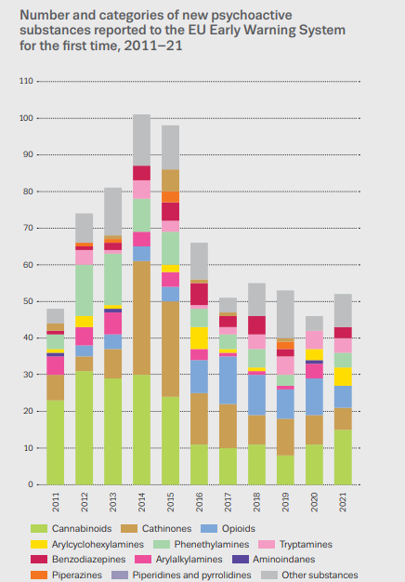
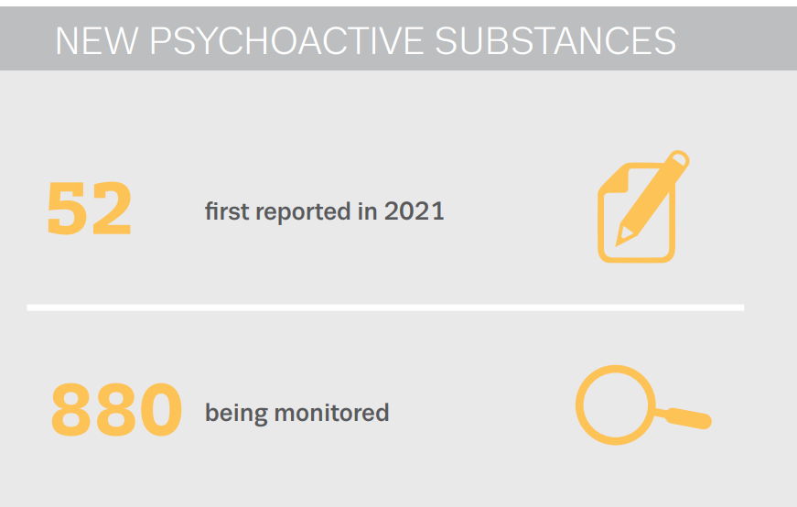
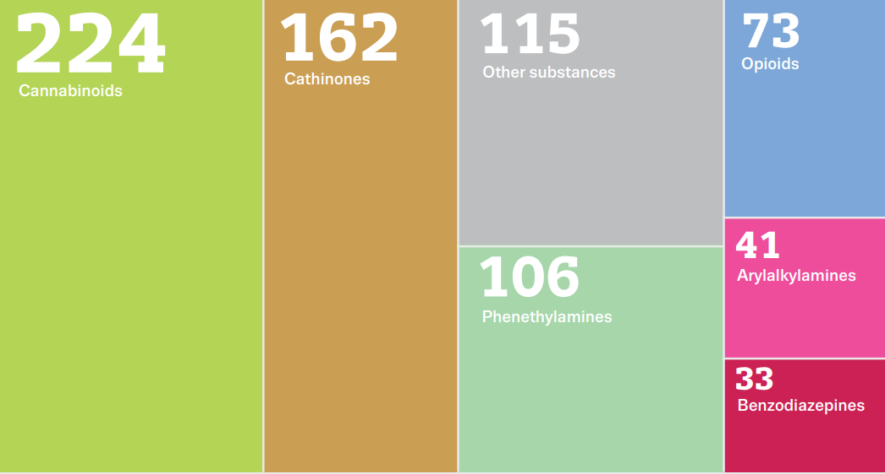
Source: European Drug Report 2022, EMCDDA
Notes:
1 new substance a week!

Slide 46
Risks
Respiratory depressant
Potent in small doses
Difficult to detect in samples
Drugs contain ‘hot spots’
Heroin purity is low
Presence of opioids in non-opioid samples, such as cocaine
Action
Information provision: NHS Inform, training
Strengthen naloxone provision and update guidance
Enhance forensic toxicology testing
Expand monitoring and data collection
Establish threat
Location
Groups
Likelihood of harms and death

Slide 47
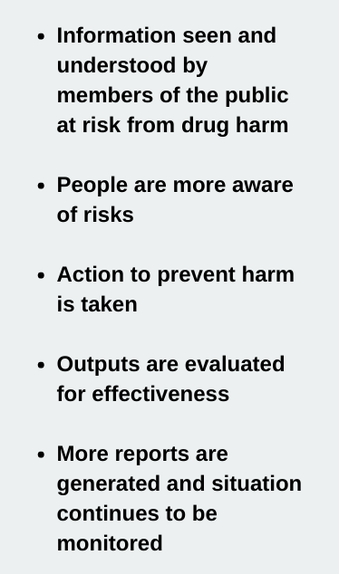
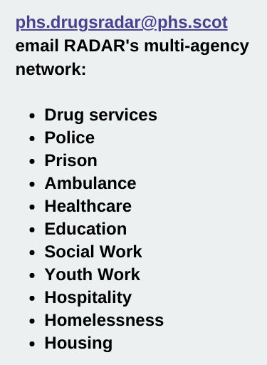
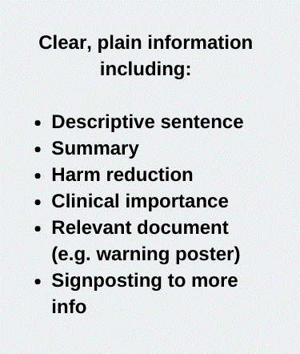

Slide 49
Section 4: Reflect on the power of developing nurturing relationships to support collective action that prevents drug-related harms

Slide 50
Collective action – challenges
Different agendas
Find common objectives
Managing expectations
Create realistic goals
Hearing all voices
Ensure representation and inclusion
Pandemic working
Collaborate in a crisis

Slide 51
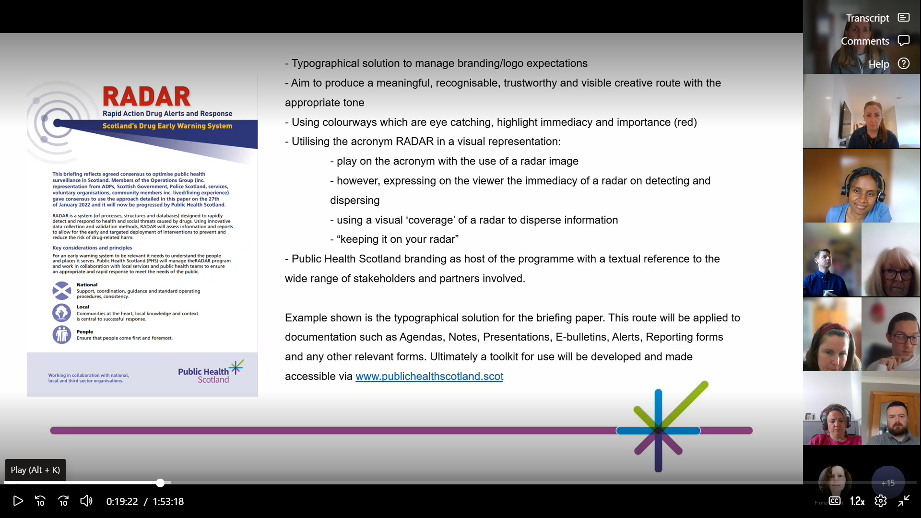
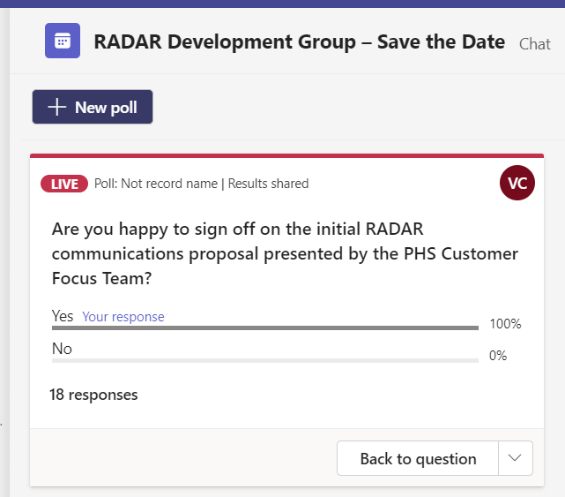
Partnership working – overcoming challenges

Slide 52
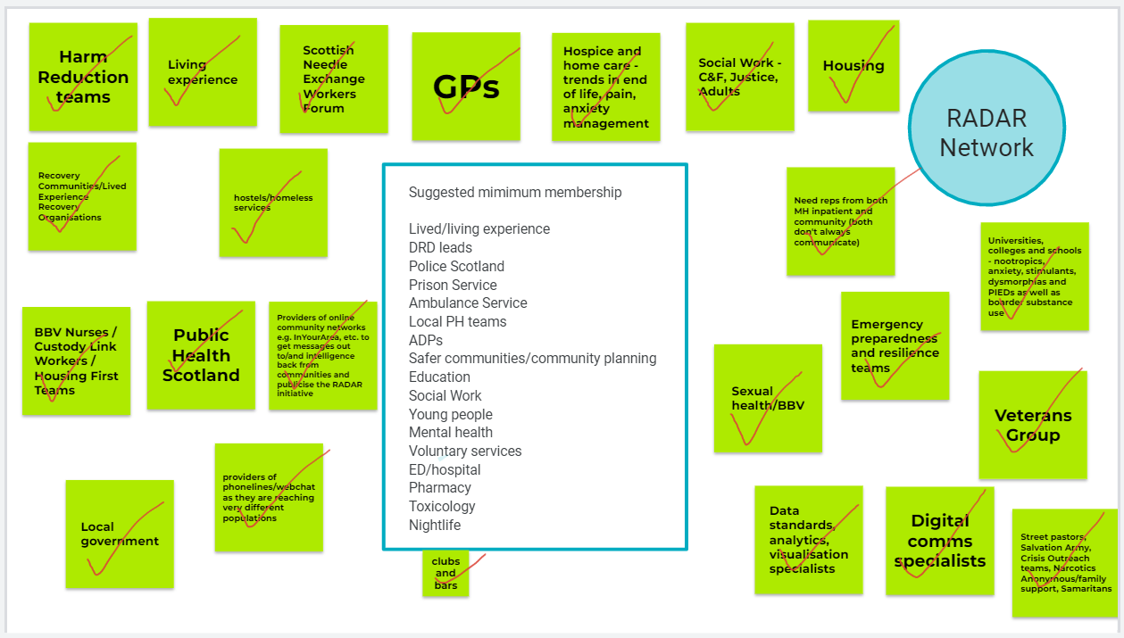
Partnership working – overcoming challenges
Challenges remain – how to encourage particpation in groups and network?

Slide 53
Collective action – benefits
Variety of inputs
Combines different knowledge and skills
Co-ownership
Builds identity, trust and credibility
Motivation
Through accountability and passion and drive of participants
Putting the action in RADAR
Our response relies on the partnership

Slide 54
























Slide 55
What can I do?

Slide 56


Slide 57
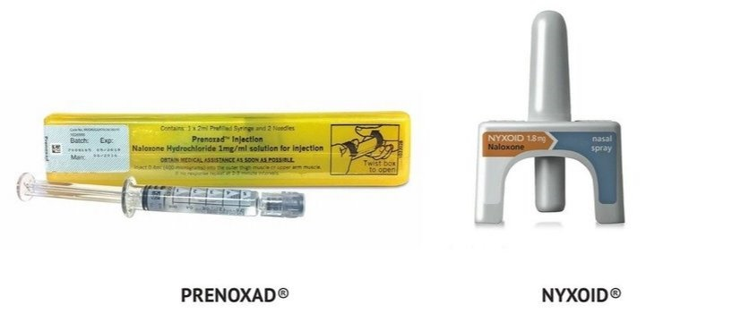
Overdose
Keep calm, get help and call 999
Give as much information as possible including location, age, gender, what has happened and be honest about what they have taken
Stay with them and check on them regularly
Naloxone should be given to anyone who is non-responsive and displaying the signs of an overdose.
If you are unsure if the person has taken opioids, always use naloxone as this will not cause any harm.

Slide 58

Video: https://www.sdf.org.uk/
Notes:
Ask Yvonne for screens in event space

Slide 59
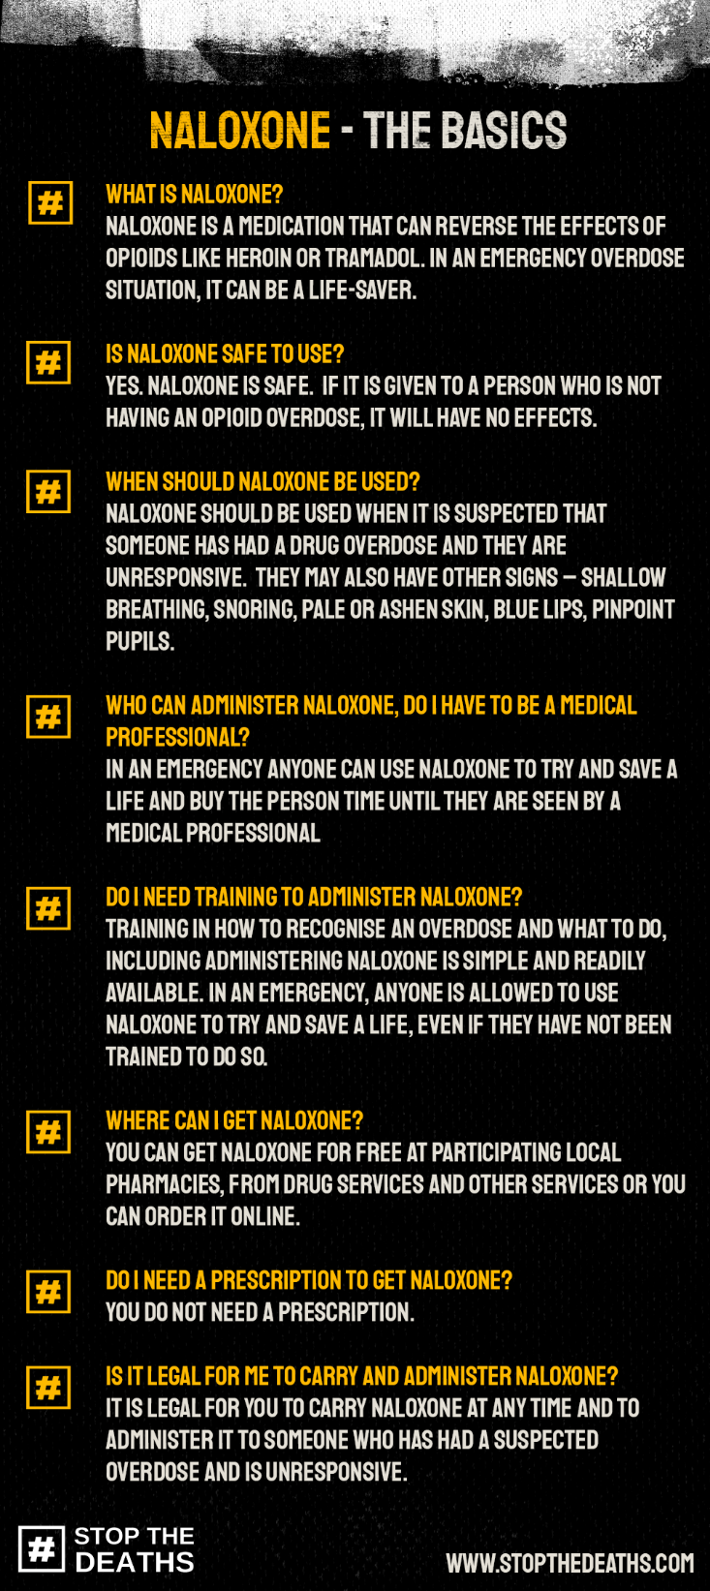

Slide 62
What now?
  Reach out
  Break the stigma
  Carry naloxone
Notes:
Thinking about your language
Check status of DPIA

Slide 63
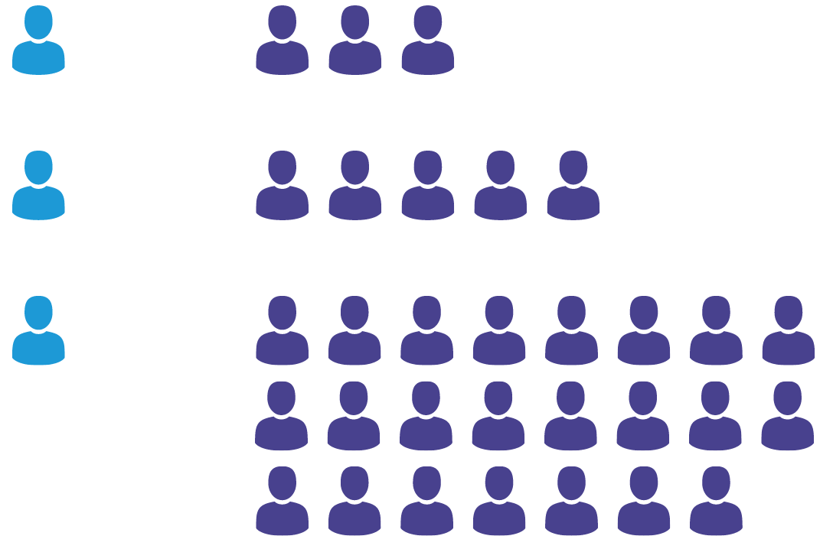
For every one death…
In Northern Ireland
In England and Wales
In Europe
Source: Scotland data, NRS | England and Wales data, ONS | Northern Ireland data, NISRA | Europe, EMCDDA
Notes:
23

Slide 65

Audience Q&A Session
ⓘ Start presenting to display the audience questions on this slide.

