Slide 1
Building Virtual Capacity for Resilience and Recovery - The Patient Will See You Now!
Insert Video Link

Slide 2
Building Virtual Capacity for Resilience and Recovery - The Patient Will See You Now!
Chair: Helen Maitland
Director of Unscheduled Care
Scottish Government

Slide 3
Building Virtual Capacity for Resilience and Recovery - The Patient Will See You Now!
Professor Graham Ellis
Deputy Chief Medical Officer, Scottish Government
Honorary Professor, Glasgow Caledonian University

Slide 4
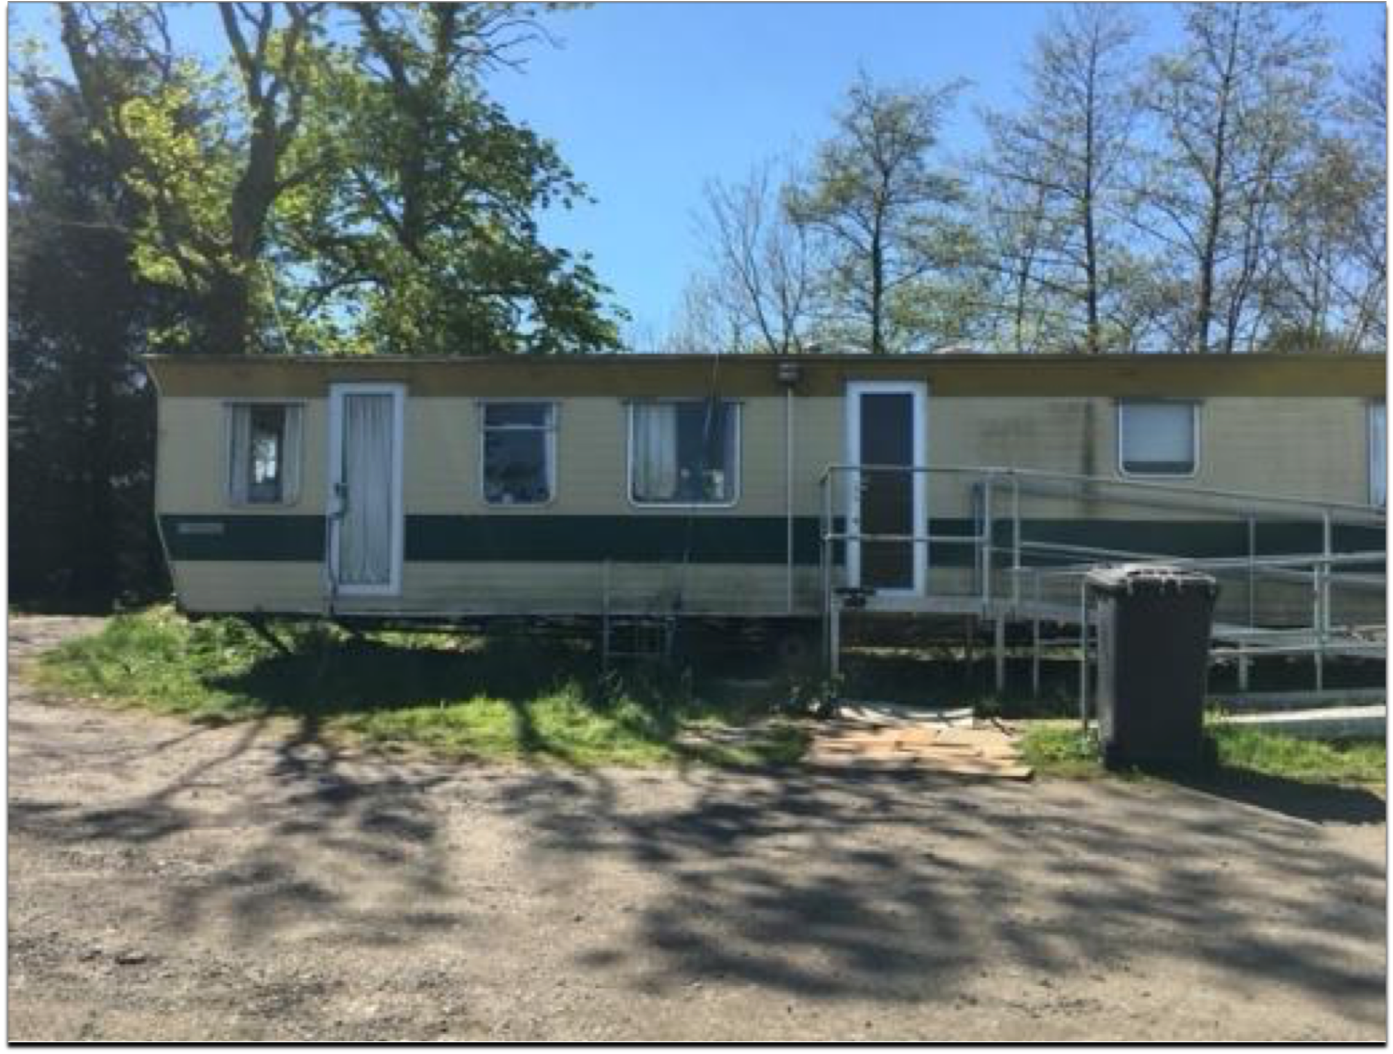

Slide 5
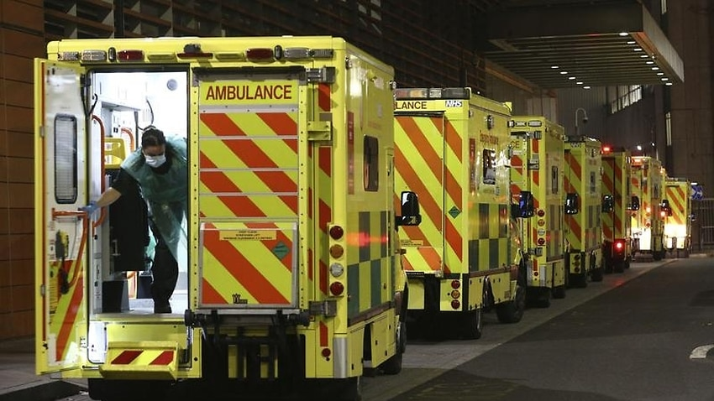

Slide 6
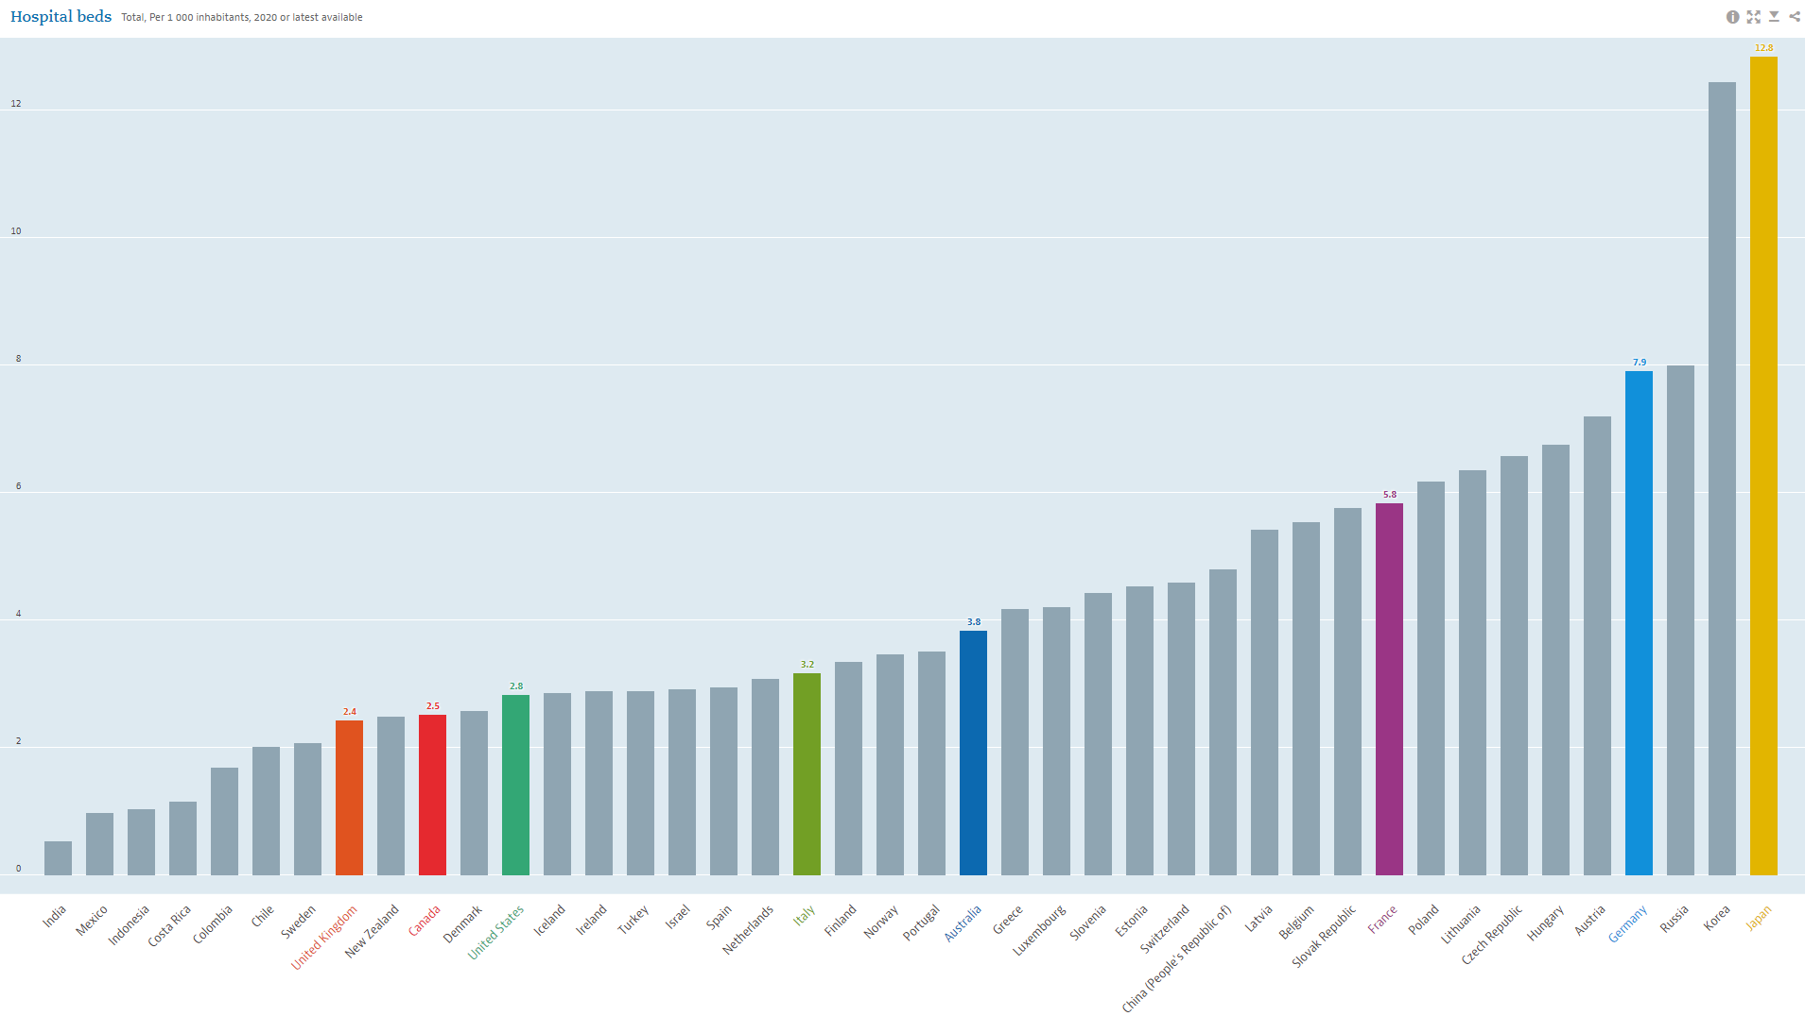
Acute Bed Capacity
Japan
Germany
UK
2.4/1000
France
Australia
Canada
Italy
USA

Slide 7

























































Virtual Beds

Slide 8
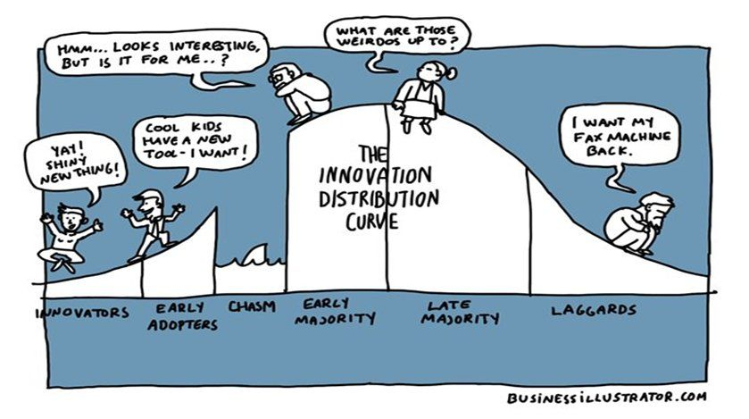
Spread?

Slide 9
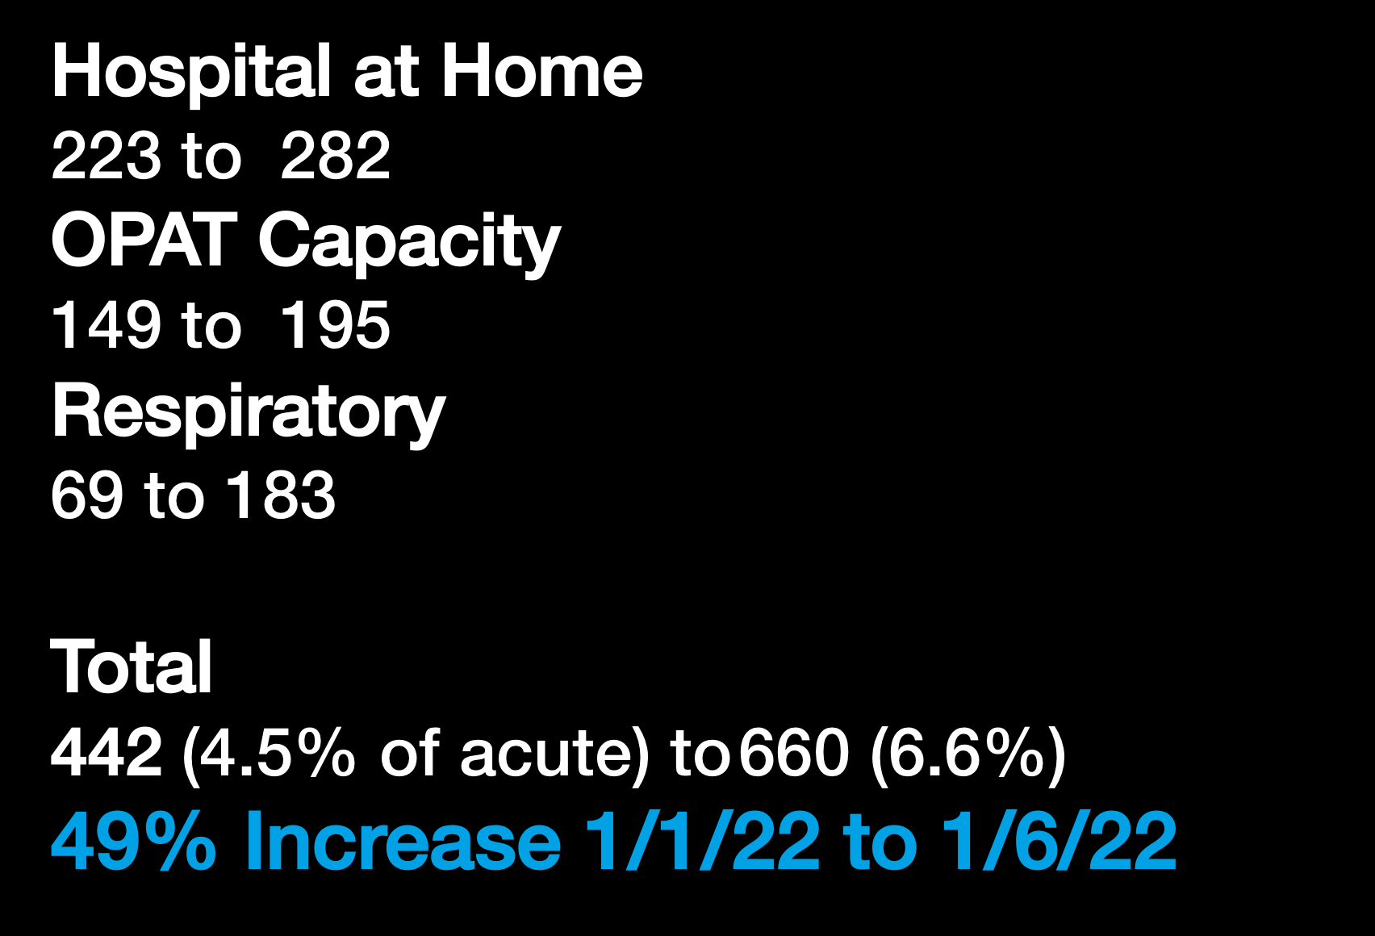
Virtual Beds

Slide 10







Victoria Hospital Fife
458 beds

Slide 11
Expanding Access to OPAT
Dr Claire Mackintosh
Infectious Diseases Consultant
NHS Lothian

Slide 12




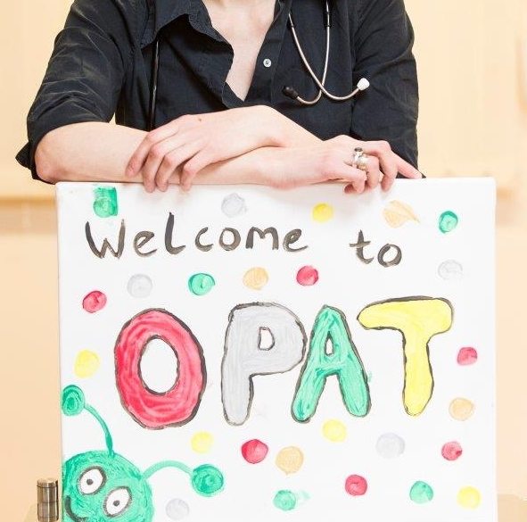
Expanding access to OPAT
Dr Claire Mackintosh
Infectious Disease Consultant
NHS Lothian

Slide 13


OPAT v 1.0
OBD

Slide 14
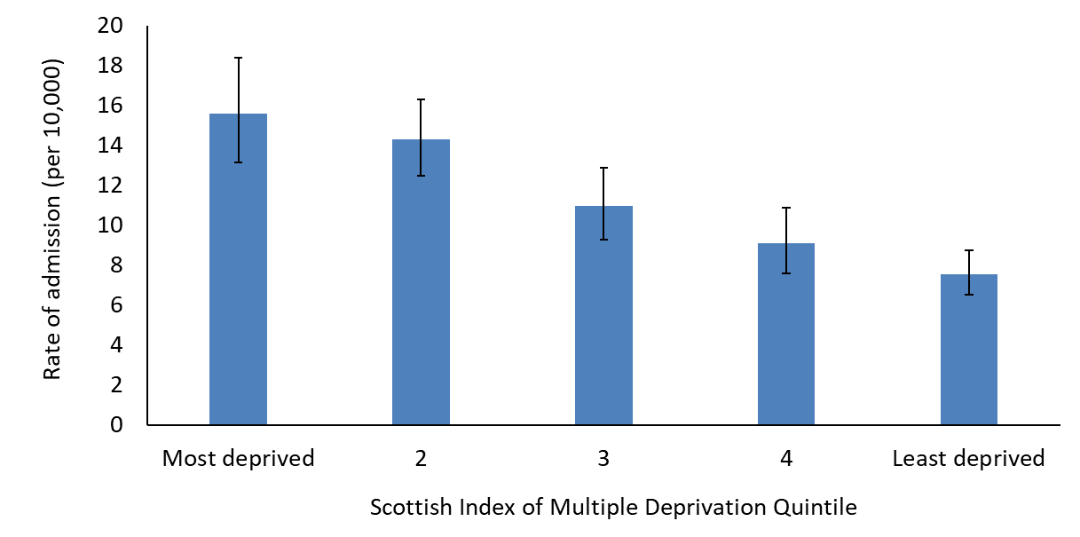
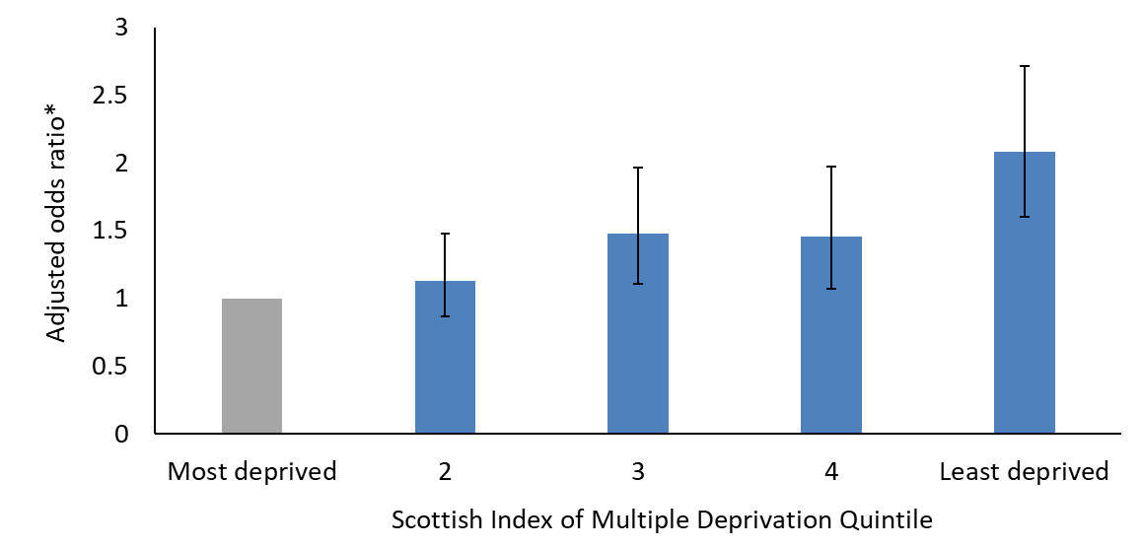
Demand for OPAT
Adjusted odds of OPAT
Adjusted for age, sex, total number of admissions, total length of stay,
total comorbidities, time since first admission and distance from clinic
Sumpter et al. International Journal for Equity in Health (2020) 19:150

Slide 15
Community OPAT
March 2020 – Feb 2021
in addition to regular hospital-based OPAT
185 patients treated at home
median age 62.8 years, median 1.8 co-morbidities
Of these 42 (22.7%) would not have managed hospital based OPAT
  These included:
    patients who were homeless (via Milestone House)
    Patients with profound anxiety
    Palliative patients
    Patients with no affordable transport

Slide 16

Milestone House Intermediate Care Unit
April 2020 – April 2021
Funded to support ongoing recovery from COVID19 in patients who were homeless or at risk of homelessness
Partnership between Edinburgh HSCP, NHS Lothian RIDU, Primary Care – Edinburgh Access Practice, Social work, Housing, Cyrenians, Waverly Care
76 admissions – 58 individuals (45 m, 13 f)
36 hospital step down
12 admissions were an alternative to hospital admission
17 were supported with complex wounds
23 supported to complete planned treatment
85% of those with a planned discharge left to sustainable accommodation

Slide 17
Drivers of equity
Avoidable Inequity
Lower SES not referred
Never heard of or forgotten about OPAT
False perception of OPAT
Lower SES cannot accept
Lower SES choose not to accept
Cost of transport
Patient Preference
Unaware of referral criteria
Unaware of availability of support
False perception of patient
Lack of time to complete referral
Aware of OPAT but not how to refer
Believe OPAT to be inferior
Professional
Patient

Slide 18
Patient assessment
Patient medically stable
Infective diagnosis clear
Source control achieved
Organism and sensitivities identified
If empirical treatment instituted then treatment plan clear
Appropriate antibiotic plan deliverable in outpatient setting
Patient keen to be at home
LOGISTICS

Slide 19
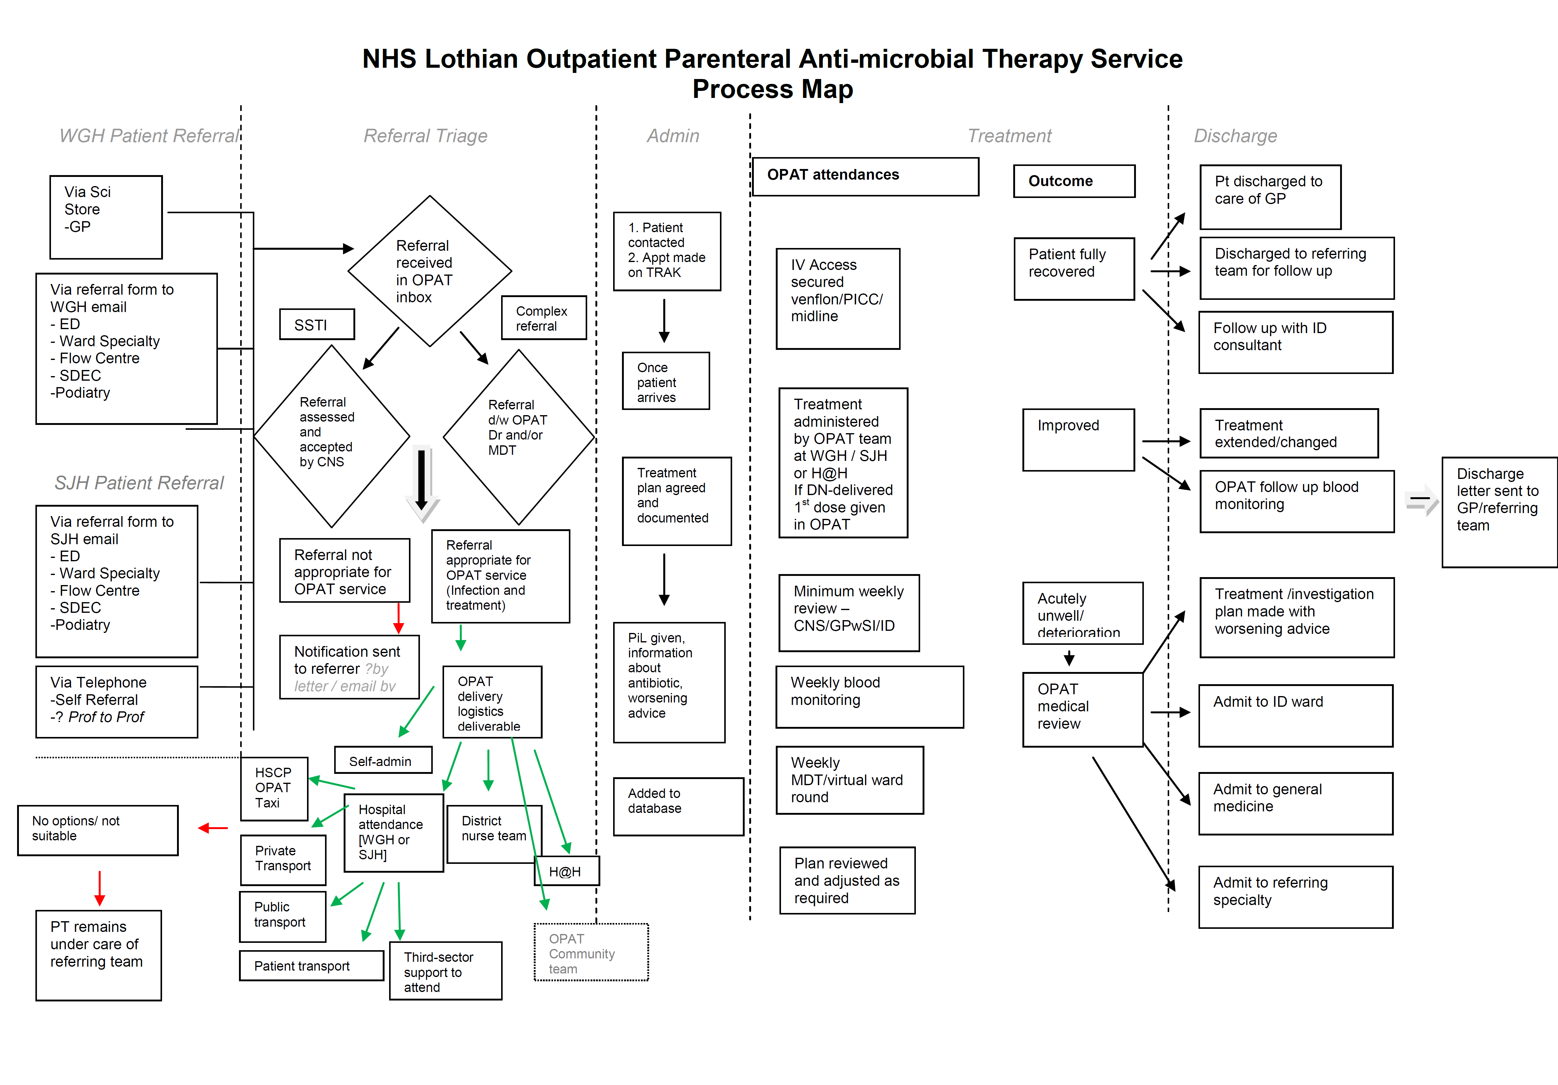

Slide 20
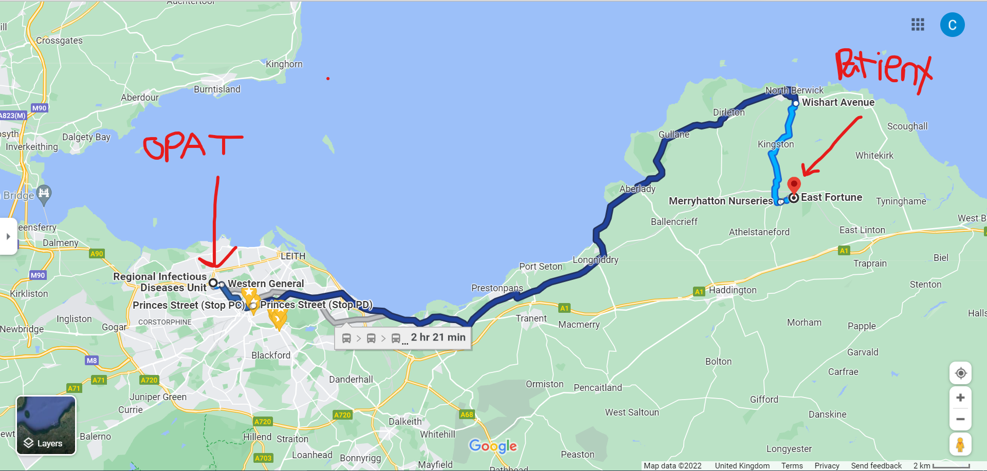
82 yr old man – septic arthritis right shoulder – organism/anbx
Usually fit and well and independent - No longer drives – cares for his wife who has dementia - desperate to get home
Alternative is minimum
2 weeks hospital admission

Slide 21
35 yr old, recently moved to UK from RSA, 13 weeks pregnant, late latent syphilis infection, penicillin allergic, HIV/HBV positive
She was living in a women’s refuge after suffering domestic violence
She knew no-one in Scotland and had very little money
Poor mental health
Requires 14 days IV antibiotics - alternative is hospital admission

Slide 22
42 year old man
Admitted with infected DVT and groin abscess with septic emboli in lungs secondary to injecting drugs
Homeless, untreated HCV infection
After 10 days in hospital – wished to take his own discharge – finding it very difficult to remain in hospital
IV line in situ
Requires 4-6 weeks of ongoing antibiotic treatment
Alternative is discharge against medical advice with a v high chance of emergency readmission and poor health outcome

Slide 23
Secondary Care Inclusion health
Those experiencing homelessness have higher acute hospital admission rates than the most deprived cohort.
Accident and Emergency attendance rates of those experiencing homelessness are almost twice that of the most deprived cohort.
Duration of admission - estimated to be three times longer for patients experiencing homelessness,
At Edinburgh Access Practice (2018 Audit)
73% have a drug use problem, 37% alcohol problem
70 % have a triple morbidity of physical, mental health and substance use problems

Slide 24
Secondary Care Inclusion health
How can you receive OPAT/Hospital at home/ambulatory care
if you don’t have a home
If you have no transport
If you have no social support
If you are suffering from addiction

Slide 25



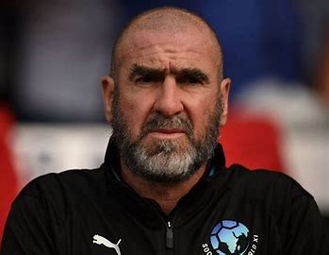





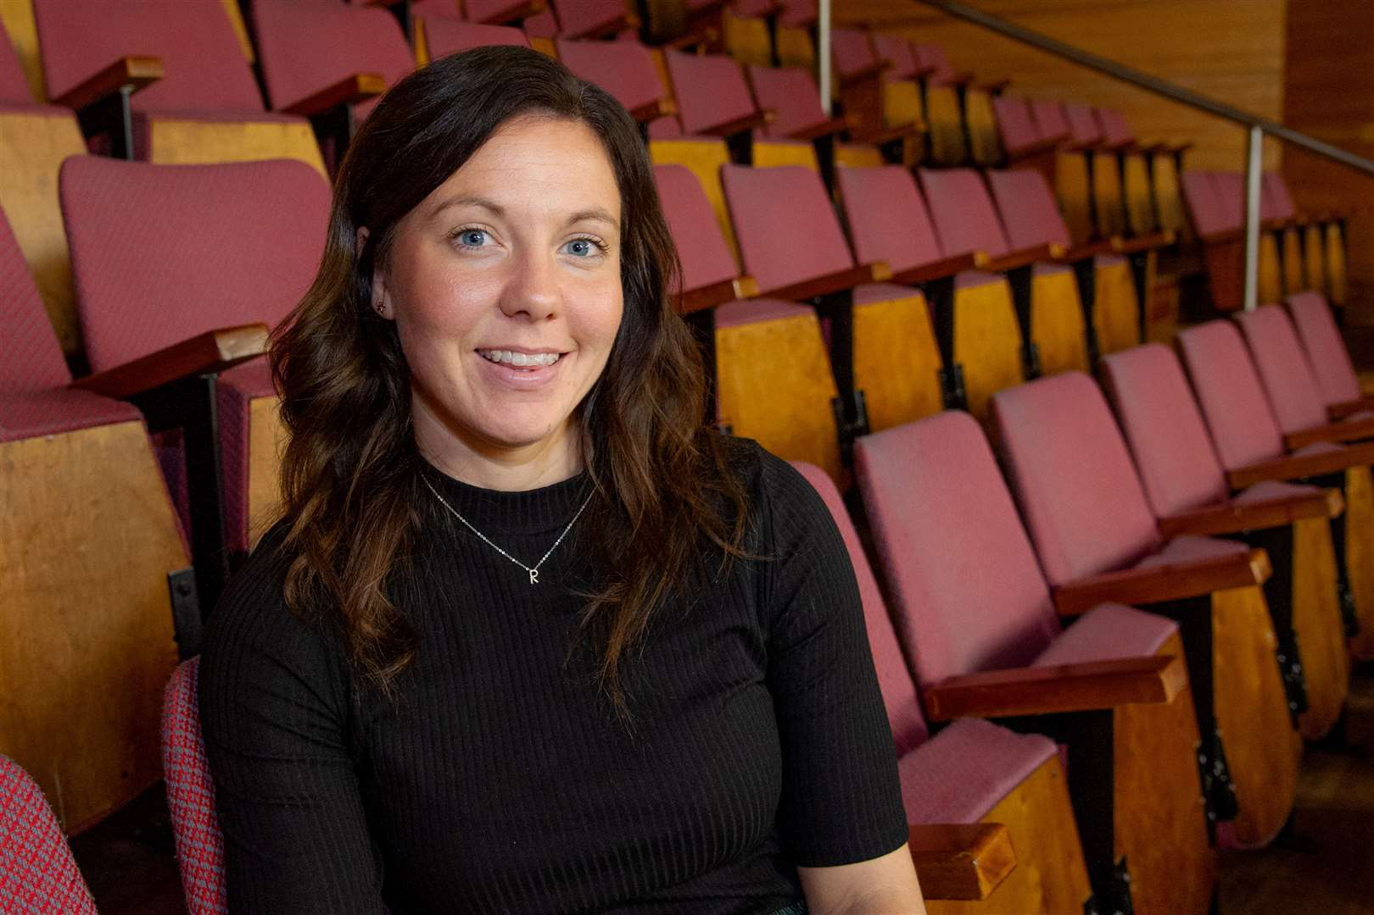
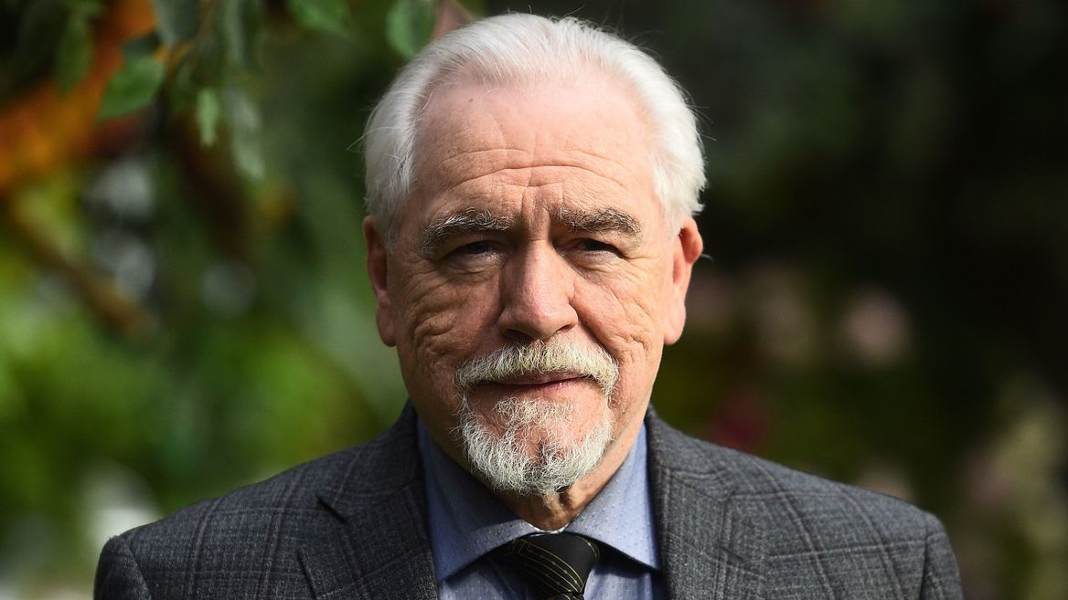









District Nursing team
Community OPAT team
Milestone House Intermediary Care Unit and 3rd Sector
Hospital at Home Team
Hospital OPAT Team

Slide 26
OPAT 2.0

Slide 27
Take home points
Data are good but inequity is easily missed and actively reducing health inequalities should be built into all new service developments (in the same way cost-effectiveness is)
Solutions should be individualised, and may be different for different needs
Solutions need to suit the patient, complexity around the delivery of the service should be carried by the service
poor housing, addiction, poverty are health issues – biomedical hospital practice not good at considering them such and pressure on flow means opportunity to improve health in its widest sense can be missed

Slide 28
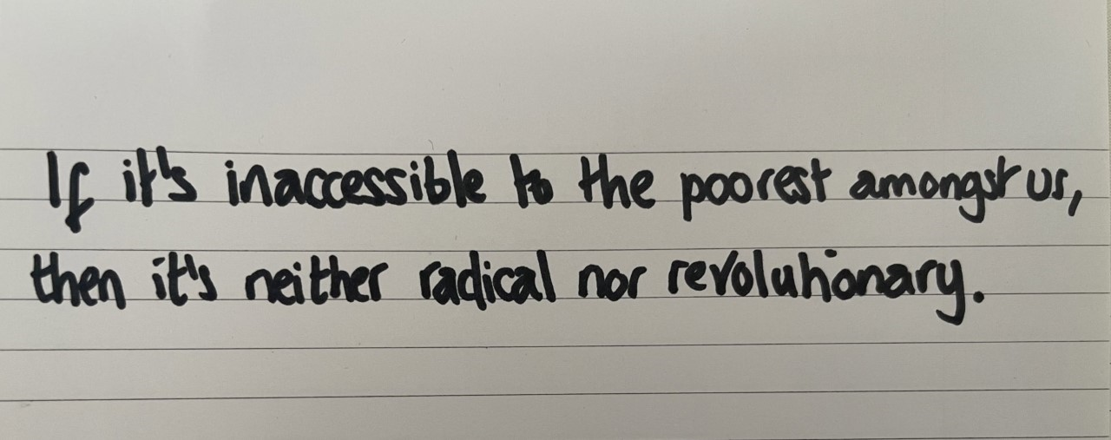
Jack Monroe Anti-poverty campaigner

Slide 29
HOSPITAL AT HOME - No boundaries
NHS Western Isles

Slide 30




Hospital at home
No Boundaries
NHSWI June 2022

Slide 31

SET UP
20K
COVID response
HIS support and expansion
Focus: decrease inpatient demand
Geography and Demographics
5K
1K

Slide 32
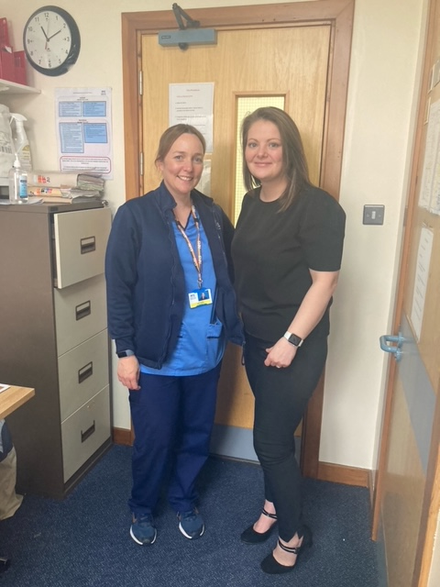
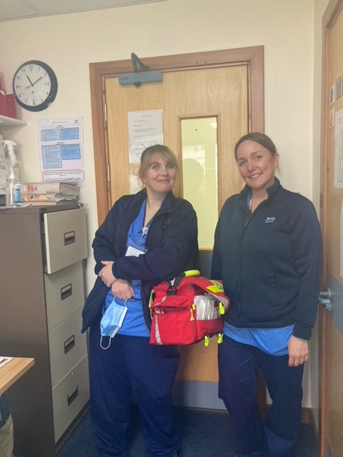
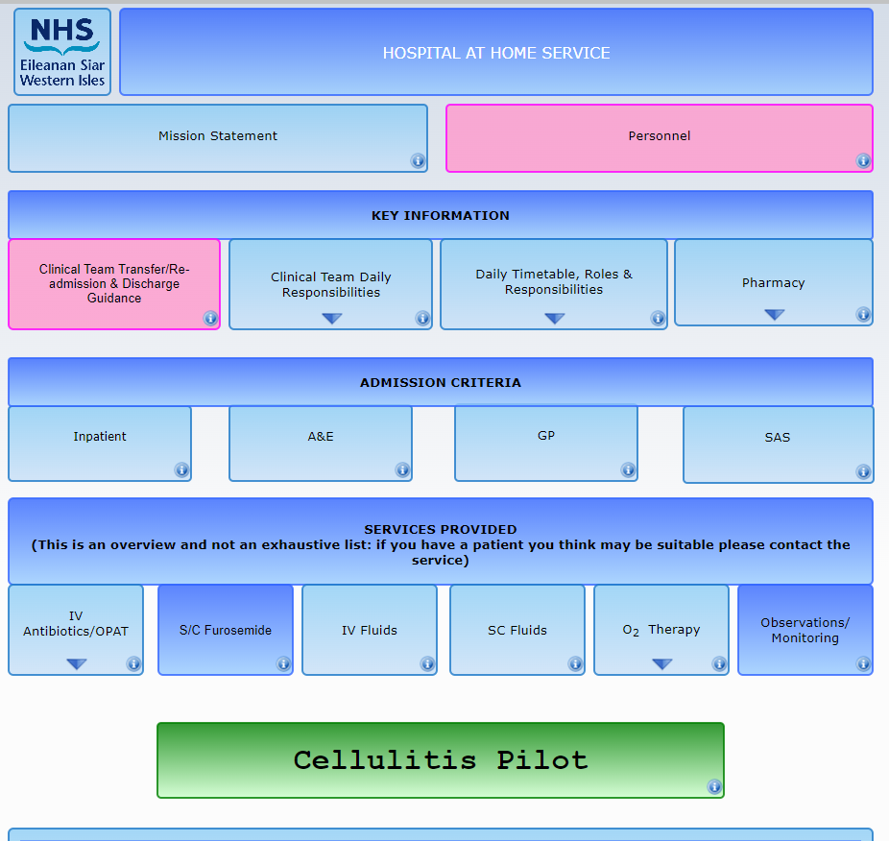
HaH-CORE DUTIES
LIMITATIONS (NO LIMITATIONS)

Slide 33
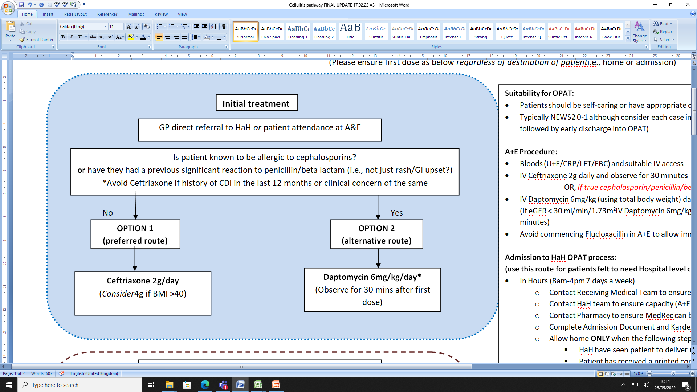
OPAT
Move to dedicated HaH team responsibility
Move to once daily
U&UC work
  Cellulitis pathway pilot
  Daily check in for all IV patients
  No restrictions (Gentamicin, Teicoplanin etc.) Direct from A+E, Direct from home/care home

Slide 34
RESPIRATORY
UNTAPPED POTENTIAL

Slide 35
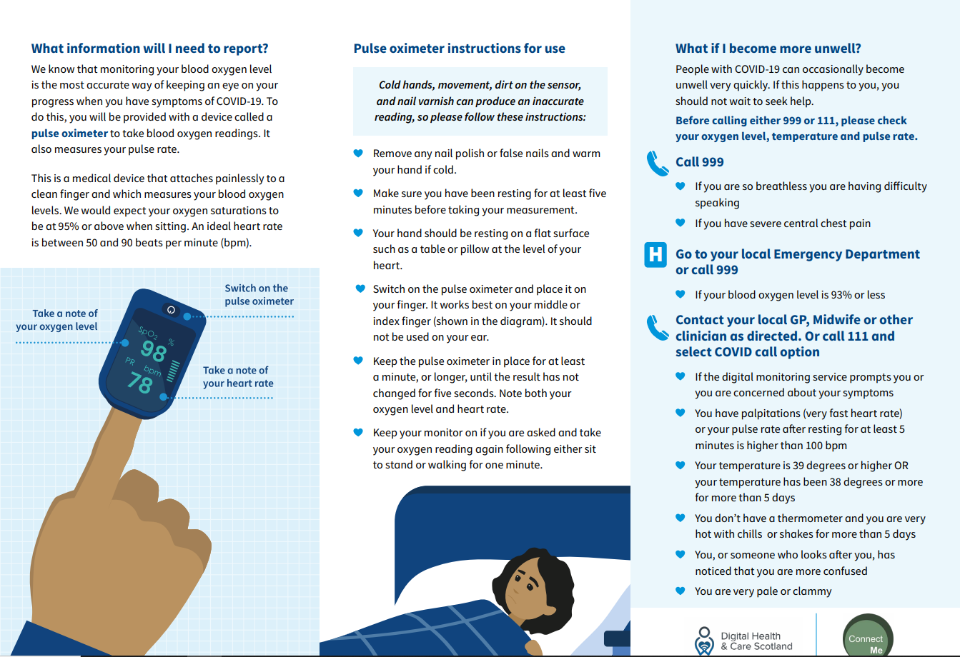
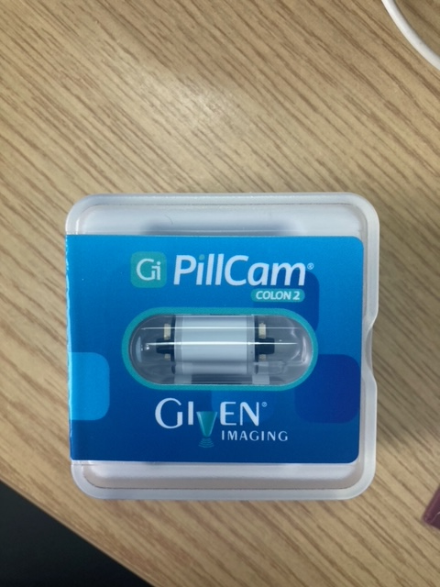
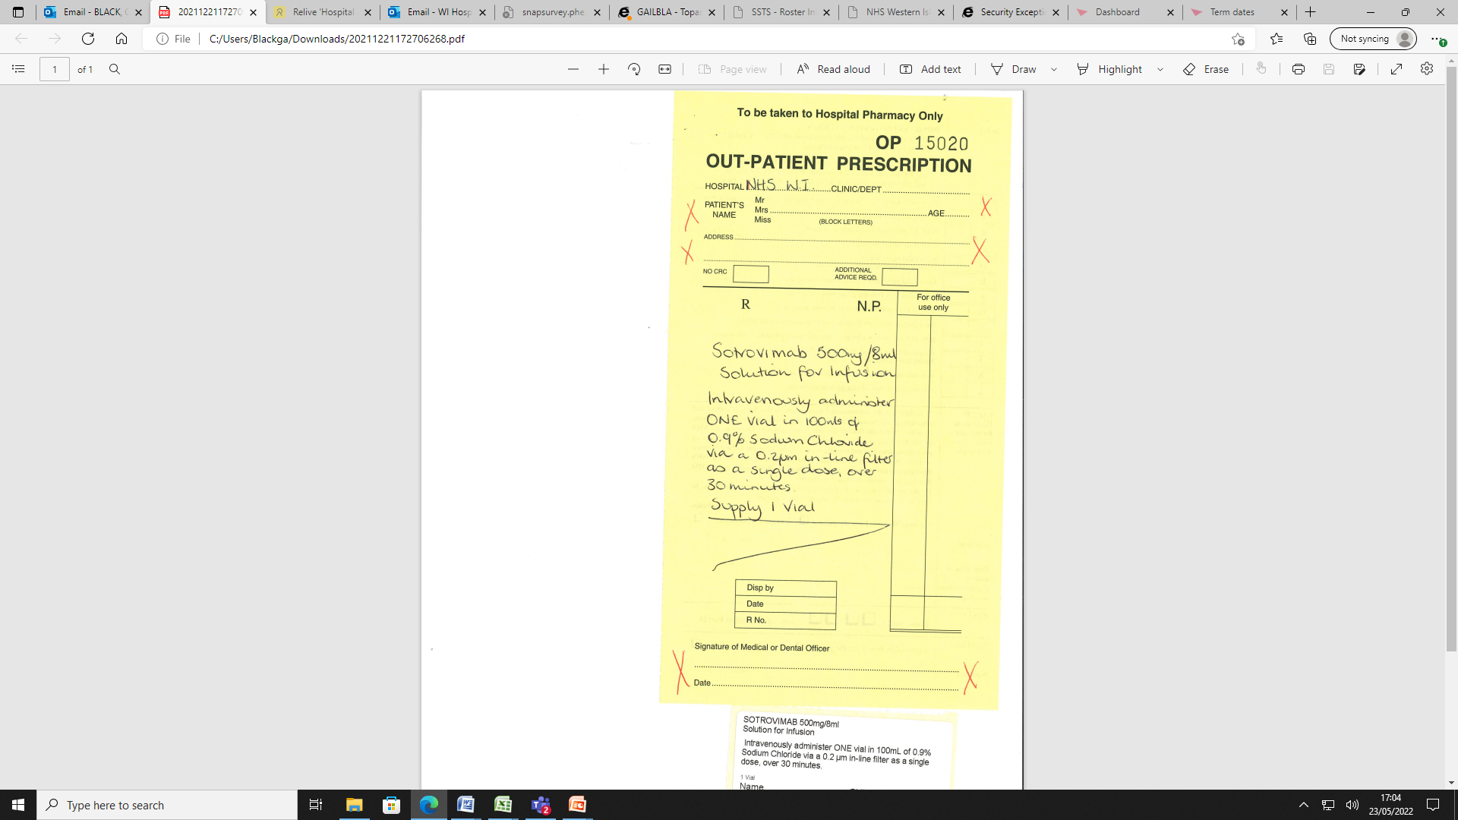
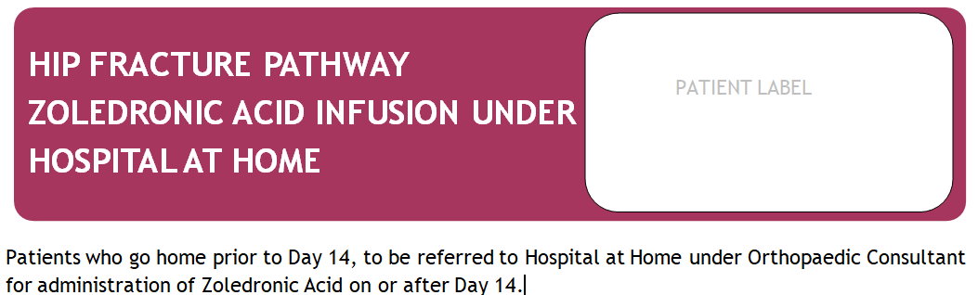
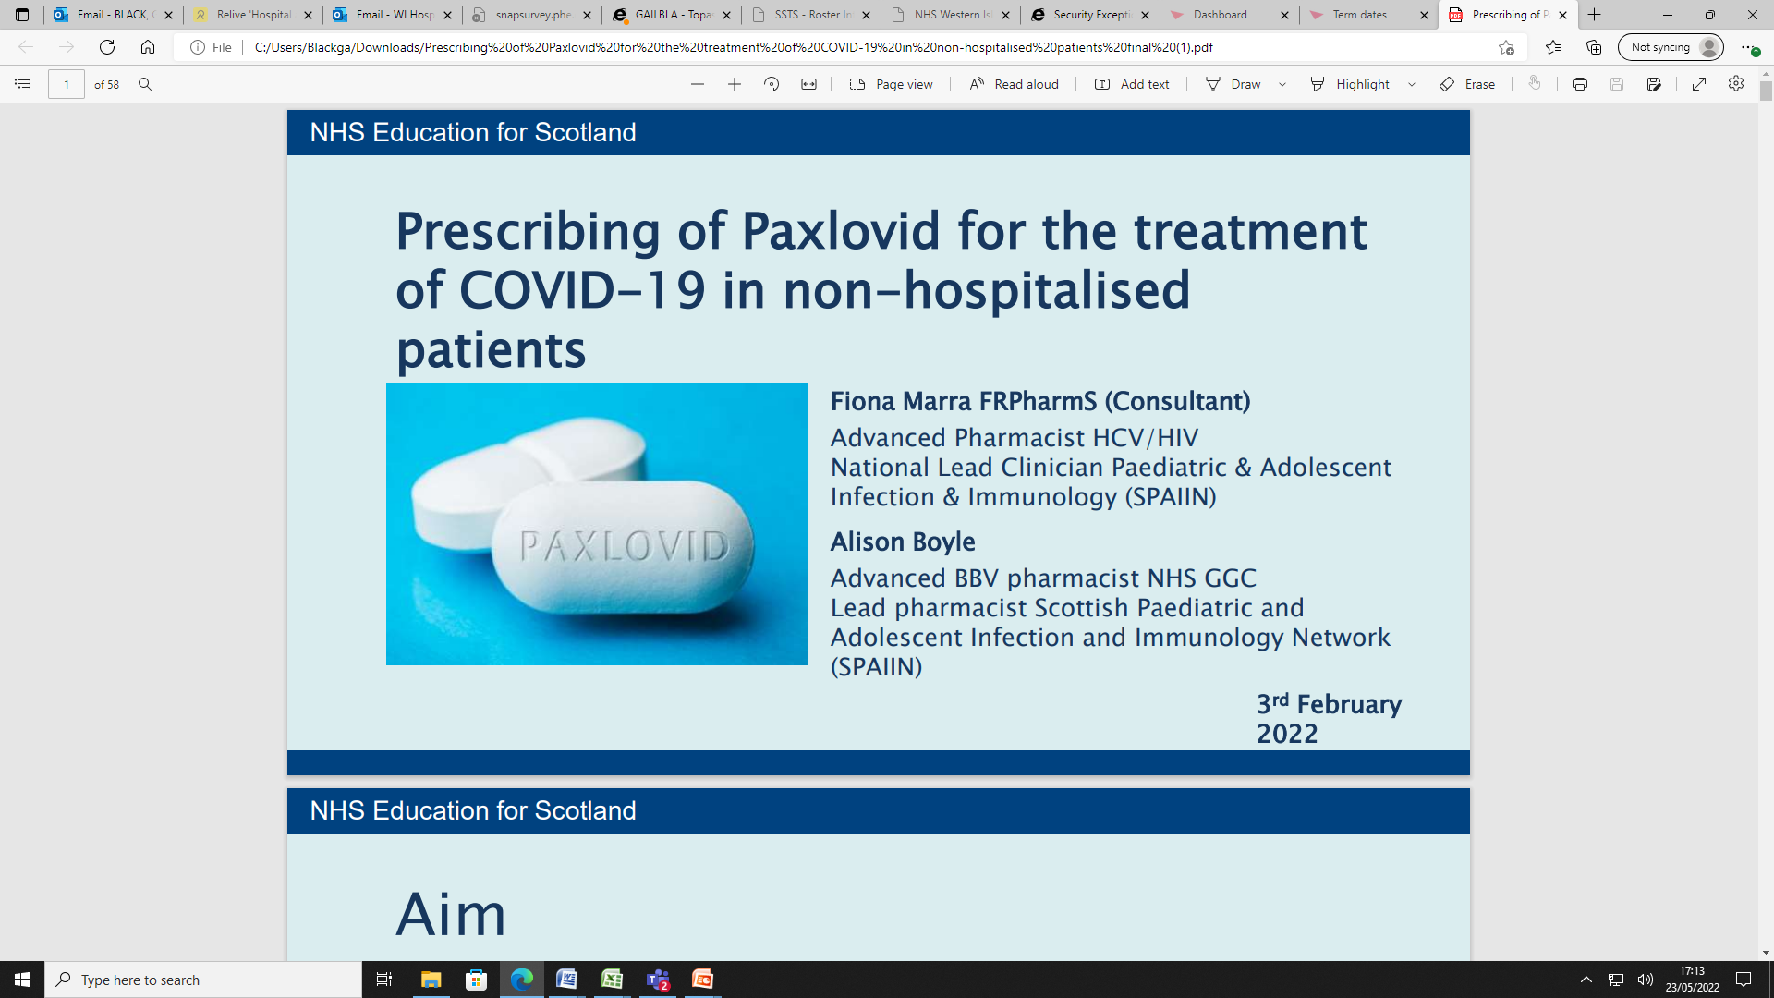
OUT OF THE BOX THINKING
SUSTAINABILITY, PROBLEM SOLVING, INNOVATION

Slide 36

SUCCESS?
Permanence
Equity of Cover (map)
Virtual Ward Round
OPAT- expansion
NHSS event
Normal Business
“Excellent service with professional friendly staff”
“Excellent care and service provided by the team for which I am so thankful for allowing me to stay at home for treatment”
“coming to work at HaH is a delight each day. Seeing patients improve in their own home gives a great level of satisfaction, knowing you have cared for them with minimal disruption to their home lives while maintaining their independence”

Slide 37
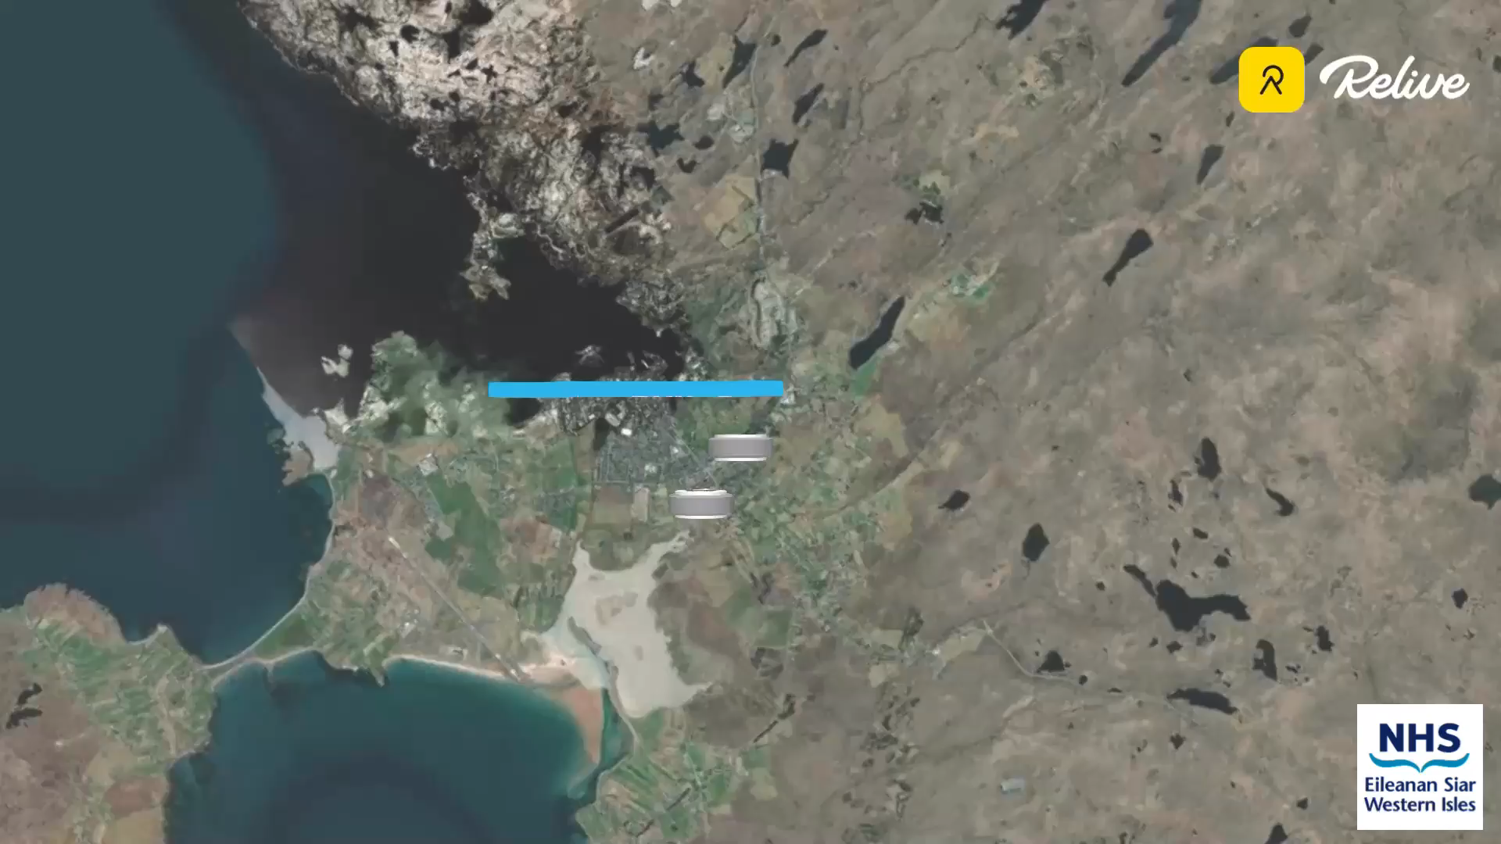

THANK
YOU
INSERT “Gail’s Journey” VIDEO TO THIS PAGE to start on click

Slide 38
Building Virtual Capacity for Resilience and Recovery - The Patient Will See You Now!
Dr David Anderson
Consultant in Respiratory Medicine
NHS Greater Glasgow & Clyde

Slide 39
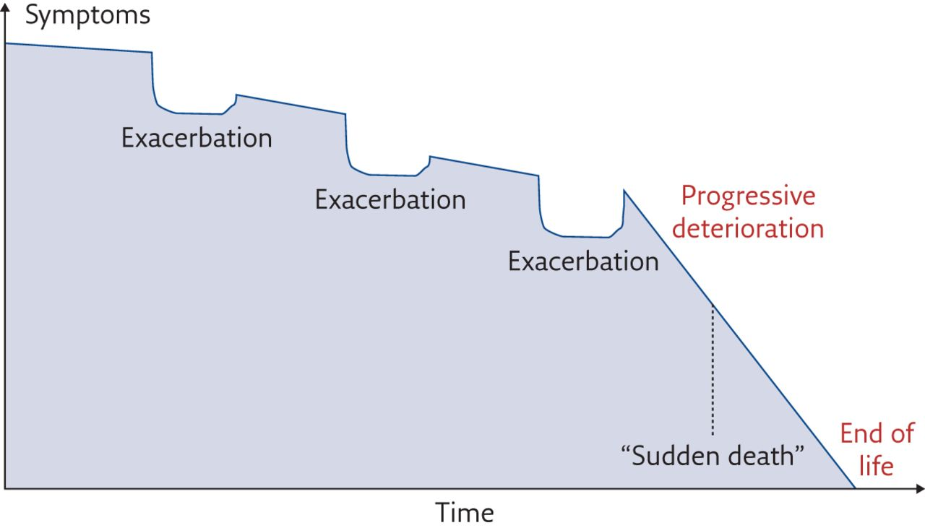
The disease trajectory expected in a patient with COPD
Improving the Journey
Early diagnosis
Smoking Cessation
Manage Exacerbations
Pulmonary
Rehabilitation
Manage Hypoxia
Respiratory Nurse Specialists
Psychology Support
Palliative
Review
Dietetic Input
Community
Resp Teams
Financial Support
Palliative
Review
Lung Volume Reduction Surgery
Transplantation
Dom NIV
Amanda Landers et al. Breathe 2017;13:310-316
©2017 by European Respiratory Society
Notes:
The disease trajectory expected in a patient with COPD. Adapted from [5].

Slide 40
Admission Alternative and Admission Prevention
Admission Alternative. Chronic conditions may deteriorate and they are unable to be safely managed at home without additional support. Eg Community Respiratory Teams
Admission Prevention. Chronic conditions interventions, which can improve quality of life, prevent hospital admission and prolong life
Often the same Respiratory service will provide both Admission Alternative and Admission Prevention during the intervention period.

Slide 41
Definitions
1. Community Respiratory Team Services
  Multidisciplinary teams based in the community to which Primary and Secondary Care teams can refer
2. Home Monitoring and Supported Self Mangement
  Use of electronic devices to supply community based support and enhance medical knowledge of patients deemed suitable for self-management
3. Early Supported Discharge Teams.
  Secondary care based respiratory teams support early discharge of patients into the community and provide early specialist input to patients
4. Ambulatory Respiratory Services Hot Clinics.
  Patients presenting with acute conditions such as community acquired pneumonia, venous thromboembolism and pneumothorax.

Slide 42
COPD Bed Days in
NHS Greater Glasgow and Clyde
14/15 46 345
15/16 43 168
16/17 41 799
17/18 37 605
18/19 33 000

Slide 43
Future Process
Prolonged period to next exacerbation
Exacerbation
Admission
Discharge
Gradual Deterioration
Emergency Serices
Digital Pathway
Formal Rehab Program
Contact CRT
Anticipatory Care Plan
(if appropriate)
COPD
PATIENT
Hospital @ Home Services
OP Antibiotic Therapy
Digital Pathway
MDT / Hot Clinic Review
Vent / Oxygen Support
Ambulatory HF
Early Introduction of Rehab
Managed at Home
Acute Frailty
Service
Digital Pathway

Slide 44
Respiratory Ambulatory Services
Benefits for Patients​
Care closer to home​
avoid longer patient hospital stays​
Reduced infection risk​
Across all ages without boundaries​
Benefits for Boards​
Improves hospital flow​
Reduced hospital occupancy ​
Improved length of stay rates​
More cost effective​
Better patient experience​
Interface Care​
Multi-professional & cross-organisational working ​
Whole system of care with overarching clinical governance​
Holistic approach to physical & mental well being​
Not a ‘one size fits all’ approach

Slide 45
Hospital @ Home
NHS Forth Valley experience
Dr Claire Copeland
Associate Medical Director – Integration and Unscheduled Care
NHS Forth Valley

Slide 46
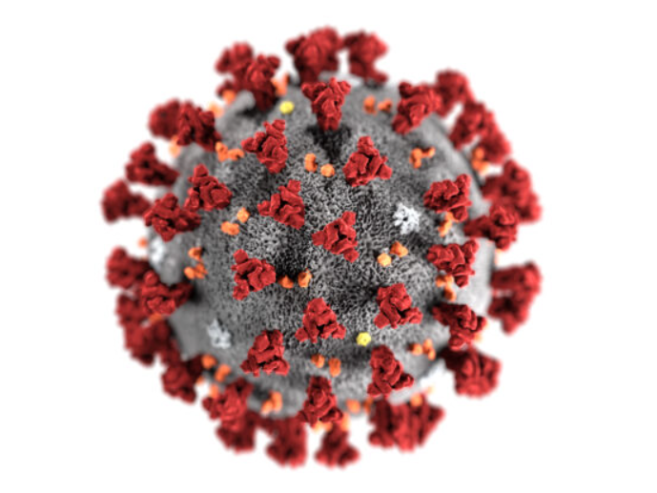
The journey begins....

Slide 47
The ask
Triage of breathlessness
  COVID
  Heart Failure
  COPD
Interface of the future & frailty
  OPAT into winter

Slide 48
Hospital at Home
Geriatrician Enhanced Care Team (ECT)
Over 6wks avoided 58 admissions
Stepped up 5 patients to community hospital
Total bed days saved (acute) = 906
Total bed days saved (community based on 14% transferred there) = 378

Slide 49
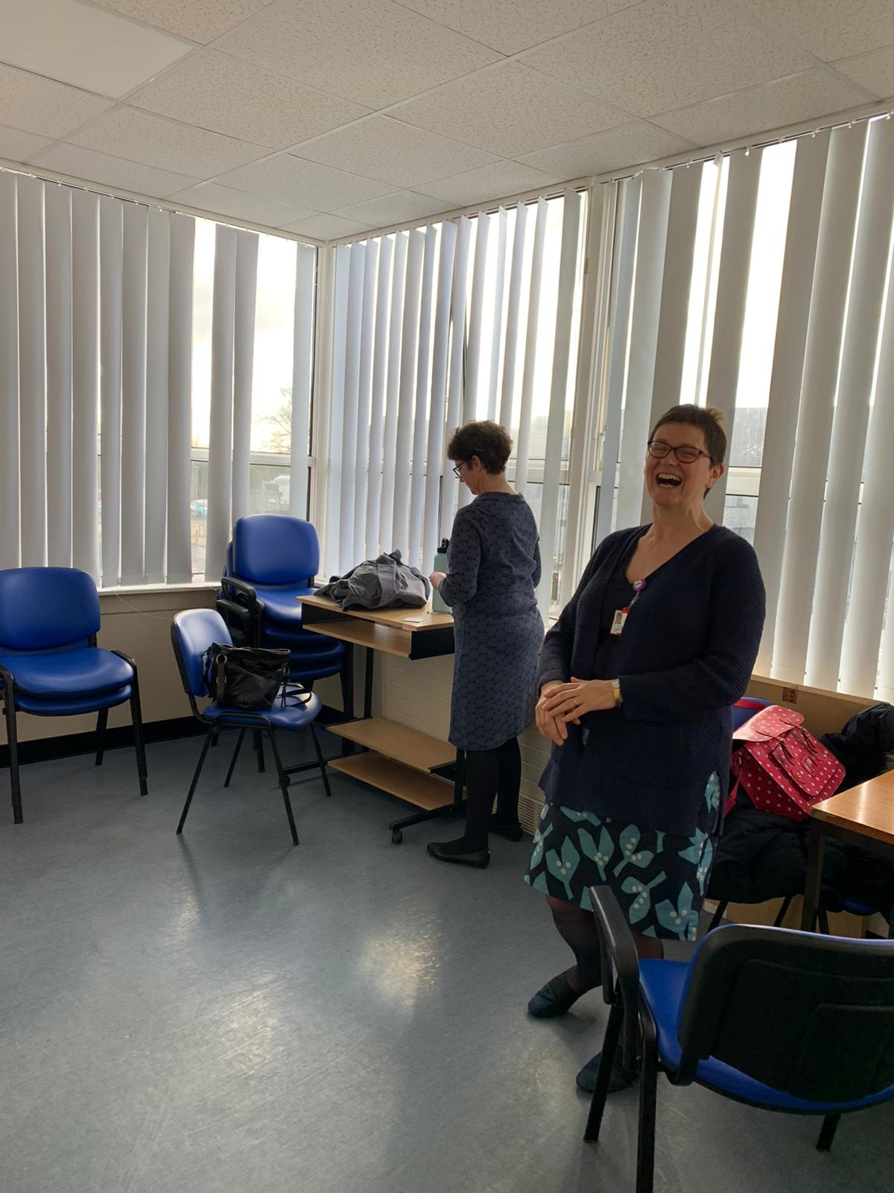
Making it happen
SPRINT meetings x2 weekly
  Core group of 10, full attendance
  30mins
  Task focused
Business case
Sub groups
  Pharmacy & hempa
  IT services
  OD Staff engagement
  Accommodation
  Transport

Slide 50
The nitty gritty
Experience of other services
Weekly safety brief
Monthly leaders meeting
Coding & HSMR
E-forms & out of hours

Slide 51
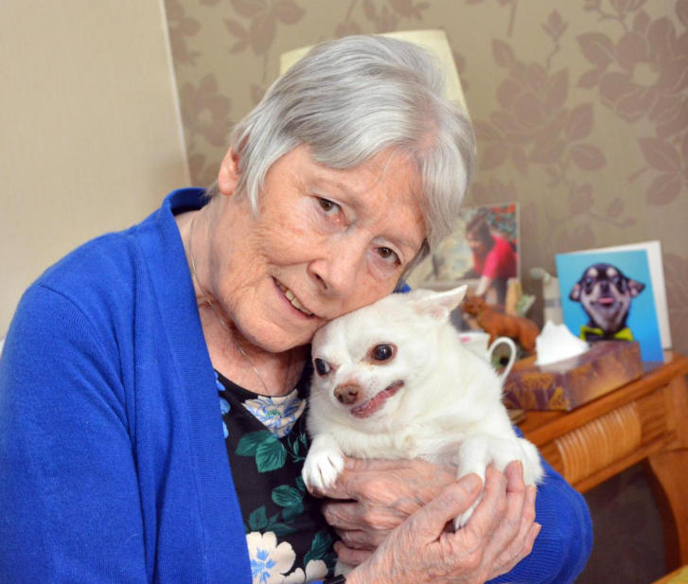
“I also have a little dog and I didn’t want to leave her. Being able to stay at home with her was very important to me and, fortunately, with the support of the Hospital at Home team I was able to do this.”

Slide 52
Data
May 2021 - May 2022

Slide 53
Number admissions |  | 771
 | Direct (GP) | 529 | 68.8%
 | Transfers (step down) | 242 | 31.40%
Locality | Falkirk | 394 | 51%
 | Clackmannanshire | 133 | 17.30%
 | Stirling | 200 | 25.90%
 | Rural Striling | 36 | 4.70%
 | Other | 8 | 1%
Step up to Acute |  | 174 | 22.6%
Average LoS |  | 6.9 days
Median Los |  | 5.0 days
Max LoS |  | 56 days
Bed days saved based on LoS 2021 for Frailty positive patients |  | 20.1 days | 15, 497

Slide 54
Future
Increase capacity
Integration
Recruitment & retention

Slide 55
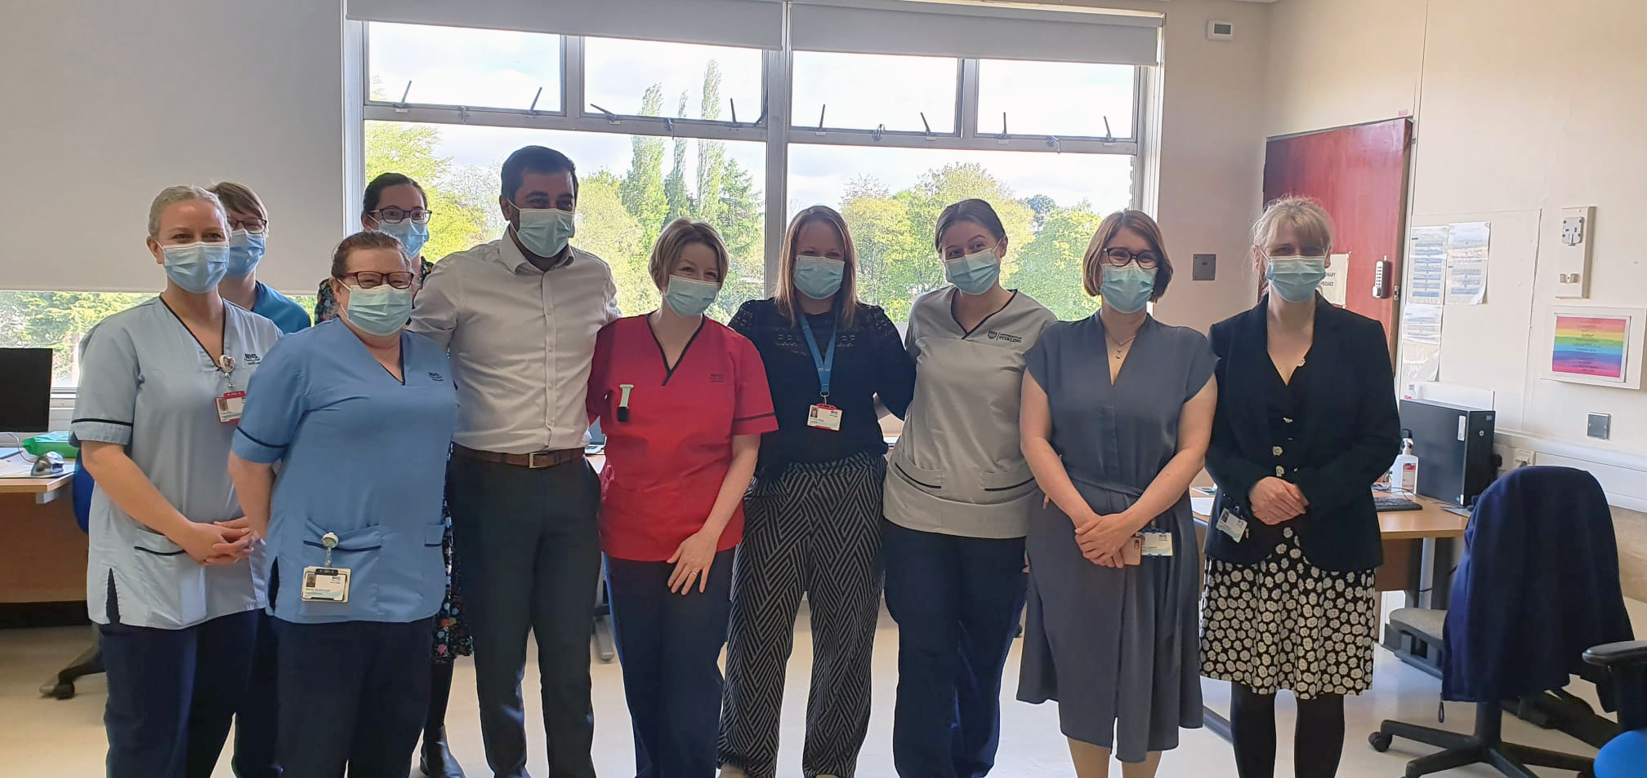
Thank you

Slide 56
Building Virtual Capacity for Resilience and Recovery - The Patient Will See You Now!
Questions
And
Thanks

