Slide 1
Welcome to the
NHS Scotland
Event 2024

Slide 2
Future of Service Delivery Thinking Differently: Care in the Digital Age

Slide 3
Key Points
We already live in the digital age. There is no part of the health & social care system that does not already rely on digital & data to function – but we are still barely scratching the surface in terms of public/patient access/interactions through digital or in using digital & data to drive system and/or behavioural change.
Digital is not a ‘thing’, but rather a way of ‘doing things’: requires rethinking how to use new capabilities to improve how services are delivered. This includes being open to re-examining our entire way of ‘doing things’.

Slide 4
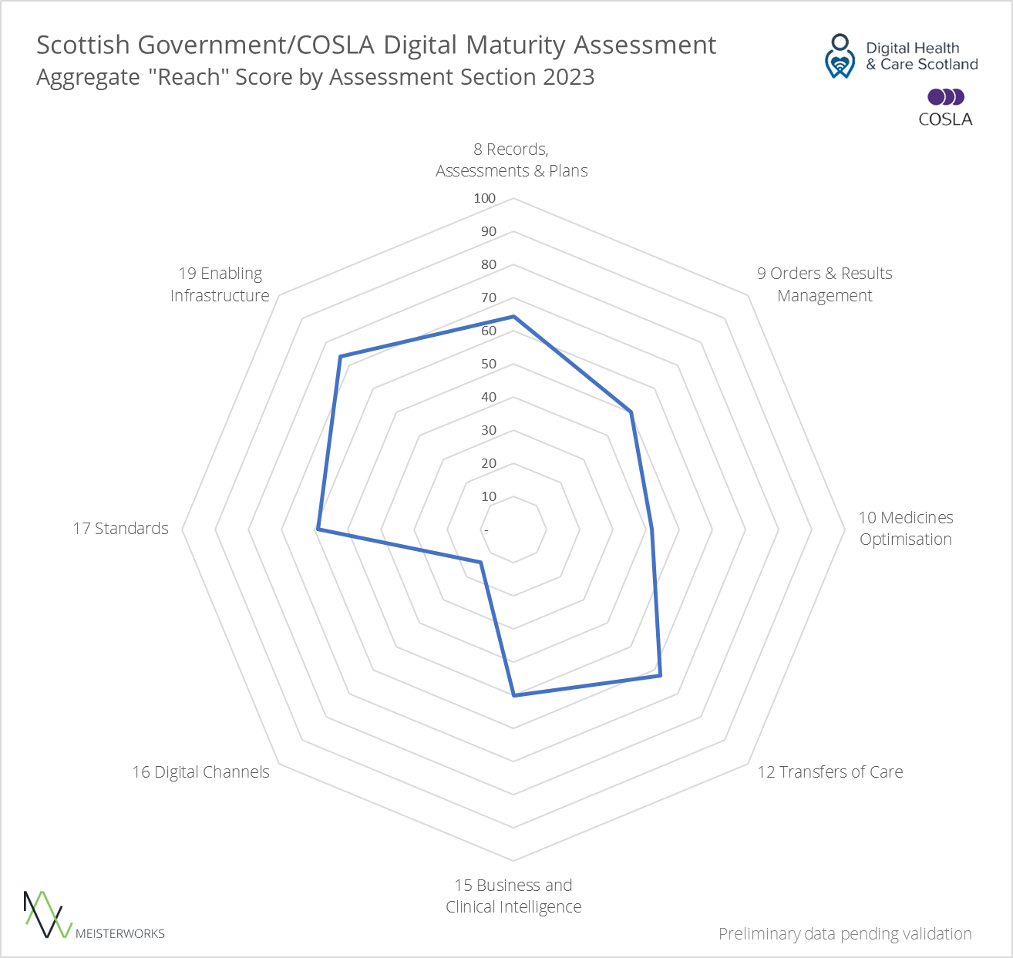
Digital practices do not yet fully permeate the Scottish health and care landscape
Notes:
Analysis of those parts of the assessment concerned with adoption for certain key metrics* shows that the nation is currently ‘mid-journey’ towards digital maturity.
Topics around digital channels scored particularly low; further investigation into causes may be warranted to ensure digital skills/confidence amongst citizens is appropriately supported.
* Digital health records, structured data, medicines administration logs, digital care handovers, adoption of digital channels, use of service user IDs, WiFi availability, amongst others.

Slide 5
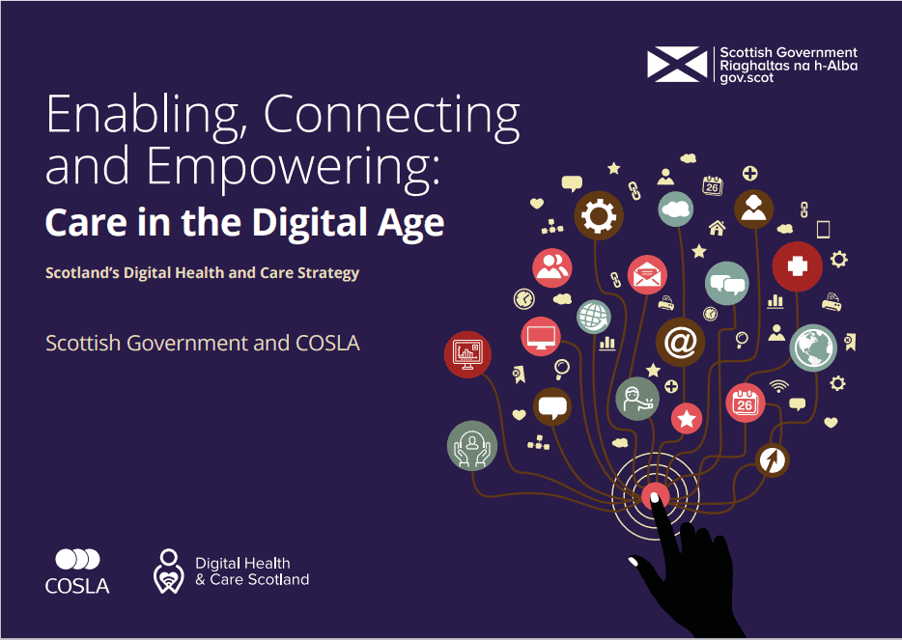
Our Vision: 'To improve the care and wellbeing of people in Scotland by making best use of digital technologies in the design and delivery of services.'
Aim 1: Citizens have access to, and greater control over, their own health and care data – as well as access to the digital information, tools and services they need to help maintain and improve their health and wellbeing.
Aim 2: Health and care services are built on people-centred, safe, secure and ethical digital foundations which allow staff to record, access and share relevant information across the health and care system, and feel confident in their use of digital technology, in order to improve the delivery of care.
Aim 3: Health and care planners, researchers and innovators have secure access to the data they need in order to increase the efficiency of our health and care systems, and develop new and improved ways of working.
Notes:
Underpinning our vision, our three aims are:
1 – Citizens have access to, and grater control over, their own health and care data – as well as access to the digital information, tools and services they need to help maintain ad improve their health and wellbeing.
2 – Health and care services are built On people-centred, safe, secure and ethical digital foundations which allow staff to record, access and share relevant information across the health and care system, and feel confident in their use of digital technology, in order to improve the delivery of care.
3 – health and care planners, researchers and innovators have secure access to the data they need in order to increase the efficiency of our health and care systems, and develop new and improved ways of working.
These will be delivered through 6 priority areas:

Slide 6
Professor Jann Gardner, BCE Lead for Digital and Co-Chair, Strategic Leadership Board for Digital & Data Transformation Chief Executive, NHS Lanarkshire
Digitally Enabled Reform in NHS Scotland

Slide 7
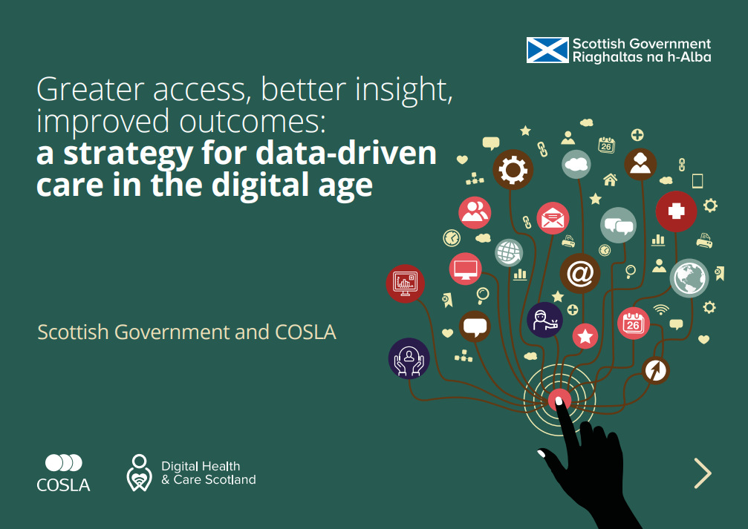
Driving Reform: Accelerating Digital Innovation
CITIZEN /PATIENT NEEDS
REFORM VISION + AMBITION
STRATEGY + FINANCE
CLINICAL NEED + AMBITION
BCE’S
COSLA
DIGITAL HEALTH & CARE SCOTLAND
ALIGNMENT

Slide 8
Driving Reform: Accelerating Digital Access
1
‘The Why’ - Drivers for Change
2
‘The What’ - Key Priorities to Enable Reform
3
‘The How’ - Creating the Conditions for Success

Slide 9
Driving Reform: Accelerating Digital Access
1
‘The Why’ - Drivers for Change
2
‘The What’ - Key Priorities to Enable Reform
3
‘The How’ - Creating the Conditions for Success

Slide 10
1
‘The Why’ - Defining the Priority Outcomes
Vision : Enable people to live longer, healthier, fulfilling lives
Population Needs - Reduce Health Inequalities – Enable our Citizens
Managing Demand – Improving Value, Affordability + Outcomes
Reforming How We Work– Optimise capability & experience
Reforming Services – Early Intervention - Reform our model of care

Slide 11
Driving Reform: Accelerating Digital Access
1
‘The Why’ - Drivers for Change
2
‘The What’ - Key Priorities to Enable Reform
3
‘The How’ - Creating the Conditions for Success

Slide 12
2
‘The What’ - Key Priorities
Citizen Access to Health & Care Data
Nationally Cohesive systems – co-ordinated agile deployment
Support care at or closer to home

Slide 13
Driving Reform: Accelerating Digital Access
1
‘The Why’ - Drivers for Change
2
‘The What’ - Key Priorities to Enable Reform
3
‘The How’ - Creating the Conditions for Success

Slide 14
3
‘The How’ – Creating the Conditions for Success
Public and Professional Access to Digital Information & Services
Accelerate Digital Innovation Adoption – Tech + Pathways
Harness Clinical & Citizen Voice
National Collaboration + Partnerships – Once for Scotland

Slide 15
NHS Scotland Patient Journey
GP

Slide 16
NHS Scotland Patient Journey – Challenges/Opportunities
Opportunity:
Support Monitoring + Care @ Home
GGP Access + Case Management
High USC Demand
A&E Access
Challenges
Extended LOS & Delayed Discharges
Opportunity:
Rapid D/C + Monitoring at Home
Pressure
Points +
Current
Challenges
GP

Slide 17
NHS Scotland Patient Journey – Challenges/Reform
Opportunity:
Support Monitoring + Care @ Home
GGP Access + Case Management
High USC Demand
A&E Access
Challenges
Extended LOS & Delayed Discharges
Opportunity:
Rapid D/C + Monitoring at Home
What do we want to change?
GP
Care @ Home
Performance
Experience
Outcomes

Slide 18
NHS Scotland Patient Journey – Challenges/Reform
Opportunity:
Support Monitoring + Care @ Home
GGP Access + Case Management
High USC Demand
A&E Access
Challenges
Extended LOS & Delayed Discharges
Opportunity:
Rapid D/C + Monitoring at Home
Key
Digital
Options
GP
DIGITAL FRONT DOOR
VIRTUAL BEDS
eTRIAGE
FNC+PLUS
WEARABLE TECH
NATIONAL
HUB & SPOKE
DIGITAL
INFRASTRUCTURE
+
FNC Plus

Slide 19
NHS Scotland Patient Journey –Reform Opportunities
CITIZEN EMPOWERMENT
COLLABORATION
COHESIVE DIGITAL CORE
PERSON CENTRED
AMBITION
COURAGE
Opportunity:
Support Monitoring + Care @ Home
Supported GP Capacity + Improved Access
Manageable
USC Demand
Controlled
A&E Access
Improved Discharge + Occupancy
Opportunity:
Rapid D/C + Monitoring at Home
Key
Digital
Options
GP
DIGITAL FRONT DOOR
VIRTUAL BEDS
eTRIAGE
FNC+PLUS
WEARABLE TECH
+
FNC Plus
NHS

Slide 20
“The biggest part of digital transformation is changing the way we think.”

Slide 21
Remote Monitoring Programme
Morag Hearty
National Remote Monitoring/Connect Me lead

Slide 22
The national Blood Pressure programme
can save lives in Scotland
Notes:
Start with a bang-

Slide 23
The story so far….
Over 98,000 people in Scotland have used Connect Me to monitor their own Blood Pressure
For every 50,000 People who routinely monitor BP, up to 745 strokes and 500 heart attacks could be avoided over a 5-year period
(BHF)
Notes:
Heading towards the 100,000 recruitment – thought to be largest of its kind in UK and Europe

Slide 24
The context….
High blood pressure is the leading modifiable risk factor for Cardiovascular disease in Scotland
50% heart attacks and strokes associated with HBP
29% adults in Scotland have HBP
500,000 adults with HBP undiagnosed
800k people with HBP are untreated
BHF source BHF Scotland CVD Factsheet
Notes:
Our flag ship pathway – Prevention!

Slide 25
Benefit Realisation….
1.2 Million appointments every year for blood pressure only
Cost savings of £14.5m over 10 years
Over 385,000
appointments saved
This Photo by Unknown Author is licensed under CC BY-NC-ND
Notes:
Key facts –so what ?

Slide 26
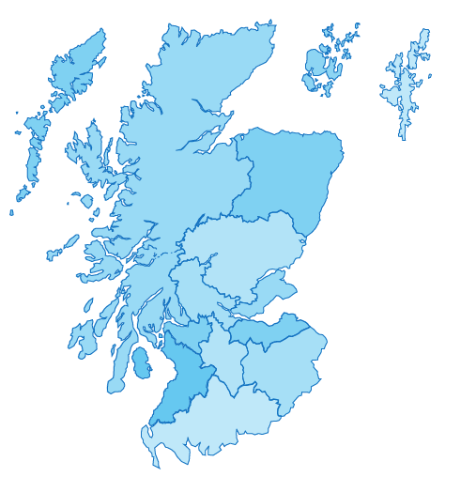
A National Solution
Key:
Live
NHS Orkney
NHS Shetland
Engagement
NHS Western Isles
Nationally Funded
Multi-Channel
Highly configurable
Good interoperability
Additional functionality
Range of pathways
5-year contract ( 3+1+1)
NHS Grampian
NHS Highland
NHS Tayside
NHS Fife
NHS Forth Valley
NHS Greater Glasgow & Clyde
NHS Lothian
NHS Ayrshire & Arran
NHS Lanarkshire
NHS Borders
NHS Dumfries & Galloway
Notes:
Nationally funded programme with all 14 boards engaged and 12 live at present.

Slide 27
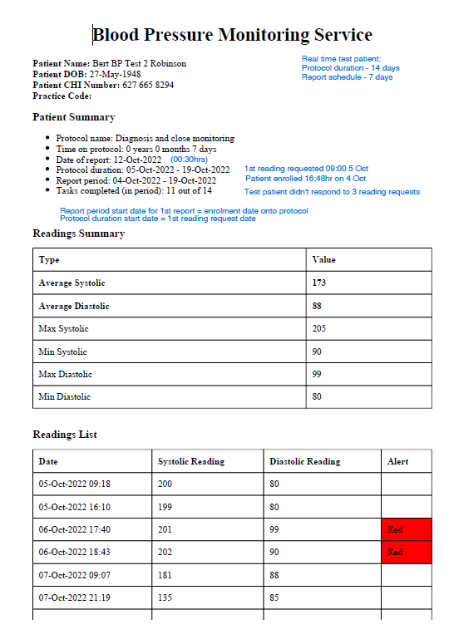
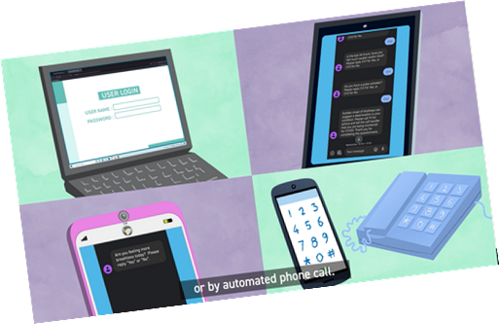
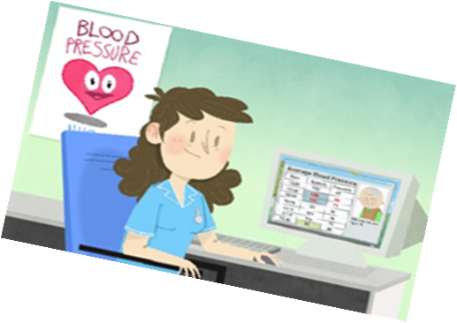
What is Connect Me?
Notes:
Multi channel and accessible. Laying down the foundations and changing the culture! Refer to Data and potential for the future.

Slide 28
Waiting list
triage
Core Monitoring
Inc BP
Women’s
Health
PROMs
Long term
Conditions
Think Digital
Blood results
Notes:
But not just for blood pressure – look to the future how can it help your service?

Slide 29
Notes:
Come with us on this journey ?

Slide 30
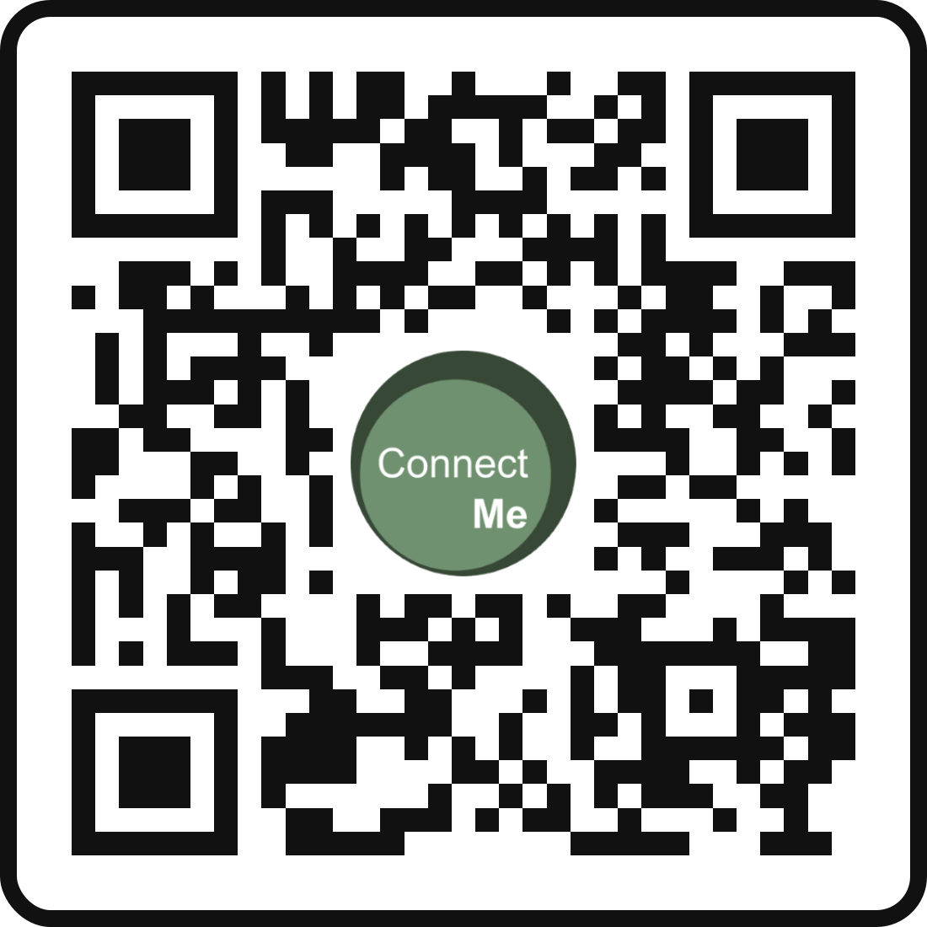
Thank You
NSS.TEC@nhs.scot
Remote Health Pathways | TEC Scotland
Remote health monitoring | Turas | Learn (nhs.scot)
Notes:
Final we note – proud to be part of this “Award winning” programme! Please feel free to get in touch with your queries.

Slide 31
Digital Health: update from psychiatry
Dr Jim Crabb June 2024

Slide 32
Positives
Challenges

Slide 33
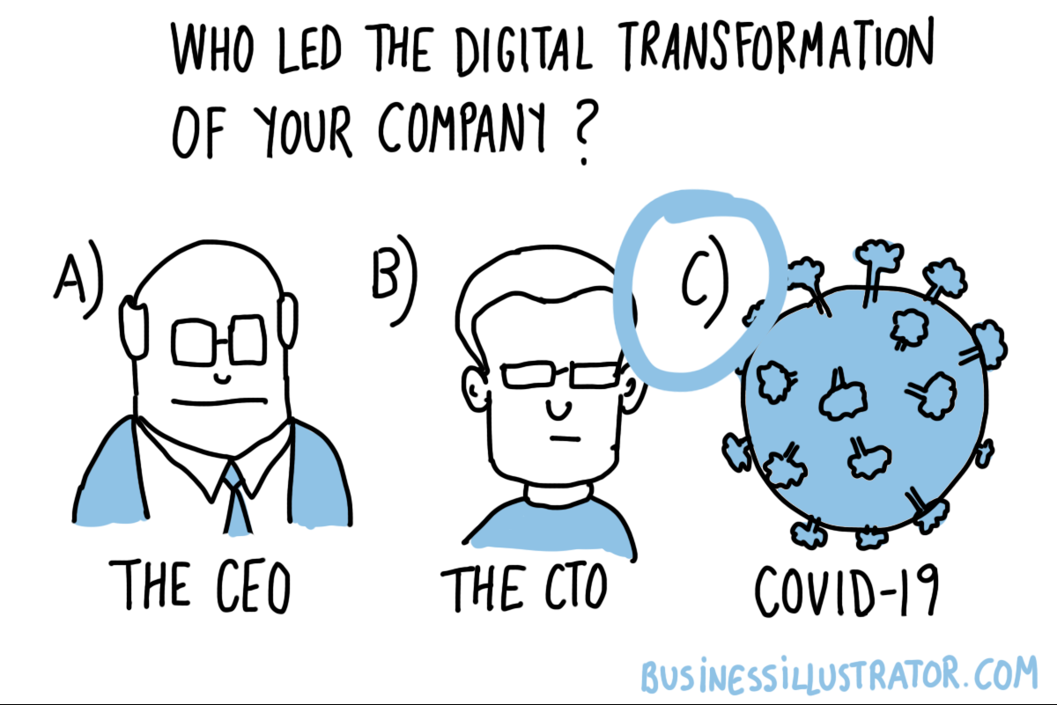

Slide 34
NearMe

Slide 35
Online group therapy

Slide 36
Agoraphobia

Slide 37
Home assessments

Slide 38
Evidenced based therapy- at last!

Slide 39
Feedback

Slide 40
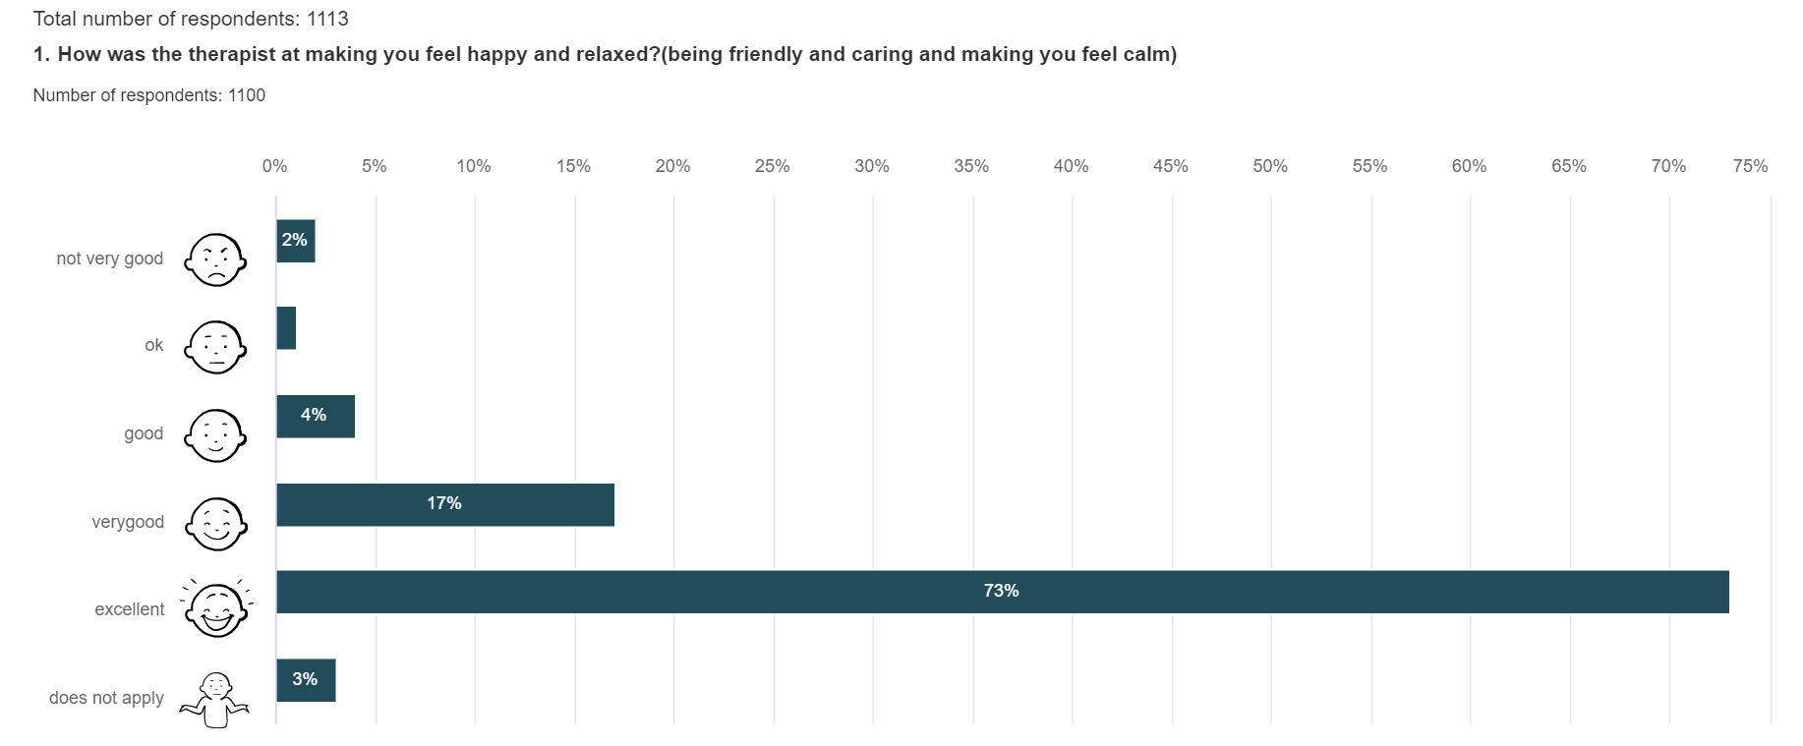

Slide 41
Funding

Slide 42
Data & reporting

Slide 43
Data & reporting

Slide 46
You can shove your mindfulness app up yer....

Slide 48
Compatibility…or else!

Slide 50
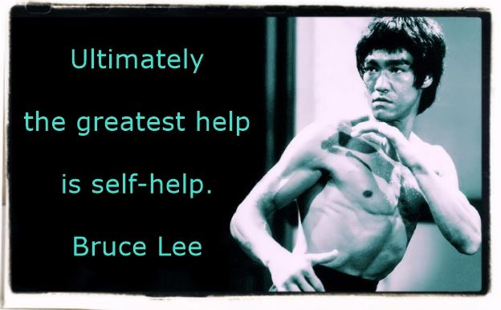

Slide 51
=realistic mental wellbeing =realistic psychiatry

Slide 52
NHS Event 2024 Data & Analytics in NHS Scotland Better Decisions with Cloud Enabled Data & Collaboration
Albert King
Chief Data Officer

Slide 53
Scotland’s Data Service for Health and Social Care
We are the national data service for the health and social care in Scotland.
We support the delivery of digital health and care across NHS Scotland and beyond using Data and Integration technology and standards aligned to national policy and frameworks.
We bring innovation in data and AI and we are recognised for thought leadership.
We combine professional capability, leading technology platforms and data assets. We provide the ability to integrate, organise, manage and create insight from data across health and care.

Slide 54
Seer
Seer is a core part of Scotland's Health & Social Care Data Strategy
The Data & Analytics service for the NDP
Supporting a broad and vast array of users, underpinning thousands of important data and analytical products
Notes:
Seer is hosted in the NES national tenancy

Slide 55
Seer : National Data & Analytics Platform
Contains the core components of Data Ingestion, Repository, Data Virtualisation, Analytics and Reporting, AI/ML, Augmented Analytics
It is at the heart of providing data to over to 20,000+ users across NHS, Scottish Government, Local Authorities, other public sector organisations, and academia
It provides over 100 data ‘products’, 500k+ reports, ~3,000 dashboards, and other analytical tools around key areas of healthcare, such as vaccinations, blood donation and usage, finance and procurement
Team of professionals in the data and analytics team deliver projects, enablement, providing the core data and analytical building blocks

Slide 56
Seer 2 : National Data & Analytics Platform
Secure & Trustworthy
Seer provides trusted information within a secure infrastructure. Security of the data you are working with is protected by leading cloud infrastructure.
The recent investment in Seer 2 capitalises on new technologies to realise benefits for our analytical and business customers across health & care. Migrating Seer to an AWS and Snowflake stack enables us to scale our services and develop new patterns for delivery and enablement.
Innovation
Becoming future ready with latest technologies for advanced analytics and AI allowing faster product creation
Agility
Bringing together data rapidly to provide users with access to the insights they need in near real time with rapid provisioning of tools
Collaboration
Providing a platform for collaboration within a trusted infrastructure, using common tools and methods

Slide 57
What does this mean for us?
Collaboration & Enablement
A trustworthy and secure platform for collaboration, enabled by a team of data professionals empowers a workforce with digital and data skills to access, interpret and apply insight from data with confidence
Modern Technology Infrastructure
The availability of a trustworthy, scalable and flexible cloud hosted national data services creates opportunities to provide scalable, secure and privacy preserving shared data and analytics services.
Data Assets
Availability of high quality, timely data national assets and services that are available across our health and social care workforce.
Saving time, saving money and improving lives
Notes:
There are three key ingredients we need to unleash the potential of data in NHS Scotland

Slide 58
Thank you
Any questions, please contact: Albert.King@nhs.scot
Notes:
We are always on the look out for collaborators and exciting new projects. Here’s how to get in touch!

Slide 59
Questions
What information do you need but can’t access?
What do you need to adopt digital solutions?
What do your patients need? What do you and your (clinical) team need?
How would you bridge perception of digital maturity between organisations and workers?
What are the opportunities and long term impacts posed by AI and other progressive technologies?
What radical solutions should we look to?

Slide 60
Thank you

