Slide 1
Recovering From Covid Experiences from the Front Line

Slide 2
Delivering Intensive Care - through and beyond the pandemic
Dr John R Colvin
Senior Medical Advisor,
Scottish Government
June 2022

Slide 3
Facing the emerging pandemic
Building on pre-pandemic resilience
Existing baseline 173 beds, local escalation and mutual aid arrangements
Pandemic ‘flu plans to double capacity
Well established national clinical/professional networks
Stretching new challenge –quadruple ICU maximum surge escalation capacity to over 700 beds

Slide 4
SG ICU Resilience and Support Group Building escalation capacity
Equipment procurement
High quality, align with current stock
Avoid ‘dirty’ marketplace
Legacy value- align with future replacement program
Facilities support
Close collaboration with clinical networks

Slide 5
Staffing escalation capacity
Local
Supportive rostering
Training
Reprioritising clinical services
National
Regulatory recognition
Ethics code
Safe staffing tool
Support for reprioritisation of clinical services
Close collaboration across clinical networks

Slide 6
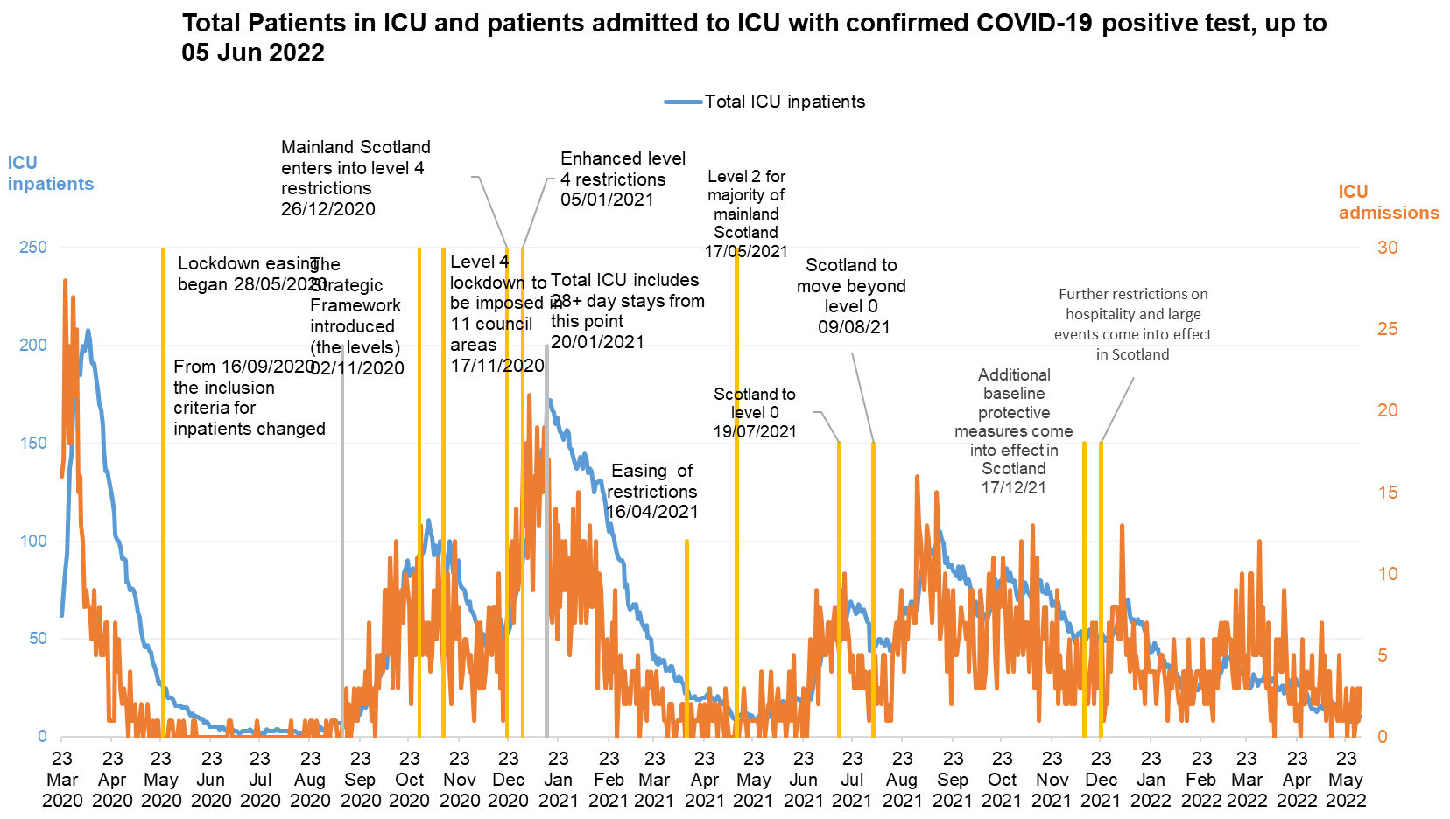
Data source: COVID-19 Daily Dashboard | Tableau Public

Slide 7
Where are we now and next steps?
Permanent increased baseline capacity
Increased flexible working across Critical and Peri-op Care
Introduction of safe staffing tool
Improved models of collaborative working
Review of escalation capacity for next winter

Slide 8
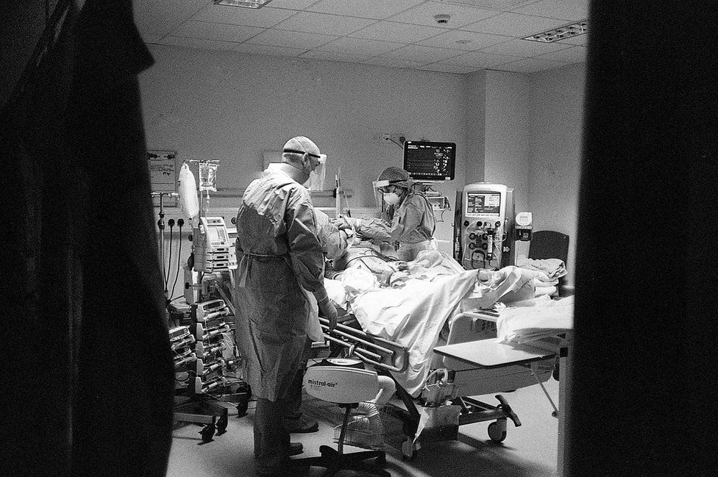
ICU nightshift

Slide 9
Acknowledgements
All front line Intensive Care and supporting staff across NHS Scotland; Scottish Intensive Care Society
SG ICU Resilience and Support group
Clinical leadership- Scottish Critical Care Delivery Group- Dr Rory Mackenzie
Medical physics network- Ted Mullen
Facilities Scotland- Ian Storrar
NSS Procurement – Kenny Rees, Kate Henderson, Josh Foggo, Laura Santi
SG- Caroline Lamb, Kerry Chalmers, Greg Ekatah, Susan Russell, John Colvin

Slide 10
Primary Care Rapid response, change and collaboration Reflections on learning for recovery
Lorna Kelly
National Strategic Lead for Primary Care,
Health and Social Care Scotland
June 2022

Slide 11
Guidance
Guidance
Covid Community Pathway | Shielding | Telephone First | Emergency Eyecare Treatment Centres
PPE | Near Me and Remote access | Prescription and Supply | Urgent Dental Care Centres
Out of Hours | Escalation | Changes to other services | Care Homes

Slide 12
Guidance
Guidance
Covid Community Pathway | Shielding | Telephone First | Emergency Eyecare Treatment Centres
PPE | Near Me and Remote access | Prescription and Supply | Urgent Dental Care Centres
Out of Hours | Escalation | Changes to other services | Care Homes
Vaccination
Remobilisation
Backlog
Continued pandemic response
Expanded multi disciplinary team

Slide 13
Contact Coordination
Comprehensiveness Continuity
4 Cs

Slide 14
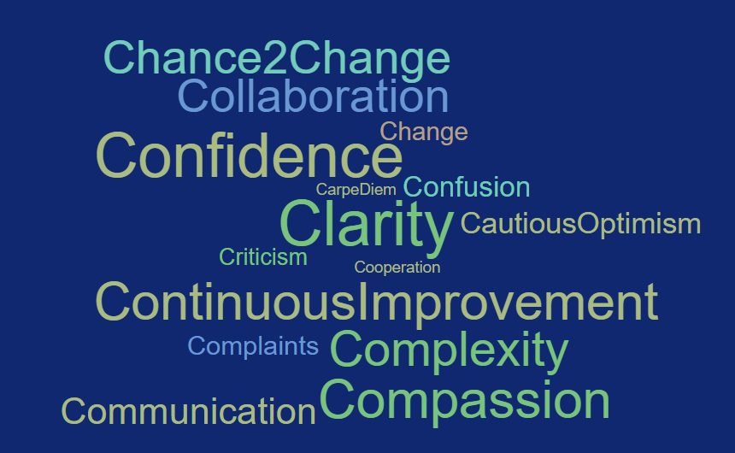

Slide 15
Constantly revising our understanding of who needed admission or who we could manage safely at home
As the system evolved we recognised that to continue we needed to adapt. Our care moved to being a primarily remote one supported heavily by our community nursing and HCSW teams who would provide rapid obs assessments
“Changed the way we delivered healthcare overnight”
Speed, Agility
Adaptation
Community Pharmacy keeping the doors open - adapting quickly by altering premises and implementing social distancing measures within their​ imprint immediately and stepping up quickly to implement delivery services
Within weeks of the initial lockdown we recognised that in making all appointments on a telephone basis in the first instance was duplicating workload as well as reducing patient satisfaction …system developed and evolved …to include many more presentations which could be booked directly to a face to face appointment and eventually allowing us to move to patient choice [of] appointment type

Slide 16
Never before in my career have the barriers between secondary and primary care been so low with the common goal of trying to get the right patient to the right person at the right time
Electronic communication and better pharmacy cross-sectoral working.
Access for community pharmacies to clinical portal
[Shielding] Having difficult and sensitive conversations with hundreds of our patients to enable conversations about future wishes at a time of heightened public anxiety and uncertainty. This was exceptionally difficult work to do over the phone -but we did it.
The vital role of communities and local knowledge and supports.
Collaboration Breaking down barriers
Emergency Eyecare Treatment Centres Using an EPR that allowed notes accessible to both Primary and Secondary care was crucial for shared and safe care
Our covid hub team created value through the relationships we developed – with each other, with colleagues across the board and with our patients.
Notes:
rapid change to pathways across hospital and community eyecare services and between Optometry practices

Slide 17
To begin with there was a shared sense of purpose of "all being in it together".
The shared learning in those early days as we established, navigated and coordinated new pathways for patients was incredible to be a part of
Twice weekly echo sessions [in remote and rural area] where we could verbally communicate with GPs all over.. it was good for information sharing but it also built a sense of community at a very hard time.
We used all available means – WhatsApp groups, Zoom, etc. to keep meeting virtually, sharing jokes, information and stories, throughout. Lots and lots of humour, and tears.
Peer Support and Learning
We were very honest from the start and allowed one another to grieve – almost every member had their moments when they broke down and cried as the realisation of what was happening finally sunk in, or as they processed the deaths of patients we knew well
Remote working often looks like it’s comfortable sitting at home in your PJs. The reality of bringing difficult clinical scenarios into your home and safe space is very different and we have recognised the need to support each other through this

Slide 18
National Centre for Remote and Rural Health and Social Care
Chronic Disease Management
New approaches to prioritisation and individual discussion; shifting the balance of power.
“We have started making much more use of digital support tools for long term conditions- Flo app, COPD digital”
Modified lifestyle advice to fit circumstances
If not now, then when?
Focus on how new extended teams work effectively together

Slide 19
Chance 2 Change
SEE ME
LISTEN
BE HONEST
HELP ME UNDERSTAND
REMEMBER I AM AN EXPERT
CONSIDER PEER SUPPORT
I am a person with feelings
my opinion matters
even if you don’t know
offer me advice and where appropriate alternative solutions
in your professional hands – 50:50 partnership each valuing the other’s expertise
people build confidence in people far more effectively than medication
https://www.gov.scot/publications/chance-change-scotland-report-chance-2-change-expert-reference-group-lived-experience-primary-care-health-inequalities-short-life-working-group/

Slide 20
Acknowledgements / quotes
Laura Muirhead, GP and Clinical Lead for Covid Hub, Grampian
Peter Cawston, GP, Glasgow
Carey Lunan, GP, Edinburgh and Chair of Scottish Deep End project
Alan Harrison, Lead Pharmacist for Community Care, NHSGGC
Charlotte Ward, Optometry Lead, NHS Grampian/Shetland
Rebecca Helliwell, GP and Deputy Medical Director, NHS Highland/Argyll&Bute HSCP
Kenmure practice, Bishopbriggs

Slide 21
Home First
Paul O’Neill
Locality Services Manager,
NHS Lanarkshire
June 2022

Slide 22
Purpose/intro
TODAY’S PURPOSE: THREE KEY GOALS
Illustrate: What the Home First ethos is – in human terms
2. Bring clarity: by clearly setting out the strategic components and drivers
3. Demonstrate: How these strands come together in practical terms

Slide 23
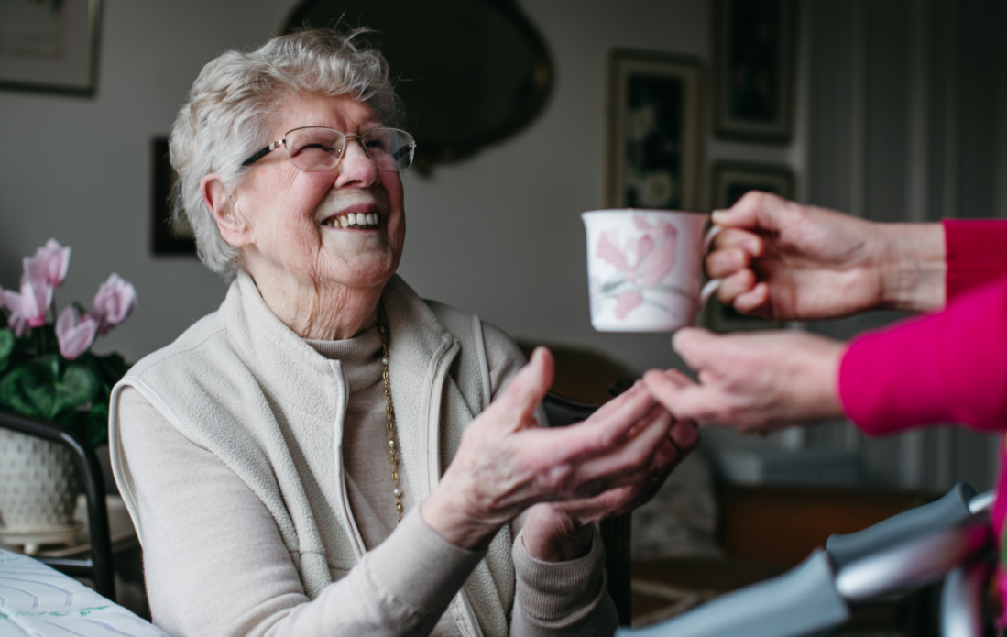

Slide 24
THE BIGGER PICTURE
Home First
explained

