Slide 1
A Fair and Sustainable Future
Chief Medical Officer for Scotland
Annual Report 2021-2022

Slide 2
“We are caught in an inescapable network of mutuality, tied in a single garment of destiny. Whatever affects one directly, affects all indirectly”
Martin Luther King
Notes:
Slide 10: Conclusion : MLK quote
In conclusion, I encourage you to read my report. I very much hope that you recognise the importance of the issues I describe, and that you will join me in providing the collective leadership and collaboration required to overcome them.
Thank you for listening

Slide 3
Notes:
Slide 2: Intro
Good morning. My name is Gregor Smith, Chief Medical Officer for Scotland, and I’m delighted you’re able to join me today, to hear about my annual report.
The world has been made more uncertain by accumulating circumstances with the potential to have an impact on the health and wellbeing of people everywhere, including Scotland. It’s impossible not to be concerned by these uncertainties and the instability people are facing, or saddened by global events that are leading to such significant direct and indirect consequences for people’s lives and security.

Slide 4
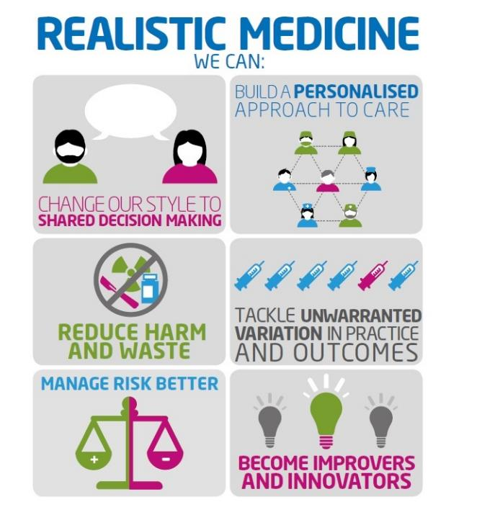
Notes:
Slide 3: Realistic Medicine
In my annual report last year, I spoke of the immense challenges that our health system was facing and how they had been compounded by the COVID pandemic. I also spoke of how important Realistic Medicine had become in helping us overcome those challenges.
While life for many of us is becoming less restricted, COVID has not gone away. The pandemic will continue to impact here and in other countries for some time yet. COVID continues to place significant strain on the health of Scotland’s people, our workforce and our health and care system

Slide 5
A Fair and Sustainable Future
Five main themes:
Collaborating for a Healthier, Fairer Scotland
Personalising care through understanding
Innovating for a more sustainable system
Supporting our workforce
The Health of Our Nation
Notes:
Slide 4: Report Key Themes
This is my second annual report as Chief Medical Officer for Scotland. I’d like it to be of interest to everyone, but hope that it will be of particular interest to healthcare professionals here in Scotland.
This year, I focus on five key areas:
Collaborating for a Healthier, Fairer Scotland
Personalising care through understanding
Innovating for a more sustainable system
Supporting our workforce
The Health of Our Nation
These topics are of great importance to me.

Slide 6
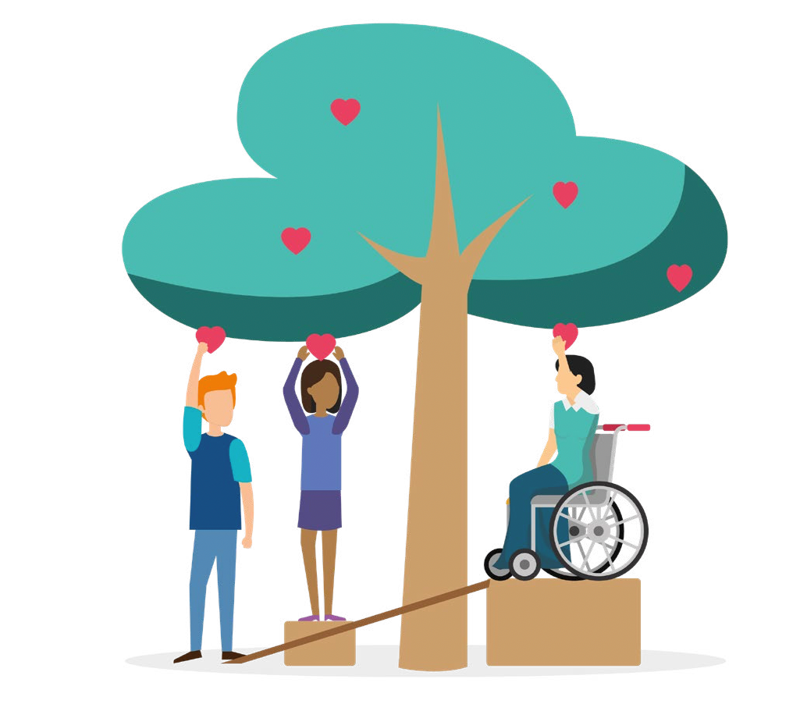
Chapter 1: Collaborating for a Healthier, Fairer Scotland
Scotland’s Child Poverty Action Plan
Navigating towards a better life
Naloxone: Improving services for people who use drugs
Conclusion
Notes:
Slide 5: Chapter 1: Collaborating for a Healthier, Fairer Scotland
The inequalities exacerbated by this pandemic continue to run deep in our society. Life expectancy in Scotland has stalled and in some our communities it is falling.
The social determinants which lead to inequalities in people’s experience of health are well understood and have been for some time.
We know too that it will take leadership, joint ownership and collaboration with partners beyond our health and care system if we are to tackle the inequality that exists in our society. Without this co-ordinated and relentless approach I am concerned that the inequalities experienced by many may persist, deepen and affect many more.
The pandemic has shown us how precarious circumstances are for many of our communities facing the greatest hardships. But, it has also shown us how quickly and effectively we can mobilise to support those most in need.
We must continue to collaborate, innovate and improve access to services, if we are to improve the lives of people living in our most disadvantaged, most vulnerable communities.
Encouragingly, there are already excellent examples across Scotland of good practice in tackling inequalities. In this chapter, I share some excellent examples of collaboration at a strategic, population and service level. We need to promote these approaches, learn from each of them, and work in partnership across our system and beyond our traditional way of doing things.
If we do, we can help create the healthier, fairer Scotland we all wish to see.

Slide 7
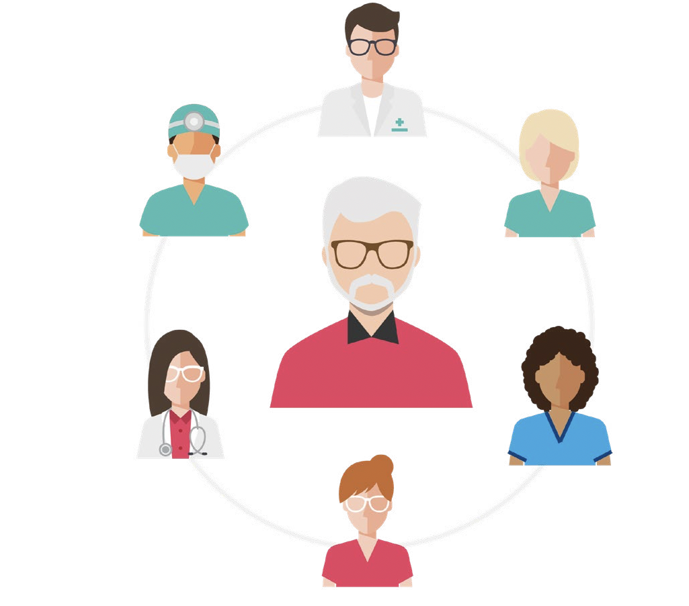
Chapter 2: Personalising care through understanding
Multidisciplinary Team (MDT) Working
Tools to Access Care
Transforming access to care for victims of sexual assault
Preventing long term ill health
Sharing Information About Things that matter
Scotcap
Notes:
Slide 6: Chapter 2: Personalising care through understanding
As we emerge from the effects of the COVID-19 emergency, many people are waiting longer than previously to access treatment. It is however clear that practising Realistic Medicine continues to be more important than ever.
Practising Realisitic Medicine is not “just for doctors”. It’s for all of Scotland’s health and care professionals. Indeed, there are many who point out that delivering personalised care has strong roots in nursing, the allied health professions and social care.
Our system and indeed our national psyche, is focussed on care being doctor led, when there is clear evidence that other members of the Multi Disciplinary Team are better placed to provide the care people need and value.
I am convinced that by listening to what matters to people and involving them in decisions about their care, we can deliver personalised care that people really value. In this chapter, I provide some very positive examples of how colleagues are innovating and improving access to care for people who need our help the most.
We have a clear ambition. We want people who live or access services in Scotland to have more years in good health, and to reduce health inequalities.
And to achieve our ambition, we must continue to promote innovation, adopt new and better ways of working, focus on prevention, and redesign the system around the lives and needs of the people we care for – not the needs of our system.

Slide 8
Chapter 3: Innovating for a more sustainable system
The Value of Research
Recovery and Re-design
A sustainable health and care system: where and how
Sustainable Care
Notes:
Slide 7: Chapter 3: Improving and Innovating for a more sustainable system
We all know that our health and care system is under significant pressure. We know too that demand for health and care services is increasing.
The COVID pandemic has accelerated the need to make optimal use of the resources we have to provide better value care - for the people we care for, and for our system.
Innovation and improvement are key to delivering value based healthcare. Medical science does not stand still nor does the world in which we practice.
The last two years have demonstrated how vital research has been in understanding, treating and vaccinating against COVID-19. The response of Scotland’s research community was simply astonishing – a vital contributor to worldwide collaboration to combat the pandemic
Research really does have the power to transform and save lives, improve outcomes for the people we care for and drive a modern, innovative health and care system.
Work continues to enable further trials of the most advanced healthcare treatments, diagnostics and medical technologies and bring them to people faster. Research is also being used to help understand what doesn’t work - low value care - so we can improve best practice and focus our precious resources on providing healthcare that people really value and will benefit from.
We are rightly proud of our history of pioneering medical innovation and must build upon this to deliver a more sustainable health and care system for the people of Scotland
There remains an urgent need to act to address the climate emergency and loss of biodiversity. Scotland must accelerate efforts to cut greenhouse gas emissions and become environmentally sustainable and Scotland’s target date for achieving net-zero emissions has now been brought forward from 2045 to 2040.
Our health and care system has shown throughout the COVID pandemic that it can act quickly in a crisis. Now, more than ever, there needs to be a focus on ensuring our health and care services are used equitably and sustainably in order to meet the needs of the people of Scotland - as well as those of our future generations.

Slide 9
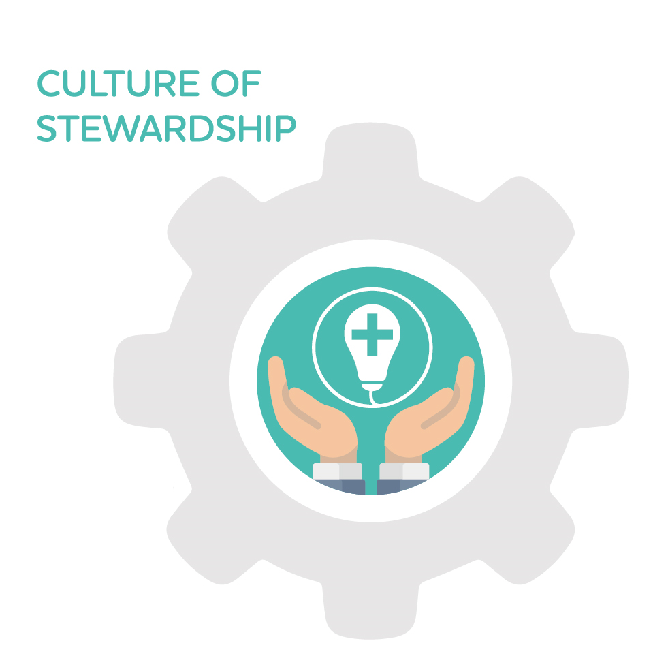
Notes:
SLIDE 8: VBH&C
The way we provide care can have a major impact on both our communities and our environment, and can support our transition to a net-zero health service. By transforming where and how we deliver services we can empower people to have more control over their health and wellbeing and deliver care which is environmentally sustainable, which increases our contribution to supporting good health and helps to reduce health inequalities.
Achieving Scotland's climate goals and Realistic Medicine fit naturally together. To become a sustainable and greener healthcare provider, we must deliver safe, effective, personalised care, and reduce harm and waste through improvement and innovation. Realistic Medicine promotes a culture of stewardship of finite NHS resources, where we take responsibility, individually and collectively, to use our healthcare resources wisely. If we wish to see a more sustainable health and care system, we must focus our efforts on reducing the waste and potential harm caused by both under treatment and over investigation. As we remobilise and reform services, we must build towards a more sustainable health and care system that delivers the better value care we are looking for.

Slide 10
Chapter 4: Supporting our workforce
Personal Reflections
Improving Retention of the Medical Workforce
Peer to Peer Support
National Workforce Leadership Strategy
Notes:
SLIDE 9: Chapter 4: Supporting Our Workforce
In the final chapter of my report, I recognise the immense pressure that you have been under, particularly over the last two years. The dedication you have shown and the sacrifices that you have made to help ensure that people continued to receive the best possible care have been humbling.
And as we recover and restore health and care services, we must recognise the toll that caring through the pandemic has had on our workforce. I listen to accounts from colleagues of their experience almost every day, and I know that some people feel disenfranchised and undervalued. This has to change if we are to recapture fulfilling careers for all and sustain this remarkable commitment and expertise that people offer day after day.
Health and care professionals are more than employees: we are colleagues, patients, family members and carers. We are sports people, musicians, artists, writers and so much more. We come from diverse backgrounds and cultures, have different preferences and priorities, hopes and concerns.
We must provide a working environment and culture which recognises this. Retaining and supporting our most valuable resource is vital if we are to deliver optimal care for those who need our help now and in the future. We must provide our health and care professionals with the support they need to fulfil their roles, and their full potential.
I will continue to advocate that every member of staff in Scotland has access to the basic things they need to do their job to the best of their ability. As a complex but compassionate system, we must ensure our staff are valued, feel valued and have access to the supports that fulfil them and sustain their careers.

Slide 11
“Over and above policies, strategies or reports it’s people who have the potential to transform people’s lives throughout what can be a very difficult and lonely journey. ”
Tommy Whitelaw

Slide 12
A Fair and Sustainable Future
Chief Medical Officer for Scotland
Annual Report 2021-2022

