Slide 1
Near-Time Data Service Creating Insights Supporting a Whole System Approach

Slide 2
Introduction
Dr Nils Krichel
Service Delivery Manager for Data & Analytics
NHS National Services Scotland
Dr Rebecca Brouwers
Operational Research Analyst
Whole Systems Intelligence Analysis
Scottish Government

Slide 3
Overview
Winter Preparedness 2023/24: the Whole System Approach
Seer 2.0: the Data Utility for Scotland’s public sector
Near-Time Data & product demonstration
Rollout, feedback, impact – defining next steps

Slide 4
Winter Preparedness 2023/24
Learning from previous Winters:
Earlier planning and pro-active interventions
More involvement and joint decisions with local authorities and systems
Evidence-based approach, supported by improved data collection and reporting

Slide 5
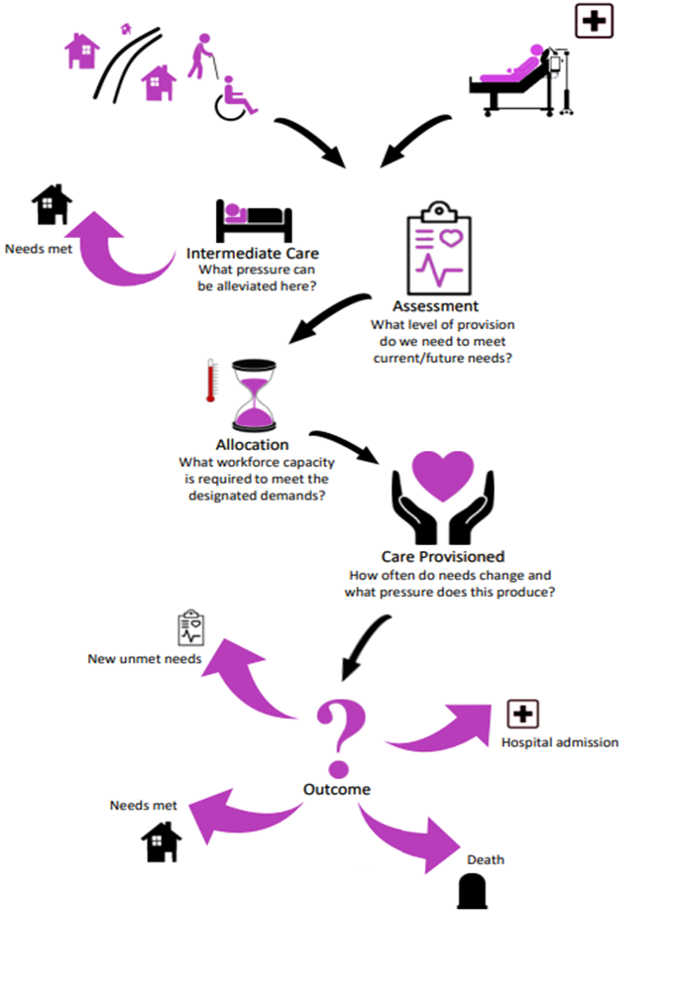
A Whole System Approach
Working in Partnership:
Consider each contact point of the individual with the health & social care system:
Capacity and throughput within the system components
Interfaces between the components
Targeted interventions and co-ordinated, early responses

Slide 6
Data Collection and Reporting
What is Business Intelligence?
Data is created and stored in separate locations, at separate times, and in different ways
We collect and combine data, and make it available to audiences across Scotland’s public sector
Fit-for-purpose data products:
Reports
Dashboards
Data interfaces
Predictive analytics: modelling, data exploration, machine learning

Slide 7
Seer 2.0 – Scotland’s Data Utility
Cloud Enablement
Trusted information and secure data infrastructure
Hosted on Scotland’s National Digital Platform
Full service offering: Data ingestions, storage, access. Dashboards, advanced analytics & AI.
Expertise & Specialist support

Slide 8
Near-Time Data
Data collection & aggregation
Indicator Data Upload
Host Data &
Dashboards
Whole System and Winter Dashboard
Social Care Response and Delayed Discharge Dashboard
Secure Authentication & Access
32 Local Authorities
Enable Access & Generate Insights
Health & Social Care Partnerships

Slide 9
Video Demonstration:
Whole System & Winter Dashboard
Social Care Response & Delayed Discharge Dashboard
Ewout Jaspers, Nabeil Salama

Slide 11
Dashboard Roll-out
Agile Delivery
Dashboard contents were chosen in collaboration with Chief Officers/Executives across Health & Social Care:
Support Target Operating Model work
Key indicators from last Winter
Enable national and local comparisons, trend analysis, and support targeted interventions
Developed and delivered as minimum viable products, allowing for launch in September ‘23, 4 months after project inception

Slide 12
Product Feedback
Listening to Users and Developers
Identify user priorities through survey, interviews, focus groups, and analysis of usage data:
Good visualisation and usability
Ability to export data
Wide range of data in one place – benchmark and make comparisons
Developers highlighted challenges around timescales and need for scope/vision during early project phases

Slide 13
Impact
Wide reach across partner organisations:
Available to 800+ users
Jan-April: 160+ access weekly or more often, opened around 4,000 times
Many users – particularly senior leaders – told us that dashboards inform decisions required in their role:
Prepare briefings
Inform situational awareness and conclusions
Provide advice, assess performance
"It is informing my advice to ministers" (Senior leader)

Slide 14
Video Testimonial:
Claire Burden
Chief Executive, NHS Ayrshire & Arran

Slide 16
Next steps for Near-Time Data
Taking stock & lessons learned
Continued user engagement and dialog:
Share findings with our users & streamlined Summary Report
Feedback from Health & Social Care Data Board
Prioritise roadmap and project backlog:
Dashboard & access improvements
Improvement and automation of data flows
Review product offering: self-service data access

Slide 17
Conclusions
The Whole System Approach considers its components’ throughput and interactions, and promotes collaborative, local/national decision-making
Seer 2.0: Reliable access to trusted indicator data is facilitated through national digital infrastructure.
User-centric focus and a cross-organisational approach enabled rapid implementation of impactful data products, and will inform our next steps

Slide 18
Questions
Interested? To discuss, or to request access, contact us:
NSS.NearTimeData@nhs.scot

