Slide 1
Home First - Lanarkshire

Slide 2
Notes:
“This will be the first time in years I’ve been at peace in my heart and in my mind – and it’s thanks to the staff here.”
This, colleagues, is the words of Ann Burns foster carer and psychiatric nurse says her life was taken to the darkest of places over the last decade following shattering personal adversity.
Ann’s current situation personifies what Home First is all about - with an emphasis on enabling more people to live as independently as possible within their own homes.
She added: “Looking back, I’d become confined not only to the house but spent most of my life on the couch because of mobility issues following strokes. With that physical confinement, I was spending all the time within my own head and got to the stage even if I was able I didn’t want to go out.
“I’d gone from such an active life, from working and caring for people, to such a terribly dark, isolated place. I was lonely and in complete and constant despair. I couldn’t see a way forward,” says Ann.
Coming to our Blantyre LIFE facility, where we live out the Home First ethos, Ann said “Has been like stepping into the light.”

Slide 3
WHY NOT HOME, WHY NOT NOW
Three key elements:
People can be cared for at home (or as close to home as possible).
Prevention of avoidable admissions to hospital.
Where hospital admission is necessary, Home First seeks to support timely discharge.

Slide 4
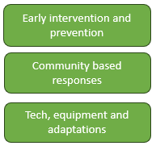
Home First
Community Nursing/AHP/SW
Intermediate Care
Direct support
Hospital @ Home

Slide 5
Strategic Drivers
Health and Wellbeing Outcomes and National Indicators
Outcome 2: People are able to live, as far as reasonably practicable, independently and at home or in a homely setting in their community
Scottish Government
Discharge without Delay Programme
National DD and Hospital Occupancy Plan
Strategic Commissioning Plans
North UHSCP
South UHSCP

Slide 6
System Pressures
Hospital occupancy is closely associated with patient safety, flow and performance and efficiency.
>85% occupancy = increased risk / >92% occupancy = Increased risk+++
Many hospitals regularly run at or above 100% capacity.
Reducing long-stays is the biggest opportunity to reduce hospital occupancy.
NHS Lanarkshire:
% of admissions with LOS >14 days: 16%
% of bed days used by patients staying >14 Days: 60%
% beds occupied by non-delayed long stays: 46%
% beds occupied by standard delays: 12%
% beds occupied by AWI delays: 2%

Slide 7
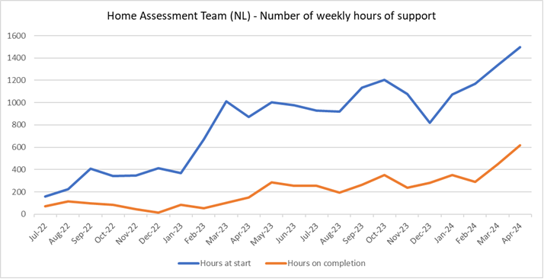
Performance Journey

Slide 8
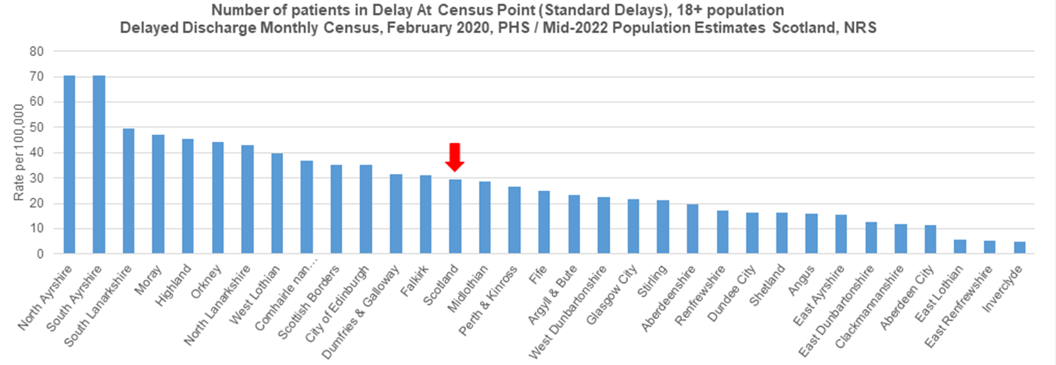
Performance Journey

Slide 9
Learning
Integration in practice within community setting
Good interface working between acute and community essential
A reflection of Lanarkshire’s commitment to whole system working and leadership in transformation
Doing the right thing is right for people and improves efficiency and effectiveness
Notes:
integration in practice within community; requiring

Slide 10
Next Steps
Continue to build on current model
Increase use of technology
Collaborative work with universities
Future proof services

