Slide 1
Advancing research and innovation to create an NHS fit for the future

Slide 2
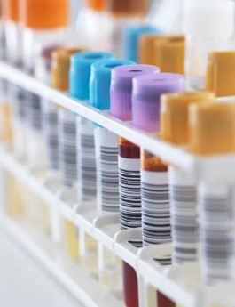
Opportunities, Challenges & Solutions
Huge advances in medical therapy, novel treatments & growth of precision medicine
Yet, attributable burden of disease is forecast to increase 21% in the next 20 years.
At the same time, NHS Scotland is under growing pressure - shifting demography, treatment of late-stage disease, workforce pressures, system inefficiencies
“There are many reasons to be pessimistic about the present, but science and technology offer a genuine cause for optimism about the future”
Times Health Commission, February 2024
Solution: need to get better at adopting and implementing innovation – that includes digital tools and AI, novel therapies, and devices
Notes:
Improvements in population health have stalled and Scotland’s health is worsening
We all know the NHS is under growing pressure
These challenges can only be resolved if we get better at adopting and implementing innovation – that includes digital tools and AI, novel therapies, and devices. This is increasingly urgent as we look to the recovery and transformation of the NHS in Scotland – driving financial sustainability, addressing health inequalities, and delivering improved patient outcomes.
The coming years will see an explosion in breakthrough technologies which will pave the way to tackle the most pressing population health burdens and provide fresh hope to patients.

Slide 3
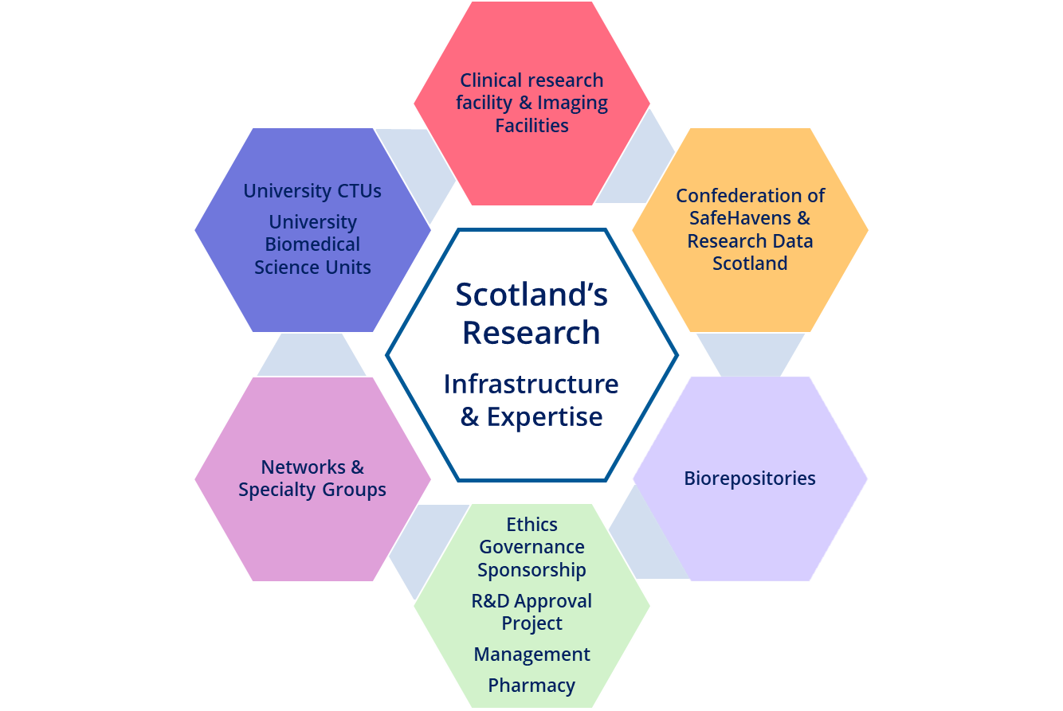
Research and Innovation Infrastructure
NHS Research Scotland (NRS) is a collaboration between Chief Scientist Office (CSO) and Scottish Health Boards to support and deliver clinical research.
A highly developed infrastructure & expertise across Scotland supports commercial, academic and charity funded studies.
During 2023-24 this included:
1,568 studies (573 commercial and 995 non-commercial)
recruiting 31,928 patients (8146 commercial and 23,782 non-commercial)
Notes:
For nearly 50 years the Chief Scientist Office (CSO) of Scottish Government has provided the supporting infrastructure for clinical research delivery across Scotland, supporting commercial, academic and charity funded studies.
This is being bolstered through new CSO initiatives to further improve collaboration between the NHS, industry and academia

Slide 4
End-to-End Innovation Pathway
Clinical Research and Development
Translation and early-stage innovation
03
Adoption
... and Beyond
01
02
04
Clinical Trials Units across NHS and Scottish Universities for early-stage research
3 CSO Innovation Hubs to facilitate collaboration among Industry, Academia, and NHS through a triple helix model
Once-for-Scotland Accelerated National Innovation Adoption (ANIA) Pathway
Deriving further economic benefit from health innovations through supporting companies access other NHS systems across the UK or export internationally.
5 CSO-supported Clinical and Research Fellowship schemes to increase capacity in the NHS
9 National innovation Small Business Research Initiatives
Identification
Assessment
Over 1500 studies delivered during 2023 - 2024
2 Innovation Fellowship schemes to foster entrepreneurship and innovation in the NHS
Adoption
Notes:
Scotland’s end-to-end innovation pathway creates a continuum between discovery, translation, and adoption, and is underpinned by significant investments in the infrastructure that support and deliver research, development and innovation adoption.
This is a highly collaborative, whole system approach across Scotland, with the value of the triple helix evident at every stage.
The pathway is designed to support transformative change in the delivery of health and social care across Scotland, with a focus on pace, prioritisation, and value.

Slide 5
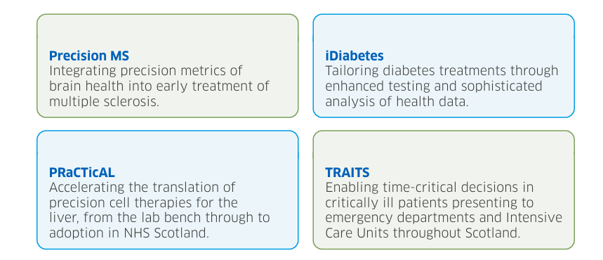
A diverse study portfolio
Precision Medicine
Tailoring of medical treatment to the individual characteristics of each person
Nearly £10million awarded to four research projects to improve the targeting of treatment for patients with serious illness.
Benefits of taking part in research
provide access to new treatments, technologies or devices which may improve outcome or help participants learn more about their condition
Research active boards have improved patient outcome, increased staff satisfaction & retention
"I was just so glad they had a treatment I could try. And taking part in a trial has the potential to help others. It’s all about gathering information”
“The technology has been hugely beneficial for me”
“As part of the trial I am monitored closely by the research team which I find very reassuring and I have found participating in the trial to be a positive experience”
Notes:
Research is not a burden - but an essential and rewarding part of effective patient care.
Studies have also shown that all patients have better health outcomes in research active hospitals, even if individual patients are not part of research5.

Slide 6
CSO Regional NHS Innovation Hubs
Transform ideas and knowledge into products and services
Facilitate collaborations with NHS, academia, and industry
Provide leadership and support across the Innovation Hub environment
Refine solutions, build evidence, inform strategy and develop thinking
Facilitate access to NHS Teams, healthcare settings, data and governance
Support scale up and mainstreaming
Engage required expertise such as regulation and funding
Notes:
A national network of regional innovation hubs, funded by CSO, are a front door for industry, academia and the third sector to work on developing products and services, translating research, and delivering benefit to both the NHS and patients, and the economy of Scotland. CSO regional innovation hubs extend across Scotland (North, South-East, West) and: • Cover all 14 territorial NHS Boards in Scotland • Address different aspects of NHS care from managing long term conditions, digitising services, and exploring health applications, to integrating AI and machine learning, and more • Consist of professionals from various fields, including eHealth, Research & Innovation, Clinical Leads, and other specialised support staff • Work with partners to ensure they understand their product or service’s applicability for the NHS system and ultimately help them develop a solution that can be adopted by the NHS in Scotland, the wider UK or exported internationally • Bring together diverse expertise to address healthcare challenges through a process of co-design, co-development, and co-evaluation. Typically, these solutions are clinically led and involve defining pathways, systematically identifying opportunities to innovate and securing funding to enable co-development with industry partners
The Hubs are a primary connection point within that triple helix, really acting as the gateway between industry and the NHS, making sure innovative products and services are directly applicable within the NHS. They do that by working with NHS teams, and providing access to healthcare settings, patients and data through directly interacting with relevant service pathways.
The provision of a ‘test bed’ environment, and the added support and expertise from the Hubs, for example around issues like information governance, clinical safety and regulatory standards, helps manage the hurdles that innovation needs to understand and overcome for solutions to adopted in Scotland, the UK or exported internationally.

Slide 7
National innovation Competitions
Notes:
A national network of regional innovation hubs, funded by CSO, are a front door for industry, academia and the third sector to work on developing products and services, translating research, and delivering benefit to both the NHS and patients, and the economy of Scotland. CSO regional innovation hubs extend across Scotland (North, South-East, West) and: • Cover all 14 territorial NHS Boards in Scotland • Address different aspects of NHS care from managing long term conditions, digitising services, and exploring health applications, to integrating AI and machine learning, and more • Consist of professionals from various fields, including eHealth, Research & Innovation, Clinical Leads, and other specialised support staff • Work with partners to ensure they understand their product or service’s applicability for the NHS system and ultimately help them develop a solution that can be adopted by the NHS in Scotland, the wider UK or exported internationally • Bring together diverse expertise to address healthcare challenges through a process of co-design, co-development, and co-evaluation. Typically, these solutions are clinically led and involve defining pathways, systematically identifying opportunities to innovate and securing funding to enable co-development with industry partners
The Hubs are a primary connection point within that triple helix, really acting as the gateway between industry and the NHS, making sure innovative products and services are directly applicable within the NHS. They do that by working with NHS teams, and providing access to healthcare settings, patients and data through directly interacting with relevant service pathways.
The provision of a ‘test bed’ environment, and the added support and expertise from the Hubs, for example around issues like information governance, clinical safety and regulatory standards, helps manage the hurdles that innovation needs to understand and overcome for solutions to adopted in Scotland, the UK or exported internationally.

Slide 8
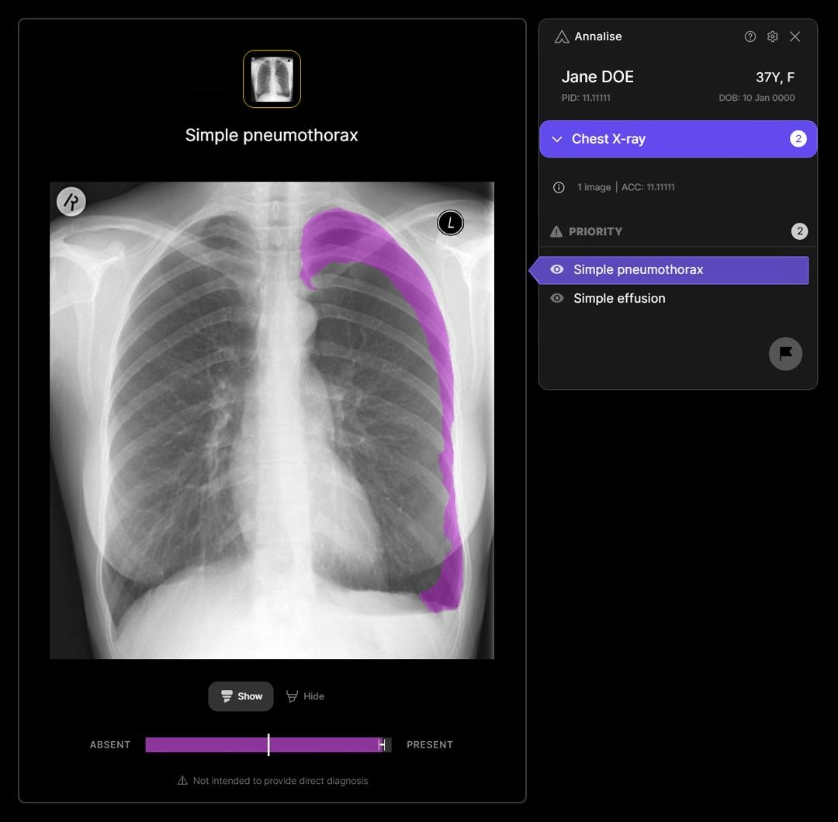
Grampian’s Radiology Assist Chest-X-ray
Evaluation (AI) GRACE
Collaboration between the CfSD, SHTG, NHS Grampian and Annalise.ai
12-month trial: can we reduce the time from CXR to lung cancer treatment
Highest risk chest x-rays urgently reported, expedited CT and CT reporting
31,000 images processed since May
Chest x-ray to CT report has dropped from
22 to 10.1 days
Proportion meeting 62-day target increased from 56% to 100%

Slide 9
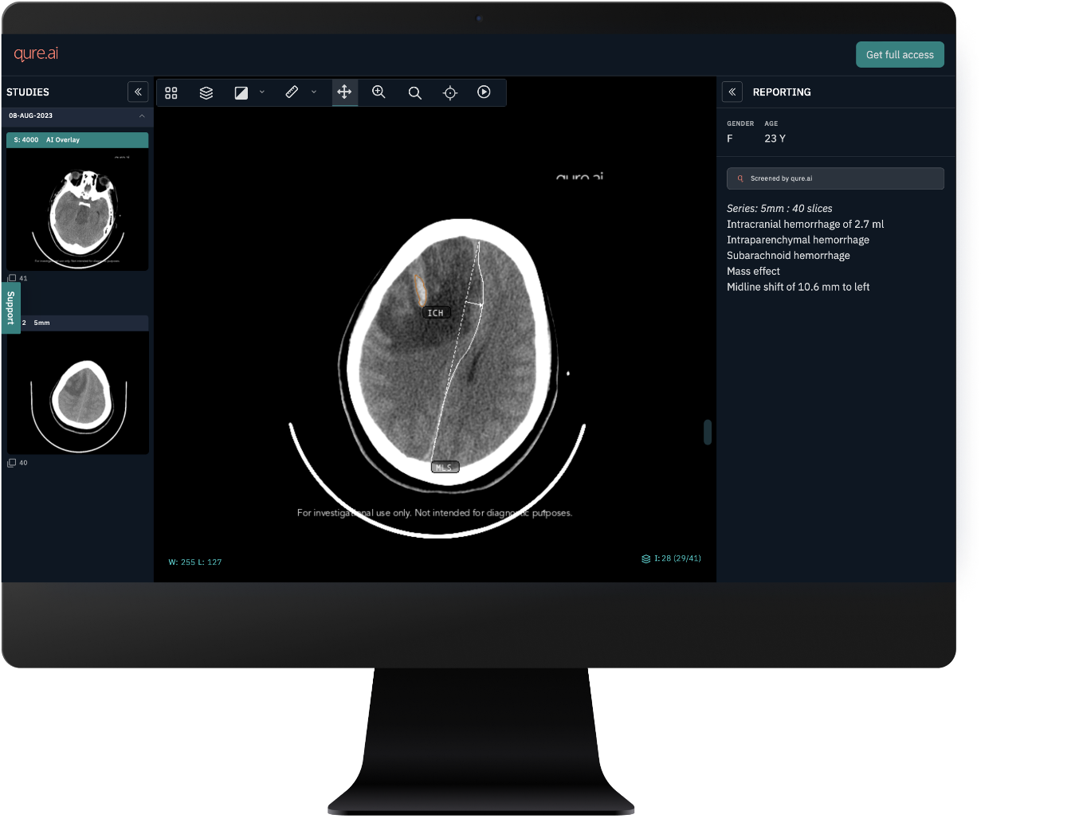
ACcEPT (Assess the Clinical Effectiveness in Prioritising CT Heads)
Collaboration- NHS Greater Glasgow and Clyde, Qure.ai, Guys& St Thomas’
The AI technology quickly examines head CT scans and accurately pinpoints critical areas of concern, creating prioritised reporting for radiology staff
In the first few weeks of the head CT AI implementation over the 2023/24 winter period, AI technology analysed 651 non-contrast head CTs, detecting 128 head injuries including cranial fractures, intracranial haemorrhage (ICH), mass effect and mid-line shift within the brain
Notes:
“Emergency Departments across the country continue to face challenges with one person presenting at a UK ED every 90 seconds, potentially requiring brain imaging. By utilising the opportunities of innovative AI to help prioritise urgent cases, we will look to deliver critical interventions whilst improving workflow and time in the ED for patients with normal scans.
Professor David Lowe, Emergency Medicine Consultant at NHS Greater Glasgow and Clyde

Slide 10
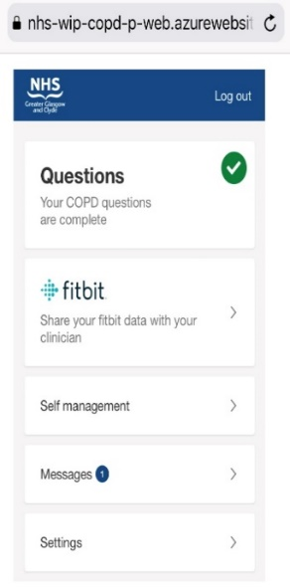
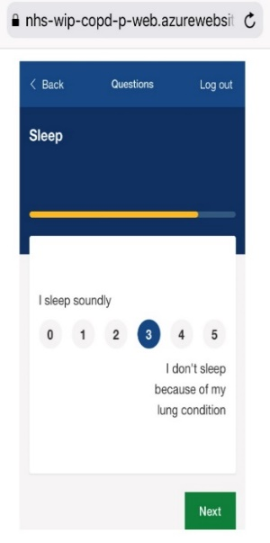
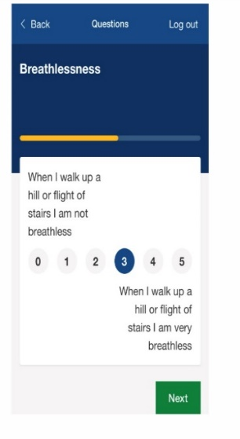
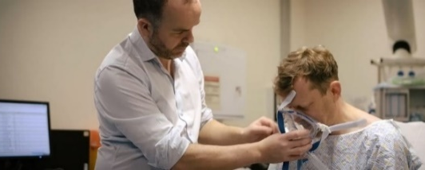
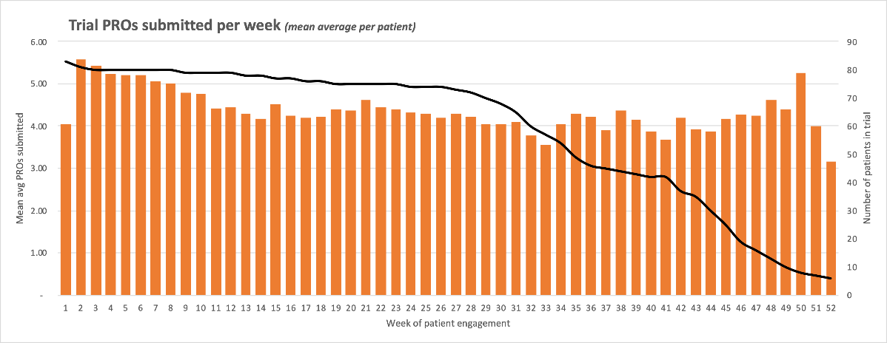
Remote-management of patients with Chronic Obstructive airways Disease (COPD) Evaluating Implementation of Digital Innovations to Enable Routine Care
Primary outcome Engagement of enrolled high-risk COPD participants with remote-management in a digital service model
Overall usage> target 1 interaction per patient per week Sustained over time - 89.8% completed
:
Clinicians analyse data
Interim Analysis:
Admissions: 28% ↓ Occupied bed days: 38% ↓

Slide 11
Reduced admissions
Reduced occupied bed days
Improved survival
Sustained usage
Quality of life
49%↓ admissions
Median time to readmission ↓155 days to 355 days.
Mean 4.74 fewer per patient per year
RECEIVER 83% 1 year survival.
Control 76% 1 year survival.
High proportion of patients continue weekly or more frequent interaction at year 1 and year 2.
QoL scores maintained stable across cohort follow up, contrasting with typical deterioration in COPD cohorts.
Scottish Govt funding 2022-24 for application in other boards
Recipient: Holyrood Connect’s 2021 Technology Enabled Independent Living Award ; 2022 Industry Collaboration award
Equality
Sustainability
Service transformation
Project 100k kg CO2e per annum saved per 500 patients. Emissions saved equivalent to powering 116 homes per year.
Improved clinician workflow /efficiency.
shift to proactive personalised remote-management facilitated by structured data, user interface and asynchronous messaging.
Cost saving
High uptake in patients from SIMD 1 residencies, Service user’s demographic distribution = COPD population.
Project £3.5m per annum
saved per 500 patients.

Slide 12
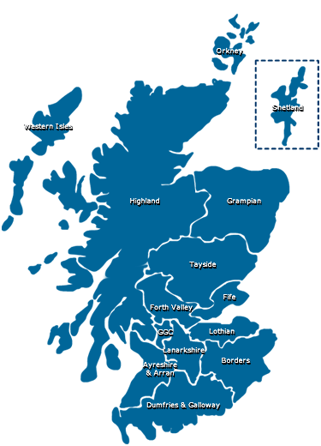
National approach to innovation adoption
ANIA PATHWAY
GOVERNANCE
Innovation Design Authority brings together SG & NHS leadership for joint decision making on priorities
APPROVED
Digital Dermatology (£1.8 million)
Accelerated deployment of Closed Loop Systems (£350K)
Under Consideration
Digital Heart Failure
Lung Cancer AI
Diabetes Remission & Prevention
Pharmacogenetics
DELIVERY
14 Territorial Health Boards, SAS & NHS Golden Jubilee reporting through annual delivery plan
Proven innovations that can transform how we deliver health care

Slide 13
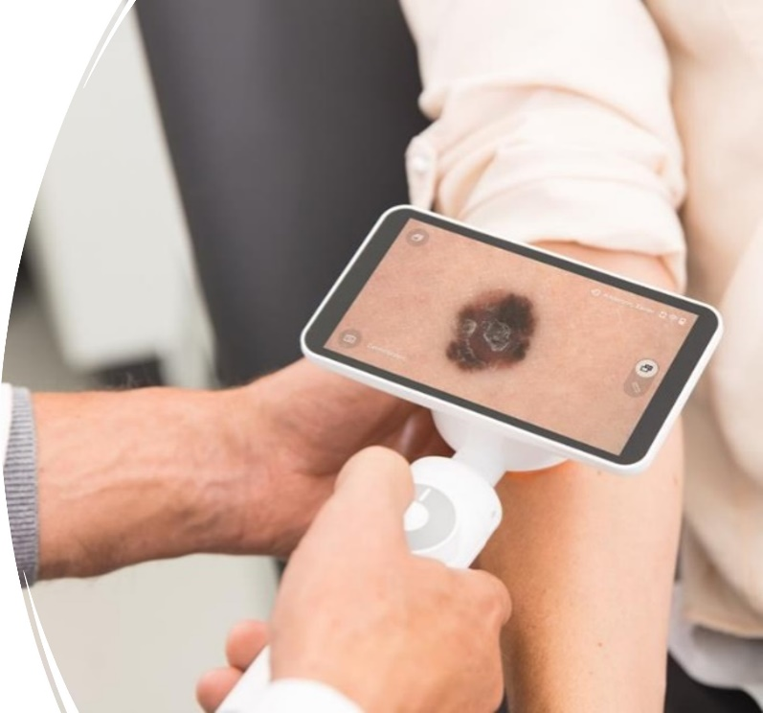
Digital Dermatology
Approved (£1.8 million over two years)
National digital dermatology programme to deliver a 90% image referral rate from primary care in 2024 reducing demand for outpatient appointments by 50% and fast-tracking of suspected skin cancer direct to treatment.

Slide 14
Next 12 months
Establish ANIA via stuffing plan aligned to new pathway (£1.5million approved)
Deliver adoption of approved innovations
Take decisions on:
Digital Heart Failure
Pharmacogenetics
Lung Cancer AI
Diabetes Prevention
Connect ANIA to adoption systems being established across the UK

Slide 15
Questions
Find out more:
www.nrs.org.uk
www.cso.scot.nhs.uk
www.nhscfsd.co.uk
www.woshealthinnovation.scot
www.hises.edinburghbioquarter.com
www.nhsscotlandnorth.scot

