Slide 1
NECU
National Elective Coordination Unit
National Centre for Sustainable Delivery –CFSD
NHS Golden Jubilee
Richard Bell | Associate Director |NECU
Supporting Planned Care Capacity and Demand
Notes:
Good afternoon everyone, I’m Ricky Bell, associate director for the National elective coordination unit or (NECU)
It’s great to be here at the NHS Scotland event to talk in a bit more detail about NECU and the work that we are doing to support planned care capacity and demand at pace within the national context.
We have a wonderful, hard working and dedicated team that support NECU and our shareholder health boards and I’m really excited to share the excellent results that we have achieved as a team.
But, before we get into the detail of the excellent work that is happening across NECU and NHS Scotland health boards in support of planned acre capacity and demand matching, I wanted to introduce NECU in the context of its host organization NHS Godlen Jubilee and the National Centre for Sustainable delivery or CFSD.

Slide 2
9%
NECU Context
Removal Rate
Strategic
Strategic
Business
and
7,00
NHS Golden Jubilee Board
NHS GJ Clinical Governance
Innovation Design Authority
NHS Scotland Delivery Board
Scottish Government
Business
Delivery
CFSD Senior Leadership Team
Patients Treated
Operational
Delivery
CFSD Programme Boards including NECU programme Board
Operational
Engagement Groups
SDGs
Clinical Leadership and Governance Groups
NECU Operational Group
Notes:
NECU is an operational unit hosted within NHS Golden Jubilee and sits within the national centre for sustainable delivery.
These strong links across both national improvement and sustainability workstreams, as well as the operational governance support from Scotland’s national waiting times centre, NHS Golden Jubilee has allowed NECU to support planned care recovery across various specialties.
Our mission in NECU is to support the matching of planned care capacity to demand within the NHS Scotland estate, whilst providing a consistent and standardized approach to effective allocation of capacity.
This is achieved through various ‘products’ , which we’ll dive into in a bit.
From operational through to strategic level, most importantly, puts patients at the centre of what we do.

Slide 3
“
“
9%
Hi, I’m James
Removal Rate
James is a patient and one of the…
and
96,000
7,500
96%
Patients Validated
Patients Treated
Of patients who engaged with NECU
…. across 39 capacity campaigns delivered by NECU
Notes:
With that in mind……I wanted to introduce James , a patient at the younger end of the diverse patient demographic that we serve, but a patient who is one of the :
96,000 patients validated, 7,500 patients treated and 96% of patients that have engaged with NECU since March 2023.
James is also one of the many patients that have been supported through over 39 cross board treatment campaigns managed by NECU.
Through NECU’s digitally supported and standardized approach to patient validation these figures have been achieved whilst maintaining a complaint rate less than 1%.
We’ll talk about what that means organizationally in a minute, but let’s first have a look at the support James can access.

Slide 4
NECU Product Offering
Through James’ local health board engagement with NECU, he was able to be supported through NECU’s service.
Digitally supported Patient validation
Supporting high volume, digitally supported patient validation with a 9% removal.
Clinical Validation
Bespoke campaigns, connecting clinical experts to demand and applying standardised approaches.
Bespoke Treatment Campaigns
Supporting ‘at pace’ deployment of bespoke treatment campaigns within NHS Scotland’s own estate and resources.
Notes:
Through NECU’s centralized function, more patients, like Jmaes now have the ability to access treatment more timely.
As well as this, NECU have been able to establish patients’ overall need for appointment, freeing capacity for those who do by recommending more than 8,500 removals, giving James who still needs his appointment greater opportunity to access services timely.
.
Through NECU’s 3 product offerings (Refer to Slides and list), patients can be supported from validation to treatment.
NECU as a system is uniquely positioned as a national resource to maximise and build on its current operating model to support further national waiting times recovery.

Slide 5
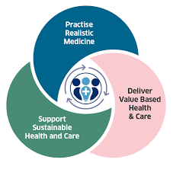
NECU Model
Putting James at the centre of what NECU does….
System
Clinician
….and supporting him through his treatment journey sooner.
Notes:
Through establishment of robust operational, process, financial, workforce, Information and clinical governance mechanisms, NECU has developed a mature delivery model that is adaptable and agile for delivery at scale.
By not only supporting key planned care targets, but also building an environment that connects systems and processes to clinicians to build efficient pathways, NECU ensures patients, like James are at the centre of what we do.

Slide 6
James’ Journey
From Health Board A
Validated through NECU.
Clinically validated by clinician through NECU campaign.
Booked to national treatment campaign by NECU.
Seen and Treated in Health board B under NECU treatment campaign.
Notes:
So, let’s chat through James’ journey from his home health board (Who have partnered with NECU) to his board of treatment, we’ll call it health board B, A terriotorial board that is working with NECU as a partner capacity provider.
When capacity is identified that matches to demand within NHS Scotland, NECU’s planning and governance structure align this capacity at pace.
Each campaign is vetted and agreed by all stakeholders, both clinical and operational within NECU and the participating health board’s teams.
Through both its operational and digital infrastructure, we have developed:
A digital patient and resource management platform that complements other systems and processes.
An operational model that harnesses the national governance systems in place to support the safe and effective transfer of staff and patients cross boundary,
A national workforce mechanisms that supports clinical teams to assist across capacity campaigns
A financial costing model that is equitable for all health boards, at approximately 1/3rd of the cost of independent sector provisioning.
So for James, who has been waiting over a year for his minor procedure, his details are transferred and James then begins his journey through a NECU cross board campaign, which sees James being:

Slide 7
NECU Ecosystem
Key Partnerships
NHS Scotland National Boards and Support Functions
Chief Operating Officer, NHS Scotland Directorate
CFSD
NHS Scotland Territorial Health Boards
Clinical Forums and Groups
Notes:
But getting James from board A to Board B can sometimes be challenging:
With a diverse collaborative approach to the development of planned care recovery, NECU and CFSD work across a unique ecosystem to support both patients like James and the national planned care recovery agenda. Not only as a backlog clearance mechanism, but by building sustainable solutions and partnerships across NHS Scotlands ecosystem.
But for James, as a patient, navigating such a complex ecosystem can be challenging….. however through this collaborative approach, NECU have developed robust relationships with shareholders. Each partner has its own benefits to be leveraged for NECU to operationally deliver its primary purpose of supporting James and the thousands of other patients who have been waiting the longest.
Supporting the longest waiting patients like James is one thing, but there are many considerations when working nationally in this collaborative manner, whilst always asking the question: “ What is the value add that NECU brings”
As well as local recovery plans within NHs boards and teams, NECU must align, complement and supplement these to deliver this added value and a supported path for James to treatment.

Slide 8
Opportunities in a National Ecosystem
High Impact
Operational Management of national resources (NTC)
High volume Patient validation
Clinical Validation Scale up
Patient stratification
Fragile Services models
Less Risk
Direct commissioning of services
More Risk
Low Impact
Notes:
Considering how more patients like James can be supported at scale and how more opportunities for NECU to support planned care waiting times recovery can be developed, there are many opportunities to connect within a national ecosystem.
These include (List from slides)
Each with their own risks and rewards, benefits and impacts. However, some common pros and cons exist across all of these opportunities, some of which have been addressed by NECU, but all of which need to be mitigated further to scale the operational model for NECU.
Thinking about fragile services models, as an example… how could NECU align with regional and national planning to support shared services models and share our experience of breaking barriers to support fragile services?

Slide 9
Local Barriers
Data Governance
Digital Infrastructure
Engagement and Uptake
Resourcing
Assuring patient data is managed and handled safely and securely both nationally and locally.
Constrained by current systems and digital processes.
Identifying opportunities can be challenging in a complex landscape
Aligning capacity resource to meet demand, internally and across campaigns.

Slide 10
Solutions
What have NECU done to mitigate perceived barriers.
Data Governance
Digital Infrastructure
NHS Board Engagement
Resourcing
Developing an agnostic digital infrastructure that complements local board processes, whilst being scalable.
Developing strong links with NHSS Boards that put the patient at the centre of what we do, whilst maximising opportunity through the wider CFSD.
Understanding of the key mechanisms for data safety and information governance is critical.
Developing a workforce model that is agile and adaptable is key to regional and national working.

Slide 11
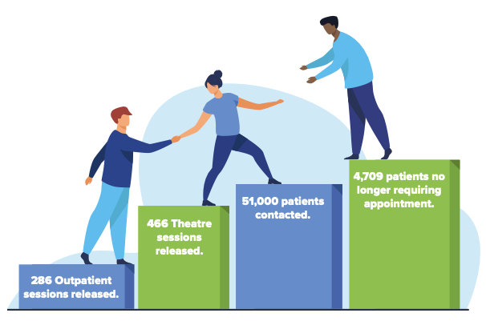
Impact
96,710
OP Drill Down
£500,391 Cost Avoidance
£66,479 Direct Cost Savings
Digitally Supported Pathways
72% Response rate from patients across digital platform.
<1% Complaint rate
Overall combined response rate of 94%
Total Patients Validated
8703 Recommended removals
9% Removal
Total Cost avoidance
(excludes diagnostics)
£4.18M
Direct Cost savings (excludes diagnostics)
£238,772
IP/DC Drill Down
£3,679,609 Cost Avoidance
£172,293 Direct Cost Savings
>£238,000
Re-invested in
services
>98% Patients
Rated NECU process
Good/Excellent
Sessions Released
485 OP Clinics released
341 Operating days released
£4.18M
Reprofiled across services
8703 appointments/
procedures back
Cost avoidance/saving assumptions based on average cost of OP appoint of £129 and £2214 average cost of theatre case. OP clinic template of 8 patients per session and 4 theatre cases per day. Direct cost savings based on avoided DNA Rate at 6%.

Slide 12
Bringing it Together- Opportunities
High volume patient validation- Ensuring waiting lists are up to date to support effective planning.
Centralised booking
and commissioning
function- standardising
pathways for timely care
across national resources.
High volume, digitally
supported clinical
validation through a digital
and workforce model that
supports cross board
working seamlessly.
Putting the patient at the
centre of what we do,
offering patient choice
and using data intelligence
to support capacity allocation and timely access.
Digital infrastructure that
optimises and supports
patient activation, without
constraining clinical
urgency or pathway.
Direct Commissioning
of capacity through
provider Health boards.
Agreed national
governance frameworks,
supporting safe transfer of
Patients.
Understanding patients
needs and promoting
collaborative working
across NHS Scotland,
particularly in fragile
services- paving the way for
new service models
Notes:
Looking at these opportunities, I believe that my approach would be to work closely with partners across the entire eco system, perhaps developing a NECU SDG, whilst maintaining that operational perspective on delivery, as quite often NECU’s delivery timelines can be far shorter than those seen through improvement pipelines.
For me it is about being pragmatic and systematic about delivery and scale and shifting the balance of opportunities from the high risk, high impact categories to the high impact low risk categories, as often the majority of risk carried is based on the ‘unknown’ of operational delivery. Piloting and then rapidly scaling, for me, is a tried and tested method to mitigate risk and maximise delivery.

Slide 13
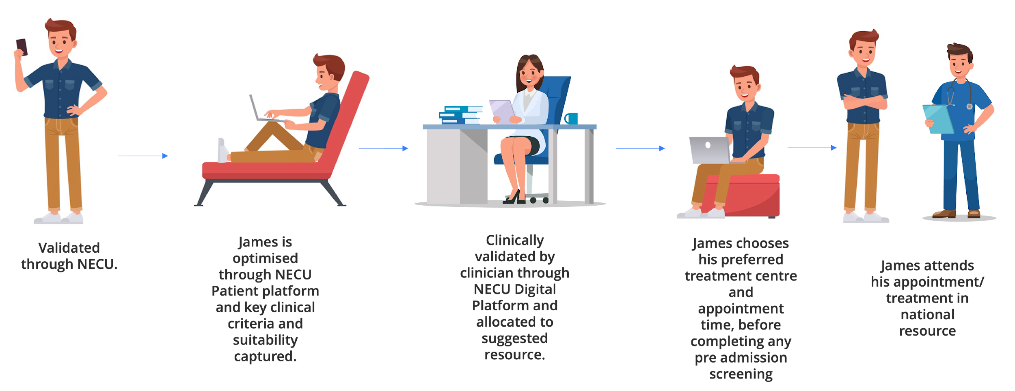
James’ Journey
How could James’ Journey be transformed
NECU’s PCC team support treatment pathways end to end to ensure equity of access.
Flowing patients through a centrally coordinated function, supports optimal patient pathways and allocation of national capacity.
Notes:
So thinking about these opportunities and referring back to James’ journey, what would James’ pathway look like in a digitally supported, nationally coordinated service that promoted patient choice.
I believe NECU as a system is uniquely positioned as a national resource to maximise and build on its current operating model to support further national waiting times recovery.
NECU is well positioned to be scaled at pace through resourcing, digital infrastructure and building its network of capacity providers in a hub and spoke approach.
By developing a digitally supported and equitable service for patients, My approach to delivery would be to continue to leverage the skills, knowledge and experience of the shareholders of NECU from across the entire NHSS ecosystem to build a fit for purpose pathway for national resource that was efficient, accessible and digitally mature for patients across Scotland like James.

Slide 14
“
“
Healthy is an outfit that looks different on everybody.
Thank You
Made an anxious experience much easier.
Experience was excellent from start to finish.
Overall, a great experience.
Richard.bell@gjnh.scot.nhs.uk
nhscfsd.co.uk
nhscfsd.co.uk/our-work/national-elective-coordination-unit
Notes:
Patient feedback questionnaires
Working with patients to understand what matters to them across campaigns
Supporting access to services through travel campaigns.

