Slide 1
The role of the Scottish Ambulance Service in the Redesign of Urgent Care

Slide 2
A day in the life of the Scottish Ambulance Service

Slide 3
Whole System Collaboration
The role of the Scottish Ambulance Service in the delivery of a sustainable emergency, urgent and unscheduled care system
Many providers, many interfaces - many opportunities
How does whole system collaboration help?

Slide 4
Our response model

Slide 5
Continually enhancing our response

Slide 6
Decision Support through NHS Grampian Flow Navigation Centre
'Everyone in Grampian receiving
the right care, at the right time, in the right place based on their individual circumstances and needs'

Slide 7
Redesign Urgent Care – SAS Work Stream
FOCUSSED KEY OBJECTIVES
Provide direct access for SAS clinicians to Flow Navigation Centre
WHOLE SYSTEM FLOW
AIM - Delivering Care closer to home for people requiring Urgent Care with equity of access to urgent , primary and community services
Enhance ability for Clinician to refer to Primary Care
Enhance ability for Clinicians to refer to Community Pathways
Improve SAS Clinicians access to professional to professional advice
Allow access and sharing information across health and care organisations

Slide 8
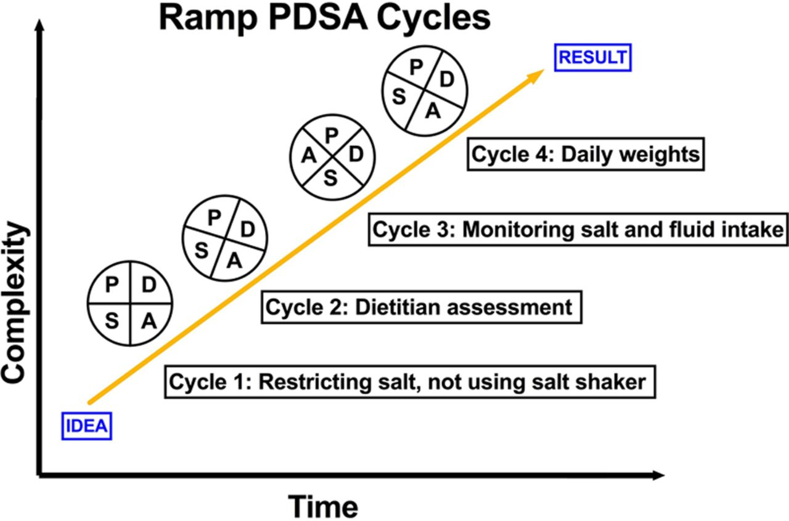
RAMP PDSA 1-4 LEARNING OUTCOMES
Cycle 4 – Test two weeks 9 – 5 pm
Learning – variation in referral pattern and understanding of process
Cycle 3 – test at weekend all crews. Is workload manageable, are calls appropriate, impact on other parts
Learning – 6 calls - 50 % calls to AMIA. Trak useful for documenting
Cycle 2 – Test one day all crews. Is workload manageable, are calls appropriate.
Learning – importance of effective communication
Cycle 1 – Test one day with 4 crews. Is workload manageable, are calls appropriate
Learning – 2 calls . Need Robust method of recording

Slide 9
RAMP PDSA 5 LEARNING OUTCOMES
Total 27 patients referred from SAS to FNC over 7 days 9am - midnight

Slide 10
Patient Experience
84 year old who lived alone and had fallen at home
Called 999 and deemed suitable for ‘Hear and Treat’ .
SAS Clinician contacted AP in FNC with Comprehensive SBAR.
AP discussed with Consultant Geriatrician and Hospital at Home Assessment arranged .
SAS Clinician stood down and hospital admission avoided
70 year old living alone with haematuria & abdominal pain
Called 999 - SAS AP carries out virtual consultation. Access to TRAK - detailed history and virtual examination.
Discussion with FNC Clinician and scheduled admission to Acute Medical Assessment
Discharged home after 3 days, community care & follow up
49 year old woman with facial weakness calls 999.
SAS Clinician reviewed patient with comprehensive neurological assessment with suspected resolved TIA.
Discussion with FNC, comprehensive SBAR. Agreed patient not requiring conveyance.
FNC arranged next day Scheduled Stroke Review/MRI and Aspirin prescription sent to patients pharmacy via Community Outpatient Prescription ( CoPPr )

Slide 12
SAS/FNC OUTCOMES 11 APRIL – 1 MAY 2022
68 calls received at the FNC from SAS 49 non-conveyed = 72% 19 conveyed to ED = 28%

Slide 13
Redesign Urgent Care – SAS Work Stream Update
ACTIONS / TESTS
WHOLE SYSTEM FLOW
Provide direct access for SAS clinicians to Flow Navigation Centre
Implemented 17/1
Enhance ability for Clinician to refer to Primary Care
Explore FNC provide necessary links with Primary Care
Delivering Care closer to home for people requiring Urgent Care with equity of access to urgent , primary and community services
Enhance ability for Clinicians to refer to Community Pathways
Now have Access H@H
Improve SAS Clinicians access to professional to professional advice
SAS AP/FNC Joint Working
Allow access and sharing information across health and care organisations
SAS Clinician Access to TRAK

Slide 14
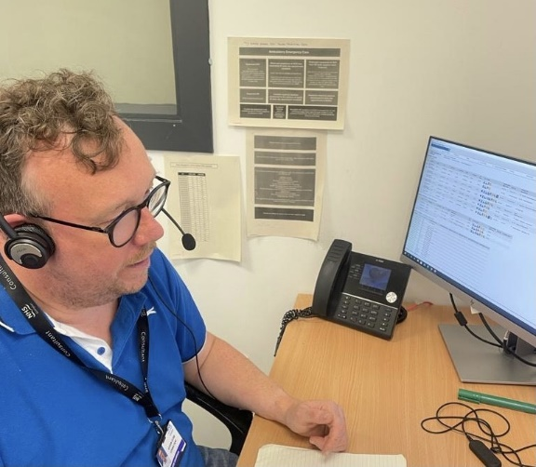
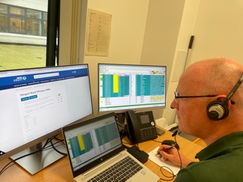
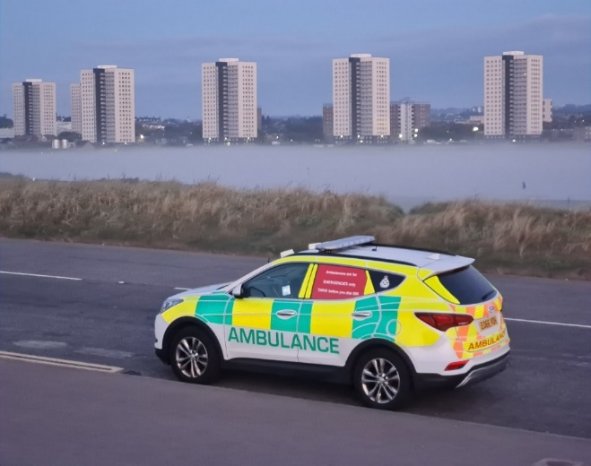
Collaborative team supporting direct access for SAS clinicians to Flow Navigation Centre

Slide 15
Thank you
A Collaborative Approach to ensuring
'Everyone in Grampian receives
the right care, at the right time, in the right place based on their individual circumstances and needs'

